Slide 1
P-train project update 3
Tuyen Nguyen
Miek Adriaens

Slide 2
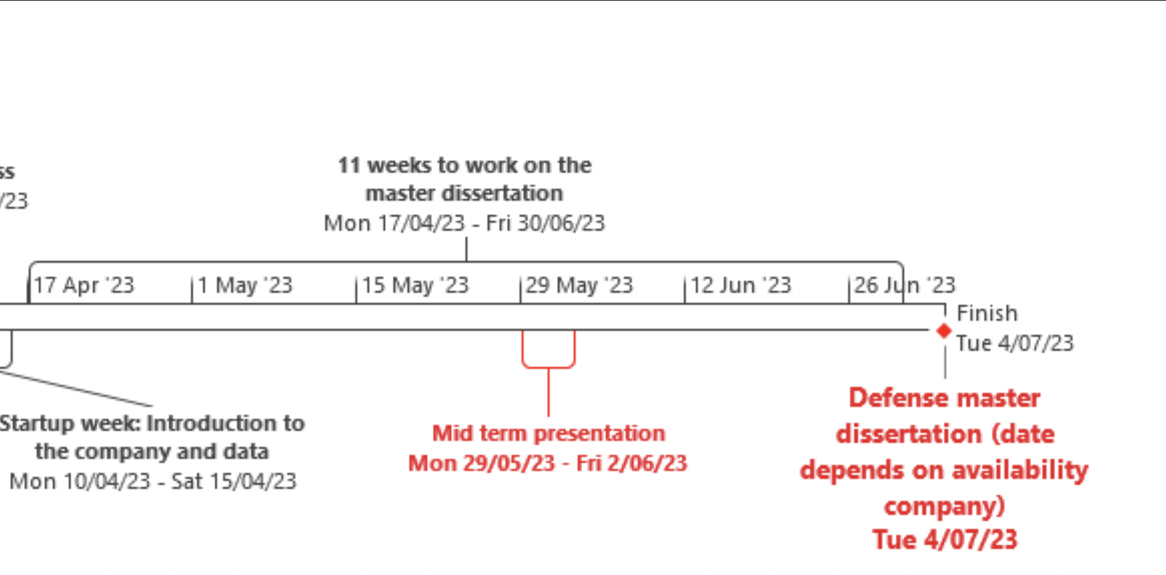
Planning (1)
Now

Slide 3
Planning (2)
May 1-7:
XGBoost continuation, refine, add new features (Graph-NN, SVM?)
Compare pre-, during-, and post-covid periods
May 8-14:
Calibration testing, Exploring feasability of percolation, forestfire and simulation models
May 15-21:
May 22-28:
May-June 29-4: Mid term presentation
June 5-11:
June 12-18:
June 19-25:
June-July 26-30: finalising
July 3-7: Defence

Slide 4
Current model approach:
Level-of-analysis:
all trains that passed on the line during a rush period on a day: how many were on time?
Label:
If 90% of trains were on time, label = 1. What is the desired service level?

Slide 5
Variables:
Time | Train, Station and Journey | Network
Season_Fall/Winter/Spring/Summer | LINE_XX | Degree
Year_Dep_2019/20/…/23 | line_importance | Betweenness
Month_1/2/.../12 | normal_train_count | Centrality
Weekend | normal_justif_count_total | Pagerank
Holiday | P-train_count
morning_rush | p_justif_count_total
small_delay_prop_total | avg_stations_count
 | brussels_prop

Slide 6
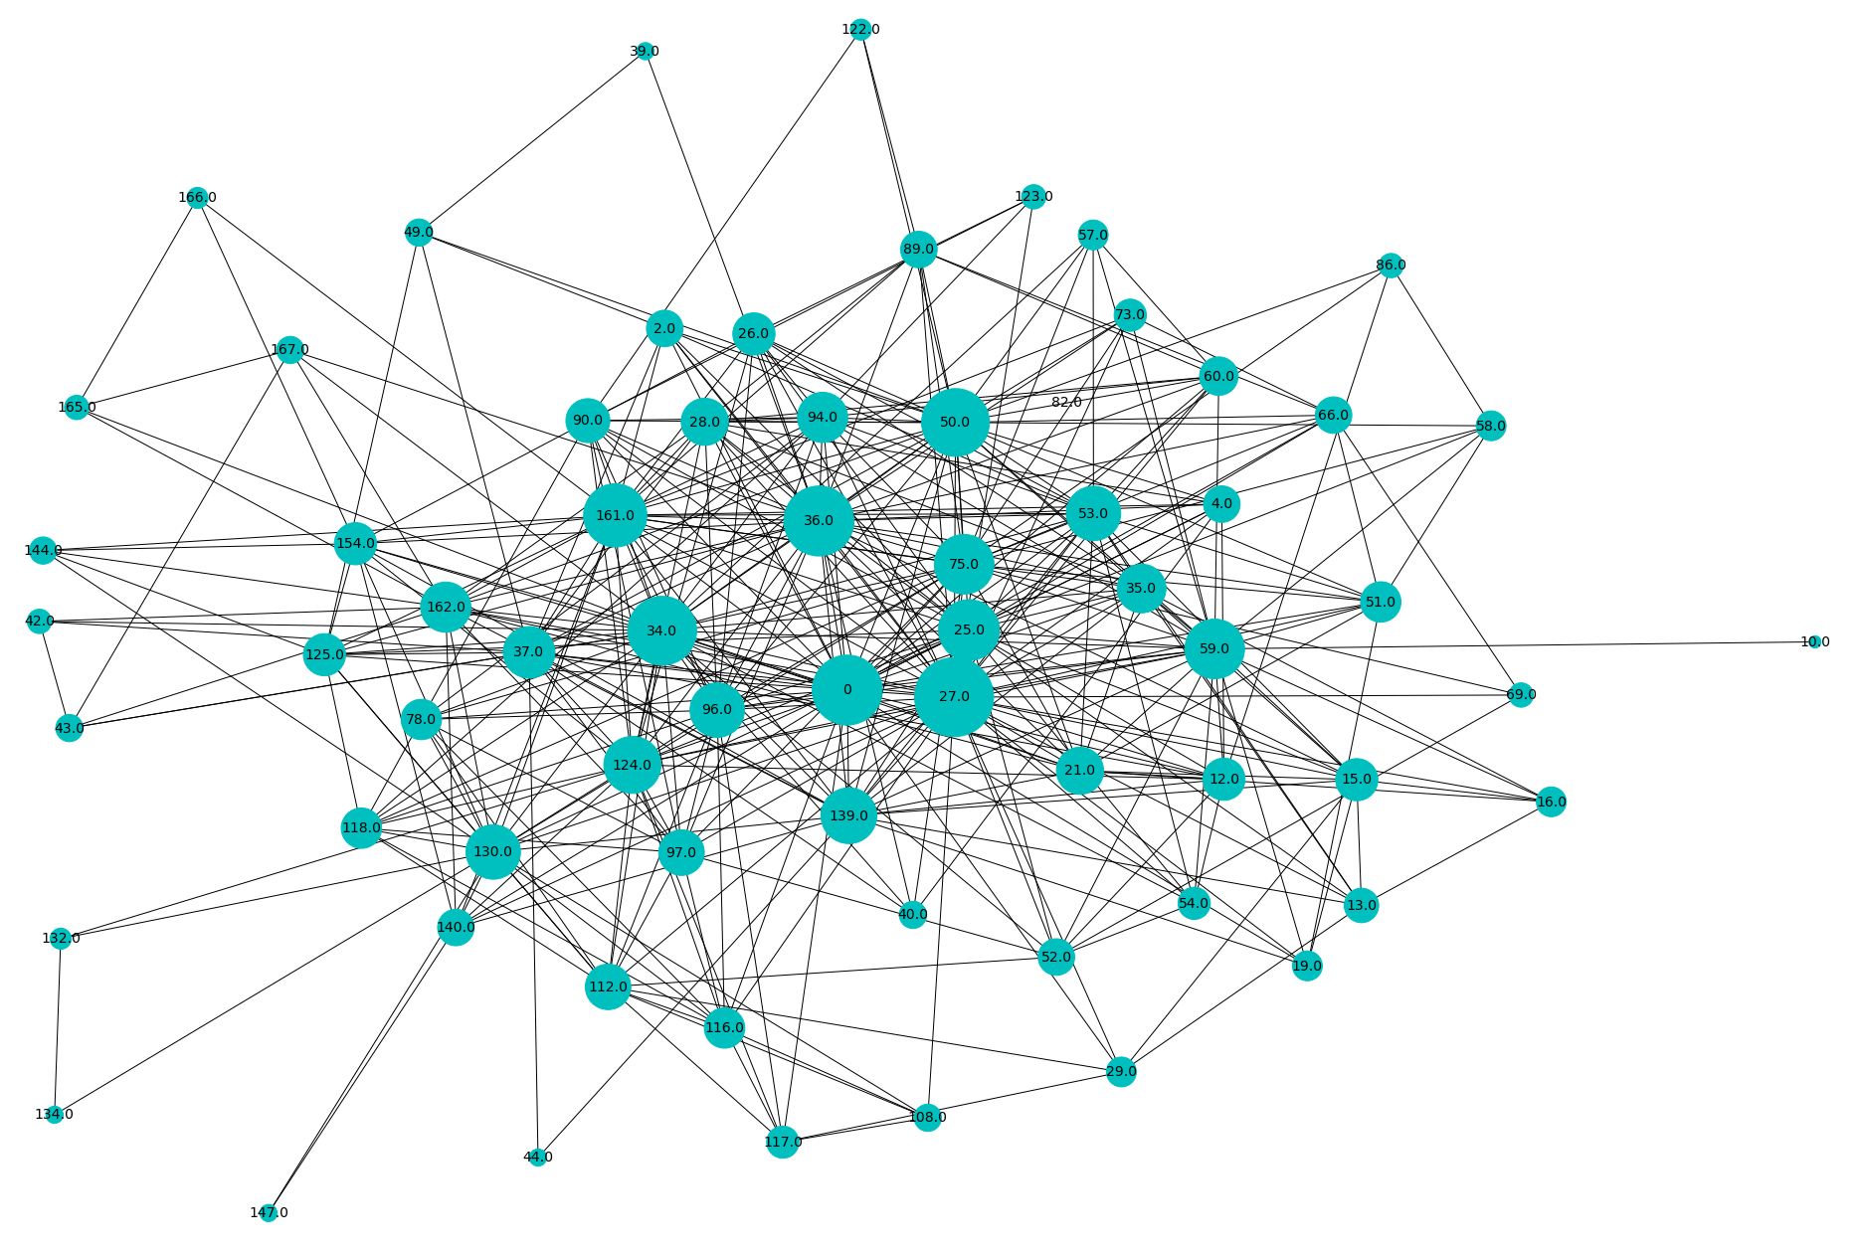
Network Characteristics
Nodes: Lines
Edge: a train switched from one line to another (= real switches)

Slide 7
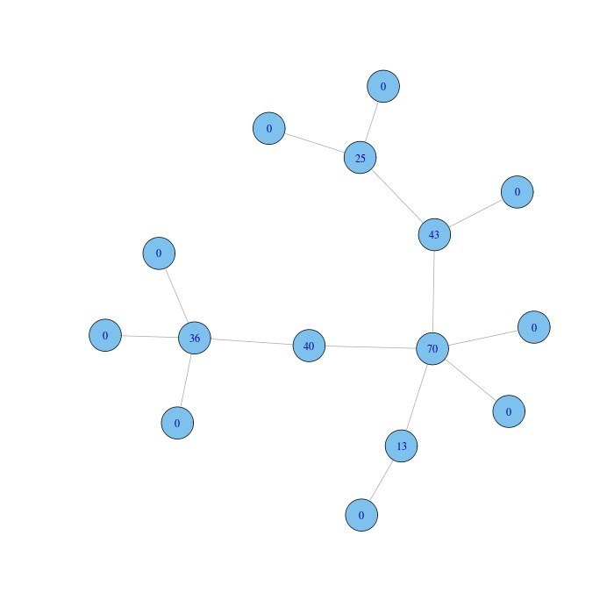
Network features
Degree
number of connections that a line has with other lines
Betweenness
How much does a line lie on the shortest path between other lines (bridge between lines)
Centrality
Measures average of shortest paths to every other line
Pagerank
Lines that are connected to many other important lines are more important themselves. This method is used to determine which lines are most important for facilitating travel between different locations.

Slide 8
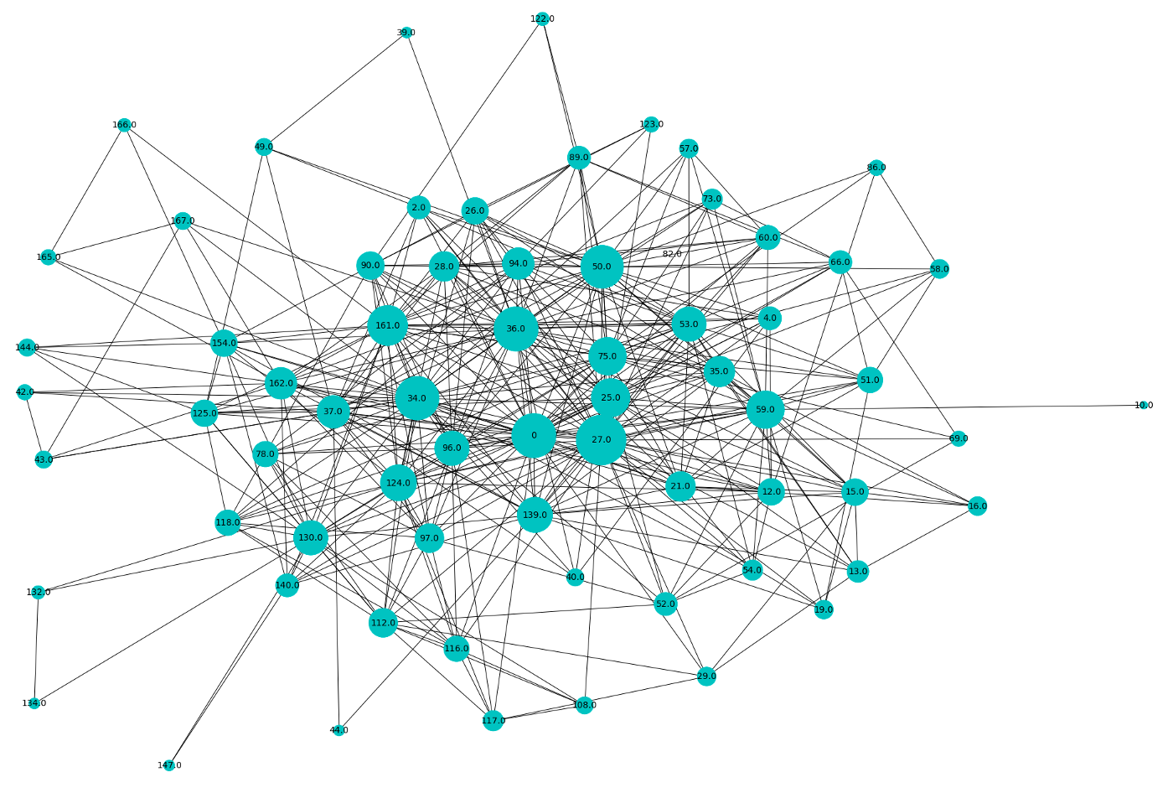
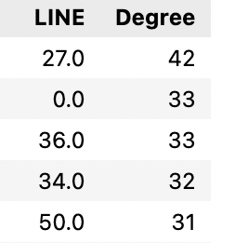
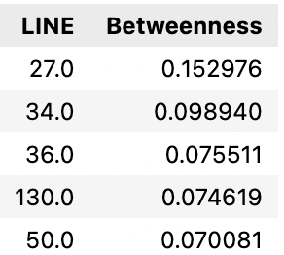
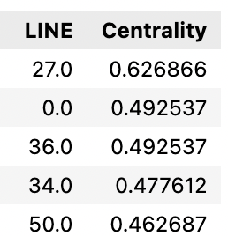
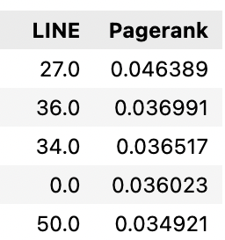
Network features
Line 27: Brussels.N – Antwerp
Line 0: Brussels.N – Brussels.S
Line 36: Burssels.N – Liege
Line 34: Hasselt - Liege
Line 50: Brussels.N - Oostende
Line 130: Namur - Charleroi
Degree Betweenness Centrality Pagerank

Slide 9
Delay features
small_delay_prop_total
Of all the stops that the trains in a row make, how many had a >90s delay?
normal_justif_count_total / p_justif_count_total
How many times were the trains delayed by another (P-) train?
Data leakage?

Slide 10
Data leakage of using complete journeys?
Small delay proportion and number of justifications
Features highly predictive for not meeting service level
Associated with small delays, which are associated with larger delay
Data leakage
We train with data on completed journeys
In production setting we cannot know this in advance, only react as they happen
This does give us an indication of how much your chance of timeliness reduces with a single additional impact.

Slide 11
Upcoming features:
Population in station locations
Line characteristics from Jens
Additionally: % of the line single track / double track
Weather

Slide 12
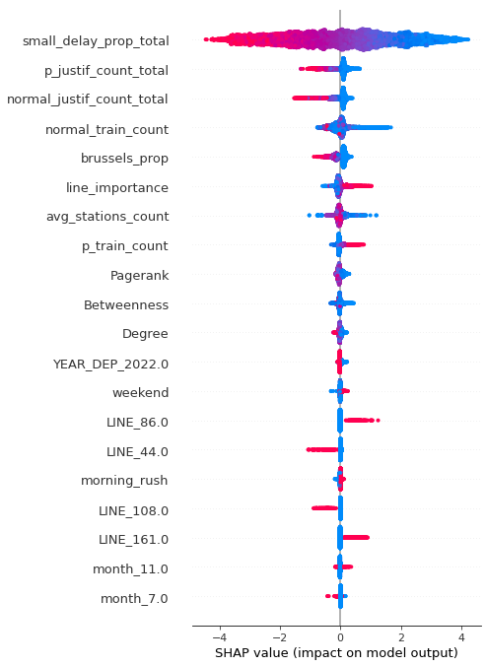
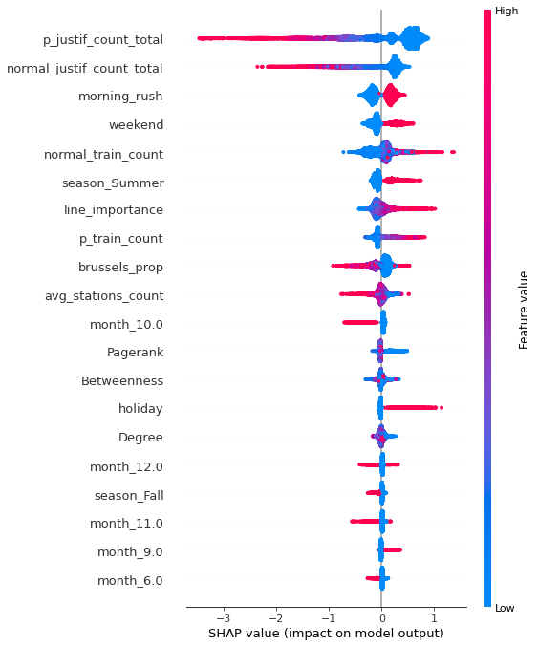
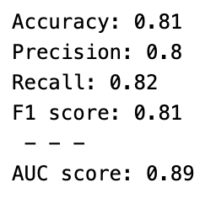
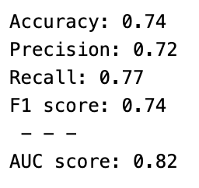
small_delay_prop included
small_delay_prop excluded
Notes:
Proposed alternative for small_delay_prop_total:
Delays in the last three stops

