Slide 1
P-train project update 5
Tuyen Nguyen
Miek Adriaens

Slide 2
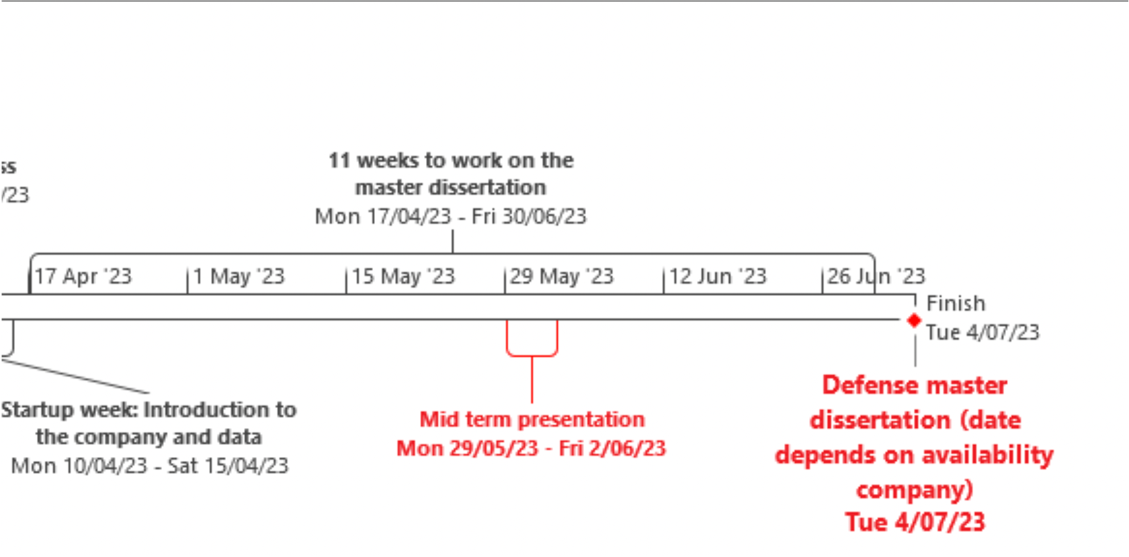

Planning (1)

Slide 3
Planning (2)
May 8-14:
Implementing dynamic/personalised features for the P-trains
May 15-21:
Implementing dynamic/personalised features (continuation)
feature selection
May 22-28:
May-June 29-4: Mid term presentation
June 5-11:
June 12-18:
June 19-25:
June-July 26-30: finalising
July 3-7: Defence

Slide 4
P-train Punctuality Project Recap
We are working with the trains punctuality and journey data
Central questions:
What impacts do P-trains have?
What makes a good P-train?
What makes a bad P-train?
If we create a new P-train, will it be good or bad?

Slide 5
Our model:
Did a P-train make at least 1 other train late (>= 6 mins delay)?
Newest Features:
Individualised:
trains_ahead: How many times a trains was 3 minutes ahead of a P-train at a particular PTCAR
trains_behind: How many times a trains was 3 minutes behind a P-train at a particular PTCAR
For both the commercial stops (stations) and intermediate PTCARS
visual explanation —>

Slide 6
Trains_ahead and Trains_behind:
PTCAR 237: Y.LUCHTBAL
THR_ARR: 9:03
= within 3 minutes of
2001
2002
THR_ARR: 9:06
7001
THR_ARR: 9:09
3001
3002
P-train 7001 has 2 trains ahead and 2 trains behind

Slide 7
Execution problems
Trains behind:
Commercial station PTCARS: individual, for interpretability
currently grouped out of necessity,
Intermediate PTCARS: grouped
Compution:
lots of crashing, memory issues
Can we run on cloud?

Slide 8
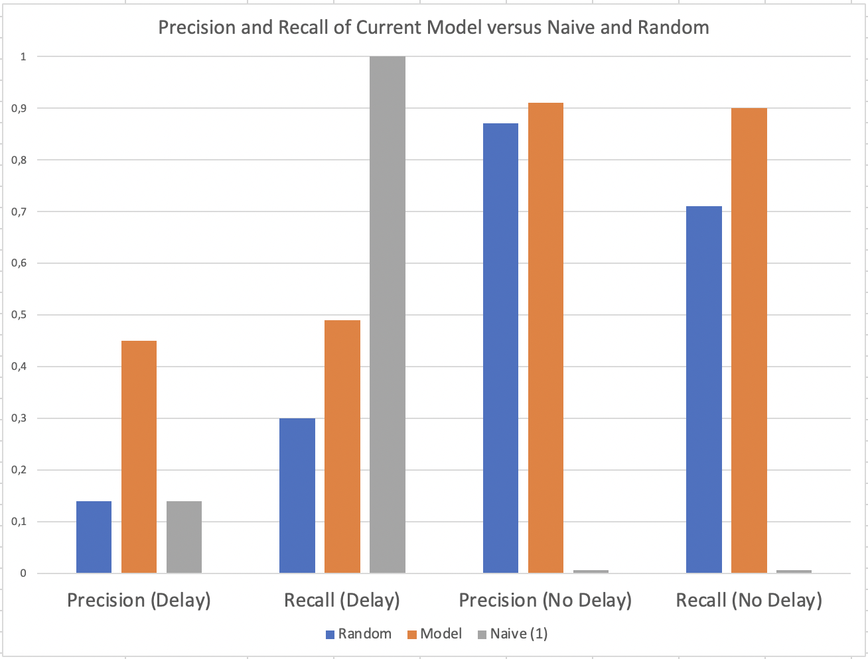
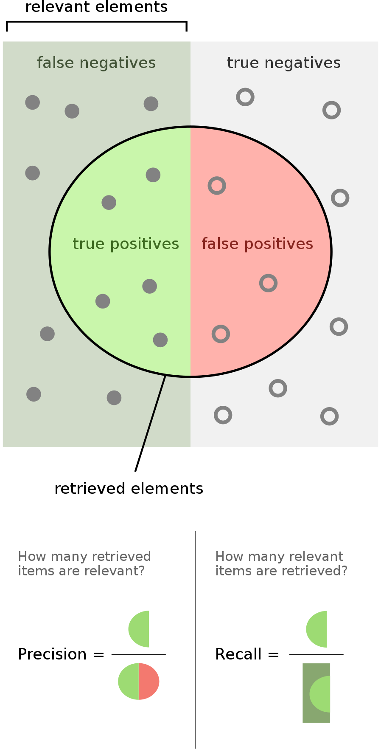
Metrics

Slide 9
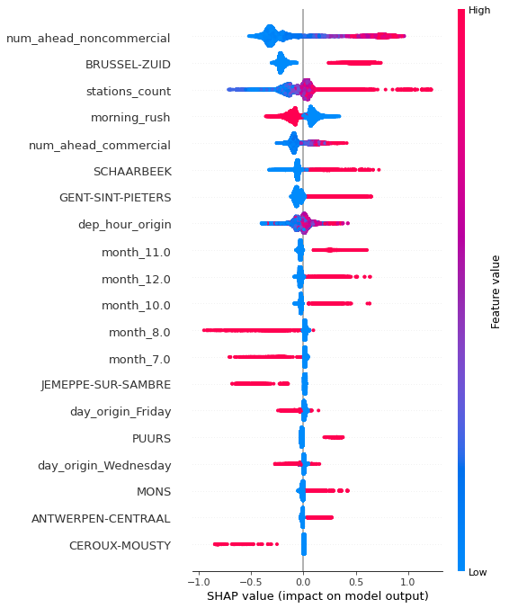
SHAP Feature Importances
Having a high number of trains planned to cross a PTCAR right before a P-train is now most predictive for P-train causing delay
Problematic stations remain
Months:
Fall/Winter has issues
Summer smooth
Days:
Wednesdays and Fridays

Slide 10
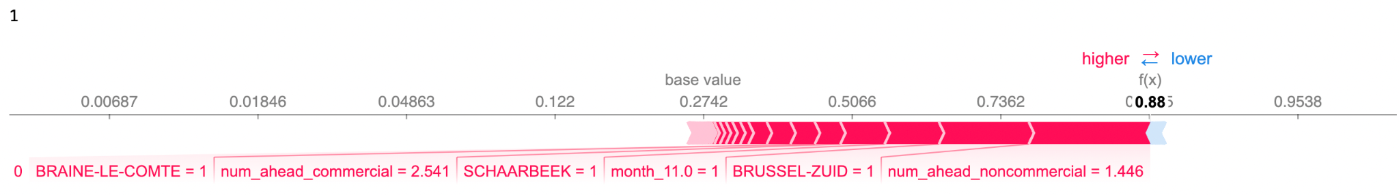
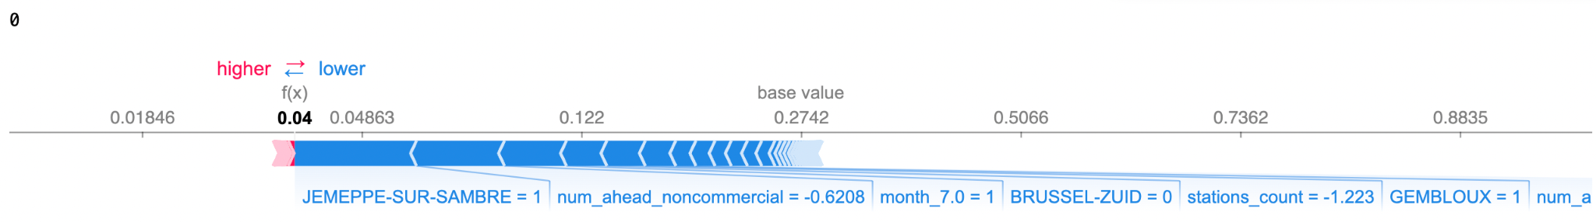
Force Plots: Model Prediction Motivations
reality
prediction
reality
prediction

Slide 11
Closing: Q&A
Ideas on computation and memory issues?
What are your views on the newest variables?
Which variables do you think are good/bad?
Which variables do you think we can add?
Our next steps:
Find a way to wrangle our large files to have split trains_ahead for the commercial stations
more variables (population, # tracks, # signals, # Y-splits / crossings)
can we get raw data for signals / tracks / weather?
What packages have you used for this in the past?

