Slide 1
P-train project update 7
Tuyen Nguyen
Miek Adriaens

Slide 2
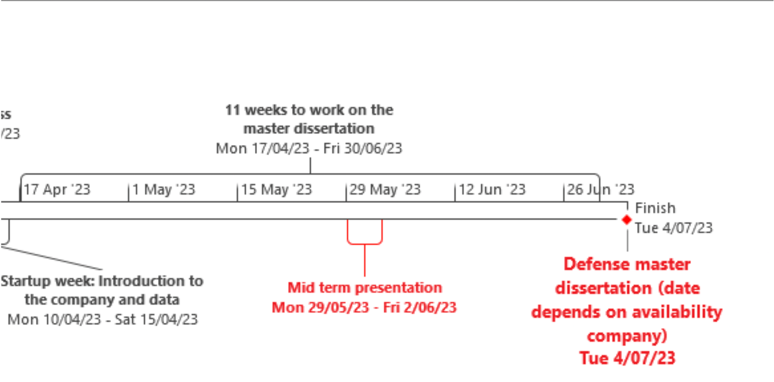

Planning (1)

Slide 3
Planning (2)
May-June 29-4: Mid term presentation, new target
June 5-11: hyperparameter tuning
June 12-18: preparing presentation and paper
June 19-25: preparing presentation and paper
June-July 26-30: finalising
July 3-7: Defence

Slide 4
P-train Punctuality Project Recap
We are working with the trains punctuality and journey data
Central questions:
What impacts do P-trains have?
What makes a good P-train?
What makes a bad P-train?
If we create a new P-train, will it be good or bad?

Slide 5
Mid-term Recap
Feedback:
change label
use igraph for weighted pagerank
do variable selection and/or hyperparameter tuning
Add to presentation:
dummy examples
difference between adding 100 trains in the morning and in the evening
show characteristics of good and bad P-trains
network capacity (if feasible)

Slide 6
Our model:
Target update:
Was a P-train part of a justifications chain that made a train late (>= 6 mins delay)?
Features:
times_ahead:
How many times a P-train was 5 minutes ahead of another train on a specific line section, travelling in the same direction
times_behind:
How many times a P-train was 5 minutes behind another train on a specific line section, travelling in the same direction
pagerank:
Importance in the network, where trains are connected by sharing a line section and direction (weighted by times they share a section)

Slide 7


Target
Previous Target:
We give the label 1 (=had impact) if a train was at the start of the chain of justifications that caused a train to be late
New Target:
We give the label 1 (= had impact) if a train is any part of the chain of justifications that caused a train to be late
label: 0
label: 0
label: 1
if delayed by ≥6 mins
label: 1
label: 1
label: 1
if delayed by ≥6 mins

Slide 8
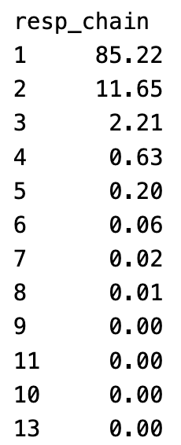
New Target
Justifications chain:
has to happen within 5 minutes
Distribution of number of trains:
Class Imbalance:
Positive class is now 35%, up from 13% with previous target

Slide 9
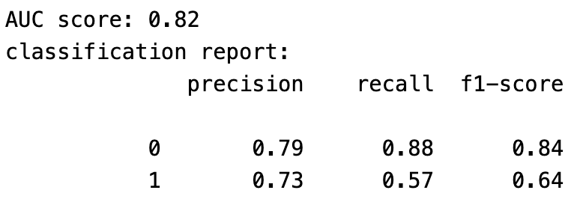

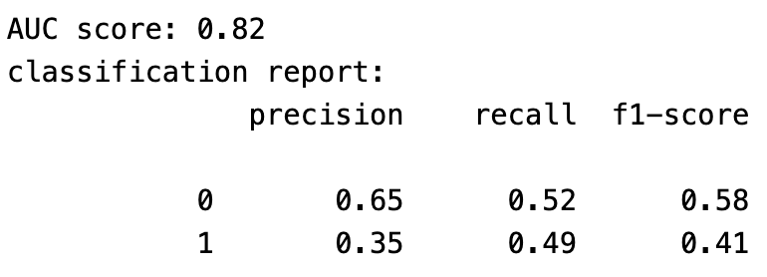

Performance:
Our model:
Random model:

Slide 10
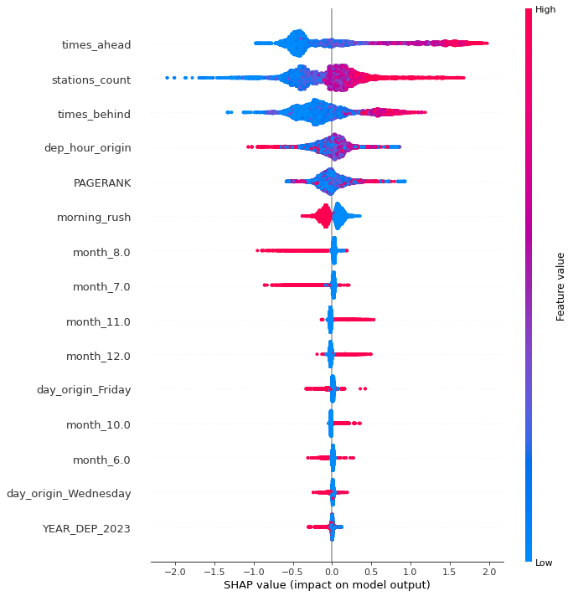
Predictor Importances

Slide 11
Closing: Q&A
Our next steps:
Integrating feedback
Tuning model
Extra meeting with Jelena & Jens?
Working on the final paper
Preparing final presentation

