Slide 1
P-train project update 8
Tuyen Nguyen
Miek Adriaens

Slide 2
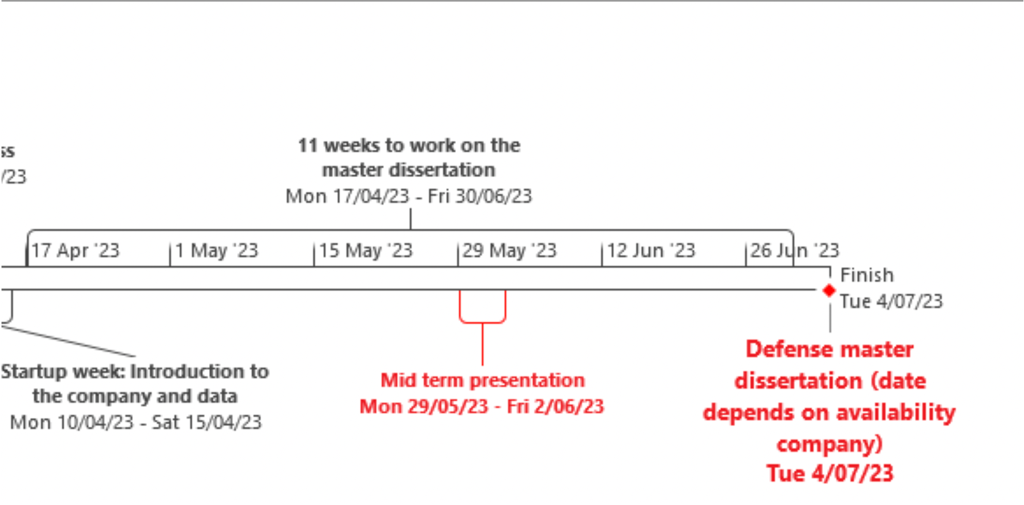

Planning (1)

Slide 3
Planning (2)
June 5-11: integrated technical feedback, added and refined features
June 12-18: preparing presentation and paper
June 19-25: preparing presentation and paper
June-July 26-30: final presentation
July 3-7: Defence

Slide 4
P-train Punctuality Project Recap
We are working with the trains punctuality and journey data
Central questions:
What impacts do P-trains have?
What makes a good P-train?
What makes a bad P-train?
If we create a new P-train, will it be good or bad?

Slide 5
Technical Session Recap
Feedback:
PCA on network features
simplify months
add region variables
reduce days
weather variables

Slide 6
PCA on Network Features
Features:
times_ahead:
How many times a P-train was 5 minutes ahead of another train on a specific line section, travelling in the same direction
times_behind:
How many times a P-train was 5 minutes behind another train on a specific line section, travelling in the same direction
pagerank:
Importance in the network, where trains are connected by sharing a line section and direction (weighted by times they share a section)
Issue:
correlations
3 PC’s did not improve model
keep original variables for interpretability

Slide 7
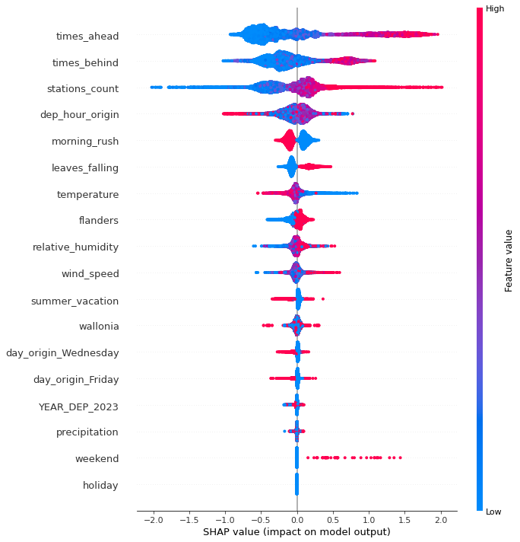
Simplified date features
Months
leaves_falling: 22 sep - 21 dec
summer_vacation: 16 jun - 31 aug
original months removed
Days
only wednesday and friday significant
others removed

Slide 8
Region Variables
Account for differences in the regions
flanders: 1 if the P-train makes at least 1 stop in Flanders
wallonia: 1 if the P-train makes at least 1 stop in Wallonia

Slide 9
Weather Variables
Temperature
Humidity
Windspeed
Precipitation

Slide 10
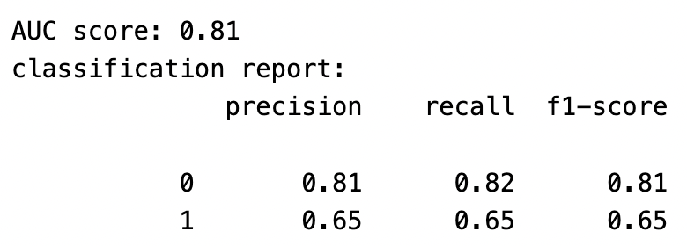

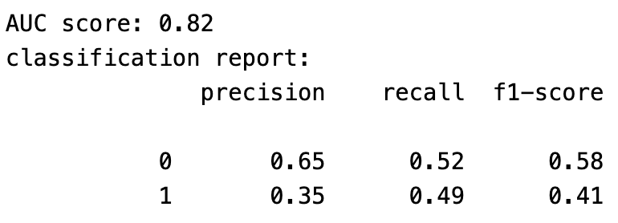

Performance:
Our model:
Random model:

Slide 11
Predictor Importances
option A: times_ahead and times_behind

Slide 12
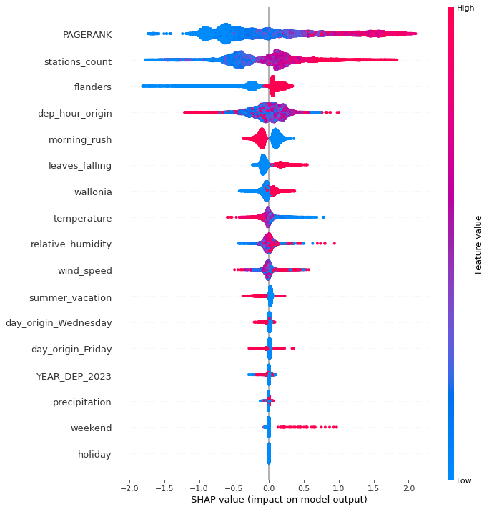
Predictor Importances
option B: pagerank
note:
flanders rises to 3rd

Slide 13
Closing: Q&A
Our next steps:
More hyperparameter tuning and/or further feature selection
we lock features for now
Working on the final paper
Preparing final presentation
Questions:
Final presentation
Date?
Location?
Code sharing
practical steps?

