Slide 1

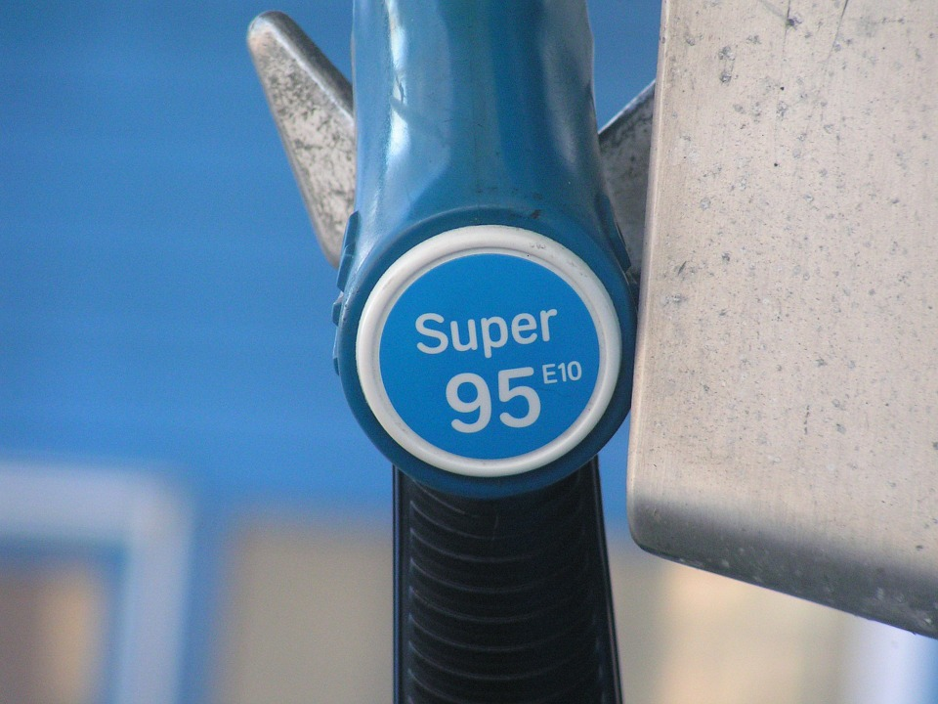


English Presentation
«How gas pump knows that your tank is full ?»
Teacher : John Michael Dudley
With the participation of:
Pierre Wargnier
Année 2016/2017

Slide 2
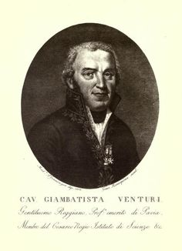
Who ?
The Venturi Effect
The Venturi Pump
The Venturi Tube
Giovanni Battista Venturi

Slide 3

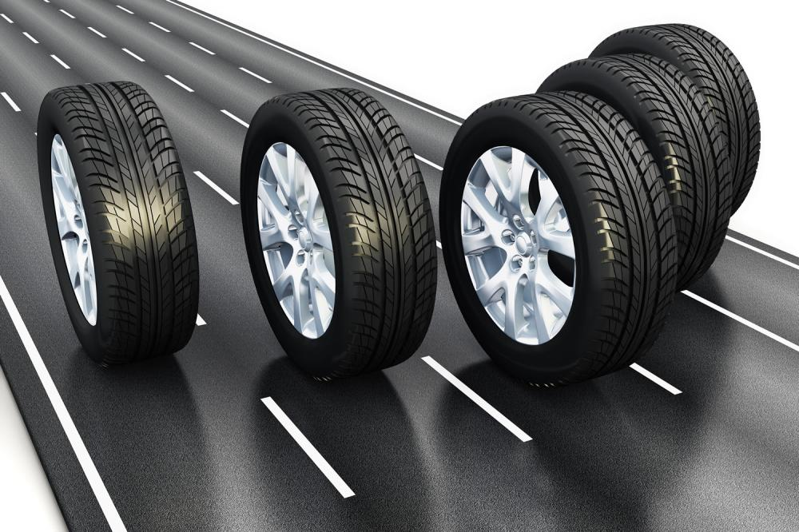
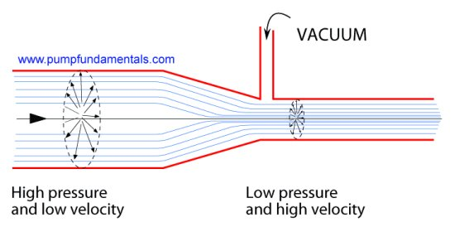
The Venturi Effect

Slide 4

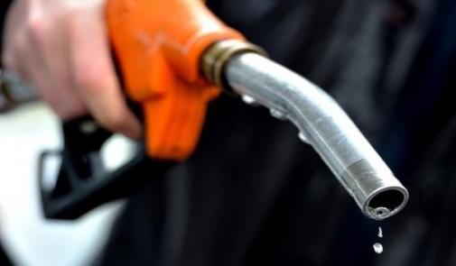
Gas Pump

Slide 5
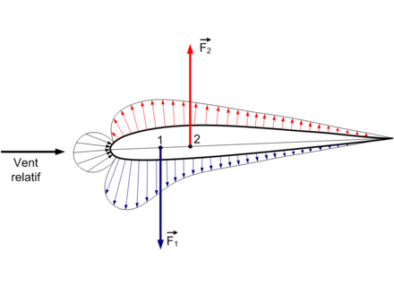
And with plane ?

