Slide 1
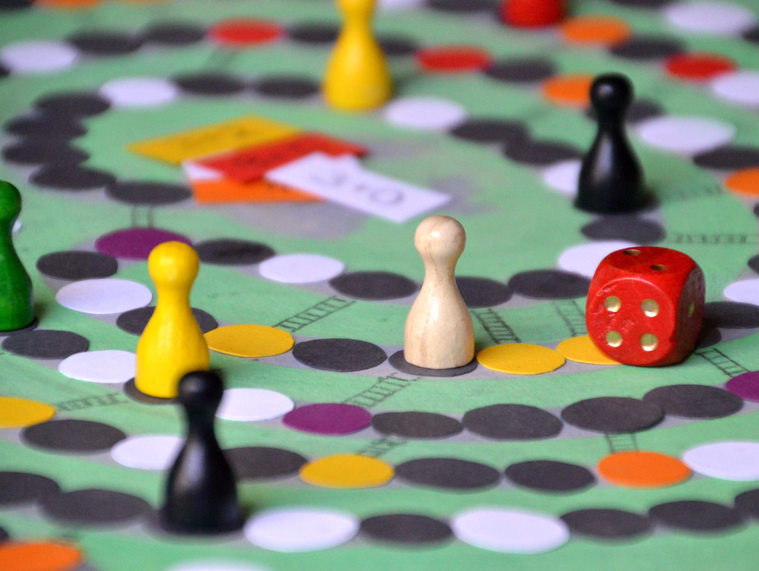
Game Arcade Token & Session Management System
Final Project Presentation

Slide 2

Introduction
This C++ system manages game zones, machines, token distribution,
and session tracking in a game arcade.
Uses fundamental DSA: Tree, Linked List, Queue, and Stack.

Slide 3
Functional Requirements
- Multiple zones (VR, Racing, Puzzle, Shooting)
- Machines managed by ID, Name, Status
- Token allocation and queue handling
- Session history tracking with player info

Slide 4

Zone & Machine Management
- Each zone contains several gaming machines
- Machines have unique IDs and statuses
- Tree structure used to manage zones and machines

Slide 5
Token & Session Handling
- Players request tokens to play games
- Queue ensures first-come-first-serve
- Stack used for session history
- Linked List used for active session tracking

Slide 6
System Flow
Player Requests -> Token Allocation (Queue)
→ Session Start (Linked List) → Session End
→ Session Stored (Stack)

Slide 7
Data Structures Used
- Tree: Manage zone & machine hierarchy
- Queue: Handle player token requests
- Stack: Store completed session history
- Linked List: Manage current active sessions

Slide 8
Core Functions
- Add Machine to Tree
1
- Request Token (Enqueue)
2
- Start Session (Linked List insert)
3
- End Session (Push to Stack)
4
- Display History
5

Slide 9
Conclusion
Efficient use of C++ and Data Structures
Real-world application for arcade management
Scalable, modular, and clear structure
Good balance of theory and practical implementation

Slide 10


