Slide 1
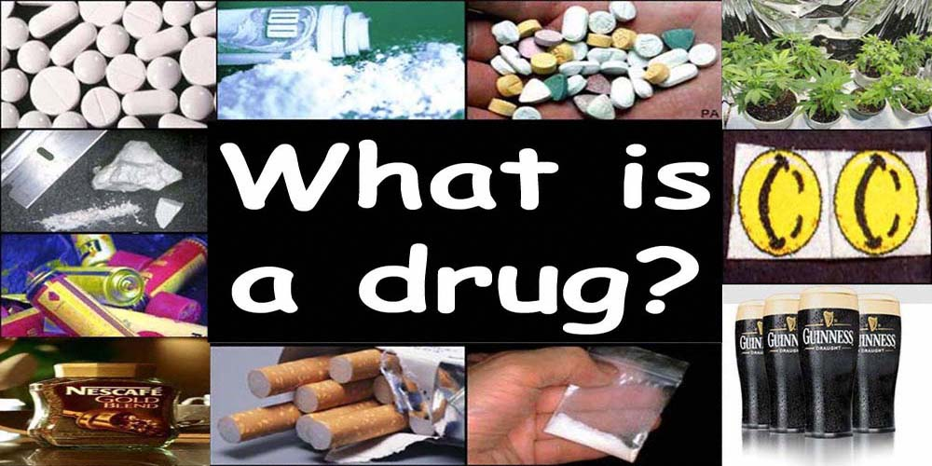

Slide 2
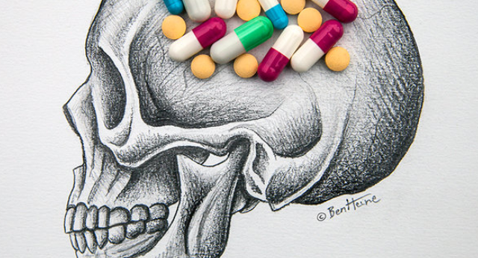

Slide 3

LEGAL AND ILLEGAL DRUGS?

Slide 4
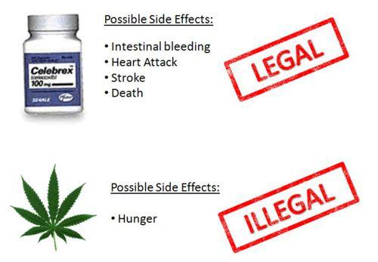

Slide 5
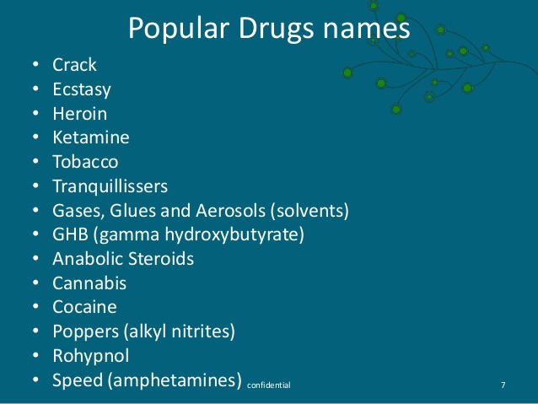

Slide 6

What are the Effects of Drugs?

Slide 7


Slide 8
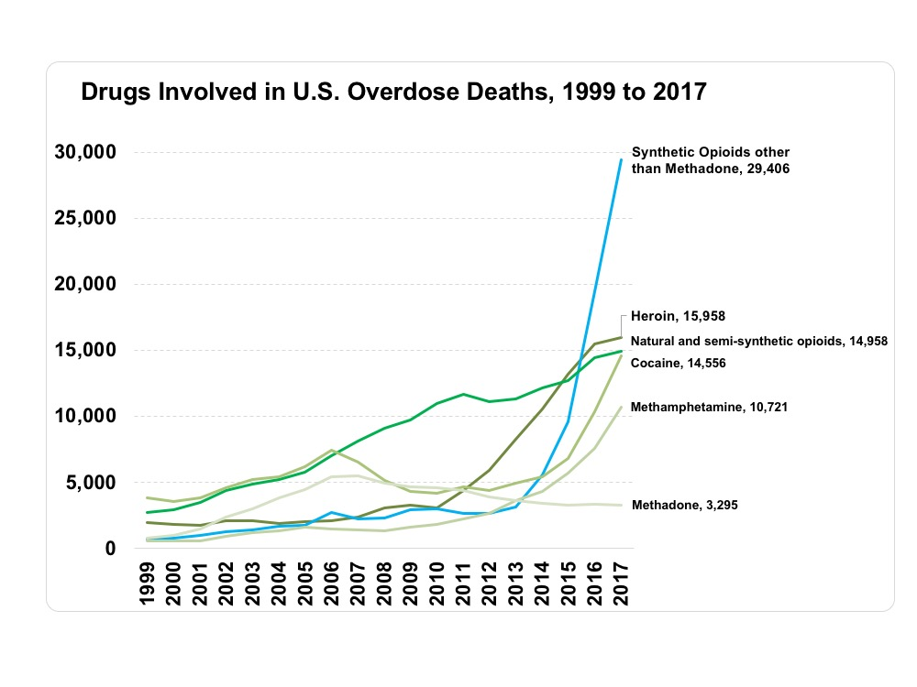

Slide 9
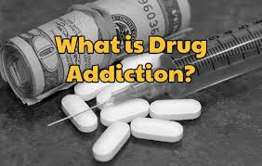
WHAT IS DRUG ADDICTION?

Slide 10
