Slide 1
From Perceptrons to TensorFlow Implementation
Deep Learning Basics
Covers perceptrons, multi-layer networks, loss functions, optimizers, and a TensorFlow example.
Notes:
Hello. Ashan Ahmad presents Deep Learning Basics. We cover perceptron fundamentals, multi-layer dense networks, and activation choices. The session includes loss functions, optimizers, and training dynamics, ending with a hands-on TensorFlow example to build a simple net.

Slide 2

Introduction to Deep Learning
Deep learning is a subfield of machine learning centered on hierarchical neural models. Breakthroughs in vision, speech, and language have popularized these architectures. Designed for beginners, this session progresses toward practical implementation, illustrating core concepts with intuitive examples.
Notes:
Deep learning utilizes hierarchical neural models within machine learning. Recent success in vision and speech has driven its popularity. This beginner-focused session bridges the gap toward practical implementation, using intuitive examples to clarify core concepts.

Slide 3
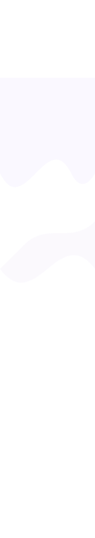

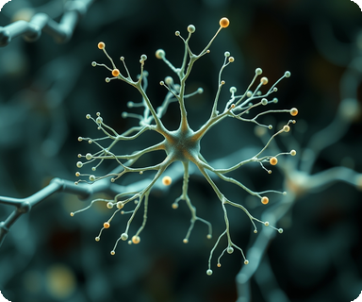

Biological Inspiration & Neurons
Human neurons inspire perceptrons: dendrites receive, soma integrates, axon transmits
Artificial neurons compute weighted sums of inputs plus bias terms
Mathematical computation that models signal processing
Biological structures mirrored in artificial neuron design
Activation thresholds determine output signals, enabling mathematical learning
Threshold functions abstract biological firing mechanisms
Notes:
Biological neurons inspire artificial perceptrons. Human neurons have dendrites for receiving, soma for integrating, and axons for transmitting. Artificial neurons compute weighted sums plus bias, with thresholds determining output, enabling mathematical learning models.

Slide 4
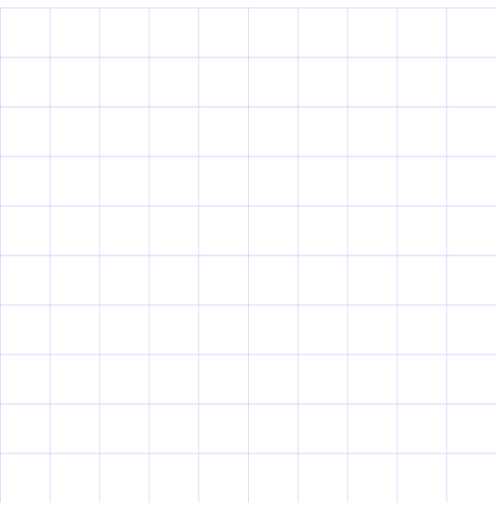
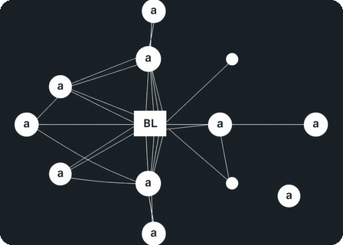
The Perceptron Model
A fundamental neural network unit acting as a linear binary classifier. It predicts outcomes using weighted inputs and a step function.
Linear Classifier Mechanism
Separates data via a hyperplane using the step function of weighted inputs and bias.
Weight Learning Rule
Adjusts weights proportionally to error magnitude and input values during training.
Binary Classification
Effective for simple tasks distinguishing between two distinct classes of data.
Notes:
The perceptron model serves as a foundational linear classifier in machine learning. It separates data using a hyperplane and updates weights based on errors to learn from binary classification tasks.

Slide 5
Perceptron Limits
LINEAR
STRUCTURE
GRADIENT
XOR Problem
Representation
Learning Stalls
Fails on non-linearly separable problems like XOR.
No hidden layers restrict complex pattern learning.
Stalls on non-linear boundaries; necessitates multi-layer nets.
Notes:
Single-layer perceptrons handle basic linear tasks but fail with complexity. They struggle with XOR problems due to missing hidden layers for deep feature extraction. This limitation necessitates multi-layer architectures to map intricate non-linear relationships effectively.

Slide 6
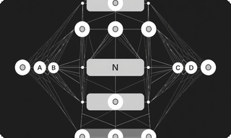
Multi‑Layer Perceptron Architecture
01
Dense Layer Stacking
02
Feed‑Forward Flow
Stacks dense layers where each neuron receives all outputs from the previous layer, typically arranged as input → hidden → output.
Inputs propagate through hidden layers to the output in a feed‑forward manner, ensuring unidirectional data flow.
03
Approximation Theorem
Guarantees that the network can model any continuous mapping given a sufficient number of neurons in the architecture.
Notes:
The Multi-Layer Perceptron stacks dense layers, with neurons receiving all previous outputs. It uses a feed-forward flow to propagate data. Crucially, the approximation theorem guarantees the ability to model any continuous mapping with sufficient neurons.

Slide 7
Activation Functions
Introduce Non‑linearity
Sigmoid Mapping Range
Sigmoid Limitations
Allows networks to capture complex patterns
Maps outputs to range (0,1)
Suffers from saturation issues
Tanh Output Range
Tanh Gradient Issue
ReLU Advantages
Outputs centered around zero (-1,1)
Prone to vanishing gradient problem
Sparse activation and efficient gradients
Notes:
Activation functions introduce non-linearity to neural networks. Sigmoid maps to (0,1) for probabilities but saturates. Tanh outputs (-1,1) centered on zero, yet still faces vanishing gradients. ReLU variants provide sparse activation with efficient gradient flow for better training.

Slide 8
ReLU and Its Variants
01
02
03
Standard ReLU
Leaky ReLU
Parametric ReLU
FORMULA & BENEFITS
MODIFICATION
KEY FEATURE
f(x)=max(0,x) offers fast computation and mitigates vanishing gradients.
Adds small slope for negative region (e.g., 0.01) to prevent zero gradient.
Learns negative slope during training for better adaptation.
LIMITATION
FUNCTION
BENEFIT
Dead neuron problem occurs when inputs stay negative, halting learning.
Allows small gradient when unit inactive, keeping the neuron alive.
Provides flexibility by adapting the activation function to the data.
Notes:
The Standard ReLU offers fast computation but suffers from the dead neuron problem. Leaky ReLU fixes this with a small slope for negative inputs, while Parametric ReLU learns this slope during training for better adaptation.

Slide 9



Loss Functions for Supervised Learning
Functions quantify prediction discrepancies against true targets.
Classification
Regression
Optimization
Categorical
MSE
Gradients
Multi-class
Squared penalty
Magnitude
Binary
Stability
Two-class
Training flow
Convg.
Behavior
Notes:
Loss functions quantify the gap between predictions and targets. For classification, categorical cross-entropy handles multi-class problems, while binary cross-entropy is for two-class tasks. Regression uses mean squared error. This choice impacts gradient magnitude, training stability, and convergence.

Slide 10
Momentum: accelerates convergence
Parameter
Update Optimizers
Moves opposite loss gradient
1
3
SGD: Faster, noisy updates
2
Adam combines momentum & rates
4
Notes:
This slide discusses various optimizers used for updating model parameters. Gradient descent simply moves against the gradient. SGD introduces mini-batches for speed. Momentum smooths out updates. Adam combines these advantages for efficient training.

Slide 11
1
Training Workflow
1
3
5
Initialize model parameters, optionally using He or Xavier schemes.
Compute loss using selected loss function.
Optimizer updates weights based on computed gradients.
2
4
6
Perform forward pass to compute predictions for a batch.
Execute backward pass to propagate gradients.
Repeat over epochs with validation checks.
Notes:
The slide details the practical workflow of model training. It covers parameter initialization, forward passes, loss computation, gradient propagation, weight updates by the optimizer, and epoch repetition with validation.

Slide 12
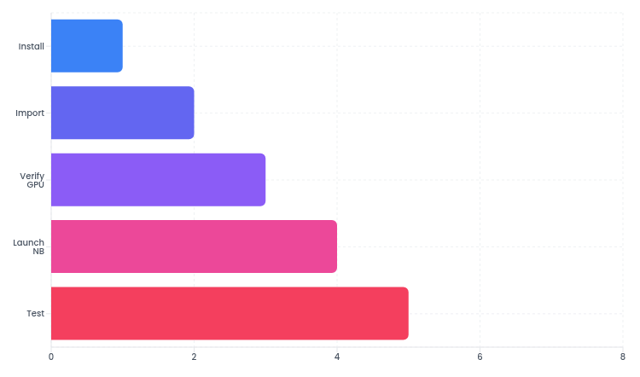
Setting Up TensorFlow Environment
Install & Import TensorFlow
Use pip install tensorflow to install the library, then import it in Python with import tensorflow as tf to begin development.
Essential steps to configure and verify TensorFlow installation for machine learning development with GPU support.
Verify GPU Availability
Run tf.config.list_physical_devices('GPU') to confirm hardware acceleration is enabled for optimal performance.
Test with Jupyter & Sanity Check
Launch Jupyter Notebook for interactive experimentation and create a constant tensor to validate your setup is working correctly.
Notes:
This slide covers the fundamental steps for setting up a TensorFlow environment. Start by installing TensorFlow using pip, then import the library in Python. It's crucial to verify GPU availability to leverage hardware acceleration. Consider using Jupyter Notebook for interactive development. Finally, run a quick sanity check by creating a constant tensor to ensure everything is configured properly before starting your machine learning projects.

Slide 13

Neural Network Implementation
CHALLENGE
Building a classification model using TensorFlow with proper layer configuration and training parameters.
TensorFlow Tutorial
Machine Learning Implementation
STEPS
1.
Defined Sequential model using Keras
20 epochs
2.
Added Dense layer with 64 ReLU units
3.
Configured softmax output layer
4.
Compiled with cross-entropy loss
5.
Trained with 20 epochs and validation
Training cycles with validation split
Notes:
This demonstrates building a simple neural network with TensorFlow. We defined a Sequential model, added Dense layers with ReLU activations, configured a softmax output for classification, compiled with cross-entropy loss and Adam optimizer, then trained on data with 20 epochs and 0.2 validation split. This step-by-step approach provides a solid foundation for building classification models.

Slide 14



Accuracy
96.5%
Goal
95.0%
Evaluating Model Performance
on test set
Val. Loss
0.12
Assess model generalization using loss and accuracy.
Max
0.20
Use model.evaluate on the test set for loss and accuracy. Plot training against validation curves to detect overfitting. Generate confusion matrices via sklearn.metrics and analyze misclassifications to drive model refinements before reporting final metrics.
score
Precision
93.0%
Target
90.0%
rate
Notes:
Start by running `model.evaluate` to get baseline metrics. Visualize training curves to check for overfitting. Use the confusion matrix to spot specific error patterns.

Slide 15

Summary
Recapped networks and TensorFlow. Next: explore deep CNNs, RNNs, regularization, and hands-on data experiments.
Notes:
We covered neural network fundamentals and TensorFlow. Next, explore deep architectures like CNNs and RNNs. Feel free to ask questions now.

