Slide 1
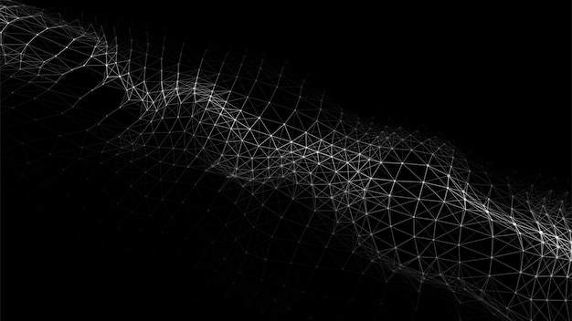
BEGINNER'S GUIDE
Unsupervised
Machine Learning
K-Means & Hierarchical Clustering
for Customer Segmentation
Clustering Algorithms
Customer Segmentation

Slide 2
Learning Journey
01
Introduction to Unsupervised Learning
02
K-Means Clustering
Deep dive into the most popular clustering algorithm and optimal K selection
Understanding the fundamentals of unsupervised learning and clustering algorithms
03
Hierarchical Clustering
04
Customer Segmentation
Building clusters through hierarchy and understanding dendrograms
Applying clustering to real business problems with mall traffic data
Beginner Level
Theory + Practical
Real-world Applications

Slide 3
CHAPTER 01
Foundations
Understanding the basics of unsupervised machine learning and clustering algorithms

Slide 4
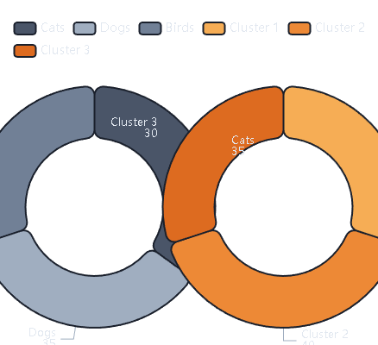
01
What is Unsupervised Learning?
Core Concept
Unsupervised learning discovers hidden patterns in data without labeled examples. The algorithm explores raw data to find structure on its own.
Visual Comparison
Think of it as exploring a new city without a map — you observe, group similar things, and discover patterns.
Supervised
Unsupervised
Data comes with labels (e.g., photos marked "cat" or "dog")
Data has no labels — algorithm finds structure
Key Applications
Customer Segmentation
Image Compression
Anomaly Detection

Slide 5
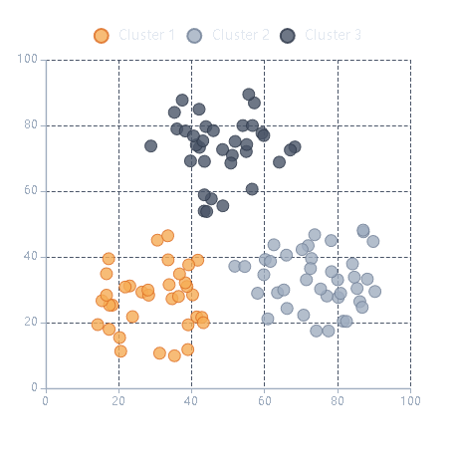
01
Clustering: Grouping Similar Data
What is Clustering?
Clustering Visualization
Clustering groups similar data points together. The goal is to maximize similarity within clusters and differences between clusters.
How It Works
1
Measure Distance: Calculate distance between points (e.g., Euclidean)
2
Group Similar Points: Points close together form a cluster
3
Optimize Groups: Ensure tight clusters and clear separation
Distance Metrics
Why Use Clustering?
Euclidean: Straight-line distance
• Discover hidden patterns
Manhattan: Grid-based distance
• Exploratory data analysis
Cosine: Angle-based for text
• Preprocessing step

Slide 6
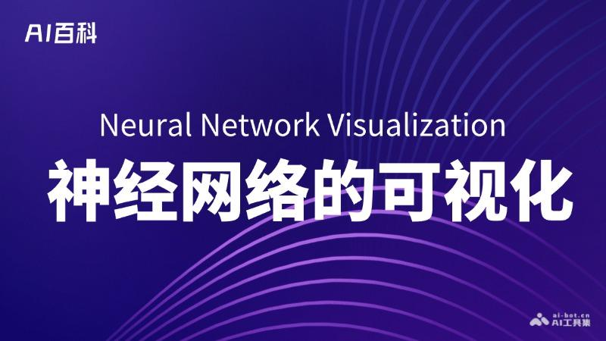
CHAPTER 02
K-Means
Clustering
Deep dive into the most popular clustering algorithm and optimal K selection

Slide 7
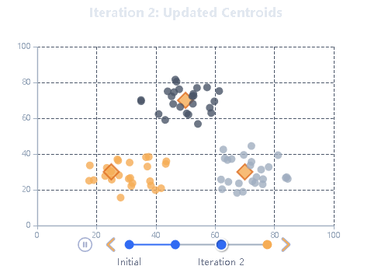
02
K-Means Algorithm: How It Works
The Algorithm
K-Means Iterative Process
K-Means partitions data into K distinct clusters. "K" is the number of groups to find.
1
Choose K
Decide how many clusters to find
2
Initialize Centroids
Randomly place K cluster centers
3
Assign Points
Assign each point to the nearest centroid
4
Update Centroids
Move centroids to the mean of assigned points
O(n)
Scales
Simple
5
Repeat
Time Complexity
Well
To Implement
Continue until centroids stop moving

Slide 8
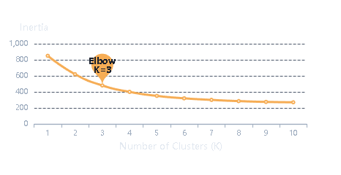
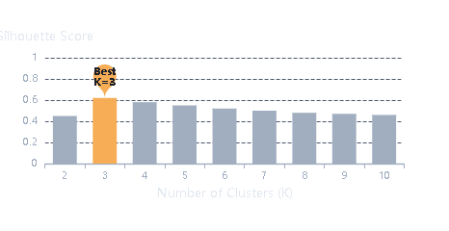
02
Choosing Optimal K
The Challenge
Elbow Method Example
K-Means requires you to specify K (number of clusters) in advance. But how do you choose the right K? Too few clusters = oversimplified. Too many = overfitting.
Elbow Method
Silhouette Score
Plot inertia (within-cluster sum of squares) vs. K. Look for the "elbow" where the rate of improvement slows.
Measures how well each point fits in its cluster. Range: -1 to +1
+1: Perfect fit
How to use: Try K=2 to 10, plot inertia, find the elbow point
0: Boundary case
-1: Wrong cluster
Silhouette Analysis
Other Validation Methods
Davies-Bouldin Index
Gap Statistic
Lower values = better separation
Compares real vs. random data

Slide 9

CHAPTER 03
Hierarchical
Clustering
Building clusters through hierarchy and understanding dendrograms

Slide 10
03
Agglomerative vs Divisive
Agglomerative
Divisive
Bottom-Up Approach
Top-Down Approach
Most Common Type — Start with each data point as its own cluster, then iteratively merge the closest pairs until one cluster remains.
Less Common — Start with all points in one cluster, then recursively split clusters until each point is in its own cluster.
1
Start
1
Start
Each point = 1 cluster (N clusters)
All points = 1 cluster
2
Merge
2
Split
Find closest clusters, merge them
Split cluster into 2 groups
3
Repeat
3
Repeat
Continue until 1 cluster remains
Continue until N clusters (1 point each)
Why Popular?
Challenges
• Simple to understand and implement
• Computationally more expensive
• Produces clear dendrogram visualization
• Harder to make splitting decisions
• No need to specify K in advance
• Less intuitive than agglomerative

Slide 11
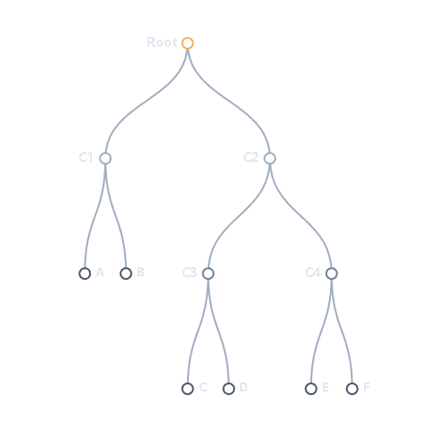
03
Dendrograms & Linkage
Reading a Dendrogram
What is a Dendrogram?
A dendrogram is a tree-like diagram that shows how clusters are merged (or split). The height represents the distance between clusters.
How to Read It
1
Vertical Axis: Shows distance/similarity between clusters
2
Horizontal Cut: "Cut" the tree to get desired number of clusters
3
Clusters Formed: All points below the cut line form one cluster
Linkage Methods
Single
Complete
Minimum distance
Maximum distance
Average
Ward
Mean distance
Minimizes variance
Advantages
• No need to specify K in advance
• Visual representation of cluster relationships
• Can choose any number of clusters after running

Slide 12
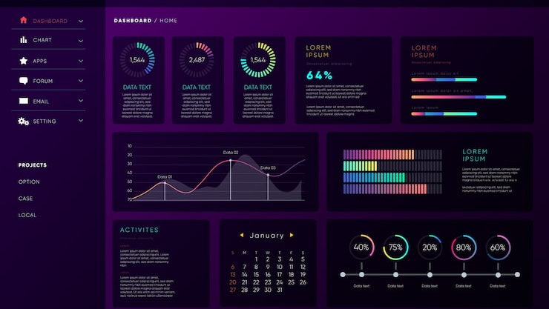
CHAPTER 04
Customer
Segmentation
Applying clustering algorithms to real business problems with mall traffic data

Slide 13
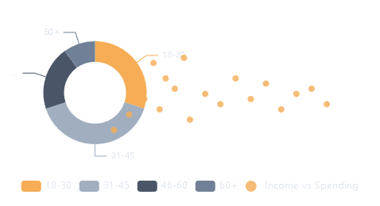
04
Mall Customer Segmentation
The Business Problem
Sample Data
A mall wants to understand customer groups for targeted marketing. Different customers have different behaviors — but there are no predefined categories.
ID | Age | Income | Score
001 | 25 | 65 | 70
002 | 35 | 85 | 45
003 | 42 | 45 | 85
004 | 28 | 90 | 60
005 | 50 | 55 | 30
... and 195 more customers
Solution: Use K-Means clustering to discover natural customer segments from purchase behavior and demographics.
The Dataset
Mall Customer Segmentation dataset contains:
CustomerID
Age
Unique identifier
Customer age
Data Distribution
Annual Income
Spending Score
in thousands
1-100 rating

Slide 14
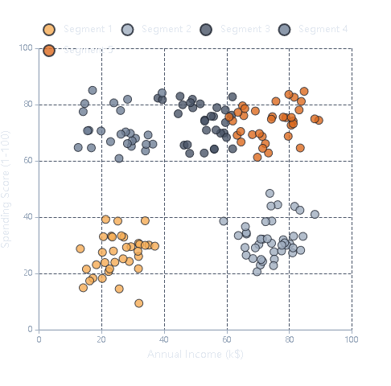
04
Applying K-Means to Mall Data
Implementation Steps
Customer Segments Discovered
1
Explore & Visualize
Plot Age vs Income, Income vs Spending Score
2
Find Optimal K
Use Elbow Method and Silhouette Analysis
3
Apply K-Means
Fit model with optimal K, get cluster labels
4
Analyze Clusters
Understand what each segment represents
Elbow Analysis Result
Optimal K = 5
The elbow method shows a clear bend at K=5, suggesting 5 distinct customer segments.

Slide 15
04
Business Impact & Insights
Customer Segments Identified
Real Case Studies
Segment 1: Budget Conscious
Wondercide
Profile: Low income, low spending. Strategy: Discounts, value products
600%
Overall ROI
Segment 2: Big Spenders
Direct mail to segmented customers: 310% ROI for opted-out, 203% for inactive
Profile: High income, high spending. Strategy: Premium products, VIP
Mountain Khakis
Segment 3: Average Joes
7.1x
5x
Profile: Mid income, moderate spending. Strategy: Loyalty programs
Sales Increase
ROAS
Segment 4: Window Shoppers
Targeted female gift-buyers during holidays: 49% boost in sales, 47% boost in customers
Profile: Low income, high browsing. Strategy: Engagement campaigns
Segment 5: Careful Planners
Key Benefits
Profile: High income, low spending. Strategy: Detailed info, reviews
Targeted Marketing
Personalized campaigns by segment
Increased ROI
Higher conversion, lower costs
Data-Driven Decisions
Replace assumptions with insights
Customer Understanding
Know your customers better

Slide 16

Key Takeaways
Unsupervised Learning
K-Means Clustering
Discovers hidden patterns without labeled data. Perfect for exploratory analysis and understanding data structure.
Fast and scalable but requires pre-set K. Use Elbow Method and Silhouette Score to find optimal K.
Hierarchical Clustering
Business Impact
Shows cluster relationships through dendrograms. No need to specify K. Choose linkage method based on data.
Customer segmentation delivers measurable ROI. Case studies show 600% ROI and 7x sales increases.
Next Steps
Happy Clustering!
Start exploring your data today
Practice with real datasets to build intuition. Try different K values, explore various linkage methods, and validate your clusters with multiple metrics.

Slide 17
Important Links
Notebook: Click here

