Slide 1

MACHINE LEARNING FUNDAMENTALS
Model Evaluation
& Optimization
A Beginner's Guide to Precision, Recall, ROC-AUC,
and Hyperparameter Tuning
Evaluation Metrics
Parameter Tuning
Hands-on Practice

Slide 2
Course Overview
What You'll Learn Today
01
Understanding Model Evaluation
02
The Confusion Matrix Foundation
Why accuracy alone isn't enough and how to properly assess your model's performance
The building blocks of all classification metrics and how to read them
03
Precision, Recall, and F1 Score
04
ROC Curves and AUC
Three essential metrics that reveal different aspects of model performance
Visualizing model performance across all possible thresholds
05
Hyperparameter Fundamentals
06
Grid Search vs Random Search
Understanding the dials and knobs that control model behavior
Two powerful techniques for finding optimal model parameters
07
Practical: Tuning a Random Forest
Hands-on lab session applying everything you've learned to optimize a real machine learning model

Slide 3

CHAPTER 01
Understanding Model
Evaluation
Why accuracy alone isn't enough and how to properly assess your model's performance

Slide 4
Foundation Concepts
The Foundation: Confusion Matrix
The confusion matrix is a 2×2 table that breaks down every prediction your model makes into four distinct categories. It's the foundation for all classification metrics.
True Positive (TP)
Model correctly predicted positive. In our example: correctly identified spam emails.
Confusion Matrix
Email Spam Detection Example
True Negative (TN)
Predicted Spam
Predicted Not Spam
Model correctly predicted negative. In our example: correctly identified legitimate emails.
Actual Spam
85
15
True Positive
False Negative
False Positive (FP)
Model incorrectly predicted positive (Type I Error). In our example: legitimate email marked as spam.
Actual Not Spam
5
195
False Positive
True Negative
False Negative (FN)
Model incorrectly predicted negative (Type II Error). In our example: spam email missed by filter.

Slide 5
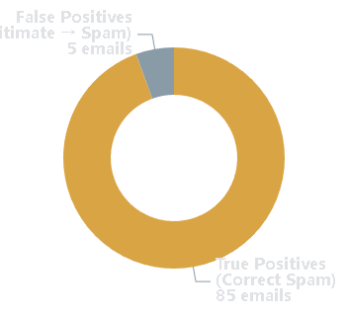
Evaluation Metrics
Precision: When You're Right, How Right Are You?
Precision Formula
Calculation Example
From our spam detection example:
Visual Representation
TP / (TP + FP)
True Positives (TP) = 85
False Positives (FP) = 5
Out of all positive predictions, how many were actually correct?
Precision = 85 / (85 + 5)
= 0.944 = 94.4%
When to Use Precision
Use precision when false positives are costly:
•
Spam detection (avoid blocking legitimate emails)
Key Insight
High precision (94.4%) means when the model says an email is spam, it's right 94.4% of the time. Only 5 legitimate emails were incorrectly flagged.
•
Search engines (show relevant results)
•
Quality control (avoid false alarms)

Slide 6
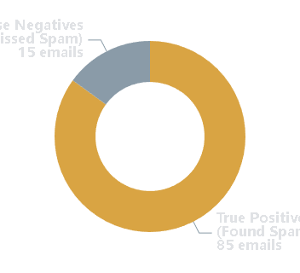
Evaluation Metrics
Recall: Did You Catch Them All?
Calculation Example
Recall Formula
From our spam detection example:
Visual Representation
True Positives (TP) = 85
TP / (TP + FN)
False Negatives (FN) = 15
Out of all actual positive cases, how many did the model find?
Recall = 85 / (85 + 15)
= 0.850 = 85.0%
When to Use Recall
Use recall when false negatives are costly:
Key Insight
•
Disease screening (don't miss sick patients)
85% recall means the model found 85% of all spam emails, but 15 spam emails slipped through to the inbox. Missing spam is less critical than blocking legitimate emails.
•
Fraud detection (catch all fraud)
•
Safety systems (don't miss dangers)

Slide 7
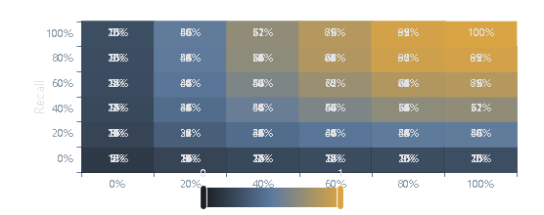
Evaluation Metrics
F1 Score: The Best of Both Worlds
Calculation Example
Using our previous calculations:
Precision = 94.4%
F1 Score Formula
Recall = 85.0%
F1 = 2 × (Precision × Recall) / (Precision + Recall)
F1 = 2 × (0.944 × 0.85) / (0.944 + 0.85)
Harmonic Mean of Precision and Recall
= 0.894 = 89.4%
The harmonic mean punishes extreme values, ensuring both metrics contribute meaningfully.
89.4% F1 shows balanced performance
Why Use F1 Score?
F1 Score Landscape
Use F1 when you need a balance between precision and recall:
•
Information retrieval (balance relevance & completeness)
•
Imbalanced datasets (avoid accuracy trap)
•
When both false positives and false negatives matter

Slide 8

CHAPTER 02
ROC Curves
& AUC
Visualizing model performance across all possible thresholds

Slide 9
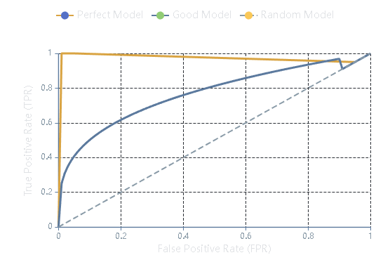
ROC Analysis
Understanding ROC Curves
What is a ROC Curve?
ROC (Receiver Operating Characteristic) curve plots the True Positive Rate against the False Positive Rate at various classification thresholds.
ROC Curve Example
X-axis: False Positive Rate (FPR)
Y-axis: True Positive Rate (TPR)
Threshold: Probability cutoff
Key Definitions
TPR
True Positive Rate
Same as Recall or Sensitivity
FPR
False Positive Rate
1 - Specificity
Interpreting the Curve
•
Perfect model: Hugs top-left corner
•
Random model: Diagonal line
•
Good model: Curve bows upward

Slide 10
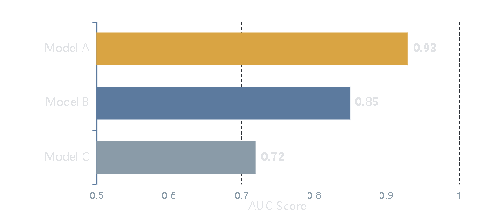
ROC Analysis
AUC: A Single Number Summary
What is AUC?
When to Use AUC
AUC stands for Area Under the Curve. It measures the entire two-dimensional area underneath the ROC curve, providing a single value that summarizes model performance.
•
Imbalanced datasets: More reliable than accuracy
•
Model comparison: Single metric to rank models
•
Threshold-independent: Evaluates all thresholds
AUC Range
•
Probability outputs: When model outputs probabilities
0.5 to 1.0
Model Comparison Example
AUC Interpretation Guide
1.0
Perfect classifier
0.9-1.0
Excellent performance
0.8-0.9
Good performance
0.7-0.8
Fair performance
0.6-0.7
Poor performance
0.5
Random guessing

Slide 11

CHAPTER 03
Hyperparameter
Tuning
Finding the optimal settings for your machine learning models

Slide 12
Hyperparameter Fundamentals
What Are Hyperparameters?
Random Forest Key Parameters
Parameters vs Hyperparameters
n_estimators
Number of trees. More trees = better performance but slower. Range: 100-500.
Model Parameters
Learned during training (weights, coefficients)
max_depth
Maximum tree depth. Controls overfitting. Deeper trees memorize more. Range: 5-15.
Hyperparameters
Set before training (model configuration)
min_samples_split
Min samples to split a node. Prevents over-splitting. Higher values = simpler trees.
Why Tuning Matters
min_samples_leaf
Hyperparameter tuning can be the difference between a poor model and an excellent one. Same algorithm, different settings, dramatically different results.
Min samples per leaf. Ensures leaves have enough data. Range: 1-5.
max_features
Typical Improvement
Features per split. 'sqrt' (default) usually optimal.
5-30%
bootstrap
Sampling with replacement. True (default) creates diversity, reduces variance.

Slide 13
Hyperparameter Tuning Methods
Grid Search: Exhaustive Exploration
How Grid Search Works
1
Define Parameter Grid
Example: Grid Search Grid
Specify discrete values for each hyperparameter
2
Generate Combinations
Parameter Grid Definition
Create all possible combinations
{
'n_estimators': [50, 100, 200],
'max_depth': [5, 10, 15, None],
'min_samples_split': [2, 5, 10]
}
3
Train & Evaluate
Train model for each combination using cross-validation
4
Select Best
Choose combination with best performance
Total Combinations
3 × 4 × 3 = 36
Advantages
Disadvantages
• Guaranteed to find best combination
• Computationally expensive
With 5-fold CV: 36 × 5 = 180 models to train!
• Thorough and systematic
• Curse of dimensionality
• Easy to understand & implement
• May waste time on poor combinations
• Parallelizable
• Requires discrete values

Slide 14
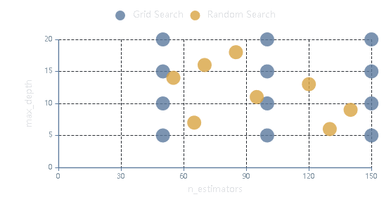
Hyperparameter Tuning Methods
Random Search: Efficient Exploration
Grid Search vs Random Search
How Random Search Works
1
Define Distributions
Specify probability distributions for each hyperparameter
2
Random Sampling
Randomly sample fixed number of combinations
3
Train & Evaluate
Train model for each sampled combination
4
Select Best
Choose best performing combination
Advantages
Disadvantages
• Much faster than Grid Search
• Might miss optimal combination
Key Research Finding
• Better for high-dimensional spaces
• Requires specifying distributions
• Often finds good solutions quickly
• Less systematic than Grid Search
Studies show that Random Search often finds optimal or near-optimal solutions much faster than Grid Search, especially when some hyperparameters are more important than others.
• Can use continuous distributions
• Results vary between runs

Slide 15
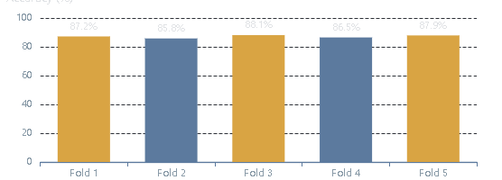
Model Validation
Cross-Validation: Your Safety Net
What is Cross-Validation?
Cross-validation is a technique that splits data into multiple folds and systematically trains/test the model on different subsets to ensure robust performance estimates.
5-Fold Cross-Validation
Why Use CV?
• More reliable than single train/test split
• Prevents overfitting during tuning
• Uses data more efficiently
• Provides confidence intervals
K-Fold CV Process
Stratified Cross-Validation
1
Split Data
Divide into k equal folds
For imbalanced datasets, use StratifiedKFold to maintain the same class distribution in each fold.
2
Train & Validate
Train on k-1 folds, validate on remaining
Recommended K value
3
Repeat K Times
K = 5 or 10
Each fold serves as validation once
4
Average Results
Compute mean performance across folds

Slide 16

CHAPTER 04
Practical
Lab
Fine-tuning a Random Forest for maximum accuracy

Slide 17
Practical Lab
Random Forest Key Parameters
n_estimators
max_depth
min_samples_split
Number of trees in the forest.
Maximum depth of each tree.
Minimum samples required to split a node.
Recommended Range
Recommended Range
Recommended Range
100 - 500
5 - 15
2 - 10
More trees = better performance but slower training. Diminishing returns after 300.
Controls overfitting. Deeper trees memorize training data. None = unlimited depth.
Prevents over-splitting. Higher values create simpler trees and reduce overfitting.
min_samples_leaf
max_features
bootstrap
Minimum samples required at a leaf node.
Features considered at each split.
Sampling with replacement.
Recommended Range
Recommended
Recommended
1 - 5
'sqrt'
True
Ensures leaf nodes have enough data. Higher values smooth the model and reduce variance.
Introduces randomness. Fewer features = more diversity. 'sqrt' usually optimal for classification.
True = each tree trained on bootstrap sample. Creates diversity, reduces overfitting.

Slide 18
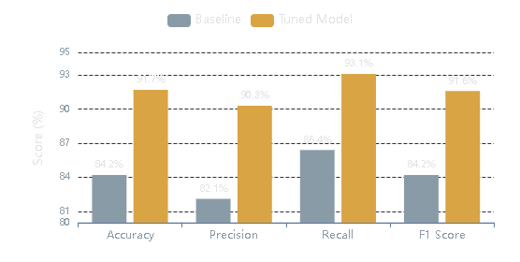
Practical Lab Results
Performance Comparison & Results
Performance Improvement
Typical Tuning Results
Metric | Baseline | Tuned | Improvement
Accuracy | 84.2% | 91.7% | +7.5%
Precision | 82.1% | 90.3% | +8.2%
Recall | 86.4% | 93.1% | +6.7%
F1 Score | 84.2% | 91.6% | +7.4%
Expected Improvement
When to Stop Tuning
Typical improvement from hyperparameter tuning ranges from 5-15%, depending on the dataset and baseline performance.
• Performance improvement < 1% between iterations
• Validation performance starts to decrease
• Computational cost outweighs benefits
• Performance is good enough for your use case

Slide 19

Key Takeaways
Choose the Right Metric
Hyperparameter Tuning is Essential
• Precision: When false positives are costly
• Can yield 5-30% improvement in performance
• Recall: When false negatives matter
• Start with Random Search for efficiency
• F1: For balanced performance
• Use Grid Search for final refinement
• ROC-AUC: For imbalanced data
• Always use cross-validation to prevent overfitting
Practice on Real Data
Context is Everything
• Build intuition through hands-on experience
Model evaluation is both art and science. Understand your problem context, know the cost of different errors, and choose metrics that align with your business goals.
• Experiment with different datasets
• Track how different metrics behave
• Learn to recognize overfitting patterns
"The right metric for the right problem makes all the difference"

Slide 20
Important Links
Notebook: Click Here

