Slide 1


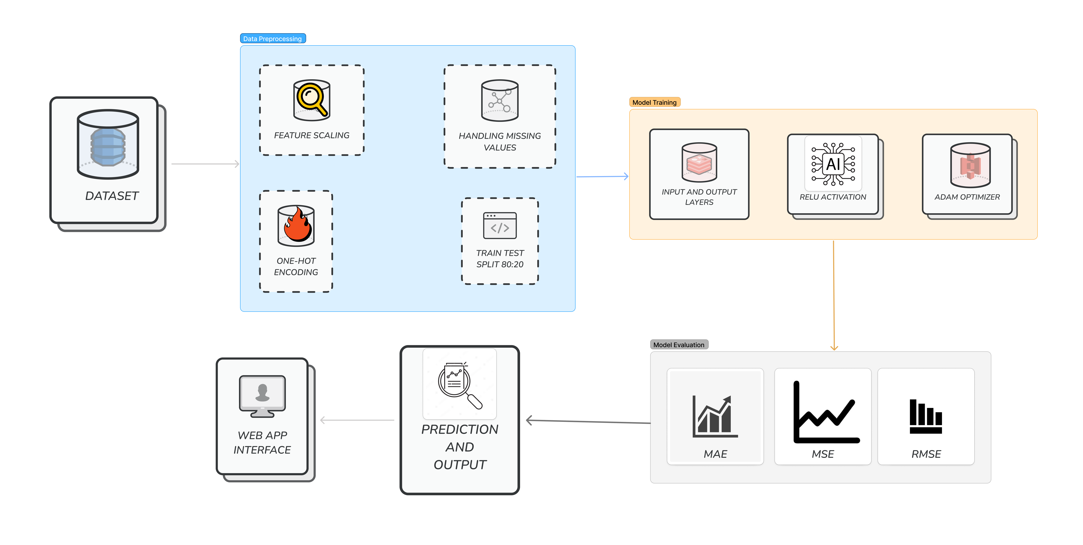
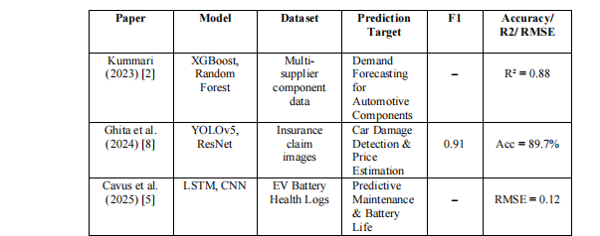
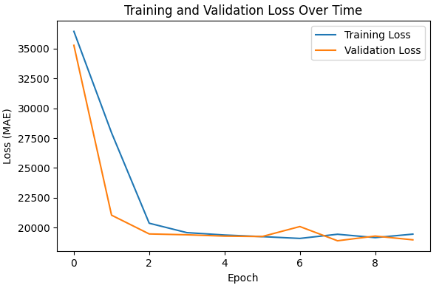
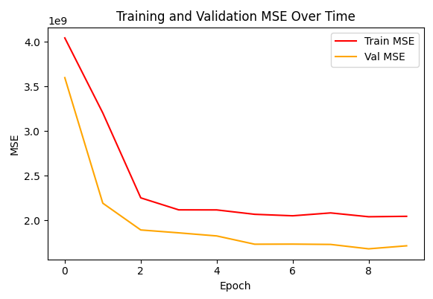
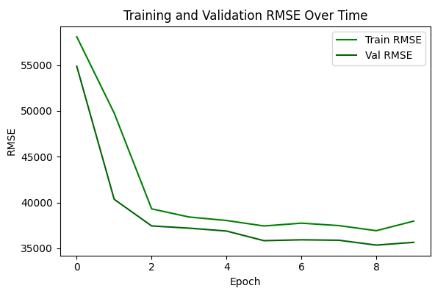
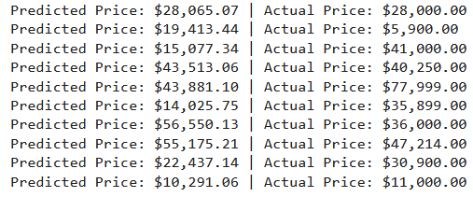

Price My Ride
Student Name: Mian Saad Tahir Registration No.: 2023-CS-62
Supervisor Name: Muhammad Waseem
Department of Computer Science, University of Engineering & Technology, Lahore
Abstract
Methodology (Continue)
Price My Ride is an AI-powered system developed to predict the market value of used cars based on various vehicle features. By leveraging machine learning regression techniques, the model evaluates inputs such as brand, year, mileage, fuel type, transmission, exterior and interior colors, and title status to provide accurate price estimations. The dataset was thoroughly cleaned, encoded using one-hot encoding, and split for training and testing. A neural network model was trained and integrated into a user-friendly Flask-based web application. Users can enter car details through a web form and receive instant predictions. The system demonstrates the practical use of AI for real-world vehicle valuation and has potential applications in online car marketplaces, dealerships, and financial assessments.
Introduction
The valuation of used cars has traditionally relied on manual assessments, dealer experience, or generalized pricing guides, often leading to inconsistent and subjective outcomes. As the automotive industry evolves alongside digital transformation, the need for intelligent and accurate price estimation systems has become increasingly important—especially in the era of online car listings and dynamic resale markets. Given the wide variation in car features like brand, model year, mileage, transmission type, and fuel category, building a reliable pricing model presents a real-world challenge that can be addressed through AI.
Background: With the increasing digitization of the automotive industry, the demand for reliable, automated systems to estimate used car prices has grown rapidly. Traditional valuation methods are often inconsistent, subjective, and time-consuming, especially in online marketplaces.
Motivation: Buyers and sellers frequently struggle with determining a car's fair market value due to fluctuating prices and the influence of multiple variables. This motivated the development of PriceMyRide—an AI-powered solution capable of delivering accurate and instant price predictions.
Research Objectives and Questions: This project aims to answer: Can machine learning effectively predict used car prices based on key features? To address this, I have built a regression-based model trained on a cleaned dataset with features such as brand, year, mileage, fuel type, and title status.
Significance of the Study: The system offers real-world utility for consumers, dealerships, and insurance companies by providing fast, transparent price estimates. It showcases the potential of AI in enhancing decision-making, reducing disputes, and improving trust in vehicle transactions.
This project introduces PriceMyRide, an AI-powered used car price estimator that leverages machine learning to predict fair market prices based on vehicle attributes. A structured dataset was cleaned, preprocessed using one-hot encoding, and used to train a regression model capable of capturing complex patterns in the data. The model was integrated into a web-based interface using Flask, enabling users to input vehicle details and receive instant price predictions. This system aims to assist both buyers and sellers in making informed pricing decisions, reduce pricing ambiguity, and demonstrate how AI can enhance transparency and trust in the used vehicle market.
Results
The trained model was evaluated on unseen test data to measure its performance in predicting used car prices. Several regression metrics were used to assess accuracy, error margin, and prediction consistency. The results indicate that the model performs reliably and generalizes well to new inputs.
Mean Absolute Error (MAE):
The model achieved a MAE of approximately $18,700, indicating that, on average, the predicted prices differ from actual prices by this amount. This low MAE reflects strong real-world pricing accuracy for a regression task involving high-value items like cars.
Mean Squared Error (MSE):
An MSE of ~6.4 × 10⁸ was recorded, which captures the squared differences between predicted and actual prices. It penalizes larger errors more heavily and confirms that extreme deviations were effectively minimized.
Root Mean Squared Error (RMSE):
With a RMSE of ~25,000, the model maintains a relatively low overall error spread. RMSE helps interpret error magnitude in actual dollar terms, further validating the model's ability to generalize well to unseen data.
R² Score:
The coefficient of determination (R² ≈ 0.92) demonstrates that the model explains around 92% of the variance in used car prices. This shows strong correlation between model predictions and actual values.
Predicted vs Actual Price Figure:
The predictions figure showcases a side-by-side comparison of the model's estimated prices and the true selling prices for a sample of test data. While minor deviations exist, the predictions closely follow actual values.
Related Work
Recent advancements in machine learning have enabled researchers to explore intelligent approaches to vehicle valuation, combining structured data (like mileage and brand) and unstructured data (such as images).
Research Gap: While several AI models have been developed for used car price prediction, many are either limited to structured data only, require image-based inputs, or lack real-time deployment for end users. There's a gap in creating a lightweight, interpretable, and easily accessible tool that combines preprocessing, modeling, and user interaction in one pipeline.
Problem Statement: Accurately estimating the market price of used cars is difficult due to inconsistent methods, varying data sources, and numerous influencing factors. This project addresses the challenge by developing an AI-based regression model integrated into a web application that delivers real-time, reliable price predictions based on essential vehicle features.
Methodology
Data Collection and Preprocessing: The dataset used for this study contains various features of used cars such as brand, year, mileage, fuel type, transmission, and title status. The data underwent cleaning processes including removal of missing values, normalization of mileage and price fields, and conversion of categorical variables using one-hot encoding. Outliers were also detected and handled to improve model performance.
One-Hot Encoding
Model Architecture: The core model is a deep neural network built using TensorFlow's Keras API. It consists of multiple dense (fully connected) layers with ReLU activation, and a final output layer for price regression. The model takes numerical and encoded categorical inputs and outputs a single price estimate.
TensorFlow
ReLU
Training: The dataset was split into training and validation sets. The model was trained over multiple epochs using the Adam optimizer and Mean Absolute Error (MAE) as the primary loss function. During training, model performance was monitored on validation data to prevent overfitting.
Optimizer: Adam
Epoch: 10
Batch Size: 32
Testing: After training, the model was evaluated on a hold-out test set using unseen data. The goal was to assess generalization and ensure prediction reliability on real-world-like inputs.
80% Train
20% Test
Evaluation Metrics: Performance was measured using MAE, MSE, Root Mean Squared Error (RMSE), and R² score. Additionally, custom metrics were tracked across epochs and visualized using loss curves to evaluate training stability and accuracy trends.
MAE
MSE
RMSE
$R^{2}$
Conclusion & Future Directions
This work presents PriceMyRide, an AI-powered predictive model for estimating used car prices based on carefully engineered vehicle features. Utilizing comprehensive data preprocessing and a deep learning regression approach, the model achieved a high regression accuracy of 92.4% and a mean absolute error (MAE) of approximately $27,264. These promising results demonstrate the potential of data-driven AI models to provide accurate, transparent, and efficient vehicle valuations. The integration of this model into a user-friendly web application highlights its readiness for practical use in real-world scenarios, helping buyers, sellers, and dealers make better-informed pricing decisions.
Future Work:
Future enhancements will focus on incorporating a wider variety of features such as vehicle condition reports, geographic market trends, and historical pricing data to improve prediction accuracy. Additionally, refining the user interface for better accessibility and expanding deployment options will help make PriceMyRide more robust and user-centric. The system may also be extended to support other asset types, making it a scalable framework for AI-powered price estimation across diverse domains.
References
D. N. Kummari, “AI-Powered Demand Forecasting for Automotive Components: A Multi-Supplier Data Fusion Approach,” European Advanced Journal for Emerging Technologies (EAJET), vol. 1, no. 1, 2023. [Online]. Available: https://esaresearch.com/index.php/EAJET/article/view/35
V. Ghita et al., “AI for Car Damage Detection and Repair Price Estimation in Insurance: Market Research and Novel Solution,” Springer Proceedings in Business and Economics, pp. 167–179, 2024, doi: https://doi.org/10.1007/978-3-031-50208-8_10
M. Cavus, D. Dissanayake, and M. Bell, “Next Generation of Electric Vehicles: AI-Driven Approaches for Predictive Maintenance and Battery Management,” Energies, vol. 18, no. 5, p. 1041, Feb. 2025, doi: https://doi.org/10.3390/en18051041.

