Slide 1
CoinControl: A PErsonal Finance Tracker

Slide 2
Finance frontiers
Ahsan Ali (23L-3031)
Zain Allauddin (23L-3036)
Mishaal Rafique (23L-3044)
Abu Bakr Majid (23L-3050)
Eshal Shahid (23L-3086)

Slide 3
01
overview of our project
02
Deliverable i: project proposal
03 Deliverable ii: software requirements specification
04
Deliverable iii: ui/ux design
05
Deliverable iv: coding and implementation
06
principles of software engineering
07
quality attributes

Slide 4
01. Overview of our project

Slide 5
Personal finance trackers are essential tools for managing our money effectively. They provide a comprehensive view of our income, expenses, and savings, helping us make informed financial decisions.

Slide 6
Aim of coincontrol
Empowering you with comprehensive financial management tools, including secure authentication, expense categorization, budgeting features, detailed transaction history, insightful analysis through graphs, and robust data security.

Slide 7
02. Deliverable i: project proposal

Slide 8
Steps taken during phase 1
Research online to grasp the functionalities of existing personal finance tracker applications.
Evaluate potential features suitable for incorporation into our personal finance tracker as students.
Identify the necessary technologies aligned with the features to be integrated into our application.
Facilitate a team discussion to deliberate and finalize the features to be included in the project proposal.
Compile and formalize the project proposal documentation.

Slide 9
Challenges and outcome of phase 1
challenges
outcome
Gathering detailed information about existing personal finance tracker apps due to the prevalence of subscription requirements.
Navigating through extensive data to pinpoint relevant features and functionalities within our capability to incorporate.
Striking a balance between the desired features and their practical implementation within the project's scope, available resources, and time limitations.
Ensuring effective communication of project objectives and features in the proposal document, maintaining clarity and coherence throughout.
Achieving timely submission of the Project Proposal, with a clear outline of the objectives and features of our application.

Slide 10
03. Deliverable ii: software requirements specification

Slide 11
Steps taken during phase 1i
Understand the components of the SRS template following IEEE format.
Allocate various sections of the SRS to team members for efficient collaboration.
Separate functional and non-functional requirements.
Develop the Use Case Model.
Organize a team meeting to consolidate and conclude on the content for inclusion in the project proposal.
Collect and formalize the Software Requirements Specification (SRS) documentation.

Slide 12
Challenges and outcome of phase 1i
challenges
outcome
Inexperience in formal documentation like an SRS created uncertainty regarding language, format, and content correctness.
Difficulty arose in accurately capturing and describing both functional and non-functional project requirements.
Struggle to define project scope and manage scope crept as new ideas emerged during SRS development.
Uncertainty existed about the format of use cases and use case diagrams because of prior inexperience in the said task.
Difficulty arose in pinpointing pertinent scenarios and use cases encompassing diverse user tasks, including budgeting, expense tracking, and investment management.
Successfully delivering the Software Requirements Specification (SRS) with a clear delineation of the project's objectives, scope, requirements, and Use Case Model within the designated time frame.

Slide 13
04. Deliverable iii: ui/ux design

Slide 14
Steps taken during phase 1ii
Conduct online research to understand the UI designs of current personal finance tracker apps.
Brainstorm ideas for components to incorporate, such as tables, graphs, and buttons.
Choose an appropriate color palette. Develop a preliminary paper prototype through sketching.
Collaborate with team members to review and refine the prototype.
Utilize the design tool 'Pencil' to create the final UI design.
Double-checking the design to ensure comprehensive coverage of both functional and non-functional requirements.

Slide 15
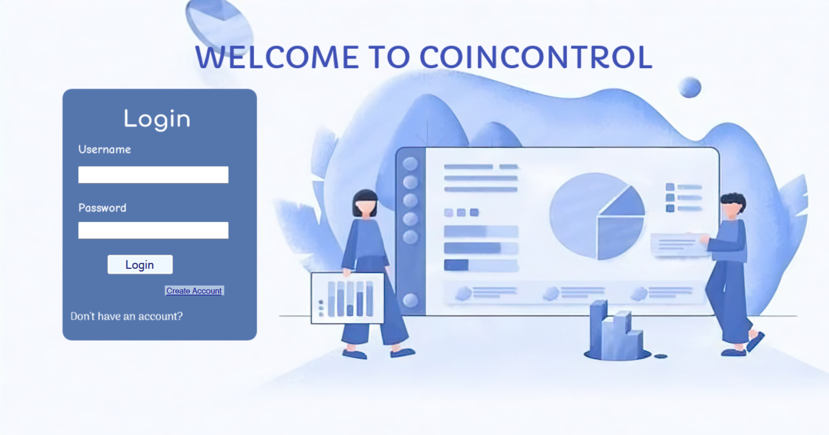

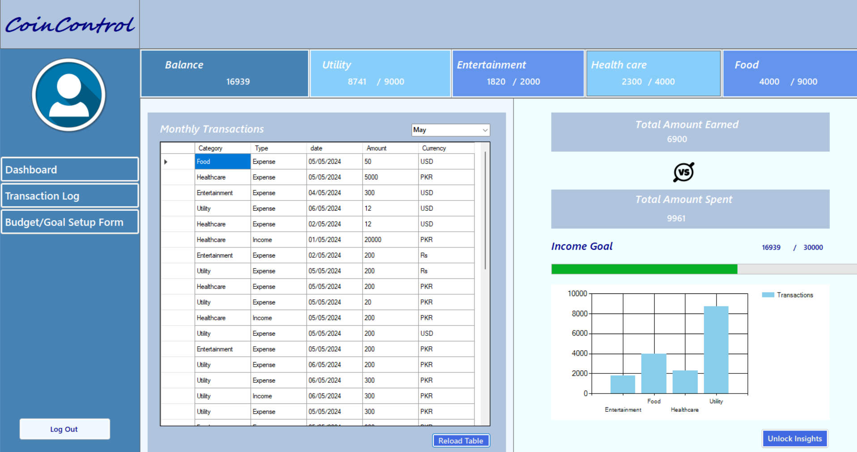
Snippets of our ui/ux design

Slide 16
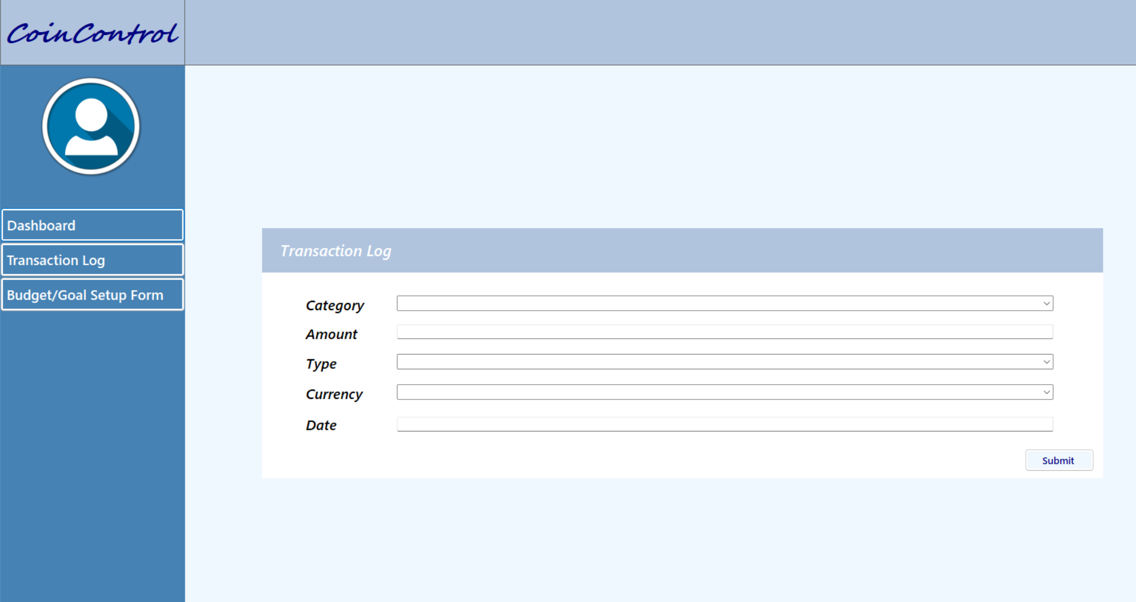
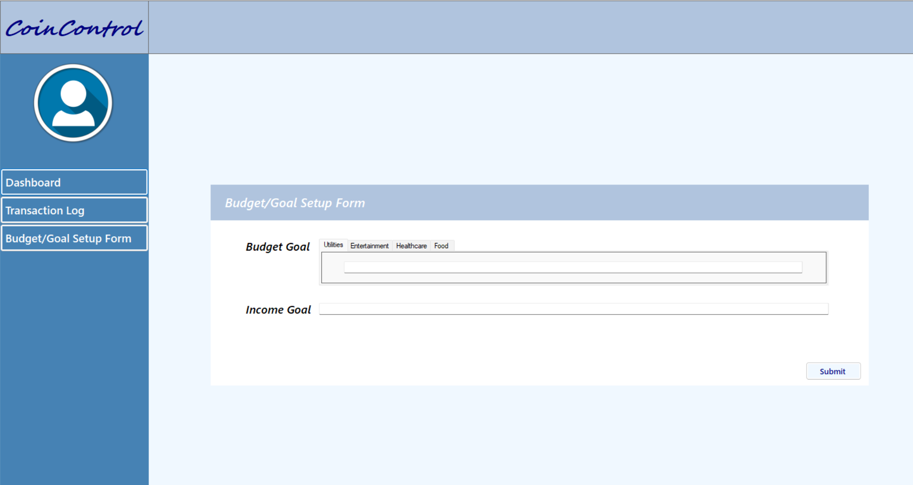
Snippets of our ui/ux design (cont.)

Slide 17
Challenges and outcome of phase 1ii
challenges
outcome
Determining which UI components to include and arranging them effectively to meet user needs and project requirements can posed a challenge.
Choosing a suitable color scheme that is visually pleasing and aligns with usability requirements presented difficulties.
Mastering the features of the design tool 'Pencil' to create the final UI design was challenging.
Condensing extensive financial information into an easily digestible format was a significant challenge.
Maintaining design and feature consistency across various pages of the application was demanding.
Providing clear messages and guidance when users encounter errors required careful consideration and planning.
Timely delivery of the UI/UX Design, encompassing all functional requirements listed in the SRS.

Slide 18
05. Deliverable iv: coding and implementation

Slide 19
Key points of phase iv
01
Programming Language
02
UI framework
03
database
04
OOP Approach
CoinControl employs C++ for main implementation alongside C# syntax in its application design.
The UI design of the application was developed using Windows Forms integrated with Visual Studio.
SQL Server is utilized for managing the backend database in the CoinControl application.
The code implementing the functionalities of the application utilizes Object Oriented Programming concepts including Classes, Inheritance and Composition.

Slide 20
Steps, challenges and outcomes of phase 1v
Steps taken
challenges
outcome
Integrate Windows Forms and SQL Server within Visual Studio.
Craft the front-end using Windows Forms.
Incorporate back-end functionality into the existing front-end code.
Implement exception handling mechanisms.
Encountering errors during the integration of Windows Forms and SQL Server within Visual Studio.
Navigating challenges when merging back-end code with UI design code.
Facing difficulty in determining the suitable class relationships to employ.
Delivering the project on schedule, covering all the aspects.

Slide 21
06.
Software Engineering principles

Slide 22
Software engineering principles
Divide and conquer
modularity
Use of abstraction
Strive for consistency
Represent problem and its solution from different perspectives
Anticipation of change
01
02
03
Break the project into smaller modules, enabling team members to work independently and effectively on different tasks.
Divide the personal finance tracker into distinct modules with clear interfaces, facilitating independent development, testing, and maintenance for each module.
Utilize abstraction to simplify intricate financial concepts, enabling users to interact with the application without requiring in-depth understanding of the complexities.
04
05
06
Ensure consistency in the UI, terminology, and functionality throughout the app to improve usability and user experience.
Presenting transaction summaries via tables and graphs, considering various solution perspectives.
Develop the personal finance tracker with flexibility, enabling future enhancements or updates without the need for extensive redesign.

Slide 23
07.
Quality attributes

Slide 24
Quality attributes
Adaptability
usability
correctness
understandability
maintainability
Timeliness
The software can accommodate future changes and updates.
The interface is easy and intuitive.
The software ensures validation of input.
The software has an understandable code.
The software has a well-structured code.
The software process were completed within time.

Slide 25
Thank you

