Slide 1


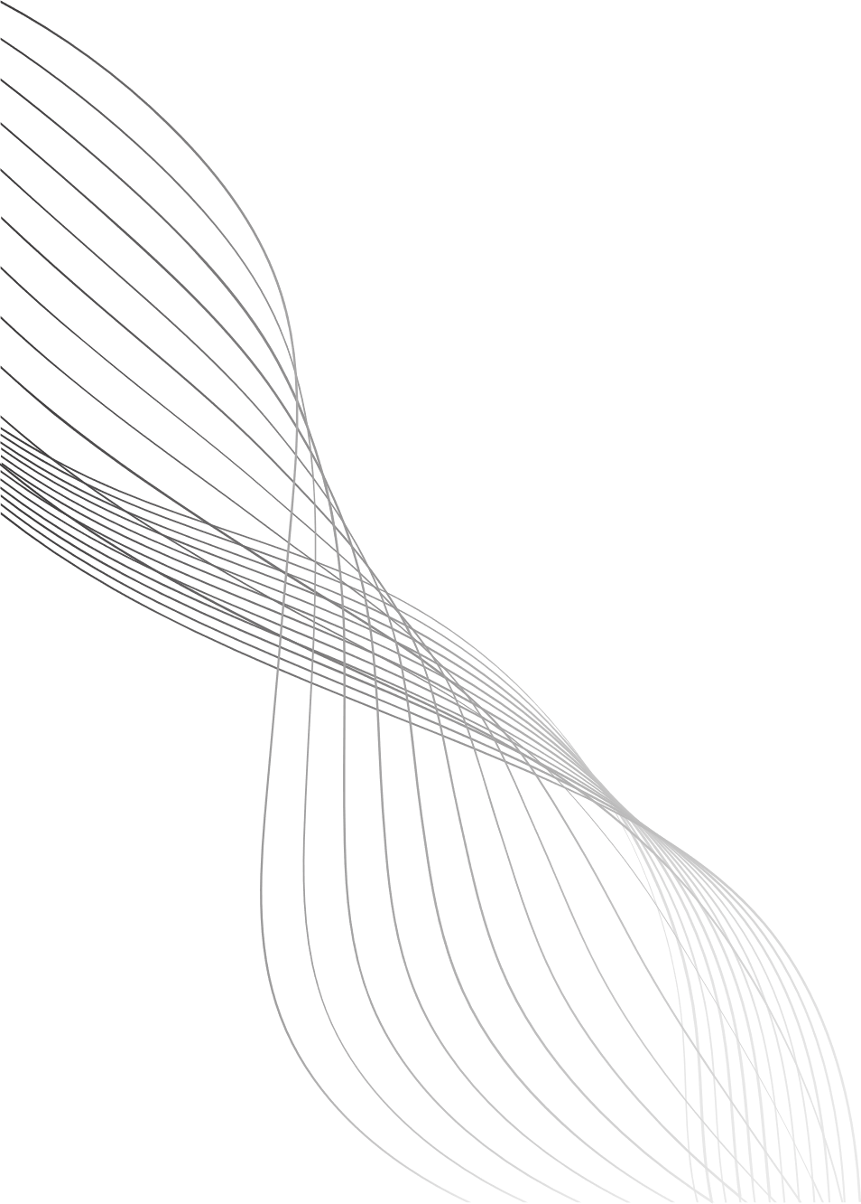
RAAH
Road Assessment And Hazards

Slide 2
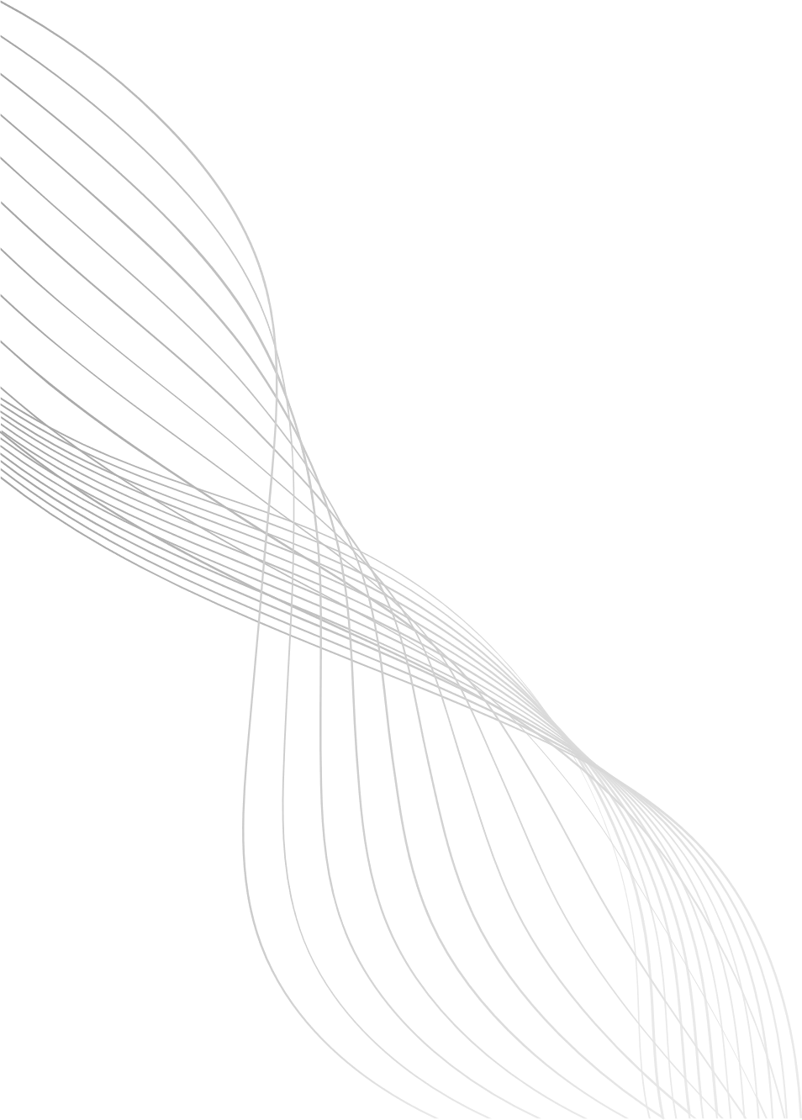
TEAM MEMBERS
1.
Eishah Iqbal 23L-2587
2.
M. Mustafa 23L-3026
3.
Zain Allaudin 23L-3036

Slide 3
INTRODUCTION
RAAH is a mobile application designed to help citizens easily report road hazards such as potholes, broken signals, garbage, clogged drains, and damaged streetlights.
The app bridges the communication gap between the public and municipal authorities by providing real-time reporting, tracking, and data-driven decision-making.
01

Slide 4
PROBLEM STATEMENT
Pakistan’s roads face chronic hazards—potholes, broken signals, clogged drains, garbage, and damaged streetlights.
These issues remain unresolved due to:
  No centralized reporting system
  Slow, manual complaint processes
  Poorly designed existing apps
  No real-time visibility for authorities
This gap causes accidents, delays, infrastructure damage, and public frustration.
02

Slide 5
VISION STATEMENT
RAAH aims to create a smart, accessible, and trustworthy platform where:
  Citizens can report hazards effortlessly
  Authorities receive organized, verified, GPS-based data
  Repairs become faster and transparent
  Communities benefit from cleaner and safer cities
The vision is to build a connected smart-city ecosystem where every citizen contributes to improving their environment.
03

Slide 6
PERSONAS
  Primary Persona – Ali Hassan (Daily Commuter)
  Secondary Persona – Kamran Ansari (Civil Engineer)
  Supplementary Persona – Haider Malik (Delivery Rider)
  Customer Persona – Ahmad Raza (Senior Municipal Officer)
  Served Persona – Sara Khan (Marketing Executive)
  Negative Persona – Bilal Siddiqui (Student)
04

Slide 7
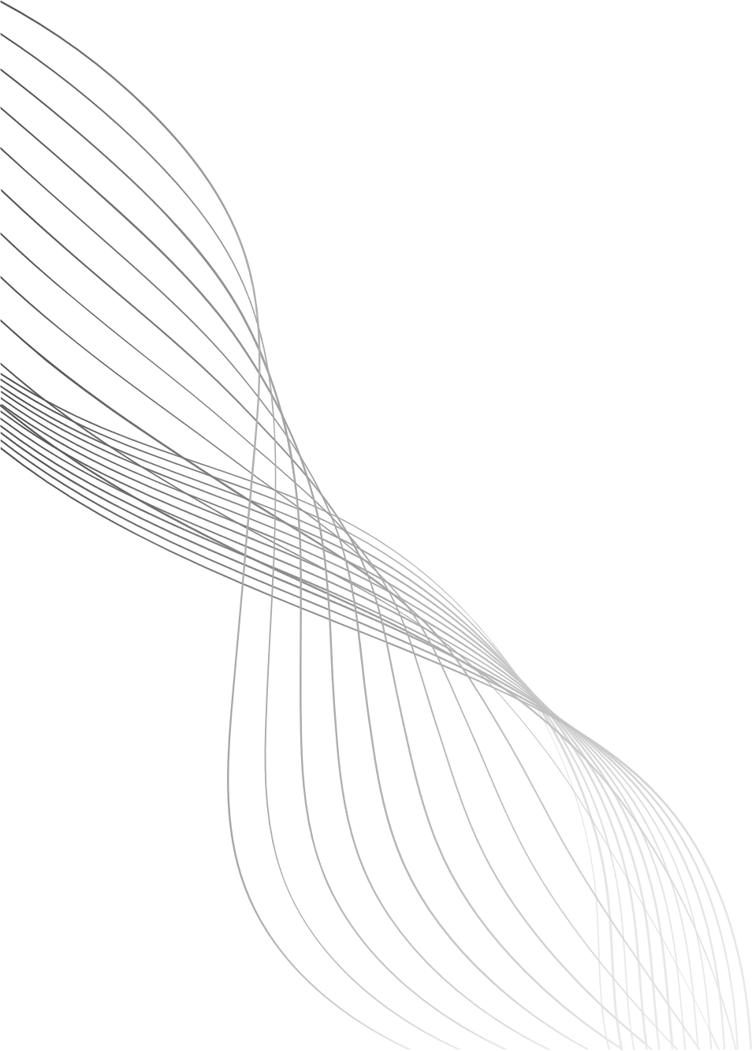
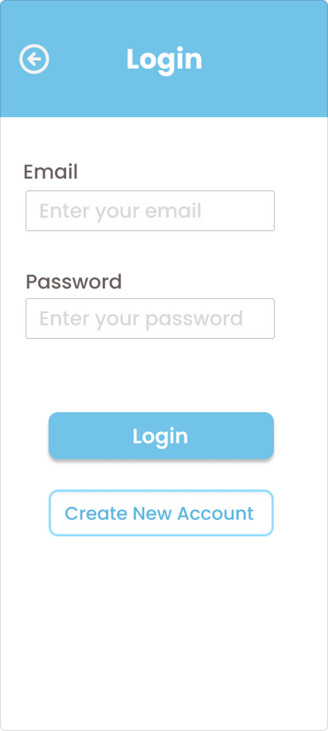
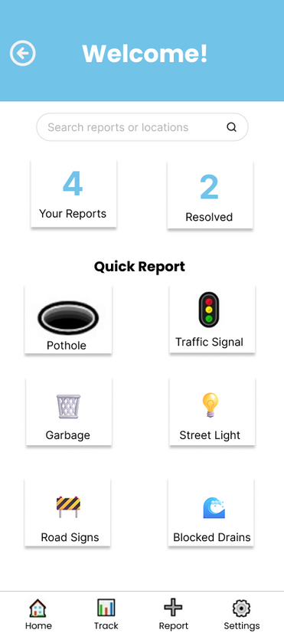
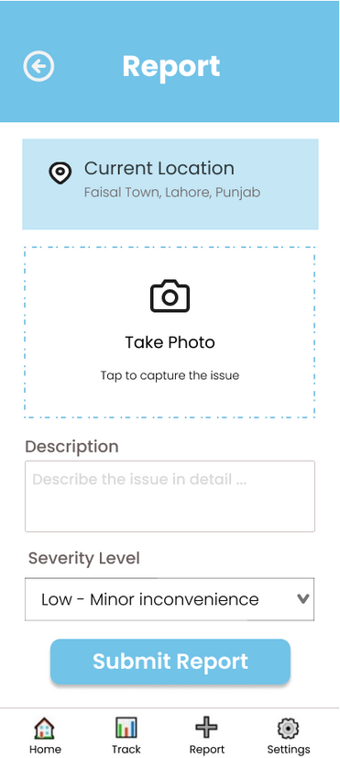
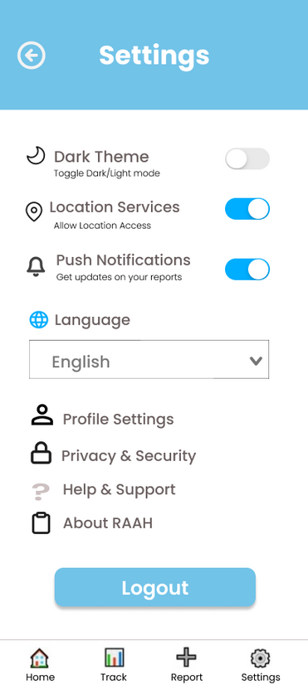
KEY PATH SCENARIO 1
CITIZEN REPORTING A POTHOLE
05

Slide 8
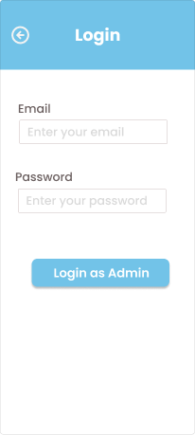
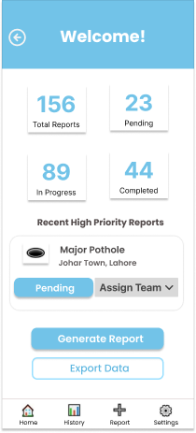
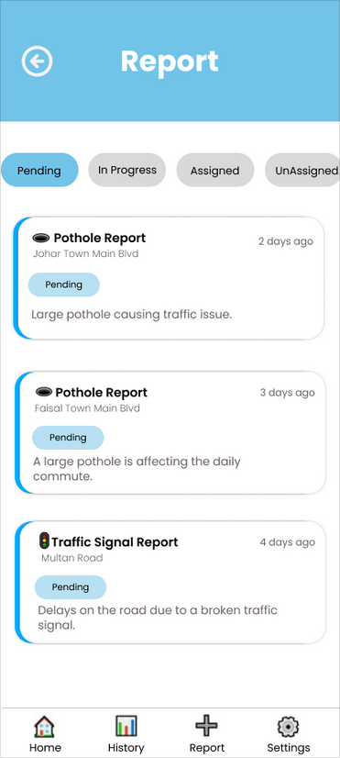
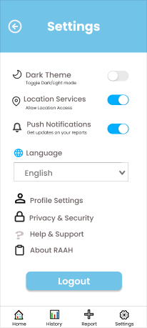
KEY PATH SCENARIO 2
MUNICIPAL MONITORING
06

Slide 9
FIGMA DESIGN
https://www.figma.com/design/jYBvWSY9HFK00adiUZmVa2/RAAH?node-id=0-1&p=f&t=1LuWrJRM5w6JWbbc-0
07

Slide 10
APPLIED HCI PRINCIPLES
  Goal-Directed Design
  Minimize Work for the User
  Provide Clear Feedback and Affordances
  Fit to Platform and Posture
  User Mental Model
  Prevent errors and support recovery
  Consistency
  Affordances & Signifiers
  Clear Visual Hierarchy & Layout
08

Slide 11
CONCLUSION
RAAH bridges the gap between citizens and authorities with a modern, inclusive road hazard reporting system. By applying UX research, personas, and HCI principles, it enables faster, reliable reporting, real-time visibility for authorities, enhanced urban safety, and active community participation—showcasing effective Human-Centered Design in a real-world context.
09

Slide 12
THANK YOU
10

