Slide 1

How much for your Airbnb?
Analysis Process
Data Exploration
Modeling
Dependent Variable: Numeric
Independent Variables: Character, Factor, Numeric, Date
Deleted: URL, host characteristics
Linear Regression, stepwise, decision tree, cross validation with boost, etc.
Feather Selection(Lasso) + Advanced Decision Tree(xgBoost)
(rmse: 52.02858)
Prediction
Raw Data
29143 Rows
96 Columns
Data Cleaning and Preparing
Missing Data
“caret” package
Leave them blank
Location information: neighborhood, neighborhood group, etc.
House characteristics: year, amenity, room type, beds, etc.
Review related data: number of reviews, review scores, etc.
Service related data: cancellation policy, cleaning fee, etc.
Availability: availability_30, etc.
Mianchun Lu
ml4273

Slide 2

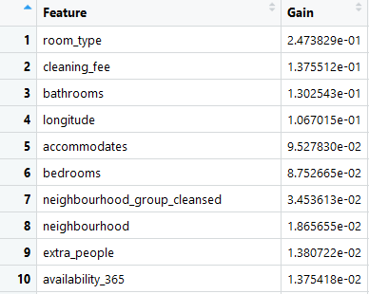


How much for your Airbnb?
Evaluation of the Analysis Process
Results
Feather selection: 58 variables in the 5 categories. Important matrix of the variables:
It took too long time to run Bagging and Random Forest model, especially when combined with cross validation.
Important Steps
Feather Selection: Using all the variables would cause over fitting. After feather selection, the results of the prediction could be better.
“Amenity”: transferred the character variable to 119 factor variables using word cloud and for loop.
Applying all cleaning, transforming, and preparing steps on both the analysis and scoring data. Making sure the levels in the factor variables are same.
Improvement:
Try different parameters;
CV with xgboost
Look for methods to improve speed of random forest
Missteps
Need to pay more attention to version saving. Instead of cleaning data in Excel, leaving records of all the conduction in Rstudio could be helpful for further model testing.
Mianchun Lu
ml4273

