Slide 1
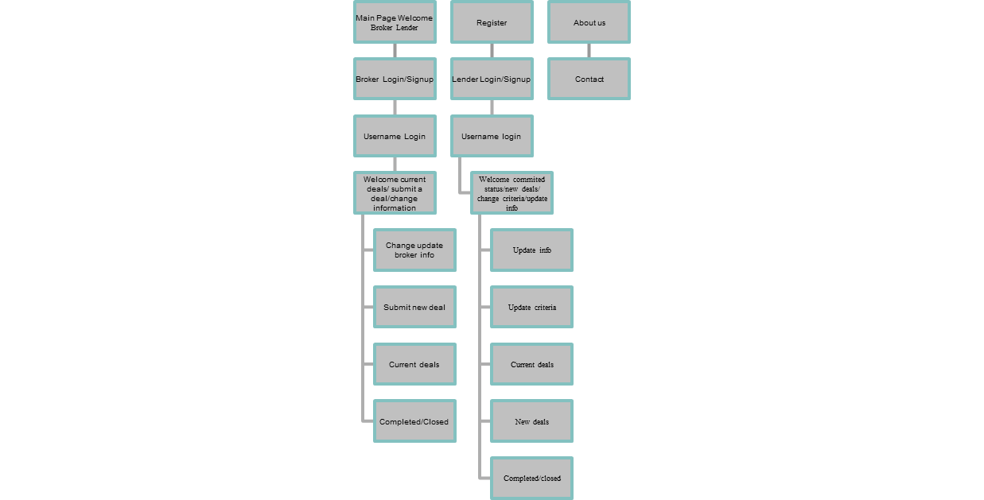
Site Map
Interior or
Internal
Pages

