Slide 1
Discovie
Arthur Chiao
Chris Myau
Andrew Hsu
Michael Le

Slide 2
What is Discovie?
A web application to help users find the movie to watch
Records user rating to implement movie suggestion algorithm
Some of the technologies this web application uses are:
Web2py
HTML, CSS
SQL
Ajax, JQuery, Bootstrap, Vue
Git, trello, slack, and more..

Slide 3
Goals
Create a movie structure for users to find movies
Develop a user-friendly and appealing interface for simple navigation
Implement a search algorithm function for users to look up movies
Expand user ratings on movies onto user movies suggestions
Accomplish a full SQL database to deploy for admin and user use

Slide 4
Search Algorithm: Natural Language Processing
Search functions have three goals:
Robust - Capture as much of the user’s intentions as accurately as possible
Efficient - Conduct your search as quickly as possible for any given database of size n for any given amount of search terms of size m
Mutable - Change your algorithm on the fly. Code has to be flexible and accessible to respond to changing user needs.

Slide 5
Direct Database Lookup
db(db.person.name == 'Star Wars: The Force Awakens').select().first()
Pros
Simple code, only takes two iterations through a for loop
Never takes longer than O(mn)
Anything that matches is 100% accurate
Cons
The query has to be exact, but your search has to be user-proof
“Does ‘Pyrites of the Carribeum’ have a ‘N’ in it?’”
“I don’t know but I can’t find movie tickets for ‘Breaking Bad’.”
“I know, I’ll just Bing it on my Samsung Galaxy Note 7.”

Slide 6
Direct Database Lookup w/ Contains
List = db(db.movie_title.contains('Star Wars: The Force Awakens').select()
Pros:
Great recall. Grabs anything you could possibly need
Totally user-proof. As long as they type even part of the word in the query, it will return something.
Probably a lot closer to what we want from a search function
Cons
If your query is made up of common words (Say you searched for ‘Up’) your search could get lost in the multitudes of results. Low precision.
No way to rank the movies by precision. Searching “Kick Ass” might return “The “Golden CompAss” before “Kick-Ass”.

Slide 7
Solution: Natural Language Processing
Process our search terms into more applicable terms using NLP techniques
Softens our search for all the Bing users out there
Implement a scoring system with a simple comparison algorithm to increase recall significantly at for little to no precision loss.
Still runs in O(m n) time

Slide 8

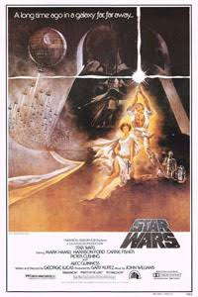


“Star Wars: A New Hope” “Star Wars: The Force Awakens” “Dragon Wars: D-War”
(1997) (2015) (2008)

Slide 9
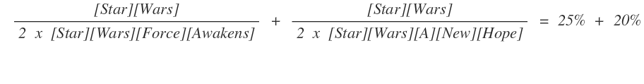
Scoring

Slide 10
Process
Tokenize:
First, parse the search terms into a list and the movie data into a list of list of words
Homogenize:
Make both search terms and movie data all lower case
Remove stopwords. [ ‘The’ , ‘at’ , ‘is’ ]
Remove plurals.
Score and Return:
Iterate over the list of titles against the search terms, keeping the origial data of the high scorers to feed into Database queries and populate our list.
Yes, we would probably return Dragon Wars. It’s a holistic process.
Algorithm Cost:
No cases of running n for loops for n times.
Multiple iterations of a loop by n, but multiplied by a constant factor
O( c m n) where c is a constant value is still O(m n)

Slide 11
Mutability
Many, many more options to adjust and improve the scoring system
Ex. For words in front of a colon, double the words in the list, since the first words the actual movie title and more significant, and the words after are usually “Redemption”, “Retribution”, “Reloaded” or “Geniysis”.
Ex. Longer words score higher, since longer words are usually more specific or meaningful.
Ex. Add flat 10% score if matched actor, change weighting between search and title (dividing the matched score by 4 and 2 or 8 and 2) and so on so forth...

Slide 12
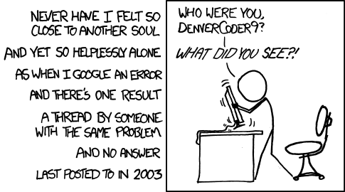
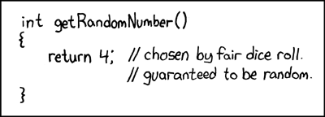
Databases: Design & Headaches

Slide 13

Databases: Challenges Robert'); DROP TABLE Students;--
Populating the database
Database normalization
Sanitizing the database

Slide 14
Databases: Recognition & Credit
https://www.kaggle.com/deepmatrix/imdb-5000-movie-dataset
https://github.com/BurntSushi/goim

Slide 15
Future Improvements
Matching up the poster images with the database
Implementation of suggested movies
Bookmarks/Watch list
More implementation with JavaScript

Slide 16
Demo
http://discovie.pythonanywhere.com/

