Slide 1

关系模型
（《数据库系统概念》第2章、第6章）
李文根
lwengen@tongji.edu.cn
计算机科学与技术系
同济大学

Slide 2
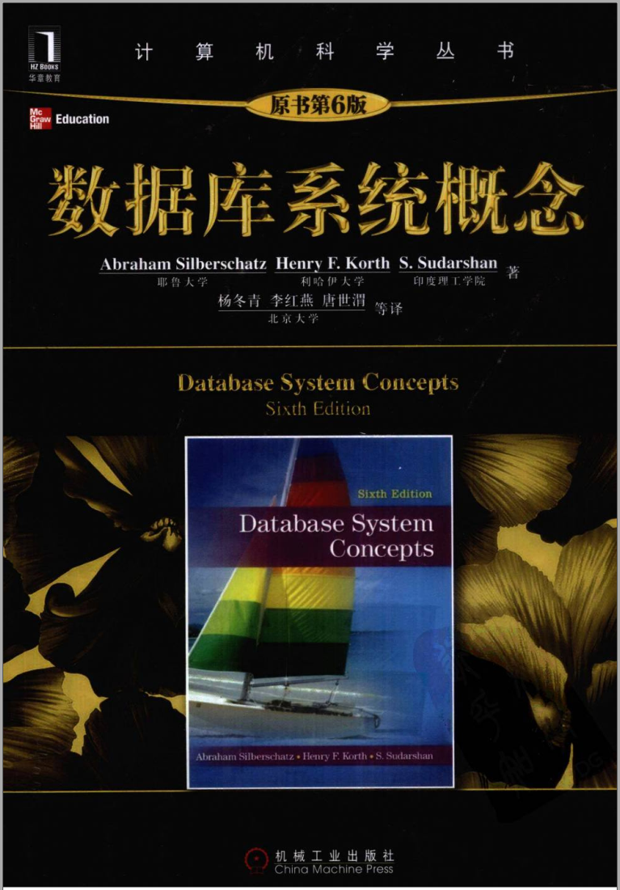
关系数据库基本原理
第2章、第6章： 关系模型介绍
第3章 SQL
第7章 数据库设计与E-R模型

Slide 3
概要
2.1 关系数据库的结构
2.2 数据库模式
2.3 码
2.4 模式图
2.5 关系查询语言
6.1 关系代数

Slide 4
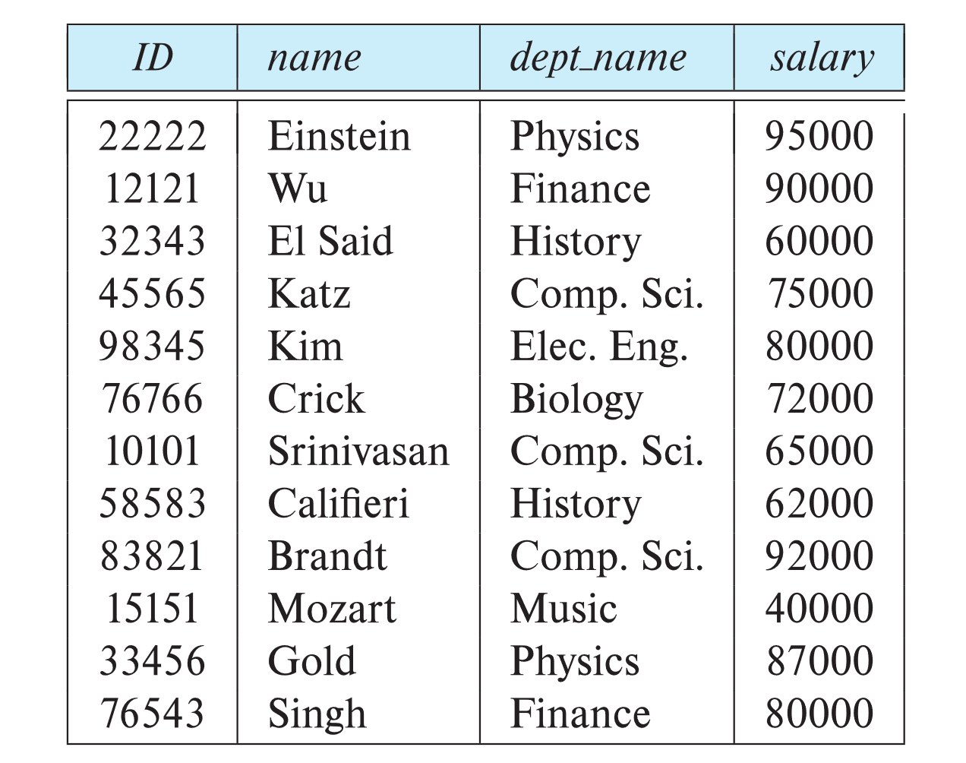
2.1 关系数据库的结构
关系举例

Slide 5
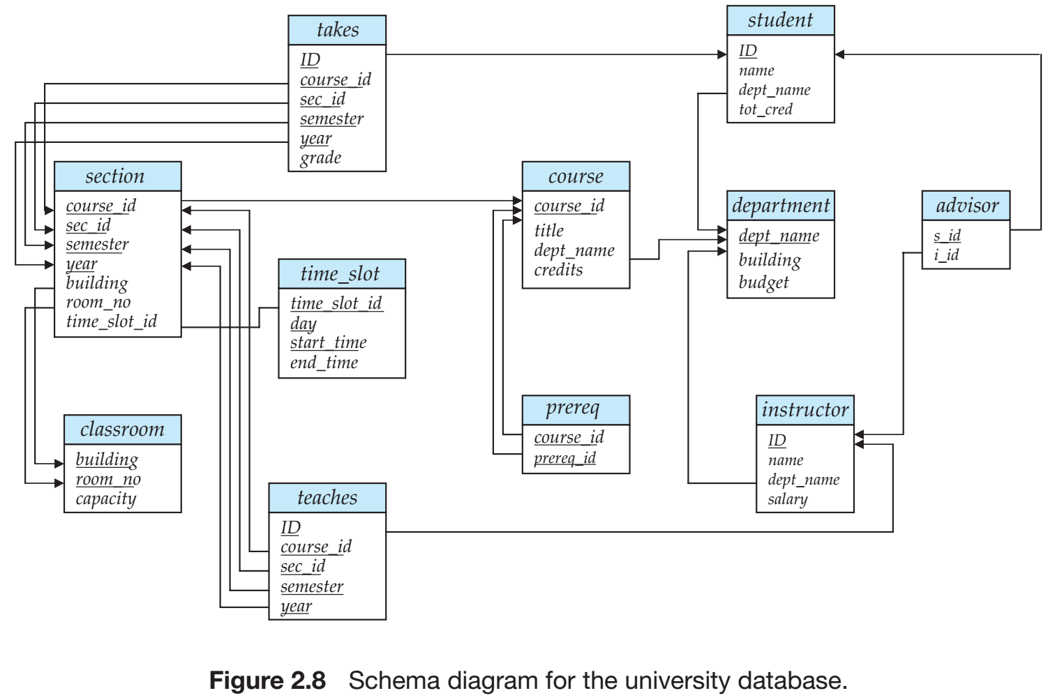
关系数据库举例

Slide 6
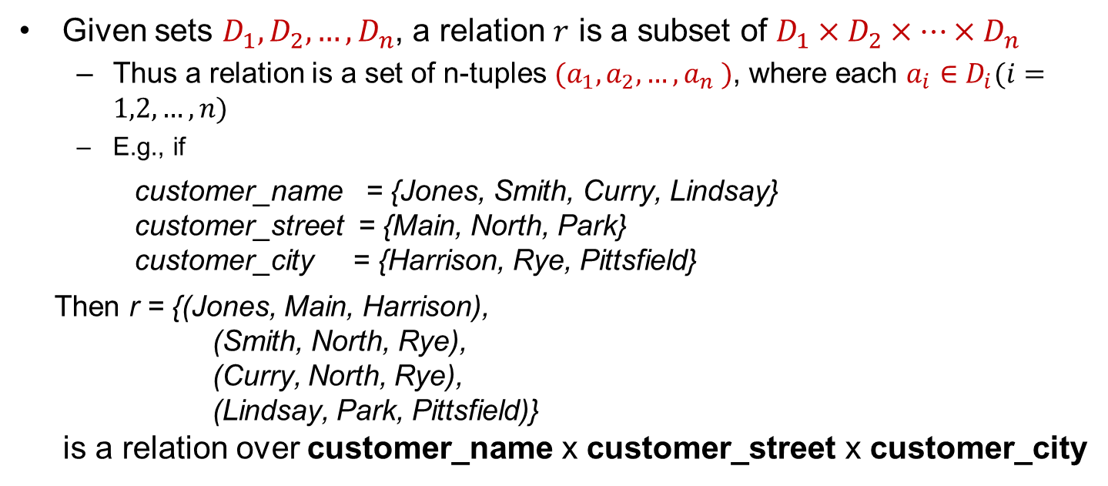
关系的基本结构
Given sets $D_{1},D_{2},…,D_{n}$, a relation $r$ is a subset of $D_{1}×D_{2}×…×D_{n}$
Thus a relation is a set of n-tuples ${(a}_{1},a_{2},…,a_{n} )$, where each $a_{i}∈D_{i}(i=1,2,…,n)$
E.g., if
customer_name = {Jones, Smith, Curry, Lindsay} customer_street = {Main, North, Park} customer_city = {Harrison, Rye, Pittsfield}
Then r = {(Jones, Main, Harrison), (Smith, North, Rye), (Curry, North, Rye), (Lindsay, Park, Pittsfield)} is a relation over customer_name x customer_street x customer_city

Slide 7
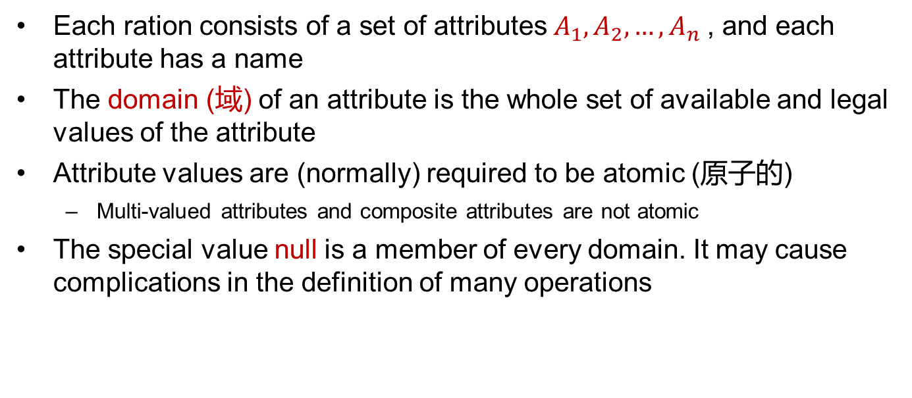
属性(Attribute)
Each ration consists of a set of attributes $A_{1},A_{2},…,A_{n}$, and each attribute has a name
The domain (域) of an attribute is the whole set of available and legal values of the attribute
Attribute values are (normally) required to be atomic (原子的)
Multi-valued attributes and composite attributes are not atomic
The special value null is a member of every domain. It may cause complications in the definition of many operations

Slide 8

关系模式(Relation Schema)
$A_{1},A_{2},…,A_{n}$ are attributes, and $R=(A_{1},A_{2},…,A_{n})$ is a relation schema
E.g., customer-schema =(customer_name, customer_street, customer_city)
$r(R)$ is a relation on the relation schema $R$
E.g., customer(Customer_schema)

Slide 9

关系实例(Relation Instance)
The current values (relation instance) of a relation are specified by a table
An element $t$ of $r$ is a tuple (元组), represented by a row in a table
attributes (or columns)
tuples(or rows)

Slide 10
关系元组无序
The order of tuples / attributes in a relation is irrelevant
E.g., instructor relation with unordered tuples

Slide 11
概要
2.1 关系数据库的结构
2.2 数据库模式
2.3 码
2.4 模式图
2.5 关系查询语言
6.1 关系代数

Slide 12
数据库模式
A database consists of multiple relations
Storing all information as a single relation results in
repetition of information, e.g., one department has many students and the information of department will be repeated for many times
the need for null values, e.g., represent a customer without an account
Normalization(规范化) theory (Chapter 7) deals with how to design relational schemas

Slide 13
Instructor relation
E-R Diagram for University Database

Slide 14
概要
2.1 关系数据库的结构
2.2 数据库模式
2.3 码
2.4 模式图
2.5 关系查询语言
6.1 关系代数

Slide 15
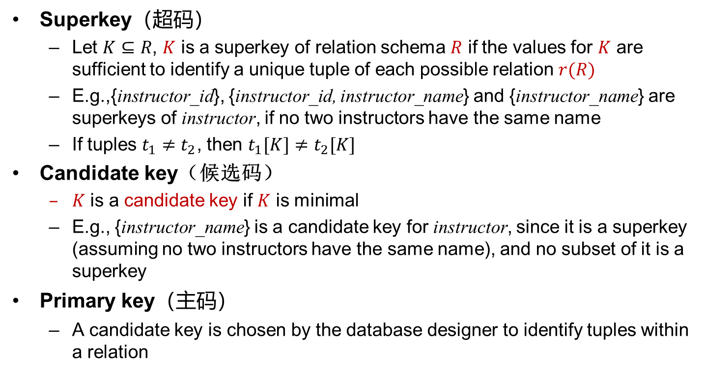
Keys (码、键)
Superkey（超码）
Let $K⊆R$, $K$ is a superkey of relation schema $R$ if the values for $K$ are sufficient to identify a unique tuple of each possible relation $r(R)$
E.g.,{instructor_id}, {instructor_id, instructor_name} and {instructor_name} are superkeys of instructor, if no two instructors have the same name
If tuples $t_{1}≠t_{2}$, then $t_{1}[K]≠t_{2}[K]$
Candidate key（候选码）
$K$ is a candidate key if $K$ is minimal
E.g., {instructor_name} is a candidate key for instructor, since it is a superkey (assuming no two instructors have the same name), and no subset of it is a superkey
Primary key（主码）
A candidate key is chosen by the database designer to identify tuples within a relation

Slide 16
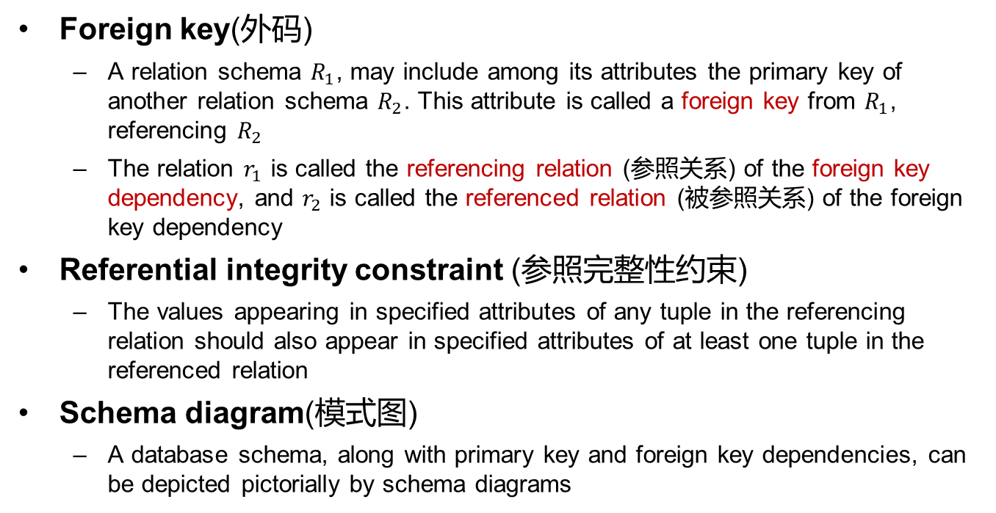
码（续）
Foreign key(外码)
A relation schema $R_{1}$, may include among its attributes the primary key of another relation schema $R_{2}$. This attribute is called a foreign key from $R_{1}$, referencing $R_{2}$
The relation $r_{1}$ is called the referencing relation (参照关系) of the foreign key dependency, and $r_{2}$ is called the referenced relation (被参照关系) of the foreign key dependency
Referential integrity constraint (参照完整性约束)
The values appearing in specified attributes of any tuple in the referencing relation should also appear in specified attributes of at least one tuple in the referenced relation
Schema diagram(模式图)
A database schema, along with primary key and foreign key dependencies, can be depicted pictorially by schema diagrams

Slide 17
概要
2.1 关系数据库的结构
2.2 数据库模式
2.3 码
2.4 模式图
2.5 关系查询语言
6.1 关系代数

Slide 18
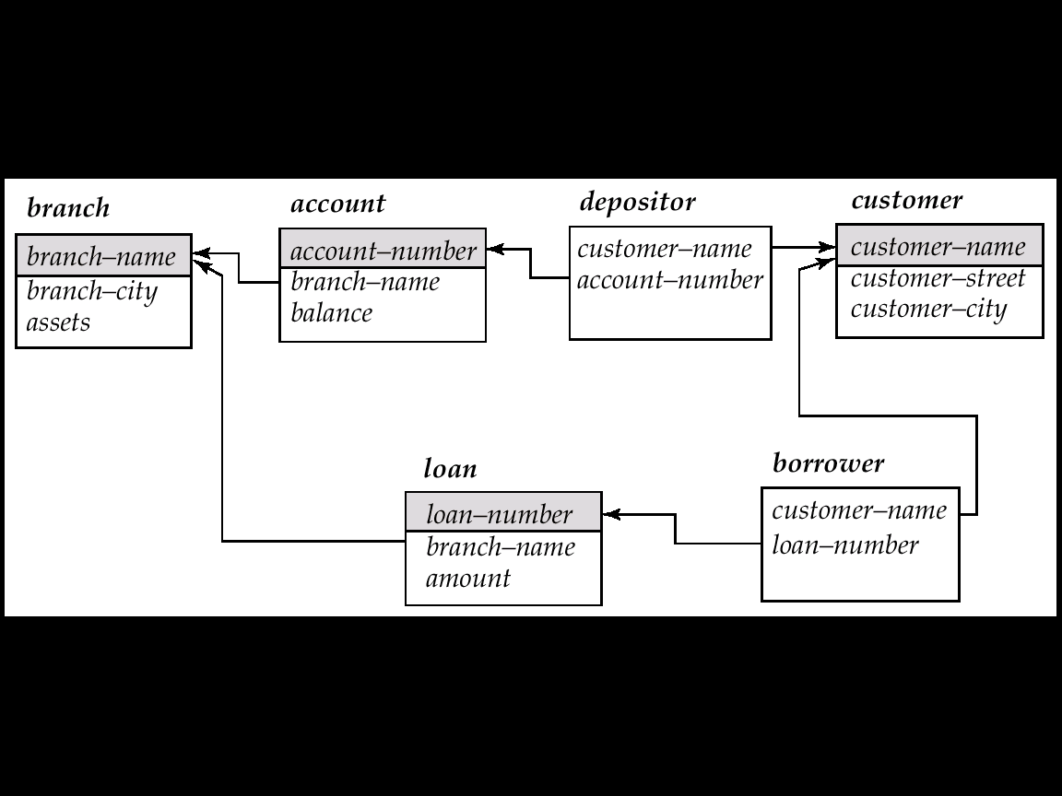
模式图
Schema diagrams for Banking Database
branch (branch_name, branch_city, assets)
customer (customer_name, customer_street, customer_city)
account (account_number, branch_name, balance)
loan (loan_number, branch_name, amount)
depositor (customer_name, account_number)
borrower (customer_name, loan_number)

Slide 20
概要
2.1 关系数据库的结构
2.2 数据库模式
2.3 码
2.4 模式图
2.5 关系查询语言
6.1 关系代数

Slide 21
关系查询语言
Languages used to request information from the database
Categories of languages
Procedural
Relational Algebra（关系代数）
Non-procedural
SQL（结构化查询语言）
Tuple Relational Calculus（元组关系演算）
Domain Relational Calculus（域关系演算）

Slide 22
概要
2.1 关系数据库的结构
2.2 数据库模式
2.3 码
2.4 模式图
2.5 关系查询语言
6.1 关系代数

Slide 23
6.1 关系代数(Relational Algebra)
以一个或多个关系作为输入，结果生成一个新的关系，该关系可以进一步作为后续操作的输入
6种基本操作
Select (选择)
Project (投影)
Union (集合并)
Set difference (集合差)
Cartesian product (笛卡尔积)
Rename (重命名)

Slide 24



选择操作
Notation: $σ_{P}\left(r\right)=\left\{t | t∈r and P\left(t\right)\right\}$
$P$ is the selection predicate(选择谓词）consisting of $∧$(and), $∨$(or), ¬(not), $=$, $≠$, $<$, $>$, $≤$, $≥$
例如：
A
B
C
D
A
B
C
D
α
α
β
β
α
β
β
β
1
5
12
23
7
7
3
10
α
β
α
β
1
23
7
10
relation $r$
$$σ_{A=B ∧ D>5}(r)$$

Slide 25

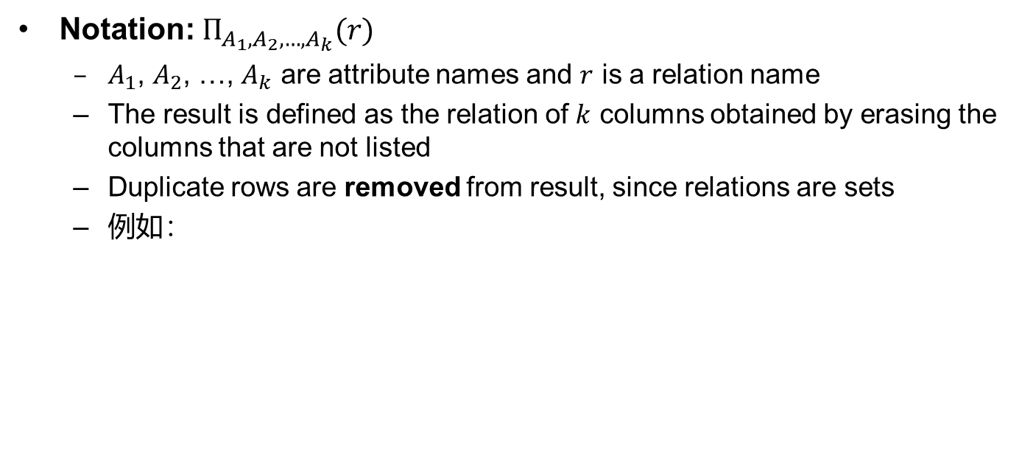

投影操作
Notation: $Π_{A_{1},A_{2},…,A_{k}}(r)$
$A_{1}$, $A_{2}$, …, $A_{k}$ are attribute names and $r$ is a relation name
The result is defined as the relation of $k$ columns obtained by erasing the columns that are not listed
Duplicate rows are removed from result, since relations are sets
例如：
A
B
C
A
C
A
C
α
α
β
β
10
20
30
40
1
1
1
2
α
α
β
β
1
1
1
2
α
β
β
1
1
2
=
relation $r$
$$Π_{A,C}(r)$$

Slide 26

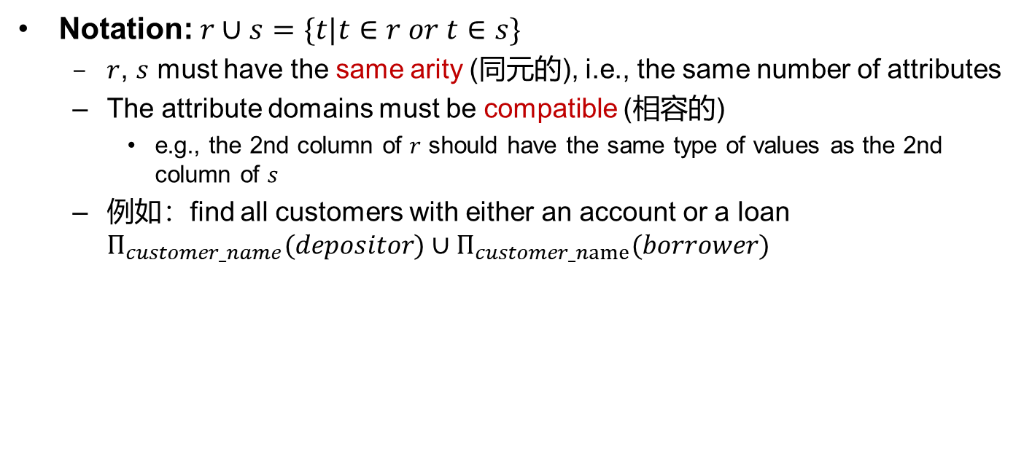

集合并操作
Notation: $r∪s=\{t|t∈r or t∈s\}$
$r$, $s$ must have the same arity (同元的), i.e., the same number of attributes
The attribute domains must be compatible (相容的)
e.g., the 2nd column of $r$ should have the same type of values as the 2nd column of $s$
例如：find all customers with either an account or a loan $Π_{customer_name}(depositor)∪Π_{customer_name}(borrower)$
A
B
A
B
A
B
α
α
β
1
2
1
α
β
2
3
α
α
β
β
1
2
1
3
s
relations $r$, $s$
$$r∪s$$

Slide 27



集合差操作
Notation: $r−s=\{t|t∈r and t∉s\}$
Set difference operation must be taken between compatible relations, i.e., $r$ and $s$ must have the same arity and the attribute domains
例如：
A
B
A
B
A
B
α
α
β
1
2
1
α
β
2
3
α
β
1
1
s
r
relations $r$, $s$
$$r−s$$

Slide 28

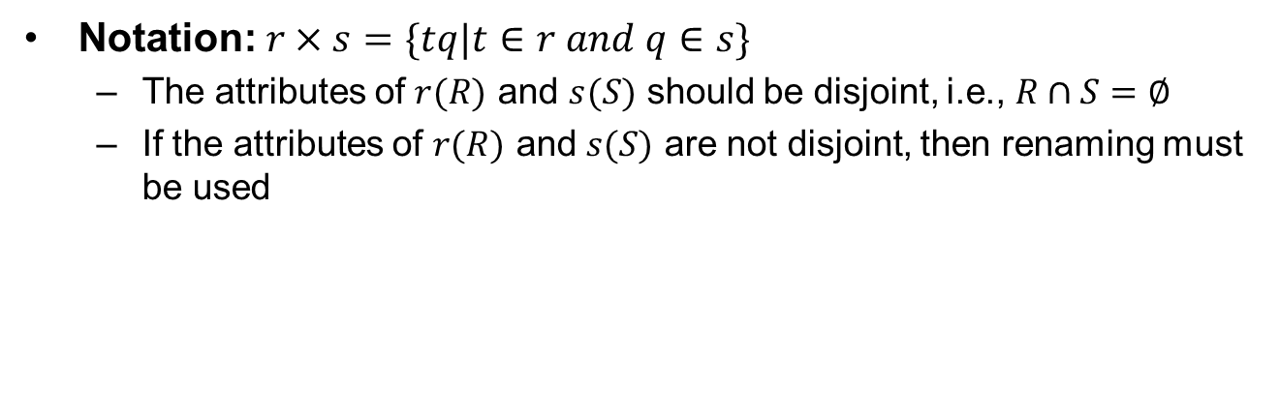

笛卡尔积
Notation: $r×s=\{tq|t∈r and q∈s\}$
The attributes of $r(R)$ and $s(S)$ should be disjoint, i.e., $R∩S=∅$
If the attributes of $r(R)$ and $s(S)$ are not disjoint, then renaming must be used
A
B
C
D
E
A
B
C
D
E
α
α
α
α
β
β
β
β
1
1
1
1
2
2
2
2
α
β
β
γ
α
β
β
γ
10
10
20
10
10
10
20
10
a
a
b
b
a
a
b
b
α
β
1
2
α
β
β
γ
10
10
20
10
a
a
b
b
r
s
relations $r$, $s$
$$r×s$$

Slide 29
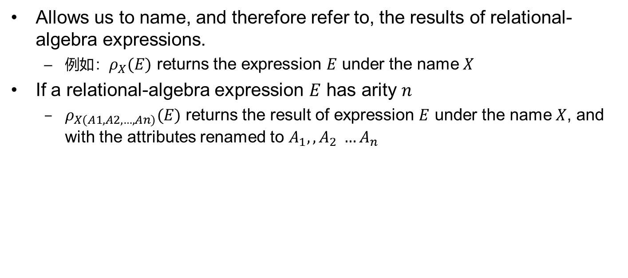
重命名操作
Allows us to name, and therefore refer to, the results of relational-algebra expressions.
例如：$ρ_{X}(E)$ returns the expression $E$ under the name $X$
If a relational-algebra expression $E$ has arity $n$
$ρ_{X(A1, A2, …, An)}(E)$ returns the result of expression $E$ under the name $X$, and with the attributes renamed to $A_{1}, ,A_{2} …A_{n}$

Slide 30



组合操作
Expressions with multiple operations
E.g., $σ_{A=C}(r×s)$
A
B
C
D
E
α
α
α
α
β
β
β
β
1
1
1
1
2
2
2
2
α
β
β
γ α
β
β
γ
10
10
20
10
10
10
20
10
a
a
b
b
a
a
b
b
A
B
C
D
E
α
β
β
1
2
2
α
β
β
10
20
20
a
a
b
$$r×s$$
$$σ_{A=C}(r×s)$$

Slide 31
关系模式（后例使用）

Slide 32


关系代数查询举例（1）
Find all loans over $1200
Find the loan number for each loan of an amount greater than $1200
$$σ_{amount>1200}(loan)$$
$$Π_{loan_number}(σ_{amount>1200}(loan))$$

Slide 33
关系代数查询举例（2）
Find the names of all the customers who have a loan, an account, or both, from the bank
Find the names of all customers who have a loan and an account at bank
$$Π_{customer_name}\left(borrower\right){ ∪Π}_{customer_name}\left(depositor\right)$$
∏_{customer_name} (borrower) ∩ ∏_{customer_name} (depositor)
r ∩ s = r - (r - s)

Slide 34
关系代数查询举例（3）
Find the names of all customers who have a loan at the Perryridge branch
Find the names of all customers who have a loan at the Perryridge branch but do not have an account at any branch of the bank
∏_{customer_name} (σ_{branch_name=“Perryridge”}
(σborrower.loan_number = loan.loan_number(borrower x loan)))
∏_{customer_name} (σ_{branch_name = “Perryridge”} (σborrower.loan_number = loan.loan_number(borrower x loan))) – ∏_{customer_name}(depositor)

Slide 35
关系代数查询举例（4）
Find the names of all customers who have a loan at the Perryridge branch
Query 1
Query 2
∏_{customer_name}(σ_{branch_name = “Perryridge”} ( σborrower.loan_number = loan.loan_number(borrower x loan)))
∏_{customer_name}(σloan.loan_number = borrower.loan_number ((σ_{branch_name = “Perryridge”}(loan)) x borrower))

Slide 36
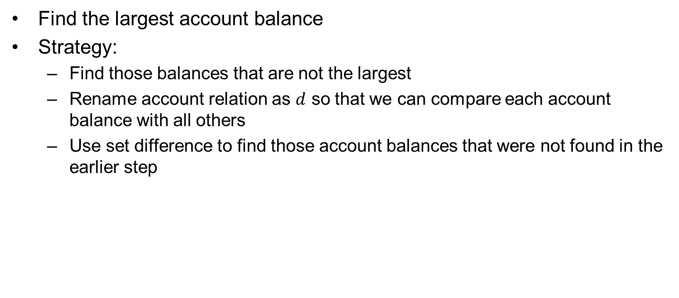
关系代数查询举例（5）
Find the largest account balance
Strategy:
Find those balances that are not the largest
Rename account relation as $d$ so that we can compare each account balance with all others
Use set difference to find those account balances that were not found in the earlier step
∏_{balance}(account)
- ∏_{account.balance}
(σ_{account.balance < d.balance} (account x ρ_{d} (account)))

Slide 37
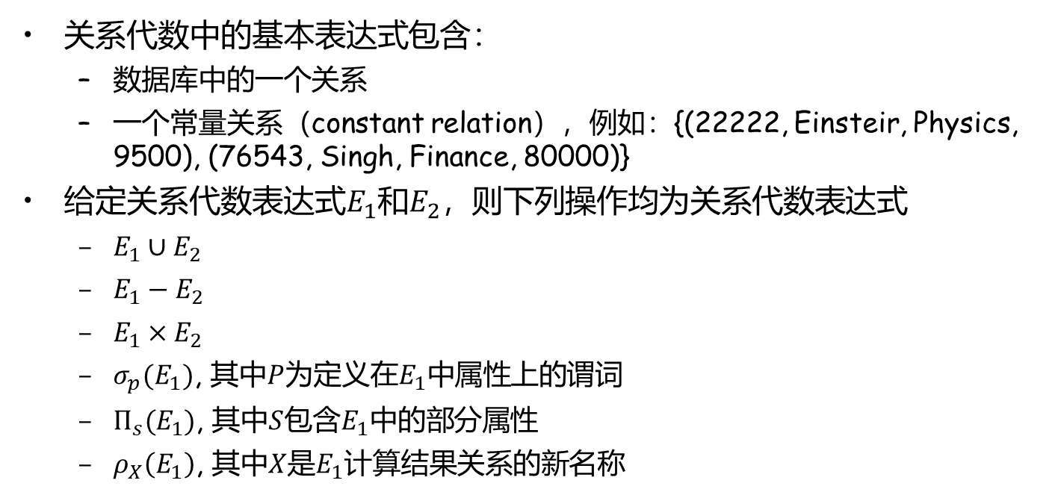
关系代数的形式化定义
关系代数中的基本表达式包含：
数据库中的一个关系
一个常量关系（constant relation），例如：{(22222, Einsteir, Physics, 9500), (76543, Singh, Finance, 80000)}
给定关系代数表达式$E_{1}$和$E_{2}$，则下列操作均为关系代数表达式
$E_{1}∪E_{2}$
$E_{1}−E_{2}$
$E_{1}×E_{2}$
$σ_{p}(E_{1})$, 其中$P$为定义在$E_{1}$中属性上的谓词
$Π_{s}(E_{1})$, 其中$S$包含$E_{1}$中的部分属性
$ρ_{X}\left(E_{1}\right)$, 其中$X$是$E_{1}$计算结果关系的新名称

Slide 38
附加关系代数操作
附加关系操作
Set intersection (集合交)
Natural join (自然连接)
Assignment (赋值)
Outer join（外连接）
附加关系操作不增强关系代数的表达能力，主要用于简化一些常用查询

Slide 39



集合交
表达形式: $r∩s=\{t|t∈r and t∈s\}$
$r$和$s$同元，即属性个数相等
$r$和$s$的属性是相容的
注意
$r∩s=r−(r−s)$
A B
A B
关系 $r$, $s$:
α
α
β
1
2
1
α
β
2
3
s
r
$r∩s$:
A B
α 2

Slide 40
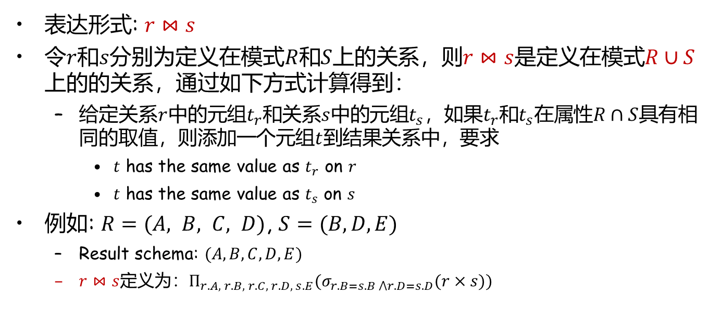
自然连接
表达形式: $r⋈s$
令$r$和$s$分别为定义在模式$R$和$S$上的关系，则$r⋈s$是定义在模式$R∪S$ 上的的关系，通过如下方式计算得到：
给定关系$r$中的元组$t_{r}$和关系$s$中的元组$t_{s}$，如果$t_{r}$和$t_{s}$在属性$R∩S$具有相同的取值，则添加一个元组$t$到结果关系中，要求
$t$ has the same value as $t_{r}$ on $r$
$t$ has the same value as $t_{s}$ on $s$
例如: $R=(A, B, C, D)$, $S=(B,D, E)$
Result schema: $(A,B,C,D,E)$
$r⋈s$定义为：$Π_{r.A, r.B, r.C, r.D, s.E}(σ_{r.B=s.B ⋀r.D=s.D}(r×s))$

Slide 41

自然连接：举例
A
B
C
D
B
D
E
α
β
γ
α
δ
1
2
4
1
2
α
γ
β
γ
β
a
a
b
a
b
1
3
1
2
3
a
a
a
b
b
α
β
γ
δ
∈
关系 $r$, $s$:
r
s
A
B
C
D
E
α
α
α
α
δ
1
1
1
1
2
α
α
γ
γ
β
a
a
a
a
b
α
γ
α
γ
δ
$r⋈s$:

Slide 42
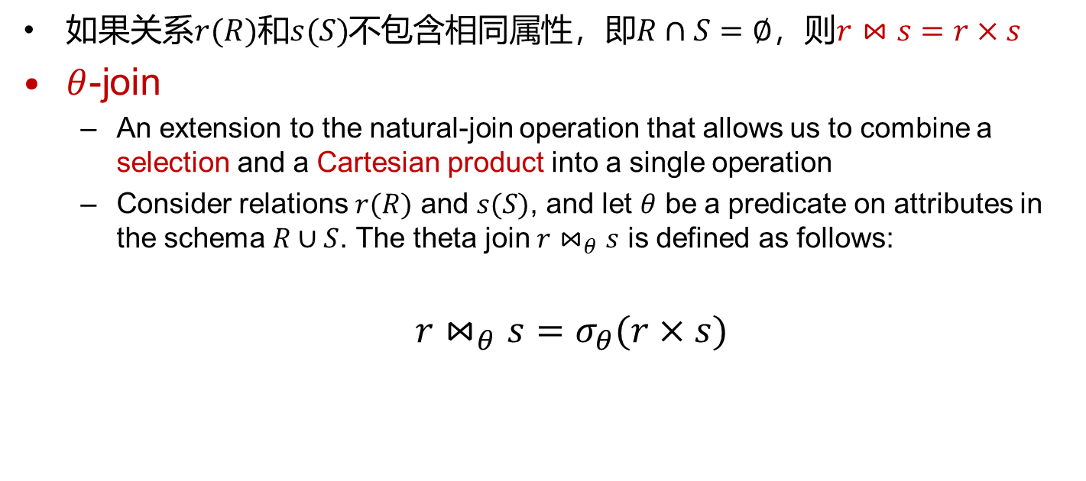
自然连接(续)
如果关系$r(R)$和$s(S)$不包含相同属性，即$R∩S=∅$，则$r⋈s=r×s$
$θ$-join
An extension to the natural-join operation that allows us to combine a selection and a Cartesian product into a single operation
Consider relations $r(R)$ and $s(S)$, and let $θ$ be a predicate on attributes in the schema $R∪S$. The theta join $r⋈_{θ}s$ is defined as follows:
$r⋈_{θ}s=σ_{θ}(r×s)$

Slide 43

连接操作：举例
r:
A B C
a1 b1 5
a1 b2 6
a2 b3 8
a2 b4 12
s:
B E
b1 3
b2 7
b3 10
b3 2
b5 2
关系 $r$, $s$:
A B C E
a1 b1 5 3
a1 b2 6 7
a2 b3 8 10
a2 b3 8 2
A R.B C S.B E
a1 b1 5 b1 3
a1 b2 6 b2 7
a2 b3 8 b3 10
a2 b3 8 b3 2
A R.B C S.B E
a1 b1 5 b2 7
a1 b1 5 b3 10
a1 b2 6 b2 7
a1 b2 6 b3 10
a2 b3 8 b3 10
$$r⋈s$$
$$r⋈_{r.B=s.B}s$$
$$r⋈_{C<E}s$$

Slide 44

关系代数查询举例(6)
Find all customers who have at least one account from each branch of “Downtown” and “Uptown”
$Π_{CN}\left(σ_{BN="Downtown"}\left(depositor ⋈ account\right)\right)∩ Π_{CN}(σ_{BN="Uptown"}(depositor ⋈ account))$
where CN denotes customer_name and BN denotes branch_name

Slide 45
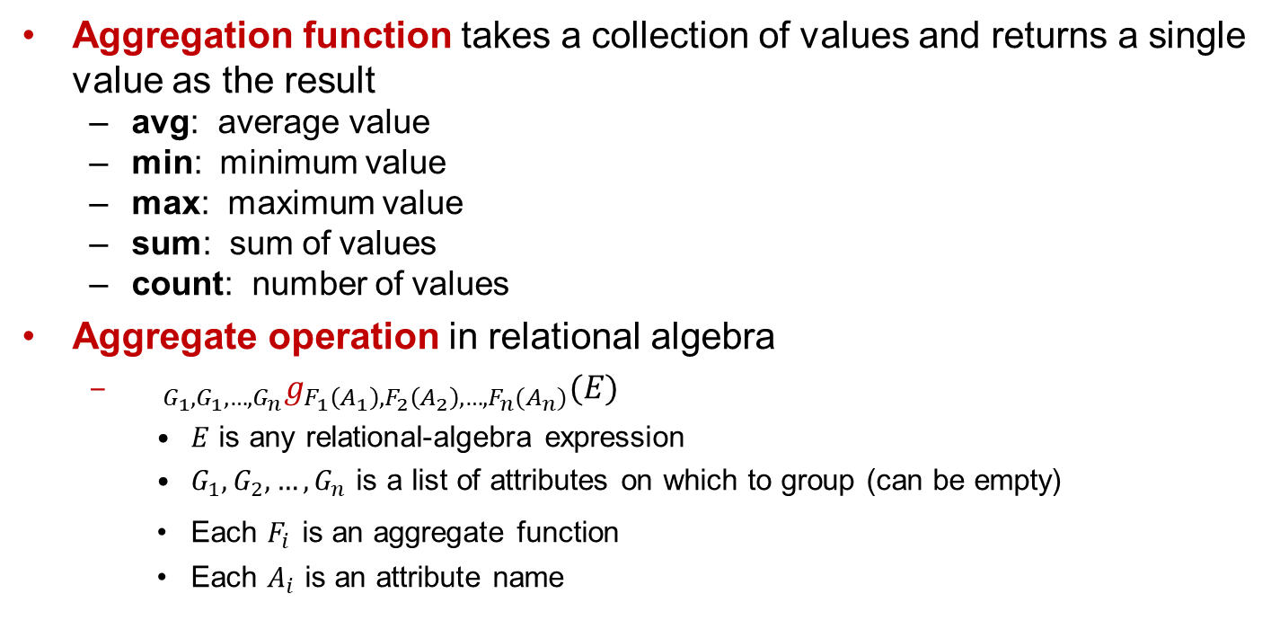
聚合函数与操作
Aggregation function takes a collection of values and returns a single value as the result
avg: average value
min: minimum value
max: maximum value
sum: sum of values
count: number of values
Aggregate operation in relational algebra
${{}_{G_{1},G_{1},…,G_{n}}g}_{F_{1}\left(A_{1}\right),F_{2}\left(A_{2}\right),…,F_{n}(A_{n})}(E)$
$E$ is any relational-algebra expression
$G_{1},G_{2},…,G_{n}$ is a list of attributes on which to group (can be empty)
Each $F_{i}$ is an aggregate function
Each $A_{i}$ is an attribute name

Slide 46
聚合：举例
Relation r :
A
B
C
g _{sum(c)} (r) :
Sum(C)
α
α
β
β
α
β
β
β
7
7
3
10
27
Relation account grouped by branch_name:
_{branch_name} g _{sum(balance)} (account)
branch_name
account_number
balance
Perryridge
Perryridge
Brighton
Brighton
Redwood
A-102
A-201
A-217
A-215
A-222
400
900
750
750
700
branch_name
balance
Perryridge
Brighton
Redwood
1300
1500
700

Slide 47
聚合函数（续）
Result of aggregation does not have a name
Can use rename operation to give it a name
For convenience, we permit renaming as part of aggregate operation
_{branch_name} g _{sum(balance) as sum_balance} (account)

Slide 48
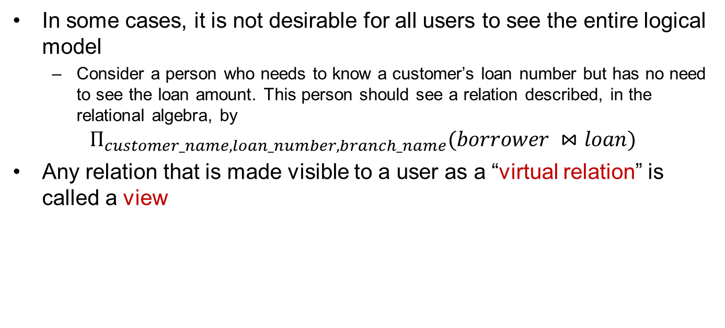
视图（Views）
In some cases, it is not desirable for all users to see the entire logical model
Consider a person who needs to know a customer’s loan number but has no need to see the loan amount. This person should see a relation described, in the relational algebra, by
$$Π_{customer_name, loan_number, branch_name}(borrower ⋈loan)$$
Any relation that is made visible to a user as a “virtual relation” is called a view

Slide 49
视图定义
A view is defined using the create view statement which has the form
create view v as < query expression >
Once a view is defined, the view name can be used to refer to the virtual relation that the view generates
View definition is not the same as creating a new relation by evaluating the query expression
a view definition causes the saving of an expression
the expression is substituted into queries when using the view

Slide 50
视图：举例
Consider the view all_customer consisting of branches and their customers
We can find all customers of the Perryridge branch by writing:
create view all_customer as
∏_{branch_name, customer_name} (depositor account)
∪ ∏_{branch_name, customer_name} (borrower loan)
∏_{customer_name} (σ_{branch_name = “Perryridge”} (all_customer))

Slide 51
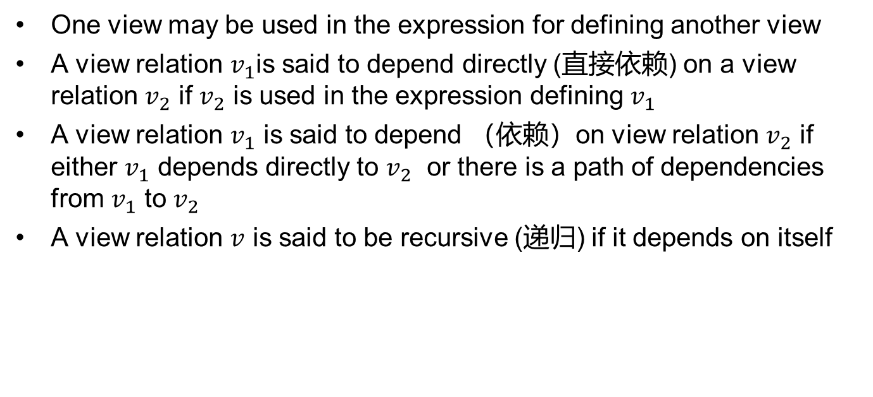
基于视图定义视图
One view may be used in the expression for defining another view
A view relation $v_{1}$is said to depend directly (直接依赖) on a view relation $v_{2}$ if $v_{2}$ is used in the expression defining $v_{1}$
A view relation $v_{1}$ is said to depend （依赖）on view relation $v_{2}$ if either $v_{1}$ depends directly to $v_{2}$ or there is a path of dependencies from $v_{1}$ to $v_{2}$
A view relation $v$ is said to be recursive (递归) if it depends on itself

Slide 52
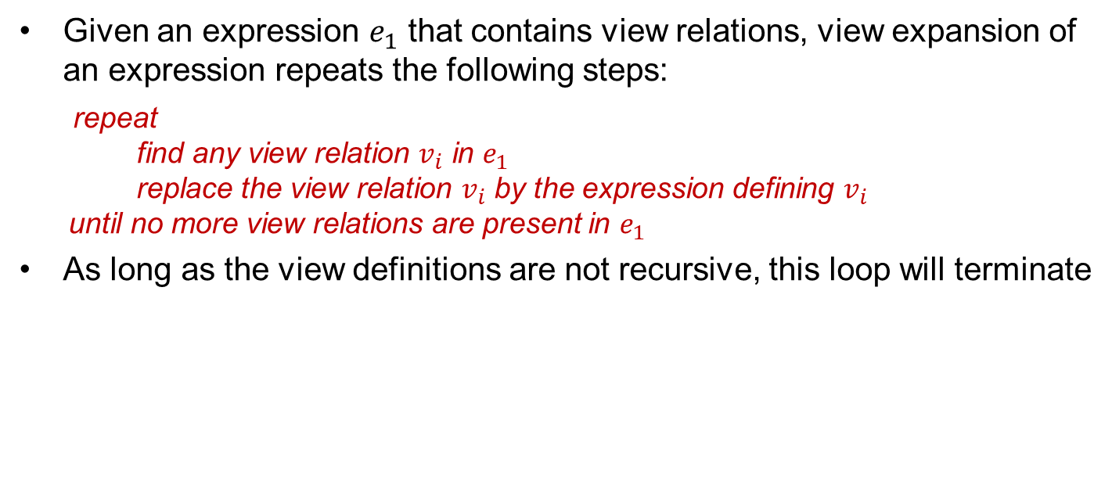
视图展开
Given an expression $e_{1}$ that contains view relations, view expansion of an expression repeats the following steps:
repeat find any view relation $v_{i}$ in $e_{1}$ replace the view relation $v_{i}$ by the expression defining $v_{i}$ until no more view relations are present in $e_{1}$
As long as the view definitions are not recursive, this loop will terminate

