Slide 1

SQL查询语言
（《数据库系统概念》第3章）
李文根
Email: lwengen@tongji.edu.cn
计算机科学与技术系
同济大学

Slide 2
概要
3.1 SQL查询语言概览
3.2 SQL数据定义
3.3 SQL查询的基本结构
3.4 附加的基本运算
3.5 集合运算
3.6 空值
3.7 聚集函数
3.8 嵌套子查询
3.9 数据库中的修改

Slide 3
SQL查询语言概览
IBM Sequel language developed as part of System R project at the IBM San Jose Research Laboratory in the early 1970s.
Renamed Structured Query Language (SQL)
ANSI (美国国家标准学会) and ISO (国际标准化组织) standard SQL
SQL-86
SQL-89
SQL-92
SQL-99
SQL: 2003, 2006, 2008
Commercial systems offer most SQL-92 features, plus varying feature sets from later standards and special proprietary features
Not all examples here may work on particular systems

Slide 4
SQL的组成
SQL语言包含
数据定义语言（Data definition language，DDL)
Relation schemas
Integrity constraints
View definition
Authorization
数据操纵语言（Data manipulation language，DML)
Queries
Deletion
Updates
Transaction processing

Slide 5
概要
3.1 SQL查询语言概览
3.2 SQL数据定义
3.3 SQL查询的基本结构
3.4 附加的基本运算
3.5 集合运算
3.6 空值
3.7 聚集函数
3.8 嵌套子查询
3.9 数据库中的修改

Slide 6
数据定义语言 (DDL)
用于定义关系，以及指定关系相关的信息，包括：
The schema for each relation
The domain of values associated with each attribute
Integrity constraints
The set of indices to be maintained for each relations
Security and authorization information for each relation
The physical storage structure of each relation on disk

Slide 7
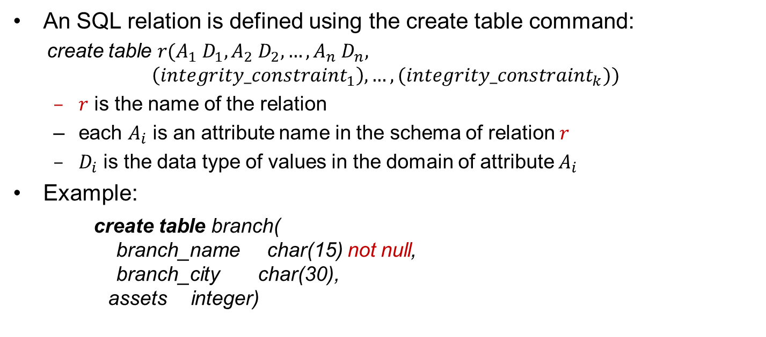
基本模式定义
An SQL relation is defined using the create table command:
create table $r(A_{1} D_{1},A_{2} D_{2},…,A_{n} D_{n},$
$$\left({integrity_constraint}_{1}\right),…,({integrity_constraint}_{k}))$$
$r$ is the name of the relation
each $A_{i}$ is an attribute name in the schema of relation $r$
$D_{i}$ is the data type of values in the domain of attribute $A_{i}$
Example:
create table branch( branch_name char(15) not null, branch_city char(30), assets integer)

Slide 8
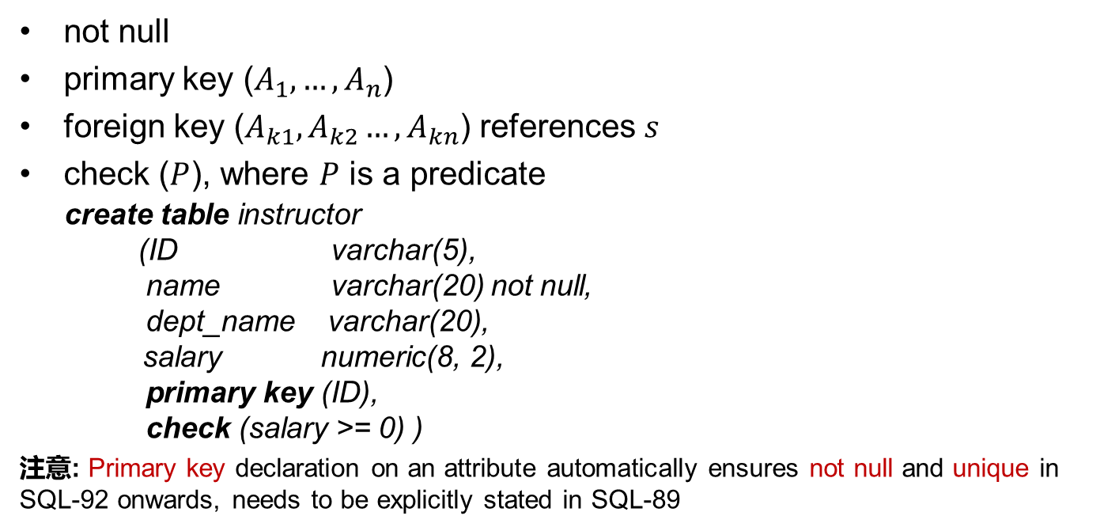
完整性约束
not null
primary key ($A_{1},…,A_{n}$)
foreign key ($A_{k1},A_{k2}…,A_{kn}$) references $s$
check ($P$), where $P$ is a predicate
create table instructor (ID varchar(5), name varchar(20) not null, dept_name varchar(20),
salary numeric(8, 2), primary key (ID), check (salary >= 0) )
注意: Primary key declaration on an attribute automatically ensures not null and unique in SQL-92 onwards, needs to be explicitly stated in SQL-89

Slide 9
元组的插入与删除
Newly created table is empty
Add a new tuple to table instructor
insert into instructor values (‘10211', ‘Smith’, ‘Computer Science’, 66000)
Insertion fails if any integrity constraint is violated
Delete all tuples from table instructor
delete from instructor

Slide 10
表的删除与修改
The drop table command deletes all information about the dropped relation from the database
The alter table command is used to add attributes to an existing relation
alter table r add A D
All tuples in the relation are assigned null as the value for the new attribute
The alter table command can also be used to drop attributes of a relation alter table r drop A
Dropping of attributes is not supported by some databases

Slide 11
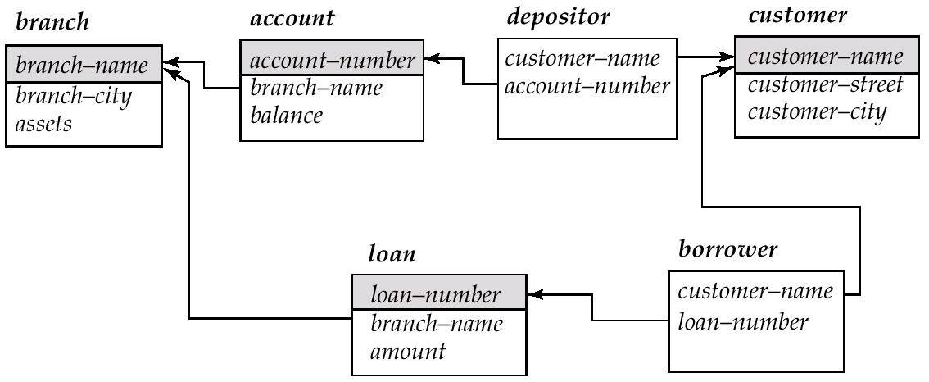
银行数据库模式

Slide 12
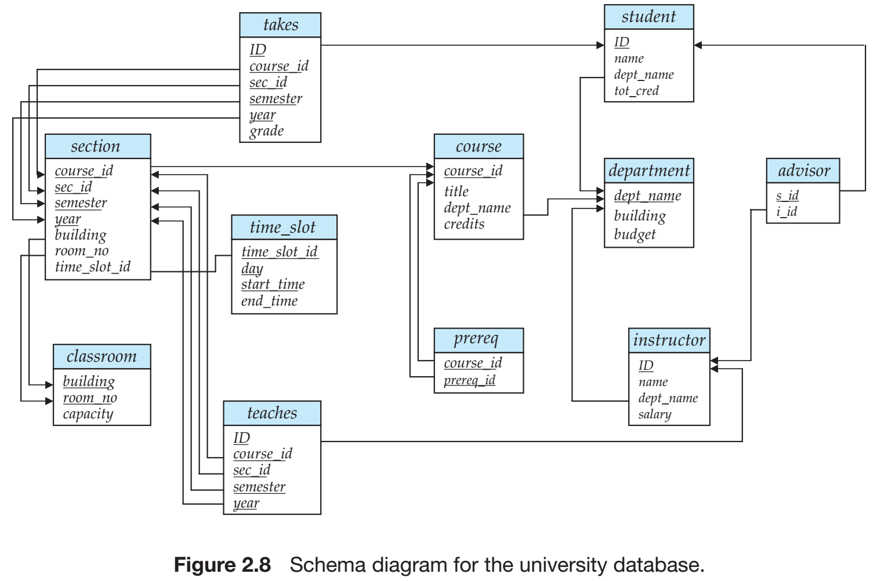
大学数据库模式

Slide 13
概要
3.1 SQL查询语言概览
3.2 SQL数据定义
3.3 SQL查询的基本结构
3.4 附加的基本运算
3.5 集合运算
3.6 空值
3.7 聚集函数
3.8 嵌套子查询
3.9 数据库中的修改

Slide 14
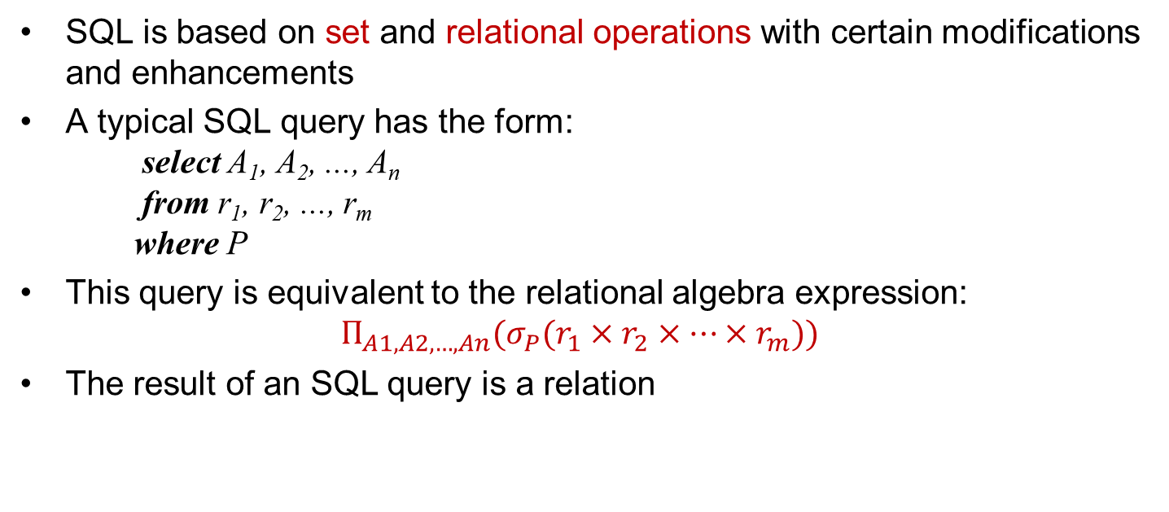
SQL查询的基本结构
SQL is based on set and relational operations with certain modifications and enhancements
A typical SQL query has the form: select A₁, A₂, ..., A_{n} from r₁, r₂, ..., r_{m} where P
This query is equivalent to the relational algebra expression:
$$Π_{A1,A2,…,An}(σ_{P}(r_{1}×r_{2}×…×r_{m}))$$
The result of an SQL query is a relation

Slide 15
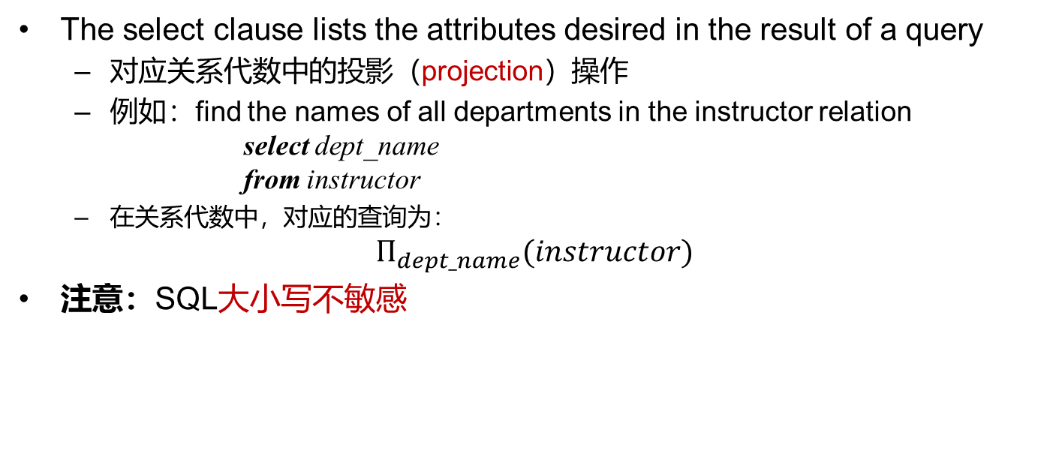
Select语句
The select clause lists the attributes desired in the result of a query
对应关系代数中的投影（projection）操作
例如：find the names of all departments in the instructor relation select dept_name from instructor
在关系代数中，对应的查询为：
$$Π_{dept_name}(instructor)$$
注意：SQL大小写不敏感

Slide 16
Select语句（续）
SQL allows duplicates in relations. To eliminate duplicates, insert the keyword distinct after select
Find the names of all departments in the instructor relation, and remove duplicates
select distinct dept_name from instructor
The keyword all specifies that duplicates should not be removed
select all dept_name from instructor

Slide 17
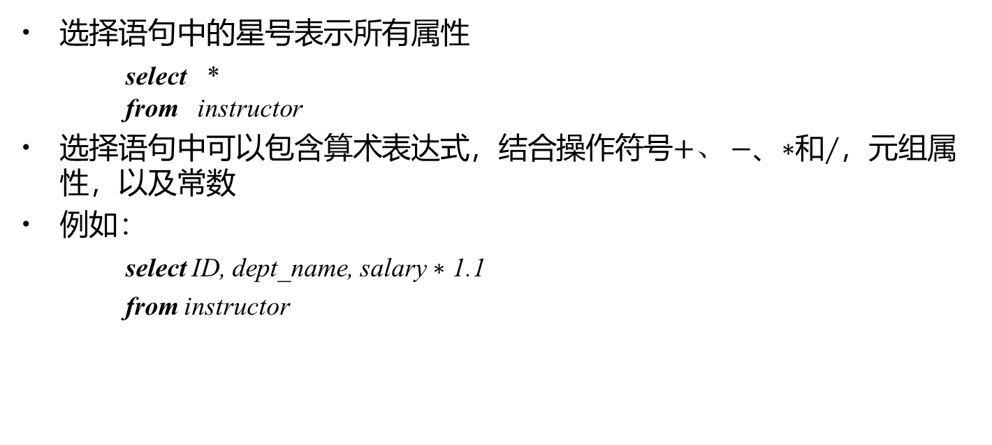
Select语句（续）
选择语句中的星号表示所有属性
select * from instructor
选择语句中可以包含算术表达式，结合操作符号$+、$ $−$、$∗$和$∕$，元组属性，以及常数
例如：
select ID, dept_name, salary $∗$ 1.1
from instructor

Slide 18
Where语句
where语句指明查询结果需满足的条件
对应关系代数中的选择谓词
例如：找出所有在Computer Science系且工资超过70000的教师的姓名 select name from instructor where dept_name = ‘Computer Science’ and salary > 70000
where中的多个条件通过逻辑连接词and, or和not连接
Notes:
Predicate：断言
In contrast, the attributes name and building appear in only one of the relations, and therefore do not need to be prefixed by the relation name.

Slide 19
Where语句（续）
SQL中的比较操作符：between
例如：找出工资介于90000和100000之间的教师的姓名
select name from instructor where salary between 90000 and 100000

Slide 20
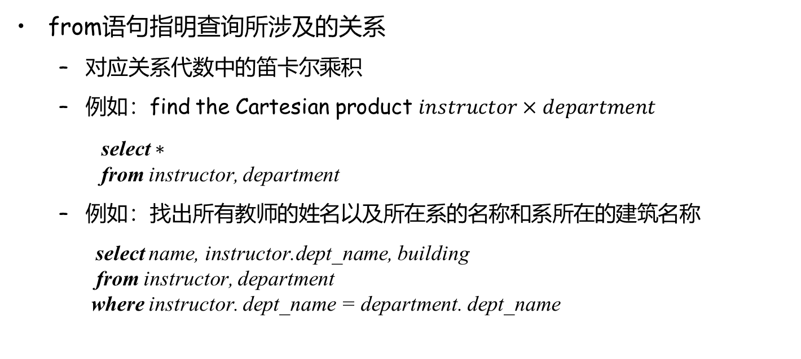
From语句
from语句指明查询所涉及的关系
对应关系代数中的笛卡尔乘积
例如：find the Cartesian product $instructor×department$
select $∗$
from instructor, department
例如：找出所有教师的姓名以及所在系的名称和系所在的建筑名称
select name, instructor.dept_name, building from instructor, department where instructor. dept_name = department. dept_name

Slide 21
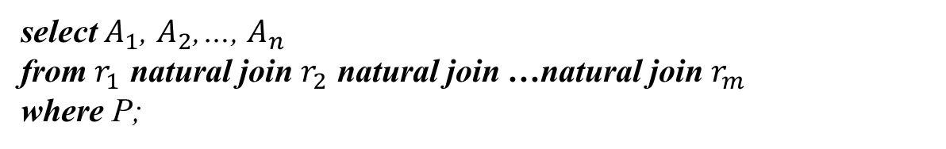
自然连接（Natural Join）
select $A_{1}$, $A_{2}$,…, $A_{n}$
from $r_{1}$ natural join $r_{2}$ natural join …natural join $r_{m}$
where P;
select name, course_id
from instructor natural join teaches;
select name, title
from instructor natural join teaches, course
where teaches.course_id=course.course_id;
Notes:
Notice that we do not repeat those attributes that appear in the schemas of both relations; rather they appear only once. Notice also the order in which the attributes are listed: first the attributes common to the schemas of both relations, second those attributes unique to the schema of the first relation, and finally, those attributes unique to the schema of the second relation.

Slide 22
概要
3.1 SQL查询语言概览
3.2 SQL数据定义
3.3 SQL查询的基本结构
3.4 附加的基本运算
3.5 集合运算
3.6 空值
3.7 聚集函数
3.8 嵌套子查询
3.9 数据库中的修改

Slide 23
附加基本运算
重命名操作（Rename Operation）
SQL允许使用as语句重命名关系及其属性： old_name as new_name
查找教师的名称及其所讲授的课程id
select name as instructor_name, course_id
from instructor, teaches
where instructor.id=teaches.id
Notes:
This naming convention requires that the relations that are present in the from clause have distinct names. This requirement causes problems in some cases, such as when information from two different tuples in the same relation needs to be combined. In Section 3.4.1, we see how to avoid these problems by using the rename operation.

Slide 24
关系重命名
查找教师的名称及其所讲授的课程id
select T.name, S.course_id from instructor as T, teaches as S where T.ID= S.ID
找出工资至少比Biology系某一位教师工资高的教师的姓名
select distinct T.name from instructor as T, instructor as S where T.salary > S.salary and S.dept_name = ‘Biology’

Slide 25
元组排序
按字母顺序列出在Computer Science系的所有教师
select name from instructor where dept_name = ‘Computer Science’ order by name
We may specify desc for descending order (降序) or asc for ascending order (升序，默认设置) for each attribute
select *
from instructor
order by salary desc, name asc

Slide 26
Where语句谓词
SQL includes a between\not between comparison operator
E.g., find the names of all instructors with salary between $90,000 and $100,000
select name from instructor where salary between 90000 and 100000
Tuple comparison
select name, course_id from instructor, teaches where (instructor.ID, dept_name) = (teaches.ID, ’Biology’);
select name, course_id
from instructor, teaches
where instructor.ID=teaches.ID and dept_name=‘Biology’
等价

Slide 27
概要
3.1 SQL查询语言概览
3.2 SQL数据定义
3.3 SQL查询的基本结构
3.4 附加的基本运算
3.5 集合运算
3.6 空值
3.7 聚集函数
3.8 嵌套子查询
3.9 数据库中的修改

Slide 28
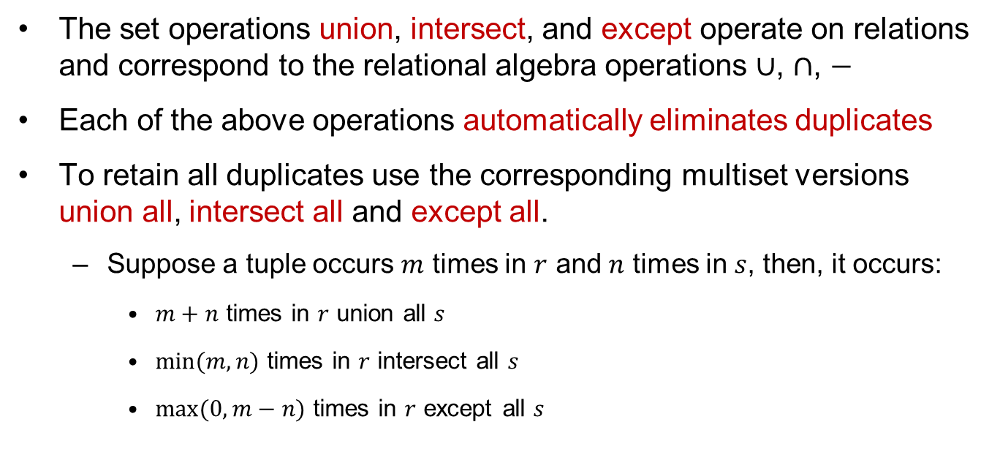
集合操作（续）
The set operations union, intersect, and except operate on relations and correspond to the relational algebra operations $∪$, $∩$, $−$
Each of the above operations automatically eliminates duplicates
To retain all duplicates use the corresponding multiset versions union all, intersect all and except all.
Suppose a tuple occurs $m$ times in $r$ and $n$ times in $s$, then, it occurs:
$m+n$ times in $r$ union all $s$
$\min{(m,n)}$ times in $r$ intersect all $s$
$max⁡(0, m−n)$ times in $r$ except all $s$

Slide 29
集合操作（续）
Find all customers who have a loan, an account, or both:
(select customer_name from depositor) union [all] (select customer_name from borrower)
Find all customers who have both a loan and an account.
(select customer_name from depositor) intersect [all] (select customer_name from borrower)
Find all customers who have an account but no loan.
(select customer_name from depositor) except [all] (select customer_name from borrower)

Slide 30
概要
3.1 SQL查询语言概览
3.2 SQL数据定义
3.3 SQL查询的基本结构
3.4 附加的基本运算
3.5 集合运算
3.6 空值
3.7 聚集函数
3.8 嵌套子查询
3.9 数据库中的修改

Slide 31
聚集函数（Aggregate Functions）
聚集函数以集合作为输入，返回单个值
avg：平均值
min：最小值
max：最大值
sum：总和
count：计数
Notes:
The input to sum and avg must be a collection of numbers, but the other operators can operate on collections of nonnumeric data types, such as strings, as well.

Slide 32
聚集函数（续）
找出Computer Science系的平均工资
select avg (salary) from instructor where dept_name = ‘Computer Science’
找出在2021年有上课的教师总数
select count (distinct ID) from teaches
where year=2021

Slide 33
分组聚集：Group By
找出每个系的平均工资
select dept_name, avg(salary) as avg_salary from instructor group by dept_name
注意：出现在select子句且不在聚集函数中的属性必须出现在group by子句中
/*错误查询*/
select dept_name, ID, avg(salary)
from instructor
group by dept_name
Notes:
There are circumstances where we would like to apply the aggregate function not only to a single set of tuples, but also to a group of sets of tuples; we specify this wish in SQL using the group by clause. The attribute or attributes given in the group by clause are used to form groups. Tuples with the same value on all attributes in the group by clause are placed in one group.
When an SQL query uses grouping, it is important to ensure that the only attributes that appear in the select statement without being aggregated are those that are present in the group by clause. In other words, any attribute that is not present in the group by clause must appear only inside an aggregate function if it appears in the select clause, otherwise the query is treated as erroneous. Each instructor in a particular group (defined by dept name) can have a different ID, and since only one tuple is output for each group, there is no unique way of choosing which ID value to output. As a result, such cases are disallowed by SQL.

Slide 34
聚集函数：Having子句
At times, it is useful to state a condition that applies to groups rather than to tuples.
例如：find the names of all branches where the average account balance is more than $1,200.
select branch_name, avg (balance) from account group by branch_name having avg (balance) > 1200
注意
predicates in the having clause are applied after the information of groups
predicates in the where clause are applied before forming groups

Slide 35
聚集函数：Having子句（续）
E.g., find the average balance for each customer who lives in Harrison and has at least three accounts
select depositor.customer_name, avg (balance) from depositor, account, customer where depositor.account_number=account.account_number and
depositer.customer_name=customer.customer_name and
customer_city=‘Harrison’
group by depositor.customer_name having count(distinct depositor.account_number) >=3
Notes:
1. As was the case for queries without aggregation, the from clause is first evaluated to get a relation. 2. If a where clause is present, the predicate in the where clause is applied on the result relation of the from clause. 3. Tuples satisfying the where predicate are then placed into groups by the group by clause if it is present. If the group by clause is absent, the entire set of tuples satisfying the where predicate is treated as being in one group. 4. The having clause, if it is present, is applied to each group; the groups that do not satisfy the having clause predicate are removed. 5. The select clause uses the remaining groups to generate tuples of the result of the query, applying the aggregate functions to get a single result tuple for each group

Slide 36
概要
3.1 SQL查询语言概览
3.2 SQL数据定义
3.3 SQL查询的基本结构
3.4 附加的基本运算
3.5 集合运算
3.6 空值
3.7 聚集函数
3.8 嵌套子查询
3.9 数据库中的修改

Slide 37
嵌套子查询（Nested Subqueries）
SQL provides a mechanism for the nesting of subqueries
A subquery is a select-from-where expression that is nested within another query in the from clause
A common use of subqueries is to perform tests for set membership, make set comparisons
Notes:
Cardinality：基数

Slide 38
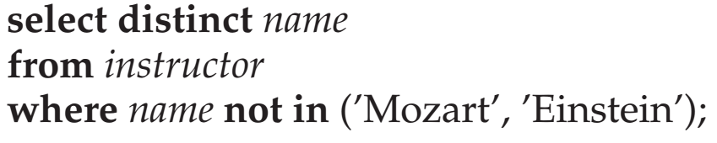
嵌套子查询：Set Membership
Find all customers who have both an account and a loan at the bank
select distinct customer_name from borrower where customer_name in (select customer_name
from depositor)
Find all customers who have a loan at the bank but do not have an account at the bank
select distinct customer_name from borrower where customer_name not in (select customer_name from depositor)

Slide 39
嵌套子查询： Set Membership（续）
Find all customers who have both an account and a loan at the Perryridge branch
select distinct customer_name from borrower, loan where borrower.loan_number=loan.loan_number and branch_name=“Perryridge” and (branch_name, customer_name) in (select branch_name, customer_name from depositor, account where depositor.account_number =account.account_number)

Slide 40
嵌套子查询：Set Comparison
Find all branches that have greater assets than some branch located in Brooklyn
select distinct T.branch_name from branch as T, branch as S where T.assets > S.assets and S.branch_city = ‘Brooklyn’
Same query using >some clause
select branch_name from branch where assets > some (select assets from branch where branch_city = ‘Brooklyn’)

Slide 41

Some子句的定义
$F<comp>some r⇔∃ t∈r$ such that ($F<comp>t$), where <comp> can be: $<,≤,>,≥,=,≠$
0
(5< some
5
) = true
(read: 5 < some tuple in the relation)
6
(5< some
0
) = false
5
(= some) ≡ in
However,
(≠ some) ≡ not in
0
(5 = some
) = true
5
0
(5 ≠ some
) = true (since 0 ≠ 5)
5

Slide 42

All子句的定义
$F<comp>all r ⇔∀t ∈r (F<comp>t)$
0
(5< all
) = false
5
6
6
(5< all
) = true
(≠ all) ≡ not in
However, (= all) ≡ in
10
4
(5 = all
5
) = false
(5 ≠ all
) = true (since 5 ≠ 4 and 5 ≠ 6)
4
6

Slide 43
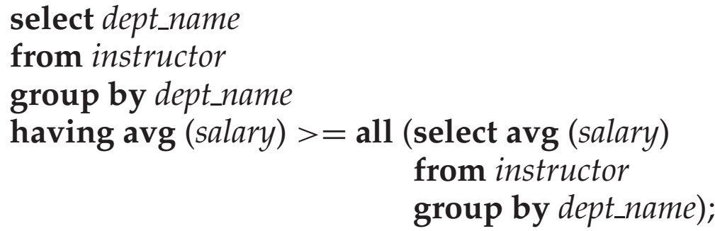
查询举例
Find the names of all branches that have greater assets than all branches located in Brooklyn.
select branch_name from branch where assets > all (select assets from branch where branch_city = ‘Brooklyn’)
找出平均工资最高的系

Slide 44
视图（Views）
In some cases, it is not desirable for all users to see the entire logical model
Consider a person who needs to know a customer’s name, loan number and branch name, but has no need to see the loan amount. This person should see a relation described by
(select customer_name, borrower.loan_number, branch_name from borrower, loan where borrower.loan_number = loan.loan_number )
A view provides a mechanism to hide certain data from the view of certain users
Notes:
Any relation that is not of the conceptual model?不是存储的概念模型的表，而是把SQL查询语句存储下来的虚拟的表

Slide 45
视图定义
A view is defined using the create view statement which has the form
create view v as < query expression >
where <query expression> is any legal SQL expression and the view name is represented by v
The view name can be used to refer to the virtual relation
When a view is created, the query expression is stored in the database and the expression is substituted into queries using the view

Slide 46
查询举例
A view consisting of branches and their customers
create view all_customer as (select branch_name, customer_name from depositor, account where depositor.account_number = account.account_number)
union (select branch_name, customer_name from borrower, loan where borrower.loan_number = loan.loan_number)
Find all customers of the Perryridge branch
select customer_name from all_customer where branch_name = ‘Perryridge’

Slide 47
From子句中的子查询
Derived Relations
Find the average account balance of those branches where the average account balance is greater than $1200.
注意：We do not need to use the having clause, since we compute the temporary (view) relation result in the from clause, and the attributes of result can be used directly in the where clause
select branch_name, avg (balance) from account group by branch_name having avg (balance) > 1200
select branch_name, avg_balance from (select branch_name, avg (balance) as avg_balance from account group by branch_name) where avg_balance > 1200

Slide 48
查询举例
Find the maximum total balance across all branches
select max(tot_balance) from (select branch_name, sum (balance) from account group by branch_name) as branch_total (branch_name, tot_balance))

Slide 49
with子句
with clause allows views to be defined locally to a query, rather than globally
Find all accounts with the maximum balance
with max_balance(value) as select max(balance) from account
select account_number from account, max_balance where account.balance = max_balance.value

Slide 50
查询举例
Find all branches where the total account deposit is greater than the average of the total account deposits at all branches
with branch_total (branch_name, value) as select branch_name, sum (balance) from account group by branch_name
with branch_total_avg (value) as select avg (value) from branch_total
select branch_name from branch_total, branch_total_avg where branch_total.value >= branch_total_avg.value
Notes:
However, using nested subqueries would have made the query harder to read and understand. The with clause makes the query logic clearer; it also permits a view definition to be used in multiple places within a query

