Slide 1

SQL查询语言
（《数据库系统概念》第3章）
李文根
Email: lwengen@tongji.edu.cn
计算机科学与技术系
同济大学

Slide 2
概要
3.1 SQL查询语言概览
3.2 SQL数据定义
3.3 SQL查询的基本结构
3.4 附加的基本运算
3.5 集合运算
3.6 空值
3.7 聚集函数
3.8 嵌套子查询
3.9 数据库中的修改

Slide 3
SQL查询语言概览
IBM Sequel language developed as part of System R project at the IBM San Jose Research Laboratory in the early 1970s.
Renamed Structured Query Language (SQL)
ANSI (美国国家标准学会) and ISO (国际标准化组织) standard SQL
SQL-86
SQL-89
SQL-92
SQL-99
SQL: 2003, 2006, 2008
Commercial systems offer most SQL-92 features, plus varying feature sets from later standards and special proprietary features
Not all examples here may work on particular systems

Slide 4
SQL的组成
SQL语言包含
数据定义语言（Data definition language，DDL)
Relation schemas
Integrity constraints
View definition
Authorization
数据操纵语言（Data manipulation language，DML)
Queries
Deletion
Updates
Transaction processing

Slide 5
概要
3.1 SQL查询语言概览
3.2 SQL数据定义
3.3 SQL查询的基本结构
3.4 附加的基本运算
3.5 集合运算
3.6 空值
3.7 聚集函数
3.8 嵌套子查询
3.9 数据库中的修改

Slide 6
数据定义语言 (DDL)
用于定义关系，以及指定关系相关的信息，包括：
The schema for each relation
The domain of values associated with each attribute
Integrity constraints
The set of indices to be maintained for each relations
Security and authorization information for each relation
The physical storage structure of each relation on disk

Slide 7
SQL中的数据类型
char(n)
Fixed length character string, with user-specified length n
varchar(n)
Variable length character strings, with user-specified maximum length n
int
Integer, a finite subset of the integers that is machine-dependent
smallint
Small integer, a machine-dependent subset of the integer domain type
numeric(p,d)
Fixed point number, with user-specified precision of p digits, with d digits to the right of decimal point
numeric(3,1) allows 44.5 to be stored exactly, but neither 444.5 nor 0.32 can be stored exactly
Notes:
The char data type stores fixed length strings. Consider, for example, an attribute A of type char(10). If we store a string “Avi” in this attribute, 7 spaces are appended to the string to make it 10 characters long. In contrast, if attribute B were of type varchar(10), and we store “Avi” in attribute B, no spaces would be added. When comparing two values of type char, if they are of different lengths extra spaces are automatically added to the shorter one to make them the same size, before comparison. When comparing a char type with a varchar type, one may expect extra spaces to be added to the varchar type to make the lengths equal, before comparison; however, this may or may not be done, depending on the database system. As a result, even if the same value “Avi” is stored in the attributes A and B above, a comparison A=B may return false. We recommend you always use the varchar.
numeric(3,1) allows 44.5 to be stored exactly, but neither 444.5 nor 0.32 can be stored exactly in a field of this type. type instead of the char type to avoid these problems.

Slide 8
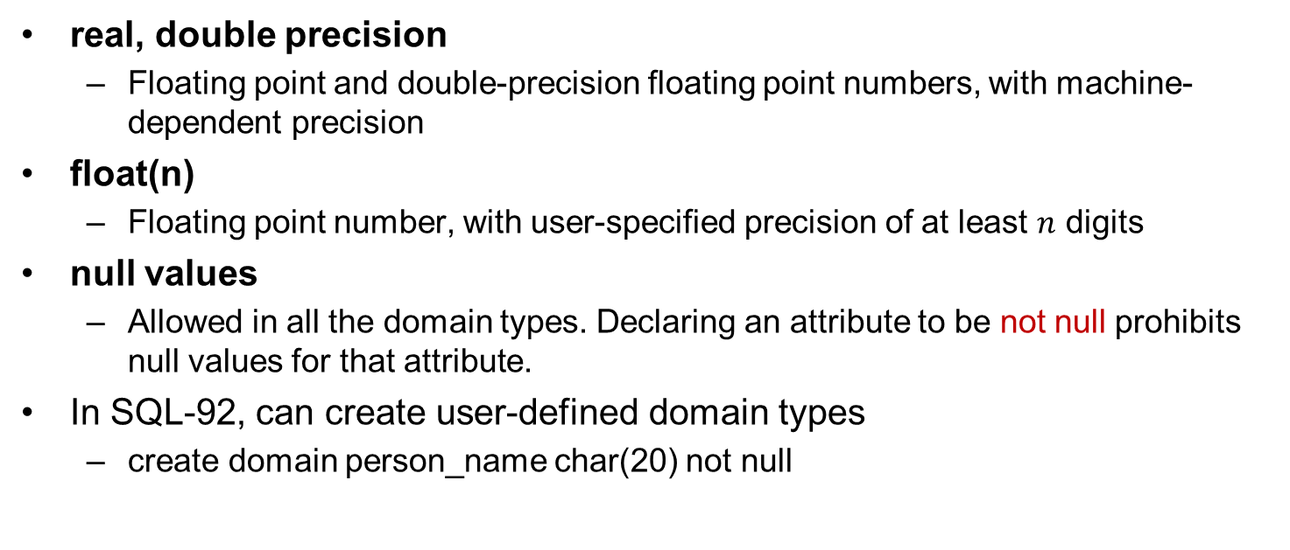
SQL中的数据类型（续）
real, double precision
Floating point and double-precision floating point numbers, with machine-dependent precision
float(n)
Floating point number, with user-specified precision of at least $n$ digits
null values
Allowed in all the domain types. Declaring an attribute to be not null prohibits null values for that attribute.
In SQL-92, can create user-defined domain types
create domain person_name char(20) not null

Slide 9
SQL中的Date/Time数据类型
date
Dates, containing (4 digit) year, month and date
E.g., date ‘2014-9-30’
time
Time of day, in hours, minutes and seconds
E.g., time ’09:00:30’ time ’09:00:30.75’
timestamp
date plus time of day
E.g., timestamp ‘2012-3-13 08:25:30.75’

Slide 10
SQL中的Date/Time数据类型（续）
Interval: period of time
E.g., Interval ‘1’ day
Subtracting a date/time/timestamp value from another gives an interval value
Interval values can be added to date/time/timestamp values
Extract values of individual fields from date/time/timestamp
E.g., extract (year from r.starttime)
Cast string types to date/time/timestamp
E.g., cast <string-valued-expression> as date

Slide 11
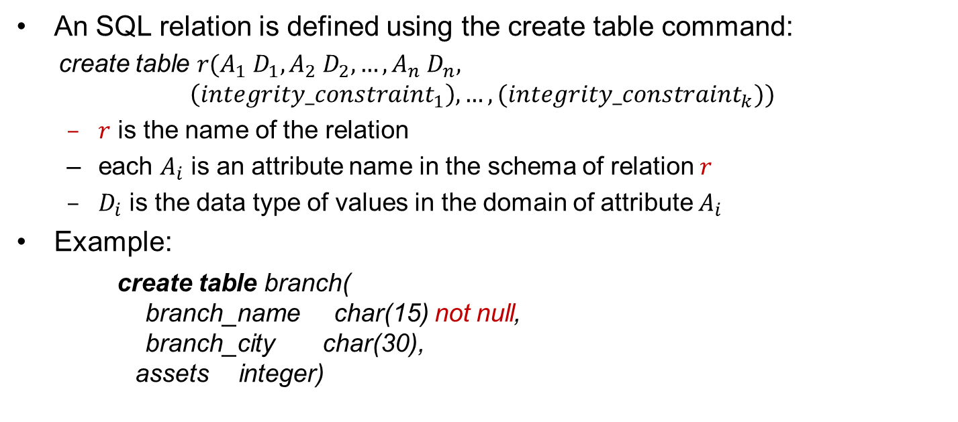
基本模式定义
An SQL relation is defined using the create table command:
create table $r(A_{1} D_{1},A_{2} D_{2},…,A_{n} D_{n},$
$$\left({integrity_constraint}_{1}\right),…,({integrity_constraint}_{k}))$$
$r$ is the name of the relation
each $A_{i}$ is an attribute name in the schema of relation $r$
$D_{i}$ is the data type of values in the domain of attribute $A_{i}$
Example:
create table branch( branch_name char(15) not null, branch_city char(30), assets integer)

Slide 12
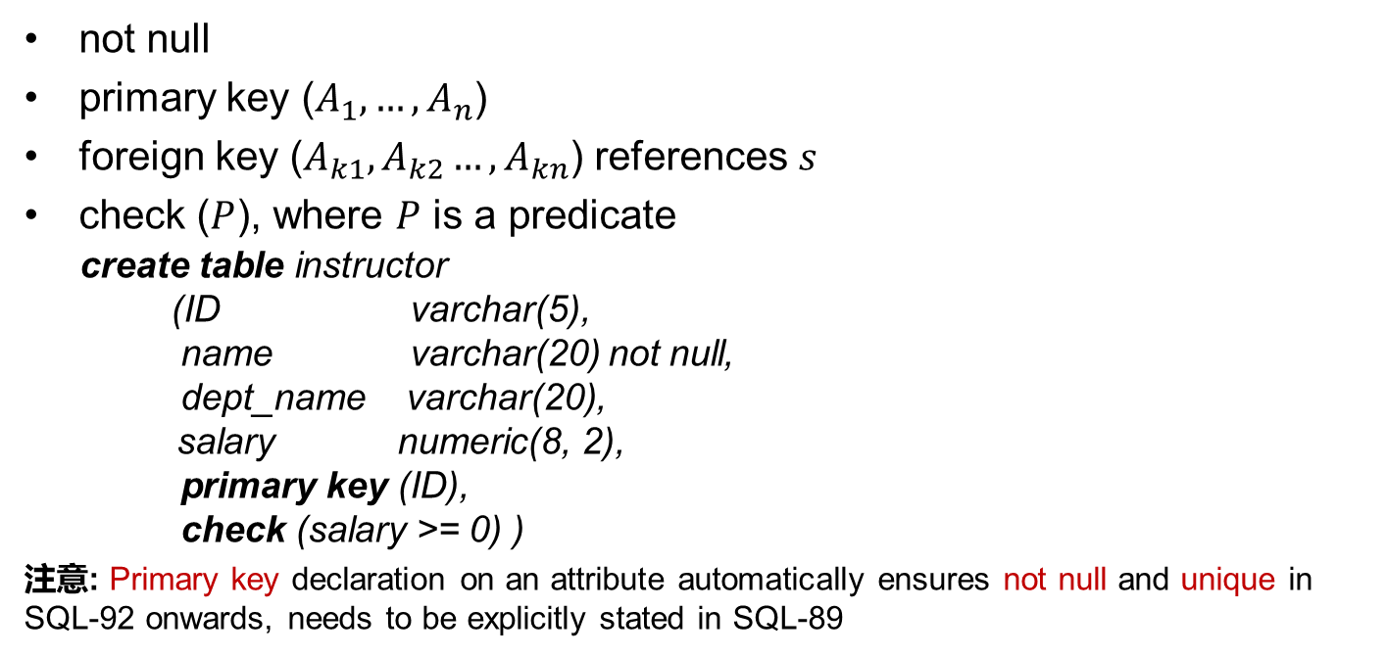
完整性约束
not null
primary key ($A_{1},…,A_{n}$)
foreign key ($A_{k1},A_{k2}…,A_{kn}$) references $s$
check ($P$), where $P$ is a predicate
create table instructor (ID varchar(5), name varchar(20) not null, dept_name varchar(20),
salary numeric(8, 2), primary key (ID), check (salary >= 0) )
注意: Primary key declaration on an attribute automatically ensures not null and unique in SQL-92 onwards, needs to be explicitly stated in SQL-89

Slide 13
元组的插入与删除
Newly created table is empty
Add a new tuple to table instructor
insert into instructor values (‘10211', ‘Smith’, ‘Computer Science’, 66000)
Insertion fails if any integrity constraint is violated
Delete all tuples from table instructor
delete from instructor

Slide 14
表的删除与修改
The drop table command deletes all information about the dropped relation from the database
The alter table command is used to add attributes to an existing relation
alter table r add A D
All tuples in the relation are assigned null as the value for the new attribute
The alter table command can also be used to drop attributes of a relation alter table r drop A
Dropping of attributes is not supported by some databases

Slide 15
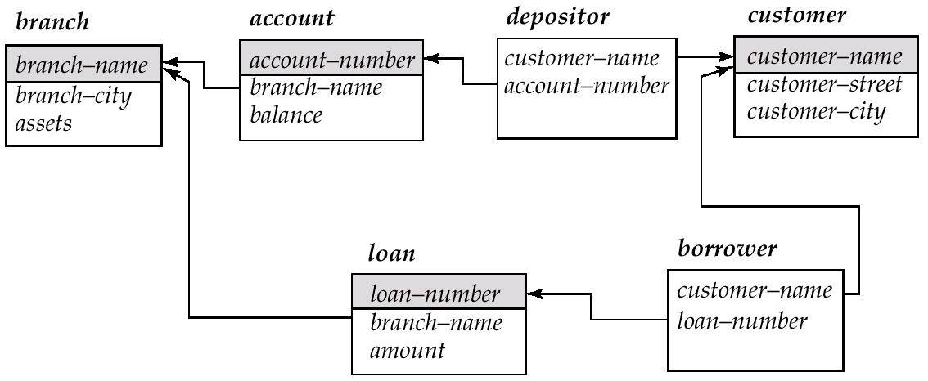
银行数据库模式

Slide 16
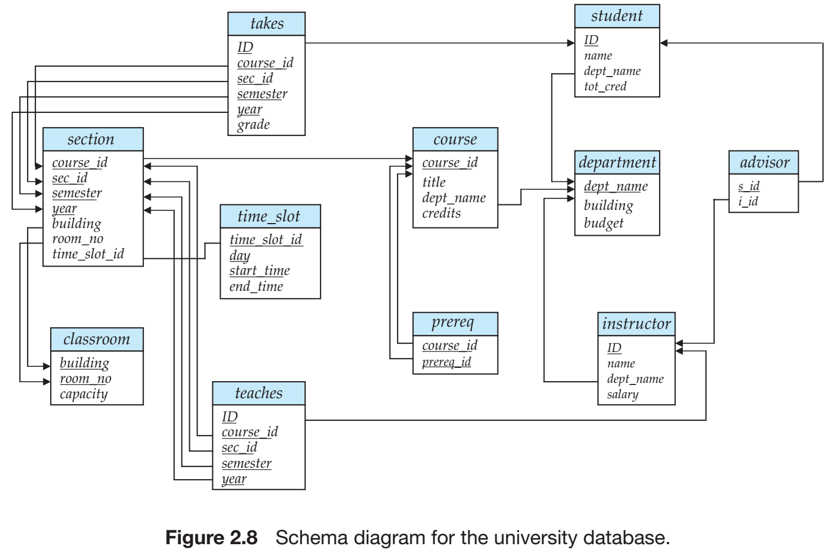
大学数据库模式

Slide 17
概要
3.1 SQL查询语言概览
3.2 SQL数据定义
3.3 SQL查询的基本结构
3.4 附加的基本运算
3.5 集合运算
3.6 空值
3.7 聚集函数
3.8 嵌套子查询
3.9 数据库中的修改

Slide 18
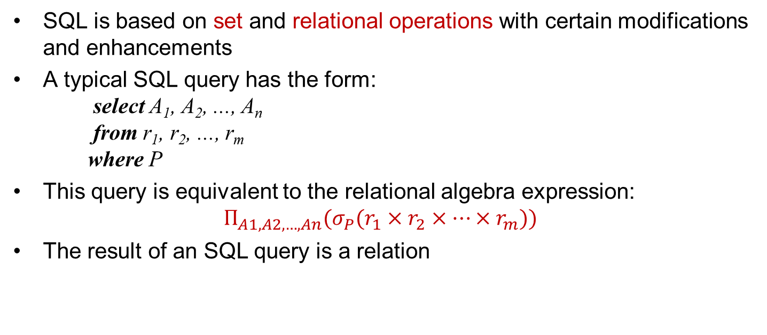
SQL查询的基本结构
SQL is based on set and relational operations with certain modifications and enhancements
A typical SQL query has the form: select A₁, A₂, ..., A_{n} from r₁, r₂, ..., r_{m} where P
This query is equivalent to the relational algebra expression:
$$Π_{A1,A2,…,An}(σ_{P}(r_{1}×r_{2}×…×r_{m}))$$
The result of an SQL query is a relation

Slide 19
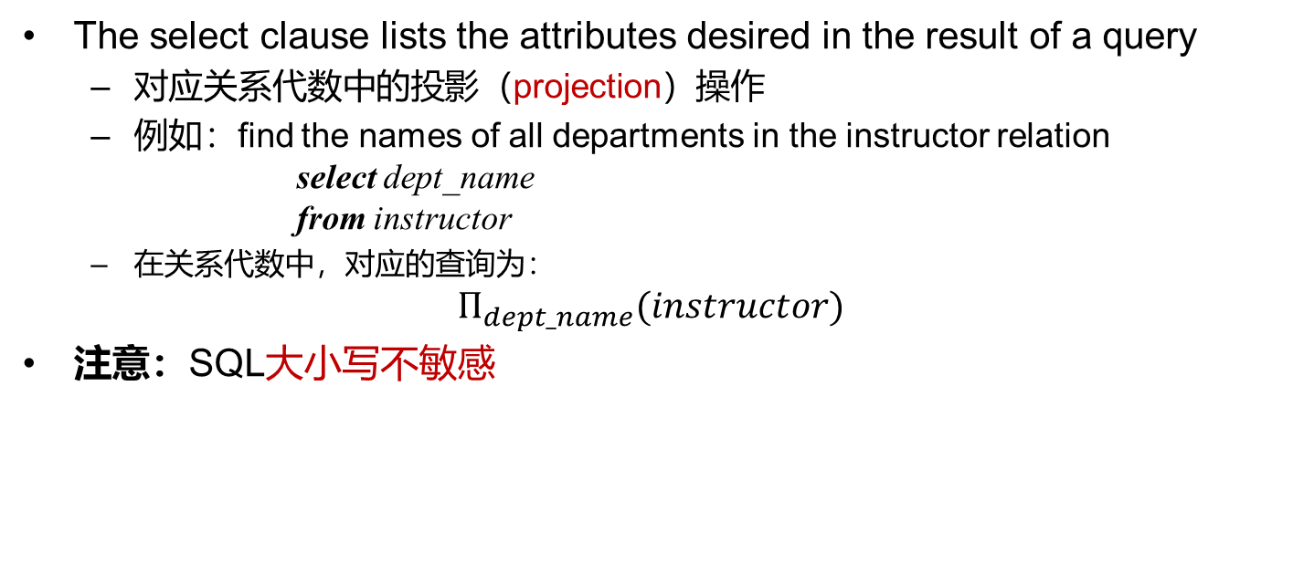
Select语句
The select clause lists the attributes desired in the result of a query
对应关系代数中的投影（projection）操作
例如：find the names of all departments in the instructor relation select dept_name from instructor
在关系代数中，对应的查询为：
$$Π_{dept_name}(instructor)$$
注意：SQL大小写不敏感

Slide 20
Select语句（续）
SQL allows duplicates in relations. To eliminate duplicates, insert the keyword distinct after select
Find the names of all departments in the instructor relation, and remove duplicates
select distinct dept_name from instructor
The keyword all specifies that duplicates should not be removed
select all dept_name from instructor

Slide 21
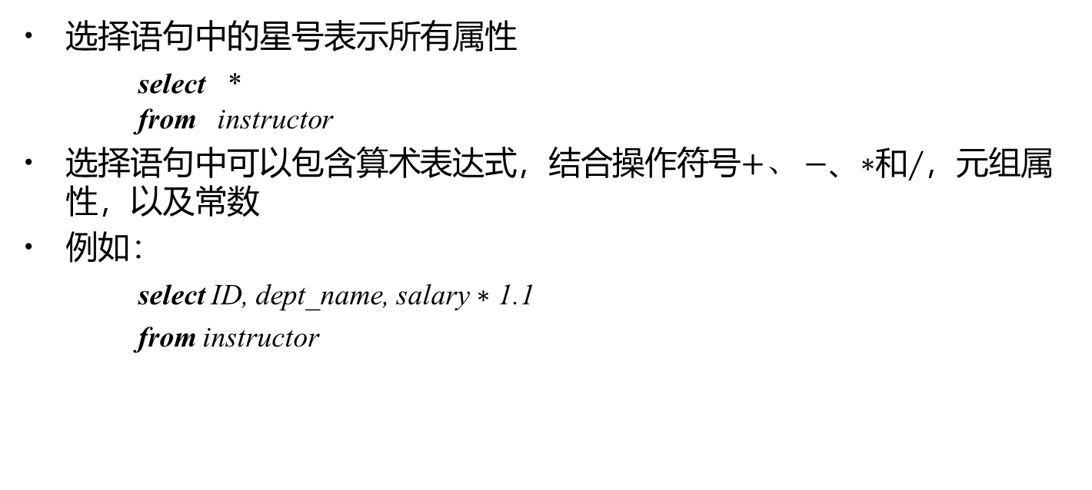
Select语句（续）
选择语句中的星号表示所有属性
select * from instructor
选择语句中可以包含算术表达式，结合操作符号$+、$ $−$、$∗$和$∕$，元组属性，以及常数
例如：
select ID, dept_name, salary $∗$ 1.1
from instructor

Slide 22
Where语句
where语句指明查询结果需满足的条件
对应关系代数中的选择谓词
例如：找出所有在Computer Science系且工资超过70000的教师的姓名 select name from instructor where dept_name = ‘Computer Science’ and salary > 70000
where中的多个条件通过逻辑连接词and, or和not连接
Notes:
Predicate：断言
In contrast, the attributes name and building appear in only one of the relations, and therefore do not need to be prefixed by the relation name.

Slide 23
Where语句（续）
SQL中的比较操作符：between
例如：找出工资介于90000和100000之间的教师的姓名
select name from instructor where salary between 90000 and 100000

Slide 24
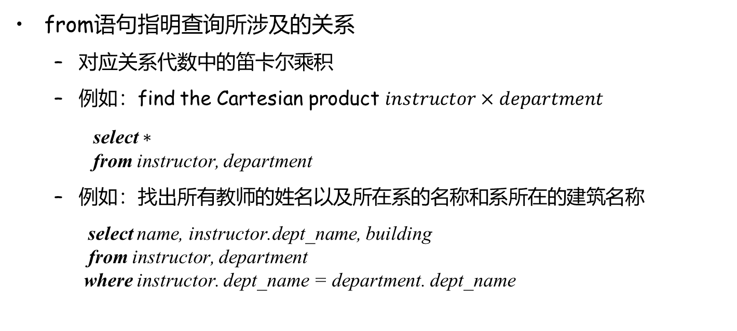
From语句
from语句指明查询所涉及的关系
对应关系代数中的笛卡尔乘积
例如：find the Cartesian product $instructor×department$
select $∗$
from instructor, department
例如：找出所有教师的姓名以及所在系的名称和系所在的建筑名称
select name, instructor.dept_name, building from instructor, department where instructor. dept_name = department. dept_name

Slide 25
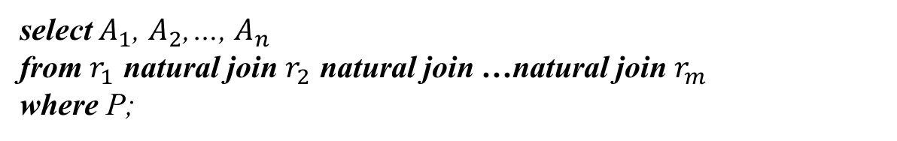
自然连接（Natural Join）
select $A_{1}$, $A_{2}$,…, $A_{n}$
from $r_{1}$ natural join $r_{2}$ natural join …natural join $r_{m}$
where P;
select name, course_id
from instructor natural join teaches;
select name, title
from instructor natural join teaches, course
where teaches.course_id=course.course_id;
Notes:
Notice that we do not repeat those attributes that appear in the schemas of both relations; rather they appear only once. Notice also the order in which the attributes are listed: first the attributes common to the schemas of both relations, second those attributes unique to the schema of the first relation, and finally, those attributes unique to the schema of the second relation.

Slide 26
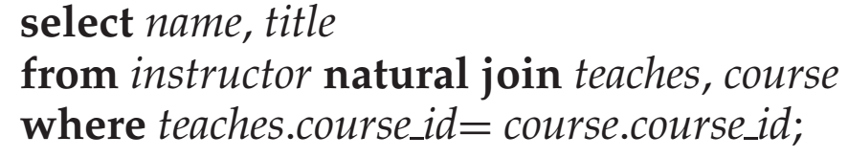
join … using(…)
natural join of instructor and teaches
(ID, name, dept_name, salary, course_id, sec_id)
course
(course_id, title, dept_name, credits)
结果不等
结果相等
Notes:
This query would then omit all (instructor name, course title) pairs where the instructor teaches a course in a department other than the instructor’s own department. The previous query, on the other hand, correctly outputs such pairs.
=where teaches.course_id=course.course_id and dept_name = course.dept_name;
结果不等是因为结果属性有重复（指定course_id，那么重复的就是dept_name）

Slide 27
概要
3.1 SQL查询语言概览
3.2 SQL数据定义
3.3 SQL查询的基本结构
3.4 附加的基本运算
3.5 集合运算
3.6 空值
3.7 聚集函数
3.8 嵌套子查询
3.9 数据库中的修改

Slide 28
附加基本运算
重命名操作（Rename Operation）
SQL允许使用as语句重命名关系及其属性： old_name as new_name
查找教师的名称及其所讲授的课程id
select name as instructor_name, course_id
from instructor, teaches
where instructor.id=teaches.id
Notes:
This naming convention requires that the relations that are present in the from clause have distinct names. This requirement causes problems in some cases, such as when information from two different tuples in the same relation needs to be combined. In Section 3.4.1, we see how to avoid these problems by using the rename operation.

Slide 29
关系重命名
查找教师的名称及其所讲授的课程id
select T.name, S.course_id from instructor as T, teaches as S where T.ID= S.ID
找出工资至少比Biology系某一位教师工资高的教师的姓名
select distinct T.name from instructor as T, instructor as S where T.salary > S.salary and S.dept_name = ‘Biology’

Slide 30
字符串操作（String Operations）
SQL includes a string-matching operator for comparisons on character strings
percent (%): The % character matches any substring
underscore (_): The _ character matches any character
like/not like: 找出所有在建筑名称中包含字符串“Watson”的所有系名
select dept_name from department where building like ‘%Watson%’
Match the name “Watson%”要匹配的字符中有百分号的情况，需要转义
like ‘Main\%’
“*” denote “all attributes” : select instructor.*
SQL supports a variety of string operations such as
concatenation（串联） (using “||”)
converting from upper to lower case (and vice versa)
finding string length, extracting substrings, etc.
Notes:
SQL specifies strings by enclosing them in single quotes, for example, ’Computer’. A single quote character that is part of a string can be specified by using two single quote characters; for example, the string “It’s right” can be specified by “It”s right”. 这里’因为需要，两边就用双引号。

Slide 31
元组排序
按字母顺序列出在Computer Science系的所有教师
select name from instructor where dept_name = ‘Computer Science’ order by name
We may specify desc for descending order (降序) or asc for ascending order (升序，默认设置) for each attribute
select *
from instructor
order by salary desc, name asc

Slide 32
Where语句谓词
SQL includes a between\not between comparison operator
E.g., find the names of all instructors with salary between $90,000 and $100,000
select name from instructor where salary between 90000 and 100000
Tuple comparison
select name, course_id from instructor, teaches where (instructor.ID, dept_name) = (teaches.ID, ’Biology’);
select name, course_id
from instructor, teaches
where instructor.ID=teaches.ID and dept_name=‘Biology’
等价

Slide 33
概要
3.1 SQL查询语言概览
3.2 SQL数据定义
3.3 SQL查询的基本结构
3.4 附加的基本运算
3.5 集合运算
3.6 空值
3.7 聚集函数
3.8 嵌套子查询
3.9 数据库中的修改

Slide 34
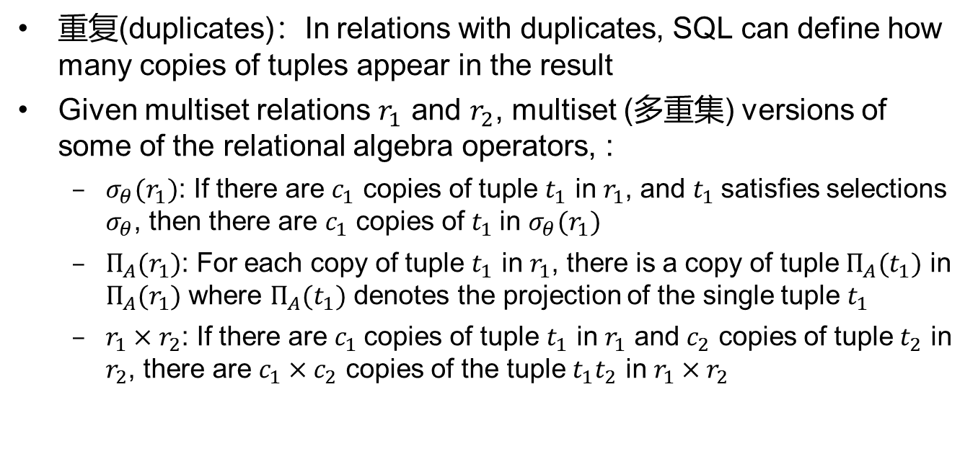
集合操作（Set Operation）
重复(duplicates)：In relations with duplicates, SQL can define how many copies of tuples appear in the result
Given multiset relations $r_{1}$ and $r_{2}$, multiset (多重集) versions of some of the relational algebra operators, :
$σ_{θ}(r_{1})$: If there are $c_{1}$ copies of tuple $t_{1}$ in $r_{1}$, and $t_{1}$satisfies selections $σ_{θ}$, then there are $c_{1}$ copies of $t_{1}$in $σ_{θ}(r_{1})$
$Π_{A}(r_{1})$: For each copy of tuple $t_{1}$ in $r_{1}$, there is a copy of tuple $Π_{A}(t_{1})$ in $Π_{A}(r_{1})$ where $Π_{A}(t_{1})$ denotes the projection of the single tuple $t_{1}$
$r_{1}×r_{2}$: If there are $c_{1}$copies of tuple $t_{1}$ in $r_{1}$ and $c_{2}$ copies of tuple $t_{2}$ in $r_{2}$, there are $c_{1}×c_{2}$ copies of the tuple $t_{1}t_{2}$ in $r_{1}×r_{2}$

Slide 35
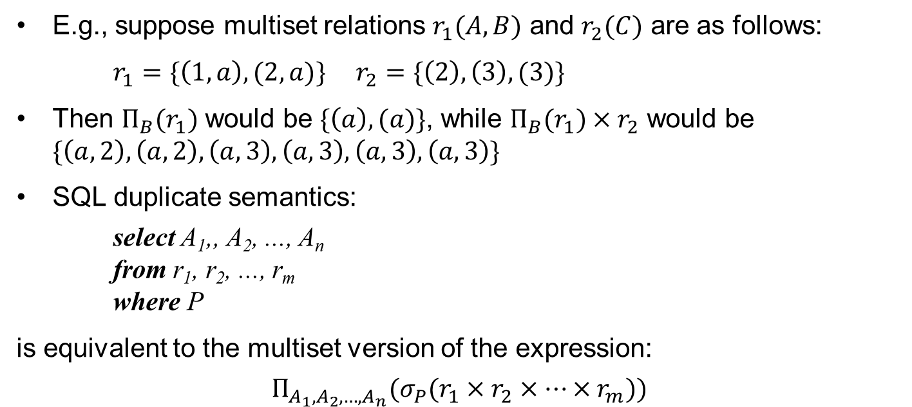
集合操作 (续)
E.g., suppose multiset relations $r_{1}(A,B)$ and $r_{2}(C)$ are as follows:
$r_{1}=\{\left(1,a\right),(2,a)\}$ $r_{2}=\{\left(2\right),\left(3\right),(3)\}$
Then $Π_{B}(r_{1})$ would be $\{\left(a\right),(a)\}$, while $Π_{B}(r_{1})×r_{2}$ would be $\{\left(a,2\right),\left(a,2\right),\left(a,3\right),\left(a,3\right),\left(a,3\right),\left(a,3\right)\}$
SQL duplicate semantics:
select A₁,, A₂, ..., A_{n} from r₁, r₂, ..., r_{m} where P
is equivalent to the multiset version of the expression:
$$Π_{A_{1},A_{2},…,A_{n}}(σ_{P}(r_{1}×r_{2}×…×r_{m}))$$

Slide 36
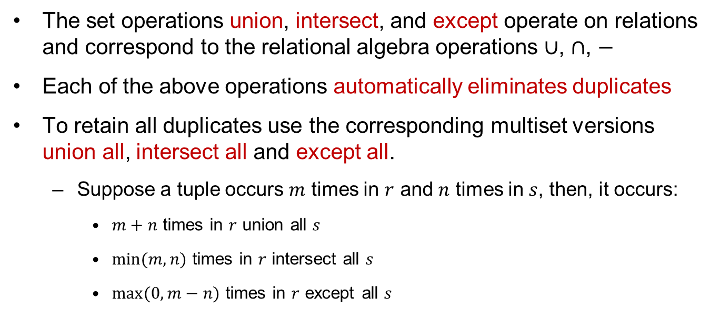
集合操作（续）
The set operations union, intersect, and except operate on relations and correspond to the relational algebra operations $∪$, $∩$, $−$
Each of the above operations automatically eliminates duplicates
To retain all duplicates use the corresponding multiset versions union all, intersect all and except all.
Suppose a tuple occurs $m$ times in $r$ and $n$ times in $s$, then, it occurs:
$m+n$ times in $r$ union all $s$
$\min{(m,n)}$ times in $r$ intersect all $s$
$max⁡(0, m−n)$ times in $r$ except all $s$

Slide 37
集合操作（续）
Find all customers who have a loan, an account, or both:
(select customer_name from depositor) union [all] (select customer_name from borrower)
Find all customers who have both a loan and an account.
(select customer_name from depositor) intersect [all] (select customer_name from borrower)
Find all customers who have an account but no loan.
(select customer_name from depositor) except [all] (select customer_name from borrower)

Slide 38
概要
3.1 SQL查询语言概览
3.2 SQL数据定义
3.3 SQL查询的基本结构
3.4 附加的基本运算
3.5 集合运算
3.6 空值
3.7 聚集函数
3.8 嵌套子查询
3.9 数据库中的修改

Slide 39
空值（Null Value）
It is possible for tuples to have a null value which signifies an unknown value or that a value does not exist
The predicate is null can be used to check for null values
select name from instructor where salary is null
The result of any arithmetic expression involving null is null
E.g., 5 + null returns null
Aggregate functions simply ignore null values
Notes:
{(’A’,null),(’A’,null)}, are treated as being identical, even if some of the attributes have a null value. a comparison “null=null” would return unknown,rather than true.

Slide 40
空值与三值逻辑
Any comparison with null returns unknown
E.g., 5 < null or null <> null or null = null
Three-valued logic using the truth value unknown:
OR: (unknown or true) = true, (unknown or false) = unknown (unknown or unknown) = unknown
AND: (true and unknown) = unknown, (false and unknown) = false, (unknown and unknown) = unknown
NOT: (not unknown) = unknown
“P is unknown” evaluates to true if predicate P evaluates to unknown
Result of where clause predicate is treated as false if it evaluates to unknown

Slide 41
空值与聚集
Calculate the sum of all loan amounts
select sum (amount) from loan
Above statement ignores null amounts
Result is null if there is no non-null amount
All aggregate operations except count(*) ignore tuples with null values on the aggregated attributes
Notes:
As a result of null values being ignored, the collection of values may be empty. The count of an empty collection is defined to be 0, and all other aggregate operations return a value of null when applied on an empty collection

Slide 42
概要
3.1 SQL查询语言概览
3.2 SQL数据定义
3.3 SQL查询的基本结构
3.4 附加的基本运算
3.5 集合运算
3.6 空值
3.7 聚集函数
3.8 嵌套子查询
3.9 数据库中的修改

Slide 43
聚集函数（Aggregate Functions）
聚集函数以集合作为输入，返回单个值
avg：平均值
min：最小值
max：最大值
sum：总和
count：计数
Notes:
The input to sum and avg must be a collection of numbers, but the other operators can operate on collections of nonnumeric data types, such as strings, as well.

Slide 44
聚集函数（续）
找出Computer Science系的平均工资
select avg (salary) from instructor where dept_name = ‘Computer Science’
找出在2021年有上课的教师总数
select count (distinct ID) from teaches
where year=2021

Slide 45
分组聚集：Group By
找出每个系的平均工资
select dept_name, avg(salary) as avg_salary from instructor group by dept_name
注意：出现在select子句且不在聚集函数中的属性必须出现在group by子句中
/*错误查询*/
select dept_name, ID, avg(salary)
from instructor
group by dept_name
Notes:
There are circumstances where we would like to apply the aggregate function not only to a single set of tuples, but also to a group of sets of tuples; we specify this wish in SQL using the group by clause. The attribute or attributes given in the group by clause are used to form groups. Tuples with the same value on all attributes in the group by clause are placed in one group.
When an SQL query uses grouping, it is important to ensure that the only attributes that appear in the select statement without being aggregated are those that are present in the group by clause. In other words, any attribute that is not present in the group by clause must appear only inside an aggregate function if it appears in the select clause, otherwise the query is treated as erroneous. Each instructor in a particular group (defined by dept name) can have a different ID, and since only one tuple is output for each group, there is no unique way of choosing which ID value to output. As a result, such cases are disallowed by SQL.

Slide 46
聚集函数：Having子句
At times, it is useful to state a condition that applies to groups rather than to tuples.
例如：find the names of all branches where the average account balance is more than $1,200.
select branch_name, avg (balance) from account group by branch_name having avg (balance) > 1200
注意
predicates in the having clause are applied after the information of groups
predicates in the where clause are applied before forming groups

Slide 47
聚集函数：Having子句（续）
E.g., find the average balance for each customer who lives in Harrison and has at least three accounts
select depositor.customer_name, avg (balance) from depositor, account, customer where depositor.account_number=account.account_number and
depositer.customer_name=customer.customer_name and
customer_city=‘Harrison’
group by depositor.customer_name having count(distinct depositor.account_number) >=3
Notes:
1. As was the case for queries without aggregation, the from clause is first evaluated to get a relation. 2. If a where clause is present, the predicate in the where clause is applied on the result relation of the from clause. 3. Tuples satisfying the where predicate are then placed into groups by the group by clause if it is present. If the group by clause is absent, the entire set of tuples satisfying the where predicate is treated as being in one group. 4. The having clause, if it is present, is applied to each group; the groups that do not satisfy the having clause predicate are removed. 5. The select clause uses the remaining groups to generate tuples of the result of the query, applying the aggregate functions to get a single result tuple for each group

Slide 48
概要
3.1 SQL查询语言概览
3.2 SQL数据定义
3.3 SQL查询的基本结构
3.4 附加的基本运算
3.5 集合运算
3.6 空值
3.7 聚集函数
3.8 嵌套子查询
3.9 数据库中的修改

Slide 49
嵌套子查询（Nested Subqueries）
SQL provides a mechanism for the nesting of subqueries
A subquery is a select-from-where expression that is nested within another query in the from clause
A common use of subqueries is to perform tests for set membership, make set comparisons
Notes:
Cardinality：基数

Slide 50
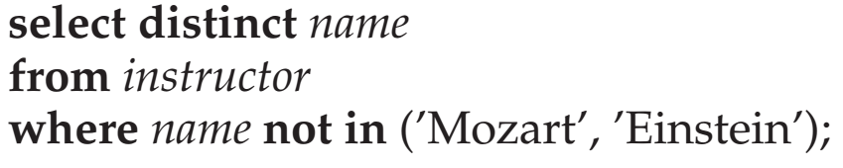
嵌套子查询：Set Membership
Find all customers who have both an account and a loan at the bank
select distinct customer_name from borrower where customer_name in (select customer_name
from depositor)
Find all customers who have a loan at the bank but do not have an account at the bank
select distinct customer_name from borrower where customer_name not in (select customer_name from depositor)

Slide 51
嵌套子查询： Set Membership（续）
Find all customers who have both an account and a loan at the Perryridge branch
select distinct customer_name from borrower, loan where borrower.loan_number=loan.loan_number and branch_name=“Perryridge” and (branch_name, customer_name) in (select branch_name, customer_name from depositor, account where depositor.account_number =account.account_number)

Slide 52
嵌套子查询：Set Comparison
Find all branches that have greater assets than some branch located in Brooklyn
select distinct T.branch_name from branch as T, branch as S where T.assets > S.assets and S.branch_city = ‘Brooklyn’
Same query using >some clause
select branch_name from branch where assets > some (select assets from branch where branch_city = ‘Brooklyn’)

Slide 53

Some子句的定义
$F<comp>some r⇔∃ t∈r$ such that ($F<comp>t$), where <comp> can be: $<,≤,>,≥,=,≠$
0
(5< some
5
) = true
(read: 5 < some tuple in the relation)
6
(5< some
0
) = false
5
(= some) ≡ in
However,
(≠ some) ≡ not in
0
(5 = some
) = true
5
0
(5 ≠ some
) = true (since 0 ≠ 5)
5

Slide 54

All子句的定义
$F<comp>all r ⇔∀t ∈r (F<comp>t)$
0
(5< all
) = false
5
6
6
(5< all
) = true
(≠ all) ≡ not in
However, (= all) ≡ in
10
4
(5 = all
5
) = false
(5 ≠ all
) = true (since 5 ≠ 4 and 5 ≠ 6)
4
6

Slide 55
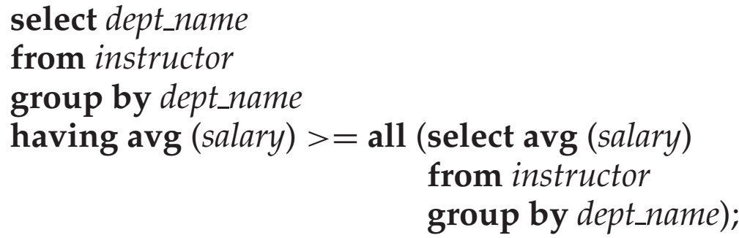
查询举例
Find the names of all branches that have greater assets than all branches located in Brooklyn.
select branch_name from branch where assets > all (select assets from branch where branch_city = ‘Brooklyn’)
找出平均工资最高的系

Slide 56
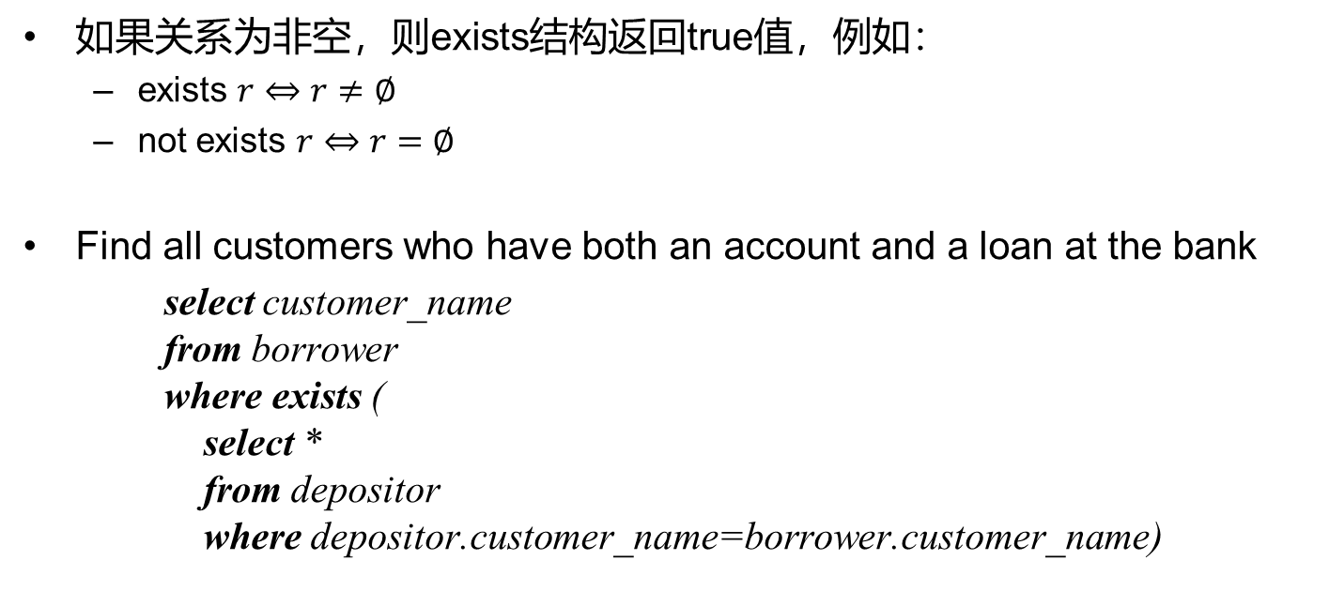
空关系测试
如果关系为非空，则exists结构返回true值，例如：
exists $r⇔r≠∅$
not exists $r⇔r=∅$
Find all customers who have both an account and a loan at the bank
select customer_name from borrower where exists ( select * from depositor where depositor.customer_name=borrower.customer_name)

Slide 57
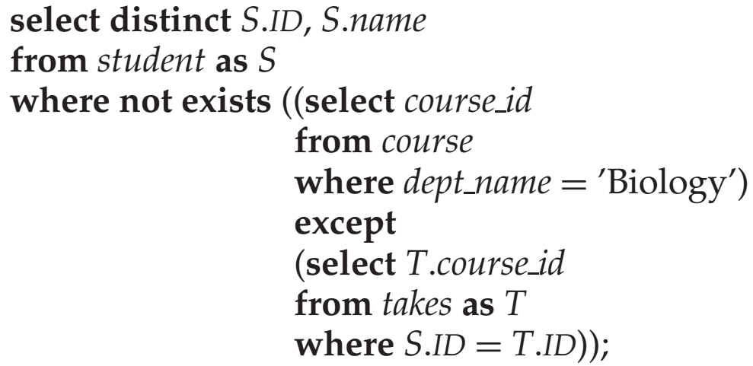
查询举例
We can write “relation A contains relation B” as “not exists (B except A)”
例如：find all students who have taken all the courses offered by the department of Biology

Slide 58
查询举例（续）
Find all customers who have accounts at all branches located in Brooklyn
select distinct S.customer_name from depositor as S where not exists ( (select branch_name /* all branches in Brooklyn */ from branch where branch_city = ‘Brooklyn’) except (select R.branch_name /* finds all the branches at which customer S.customer_name has an account */
from depositor as T, account as R where T.account_number = R.account_number and S.customer_name = T.customer_name))
Notes:
Note: Cannot write this query using = all and its variants
因为=all的左边是一条记录，而这里是两个集合？

Slide 59
重复元组存在性测试
SQL提供一个布尔函数，用于测试在一个子查询的结果中是否存在重复元组
如果作为参数的子查询结果中没有重复的元组，unique结构将返回true值
例如：find all customers who have at most one account at the Perryridge branch
select T.customer_name
from depositor as T
where unique (
select R.customer_name from account, depositor as R where T.customer_name = R.customer_name and R.account_number = account.account_number and account.branch_name = ‘Perryridge’)

Slide 60
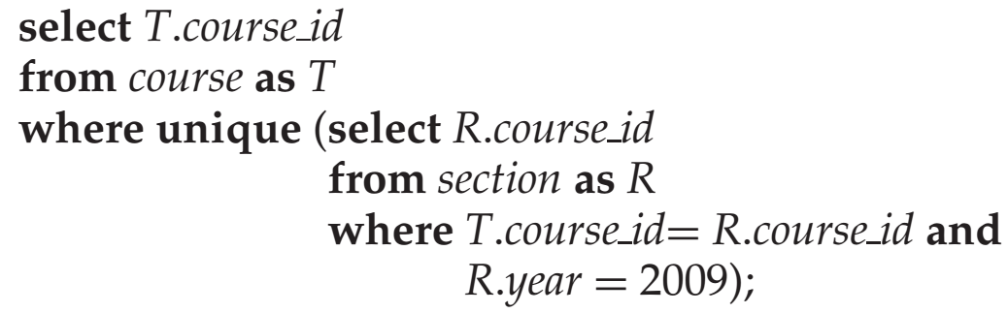
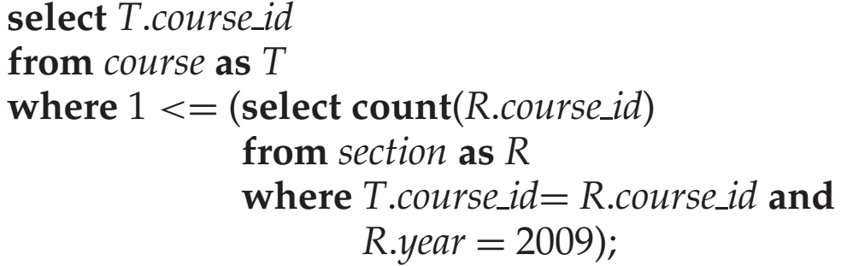
查询举例
例：找出所有在2009年最多开设一次的课程
等价
1>=
Notes:
Note that if a course is not offered in 2009, the subquery would return an empty result, and the unique predicate would evaluate to true on the empty set. 小于号应该改为大于号

Slide 61
视图（Views）
In some cases, it is not desirable for all users to see the entire logical model
Consider a person who needs to know a customer’s name, loan number and branch name, but has no need to see the loan amount. This person should see a relation described by
(select customer_name, borrower.loan_number, branch_name from borrower, loan where borrower.loan_number = loan.loan_number )
A view provides a mechanism to hide certain data from the view of certain users
Notes:
Any relation that is not of the conceptual model?不是存储的概念模型的表，而是把SQL查询语句存储下来的虚拟的表

Slide 62
视图定义
A view is defined using the create view statement which has the form
create view v as < query expression >
where <query expression> is any legal SQL expression and the view name is represented by v
The view name can be used to refer to the virtual relation
When a view is created, the query expression is stored in the database and the expression is substituted into queries using the view

Slide 63
查询举例
A view consisting of branches and their customers
create view all_customer as (select branch_name, customer_name from depositor, account where depositor.account_number = account.account_number)
union (select branch_name, customer_name from borrower, loan where borrower.loan_number = loan.loan_number)
Find all customers of the Perryridge branch
select customer_name from all_customer where branch_name = ‘Perryridge’

Slide 64
From子句中的子查询
Derived Relations
Find the average account balance of those branches where the average account balance is greater than $1200.
注意：We do not need to use the having clause, since we compute the temporary (view) relation result in the from clause, and the attributes of result can be used directly in the where clause
select branch_name, avg (balance) from account group by branch_name having avg (balance) > 1200
select branch_name, avg_balance from (select branch_name, avg (balance) as avg_balance from account group by branch_name) where avg_balance > 1200

Slide 65
查询举例
Find the maximum total balance across all branches
select max(tot_balance) from (select branch_name, sum (balance) from account group by branch_name) as branch_total (branch_name, tot_balance))

Slide 66
with子句
with clause allows views to be defined locally to a query, rather than globally
Find all accounts with the maximum balance
with max_balance(value) as select max(balance) from account
select account_number from account, max_balance where account.balance = max_balance.value

Slide 67
查询举例
Find all branches where the total account deposit is greater than the average of the total account deposits at all branches
with branch_total (branch_name, value) as select branch_name, sum (balance) from account group by branch_name
with branch_total_avg (value) as select avg (value) from branch_total
select branch_name from branch_total, branch_total_avg where branch_total.value >= branch_total_avg.value
Notes:
However, using nested subqueries would have made the query harder to read and understand. The with clause makes the query logic clearer; it also permits a view definition to be used in multiple places within a query

Slide 68
标量子查询（Scalar Subquery）
Scalar subquery is used where a single value is expected
E.g., list all departments along with the number of instructors in each department
select dept_name, (select count(*) from instructor where department.dept_name = instructor.dept_name) as num_instructors from department;
Runtime error if subquery returns more than one tuple

Slide 69
概要
3.1 SQL查询语言概览
3.2 SQL数据定义
3.3 SQL查询的基本结构
3.4 附加的基本运算
3.5 集合运算
3.6 空值
3.7 聚集函数
3.8 嵌套子查询
3.9 数据库中的修改

Slide 70
数据库的修改：删除（Deletion）
Delete all account records at the Perryridge branch
delete from account where branch_name = ‘Perryridge’
Delete all accounts at every branch located in Needham city
delete from account where branch_name in (select branch_name from branch where branch_city = ‘Needham’)
delete from depositor where account_number in (select account_number from branch, account where branch_city = ‘Needham’ and branch.branch_name = account.branch_name)

Slide 71
删除举例
Delete the records of all accounts with balances below the average at the bank
delete from account where balance < (select avg(balance) from account)
Problem: as we delete tuples from account, the average balance changes
Solution used in SQL:
First, compute avg balance and find all tuples to delete
Next, delete all tuples found above (without recomputing avg or retesting the tuples)
Notes:
Performing all the tests before performing any deletion is important—if some tuples are deleted before other tuples have been tested, the average salary may change, and the final result of the delete would depend on the order in which the tuples were processed!

Slide 72
数据库的修改：插入（Insertion）
Add a new tuple to account
insert into account values (‘A-9732’, ‘Perryridge’,1200)
or equivalently
insert into account (branch_name, balance, account_number) values (‘Perryridge’, 1200, ‘A-9732’)
Add a new tuple to account with balance set to null
insert into account values (‘A-777’,‘Perryridge’, null)

Slide 73
插入举例
Provide as a gift for all loan customers of the Perryridge branch, a $200 savings account. Let the loan number serve as the account number for the new savings account
insert into account select loan_number, branch_name, 200 from loan where branch_name = ‘Perryridge’
insert into depositor select customer_name, loan_number from loan, borrower where loan.loan_number = borrower.loan_number
and branch_name = ‘Perryridge’
Notes:
might insert an infinite number of tuples, if the primary key constraint on student were absent. Without the primary key constraint, the request would insert the first tuple in student again, creating a second copy of the tuple. Since this second copy is part of student now, the select statement may find it, and a third copy would be inserted into student. The select statement may then find this third copy and insert a fourth copy, and so on, forever. Evaluating the select statement completely before performing insertions avoids such problems.

Slide 74
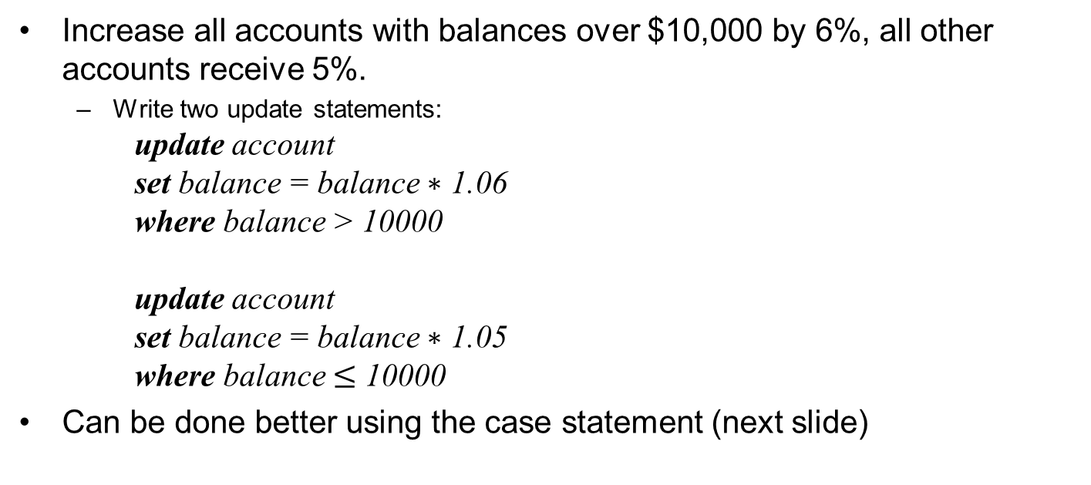
数据库的修改：更新（Updates）
Increase all accounts with balances over $10,000 by 6%, all other accounts receive 5%.
Write two update statements:
update account set balance = balance $∗$ 1.06 where balance > 10000
update account set balance = balance $∗$ 1.05 where balance $≤$ 10000
Can be done better using the case statement (next slide)

Slide 75
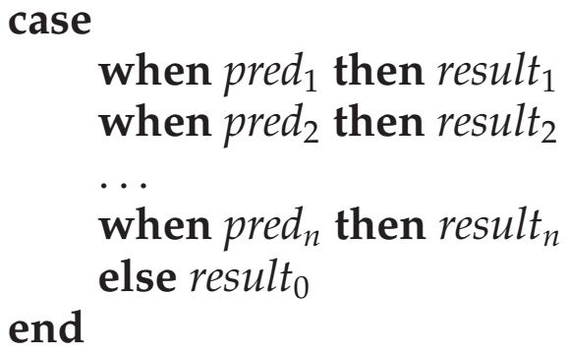
Case结构
The same query as before: Increase all accounts with balances over $10,000 by 6%, all other accounts receive 5%.
update account set balance =
case when balance <= 10000 then balance *1.05 else balance * 1.06 end

Slide 76
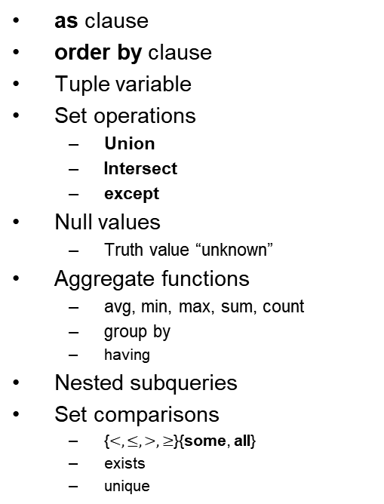
Review Terms
Data definition language
Data manipulation language
Database schema
Database instance
Relation schema
Relation instance
Primary key
Foreign key
Referencing relation
Referenced relation
Null value
Query language
SQL query structure
select clause
from clause
where clause
Natural join operation
as clause
order by clause
Tuple variable
Set operations
Union
Intersect
except
Null values
Truth value “unknown”
Aggregate functions
avg, min, max, sum, count
group by
having
Nested subqueries
Set comparisons
{$<,≤,>,≥$}{some, all}
exists
unique
with clause
Scalar subquery
Database modification
Deletion
Insertion
Updating

Slide 77
课后作业
阅读
《数据库系统概念》第3章
习题
3.8, 3.9, 3.15
10月13日之前发到邮箱pfeilee@163.com (助教：李鹏飞)
学号-姓名-大数据管理系统作业2

