Slide 1

关系数据库设计与E-R模型
（《数据库系统概念》第7章）
李文根
Email: lwengen@tongji.edu.cn
计算机科学与技术系
同济大学

Slide 2
概要
设计过程概览
实体联系模型（Entity-Relationship model）
约束（Constraints）
实体联系图（Entity-Relationship diagram）
关系模式转换

Slide 3
开发数据库应用包含的任务
用户需求
设计数据库模式
设计访问和更新数据的程序
设计控制数据访问的安全模式
关系（表）
关系的属性
约束

Slide 4
数据抽象
Real Word
Abstraction
Real world Conceptual model
Database Designers
Information world
Conceptual model
Conceptual model Logical model
Database Designers
Data model supported
by DBMS
Machine World
Logical model Physical model
DBMS

Slide 5
数据库设计
Conceptual design(概念设计)
Map a real world organization to a conceptual model
Logical design(逻辑设计)
Transform the conceptual model to a logical model
Physical design(物理设计)
Instantiate the logical model to physical organization and storage
Notes:
Instantiating：实例化

Slide 6
数据库设计基本流程
Understand the real-world domain being modeled
Specify it using a database design model
Design models are especially convenient for schema design, but are not necessarily implemented by DBMS
Entity-Relationship (E-R) model
Object Definition Language (ODL)
Translate specification to the data model of DBMS
Relational, XML, object-oriented, etc.
Create the DBMS schema

Slide 7
概要
设计过程概览
实体联系模型（Entity-Relationship model）
约束（Constraints）
实体联系图（Entity-Relationship diagram）
关系模式转换

Slide 8
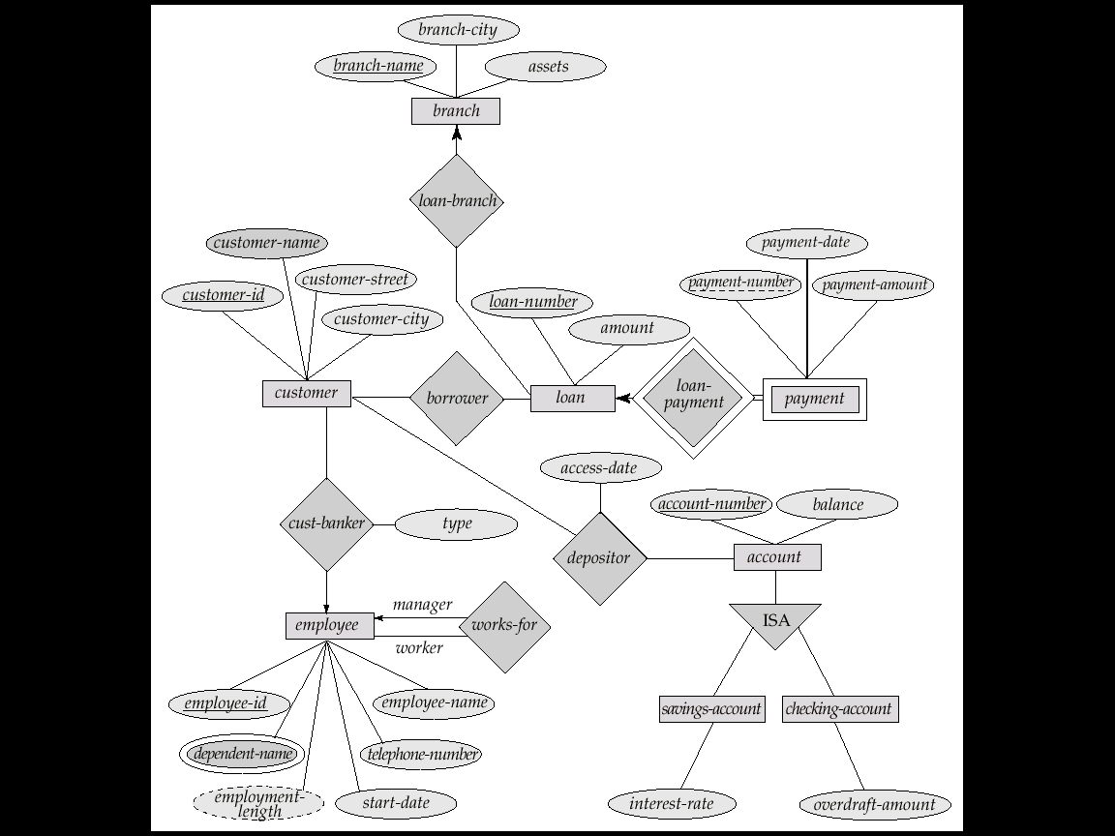
银行企业E-R图

Slide 9
大学E-R图

Slide 10
数据库概念设计
概念设计(主要使用E-R模型)
What are the entities and relationships?
What information about these entities and relationships should be stored in the database?
What are the integrity constraints or business rules?
Notes:
Pictorially：绘画般地

Slide 11
E-R模型
面向对象设计模型的弱化版本
Historically very popular
E-R diagrams represent designs
Primarily a design model, not implemented by any major DBMSs
三个主要组成部分
实体集（Entity set）
属性（Attributes）
联系集（Relationship set）
Notes:
“watered-down”：淡化了的

Slide 12

Peter Pin-Shan Chen（陈品山）
Dr. Peter P. Chen is the originator of the Entity-Relationship Model (E-R Model), and the founder of ER international conference
The E-R Model serves as the foundation of many systems analysis and design methodologies, computer-aided software engineering (CASE) tools, and repository systems
Peter Chen, The Entity-Relationship Model--Toward a Unified View of Data ACM Transactions on Database Systems, Vol. 1, No. 1, March 1976, Pages 9 - 36

Slide 13
实体集（Entity Set）
A database can be modeled as
a collection of entities
relationship among entities
An entity is an object that exists and is distinguishable from other objects
E.g., specific person, company, event, university
Entities have attributes
E.g., people have names and addresses
An entity set is a set of entities of the same type that share the same properties
E.g., the set of all persons, companies, trees, holidays
Notes:
An entity set（一个实体或关系） is a set of entities of the same type that share the same properties, or attributes. The set of all people who are instructors at a given university, for example, can be defined as the entity set instructor. Similarly, the entity set student might represent the set of all students in the university.
extension of the entity set to refer to the actual collection of entities belonging to the entity set. Thus, the set of actual instructors in the university forms the extension of the entity set instructor. The above distinction is similar to the difference between a relation and a relation instance

Slide 14
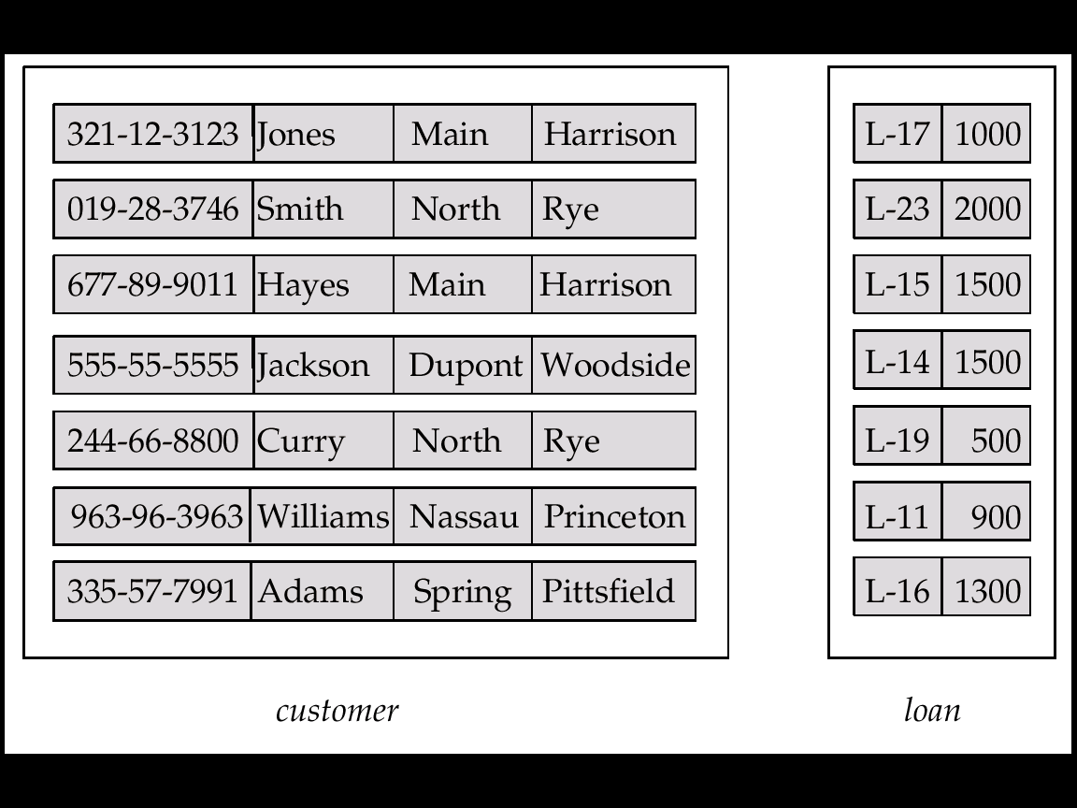
实体集customer和loan
Customer_ customer_ customer_ customer_ loan_ amount id name street city number

Slide 15
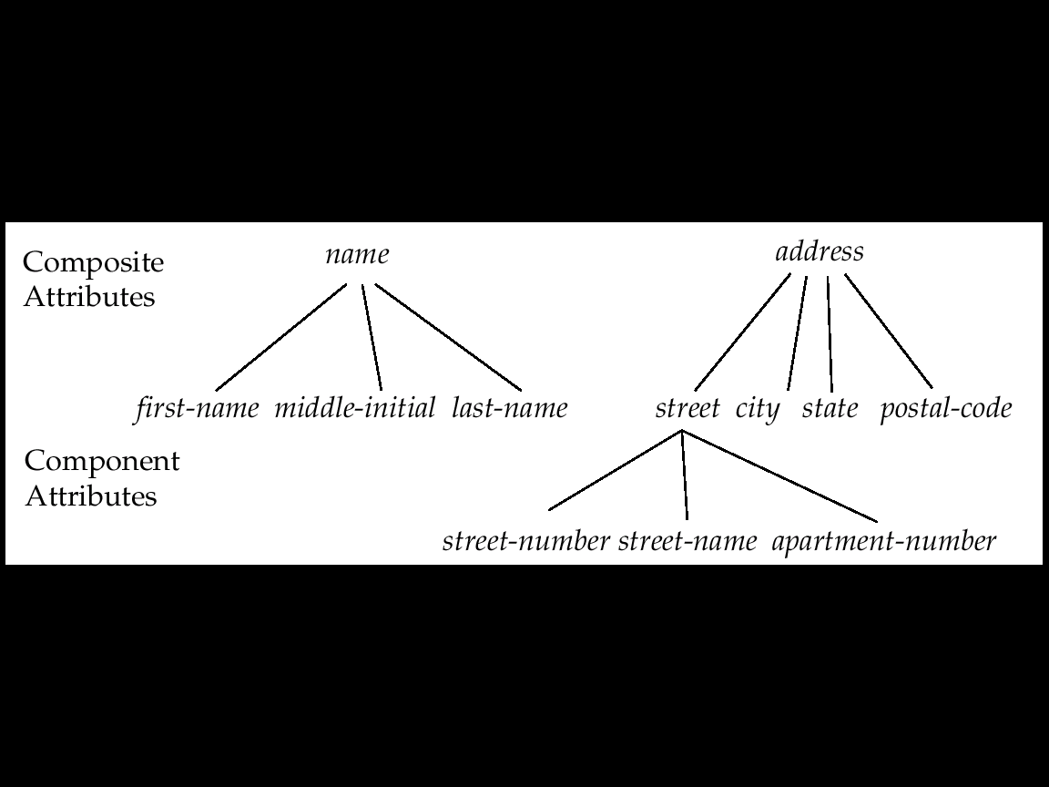
属性（Attributes）
An entity is represented by a set of attributes, i.e., descriptive properties possessed by all members of an entity set
例如：
customer = (customer_id, customer_name, customer_street, customer_city) loan = (loan_number, amount)
Domain (域)
The set of permitted values for each attribute
Attribute types（属性类型）
Simple and composite attributes (复合属性)
Single-valued and multi-valued attributes
Derived attributes
Notes:
a composite attribute may appear as a hierarchy . upper and lower bounds may be placed on the number of values in a multivalued attribute. For example, a university may limit the number of phone numbers recorded for a single instructor to two.
The value of a derived attribute is not stored but is computed when required.

Slide 16
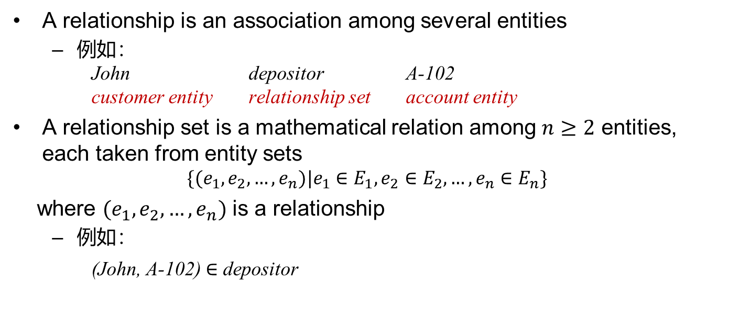
联系集（Relationship Set）
A relationship is an association among several entities
例如： John depositor A-102 customer entity relationship set account entity
A relationship set is a mathematical relation among $n≥2$ entities, each taken from entity sets
$$\{(e_{1},e_{2},…,e_{n})|e_{1}∈E_{1},e_{2}∈E_{2},…,e_{n}∈E_{n}\}$$
where $(e_{1},e_{2},…,e_{n})$ is a relationship
例如：
(John, A-102) $∈$ depositor

Slide 17
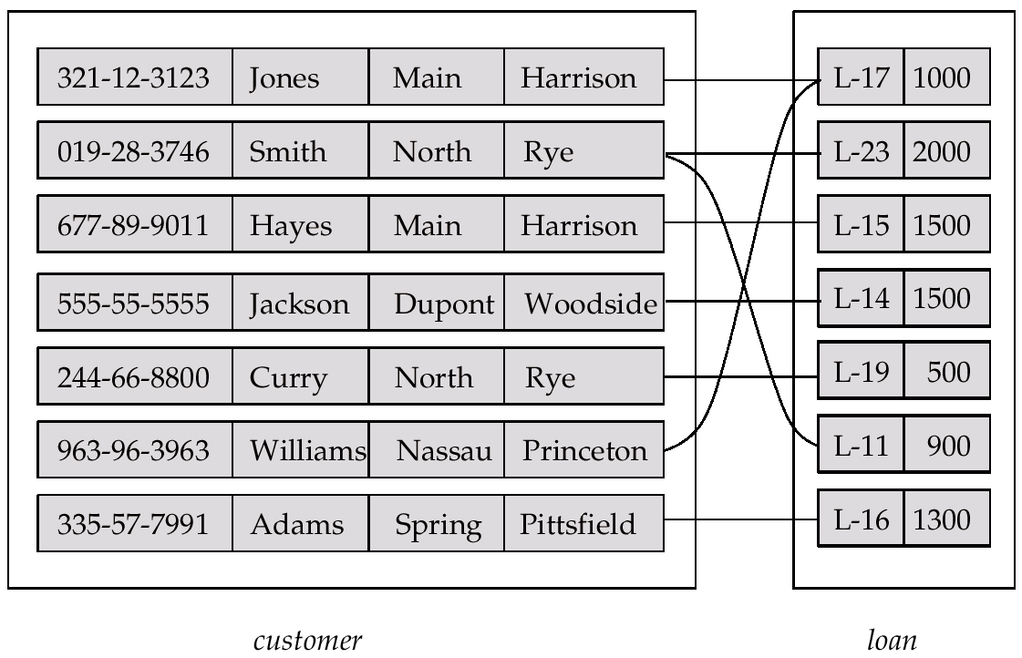
联系集borrower

Slide 18
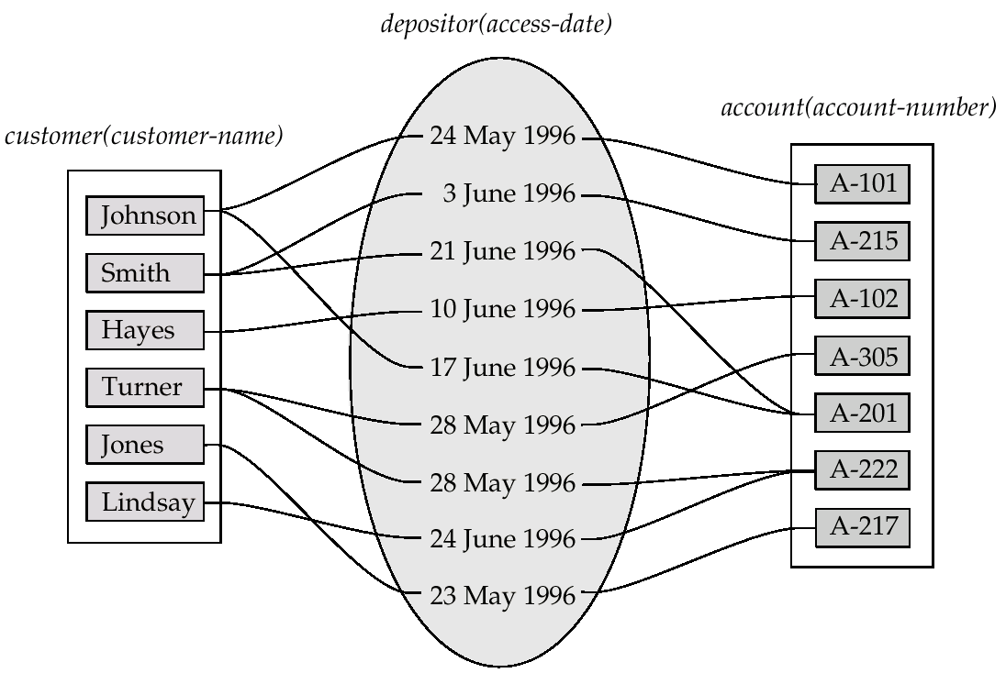
联系集（续）
Relationship set can also have attributes
E.g., the depositor relationship set between entity sets customer and account may have the attribute access-date

Slide 19
联系集的度（Degree）
The number of entity sets that participate in a relationship set
Relationship sets that involve two entity sets are binary (二元的)
Relationship sets may involve more than two entity sets
Relationships between more than two entity sets are rare, and most relationships are binary
思考
什么情况下存在三元联系集？

Slide 20
概要
设计过程概览
实体联系模型（Entity-Relationship model）
约束（Constraints）
实体联系图（Entity-Relationship diagram）
关系模式转换

Slide 21
映射基数（Mapping Cardinality）
映射基数
表示一个实体能通过联系集关联另一些实体的数量，在描述二元联系集时最有用
对于实体集A和B之间的二元联系集R，映射基数有以下情况：
One to one (一对一): An entity in A is associated with at most one entity in B, and an entity in B is associated with at most one entity in A
One to many (一对多): An entity in A is associated with any number (zero or more) of entities in B. An entity in B can be associated with at most one entity in A
Many to one (多对一): An entity in A is associated with at most one entity in B. An entity in B can be associated with any number (zero or more) of entities in A
Many to many (多对多): An entity in A is associated with any number (zero or more) of entities in B, and an entity in B is associated with any number (zero or more) of entities in A

Slide 22
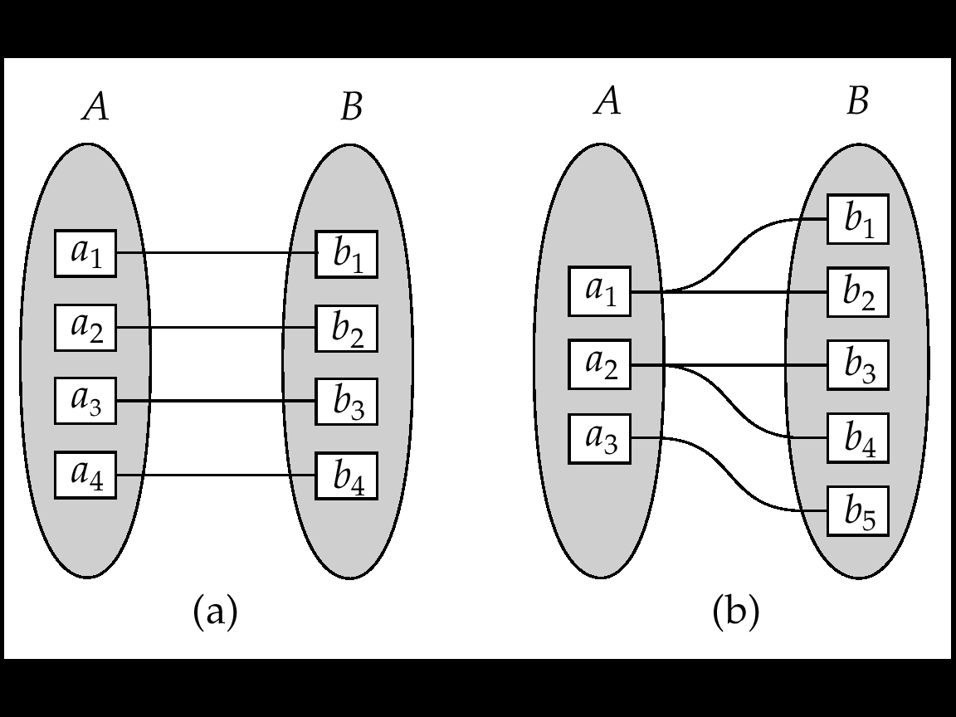
映射基数（续）
One to one
One to Many
注意: Some elements in A and B may not be mapped to any elements in the other set

Slide 23
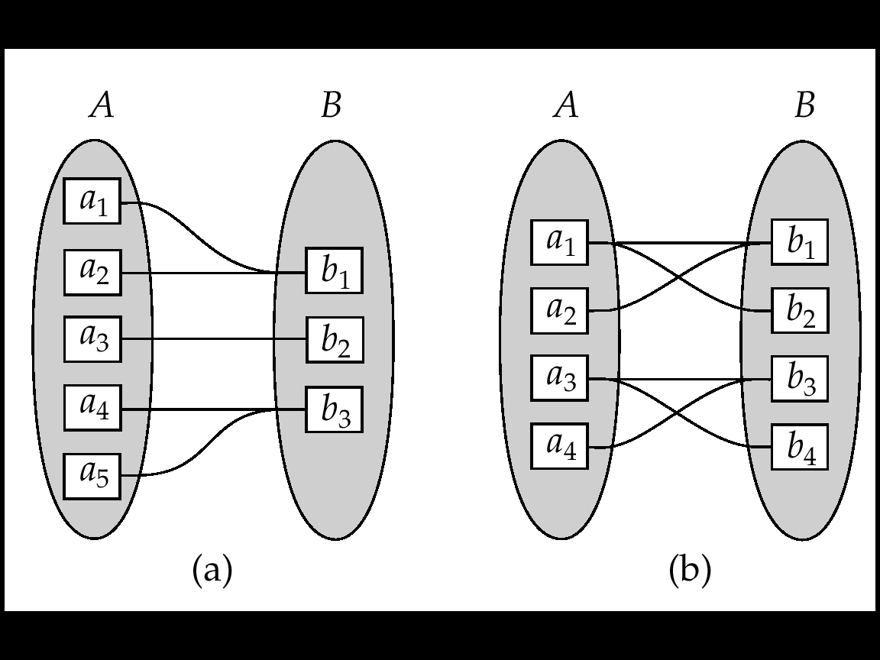
映射基数（续）
Many to one
Many to many
注意: Some elements in A and B may not be mapped to any
elements in the other set

Slide 24
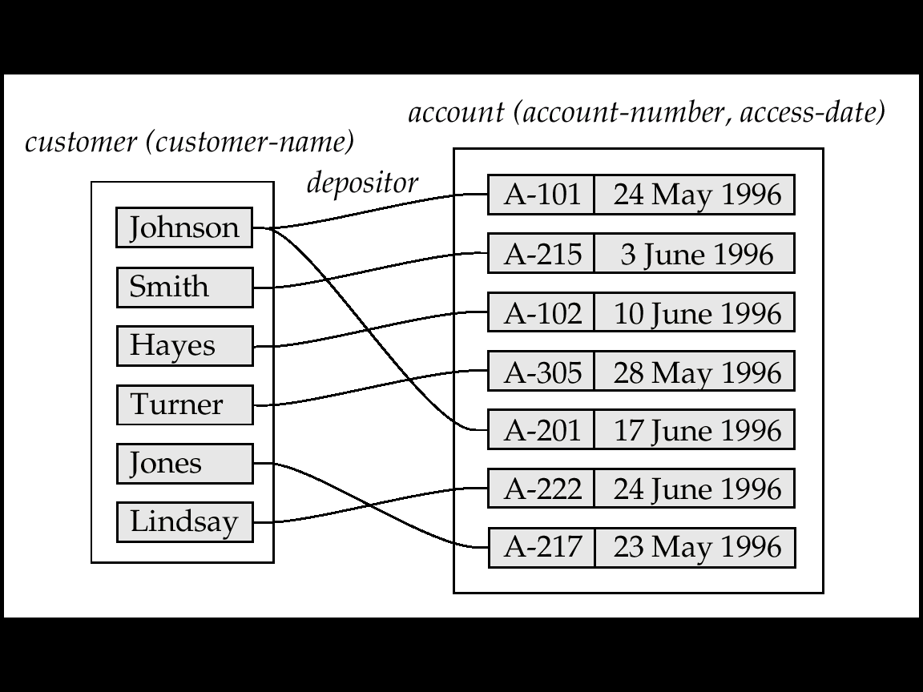
映射基数影响E-R设计
Can make access-date an attribute of account, instead of a relationship attribute, if each account can have only one customer

Slide 25
参与约束（Participation Constraints）
全部参与（total participation）：every entity in the entity set participates in at least one relationship in the relationship set
例如，每个student实体通过联系集advisor同至少一名教师相联系，student在联系集advisor中是全部参与
部分参与（partial participation）：some entities may not participate in any relationships in the relationship set
例如, 有的instructor可能不指导学生，所以instructor在联系集advisor中是部分参与

Slide 26
概要
设计过程概览
实体联系模型（Entity-Relationship model）
约束（Constraints）
实体联系图（Entity-Relationship diagram）
关系模式转换

Slide 27
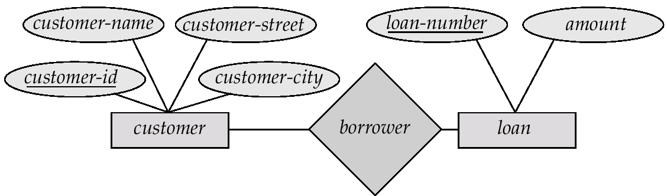
实体联系（E-R）图
Rectangles represent entity sets
Diamonds represent relationship sets
Lines link attributes to entity sets and entity sets to relationship sets
Ellipses represent attributes
Double ellipses represent multi-valued attributes
Dashed ellipses denote derived attributes
Underline indicates primary key attributes

Slide 28
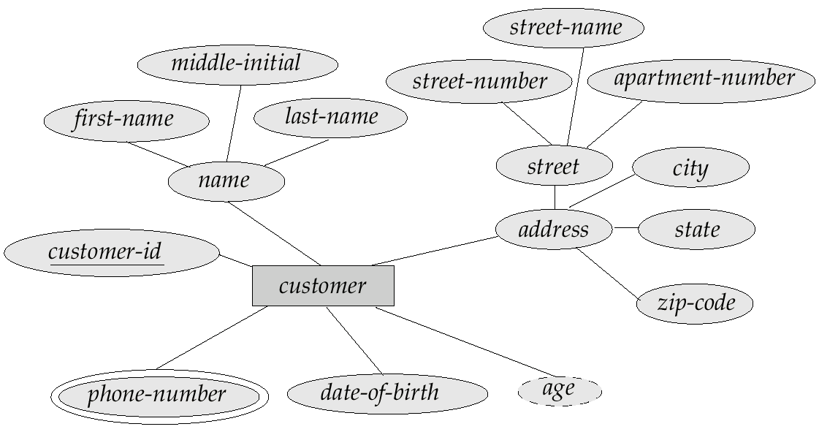
E-R图
E-R Diagram with composite, multivalued, and derived attributes
composite attribute
derived attribute
multi-valued attribute

Slide 29
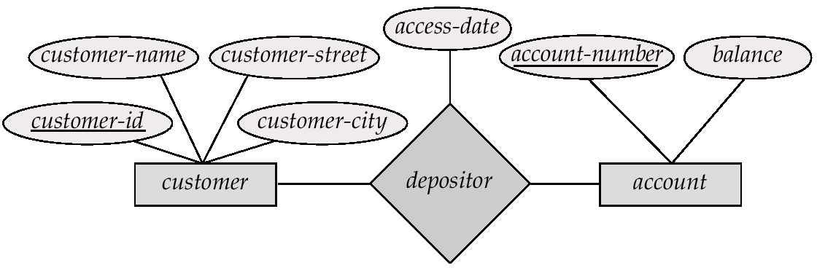
带属性的联系集

Slide 30
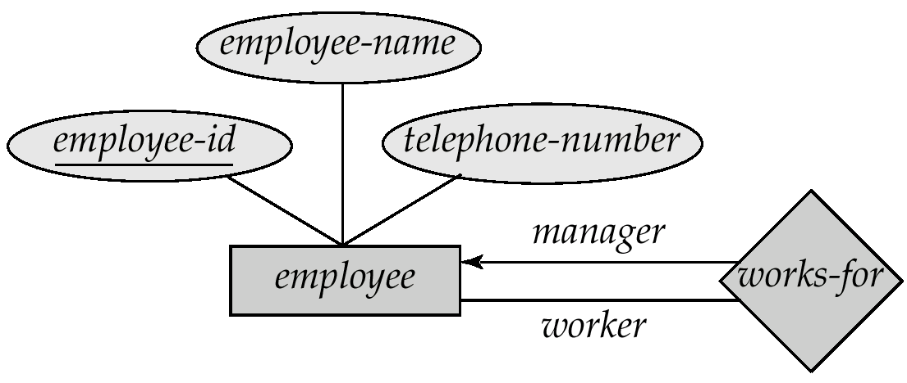
角色（Roles）
Entity sets of a relationship may be not distinct
The labels “manager” and “worker” are called roles. They specify how employee entities interact via the works-for relationship set
Role labels are optional, and are used to clarify semantics of the relationship

Slide 31
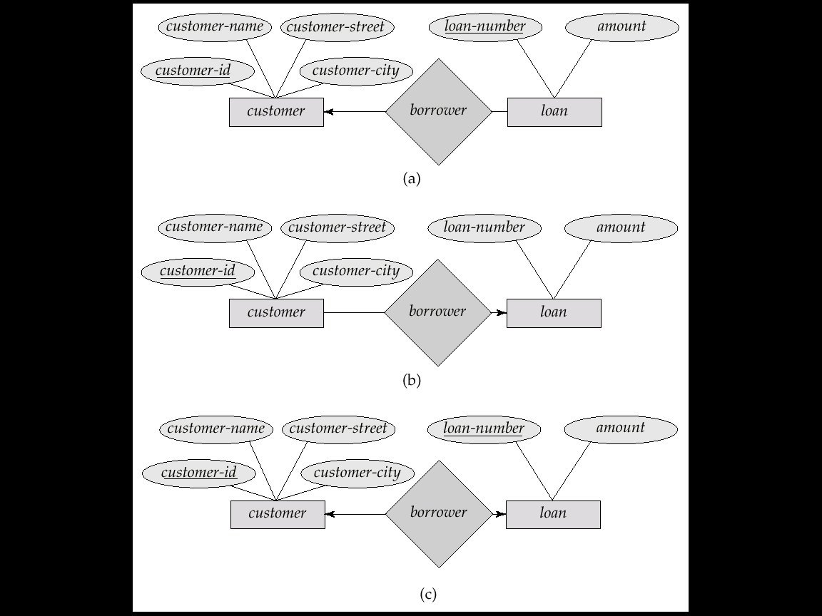
基数约束
We express cardinality constraints by drawing either a directed line (→), signifying “one,” or an undirected line (—), signifying “many,” between the relationship set and the entity set
例如，one-to-one relationship:
A customer is associated with at most one loan via the relationship borrower
A loan is associated with at most one customer via borrower

Slide 32
One-to-Many联系
One-to-many relationship
A loan is associated with at most one customer via borrower, a customer is associated with several (including 0) loans via borrower

Slide 33
Many-to-One联系
Many-to-one relationship
A loan is associated with several (including 0) customers via borrower, a customer is associated with at most one loan via borrower

Slide 34
Many-to-Many联系
Many-to-many relationship
A customer is associated with several (possibly 0) loans via borrower
A loan is associated with several (possibly 0) customers via borrower

Slide 35
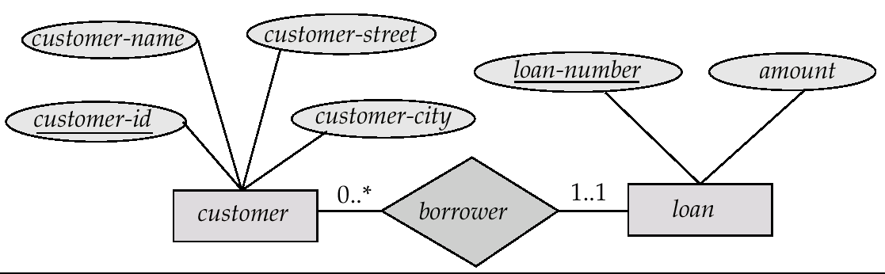

参与约束
Cardinality limits can also express participation constraints
Notation: $l$..$h$, where $l$ and $h$ are the minimum and maximum cardinalities, respectively
One to Many

Slide 36
码/键（Keys）
A super key (超码) of an entity set is one or a set of attributes whose values uniquely determine each entity
A candidate key (候选码) of an entity set is a minimal super key
customer_id is a candidate key of customer
account_number is a candidate key of account
Although several candidate keys may exist, one of the candidate keys is selected to be the primary key (主码)

Slide 37
联系集的码
参与实体集的主码组合构成联系集的一个super key
(customer_id, account_number) is the super key of depositor
当存在多个候选码时，主码选择需要考虑联系集的语义

Slide 38
实体集、属性和联系集的选择
实体集 vs. 属性
depend on the structure of the enterprise being modeled, and on the semantics associated with the attribute in question
实体集 vs. 关系集
Possible guideline is to designate a relationship set to describe an action that occurs between entities
Notes:
designate ：指定
Placement：位置

Slide 39
弱实体集（Weak Entity Sets）
An entity set that does not have a primary key is referred to as a weak entity set
The existence of a weak entity set depends on the existence of an identifying entity set（标识实体集）
Identifying relationship depicted using a double diamond
The primary key of a weak entity set
Discriminator (分辨符) + primary keys of identifying entity sets

Slide 40
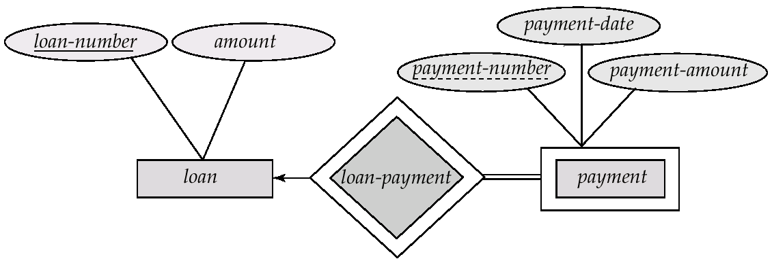
弱实体集（续）
弱实体集用双矩形表示
弱实体集的分辨符用虚下划线表示
payment_number – discriminator of the payment entity set
primary key for payment – (loan_number, payment_number)
注意：
强实体集的主码不显式地与弱实体集存放在一起，通过关系隐含体现
如果显式存储loan_number到payment，则payment将是一个强实体集
Notes:
如果payment_number不重复，实体集payment将有一个主码。不过我们任然使之为弱实体集，因为它存在依赖于实体集loan.

Slide 41
特化（Specialization）
自上而下的设计过程
Designate subgroupings within an entity set that are distinctive from other entities in the set
These subgroupings become lower-level entity sets that have attributes or participate in relationships that do not apply to the higher-level entity set.
Depicted by a triangle component labeled ISA, e.g., customer “is a” person
Attribute inheritance（属性继承）
A lower-level entity set inherits all the attributes and relationship participation of the higher-level entity set to which it is linked
Notes:
Designate：指定

Slide 42
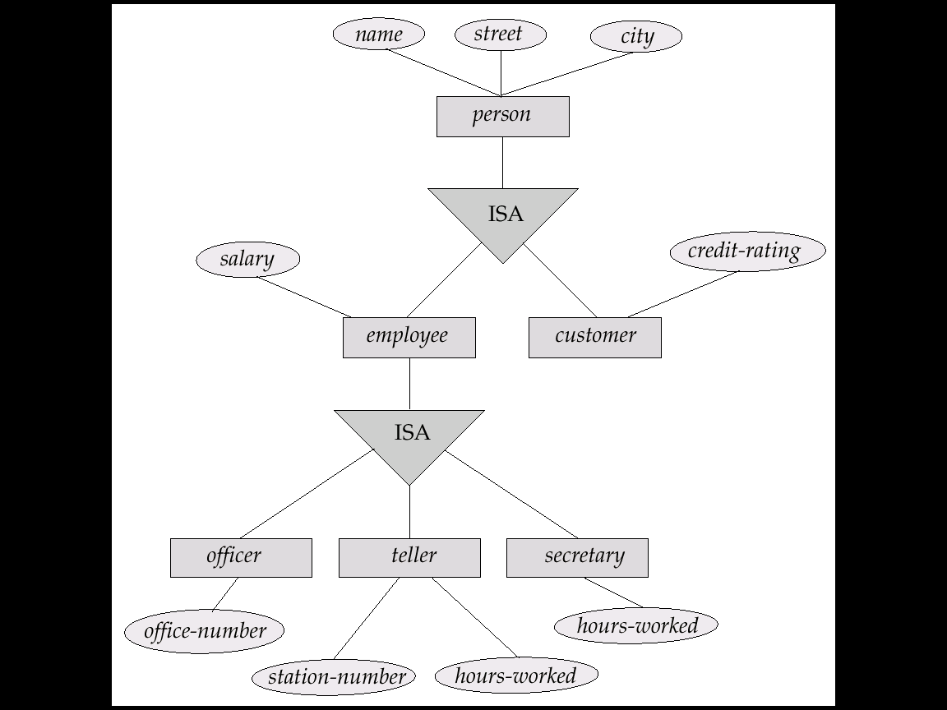
特化举例

Slide 43
泛化（Generalization）
自下而上的设计过程
Combine a number of entity sets that share the same features into a higher-level entity set
特化与泛化
Specialization and generalization are simple inversions of each other
They are represented in an E-R diagram in the same way

Slide 44
特化与泛化（续）
Different specializations of an entity set based on different features
例如：permanent-employee vs. temporary-employee, in addition to officer vs. secretary vs. teller
Each particular employee would be
a member of one of permanent-employee or temporary-employee,
and also a member of one of officer, secretary, or teller
The ISA relationship is also referred to as superclass - subclass relationship
Notes:
The way we depict specialization in an E-R diagram depends on whether an entity may belong to multiple specialized entity sets or if it must belong to at most one specialized entity set. The former case (multiple sets permitted) is called overlapping specialization, while the latter case (at most one permitted) is called disjoint specialization.

Slide 45
银行企业E-R图

Slide 46
大学E-R图

Slide 47
概要
设计过程概览
实体联系模型（Entity-Relationship model）
约束（Constraints）
实体联系图（Entity-Relationship diagram）
关系模式转换

Slide 48
E-R模型→关系表
Converting an E-R diagram to a table format is the basis for deriving a relational database design from an E-R diagram
Reduction of an E-R schema to tables
For each entity set and relationship set, there is a unique table
Each table has a number of columns
Primary keys allow entity sets and relationship sets to be expressed uniformly as tables

Slide 49
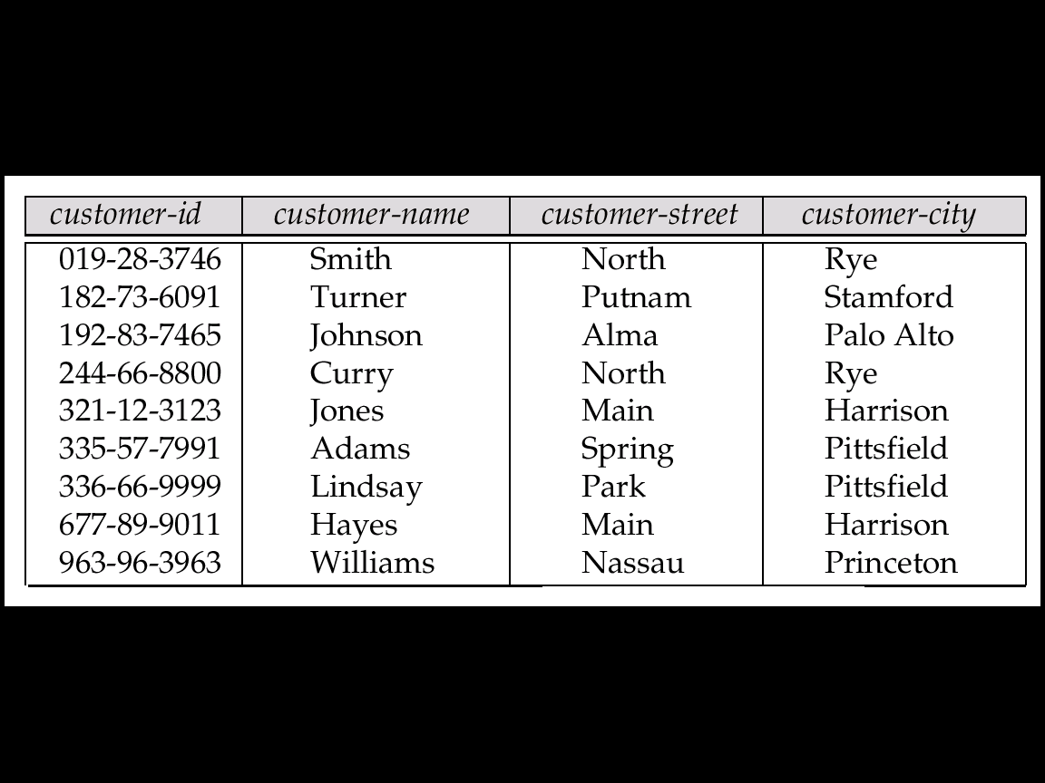
实体集→关系表
A strong entity set reduces to a table with the same attributes

Slide 50
复合与多值属性
复合属性
将复合属性展开，为每个子属性创建一个单独的属性
多值属性
将实体E的多值属性A表示为一个单独的表EM
EM的属性包括实体E的主码和对应多值属性
多值属性的每一个取值对应EM中的一个元组
Notes:
if we had an instructor with ID 22222, and phone numbers 555-1234 and 555-4321, the relation instructor phone would have two tuples (22222, 555-1234) and (22222, 555-4321).

Slide 51
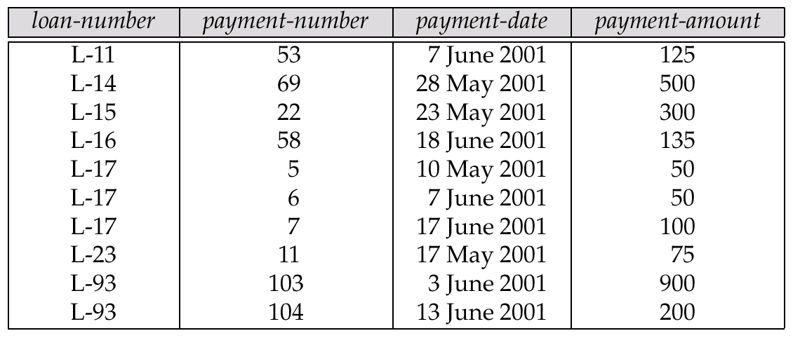
弱实体集的表示
A weak entity set becomes a table that includes a column for the primary key of the identifying strong entity set
Notes:
identifying ：识别

Slide 52
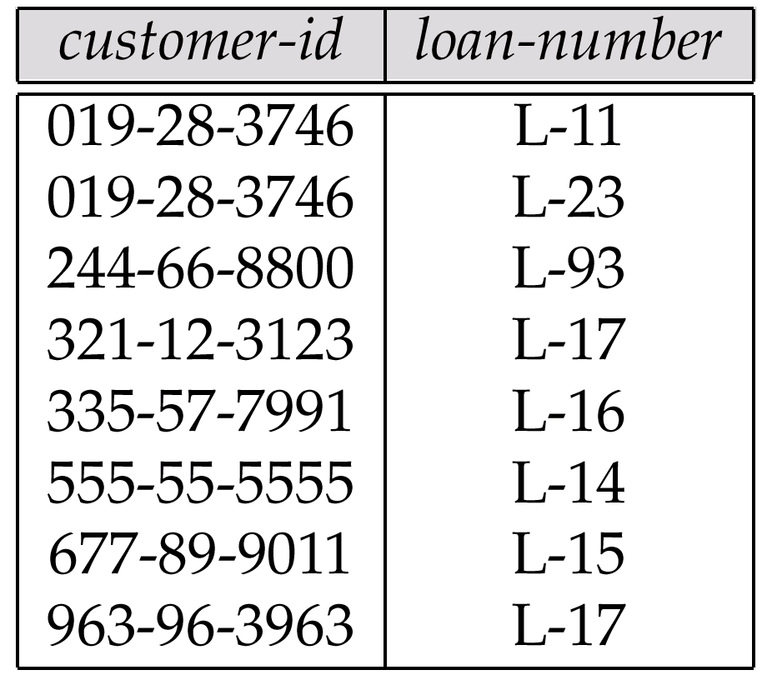
联系集→关系表
A many-to-many relationship set is represented as a table with columns for the primary keys of the two participating entity sets, and any descriptive attributes of the relationship set.
E.g., table for relationship set borrower

Slide 53
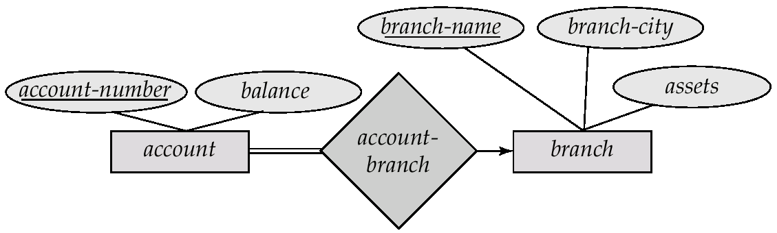
关系表的冗余
Many-to-one and one-to-many relationship sets
Can be represented by adding an extra attribute to the many side, containing the primary key of the one side
E.g., instead of creating a table for relationship account-branch, add an attribute branch-name to the entity set account
many side
one side

Slide 54
关系表的冗余（续）
If participation is partial on the many side, it could result in null values
For one-to-one relationship sets, either side can be chosen to act as the “many” side

Slide 55
特化的关系表表示
Method 1
Form a table for the higher level entity
Form a table for each lower level entity set, include primary key of higher level entity set and local attributes
table table attributes person name, street, city customer name, credit-rating employee name, salary
Drawback: getting information about entities, e.g., employee, requires accessing two tables

Slide 56
特化的关系表表示（续）
Method 2
Form a table for each entity set with all local and inherited attributes
table table attributes person name, street, city customer name, street, city, credit-rating employee name, street, city, salary
Drawback: street and city may be stored redundantly for persons who are both customers and employees

Slide 57
银行企业的E-R图

Slide 58
Banking关系数据库模式
branch = (branch_name, branch_city, assets)
customer = (customer_id, customer_name, customer_street, customer_city)
loan = (loan_number, amount)
account = (account_number, balance)
employee = (employee_id, employee_name, telephone_number, start_date)
dependent_name = (employee_id, dname) (derived from a multivalued attribute)
account_branch = (account_number, branch_name)
loan_branch = (loan_number, branch_name)
borrower = (customer_id, loan_number)
depositor = (customer_id, account_number, access_date)
cust_banker = (customer_id, employee_id, type)
works_for = (worker_employee_id, manager_employee_id)
payment =(loan_number,payment_number,payment_date,payment_amount)
savings_account = (account_number, interest_rate)
checking_account = (account_number, overdraft_amount)

Slide 59
数据库设计过程
需求分析
概念设计(E-R Model)
功能需求分析
Describe the operations that will be performed on the data
Review the design
逻辑实现
Map from conceptual model to implementation model
E.g., relational model and OO model
物理实现
Specify physical features of the database
E.g., buffer size, index…
Notes:
OO：面向对象

Slide 60
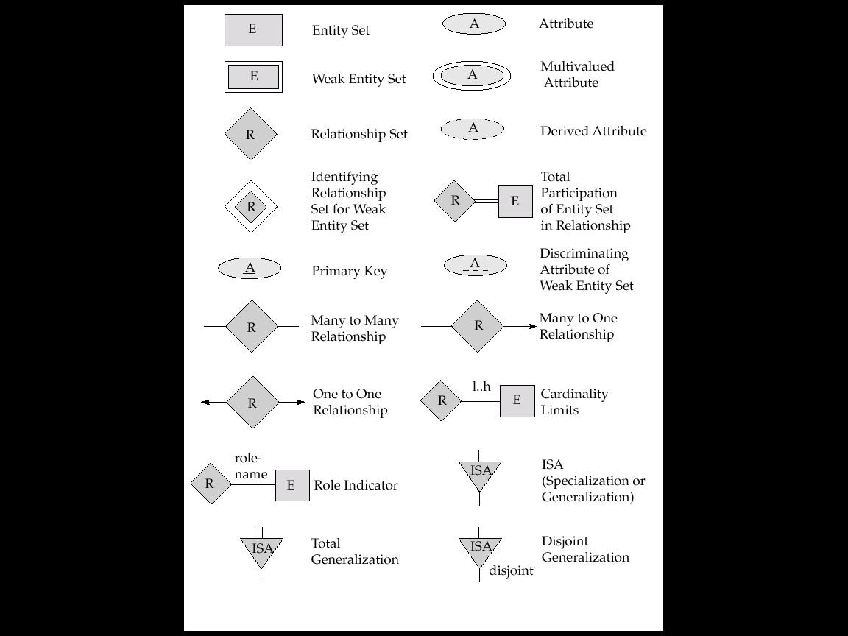
E-R图符号总结

Slide 61
E-R图符号总结（续）

Slide 62
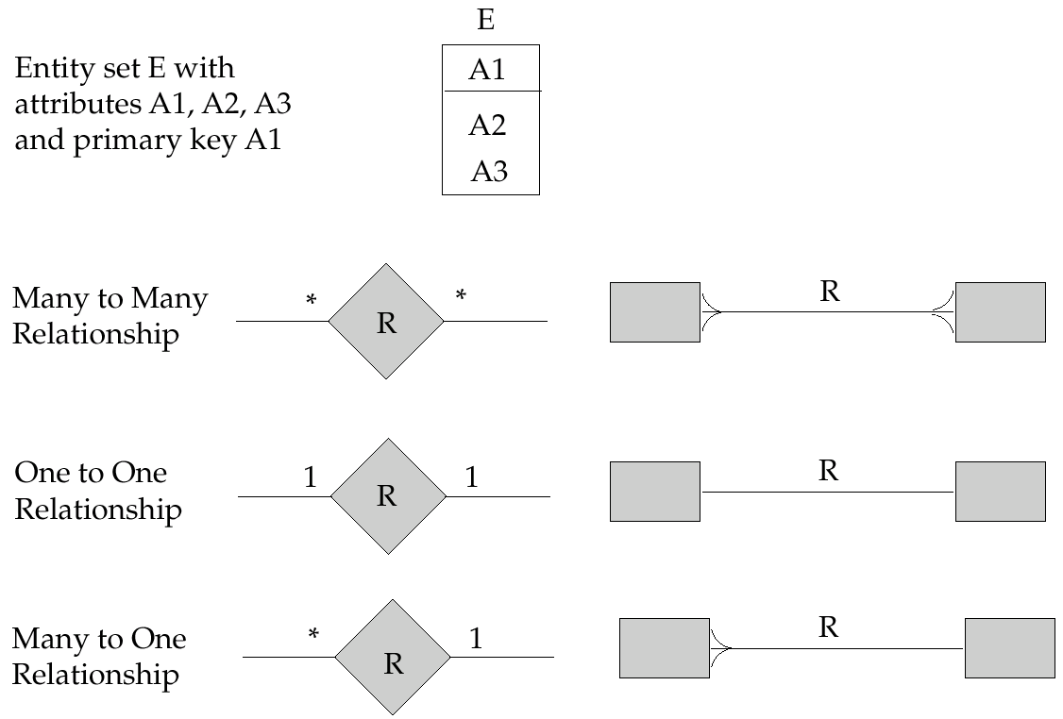
E-R图的另一种表示

Slide 63
设计工具
Rational Rose
http://www-306.ibm.com/software/rational/
Visio Enterprise
http://www.microsoft.com/china/office/xp/visio/default.asp
Erwin
http://www3.ca.com/Solutions/Product.asp?ID=260
Power Designer
http://www.sybase.com/products/developmentintegration/powerdesigner

Slide 64
E-R模型总结
Conceptual design follows requirements analysis
Yields a high-level description of data to be stored
E-R model is popular for conceptual design
Constructs are expressive, close to the way people think about their applications
Basic constructs: entities, relationships, and attributes (of entities and relationships)
Some additional constructs: weak entities, ISA hierarchies
注意：E-R模型有多种变体

Slide 65
E-R模型总结（续）
Integrity constraints in the E-R model
key constraints, participation constraints, and overlap/covering constraints for ISA hierarchies. Some foreign key constraints are also implicit in the definition of a relationship set
Some constraints (notably, functional dependencies) cannot be expressed in the E-R model
Constraints play an important role in determining the best database design for an enterprise

Slide 66
E-R模型总结（续）
ER design is subjective
There are often many ways to model a given scenario! Analyzing alternatives can be tricky, especially for a large enterprise. Common choices include:
Entity vs. attribute, entity vs. relationship, binary or n-ary relationship, whether or not to use ISA hierarchies
Ensuring good database design
Relational schema should be analyzed and refined further
FD information and normalization techniques are especially useful (cf.《数据库系统概念》第8章)
Notes:
FD :Functional Dependencies

Slide 67
其他重要内容
关系规范化（第8章）
应用设计与开发（第9章）
事务处理（第14、15、16章）
索引结构（第11章）
查询优化（第13章）

