Slide 1
HLHMS
Airport Management System

Slide 2
Title and Content Layout with List
Introduction
Enterprises
Application

Slide 3
Introduction
A modern airport management software. Integrating passenger interaction with the airport into one application. Not only does it provide passengers with access to flight information, but also airlines to modify flight information, airport ground staff to assign upcoming aircraft runs, etc.

Slide 4
Enterprise, Organization and User Roles
4enterprises
Airports
Airlines
Government departments
Services
8organization
Airport check-in counter, Airport ticket office, CBP custom office, Security check, VIP Lounge, Airport Air Traffic Controller Center, Pickup location, Airline despatcher office
13roles
Ground crew, flight crew, check-in counters, ticket agents, store salesmen, lounge greeters and police officers. Passengers and pick-ups. In terms of control, we have airline administrators, airport administrators, system administrators, etc.

Slide 5
Skills and structures
Graphical desktop application developed based on Java Swing. Relying data on Azure Mysql server for secure and stable data management.
The MVC architecture is used to achieve loose coupling, reusability, portability, and sustainable development of the system. The data connection layer is responsible for all operations on database information. The ui interface is elegant and succinct, and very user-friendly. The model layer specifies the structure and relationship of each object, which makes post-maintenance and code processing well-dependent.
Animated effects are implemented. Email notification. Introduced flatfat interface, introduced datepicker, jfreecharts and other additional components.

Slide 6
Work Flows
Create Different Users
Create Flight Company
Create Flight
Buy Tickets
Assign Flight Terminal and runway
Checked-in
Security Check
Immigrarion check
Passenger Rest
Shopping
……

Slide 7
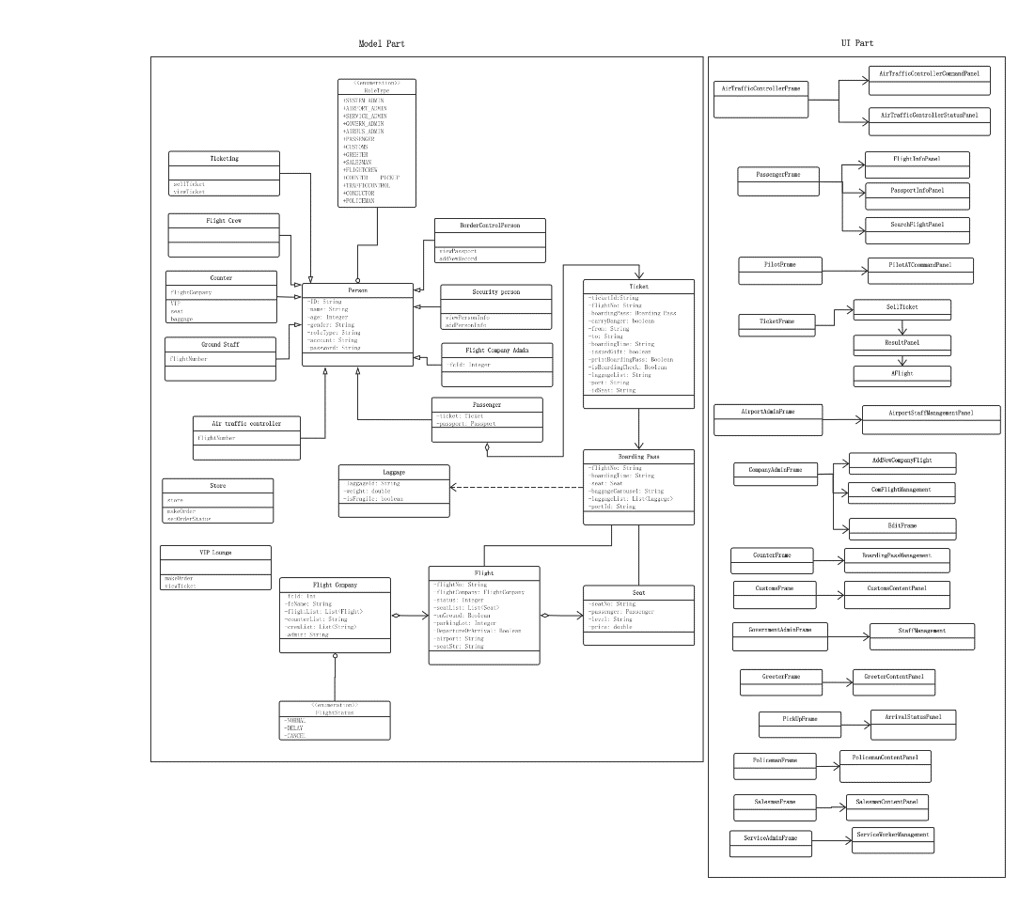
Class Diagram

Slide 8
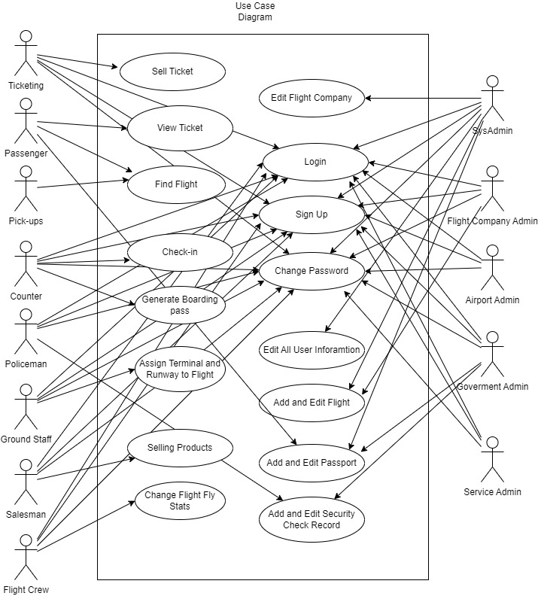
Use Case Diagram

Slide 9
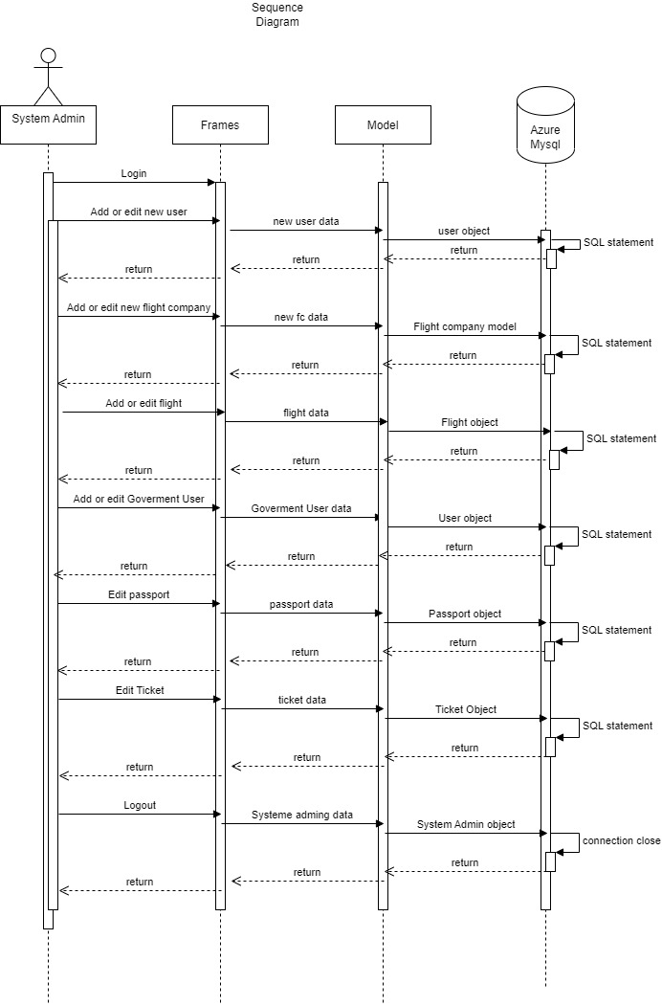
Sequence Diagram

Slide 10
Create Different Users
Create Flight Company
Create Flight
Buy Tickets
Assign Flight Terminal and runway
Checked-in
Security Check
Immigrarion check
Passenger Rest
Shopping
……

