Slide 1

Welcome to the E-learning Suite
No Food or drink to be consumed in E-learning suite (There should be tables & chairs outside in corridor)
We usually provide tea, coffee, water & biscuits outside at tea and coffee breaks.
We are unaware of any fire-drills so if an alarm is sounded we will treat it as a real incident and evacuate the building via reception.
Toilets are down one level (via spiral staircase near reception). At bottom of stairs turn left and then left again and follow signage. If you cannot use the stairs there is a lift.
Post-its – please use them to let us know when you’ve completed a practical (yellow/green) and when you are having problems (red/pink). We will also use them to get immediate feedback during the day.
Food – there is a Café near reception that takes cash and cards.
Lunch break (30 mins or 1 hour?) – longer lunch means finishing later
Login instructions are on the computer screen – note your desk number e.g. K5 and use that as username suffix.

Slide 2
Data Carpentry in R
https://pad.carpentries.org/2019-01-15-CRUK-Cambridge
15-16 January 2019 - 9:30-17:30
Mark Fernandes, Anne Pajon, Ashley Sawle, Jing Su

Slide 3
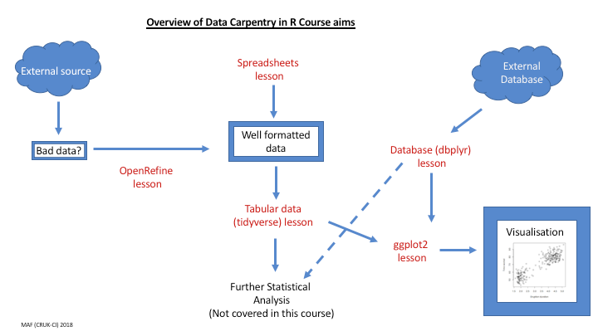
Data Carpentry in R
https://pad.carpentries.org/2019-01-15-CRUK-Cambridge

Slide 4
Data Carpentry in R
https://pad.carpentries.org/2019-01-15-CRUK-Cambridge
Day 1
Morning (Anne)
Data organisation in spreadsheet
Data cleaning with OpenRefine
Afternoon (Jing)
Overview of R and RStudio
Introduction to R
Working with tabular data in R
Day 2
Morning
Recap (Jing)
Data manipulation using the R package dplyr (Ash)
Afternoon
Data visualisation using the R package ggplot2 (Ash)
Interacting with databases from R (Mark)

Slide 5
Data Carpentry in R
https://pad.carpentries.org/2019-01-15-CRUK-Cambridge
Code of Conduct
The Carpentries is a community-led project. We value the involvement of everyone in the community. We are committed to creating a friendly and respectful place for learning, teaching and contributing. All participants in our events and communications are expected to show respect and courtesy to others.
Setup
Web browser
Spreadsheet software
OpenRefine
RStudio and R
SQLite

