Slide 1
Semi-Autonomous Parking System
EMBEDDED SYSTEMS DESIGN PROJECT
Under the guidance of : Prof. Dr. Mathias LINDEMANN
Keshav KUMAR, 33410
Keshavaditya GOLLA, 33392
Karan VERMA, 33398
Miaoshun WU, 33289
Shobhit GUPTA, 33435

Slide 2
CONTENTS
Introduction
Basic Flow of Events
Hardware Description
Connecting to LEGO MINDSTORMS
Software description
First Object Detection
Parking Spot Detection
Second Object Detection
Parking Manoeuvre
Stateflow
Conclusion

Slide 3
INTRODUCTION
WHAT IS SAPS?
Integrated Parking System in modern vehicles which increases comfort in parking in difficult parking environments.
Velocity provided by driver as compared to Fully Autonomous Parking System.
Sensors and Actuators scan environment for suitable parking spot.
Parking Maneuver is performed if suitable spot without any obstacles is found.

Slide 4
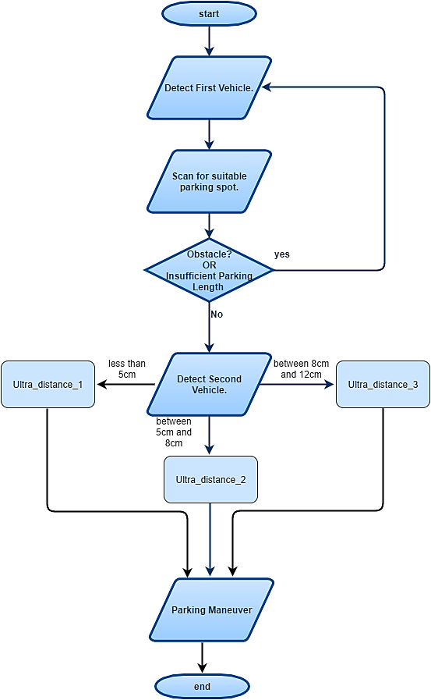
BASIC FLOW OF EVENTS IN SAPS

Slide 5
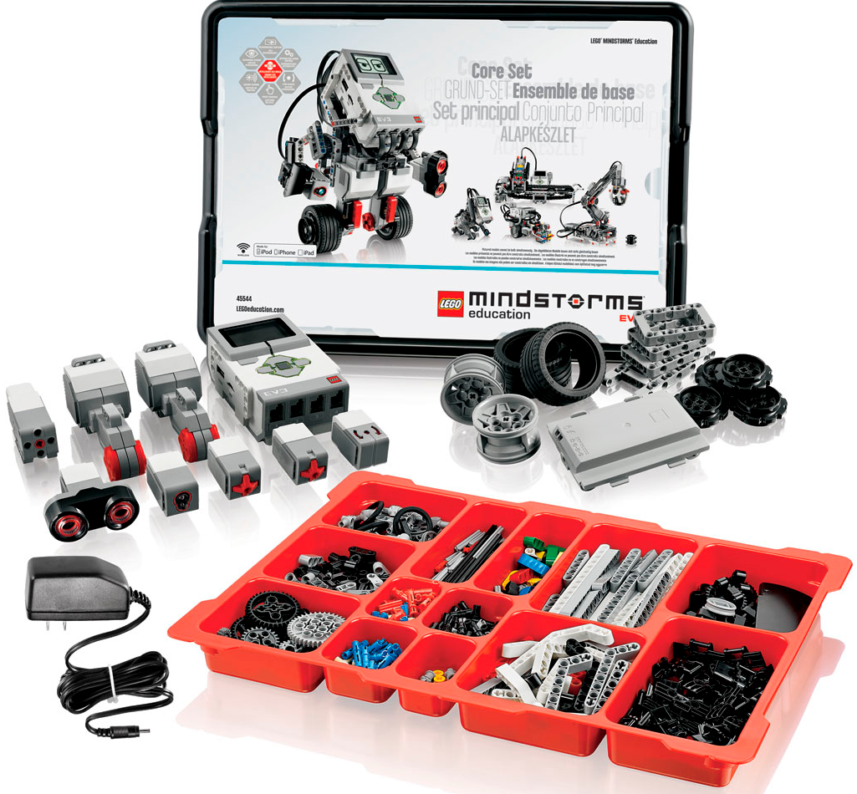
HARDWARE DESCRIPTION
A typical LEGO MINDSTORMS EV3 set consists of:
• Programmable LEGO Brick
• Large Motor
• Medium Motor
• Ultrasonic Sensor
• Differential Gear
• Steering Mechanism
• Touch Sensor and more..

Slide 6
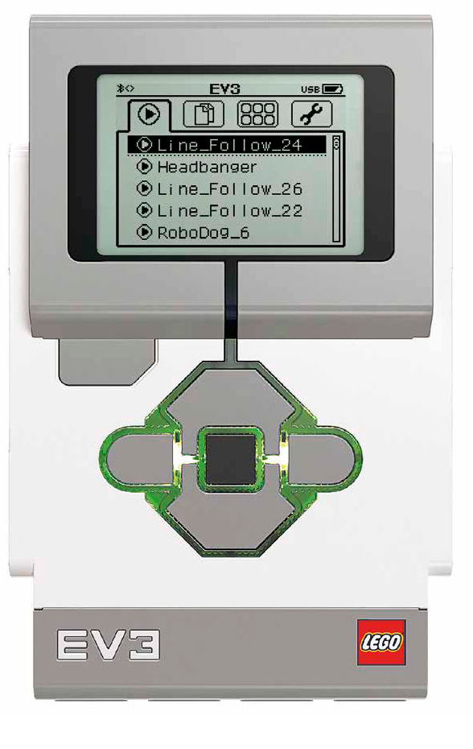
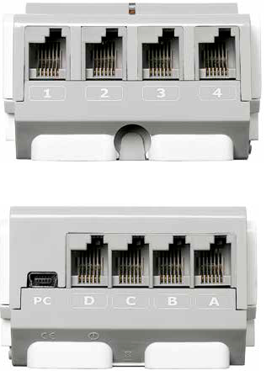
HARDWARE DESCRIPTION
Programmable LEGO Brick:
Main processing centre which can be programmed as required
Can receive signals from up to four sensors using the input ports ( 1, 2, 3, 4)
Can controls up to 4 motors using the output ports ( A, B, C, D)

Slide 7
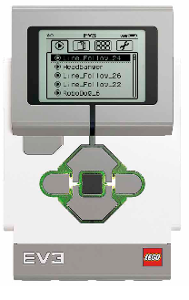


Connecting to LEGO MINDSTORMS
The LEGO Brick can be connected to a PC/ Laptop in three modes:
+
+
3. Using Wi-Fi
1. Using USB Cable
2. Using Bluetooth

Slide 8
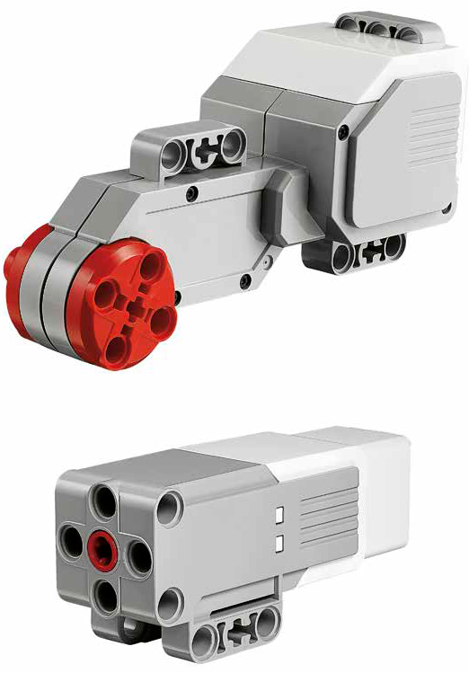
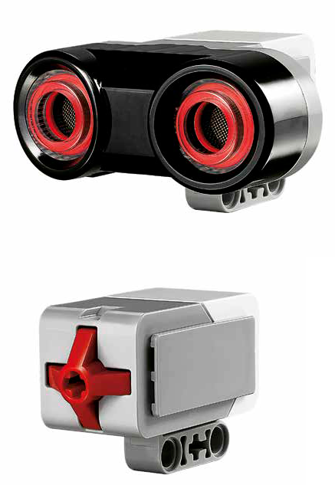
HARDWARE DESCRIPTION
Large Motor: It provides the main drive to the bot.
Ultrasonic Sensor: Measures distance between the sensor and object in front.
Touch Sensor: It’s an physical button used as a safety stop button
Medium Motor: Control the steering of the bot.
Both motors have encoders built-in.

Slide 9
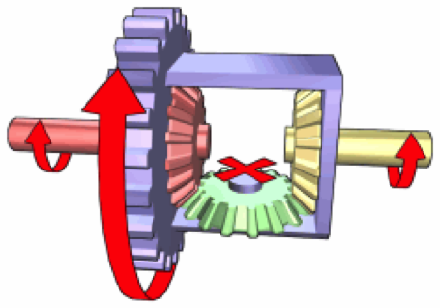
HARDWARE DESCRIPTION
Differential Gear Mechanism: While turning it allows the outer
drive wheel to rotate faster than the inner drive wheel thus decreasing the chances of slip.
Simple Steering Mechanism: In this kind of steering, steering wheels are connected to each other and have individual pivot points.

Slide 10
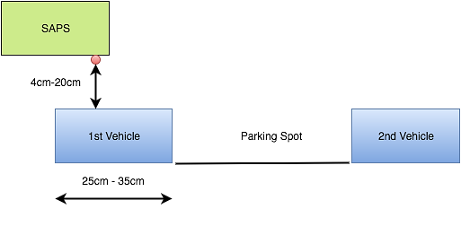
SOFTWARE DESCRIPTION
FIRST OBJECT DETECTION:
Ultrasonic Sensor Range should measure between 4cms and 20cms.
Object Length should be between 25 – 35cm.
Object Length (in cm ) = Encoder Value/9.9
If first object is a tree or group of trash cans , SAPS treats it as an invalid object.

Slide 11
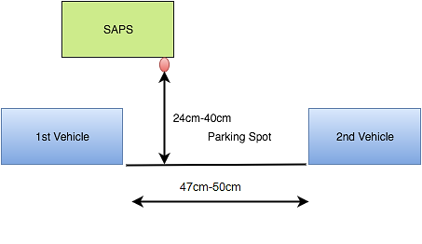
SOFTWARE DESCRIPTION
PARKING SPOT DETECTION:
Encoder is reset
Parking Length should be between 45 – 50 cm.
Ultrasonic Sensor should measure between 24 – 40 cm.
Parking Spot is rejected by SAPS if obstacle is present

Slide 12
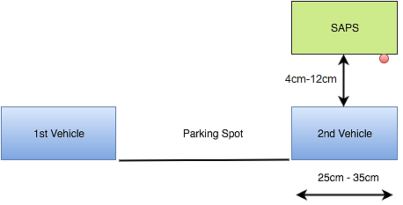
SOFTWARE DESCRIPTION
SECOND OBJECT DETECTION :
Encoder is reset again.
Object Length should be between 25 – 35 cm.
Ultrasonic sensor should measure between 4 – 20cm
After 2nd object is detected , SAPS performs parking maneuver.

Slide 13
PARKING MANOEUVER:
After Parking Spot has been found.
Second object is found and confirmed with sufficient space.
Parking Manoeuvre is estimated, activated and then to be implemented.
Constant Curvature Parking Manoeuvre:
The path followed by the bot which is formed by joining arcs of two circles at one particular point.

Slide 14
Constant Curvature Parking Manoeuvre
Arc of Radius ‘R’
Vehicle
Parking Manoeuvre
(Curve ‘SC’)
Parking spot
Object 1
Object 2

Slide 15
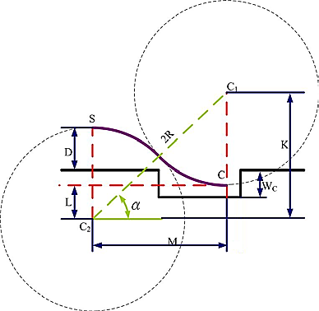
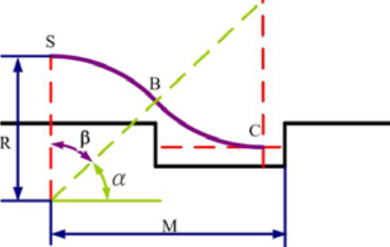
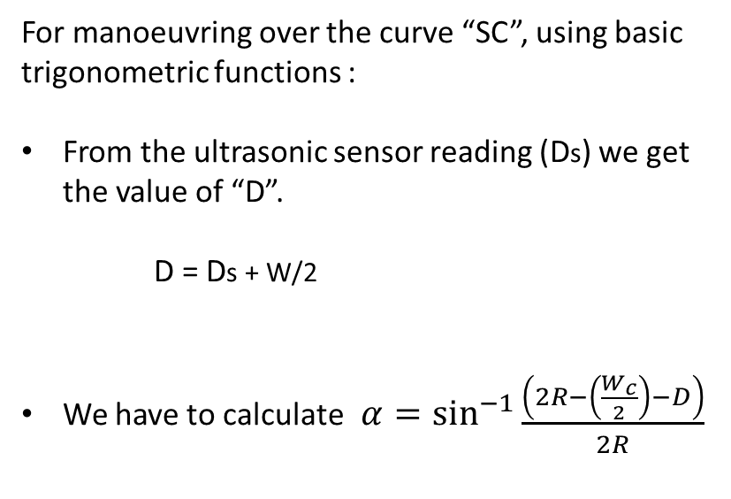
Constant Curvature Parking Manoeuvre
For manoeuvring over the curve “SC”, using basic trigonometric functions :
From the ultrasonic sensor reading (Ds) we get the value of “D”.
D = Ds + W/2
We have to calculate$α=\sin^{−1}{\begin{aligned}\frac{\left(2R−\left(\begin{aligned}\frac{W_{c}}{2}\end{aligned}\right)−D\right)}{2R}\end{aligned}}$
N

Slide 16
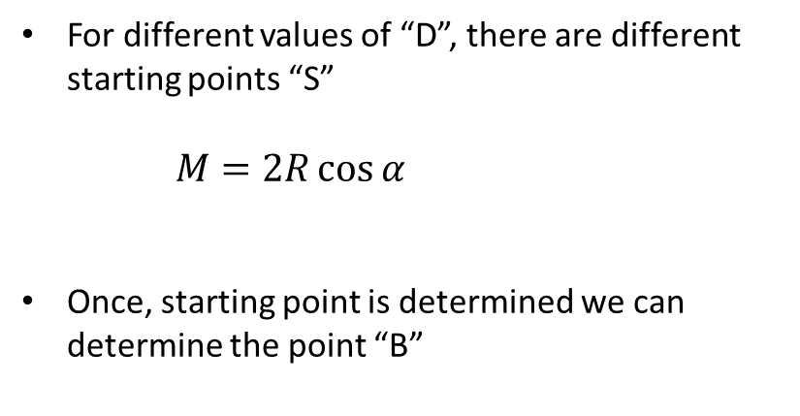
Constant Curvature Parking Manoeuvre
For different values of “D”, there are different starting points “S”
$M=2R\cos{α}$
Once, starting point is determined we can determine the point “B”

Slide 17
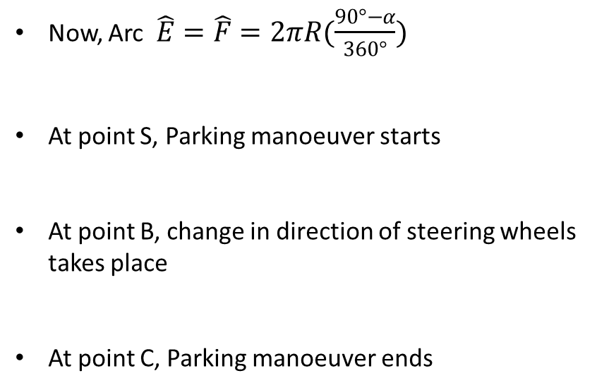
Constant Curvature Parking Manoeuvre
Now, Arc $\hat{E}=\hat{F}=2πR(\frac{90°−α}{360°})$
At point S, Parking manoeuver starts
At point B, change in direction of steering wheels takes place
At point C, Parking manoeuver ends

Slide 18
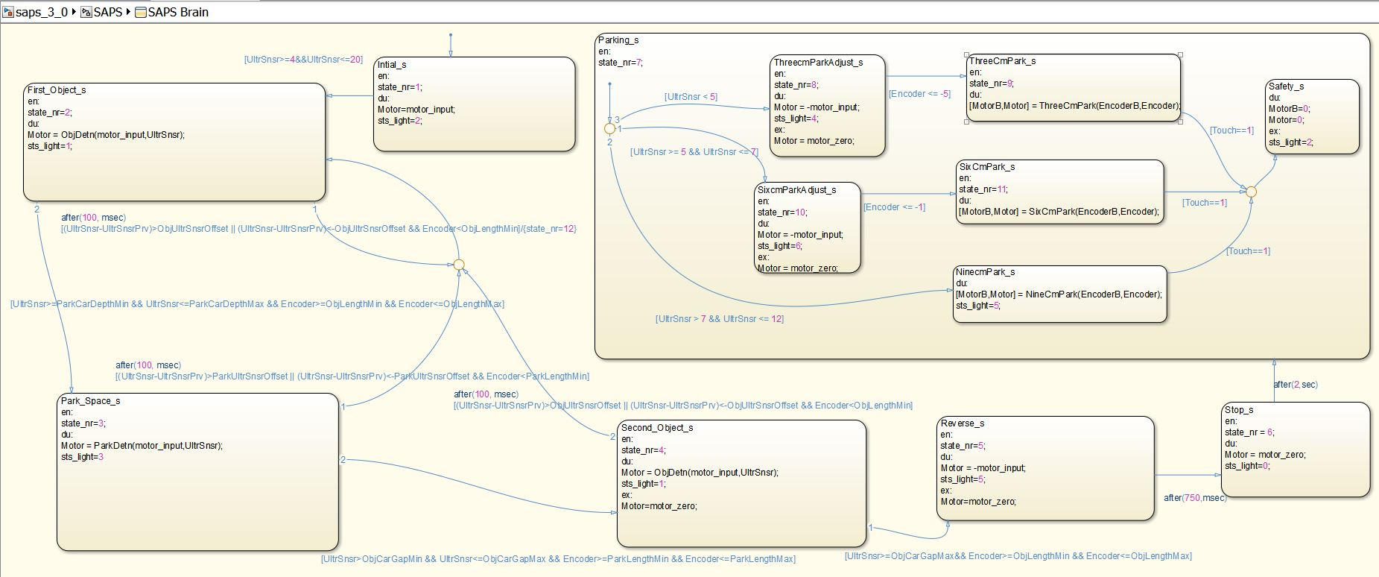
SOFTWARE DESCRIPTION
Stateflow

Slide 19
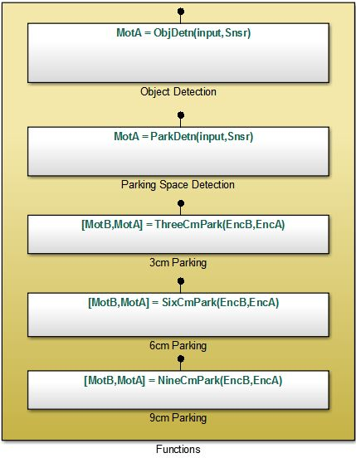
SOFTWARE DESCRIPTION
Stateflow
State 1
event_or_message [condition]{condition_action}/transition_action
State 2

Slide 20
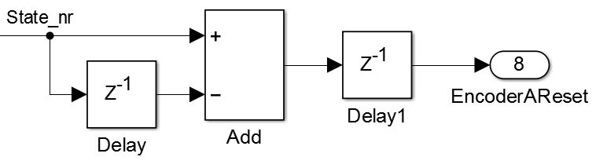
SOFTWARE DESCRIPTION
Stateflow
State 1
State_nr=1
Encoder reset
Encoder reset
State 2
State_nr=2

Slide 21
SOFTWARE DESCRIPTION
Stateflow

