Slide 1


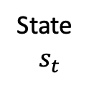
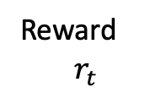
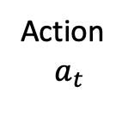

Agent
State
$$s_{t}$$
Reward
$$r_{t}$$
Action
$$a_{t}$$
$$r_{t+1}$$
Environment
$$s_{t+1}$$

