Slide 1
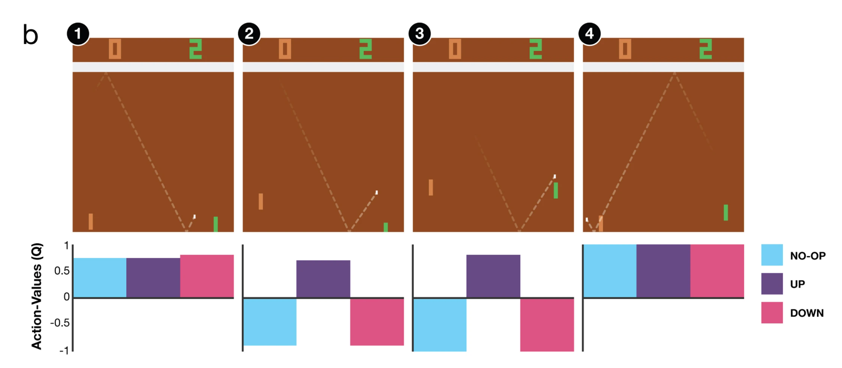


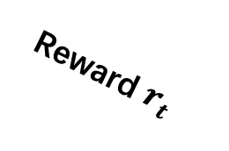

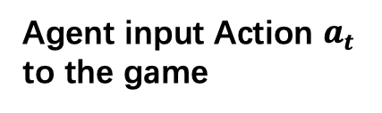

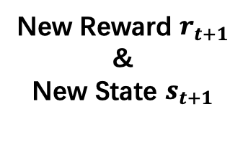

Game at time $t$
Reward $r_{t}$
Some magic
State $s_{t}$
Agent
New Reward $r_{t+1}$
&
New State $s_{t+1}$
Game at time $t+1$
Agent input Action $a_{t}$ to the game

