Slide 1
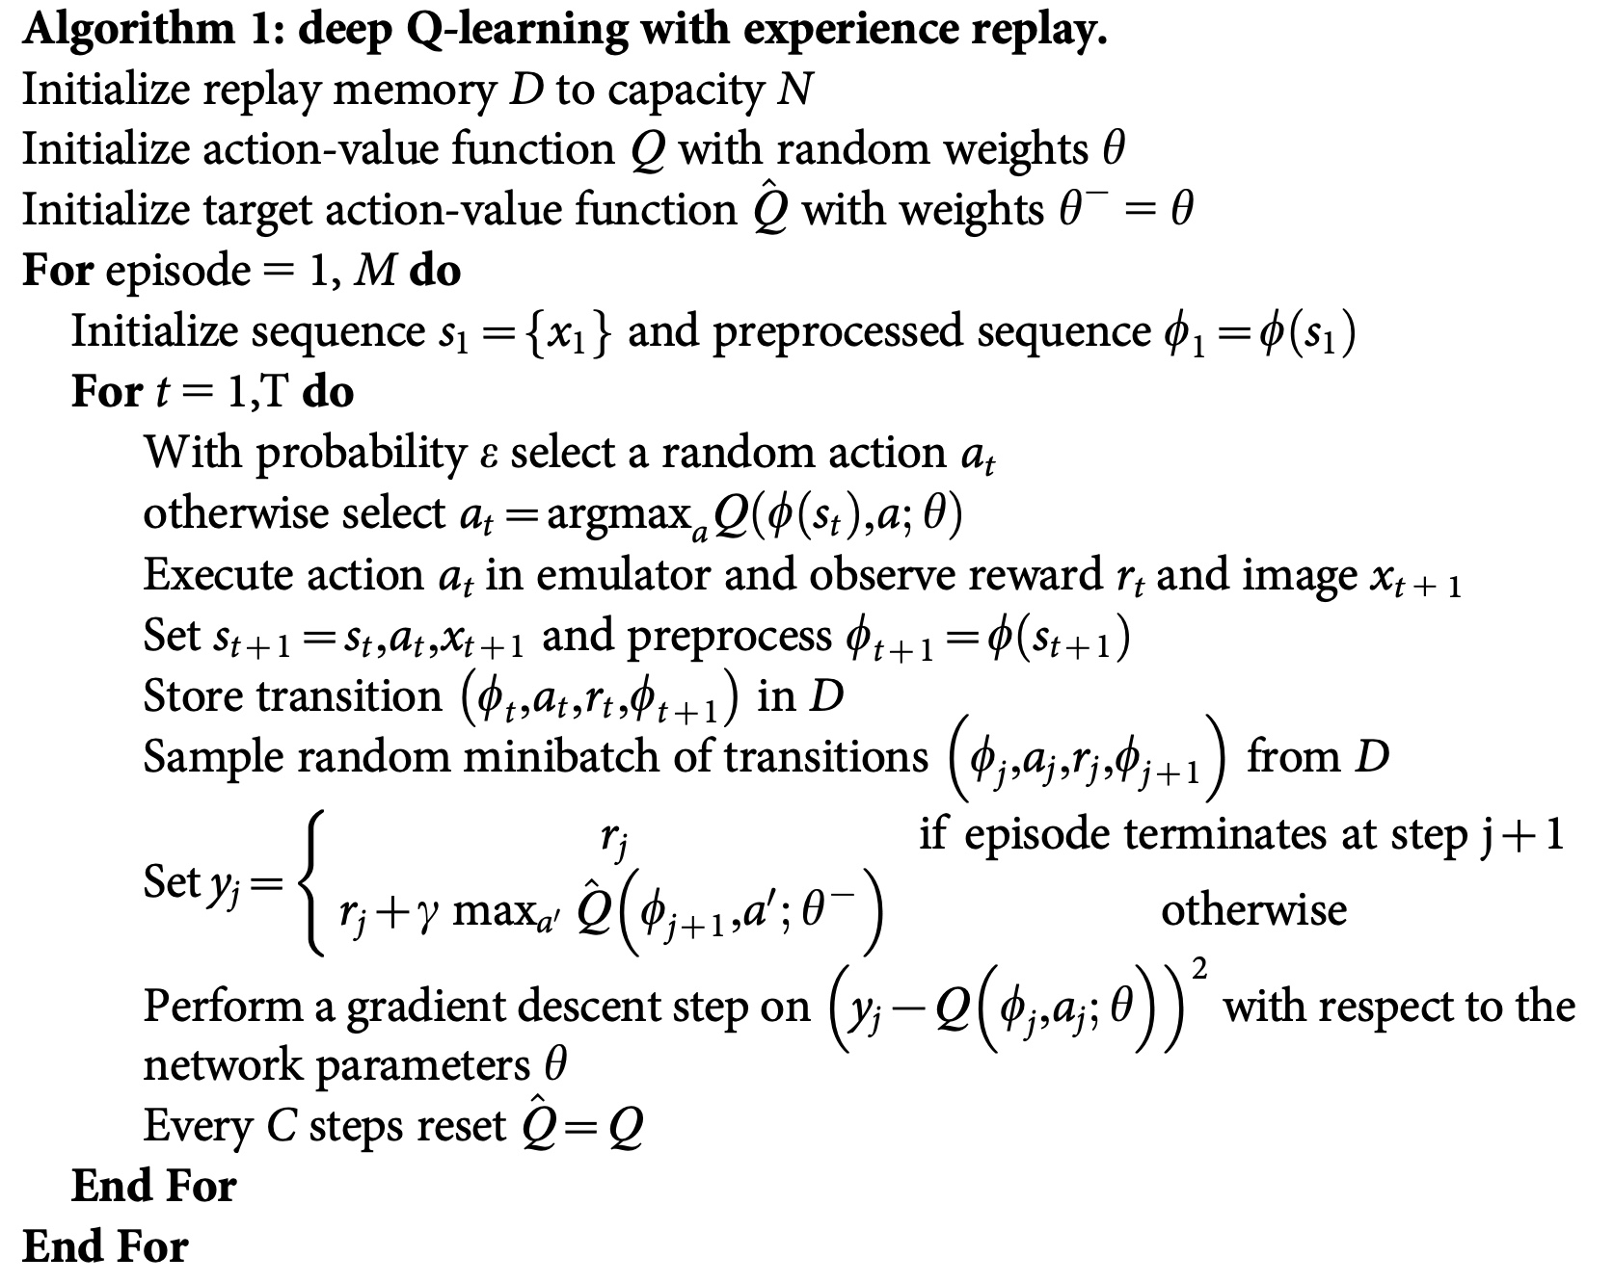




Initialize Second target network$\hat{Q}$
$φ$: Image preprocessing function
$ε$-greedy policy
Experience replay
Set target value
Update Second target network$\hat{Q}$

