Slide 1
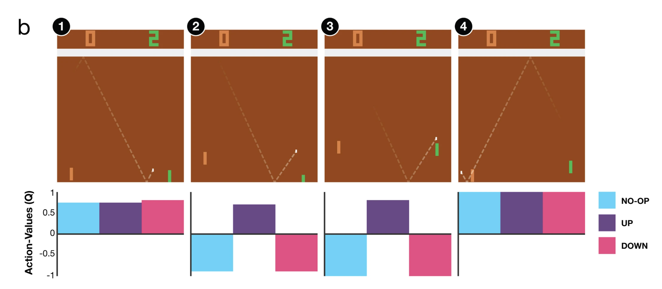


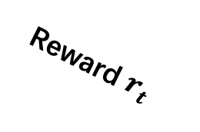

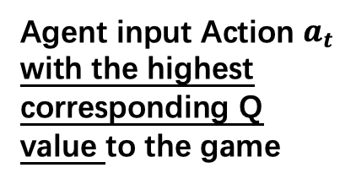


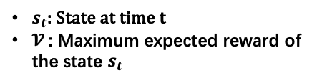



`
Game at time $t$
Reward $r_{t}$
Some magic
Game screen at $t$
State $s_{t}$
Agent
3 convolution layers and 1 fully connected layer
Agent input Action $a_{t}$ with the highest corresponding Q value to the game
New Reward $r_{t+1}$
&
New State $s_{t+1}$
Game at time $t+1$
$$s_{t}+ 𝓥$$
$s_{t}$: State at time $t$
$𝓥$: Maximum expected reward of the state $s_{t}$
Q values
Network Output
1 fully connected linear layer

