Slide 1
Compiler Support for Learning Invariants
Michael Lay Supervisor: Matt Roberts
May 25th, 2022

Slide 2
Schedule
Introduction (5 minutes)
Pre-Workshop Test (15 minutes)
Learning Content (40 minutes)
Workshop questions (40 minutes)
Post Workshop Test (15 minutes)
With short 5-minute breaks in between

Slide 3
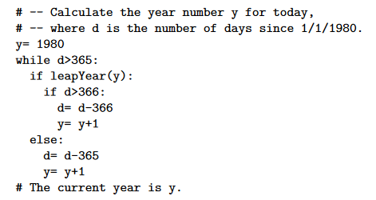
Learning Invariants
Ensuring correctness
Why should we care about program correctness?

Slide 4
Learning Invariants
Verification techniques
Wide variety of verification techniques
Dynamic verification
Unit testing
Functional testing
Runtime assertions
Static verification
Linting
Formal verification

Slide 5
Learning Invariants
Unit testing
Test individual units or components of a program
Must develop representative test cases
Must check edge cases
How do you know you have enough tests?
How do you know you have the correct tests?

Slide 6
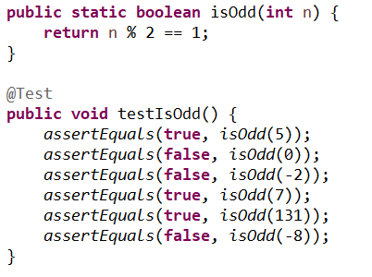
Learning Invariants
UNIT TESTING
Does the below unit test check sufficient cases?

Slide 7
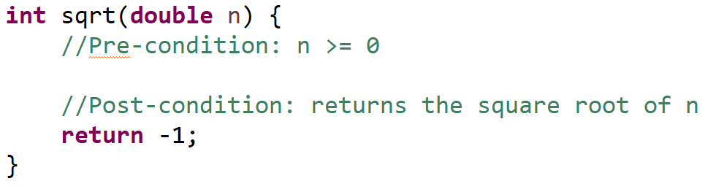
Pre and Post Conditions
Contract between a user and the programmer
Pre-condition - Specification of what must be true at the start of the program
(what the user must ensure)
Post-condition – Specification of what must be true at the end of the program
(what the programmer must ensure)

Slide 8
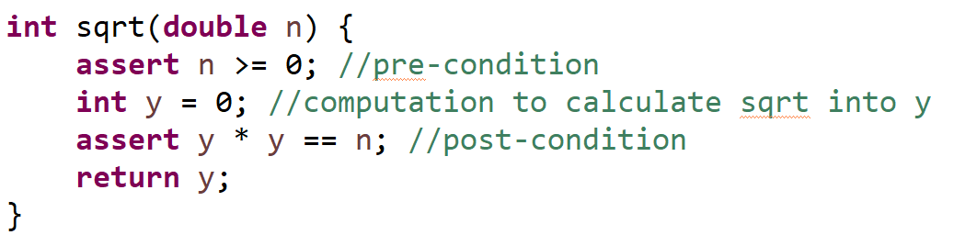
Pre and Post Conditions

Slide 9
Hoare Logic
Hoare Logic
How do we show that a program will reach the post condition?
Hoare triples
{P} S {Q}
P and Q are predicates representing our pre and post conditions
S is the program
If the program is in state P and we execute S (and S terminates), Q will be true.
{k = 3} k = 15 {k = 15}
{x = y} y = y + 3 {y = x + 3}
{x < 0} x = (x * 2) - 4 {x < -6}

Slide 10
Hoare Logic
Weakest and strongest pre/post
Are the following Hoare triples correct?
{x = 5} x = x * 2 {x = 10}
{x = 5} x = x * 2 {x > 0}
{x = 5} x = x * 2 {true}
{true} x = x * 2 {true}
What about this?
{false} k = 3 {k = -4}

Slide 11
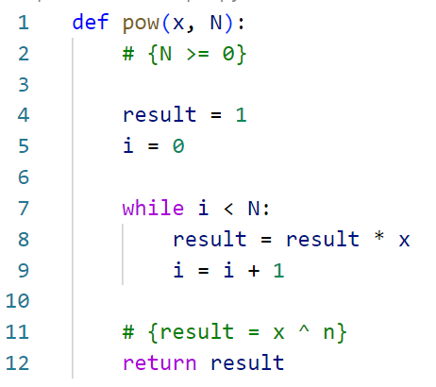
Invariants
Loops?
How do we deal with the loop in the following code?
Are Hoare triples enough?

Slide 12
Invariants
For code without loops, we are simulating execution directly
We prove one Hoare Triple for each statement, and each statement is executed once
For code with loops, we are doing one proof of correctness for multiple loop iterations
Don’t know how many iterations there will be
Need our proof to cover all of them

Slide 13
Invariants
The invariant is a general condition that must be true for every execution of the loop, but still be strong enough to provide us the postcondition.
An invariant is correct when it adheres to the following rules:
Is true before it starts
Is maintained on each loop iteration
Each loop iteration makes progress towards the loop stopping (no infinite loops!)
The postcondition is true when the loop terminates

Slide 14
Invariants
examples
Given x and n, calculate x^n
What is the invariant for the program?

Slide 15
Invariants
examples
What is the loop invariant?
Is it true before the first iteration?
Is it true after each iteration?
Notes:
Invariant
result = x ^ i

Slide 16
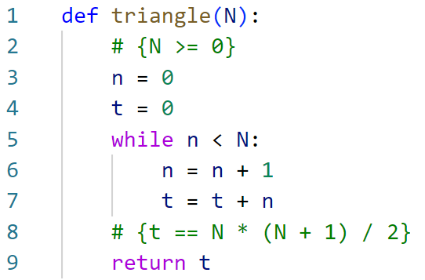
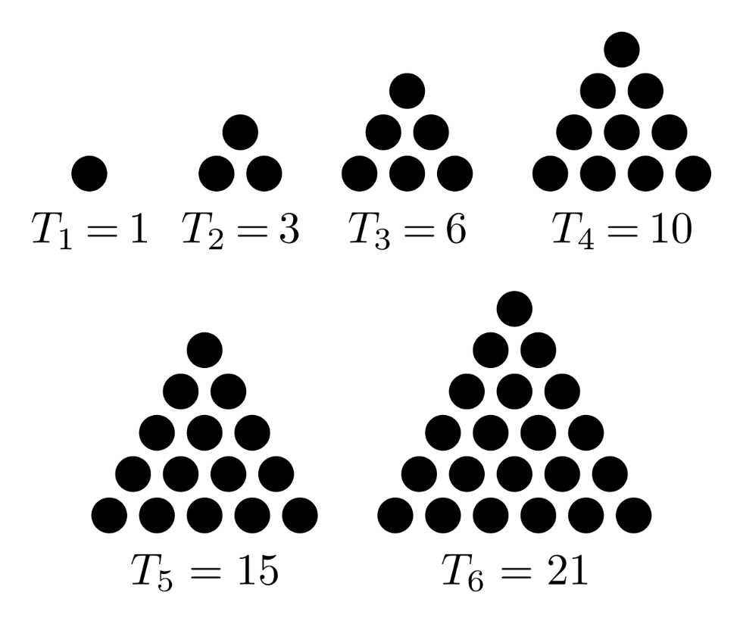
Invariants
examples
Given n, calculate Tn

Slide 17
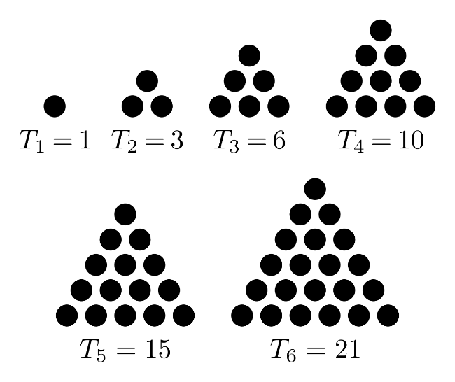
Invariants
examples
What is the loop invariant?
Is it true before the first iteration?
Is it true after each iteration?
Notes:
Invariant
t = n * (n + 1) / 2

Slide 18
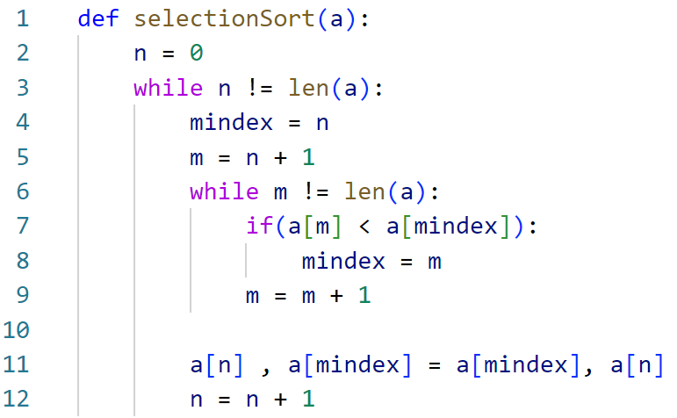
Invariants
examples
Given an array, sort it in ascending order

Slide 19
Invariants
examples
What is the loop invariant?
Is it true before the first iteration?
Is it true after each iteration?
Notes:
Invariants
Inner loop:
forall i :: n <= i < m ==> a[mindex] <= a[i] //mindex is current smallest in range n < m
outter loop:
forall i, j :: 0 <= i < n <= j < a.Length ==> a[i] <= a[j] //all the values in the sorted section will be lower then any value in the non sorted section
forall k1, k2 :: 0 <= k1 < k2 < n ==> a[k1] <= a[k2] //all values in the sorted section are sorted with respect to one another

Slide 20
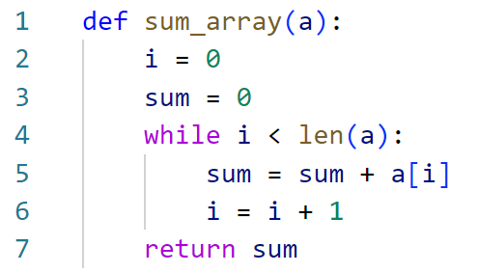
Invariants
examples
Given an array, return the sum of all numbers
Notes:
https://www.win.tue.nl/~kbuchin/teaching/JBP030/notebooks/loop-invariants.html
https://www.win.tue.nl/~kbuchin/teaching/JBP030/notebooks/loop-invariants.html
Loop Invariant: At the start of iteration j of the loop, the variable answer should contain the sum of the numbers from the subarray A[0:j].
Initialization: At the start of the first loop the loop invariant states: 'At the start of the first iteration of the loop, the variable answer should contain the sum of the numbers from the subarray A[0:0], which is an empty array. The sum of the numbers in an empty array is 0, and this is what answer has been set to.
Maintenance: Assume that the loop invariant holds at the start of iteration j
. Then it must be that answer contains the sum of numbers in subarray A[0:j]. In the body of the loop we add A[j] to answer. Thus at the start of iteration j+1, answer will contain the sum of numbers in A[0:j+1], which is what we needed to prove.
Termination: When the for-loop terminates i=(n−1)+1=n
. Now the loop invariant gives: The variable answer contains the sum of all numbers in subarray A[0:n]=A. This is exactly the value that the algorithm should output, and which it then outputs. Therefore the algorithm is correct.

Slide 21
Invariants
examples
What is the loop invariant?
Is it true before the first iteration?
Is it true after each iteration?
Notes:
https://www.win.tue.nl/~kbuchin/teaching/JBP030/notebooks/loop-invariants.html
https://www.win.tue.nl/~kbuchin/teaching/JBP030/notebooks/loop-invariants.html
Loop Invariant: At the start of iteration j of the loop, the variable answer should contain the sum of the numbers from the subarray A[0:j].
Initialization: At the start of the first loop the loop invariant states: 'At the start of the first iteration of the loop, the variable answer should contain the sum of the numbers from the subarray A[0:0], which is an empty array. The sum of the numbers in an empty array is 0, and this is what answer has been set to.
Maintenance: Assume that the loop invariant holds at the start of iteration j
. Then it must be that answer contains the sum of numbers in subarray A[0:j]. In the body of the loop we add A[j] to answer. Thus at the start of iteration j+1, answer will contain the sum of numbers in A[0:j+1], which is what we needed to prove.
Termination: When the for-loop terminates i=(n−1)+1=n
. Now the loop invariant gives: The variable answer contains the sum of all numbers in subarray A[0:n]=A. This is exactly the value that the algorithm should output, and which it then outputs. Therefore the algorithm is correct.

Slide 22
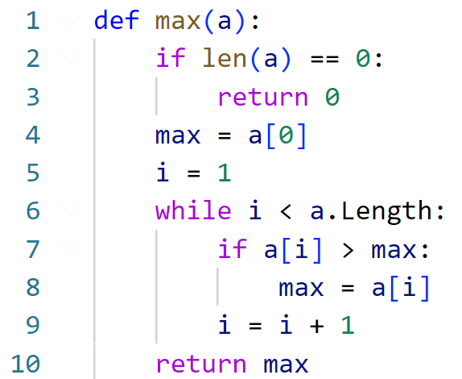
Invariants
Designing with Invariants
Given an array, return the highest number in the array
Notes:
https://www.baeldung.com/cs/loop-invariant

Slide 23
Invariants
examples
What is the loop invariant?
Is it true before the first iteration?
Is it true after each iteration?
Notes:
Invariants
forall j :: 0 <= j < i ==> max >= a[j] //max is bigger or equal to anything seen so far (up to j)
exists j :: 0 <= j < i && max==a[j] //max exists somewhere in the seen portion of the array

Slide 24
Extra Slides
Designing with Invariants
Notes:
https://www.baeldung.com/cs/loop-invariant

Slide 25
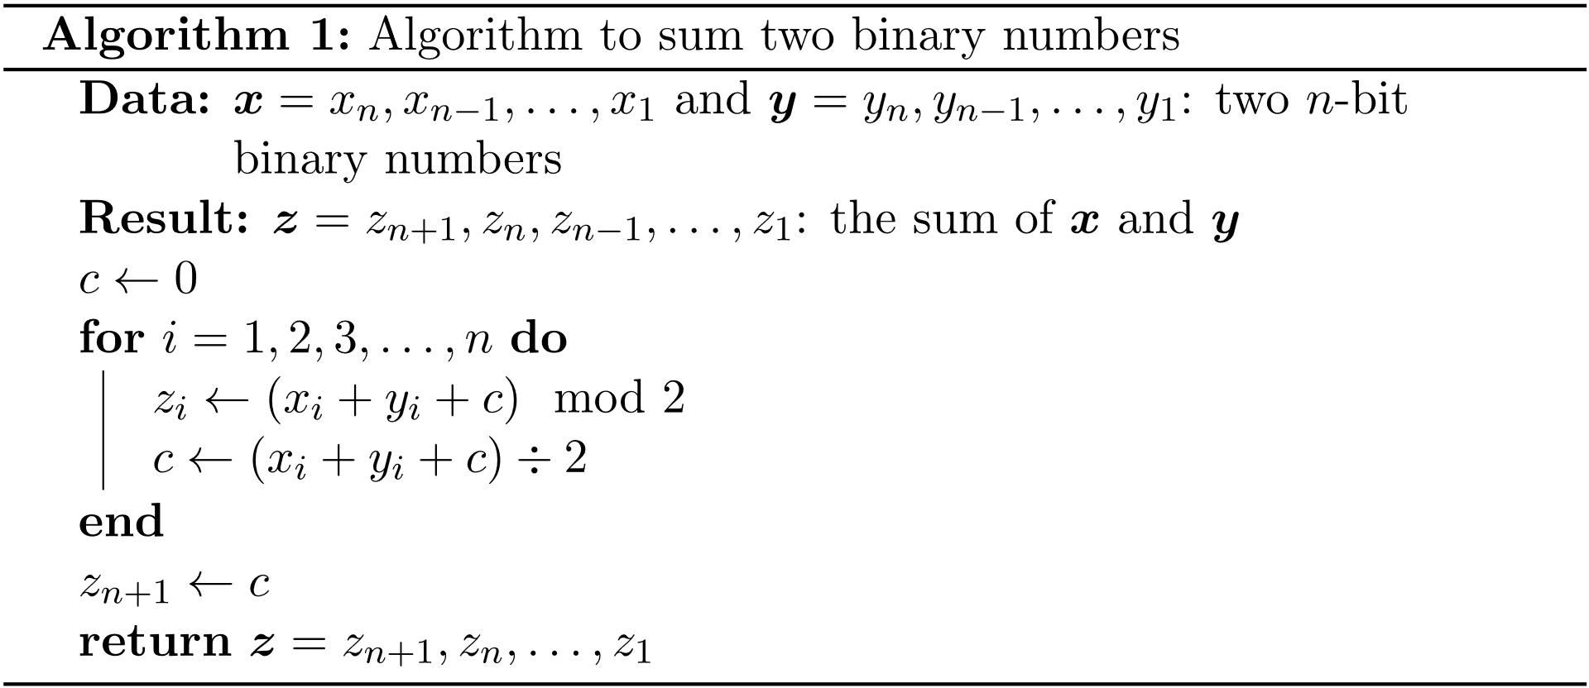
Invariants
examples
Given two n bit binary numbers x and y, calculate x the sum of both numbers
Notes:
https://www.baeldung.com/cs/loop-invariant Talk about the problem
Short example of binary addition
Talk about the algorithm

Slide 26
Invariants
examples
What is the loop invariant?
Is it true before the first iteration?
Is it true after each iteration?
Notes:
https://www.baeldung.com/cs/loop-invariant
At the beginning of the i-th iteration Ci, Zi-1, Zi-2, …, Z1 is the sum of Xi-1, Xi-2, … X1 and Yi-1, Yi-2, …, Y1
START
Before main loop, i = 1 and c = 0, the sum of no digits (Zi-1 = Z0) must be 0.
X0 and Y0 don’t exist, there is nothing to add.
CONTINUATION
Assume Ci, Zi-1, Zi-2, …, Z1 is the sum of Xi-1, Xi-2, … X1 and Yi-1, Yi-2, …, Y1
How is Zi calculated?
When we add Xi + Yi + C and divide by 2 the integer remainder is Zi
e.g. Xi(1) + Yi(1) + C(0) = Zi(0) and next C (quotient) of 1
Xi(1) + Yi(1) + C(1) = Zi(1) and next C of 1
So yes, the invariant will be true for the next iteration

Slide 27
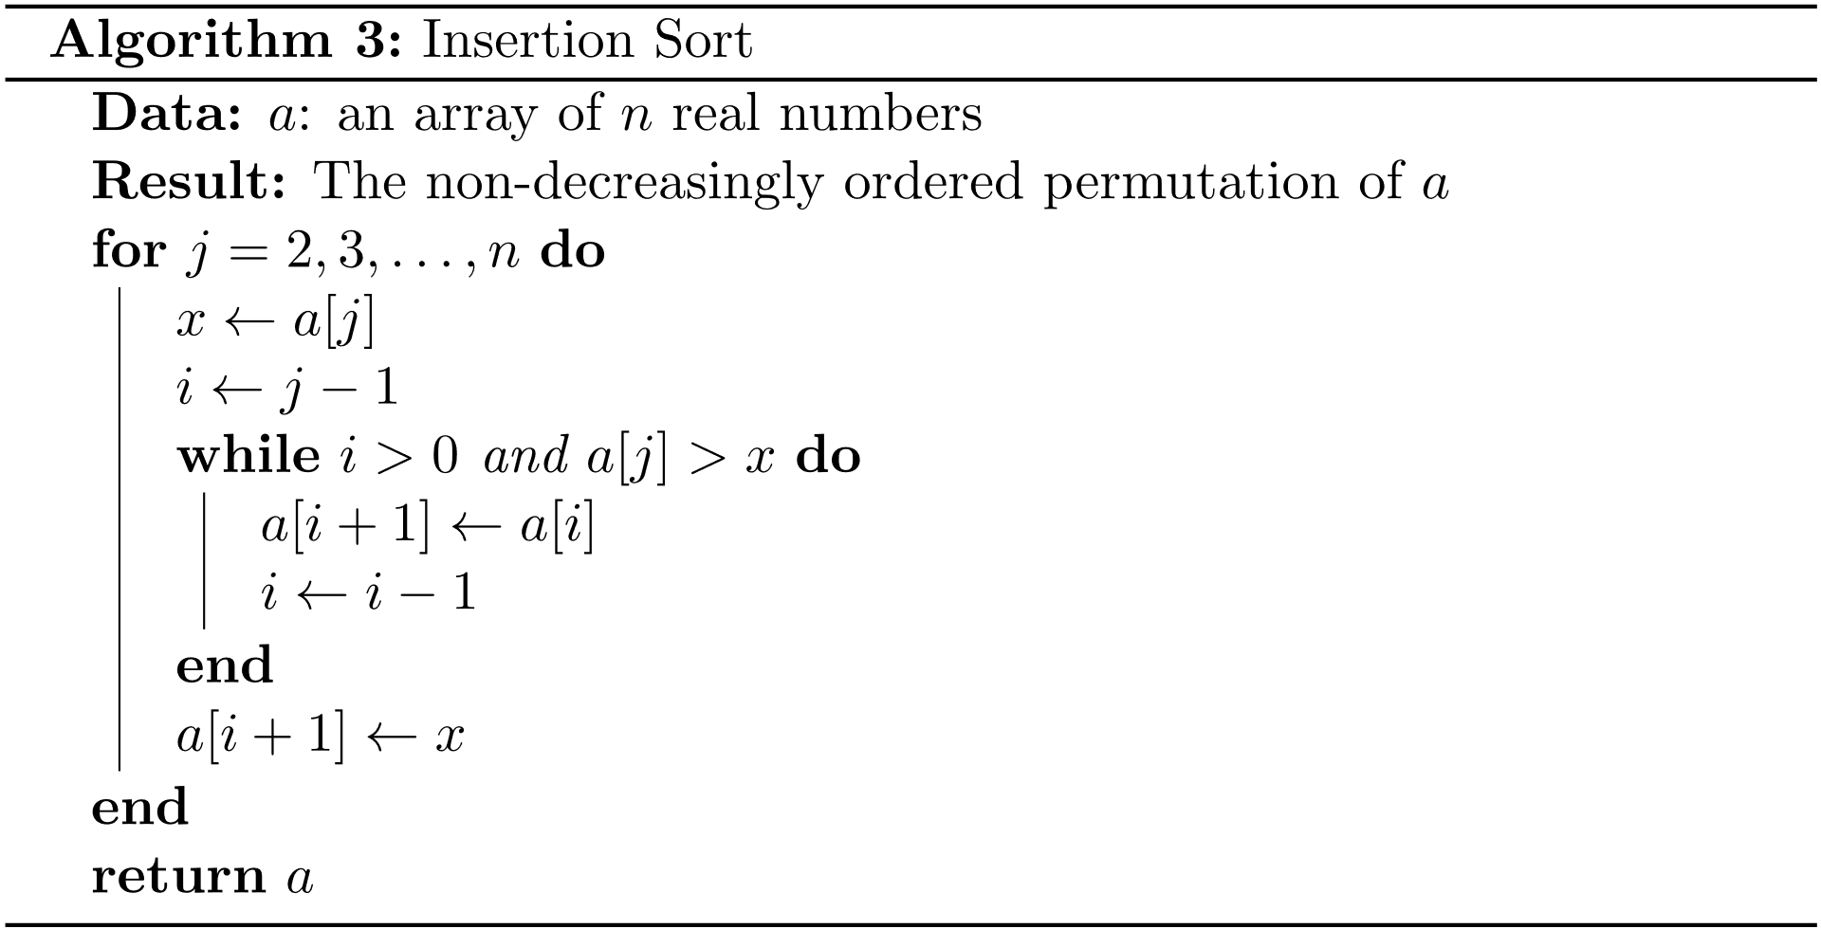
Invariants
examples
Given an array, sort it in ascending order

Slide 28
Invariants
examples
What is the loop invariant?
Is it true before the first iteration?
Is it true after each iteration?
REPLACE WITH SELECTION SORT
Notes:
https://www.baeldung.com/cs/loop-invariant
At the start of each iteration of the for–loop, the subarray A[1], A[2], …, A[j-1] consists of the elements originally in A in the positions 1 through j-1, but in sorted order.
START
J = 2 before the first iteration, everything between A[1] to A[1] is sorted as there is only one item
CONTINUATION
Need to show that after the inner loop, elements A[i+1], A[i+2], …, A[k – 1] are greater then x (the original A[j]) and A[1], A[2], …, A[i] are lower then or equal to x.
Informally
The inner loop shifts items in A one item to the right as long as they are bigger then x (the original A[j]). It only stops when it finds an A[i] which is lower then or equal to x.
Therefore all elements shifted (A[i+1], A[I +2], …, A[j – 1]) are greater then x = A[j]. All those not shifted (A[1], A[2], …, A[i]) are lower then x = A[j]. Therefore placing A[j] at the i-th position in A will result in a sorted subarray.
At the beginning of the i-th iteration Ci, Zi-1, Zi-2, …, Z1 is the sum of Xi-1, Xi-2, … X1 and Yi-1, Yi-2, …, Y1

