Slide 1
Evergreen Classroom
By: Michael Mercer, Christopher Creatura, Juan Pablo Vargas

Slide 2
Contact Info
Juan Pablo Vargas
  LinkedIn - https://www.linkedin.com/in/juan-pablo-vargas-ba1648216
  Email – vargasjp@mail.uc.edu
Michael Mercer
  LinkedIn - https://www.linkedin.com/in/michael-mercer-cs2026/
  Email – mercerma@mail.uc.edu
Christopher Creatura
  LinkedIn - https://www.linkedin.com/in/christopher-m-creatura/
  Email – creatucm@mail.uc.edu
Dr. David Evenhouse
  Email – evenhodd@ucmail.uc.edu

Slide 3
Abstract
The goal of our project is to create a tool that is a catalyst to learning. The tool Evergreen classrooms, will generate problems related to statics for professors to use for their homework assignments. The prototype will include free body diagram generation.
We want to use algorithms to implement this instead of relying on api calls to a large language model. That way our project is cheap to sustain, and our backend is easy to understand
We are working with multiple statics professors to deliver a prototype that will grow over the years to be a useful study tool for students, and a helpful homework creation tool for professors.

Slide 4
User Stories
Professor
  I want to generate new fresh example statics problems for homework and for practice.
  I want to be able to reframe questions to be relevant to students in various fields.
  I want to refresh my problems going into each new year, so that cheating isn't possible.
Student
  I want easy access to numerous practice problems ahead of exams.
Teaching Assistant
  I want rubrics to be able to grade quickly and accurately.

Slide 5
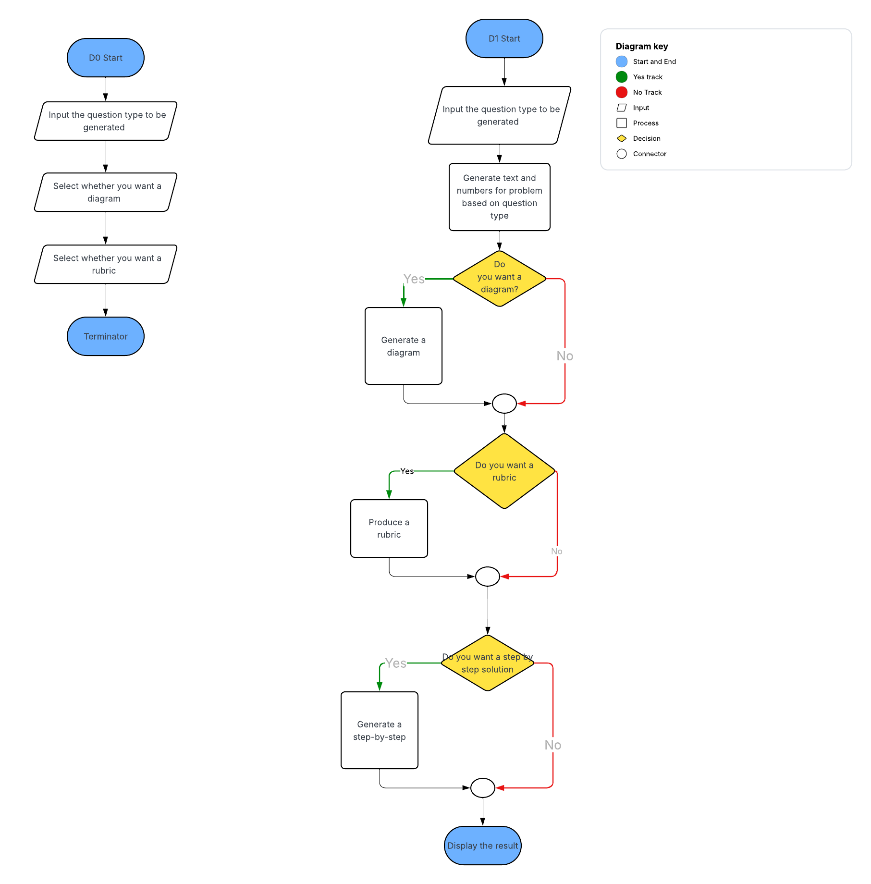
Design Diagram
D0 - D1

Slide 6
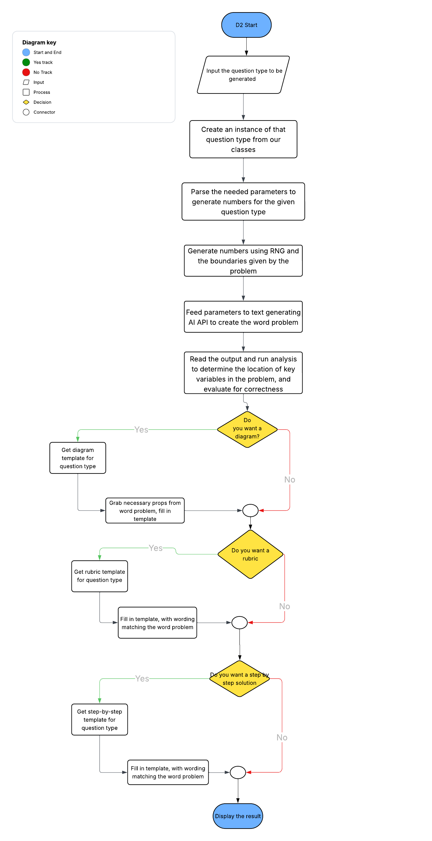
Design Diagram
D2

Slide 7
Constraints
Economic – want to avoid using API calls where possible to keep the tool cheap
Social – We want the product to deter cheating
Environmental – We want our product to not suck up large amounts of energy
Ethical – We want the product to avoid copyright

Slide 8
Progress so far
We have contacted professors to start collecting data
We have been given a statics book to study Freebody diagrams
We have a GitHub repo setup with important details and our first draft design diagram.

Slide 9
Division of Work
Chris- Programming lead, problem diagram creation, and solution check-in
Michael – Programming, word problem creation.
Juan Pablo – Lead of consumer research, co-lead software testing and analysis, and programming lead for Free Body Diagram creation

Slide 10
Goal for end of term
We want to refactor our project to fit our new objective of generating free body diagrams.
We want to determine our force matrix and algorithms at a high level.

Slide 11
Expected demo
Creating a whole problem from scratch using Evergreen classrooms

