Slide 1
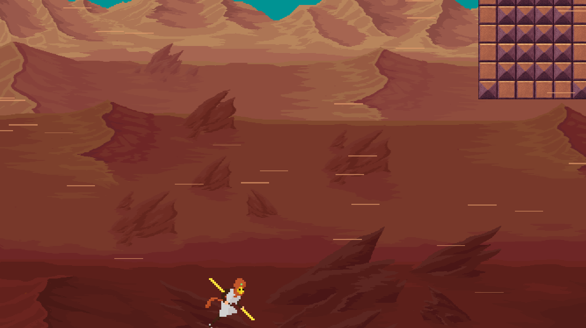
Desert Run
Introduction

Slide 2
Desert Run
Who did what?

Slide 3
Desert Run
Main Idea

Slide 4
Desert Run
Game Design

Slide 5
Desert Run
Storyline

Slide 6
Desert Run
Demo

Slide 7
Desert Run
Retrospective

Slide 8
Desert Run
Difficulties

Slide 9
Desert Run
What was easy?

Slide 10
Desert Run
Source Control

Slide 11
Desert Run
Return on the GDD

