Slide 1
Python programming language
Micah miller and Vincent daughterty

Slide 2
Overview
Homepage
History of Python
What can it do?
What and what is it not capable of?

Slide 3
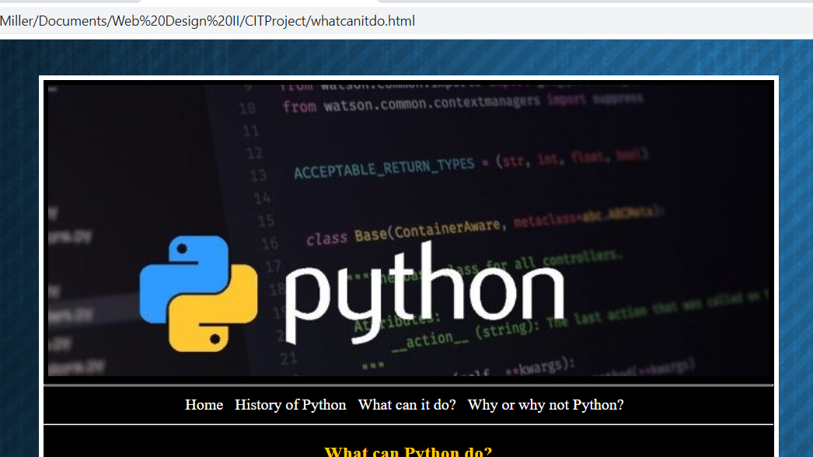
Banner

Slide 4
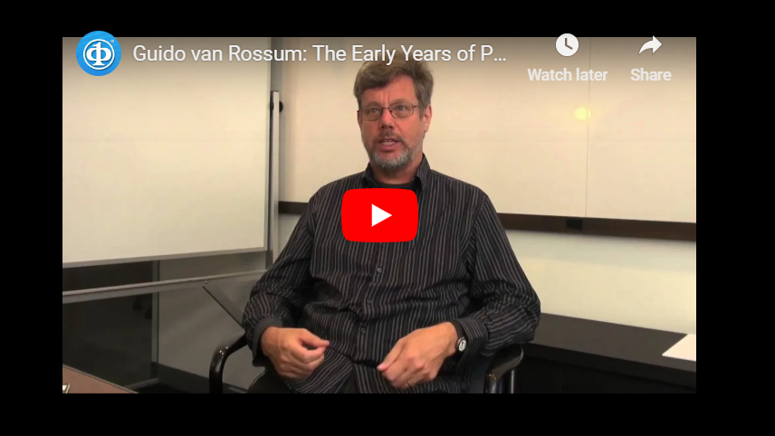
Video

Slide 5

Background Image

Slide 6
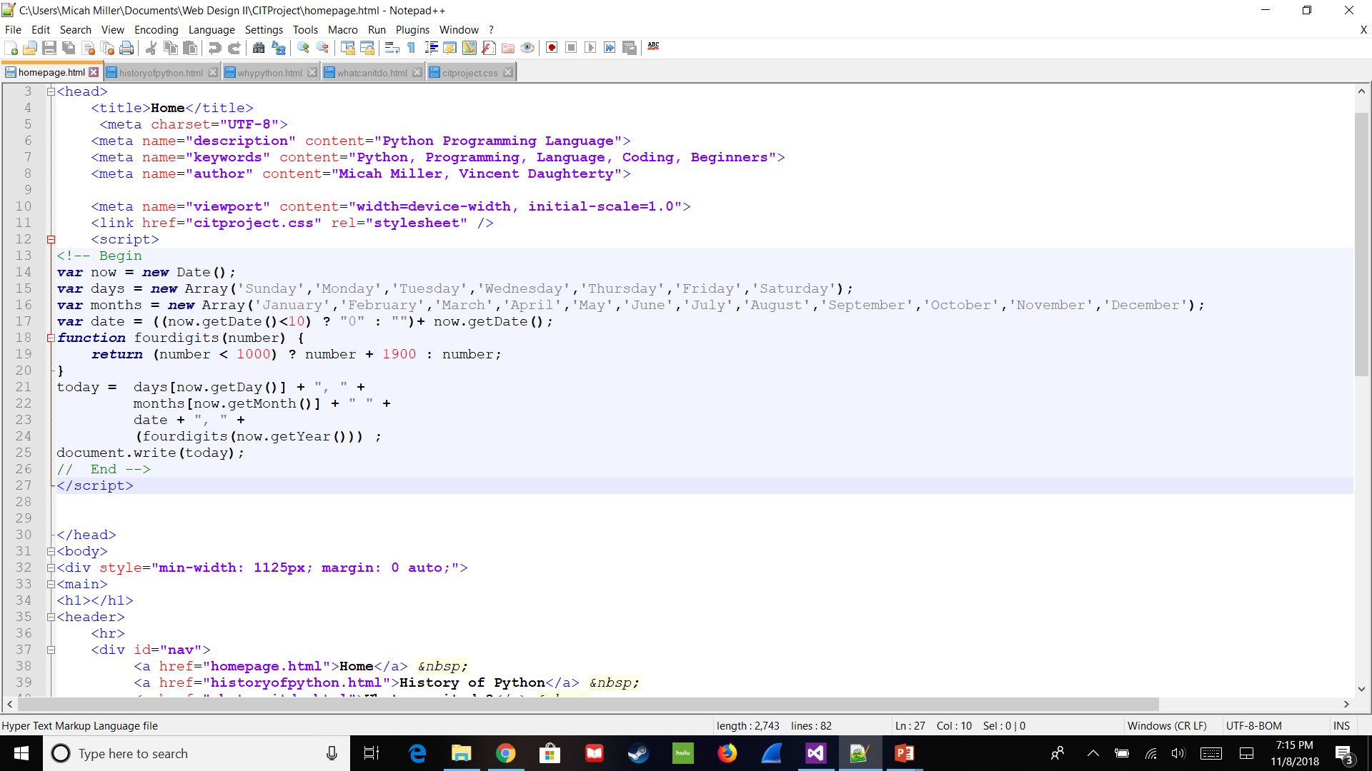
Javascript

