Slide 1

CS 483: Machine Learning
Week 10: Forests, Boosting, Regression

Slide 2
Last module
We learned about Gini impurity
We learned how to actually build a decision tree
We learned about random forests

Slide 3
This module
We’re going to learn more about random forests
We’re going to learn about another ensemble technique: gradient boosting trees. Like random forests but different.
We’re going to learn about using trees for regression.

Slide 4

But first, a quiz
Get ready

Slide 5
The quiz
Calculate the Gini impurity of this bag: { 10 * a, 5 * b, 5 * c }
Generate a tree with one inner node that classifies its training set with 100% accuracy and yields no entropy or Gini impurity. You only need to show the number of members of each class under each child.
How do we create, train, and predict a random forest with a max depth of 3 in SciKit-learn?

Slide 6
Quiz answers
1 - .5*.5 - .25*.25 - .25*.25 = 1- .25 - .125 - .125 = .5
forest = RandomForestClassifier( max_depth = 3 ) forest.fit( train_x, train_y ) predictions = forest.predict( test_x )
Something [53, 79]
[53,0]
[0,79]

Slide 7

Questions?

Slide 8
Remind me about random forests
Why do we use random forests instead of just decision trees?
What’s wrong with decision trees?
How do random forests work?
[class]

Slide 9
Remind me about random forests? (2)
Why do we use random forests instead of just decision trees? What’s wrong with decision trees?
Decision trees tend to overfit
We can fix this by trimming them, but it tends to destroy their performance.
How do random forests work?
(next slide)

Slide 10
How they work
Random forests are groups of different decision trees
We use each tree to classify/predict the same instance
Then, we average the results together:
< Sunny, 720 mm hg, Middle of fall >
Average: ( 60% + 70% + 50% + 40% ) / 4 = 55% rain
1-55% = 45% sun
Tree 1
Tree 2
Tree 3
Tree 4
60% rain, 40% sun
70% rain, 30% sun
50% rain, 50% sun
40% rain, 60% sun

Slide 11
How do we train a forest?
We know how to train a tree
Training a forest is pretty easy too
Let’s see if we can figure out how to do it.
If you wanted to generate a bunch of trees from a dataset, how would you do it? Remember: if all the trees are the same, having lots of them vote doesn’t help us.
[class]

Slide 12
Building random forests
We want a set of trees that are uncorrelated with each other, but which are pretty good on their own
There are two basic techniques:
Bagging + Bootstrapping
Random feature selection
Let’s take a look at bagging first.

Slide 13
Bagging
Bagging is the idea that we build each tree with a subset of data
Imagine our training set has 10,000 instances
We build each tree on 5,000 instances, but those instances are randomly chosen.
Typically, we allow replacement to make this faster [why is it faster with replacement?].
If replacement is used, we call it “bootstrapping”
Each tree is still pretty good, but they end up being built with different data, so they learn slightly different splits.

Slide 14
Issues with bagging
Bagging is still used, but it is not the primary way that decision trees achieve diversity.
[What is wrong with bagging?]
The main issue is that if you train a tree on 5,000 out of 10,000 instances, it will still be very similar.
You need to go way down in size to get major differences, but then the trees are undertrained. (think < 1000)

Slide 15
Alternative to bagging: feature sampling
In the bagging + bootstrapping technique, we select random rows of our dataset.
[What do you think bootstrapping is?]
It’s picking random features instead of random columns
Once we pick random features, we use all the data, but we only split on the features we picked.
So, suppose we choose 10 out of 100 features. We train the tree as normal, but it can only select from those 10 features.
If we train 10 different trees, they will have very low correlation on average.

Slide 16
Controlling the forest
Let’s look at what we can configure about random forests
Here is the reference: https://scikit-learn.org/stable/modules/generated/sklearn.ensemble.RandomForestClassifier.html
[Line by line explanation]

Slide 17
Bagging vs. random features
So which should we use?
Typically, we pick from a random subset of features. That is how forests work in sci-kit learn.
If you want to use bagging, you can. But it’s not an option inside of RandomForestClassifier or RandomForestRegressor.
Instead, you use BaggingClassifier, which takes any classifier and applies bagging to it: https://scikit-learn.org/stable/modules/generated/sklearn.ensemble.BaggingClassifier.html

Slide 18
Questions?

Slide 19
Bagging in general
The idea that we’ve just applied, called “ensemble learning”, can apply to any other classifier or regressor.
We can use BaggingClassifier with linear regression, for example, to have 10 different linear regression models.
How do we use that to make a prediction? Just average the lines together for a particular x value.
In fact, that’s how we can turn trees and forests into regressors too.

Slide 20
Decision tree regression
We’ve only looked at decision trees for classification, but they can also be used for regression.
[What would be different about this tree if we used it for regression?]
Something [53, 79]
[53,0]
[0,79]

Slide 21
Doing regression
When we use trees for ordinary classification, we are predicting probabilities.
For example, this tree predicts 60% true if Something = false:
So how do we do regression instead of classification?
Something [50, 50]
[40, 60]
[80, 20]

Slide 22
Take the mean
For decision tree regression, we just take the mean.
Here’s an example:
If Something = false, the regressor predicts mean(1,2,3,5) = 2.75
If Something = true, the regressor predicts mean(17,14,14) = 15
Something [1,17,14,2,3,14,5]
[1,2,3,5]
[17,14,14]

Slide 23
Similarity
This is actually the same technique used for classification
If a node has 4 false and 1 true, it’s as if we’re averaging: 0%, 0%, 0%, 0%, and 100%,
So either way, we’re just returning the average.
So that raises the question: what about forests?
[what do you think?]

Slide 24
Random forest regression
With random forest classifiers, we take the average probability from the different trees.
With regressors, we take the average target
They are pretty much the same
The main difference is that in scikit-learn, the classifier supports “predict_proba” and the regressor doesn’t.

Slide 25
Questions?

Slide 26
A different trick
So here’s the thing
We’ve learned about this technique called ensemble learning, which lets us use a bunch of weak classifiers to make a much stronger, less “over-fitty” classifier.
But the random forest technique is totally “parallel”. Each model is doing is best (which isn’t very good), and doesn’t take in information from other models.
But is there a technique in which many weak learners team up to produce a strong learner, and it works a little differently.

Slide 27
Boosting
The technique is called “boosting”
This is a generic technique with many different versions
Let’s discuss a few:
AdaBoost (Adaptive Boosting): Like a random forest except we assign a weight to each tree/learner so that the more accurate learners are more favored. Add more importance to instances that are misclassified.
BrownBoost: The opposite of AdaBoost: if an instance is misclassified, give up on it. Good for noisy data.
Gradient Boosting: what we’re about to talk about…

Slide 28
Gradient boosting
Gradient boosting is a technique that involves putting a bunch of small decision trees in a sequence, rather than parallel.
Sometimes these are proper trees, other times they are decision stumps (depth = 1)
The basic idea is this: the first tree does its best (but it’s bad)
The second tree tries to predict the error caused by the first tree
The third tree tries to predict the error caused by the second tree
…etc.

Slide 29
Example
Let’s generate some random data with some patterns: xs = np.arange(0, 100).reshape( -1, 1 ) y1 = np.random.uniform(20, 25, 20) y2 = np.random.uniform(50, 55, 20) y3 = np.random.uniform(0, 10, 20) y4 = np.random.uniform(70, 80, 20) y5 = np.random.uniform(90, 100, 20) ys = np.concatenate((y1, y2, y3, y4, y5))
Uniform generates random numbers with a uniform distribution

Slide 30
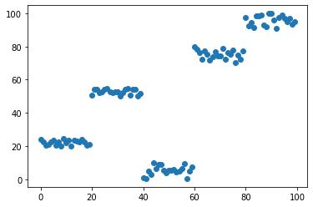
Visualizing it
We’ll use scatter plots for our visualizations. Here’s what we just generated→
Notice that there’s a lot of regularity here, but also some randomness.
It’s not linear, but a tree could do a good job predicting this data.

Slide 31
Building the tree
SkLearn makes things easy for us: dr1 = DecisionTreeRegressor( max_depth = 2 ) dr1.fit( xs, ys ) p1 = dr1.predict( xs )
xs and ys are the values we predicted
p1 are the predictions from the tree, which is trying to match the ys.

Slide 32
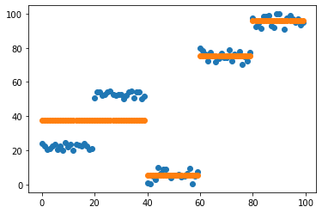
Predicting errors
Now let’s plot our tree’s predictions in orange.
Here is the data we saw before, with the weak decision tree’s prediction placed on top of it.
How does it look?

Slide 33
How does it look?
Notice that decision tree predictions go in straight lines
These lines are the “bins” that instances are classified in.
Notice that on the left, one line is stretched over two different clusters.
This makes the tree worse. Ideally we’d have two lines there, one for each cluster.
[Why is this happening?]

Slide 34
Going back to regression
[Does the output of the decision tree regressor make sense?]
Each “bin” in the tree is a group of instances that have been placed together by the tree.
The regressor takes the instance as input, follows it down the tree, and outputs the average value of the bin that it ends up in.

Slide 35
Questions?

Slide 36
The residuals
It’s very rare for a prediction to be perfect
We can subtract the prediction from the actual value.
This difference is called a “residual”
Let’s take a look at some residuals

Slide 37
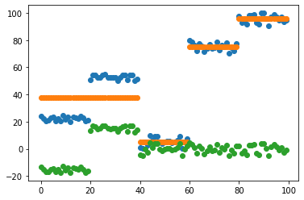
The residuals (2)
Here’s a plot
The residuals are green
To get the residuals, subtract the predictions (orange) from the actual y values (blue)

Slide 38
The next step
Now, we build another tree.
The job of this tree is to predict the residuals.
[remind me what the residuals are]
Help me understand this code: dr2 = DecisionTreeRegressor( max_depth = 2 ) dr2.fit( xs, rs1 ) p2 = dr2.predict( xs ) rs2 = p2 - rs1

Slide 39
The code
We’re creating a new regressor, dr2
The purpose of this regressor is to learn the residuals
Now we predict the residuals from the xs
Then, we calculate the residuals of the residuals
Get that? Each tree tries to predict the errors of the previous tree, and the errors of the errors are the target of prediction for the following trees.

Slide 40
Visualizing it
Let’s view the following:
The residuals from the first tree
The predictions from the second tree
The residuals of the residuals
How?
Draw the following:
plt.scatter( xs, rs1 )
plt.scatter( xs, p2 )
plt.scatter( xs, rs2 )
[all of this will work in your notebook, just import matplotlib.pyplot as plt ]

Slide 41
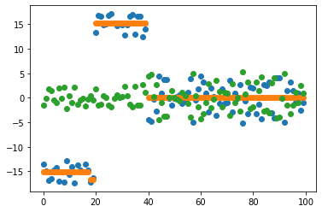
The result
Blue is original residuals
Orange is predicted residuals
Green is residual residuals
[What do you notice?]
[Can we go further?]

Slide 42
Something to notice
There’s something out of place in the last image
There’s a stray orange line
[Do you see it?]
Look in the bottom left of the image
That’s overfitting in action
We know that the bottom cluster was generated as one uniform random range. It should not be split in two. The tree is getting fooled by noise. Whenever you start classifying noise (instead of the mean), you are overfitting.

Slide 43
Can we go further?
Only one way to find out:
dr3 = DecisionTreeRegressor( max_depth = 2 ) dr3.fit( xs, rs2 ) p3 = dr3.predict( xs ) rs3 = p3 - rs2
[What do you think will happen?]

Slide 44
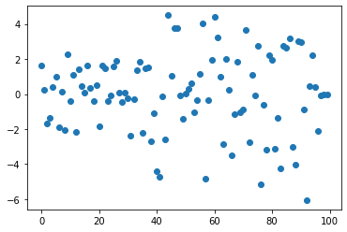
What happened
plt.scatter( xs, rs3 )
this is the residuals of the residuals of the residuals

Slide 45
Other things to notice about that chart
The y-axis is much smaller. The error of the error of the error is smaller than the original error.
This is good, if it was larger, what would that tell us about our boosting technique?
[How would you describe its distribution?]

Slide 46
It looks random
Here’s a sad statistical fact:
Randomness is impossible to predict
In fact, that’s definitional.
If we do end up “predicting” something that was randomly generated, we have definitely overfit our model
[why?]

Slide 47
Questions?

Slide 48
What does the randomness tell us?
[what do you think?]
It tells us that we’re “done”
Adding more decision trees is not going to help, and may very well hurt (because of overfitting)
Random aside: [how do we measure randomness?]
We can use entropy.

Slide 49
Let’s try it anyway
Suppose we go one step further and try to predict those random residuals
What do you expect those residuals to be? (the residuals of the residuals of the residuals of the residuals)
[please make your guess now]

Slide 50
Trying it out
dr4 = DecisionTreeRegressor( max_depth = 2 ) dr4.fit( xs, rs3 ) rs4 = dr4.predict( xs ) - rs3
plt.scatter( xs, rs4 )

Slide 51
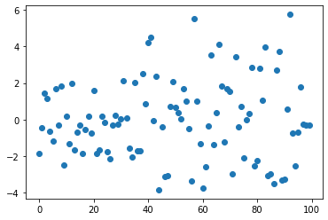
The results
They got slightly worse. [let’s compare]

Slide 52
The results (2)
If you compare with the previous residuals, they are roughly as random, but there’s a little more variance
The max value is larger now. The variance seems a bit worse.
Otherwise, it still looks random.

Slide 53
Making the prediction
Remember, the trees were predicting the errors of the previous trees.
To construct a prediction out of that, we take the prediction from the original tree, and:
Add the prediction of the residuals
And the prediction of the residuals of the residuals
And the prediction of the residuals of the residuals of the residuals
etc.
How do we do that?

Slide 54
Making the prediction (2)
We stored the prediction of the first tree in p1, the second in p2, etc.
Just add them together:
Predicted y = p1 + p2 + p3
Remember, p1 was the prediction our first tree trying its best
p2 was the prediction of the second tree, trying to guess how p1 was wrong. A residual of 1 is like saying “you should have been 1 higher for this value”, so if we add these residuals, we expect to more closely match the value we’re predicting.

Slide 55
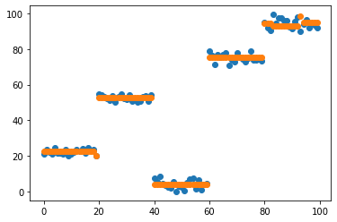
What it looks like
plt.scatter( xs, ys ) plt.scatter( xs, p1 + p2 + p3 )

Slide 56
What this means
We can use gradient boosting to improve our results.
Notice: we got decent results. It looks like the tree is predicting the data will, with a couple of instances of fitting noise
There’s a limit to how far we can go, we can’t apply this infinitely.

Slide 57
Questions?

Slide 58
What about other predictors?
We could try linear regression
[What do you think will happen?]

Slide 59
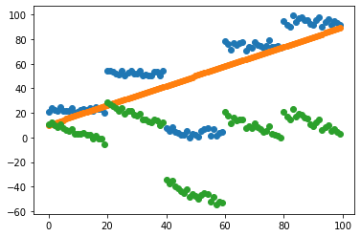
First run
Blue is original ys, orange is predicted line, green is residuals

Slide 60
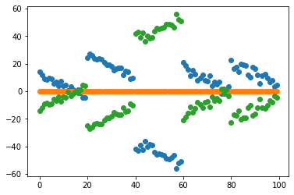
Predicting residuals
Let’s try to predict the residuals:
Uh…

Slide 61
What does that mean?
Fun fact: if the prediction line is horizontal, it means no relationship.
[let’s think about this]
So basically we are stopped after the first round of predictions.
Gradient booting is great for trees, not so much for linear regression.
Remember, if we add lines, we get another line. So we really don’t expect to add anything by adding lots of linear regression classifiers.
That doesn’t mean there aren’t other options, just that linear regression doesn’t work well with gradient boosting.

Slide 62
How do we use it?
Okay, so if you want to use gradient boosting, there’s a convenient class to use in sklearn: sklearn.ensemble.GradientBoostingClassifier (or Regressor): https://scikit-learn.org/stable/modules/generated/sklearn.ensemble.GradientBoostingClassifier.html
It has many of the same parameters as random forests do, but there’s one more:
Learning rate

Slide 63
Learning rate
Sometimes, if we’re learning to fit a complex curve, it can be challenging to predict the residuals.
Instead, we can only try to predict some of them. By multiplying the residual predictions by a constant factor.
The larger the factor, the more ambitious we are.
This factor is very important in training neural networks, but we won’t worry about it now. The defaults are reasonable. Note that the lower the learning rate, the higher the quality of the model, but the more trees you need. [discussion of DNN learning rate]

Slide 64
Questions?

Slide 65
How good is gradient boosting
Now that we’ve covered this method, how good is it?
Gradient boosting trees are highly effective, and one of the most widely used non-linear techniques, next to neural networks.
They train relatively quickly (compared to NNs, they are a bit slower to train than random forests because they can’t be trained in parallel)
They can be vulnerable to overfitting as we saw, but we can adjust the learning rate to mitigate that somewhat.
Plusses: great accuracy
Minuses: a bit slower than random forests. May overfit more.

Slide 66
Learning exercises
Replace your random forest for project 3 with a gradient boosting regressor. How well does it perform? Try to optimizing the number of estimators and the learning rate.
Try to build your own gradient boosting forest the same way we did in the lecture. I recommend using a notebook.

Slide 67
Questions?

