Slide 1
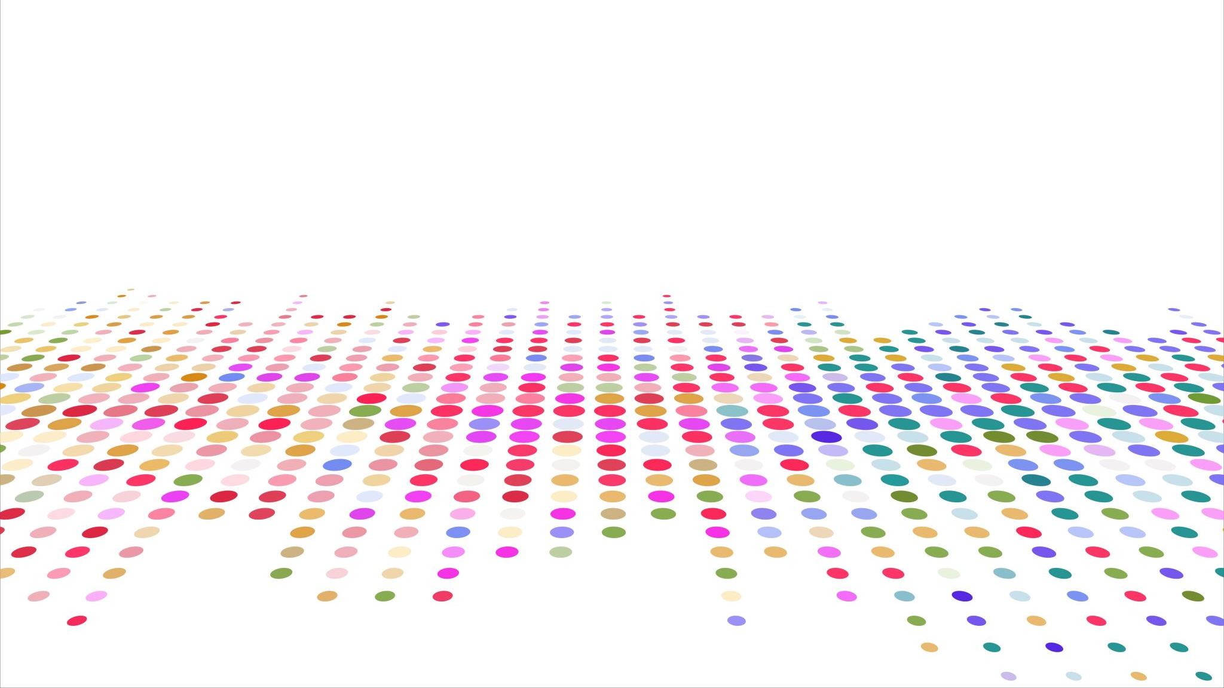
CS 483: Machine Learning
Week 11: Unsupervised Learning

Slide 2
Prior classes
We’ve spent most of our time up to this point on supervised learning
[What are the two forms of supervised learning we have learned?]
[What is the difference between them?]

Slide 3
This class
Now it’s time to finally learn about unsupervised learning
We’ll talk about some basic concepts
Then we’ll learn an application of it: clustering.

Slide 4
What is unsupervised learning?
Fundamentally, it’s machine learning without a target
This seems confusing at first
We’ve thought of machine learning algorithms as “teach the computer to predict something”
And obviously there needs to be something to predict.
What else would we do without a label?

Slide 5
Pattern recognition
Unsupervised learning is more like “pattern recognition”
The idea is to notice relationships in the data without necessarily having an idea of what you’re looking for up front.
A simple example: remember those correlation tables we used for project 2 to help us determine which features to use?
If we didn’t care about the label, and only wanted to merge features based on their correlation, that would be an example of unsupervised learning.

Slide 6
A classic example
One form of unsupervised learning is a data mining technique called “association rule mining” (or learning): https://en.wikipedia.org/wiki/Association_rule_learning
The basic idea: what if every feature were potentially a label and we perform classification for each one?
So we could predict whether low pressure and high moisture lead to rain, or whether rain and low pressure lead to high moisture, etc.
Let’s take a look.

Slide 7
Market basket analysis
Publication: Mining association rules between sets of items in large databases. Agrawal, Imielinski, Swami. ACM SIGMOD volume 22, iss. 2 https://dl.acm.org/doi/10.1145/170036.170072
The idea was to look at retail point of sale data to see what items were bought together.
The goal was not just to identify correlations, but to determine rules.
For example { tomatoes, hamburger buns, onions } => { hamburger meat } would be a strong implication, that if someone was buying the three thing on the left, they would likely purchase hamburger meat.

Slide 8
Using this information
Why would a supermarket want to know this information?
How could they use it to help the shopping experience?
[class?]
Trick question: they would use it to put the hamburger ingredients as far away from the hamburger as possible (to make you walk through the store and impulse-buy stuff along the way)

Slide 9
Why don’t we do this all the time?
Association rule mining sounds like “better classification”
Like, not only do we classify the target, we would also presumably figure out which features are the best, too (because they would participate in association rules).
Unfortunately, it’s computationally very challenging.
There are hyperparameters to optimize to determine how much evidence a rule needs to be reported, and opening yourself up to lots of rules means massive, overwhelming amounts of rules end up getting generated.
we’re dealing with powersets here, so exponential space of rules

Slide 10
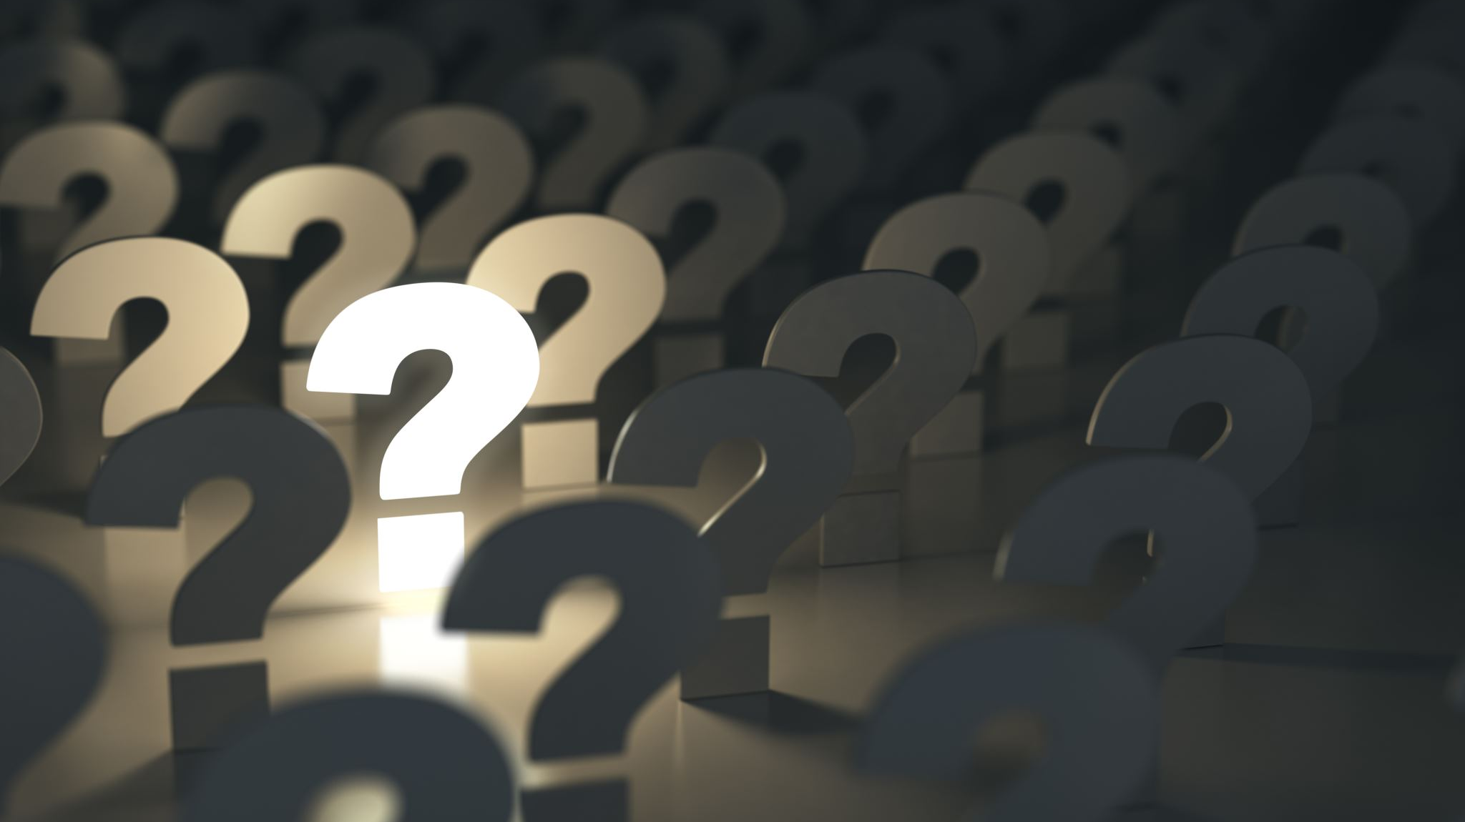
Questions?

Slide 11
Clustering
Now let’s learn a common form of unsupervised learning: clustering.
When clustering, we usually don’t have a label
We aren’t trying to predict or classify a label.
Instead, we just want to know what instances are similar to each other.
To do this, we define a set of clusters in which each instance is added to (usually exactly one) cluster.

Slide 12
Clustering goals
Imagine we have a bunch of datapoints.
We group them into clusters based on their features.
Imagine that the X and Y coordinates are different features (like square footage and lot size)
Here is an example of clustering them. Each color is a different cluster.
Feature Y
Feature X

Slide 13
How good are the clusters?
On the previous page, I think we would agree that the clusters are good.
What about these instead?
Feature Y
Feature X

Slide 14
What do the dots represent?
Anything
They can be houses, which could be grouped together by size and cost.
They can be people, grouped together by shared interests
They can be cars, grouped together by size, power, or other attributes
They can emergencies, such as forest fires, which we group together in order to know where to place our fire departments.
[any other ideas?]

Slide 15
Clustering algorithms
Clustering algorithms are like the classification or regression algorithms you have already learned.
The only difference is: there are X values, and no Ys
Their goal is to generate the best “clustering” (a clustering is a set of clusters).
We’ll define what “best” means later, but for now, let’s learn a simple and popular algorithm: K-means

Slide 16
Questions?

Slide 17
K-means clustering
K-means clustering is a simple sorting algorithm that is surprisingly robust and popular
It’s kind of like the “naïve bayes” of clustering algorithms. Not usually ideal, but fast and easy to understand.
It’s often used as a baseline.
So what does the name mean?

Slide 18
K-means clustering (2)
In order to use K-means, you must select a value of K.
K is the number of clusters, and each cluster has one mean (which is the center of the cluster).
So we decide ahead of time how many clusters we want.
(this works well for some problems and not for others. We’ll talk about how to “solve” for K later when we don’t know ahead of time)

Slide 19
K-means process
Once you pick a value for K, the clustering algorithm picks K random values and treats them as the center of a cluster.
As an example, suppose K = 3. We put three random, imaginary points in the feature space. These points are not instances, they are the centers of clusters that we haven’t created yet.
1
Feature Y
3
2
Feature X

Slide 20
K-means process: the assignment step
Each mean is the center of one cluster.
We assign each instance to the closest mean. That’s how we cluster it.
Notice how the “means” aren’t actually at the center of the clusters yet (they will be, soon)
1
Feature Y
3
2
Feature X

Slide 21
K-means process: the update step
You’ll notice that our clusters are a little weird. The means are on the edges of them
Now that we have assigned every instance to a cluster, we recalculate the means to be in the middle of their clusters.
That’s a little better…
1
Feature Y
3
2
Feature X

Slide 22
K-means iterations
The problem is, after updating our means, we now have points that are close to the wrong one. For example, there’s a green node near 3.
[How might we fix this?]
1
Feature Y
3
2
Feature X

Slide 23
Re-assignment
We iterate over all the data points and re-assign them to their closest means.
This means some data points will change color.
1
1
Feature Y
Feature Y
3
3
2
2
Feature X
Feature X

Slide 24
Let’s keep going: update
Now we move the clusters means again
Notice that they don’t move as much as before
Things are starting to settle down.
1
Feature Y
Feature Y
3
1
3
2
2
Feature X
Feature X

Slide 25
Let’s keep going: assignment
Now we move the clusters means again
Notice that they don’t move as much as before
Things are starting to settle down.
Feature Y
Feature Y
1
3
1
3
2
2
Feature X
Feature X

Slide 26
Finishing up
During the update step, we move the means back to the center
However, notice that the points are all clustered correctly.
At this point, no changes to color happen, which signifies that we are totally done.
Feature Y
Feature Y
1
3
1
3
2
2
Feature X
Feature X

Slide 27
The algorithm overview
K-means proceeds by doing these two steps over and over:
Assign each instance to its nearest mean
Move each mean to be in the middle of its instances (to be an actual mean)
We keep doing this until no assignments change
This is guaranteed to happen as long as we use Euclidean distance.

Slide 28
Animated example

Slide 29
Minor notes
Technically, we don’t use the Euclidean distance for this
We use the square of the Euclidean distance. Why do you think this is?
The result will not change. Assigning by distance and by squared distance will result in the same assignments.
[Hint: performance]
Reason: Euclidean distance requires a square root. Squaring it removes the square root but doesn’t change the results. Faster.
Using a different distance metric means we are not guaranteed to converge [do we know any other distance metrics?].

Slide 30
Questions?

Slide 31
Using K-means
Recall that scikit-learn refers to models as “estimators”
Estimators support the “fit” and the “predict”
Clusterers are no different
First, let’s import our KMeans clusterer: from sklearn.cluster import KMeans
https://scikit-learn.org/stable/modules/generated/sklearn.cluster.KMeans.html

Slide 32
Generating a dataset
Let’s get some some instances:
xs = np.array( range(0, 80) ) y1 = np.random.uniform(20, 25, 20) y2 = np.random.uniform(50, 55, 20) y3 = np.random.uniform(0, 10, 20) y4 = np.random.uniform(70, 80, 20) y5 = np.random.uniform(90, 100, 20) ys = np.concatenate( [ y1, y2, y3, y4, y5 ] ) instances = np.array( list( zip( xs, ys ) ) )
#note, we can use pandas dataframes too, not just np arrays

Slide 33
What’s going on here?
Our x values are just the numbers from 0 to 99
We generate random uniform noise for the y values over different ranges of the x values.
There are 5 natural clusters here.
Clustering doesn’t really have the concept of x values and y values, though. We don’t treat the y value specially. Instead, we combine x and y (and z and w and whatever other features we have) together into an array of arrays.
Remember, we will have more than just x and y in the future.

Slide 34
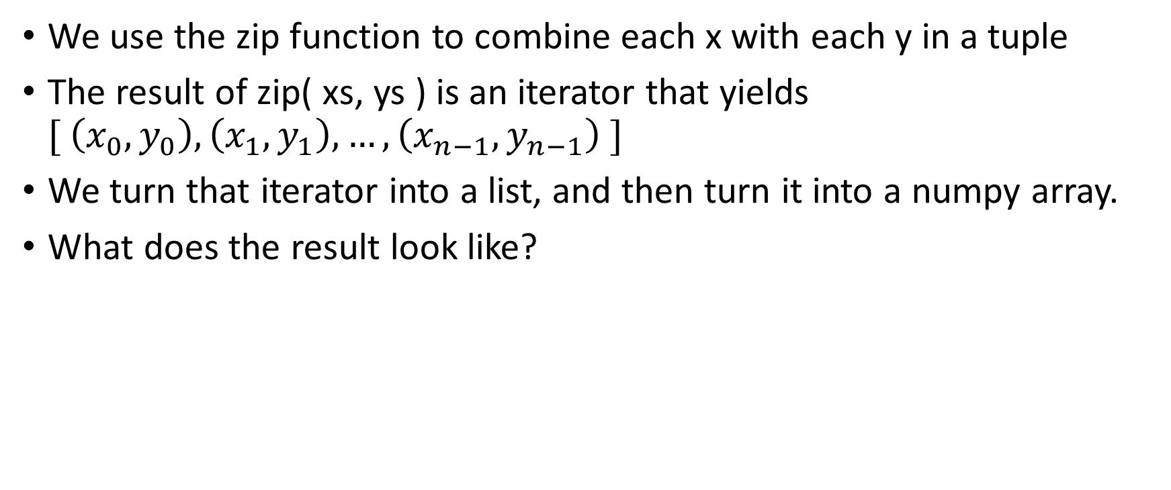
What’s going on here? (2)
We use the zip function to combine each x with each y in a tuple
The result of zip( xs, ys ) is an iterator that yields $[ \left(x_{0},y_{0}\right), \left(x_{1},y_{1}\right), …, \left(x_{n−1},y_{n−1}\right) ]$
We turn that iterator into a list, and then turn it into a numpy array.
What does the result look like?

Slide 35
What does this dataset look like?
We can use matplotlib to generate scatterplots
First: import matplotlib.pyplot as plt
Then, we can use the “scatter” function to draw a scatterplot: plt.scatter(xs, ys)

Slide 36
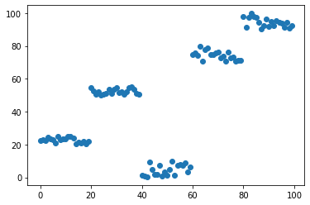
The result

Slide 37
Clustering that data
First, create a KMeans clusterer.
Just use the constructor, same as linear regression or tree techniques: clusterer = KMeans( 5 )
What is the 5? That’s the number of clusters. We have to guess in advance how many clusters to use with KMeans. Some other clustering techniques don’t have this limitation (but they have other problems)
Fit the clusters to the data. This is the same as fitting a classifier or regressor, but because this technique is unsupervised, there are no “target” or “label” values: clusterer.fit( instances )

Slide 38
Getting predictions
In the past, once we trained our classifiers or regressors, we would call “predict” to actually get the labels or predicted y values out.
That function still works here, but it returns the cluster ID
Because we set K = 5, we have clusters 0 through 4
predictions = clusterer.predict( instances )
predictions == array([4, 4, 4, 4, 4, 4, 4, 4, 4, 4, 4, 4, 4, 4, 4, 4, 4, 4, 4, 4, 0, 0, 0, 0, 0, 0, 0, 0, 0, 0, 0, 0, 0, 0, 0, 0, 0, 0, 0, 0, 2, 2, 2, 2, 2, 2, 2, 2, 2, 2, 2, 2, 2, 2, 2, 2, 2, 2, 2, 2, 3, 3, 3, 3, 3, 3, 3, 3, 3, 3, 3, 3, 3, 3, 3, 3, 3, 3, 3, 3, 1, 1, 1, 1, 1, 1, 1, 1, 1, 1, 1, 1, 1, 1, 1, 1, 1, 1, 1, 1])

Slide 39
What are the means?
Scikit learn refers to the means as “cluster centers”
Let’s get them: clusterer.cluster_centers_
Result: array( [[29.5 , 52.32162755], [89.5 , 94.3453179 ], [49.5 , 4.49244002], [69.5 , 74.21279577], [ 9.5 , 22.7466891 ]])

Slide 40
Visualizing the clusters
It’s hard to visualize clusters in more than 2 dimensions.
It’s possible to “project” a higher dimensional figure down into 2 dimensions using techniques like principal components analysis (PCA).
However, for now, let’s stick with 2D scatter plots that show each cluster in a different color.

Slide 41
Drawing the scatter plot
We have five clusters, so let’s use five colors, one for each: colors = [ 'red', 'blue', 'orange', 'green', 'violet’ ]
We need to assign each cluster label one of these colors. Let’s use “map” to match each cluster id to one of the colors above: instance_colors = \ list( map( lambda cluster_id: colors[cluster_id], predictions ) )
Now, we can draw our scatter plot: plt.scatter( instances[:, 0], instances[:, 1], c = instance_colors )

Slide 42
Numpy column notation
Numpy uses multi-dimensional slice notation
To get the zeroth column of a numpy array, we write: arr[:, 0]
The colon means “all rows”, the zero means “zeroth column”.
By using this slice notation, we don’t have to use “map” again.

Slide 43
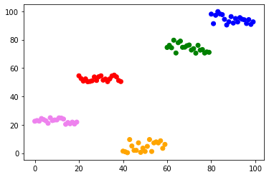
Colorized clusters

Slide 44
Clusters compared to what you already know
You can use clusters in pipelines
You can cluster pandas dataframes (if all the features are numeric)
You can save clusterers in pickles
Because you understand estimators, you understand how to use clusterers.
It’s challenging to use them with GridSearchCV, however. Their scoring works a bit different, and you can’t just pass a convenient clustering metric to the searcher.
You can use GridSearchCV, it’s just not ideal (can’t choose scoring)

Slide 45
Questions?

Slide 46
Does this look good?
The clusters we just generated look perfect.
Is that always the case?
Take a look for yourself: https://scikit-learn.org/stable/modules/clustering.html
Notice that the KMeans implementation (called “Minibatch KMeans”) breaks on certain patterns. Concentric circles for example don’t work (because we look for clusters with tight Euclidean distance)

Slide 47
Defining good vs. bad clustering
What makes a set of clusters good or bad
We can clearly see that clustering two is worse than number one, but we need a way of mathematically determining this.
[What do you think?]

Slide 48
Good versus bad clustering
There are two concepts that relate to the quality of clusters:
Separation: how far apart clusters are (sometimes the compliment is called “coupling”)
Cohesion: how close the points within a cluster are together
Ideally, we want low coupling and high cohesion
That is, we want the points in a cluster to be very tight and close together, and we want that cluster to be far from other clusters.
[you might remember these concepts from software engineering. What did they mean there?]

Slide 49
Defining cohesion
Cohesion is defined as the average distance between all the pairs of points in a cluster.
That is: how close are the points (on average)
How would you define this mathematically?
[class]

Slide 50
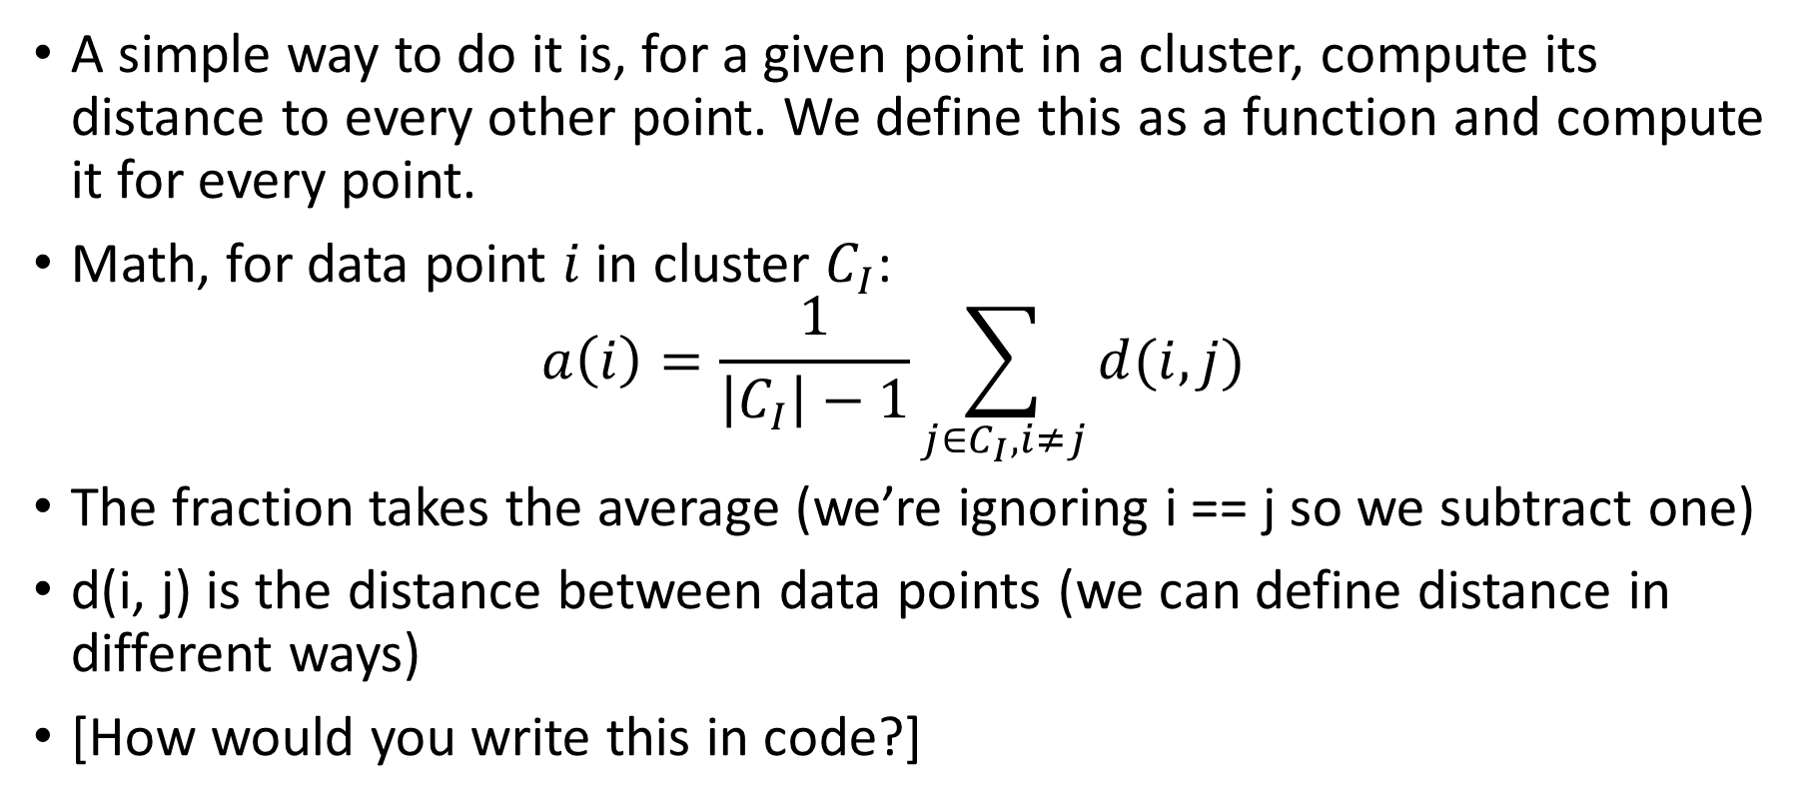
Defining (anti) cohesion (2)
A simple way to do it is, for a given point in a cluster, compute its distance to every other point. We define this as a function and compute it for every point.
Math, for data point $i$ in cluster $C_{I}$: $a\left(i\right)=\frac{1}{\left|C_{I}\right|−1}\sum_{j∈C_{I},i≠j}{d(i,j)}$
The fraction takes the average (we’re ignoring i == j so we subtract one)
d(i, j) is the distance between data points (we can define distance in different ways)
[How would you write this in code?]

Slide 51
What does cohesion mean?
The previous metric really is “anti-cohesion”
The bigger the average distance is, the more spaced out our cluster is.
So, perhaps “spread” is a better word for this.
The more spread we have, the less “good” our set of clusters is.
Note: we don’t always get to have good cohesion/narrow spread. Sometimes the data is just spread out.
But when we’re comparing clustering algorithms, it makes sense to pick one with lower spread (if everything else is equal)

Slide 52

Defining separation
Separation is defined between clusters
How much is cluster $C_{i}$ separated from cluster $C_{j}$?
If you had to measure this, what would you do?
[I want you to write your own metric]

Slide 53
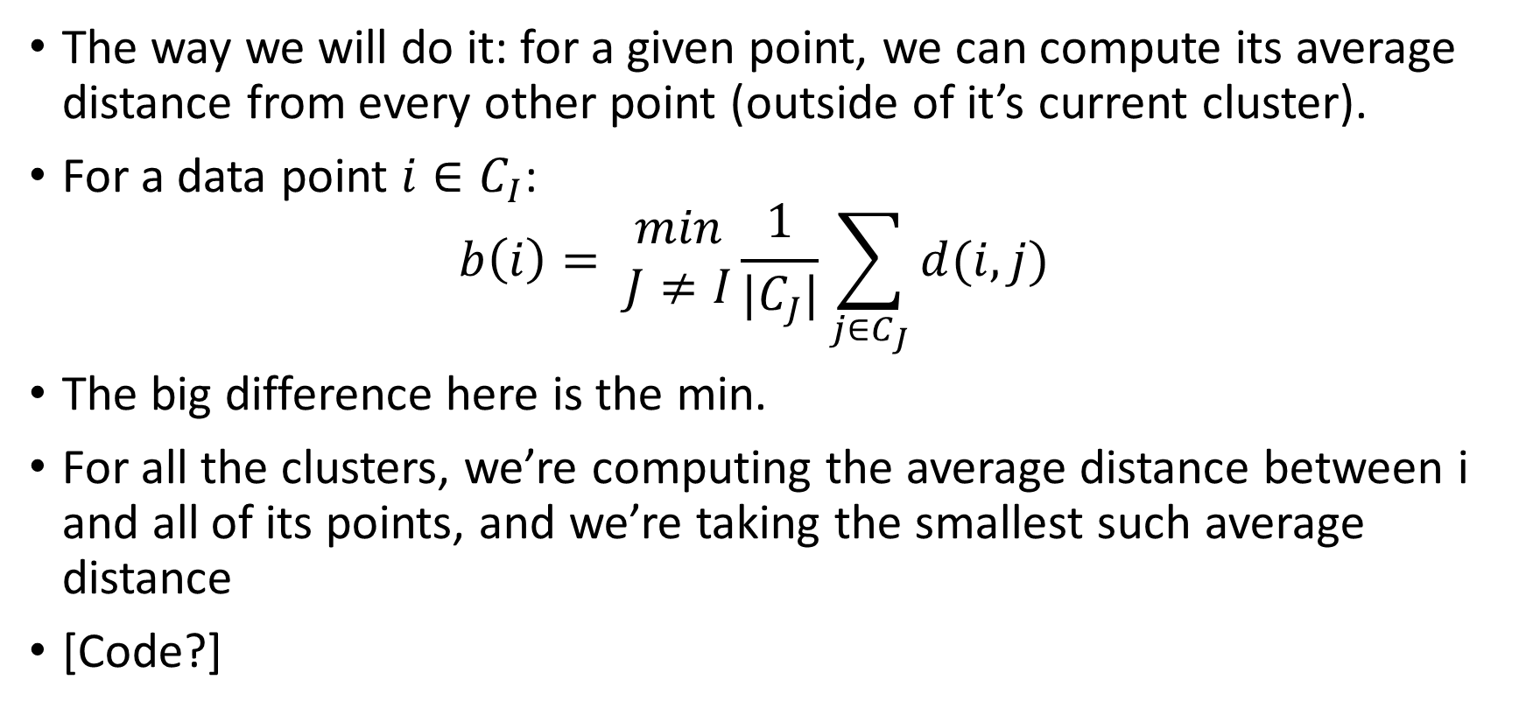
Defining separation (2)
The way we will do it: for a given point, we can compute its average distance from every other point (outside of it’s current cluster).
For a data point $i∈C_{I}$: $b\left(i\right)= \begin{matrix}min \\ J≠I\end{matrix}\frac{1}{|C_{J}|}\sum_{j∈C_{J}}{d(i,j)}$
The big difference here is the min.
For all the clusters, we’re computing the average distance between i and all of its points, and we’re taking the smallest such average distance
[Code?]

Slide 54
Why is this useful?
Ideally, clusters are supposed to represent distinct groups of values.
For example, suppose we’re using clusters to see where people live.
Suppose we’re a restaurant franchise. We want to know where to put the locations.
We use clustering so that we can locate our restaurants in groups of people.
However, if our clustering algorithm puts a bunch of clusters right next to each other, that would be inefficient for us.

Slide 55
Questions?

Slide 56
Combining spread and separation
Now that we have a way of measuring spread (a) and separateness (b), we need some way of putting them together
There is a metric, the Silhouette coefficient, which does this: https://en.wikipedia.org/wiki/Silhouette_(clustering)
(this is also where I got the formulae for the previous and following slides)
The silhouette coefficient is defined as follows…

Slide 57
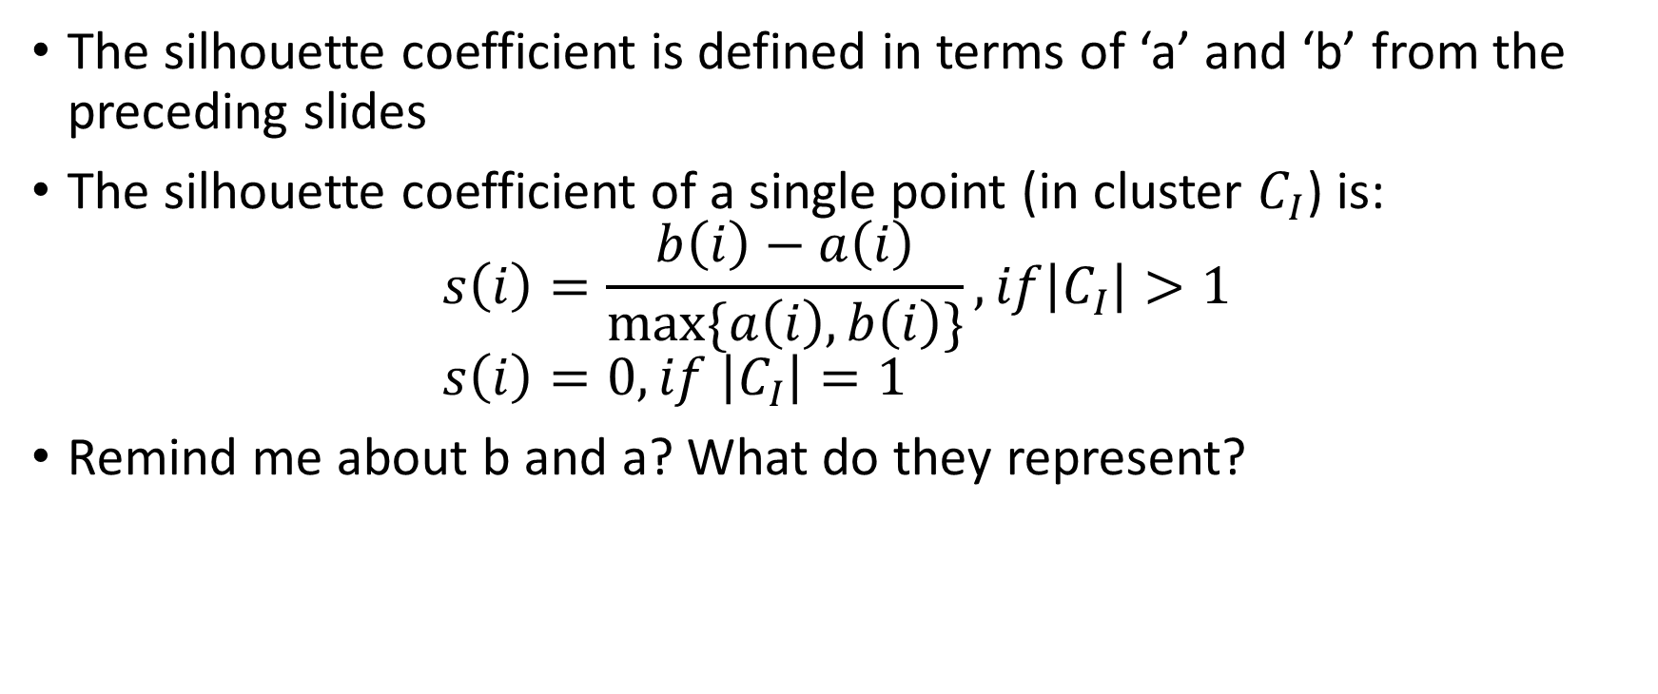
The silhouette coefficient
The silhouette coefficient is defined in terms of ‘a’ and ‘b’ from the preceding slides
The silhouette coefficient of a single point (in cluster $C_{I}$) is: $s\left(i\right)=\frac{b\left(i\right)−a\left(i\right)}{max⁡\{a\left(i\right),b\left(i\right)\}},if\left|C_{I}\right|>1$ $s\left(i\right)=0,if \left|C_{I}\right|=1$
Remind me about b and a? What do they represent?

Slide 58
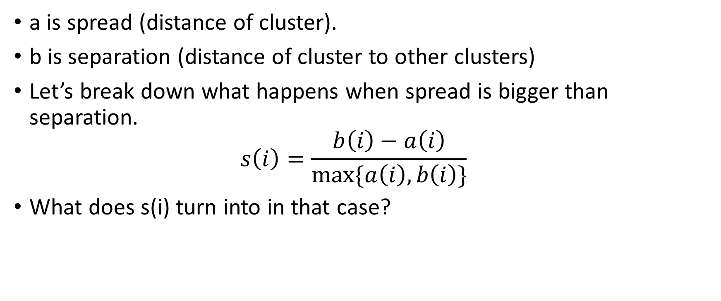
The silhouette coefficient
a is spread (distance of cluster).
b is separation (distance of cluster to other clusters)
Let’s break down what happens when spread is bigger than separation. $s\left(i\right)=\frac{b\left(i\right)−a\left(i\right)}{max⁡\{a\left(i\right),b\left(i\right)\}}$
What does s(i) turn into in that case?

Slide 59
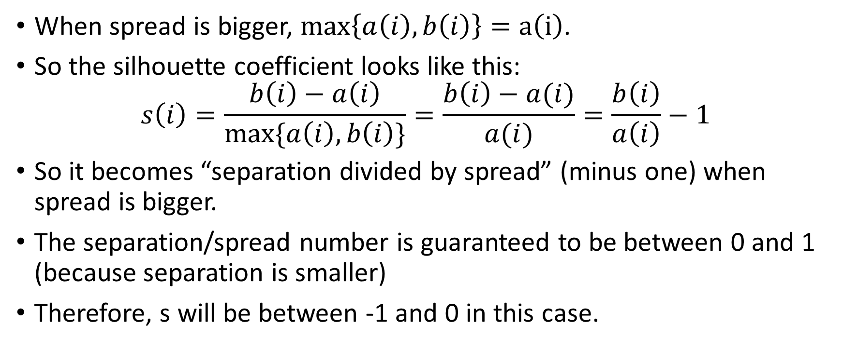
When spread is bigger
When spread is bigger, $\max\left\{a\left(i\right),b\left(i\right)\right\}=a\left(i\right)$.
So the silhouette coefficient looks like this: $s\left(i\right)=\frac{b\left(i\right)−a\left(i\right)}{max⁡\{a\left(i\right),b\left(i\right)\}}=\frac{b\left(i\right)−a(i)}{a(i)}=\frac{b\left(i\right)}{a\left(i\right)}−1$
So it becomes “separation divided by spread” (minus one) when spread is bigger.
The separation/spread number is guaranteed to be between 0 and 1 (because separation is smaller)
Therefore, s will be between -1 and 0 in this case.

Slide 60
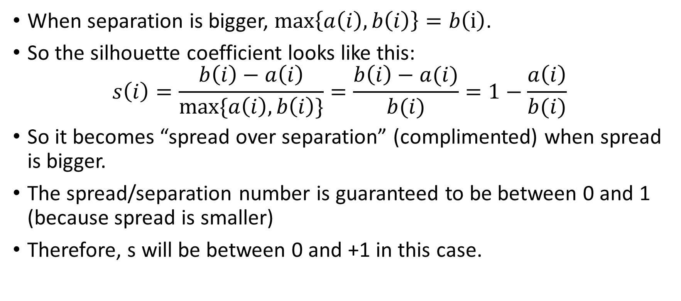
When separation is bigger
When separation is bigger, $\max\left\{a\left(i\right),b\left(i\right)\right\}=b\left(i\right)$.
So the silhouette coefficient looks like this: $s\left(i\right)=\frac{b\left(i\right)−a\left(i\right)}{max⁡\{a\left(i\right),b\left(i\right)\}}=\frac{b\left(i\right)−a(i)}{b(i)}=1−\frac{a\left(i\right)}{b(i)}$
So it becomes “spread over separation” (complimented) when spread is bigger.
The spread/separation number is guaranteed to be between 0 and 1 (because spread is smaller)
Therefore, s will be between 0 and +1 in this case.

Slide 61
Combining these views
So either the spread is bigger, and we get a number between [-1, 0)
Or separation is bigger and we get a number between (0, 1]
Or the point is the only point in its cluster, in which case it’s 0
So how do we interpret this? What does it represent?

Slide 62
What Silhouette represents
Silhouette intuitively tells us “how much more separated are clusters from each other than they are spread out”
This is basically “goodness” for clusterings. We want a silhouette as close to 1 as possible.
We can use Silhouette coefficient to determine which clustering algorithm gives us the best set of clusters.

Slide 63
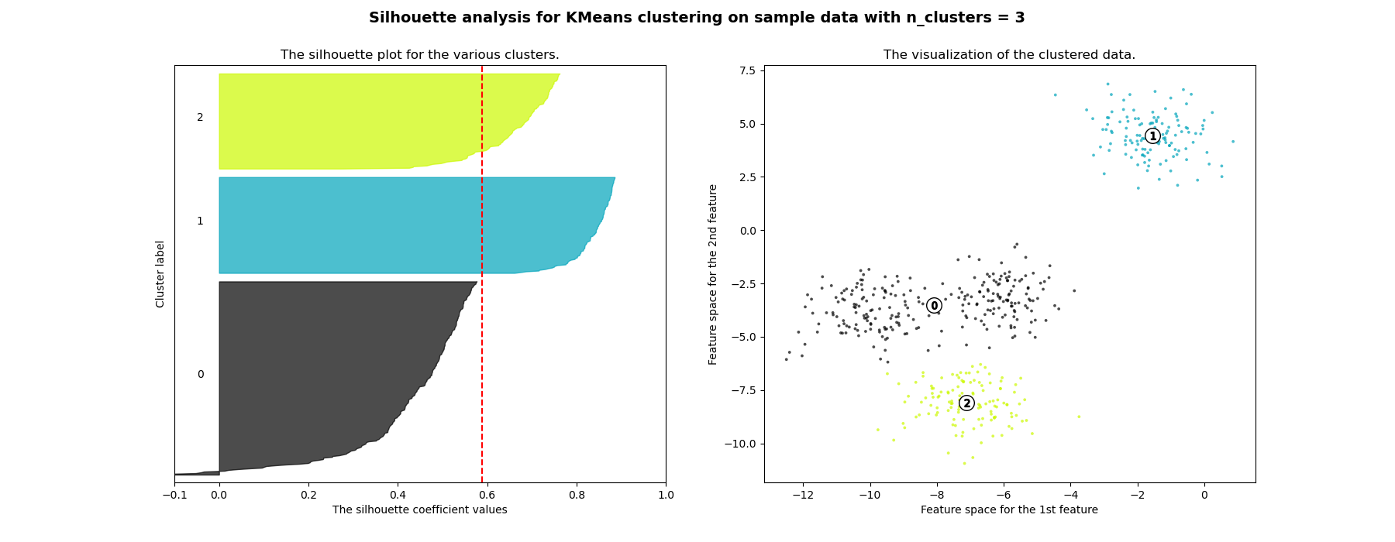
Plotting silhouette scores
A silhouette plot shows the score for each instance in decreasing order.
Usually instances are color coded by cluster
https://scikit-learn.org/stable/auto_examples/cluster/plot_kmeans_silhouette_analysis.html

Slide 64
Other ways of using Silhouette coef.
Remember how with K-means we have to choose how many clusters we have up front?
What if we don’t know? What if we’re clustering something like “customer types” where we might want to break them into 3 groups or 30?
Here’s where silhouette coefficient helps us optimize. We can let K=range(2,100) (using GridSearchCV) and try all of them.

Slide 65
Other ways of using Silhouette coef. (2)
Somewhere in that range will be a number of clusters that maximizes the silhouette coefficient.
If we have too many clusters, the distance between clusters will be too close (bad separation, bad silhouette)
If we have too few clusters, the clusters will be too spread out (bad cohesion)
So there’s an optimum somewhere in that range, where we find the “best” number of clusters.

Slide 66
Other techniques
Silhouette coefficient is not the only useful metric
Notice that some of these shapes would have clusters that generate a bad silhouette score, even if the clustering is excellent: https://scikit-learn.org/stable/modules/clustering.html
However, for our purposes so far, it’s a useful technique.

Slide 67
Questions?

Slide 68

Let’s look at the project

