Slide 1

CS 483: Machine Learning
Week 12: Distance Metrics, Agglomerative Clustering, Scaling

Slide 2
Last module
[what did we learn?]
We learned about K-Means clustering
[How does K-means work?]

Slide 3
This class
We’re going to learn how to use different distance metrics.
We’re going to learn a clustering algorithm that can make use of them

Slide 4

But first, a quiz

Slide 5
The quiz
Given the following instances:
Calculate the silhouette coefficient for the instance in the top row.
Suppose you have defined the method silhouette_coefficient(n_clusters, data), which returns the silhouette for a given dataset and number of clusters. Write a method “optimize_n_clusters” which takes a range and the data and returns the best number of clusters in that range by silhouette.
X | Y | Z | Cluster
10 | 0 | 0 | 1
5 | 0 | 0 | 1
0 | 0 | 10 | 2
0 | 0 | 20 | 2

Slide 6
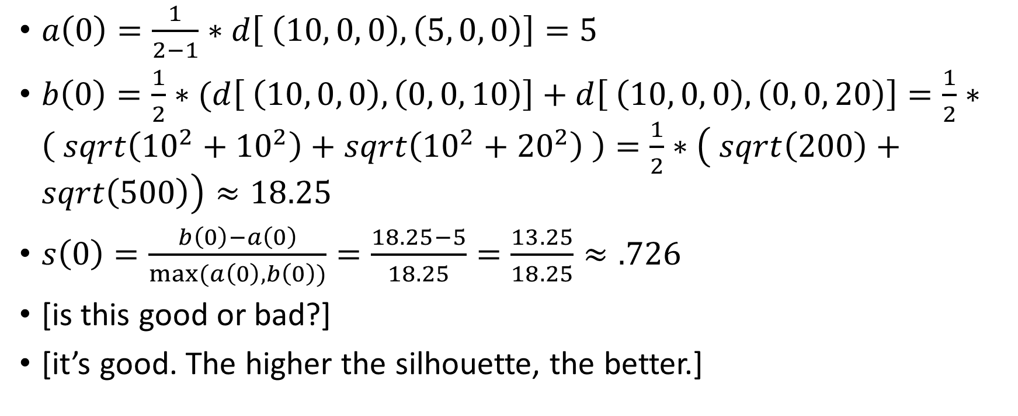
The quiz answers
$a\left(0\right)=\frac{1}{2−1}∗d\left[ \left(10, 0, 0\right), \left(5, 0, 0\right)\right]=5$
$b\left(0\right)=\frac{1}{2}∗(d\left[ \left(10, 0, 0\right), \left(0, 0, 10\right)\right]+d\left[ \left(10, 0, 0\right), \left(0, 0, 20\right)\right]=\frac{1}{2}∗\left( sqrt\left({10}^{2}+{10}^{2}\right)+sqrt\left({10}^{2}+{20}^{2}\right) \right)=\frac{1}{2}∗\left( sqrt\left(200\right)+sqrt\left(500\right)\right)≈18.25$
$s\left(0\right)=\frac{b\left(0\right)−a\left(0\right)}{max⁡(a\left(0\right),b\left(0\right))}=\frac{18.25−5}{18.25}=\frac{13.25}{18.25}≈.726$
[is this good or bad?]
[it’s good. The higher the silhouette, the better.]

Slide 7
Quiz answer 2
def optimize_n_clusters( r, data ): best_choice = r.start best_silhouette = float( ‘-inf’ ) for n_clusters in r: score = silhouette_coefficient( n_clusters, data ) if score > best_silhouette: best_silhouette = score best_choice = n_clusters return best_choice, best_silhouette #we didn’t have to return the score

Slide 8
How does that range work?
You may be used to this pattern: for i in range ( 0, 10 ): …
“range” is actually a constructor for a range object (technically it’s a generator)
We can therefore pass it to functions, too: optimize_n_clusters( range( 10, 20 ), data )
Generators are useful to understand, too: https://pythongeeks.org/python-generators-with-examples/

Slide 9
Another note
There is a silhouette coefficient metric in sklearn.
Let’s take a look: https://scikit-learn.org/stable/modules/generated/sklearn.metrics.silhouette_score.html
You can use it for your project.
Notice that there’s a special group for clustering metrics
These have only xs, no ys. [why?]

Slide 10

Questions?

Slide 11
Distance metrics
There’s a problem with clustering as we’ve seen it that we’ve not discussed.
Rather than explaining it directly, let’s see if you can see it yourself.
Consider the following dataset:
Feature A | Feature B
100% | 1,000,000
99% | 2,000
99.7% | 50,000
0% | 500,000
1% | 800,000
0.2% | 100,000

Slide 12
What do you think will happen?
Mentally, how much do the columns seem to be clustered?
Do some of the columns seem naturally clustered?
[what do you think?] [previous slide]

Slide 13
My thoughts
Notice the left column is very organized. The instances seem clearly to be cut into too parts: A near 100% and A near 0%
Feature B seems totally unorganized, very spread out.
So my expectation might be that the first three instances will be in cluster 0, and the second three instances will be in cluster 1.
But to know what’s going to happen, it’s easiest to just run the experiment.
Let’s see what sklearn says

Slide 14
The code
data = np.array([ [ 1.0, 1000000 ], [ 0.99, 2000 ], [ 0.997, 50000 ], [ 0, 500000 ], [ 0.01, 800000 ], [ 0.002, 100000 ], ])
kmeans = KMeans( n_clusters = 2 ) kmeans.fit( data ) kmeans.predict( data )

Slide 15
The result
Here’s what we get…
Wait…what?
[What do you think happened?]
Feature A | Feature B | Cluster
100% | 1,000,000 | 1
99% | 2,000 | 0
99.7% | 50,000 | 0
0% | 500,000 | 1
1% | 800,000 | 1
0.2% | 100,000 | 0

Slide 16
Here’s what happened
The problem is that K-Means is based on Euclidian distance
[Quick review of K-Means]
Ultimately, all the instances are assigned to their closest mean
Where are the means?
kmeans.cluster_centers_ → array([ [6.63000000e-01, 5.06666667e+04], [3.36666667e-01, 7.66666667e+05] ])
One mean is at 66%, the other at 34% for feature A
But feature B varies a lot

Slide 17
Here’s what happened (2)
The first feature only varies between 0 and 1
The second feature goes up to a million
The second feature is so much bigger than the first, that it overwhelms it.
Here’s an example. Suppose we have a very wide feature space:
Feature Y
Feature X

Slide 18
What we expect
We might think: “feature A completely separates the blue from the orange points”
“Therefore, let’s draw a line in between to make two clusters:
Cluster 1
Feature Y
Feature X
Cluster 2

Slide 19
Questions?

Slide 20
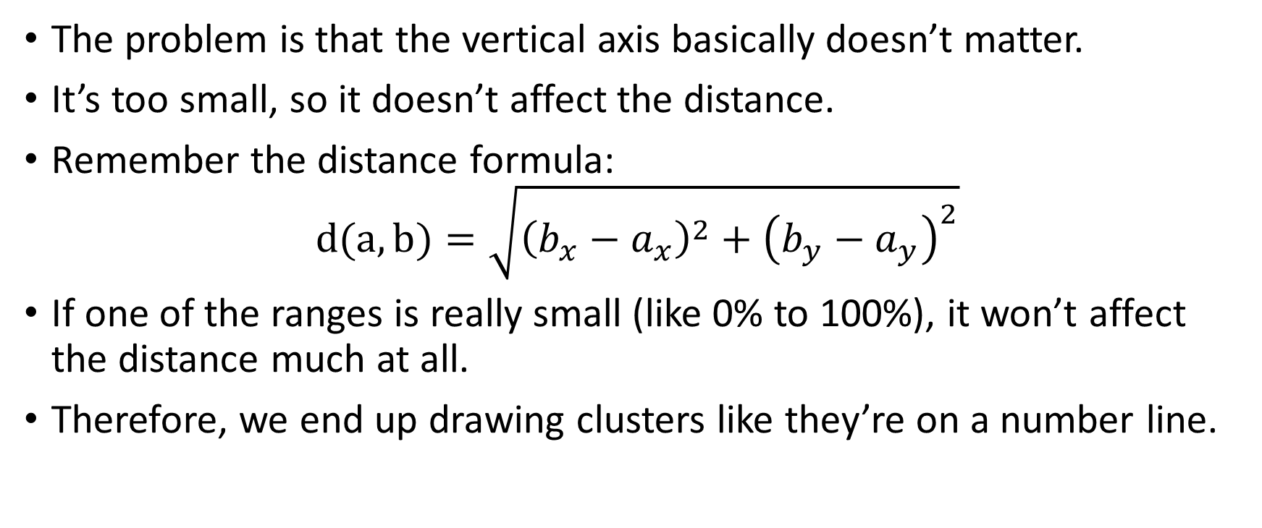
What happens
The problem is that the vertical axis basically doesn’t matter.
It’s too small, so it doesn’t affect the distance.
Remember the distance formula: $d(a,b)=\sqrt{{\left(b_{x}−a_{x}\right)}^{2}+{\left(b_{y}−a_{y}\right)}^{2}}$
If one of the ranges is really small (like 0% to 100%), it won’t affect the distance much at all.
Therefore, we end up drawing clusters like they’re on a number line.

Slide 21
What happens (2)
With two clusters, we will probably put either the first two points in a cluster or the last two (depends on the starting means)
Cluster 1
Cluster 2
Feature Y
Feature X

Slide 22
How do we fix it?
[What do you think?]
Fundamentally, the problem is that we’re ignoring one feature because its range is too small
So, we can just make it bigger. Or, we can make the other one smaller.
Basically, we can just scale to make the minimum 0 and the maximum 1. Then they are the same.

Slide 23
Fixed
Before:
After:
Y
X
Y
X

Slide 24
Fixed 2
See what happened?
Both axis lines are the same length
The clusters are obvious now.
What’s the math?
Suppose a feature ranges from 25 to 100
We want the new minimum, 25, to be 0
We want the new maximum, 100, to be 1

Slide 25
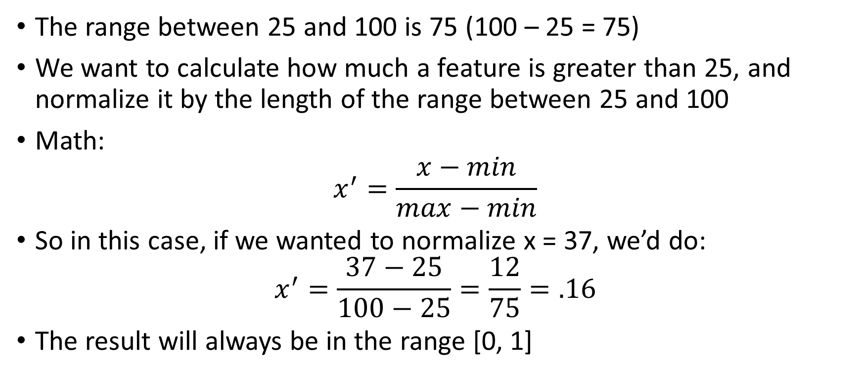
The math
The range between 25 and 100 is 75 (100 – 25 = 75)
We want to calculate how much a feature is greater than 25, and normalize it by the length of the range between 25 and 100
Math: $x^{′}=\frac{x−min}{max−min}$
So in this case, if we wanted to normalize x = 37, we’d do: $x^{′}=\frac{37−25}{100−25}=\frac{12}{75}=.16$
The result will always be in the range [0, 1]

Slide 26
Questions?

Slide 27
Doing this in scikit-learn
There is a built-in class that allows you to min-max scale a dataset.
It’s called…MinMaxScaler
Let’s give it a try: from sklearn.preprocessing import MinMaxScaler
Creating it is pretty straightforward: scaler = MinMaxScaler()
By default, it uses [0, 1] as the range it will transform into (the x’). You can change the range with: scaler = MinMaxScalar( feature_range = ( 20, 50 ) )
However, using [0, 1] is fine for clustering.

Slide 28
Fitting and transforming
Using the same np array as before: scaler.fit( data )
This makes scaler calculate the max and min of the data and store those values as instance variables to be used when transforming.
scaler.transform( data ) → array([ [1. , 1. ], # this instance has both max values [0.99 , 0. ], # this instance has the lowest feature B [0.997 , 0.04809619], [0. , 0.498998 ], # this instance has the lowest feature A [0.01 , 0.7995992 ], [0.002 , 0.09819639]])

Slide 29
Predict vs. transform
In the past, we used “fit” followed by “predict”
Now we’re using “fit” followed by “transform”
Earlier, we talked about the difference, how in pipelines transform takes us from one stage to the next and predict is the last stage.
But what’s actually the difference?
Basically it’s this:
Predict means “try to assign the best cluster/classification/regression prediction possible to this data”. It’s a guess.
Transform means “use what you know to determine exactly what the new data should be”. It’s not a guess.

Slide 30
Speaking of pipelines…
Scalers are perfect for being used in pipelines
They will typically be at an early stage. It can improve both clustering and feature selection to do scaling early on.
[Can the class help me write a pipeline that has these stages?]
A stage that scales
A stage that clusters
?

Slide 31
A simple pipeline
steps = [ ( 'scale', MinMaxScaler() ), ( 'cluster', KMeans( random_state = 0 ) ),
]
pipe = Pipeline( steps )
(I’m using random_state to make the clusters deterministic)

Slide 32
A review of pipelines
Just a quick reminder
When we call “fit” on the pipeline, it will do the following:
Call “fit” on the MinMaxScalar
Call “transform” on the MinMaxScalar using the given X values
Take the transformed X values and call “fit” on the KMeans with them
When we call “predict” on the pipeline, it will do the following:
Call “transform” on the MinMaxScalar
Take the transformed X values and call “predict” on the KMeans with them

Slide 33
Questions?

Slide 34
And now for something completely different
We’ve been using Euclidean distance this whole time
It makes sense: it’s how distance is defined in the 3D space that we all live in.
But there are other, completely different, ways to measure distances.
First, let’s think about what we might not like about Euclidean distance.

Slide 35
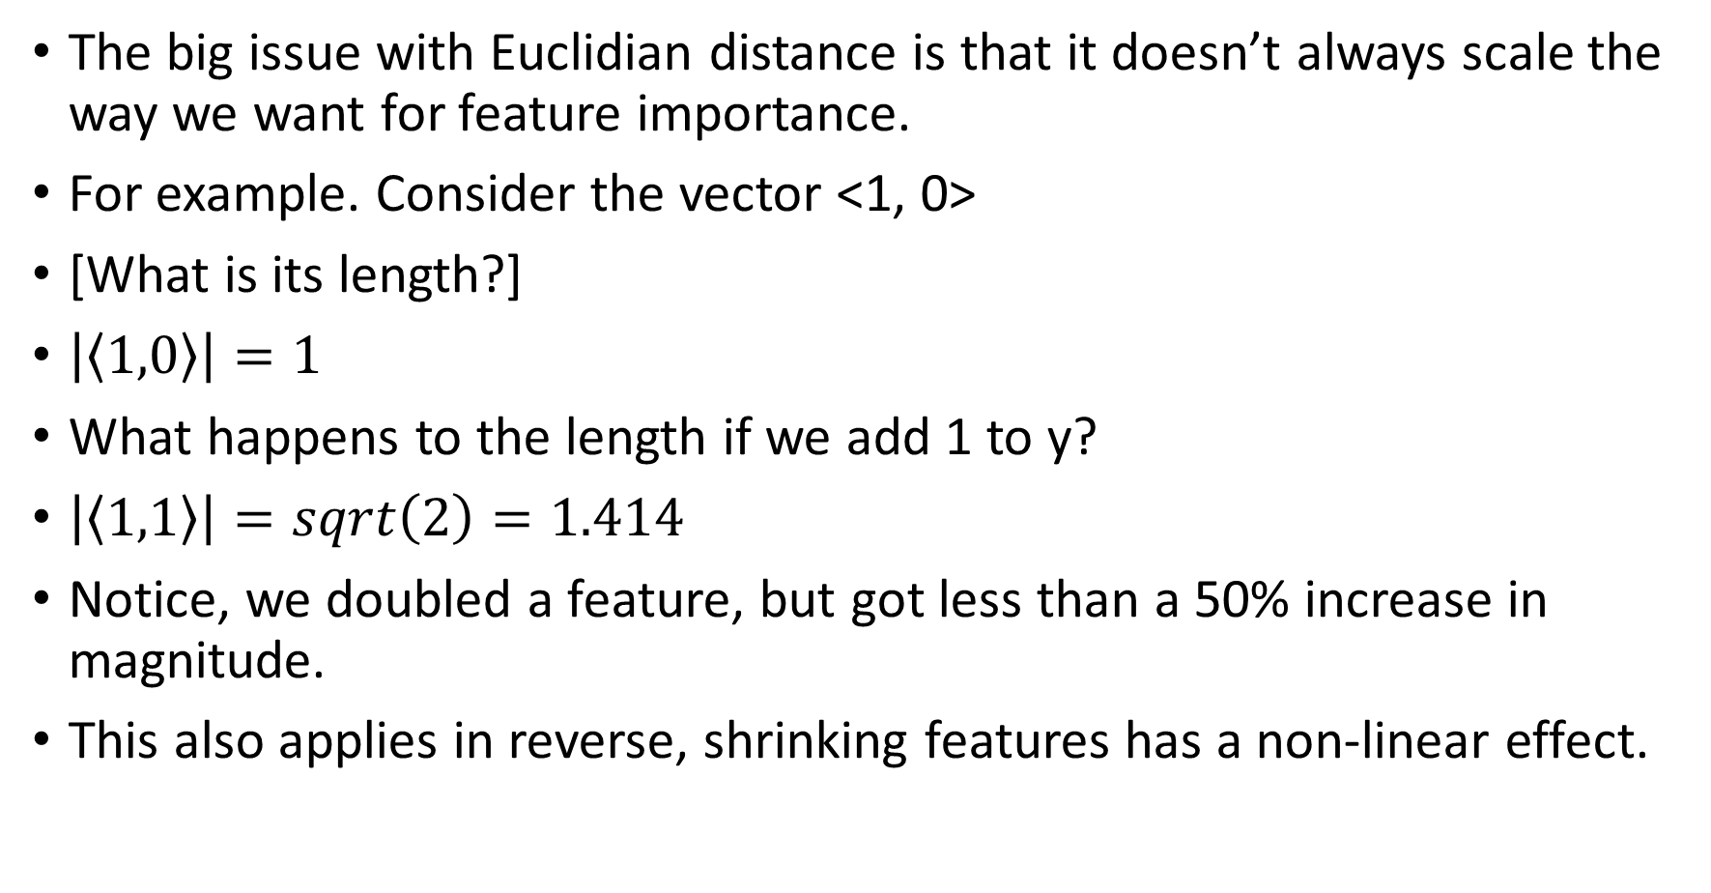
Problems with Euclid
The big issue with Euclidian distance is that it doesn’t always scale the way we want for feature importance.
For example. Consider the vector <1, 0>
[What is its length?]
$\left|\left\langle 1,0\right\rangle \right|=1$
What happens to the length if we add 1 to y?
$\left|\left\langle 1,1\right\rangle \right|=sqrt\left(2\right)=1.414$
Notice, we doubled a feature, but got less than a 50% increase in magnitude.
This also applies in reverse, shrinking features has a non-linear effect.

Slide 36
Problems with Euclid (2)
The issue here is that the distance function “curves” when one feature is much bigger than the others: https://www.wolframalpha.com/input?i=sqrt%28x%5E2%2By%5E2%29
This becomes an issue when lots of features are 0 (sparse spaces)
For example, a vector can represent the presence or absence of individual words in a dictionary.
A given sentence might have 20 out of 100,000 words.
Comparing that sentence to another sentence will be very sensitive to the amount of overlap, and will not have a linear response.

Slide 37
Manhattan distance
To resolve the issues with Euclidean distance when in a high-dimensional or sparse feature space, we can use “Manhattan Geometry”, also known as “Taxicab Geometry”: https://en.wikipedia.org/wiki/Taxicab_geometry
The idea here is that the distance of a path is the total amount that you travel in each dimension, like specifying locations in Manhattan (“go from 3rd and 26th to 5th and 19^{th”} )
Specifically, the distance between two vectors is the sum of the distance between each of their features
So <1, 2, 3> and <3, 6, 3> have a distance of 2 + 4 + 0 = 6

Slide 38
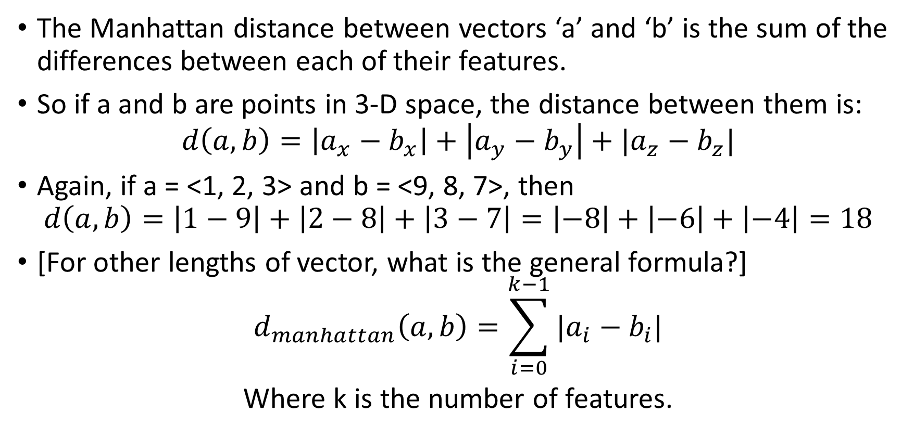
Manhattan distance definition
The Manhattan distance between vectors ‘a’ and ‘b’ is the sum of the differences between each of their features.
So if a and b are points in 3-D space, the distance between them is: $d\left(a,b\right)=\left|a_{x}−b_{x}\right|+\left|a_{y}−b_{y}\right|+|a_{z}−b_{z}|$
Again, if a = <1, 2, 3> and b = <9, 8, 7>, then $d\left(a,b\right)=\left|1−9\right|+\left|2−8\right|+\left|3−7\right|=\left|−8\right|+\left|−6\right|+\left|−4\right|=18$
[For other lengths of vector, what is the general formula?]
$$d_{manhattan}\left(a,b\right)=\sum_{i=0}^{k−1}{|a_{i}−b_{i}|}$$
Where k is the number of features.

Slide 39

Contrast: Euclidian distance definition
[By contrast, how does Euclidean distance look?]
Like this: $d_{euclid}\left(a, b\right)={\left(\sum_{i=0}^{k−1}{{\left(a_{i}−b_{i}\right)}^{2}}\right)}^{\frac{1}{2}}$
[generalizations]

Slide 40
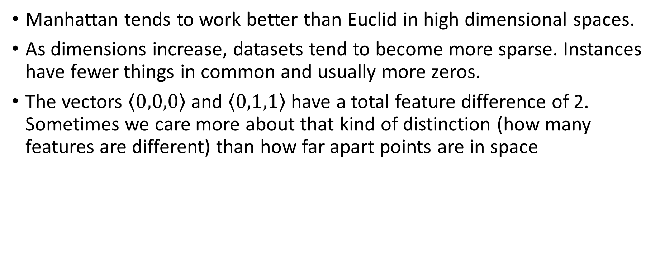
Why?
Manhattan tends to work better than Euclid in high dimensional spaces.
As dimensions increase, datasets tend to become more sparse. Instances have fewer things in common and usually more zeros.
The vectors $\left\langle 0,0,0\right\rangle$ and $\left\langle 0,1,1\right\rangle$ have a total feature difference of 2. Sometimes we care more about that kind of distinction (how many features are different) than how far apart points are in space

Slide 41
Why? (2)
Aggarwal, C. C., Hinneburg, A., & Keim, D. A. (2001, January). On the surprising behavior of distance metrics in high dimensional space. In International conference on database theory (pp. 420-434). Springer, Berlin, Heidelberg.
https://kops.uni-konstanz.de/bitstream/handle/123456789/5715/On_the_Surprising_Behavior_of_Distance_Metric_in_High_Dimensional_Space.pdf?sequence=1

Slide 42
Questions?

Slide 43
L1 and L2 norms
Manhattan distance is often called the “L1” norm
Euclidean distance is often called the “L2” norm
These terms are used when we “regularize” data before sending them to a machine learning model.
If we penalize data by how far it is from 0 in Euclidean distance, we are using L2 regularization (also called “LASSO—Least Absolute Shrinkage and Selection Operator)
If we penalize data by how far each feature is from 0 (which is Manhattan distance), we are using L1 regularization. Also called “Ridge”.

Slide 44
L1 and L2 norms
Both L1 and L2 reduce unimportant features to zero.
This gives you a simpler model, which is typically more resistant to overfitting.
Now you understand the “l1” and “l2” parameters for ML models like Linear regression: https://scikit-learn.org/stable/modules/generated/sklearn.linear_model.LogisticRegression.html
In this case “C” is a parameter that represents “complexity”. The higher it is, the less we try to regularize features and the more complex our model is. Typically, higher C means better train performance, but more risk of overfitting.

Slide 45
Cosine similarity
There is another way to detect how similar two vectors are to one another: using the cosine between them
What does the cosine represent [graphics students]?
It’s the amount that two vectors are pointing in the same direction.
If the cosine between them is 1, they are perfectly in line.
If it is 0, they are perpendicular
If it is -1, they are pointing in opposite directions

Slide 46
Cosine dissimilarity (or “cosine distance”)
The thing is, distance is the opposite of similarity
We want a number that is small when the points/vectors are close together and big when they are far apart
Cosine similarity does the opposite
[So, how do we fix it?]
Cosine distance = 1 – cosine similarity
Now –1 means perfectly aligned, and 1 means opposite.
This still allows us to have negative distance, so we can correct for that by adding 1 and then dividing by 2 if we want.

Slide 47
Why not just use the angle?
Why not just use the angle between the two vectors as a distance.
The wider the angle, the more different they are.
[class: what’s wrong with that?]
It’s more challenging to compute. We need to use an inverse trig function.
In contrast, computing the cosine between two arbitrary vectors is very easy, especially if they are the same length.

Slide 48
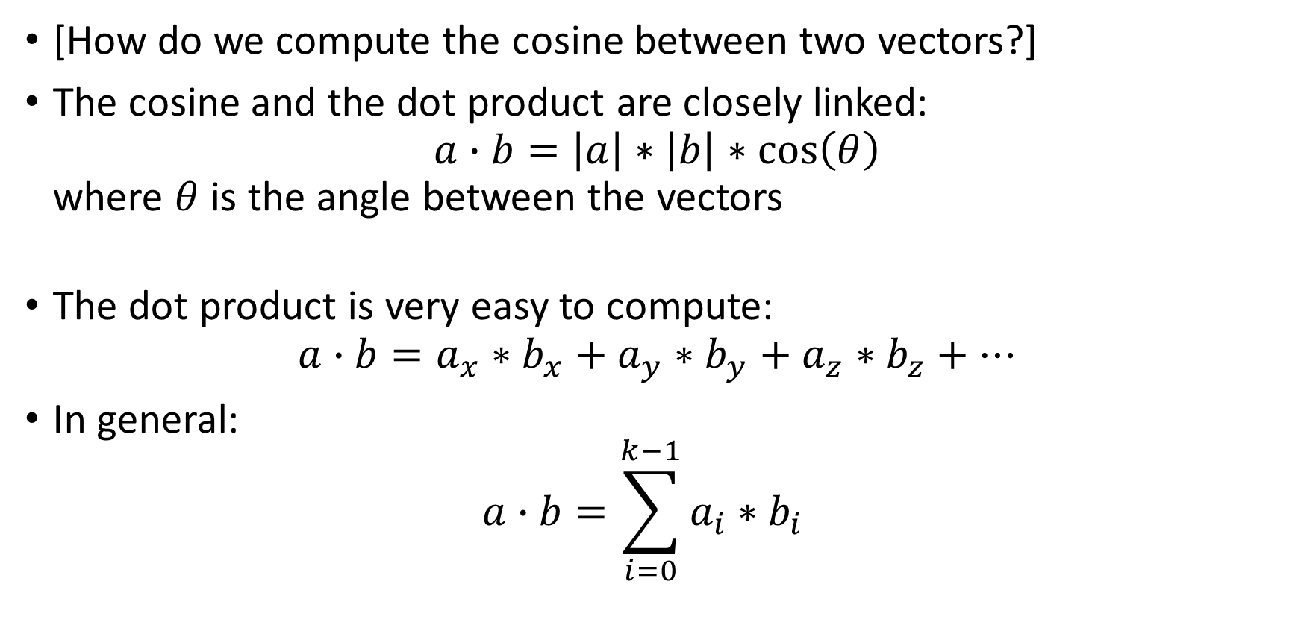
Computing the cosine
[How do we compute the cosine between two vectors?]
The cosine and the dot product are closely linked: $a∙b=\left|a\right|∗\left|b\right|∗\cos\left(θ\right)$ where $θ$ is the angle between the vectors
The dot product is very easy to compute: $a∙b=a_{x}∗b_{x}+a_{y}∗b_{y}+a_{z}∗b_{z}+…$
In general: $a∙b=\sum_{i=0}^{k−1}{a_{i}∗b_{i}}$

Slide 49
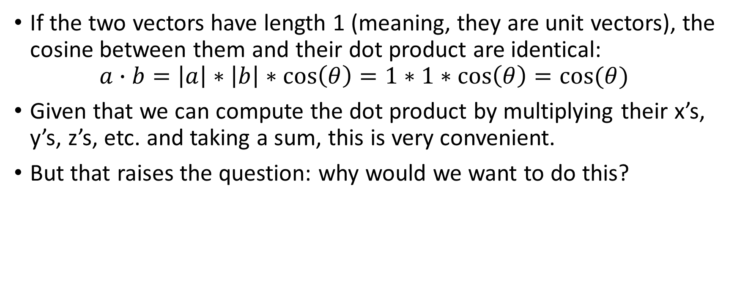
Computing the cosine (2)
If the two vectors have length 1 (meaning, they are unit vectors), the cosine between them and their dot product are identical: $a∙b=\left|a\right|∗\left|b\right|∗\cos\left(θ\right)=1∗1∗\cos\left(θ\right)=cos⁡(θ)$
Given that we can compute the dot product by multiplying their x’s, y’s, z’s, etc. and taking a sum, this is very convenient.
But that raises the question: why would we want to do this?

Slide 50
When direction matters more than location
Sometimes the direction of an instance is more important than its position.
For example, consider a dataset of two features, where the first feature is the number of positive emoji in a tweet and the second is the number of negative emoji in a tweet.
Is there a big difference between <0, 10> and <0,20>?
They’re both just composed entirely of negative emoji.
If we take the cosine distance between these two, it would be -1 (or 0 if we’re normalizing it)

Slide 51
Final notes
Typically we start with Euclidean distance as a default
We then experiment with other distance metrics, like Manhattan or Cosine, as part of our optimization process (they can be in your grid/feature set for GridSearchCV and RandomizedSearchCV).
If you are doing machine learning with string or other social data, it’s very common to use Manhattan distance or cosine dissimilarity.
We can’t use these distance metrics with KMeans clusters (because they require Euclidean distance to guarantee they converge). However, we can use it with the clustering algorithm we’re about to learn.

Slide 52
Questions?

Slide 53
Nearest neighbor classification/regression
Now that we understand how distances can work, let’s very briefly learn a new supervised algorithm.
It’s so fast it will only take a couple of slides.
It’s called “nearest neighbor”
It works like this: classify a point as the same class as its nearest neighbor.
If doing regression: the predicted value of an unknown point is the same as the value of it’s nearest neighbor.

Slide 54
Example
Suppose our dataset looks like this:
Suppose we want to predict the value of a house with 9 rooms, 2300 square feet, and overall quality of 10.
It’s closest to the top row, so we say “$500,000”
Not very smart, but it’s simple and a good guess.
# Rooms | Square Footage | Overall Qual. | Price
10 | 2200 | 10 | $500,000
5 | 1100 | 8 | $200,000
7 | 1500 | 9 | $350,000

Slide 55
K-nearest neighbors
We don’t have to look at only the closest neighbor.
We could look at the two closest neighbors, and average their prices together (weighted by distance, so the predicted price is closer to the closer neighbor’s).
If doing classification, we can use the different neighbors to get our probability prediction.
So if there are 5 neighbors of an unknown instance, and 3 of them are mammals, and 2 are birds, then we would predict “mammal: 60%”
In general, the number of neighbors is called “K”, so this algorithm is known as “K-nearest neighbors”

Slide 56
In Scikit
https://scikit-learn.org/stable/modules/generated/sklearn.neighbors.NearestNeighbors.html
regressor = sklearn.neighbors.NearestNeighbors( n_neighbors = 5 )
There is a “radius” parameter for excluding neighbors that are too far away.
You can change the metric function with “metric”. By default, it’s “minkowsky” with p = 2 which is the same as Euclidean. Change p = 1 for Manhattan. You can also pass your own function to use.
If you want to classify, use KNeighborsClassifier instead.

Slide 57
Questions?

Slide 58
A new clustering algorithm
Recall how many different clustering algorithms sklearn supports: https://scikit-learn.org/stable/modules/clustering.html
Each one has benefits and drawbacks [what about kmeans?]
The main benefits of KMeans are that it is fast and it works well when clusters are evenly sized and uniformly distributed.
But what if clusters can have wild shapes, like the crescent moons example?
KMeans doesn’t work at all, here.
It also doesn’t support alternative distance metrics.
It also forces us to choose the number of clusters in advance

Slide 59
Agglomerative clustering
The idea behind agglomerative clustering is that we “agglomerate” (i.e., combine) different clusters until the remaining clusters are too far apart.
Here’s the basic algorithm:
Every point starts out within its own cluster
We combine the two closest clusters into a single cluster. (this is called “agglomeration”)
Go back to step 2 until all clusters are farther apart than a pre-decided distance threshold.

Slide 60
Example
Consider this dataset:
Each instance starts off in its own cluster. We’ll make them all different colors.
We decide on a threshold. In this case, let it be this long: ---
Feature Y
Feature X

Slide 61
Step 1 and 2
Feature Y
We combine the closest clusters. Those are in the top left corner:
Then we combine the two close clusters on the right side
Feature X
Feature Y
Feature X

Slide 62
Remaining steps
Keep doing that until all the clusters are farther apart than three hyphens: ---
That’s it.
Feature Y
Feature X

Slide 63
Things to notice
We had to decide on a distance and metric up front.
Here we are using Euclidean distance, and we wanted our threshold to be the length of three hyphens (---).
In reality, we might not know what distance is appropriate. We could pick the one that gives us the best silhouette coefficient for example.
However, notice that we did not have to specify the number of clusters up front. We ended up getting 4, but that was a consequence of the distance we picked.

Slide 64
Questions?

Slide 65
Distance between clusters
The concept of “distance” between clusters actually has multiple definitions. The distance between the closest points? The farthest points? The centers of the clusters?
Given that it determines how we link clusters together into a new cluster, we call each one a different kind of “linkage”
In our silhouette coefficient discussion, for a given point, we took the average distance between that point and all the points in another cluster.
This is called “average linkage”

Slide 66
Average linkage
To get the average linkage between two clusters (x and y), we calculate the average distance between the points between them: def average_linkage( x, y, dist ): sum_distance = 0 for a in x: # a is a point in cluster x for b in y: # b is a point in cluster y sum_distance += dist( a, b ) return sum_distance / ( len(x) * len(y) ) # |x||y| is the # of pairs
In this example, dist is the distance function. This lets us compute linkage using any distance metric. Just pass a function that computes manhattan distance to use that, e.g.,: average_linkage( x, y, lambda a, b: sum( [ abs( i – j ) for i, j in zip( a, b ) ] ) )

Slide 67
Why do we need this concept?
Average linkage seems like the “default”, but there are other choices, and they can result in radically different clusters.
For example, there is “centroid linkage”, which is where we compare the distance between the center of each cluster (where the center is the average of the points in the cluster)
This uses the same “centroid” concept as KMeans (and it’s different from average linkage despite how it might seem)
There are also…

Slide 68
Linkage types
Single linkage: use the closest pair of points between two clusters:
Complete linkage (aka. “maximum linkage): use the farthest apart pair of points between two clusters:
Feature Y
Feature X
Feature Y
Feature X

Slide 69
Lastly: ward linkage
This is the default type of linkage when using AgglomerativeClustering in sklearn
Ward linkage means to merge the clusters that will result in the least increase in the average within-cluster distance.
This is also a concept from the silhouette coefficient: remember how we tried to minimize the distance between points in a cluster and maximize distance between clusters?
Here we merge points that result in the smallest disturbance to the distance between points in a cluster.

Slide 70
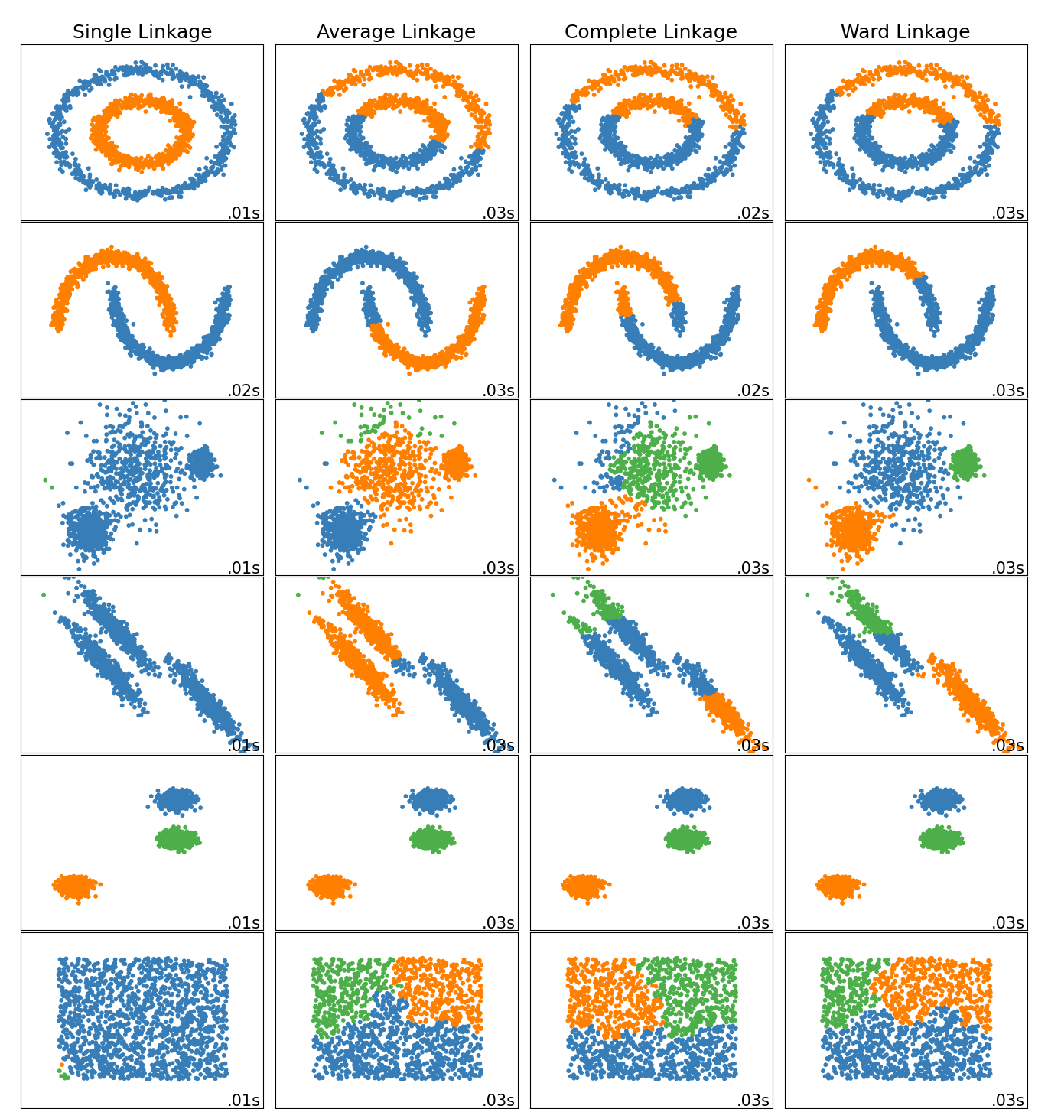
Comparison of linkage functions
https://scikit-learn.org/stable/auto_examples/cluster/plot_linkage_comparison.html

Slide 71
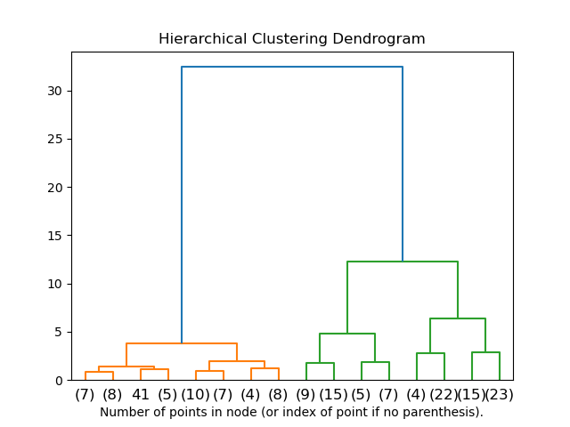
Dendrograms
We can visualize combining clusters together in a dendrogram.
This can help us decide if we want to stop combining after a certain number of agglomerations (instead of using the distance threshold)
From: https://scikit-learn.org/stable/auto_examples/cluster/plot_agglomerative_dendrogram.html#sphx-glr-auto-examples-cluster-plot-agglomerative-dendrogram-py

Slide 72
Questions?

Slide 73
Doing all this in Scikit-Learn
The agglomerative clustering class is here: https://scikit-learn.org/stable/modules/generated/sklearn.cluster.AgglomerativeClustering.html
We use it the same way as we used KMeans, but there are some differences:
We can choose “n_clusters” for the number of clusters if we want. But it’s optional now.
Now we can specify the “distance_threshold” (if we don’t, it will go until we have n_clusters)
We can also specify the “linkage” and the “affinity” (which is distance/similarity metric to use)

Slide 74
Creating an AgglomerativeClustering
Suppose our dataset is an x,y plane of objects, and we want to cluster them together.
Here, we’re in Euclidean space, and we suspect that single linkage will work best.
We don’t know how many clusters to use, but we know that we won’t want to combine clusters that are farther apart than 10 meters.
Here’s how we specify this: clusterer = AgglomerativeClustering( n_clusters = None, # no limit on number of clusters affinity = ‘euclidean’, linkage = ‘single’, distance_threshold = 10 )

Slide 75
Another scenario
Suppose our dataset is a bunch of tweets.
Each tweet is a 10 dimensional vector, where each dimension is a different kind of emoji. We suspect cosine similarity makes sense.
We want to use average linkage to group tweets together.
We want to end up with 20 clusters.
Here’s what we do: clusterer = AgglomerativeClustering( n_clusters = 20, affinity = ‘cosine’, linkage = ‘average’ )

Slide 76
Anything else?
Aside from those small differences, AgglomerativeClustering is essentially a drop-in replacement for KMeans.
Your project uses only K-means, but feel free to experiment.
There are other clustering algorithms worth knowing. DB-SCAN is a very popular one (and winner of the “test of time” award at the ACM SIGKDD conference—knowledge discovery in data)

Slide 77
Questions?

