Slide 1

CS 483: Machine Learning
Week 1: Introduction

Slide 2
Welcome!
My name is Grant Williams
I used to be a professional data scientist at Microsoft Corporation
[the stuff I used to do]

Slide 3
This class
In this class, we’re going to learn about machine learning.
Specifically:
We’re going to learn several common machine learning algorithms
We’re going to learn a machine learning framework (Sci-Kit learn)
We’re going to complete projects that rely on machine learning

Slide 4
My goals for this class
I want you to have hands-on experience with machine learning
I want machine learning to not seem “magic”, but rather, a useful tool to have in your toolkit for solving problems and understanding the world.
I want you to not feel afraid to break out machine learning methods when they are appropriate.
I want the techniques you use to be actively applicable.
This is an introductory class. Unfortunately, we won't be covering deep learning.

Slide 5
Let’s look at the syllabus: Major points
We’ll outline some key points in the slides, but everyone is responsible for reading the syllabus.
The syllabus is the contract between us. It binds my behavior and yours.
If there is a discrepancy between the syllabus and the slides or something I say in class, the syllabus wins.
Let’s pull it up on canvas now

Slide 6
Office, hours, and TA.
My office is VECS-301G
Official office hours are: M/W from 10:30 to 12:00 (right after this class)
I’m very much on a hybrid schedule, so you’ll likely want to set up an appointment ahead of time outside of these hours.
If office hours aren’t sufficient, I will add more.

Slide 7
Contacting me
Please use email to contact me outside of office hours.
We can set up Zoom meetings via email if you are unable to make it to office hours.

Slide 8
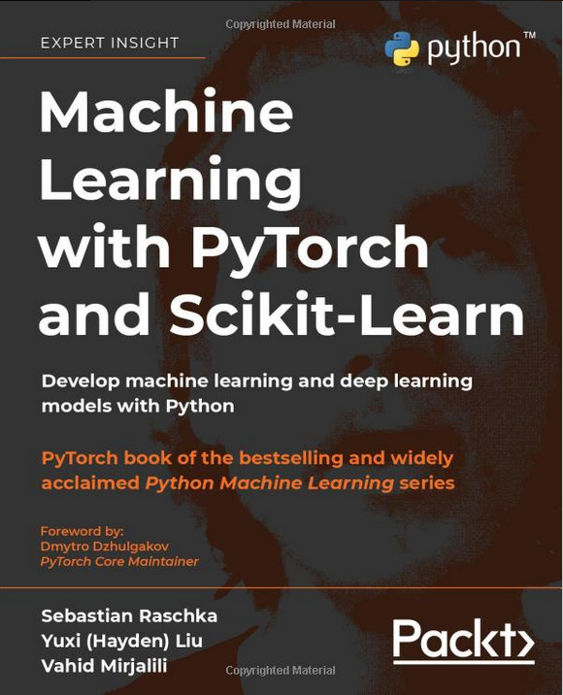
Textbook
I won’t be assigning readings or homework from the book.
You can get away without it for the class.

Slide 9
Grades
Item for Assessment | Weight
Projects | 40%
Term Project | 20%
Exam 1 | 20%
Exam 2 | 20%
A 95 % | A- 90 % | B+ 87 % | B 83 %
B- 80 % | C+ 77 % | C 73 % | C- 70 %
D+ 67 % | D 60 % |  | F < 59.5 %

Slide 10
Exams
Exams are expected to be take home
If this doesn't work, I'll notify you at least one week in advance.
Most likely format: you'll be asked to choose a dataset on a website like kaggle.com and create an ML model based on it by following instructions.
I will likely ask you to create a notebook for the exam. We will learn more about notebooks soon.
These will be very hands-on exams.

Slide 11
Exams (2)
There will be 2 exams:
The 1st term exam, roughly in the middle of the term
The 2nd term exam, probably the second to last week
No final exam.
The second term exam may cover some of the same material as the first term exam.

Slide 12
Projects
There are expected to be 4 projects, worth 10% each. There may be more or less, however.
Given that each project will be worth roughly a letter grade, I usually add a discretionary component to each project grade.
I almost never give someone a raw 0. There is some effort component.
However, it’s up to you to submit them. Non-submissions are a zero.

Slide 13
The term project
You will have the opportunity to work in teams of up to 3.
I expect all team members to contribute: compared to the top team member, the others should contribute at least 50% of the amount of code.
I’m telling you this now so that you can plan for it. You know the rules up front, so you can organize pair programming and make sure everyone contributes.
Lastly: the term project is expected to be unique for each team.

Slide 14

Questions

Slide 15
Curves
I’m not the worlds hardest grader: I usually don’t have to curve.
If I do, I typically do one of the following:
Make one or more problems extra credit
Add a flat score increase
Change the boundaries of grade levels
The key here is that anything I do applies to everyone.
Please do not say “I know you have ways to make a student pass if you want to.” I will not compromise academic integrity.

Slide 16
Academic honesty
Copying someone else’s code for an assignment is a violation of academic honesty.
An AI counts as a person, here.
You can read code online, but you have to write your own code that you submit.
If an assignment gives you permission to use a snippet of code, or to cite code, you may do so. That permission only applies to that one assignment.
I may use anti-cheating software. It may index your code.
The minimum penalty for cheating is a 0 for the assignment. If you do it twice, you get a 0 for the class.
If you manipulate someone you get a 0 for the class.
See the syllabus for more information.

Slide 17
Laptops
Feel free to bring laptops/tablets to class
They are useful to take notes and follow along with slides
Please don't use them to play games, watch movies, or view other distracting content.
I won’t police this specifically, but if your use of electronic devices in class is disruptive to classmates, I may ask you to put it away or leave.
If you don’t have access to a laptop, you can borrow a good one from the library using a voucher provided by your advisor. Do this ASAP: they tend to run out.
You won't need a GPU for this class.

Slide 18
Fake quizzes
I used to give quizzes every week in my classes.
Students liked the review and the fact that I designed my tests based on them.
However, they were unpopular because they forced attendance and didn’t give students too long to learn new material.
Therefore, I started giving fake quizzes, which are just like real quizzes except not.

Slide 19
Fake quizzes (2)
I like to use problems similar to fake quiz problems in my exams. You can think about them as in-class homework.
I won’t be grading them but taking them seriously will likely improve your grade and your understanding.
Testing oneself improves recall substantially.

Slide 20
A tentative schedule
Let’s look at the syllabus
The schedule will help us understand where we are during a lecture.
Note: it does not include school closures or days that I am forced to miss. There are some extra lectures just in case.

Slide 21
Questions

Slide 22
Introduction to machine learning
What is machine learning?
We hear about it a lot, but what actually is it?
[Class thoughts?]

Slide 23
Definition
Machine learning is the field involved with computer algorithms that improve their performance based on data.
Machine learning is in the intersection between data-science, AI, and computer science
You can contrast machine learning with the algorithms you have learned in the past which always apply rigid rules to determine what to do.
Machine learning algorithms have “soft rules”, which they apply partially or intermittently in order to maximize a metric we care about, such as classification accuracy

Slide 24
Disambiguation
We aren’t going to be covering the following things in this class, although they are related:
Big data: this means special techniques that modify algorithms to work on huge datasets and distributed computing.
Data mining: this means techniques that generate insights from data without needing to be trained. (our techniques will require training)

Slide 25
Disambiguation (2)
We aren’t going to be covering the following things in this class, although they are related:
Artificial intelligence: this is a field full of techniques that let computers do “intelligent” things. However, the only things we will learn involve a learning component.
Deep learning: this means using so-called “deep neural networks” to do complex things associated with human intelligence, like drive cars. Deep neural networks are a special machine learning technique that is complicated and obscure. The things we learn in this class can be a steppingstone to deep learning if you’re interested in it.

Slide 26
Machine learning and AI
When people think of machine learning, they typically think of AI.
I find that it’s useful to think of AI and machine learning as overlapping fields, rather than machine learning being a part of AI.
Some machine learning techniques are essentially computational statistics, so it’s hard to think of them as “intelligent”
On the other hand, many AI techniques are quite successful without having any notion of “learning”, such as game-winning strategies like minimax.
There is still a lot of overlap. For example: reinforcement learning is a machine learning approach that often involves more general AI techniques.

Slide 27
ML and data science
If there is a field that ML is a subset of, it is data science
Data science can be thought of as “applied statistics”.
ML and data mining are both data science
In this class, everything you learn will be considered data science.

Slide 28
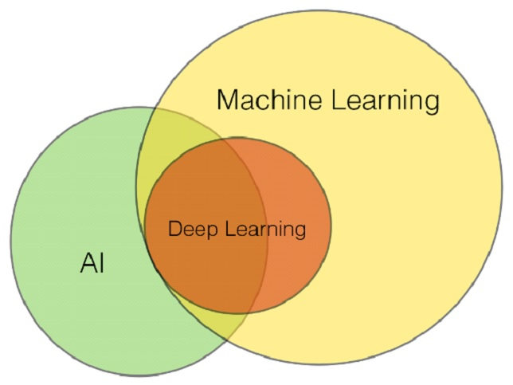
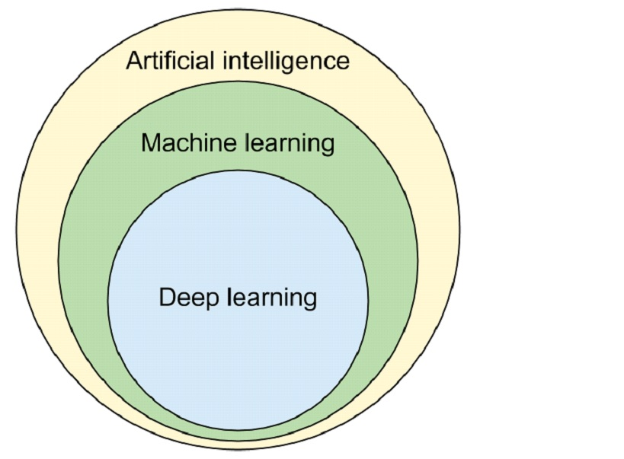
How some people see machine learning
How others see machine learning
Image: CC-BY-SA 4.0, Yakoove,https://en.wikipedia.org/wiki/File:Fig-X_All_ML_as_a_subfield_of_AI.jpg
Image: CC-BY-SA 4.0, Yakoove, https://en.wikipedia.org/wiki/File:Fig-y_Part_of_ML_as_subfield_of_AI_or_AI_as_subfield_of_ML.jpg

Slide 29
“branches” of ML
If ML, there are three, different overarching problem-types that practically all techniques fall into.
Supervised learning : you give the computer a set of labeled data. The computer uses this data to make predictions about data it hasn’t seen.
Unsupervised learning (overlaps with data mining): you do not give the computer any training data. Instead, the computer tries to find patterns in the data without supervision. For example “these two things are related in this way”.
Reinforcement learning (overlaps with AI): the computer is in some kind of environment, and has the ability to take actions. It chooses what action to take based on what will maximize its reward (learning the choice and reward expectation can be a supervised learning task). It alternates between choosing efficient actions and choosing sub-optimal actions as a way to try new things and learn from the experience.

Slide 30
Questions

Slide 31
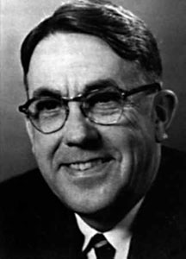
A brief history of machine learning
The term was coined by Arthur Samuel in 1959.
He developed an early machine learning application: a checkers-playing AI
It played games against itself in order to learn which game states were good and which were bad. Then it tried to make moves that made it hard for its opponent to find good game states.
This same basic approach is still used today for playing competitive games, such as Chess and Go.

Slide 32
A brief history of machine learning (2)
Machine learning grew out of artificial intelligence
Early AI research was booming in the 1970s, with a focus on simple neural networks as well as symbolic methods (“solving” for the right action)
Over time, the field developed a preference for symbolic manipulations over applied statistics.
Machine learning is applied statistics, so this “rejected” part of AI started to take on a life of its own.
[the AI winter may have played a role, too] [ai winter]

Slide 33
ML in practice
ML usage has exploded recently, both in academia and the industry.
I can’t say for certain, but I feel like much of this has to do with improved confidence on the part of ML developers through a series of victories
Machine learning has distinguished itself as a way for businesses to make money and researchers to publish new papers.
Data-science tends to scare people away, but excellent frameworks and improved computer hardware leading to previously intractable techniques becoming tractable have attracted new people to the field

Slide 34
How do you “do” machine learning?
First, you decide which of the 3 branches the problem you’re trying to solve fits into.
Let’s take supervised learning as an example.
Suppose you want to predict whether it will rain tomorrow based on the weather today.
This is a classification task (some also call it prediction). Our goal is to take a bunch of weather data, and output “rain” or “no rain”

Slide 35
Using a framework
The machine learning algorithms have already been implemented by many smart people
The framework we will use in class is called SciKit-learn: https://scikit-learn.org/stable/index.html
They often have lots of thought put into performance optimization: both performance in terms of CPU usage, and performance in terms of how well the model performs at its task.

Slide 36
Building the model
This framework has classes for the different algorithms
You choose an algorithm that handles classification problems.
You assemble your weather data and your labels (assigning a label of “rain” or “not rain” to all of the rows in your spreadsheet.
You create a new “model”. A model is like a “brain”. It contains all the information that has been learned from training. It starts out knowing nothing.
You train the model on your data, giving you a trained model that knows something about predicting the weather

Slide 37
Using the model
This model will be stored as an object with a data structure inside of it.
You can write the model to disk to share it with people.
If you get new data, you can re-train the model to improve it.
When you’re ready to use it, you call a function called “predict”, which takes un-labeled data as its input.
The output is the predicted label: “rain” or “no rain”. Possibly with probabilities attached to each one.
You can have another set of data (called test data) that the model hasn’t seen before to see how good it does. The better it does on data it hasn’t seen, the more useful it is, and the more it has actually learned.

Slide 38
Questions

Slide 39
Environments
The most common programming language for data science (which includes machine learning) is python.
Python is easy to get up and running, but if you install packages the default way, you will run into problems with version management.
Basically: packages will require other packages, and sometimes you get a conflict where one package wants version 1 and another wants version 2 of some random thing.
To fix this, you can set up an “environment”, which is like a separate python install that only has exactly the packages you want.

Slide 40
Conda
The most popular environment management system is called “conda”.
Conda allows you to create a named environment, switch to it, and install packages that only appear when you’re using that environment.
Conda is part of a python distribution called Anaconda, which consists of roughly 1,500 data-science related packages.
It’s not necessary to bring in that many dependencies. We’ll be using a smaller version called “miniconda”

Slide 41
Getting miniconda
Go here: https://docs.conda.io/en/latest/miniconda.html
Download the most appropriate version for your OS/repo
The Linux one is a shell script that should handle installation for you
We will be using python 3. Python 2 comes with the distro, but we won’t be using it.
On Windows: do not choose the option that adds Conda to your path.

Slide 42
Opening a prompt
On windows you will need to open a special program to use your python distribution in a prompt.
Search for the command: “Anaconda Prompt (miniconda3)”
This prompt is where you will manage environments and run programs.
On Linux and mac, just use whatever terminal you prefer. No need to open a special prompt.

Slide 43
Creating an environment
Before we start managing packages, we need to create an environment.
Environments are like boxes that packages can live in. If you change environments, it’s as if the old packages are not installed. We can use this to avoid conflicts.
On windows: this affects the PATH variable, which is why it’s not recommended that you add Conda to it.

Slide 44
Creating an environment (1)
Type “conda create --name environment_name”
For this we’ll call it “machine_learning”
So: conda create --name machine_learning
There are two dashes before name
Then, activate your new environment: conda activate machine_learning
Your prompt should now start with (machine_learning)

Slide 45
Installing packages
We need to install scikit-learn into our new environment
To do that, run this command (still using the prompt in windows): conda install -c conda-forge scikit-learn
The “-c” option means “use this channel” (conda-forge)
SciKit-learn is the framework we are going to use.
You will be asked if you want to install a large list of packages. Hit yes.
These will only be visible inside your environment, which is especially important on Linux (where distros manage package versions and use python scripts for configuration).

Slide 46
Installing Python
Anaconda comes with Python, however, it won't necessary be visible to the environments you create.
You can use conda to install python like this: conda install python
It will pull the latest version and make it available inside the environment.

Slide 47
Questions

Slide 48
Notebooks
A lot of data science work takes place in notebooks.
You won’t be using these for your projects, but they are very useful for testing out an approach.
They make it very easy to run small sections of code.
The notebook environment we will be using is called “Jupyter”

Slide 49
Installing Jupyter
Jupyter might be better if installed globally. It has a way of selecting environments using a GUI if you do that.
Deactivate the current environment: conda deactivate
Now, install jupyterlab:
Conda install jupyterlab -c conda-forge

Slide 50
Making our environment visible to it
In order to have your notebooks run inside the machine_learning environment, first activate it: conda activate machine_learning
Then, install ipykernel. “Kernel” is the term that Jupyter uses to refer to a python environment and its associated python version: conda install ipykernel (note: Jupyter notebooks used to be called iPy Notebooks)
Now run this command: python –m ipykernel install --user --name machine_learning --display-name “machine learning”

Slide 51
Installing the notebook
Now we have to deactivate our environment again: conda deactivate
You should see (base) to the left of your prompt
Install Jupyter notebook’s kernel support: conda install -c conda-forge nb_conda_kernels
To run it (from the (base) environment), type: jupyter notebook

Slide 52
The file browser
The notebook is a web application that runs from a local web server
Your browser should be automatically redirected to a file browser
I recommend creating a new folder for your notebooks in the directory you use for this class.
Each notebook is one file.
Let’s make a sample notebook to show how they work.

Slide 53
Creating a notebook
On your machine, use the jupyter web interface to naviage to your new folder
If you don’t see it, try opening your prompt again, hitting ctrl+C to kill the web service, and change directories manually to the directory you want to use.
Then, re-run jupyter notebook
Once you’re at the folder: create a notebook and choose the option: “Python [conda env:machine_learning]”
This will ensure that all the code in the notebook runs in our new environment (and all the packages we install will be available to it)

Slide 54
How do notebooks work?
The notebook’s name is “Untitled”. Click the title at the top of the screen to change it to something more appropriate.
You should see a single blank text entry called “In [ ]”. This is a “cell”
You can type code here, and hit “shift + enter” to run it.
Try this: print( ‘hello, world!’ )
Hit shift+enter to run it and move the active cell down one.
If the selection box around a cell is blue, you’re in cell mode. You can hit escape to enter this mode. In this mode, hit ‘a’ to insert a cell above, and ‘b’ to insert one below.

Slide 55
More examples
Try putting this in a cell: 2+2
This time hit ctrl+enter instead of shift+enter.
Afterwards, notice that it automatically printed the result. The result returned by the last expression in a cell is printed below it.
Let’s try some more short snippets.

Slide 56
Questions

Slide 57
Why is this useful?
Data science typically follows a very “functional” workflow
That means one function’s outputs usually feed into another’s inputs in a “pipeline” type mechanism
Notebooks give you a way to inspect different stages of the pipeline and verify that everything is working correctly at each phase
For example:
Data preparation
Training
Evaluation
Etc.

Slide 58
Numpy
Numpy is a numerical computing framework for python
It’s very useful, and it’s also what SK learn uses by default
You may already be familiar with it, but if not, it adds fast multi-dimensional array functionality to python.
(fun fact: some of numpy is written in Fortran)

Slide 59
Using Numpy in a notebook
We still need to import the packages we use: import numpy as np
You can turn an ordinary python list into a numpy array like this: arr = np.array( [1, 2 ,3 ,4] )
Let’s experiment with fast 2D arrays. These will be useful for ML: arr = np.array([ [2, 0, 0, ], [0, 2, 0, ], [0, 0, 2, ], ]

Slide 60
Why numpy arrays?
Python lists are not “dense”. Each element of the list could be a different kind of object. Adding and removing elements to/from a list involves memory management and garbage collection.
NumPy arrays are uniform and dense. They are implemented as true rectangular arrays. No gaps between elements, no pointers.
Doing numerical operations on this kind of data is dramatically faster.
Try displaying the array by ending a cell with “arr”
Display the dimensions of it by typing arr.shape
Note: it’s useful to manage your dependencies so that you only use variables declared in cells above the current cell. Otherwise it gets confusing.

Slide 61
Pandas
Data scientists also often use a library called “Pandas”
Pandas adds a more complex data structure called a “data frame”, which is a like a relational table.
Data frames have fancy query functionality that helps you work with large and complex data.
They are compatible with Numpy and with sci-kit learn,

Slide 62
Installing pandas
We’ll need to kill the web server process that’s running jupyter notebook to install the package (select the terminal window it’s running in and hit ctrl + C)
Activate your machine learning environment conda activate machine_learning
Run the following: conda install -c conda-forge pandas

Slide 63
Using Pandas
Once of the easiest ways to use Pandas is to load a CSV file.
Try opening Excel and creating a random table.
The top row can be a header row. Use it to name your columns
Export it as a CSV
In your notebook, write: import pandas as pd df = pd.read_csv( ‘path_to_file.csv’ )
Now, as the last line of a cell, to see a preview, write: df.head()

Slide 64
Pandas benefits
You can plot histograms of the data, which can help you visualize it: df[‘col_name’].plot( kind = ‘hist’ )
You can write queries that select only some elements: df.query( ’0 <= Mpg < 20’ )
You can use groups like in SQL: df.groupby( [‘Ndoors’, ‘DriveTrain’ ] ).count()
Pandas is often very useful in creating custom tailored datasets and debugging problems.

Slide 65
Fixing the environment
Every time you run conda install, it creates a “revision”
You can get a list of revisions like this: conda list --revisions
You can revert to an earlier revision with: conda install --revision N (where N is the rev number)
You can use this if you accidentally install something in the base environment.

Slide 66
Questions

Slide 67
Suggested exercises
Install all the packages we’ve discussed
Do these numpy exercises to make sure you’re as comfortable working with them as you are with python lists: https://www.w3schools.com/python/numpy/numpy_exercises.asp
Do these Pandas exercises to build familiarity with it: https://towardsdatascience.com/30-examples-to-master-pandas-f8a2da751fa4

Slide 68
Questions

