Slide 1

CS 483: Machine Learning
Week 2: Supervised Learning, Find-S

Slide 2
Last class
Last class we went over the syllabus
We learned some definitions and history
We set up sci-kit learn in an environment with notebooks, pandas, and numpy.

Slide 3
This class
We will learn about supervised learning, We will learn our first machine learning algorithm: Find-S
We will learn about the problem of noise.

Slide 4
But first, the quiz
Pretend it’s a real test
Suggested to use pencil and paper or type on laptop
No need for calculators

Slide 5
The “quiz”
Using pandas: open a csv file and show a summary of it.
Print the dimensionality in a notebook of a numpy array named “arr”
What field did machine learning evolve out of?

Slide 6

Let’s review

Slide 7
The answers
Using pandas: open a csv file and show a summary of it: df = pd.read_csv( 'data/snp500_companies_description.csv’ ) df.head()
Print the dimensionality in a notebook of a numpy array named “arr” arr.shape
What field did machine learning evolve out of? AI

Slide 8

Questions?

Slide 9
The three kinds of ML problem
Recall that there are three basic kinds of machine learning problem:
Supervised: there is a labeled training set
Unsupervised: there is not a labeled training set
Reinforcement: the algorithm generates its own labels through exploration
But what do I mean by labels?

Slide 10
Datasets
Datasets in data science are tabular
Imagine a SQL table or a spreadsheet
The columns are called “features” (sometimes called “attributes”). They are the attributes of each piece of data.
The rows are called “instances” (sometimes just called “rows”). You can think of them like objects/instances in object-oriented programming.
One column is special. It is called the “label” or “target”. (This is unique to supervised algorithms)

Slide 11
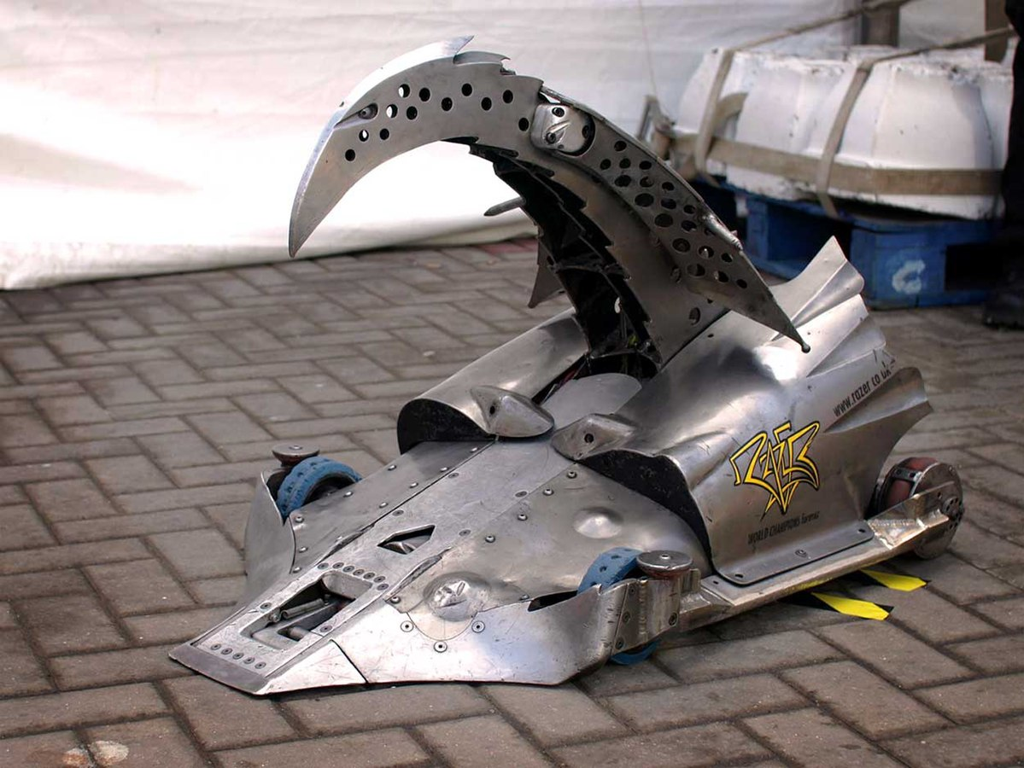
Example
Consider the following simple example
The show Robot Wars was a robot fighting show that was broadcast between 1998-2004 and 2016-2018.
Each robot had one main weapon, such as a buzzsaw, skewer, flipper, or hammer.
The goal was for a robot to either immobilize or ring-out the other robot, or push it into the “pit of oblivion”.
Image: CC-BY 2.0, Alex Healing, https://en.wikipedia.org/wiki/File:Razer_side-on_view.jpg

Slide 12
Predicting a winner
Suppose that you want to compete in your own robot competition.
You’re a data scientist, so you want to gather data about winning loadouts and learn what’s good against what.
You decide to use supervised machine learning to build a predictive model.
The goal: create a model that will take in information about a robot and its opponent, and tell you whether or not it’s likely to win

Slide 13
Feature engineering
Deciding what features to include and how to transform them is called “feature engineering”
For our robots, we need to decide what features they will have.
The weapon is an obvious choice.
The weight is useful too: some weapons, like flippers, may rely on the opponent being light enough to flip on its back or out of the ring.
Lastly, some robots have the ability to right themselves, which is good against certain weapons
Let’s try to assemble this information into a table

Slide 14
(half of) The dataset
Weapon | Weight | Self-righting | Opp. Weap. | Opp. Weight | Opp. SR | Winner?
Buzzsaw | Light | False | Hammer | Medium | False | True
Buzzsaw | Medium | True | Flipper | Medium | False | False
Flipper | Medium | False | Drill | Heavy | False | False
Lance | Light | True | Flipper | Heavy | False | False
Lance | Light | True | Hammer | Medium | True | True
Drill | Heavy | False | Lance | Medium | True | True
Drill | Heavy | False | Buzzsaw | Light | True | True
(the other half of the dataset is the columns reversed so that we’re evaluating the winner from the opponent’s point of view.

Slide 15
The goal
All the columns except the right represent information that we can get before a match happens
The right represents information that we want to predict. This is the target column.
We want a machine learning system that will take the first 6 columns, and will guess the last column as its output
This really is a guess: it won’t be perfect.

Slide 16
Pop quiz
What are the features in our data?
What are the instances?
What is the target?

Slide 17
Answers
The features are:
Weapon
Weight
Self-righting
The opponent version of those
The label column is also a feature: Winner?
There are 7 instances. They are the rows.
The target is “Winner?”

Slide 18
Questions?

Slide 19
Feature types
All of our features are so-called “categorical features”
Categorical features are like “enums”. There are a handful of valid categories we can choose from.
For the self-righting category, the two values are “true” and “false”
For the weapon category, the values are “drill”, “hammer”, etc.
Categorical values are treated as being entirely different from each other. The machine learning classifier cannot infer anything about them. Whatever it learns about “hammer” does not apply to “lance”
Numerical values aren’t in this dataset, but could be if we represented the actual weight (instead of saying “light”, “heavy”, etc.)

Slide 20
Categorical vs. numeric features
Machine learning systems can do more with numeric features.
They can infer, for example, that if weight is a very important feature, then a 30 kg robot will do better than a 20 kg robot
With ordinary categories, they cannot infer this.
There is a data type called “ordinal”, which is when we order the categories. For example, ‘low’ weight is less than ‘medium’ which is less than ‘high’.
However, for now, let’s treat all of our features as categorical.

Slide 21
Examples of feature types
Categorical
Whether a car is front-wheel, rear-wheel, or all-wheel drive
Whether a pokemon is fire, ice, grass, etc. (combinations can be unique categories)
The operating system of a computer (Windows, Mac, Linux, BSD, etc.)
[Give me more]
Numerical
A student’s GPA
A person’s height
A car’s gas mileage
[Give me more]

Slide 22
Classification vs. regression
This is a classification task. We are reading in features and classifying whether the robot with those features will win
The output of a classification task is the target. In our case: true or false for whether the robot will be a winner
Another kind of supervised task is called regression. Classification tasks predict categorical features, while regression tasks predict numeric features.
If we wanted to predict how many points the judges would award the robot, that would be a regression task.

Slide 23
Important vocabulary
There’s a lot of vocabulary that just got introduced
Now is a good time to ask questions about the following terms:
Feature (or attribute)
Target (or label)
Instance
Classification
Regression
Supervised learning
Categorical feature
Numerical feature

Slide 24
Questions?

Slide 25
The hypothesis
In machine learning, a hypothesis is a statement that represents what the machine learning algorithm is supposed to learn.
For example: “drill is the best weapon, it always wins. Otherwise, only weight matters” is a hypothesis.
We can apply this hypothesis to build a classifier as follows:
Read one instance from our data set
Check the weapon feature
If the weapon is “drill” and opponent’s weapon is not “drill”, then Winner? = true
Else, if the opponent has a drill and we don’t, then Winner? = false
Else, if the weight is greater than the opponents, Winner? = true
Else, Winner? = false
(note: if both we and our opponent are identical in both attributes.)

Slide 26
The hypothesis as a function
We can think of a hypothesis as a mathematical function.
It takes an input. In our example, a matchup between two robots.
It renders and output. In our example: Winner? = true | false.
Recall the hypothesis of “drill always wins”. We can write it as a function as follows: h( matchup ) = if matchup.robot_a.weapon == “Drill” and matchup.robot_b.weapon != “Drill” then true else if matchup.robot_b.weapon == “Drill”and matchup.robot_a.weapon != “Drill” then false else matchup.robot_a.weight > robot_b.weight
(note: we’re treating weight as an ordinal feature, which means we can compare it with ‘>’)

Slide 27
The hypothesis space
The hypothesis we just used was only one possible hypothesis.
You might think there are an infinite number, but it’s actually finite
The set of all possible hypotheses is called the “hypothesis space”
When we train the classifier, the input is the labeled training data, and the output is one of the hypotheses in this set.

Slide 28
Example hypothesis space
Pretend there are only two weapons: lance and flipper
And pretend there are only two weights: light and heavy
Let’s ignore “self-righting” for now.
We have 4 non-label features, and each one would have 2 possible values.
Therefore, we can represent the entire hypothesis space (meaning, all possible hypotheses) as a list of Boolean functions.

Slide 29
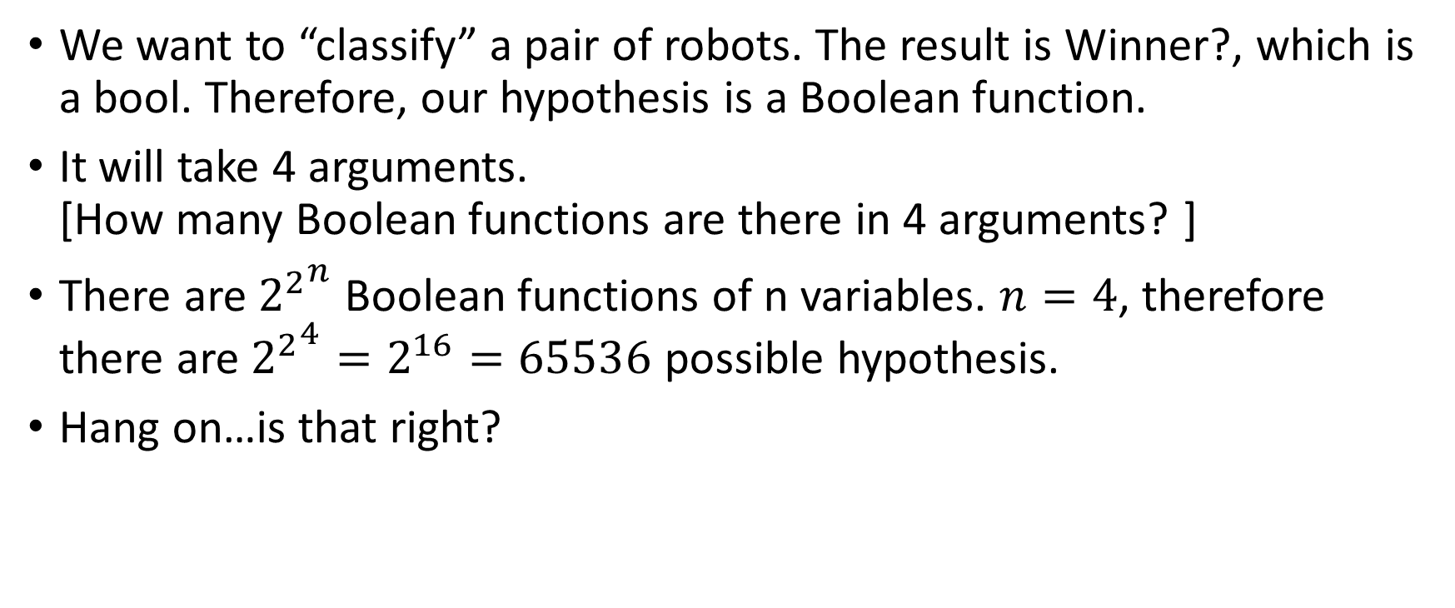
Reminder about Boolean functions
We want to “classify” a pair of robots. The result is Winner?, which is a bool. Therefore, our hypothesis is a Boolean function.
It will take 4 arguments. [How many Boolean functions are there in 4 arguments? ]
There are ${2^{2}}^{n}$ Boolean functions of n variables. $n=4$, therefore there are ${2^{2}}^{4}=2^{16}=65536$ possible hypothesis.
Hang on…is that right?

Slide 30
Looking at one hypothesis
Let’s look at a single hypothesis
This hypothesis can be summed up in English as: “drill beats flipper, and if both robots have the same weapon, then the heavy robot wins.”
What does this look like as a truth table?

Slide 31
This hypothesis as a truth table
Weapon A | Weight A | Weapon B | Weight B | Winner?
Drill | Heavy | Drill | Heavy | False
Drill | Heavy | Drill | Light | True
Drill | Heavy | Flipper | Heavy | True
Drill | Heavy | Flipper | Light | True
Drill | Light | Drill | Heavy | False
Drill | Light | Drill | Light | False
Drill | Light | Flipper | Heavy | True
Drill | Light | Flipper | Light | True
Flipper | Heavy | Drill | Heavy | False
Flipper | Heavy | Drill | Light | False
Flipper | Heavy | Flipper | Heavy | False
Flipper | Heavy | Flipper | Light | True
Flipper | Light | Drill | Heavy | False
Flipper | Light | Drill | Light | False
Flipper | Light | Flipper | Heavy | False
Flipper | Light | Flipper | Light | False

Slide 32
Encoding the truth table
We are using a pattern. The first 8 rows all start with “Drill”. The first 4 rows all start with “heavy”, etc.
This order will be the same for each hypothesis. The only thing that changes is the labels.
That is, another hypothesis might be “flipper always wins”, but that just changes the last column. It doesn’t have to change the order we put the rows in.
So, how can we encode the last column? [class?]

Slide 33
The answer
As a binary number
The previous hypothesis is: 0111001100010000
This is a 16-bit binary number.
Does it make sense now why there are 65,536 hypotheses?

Slide 34
Helpful note
The size of the hypothesis space of our problem is related, but different, to the size of the truth table.
Each hypothesis is one truth table.
So the size of the hypothesis space is not the size of the truth table directly, it’s the total number of truth tables
We didn’t have to use a truth table to encode the hypothesis. We could use the h( match ) notation we used earlier). Using the table makes it easier to count them.
Another note: different problems have different tables. And if our target is a smooth variable (a regression problem), we wouldn’t use a table.

Slide 35
Questions?

Slide 36
How do we determine the best hypothesis?
When we “train” a supervised model, we take a list of examples, and the “output” is a hypothesis (which is the core of the new model).
So how do we know which hypothesis is best?
We’ll talk about performance metrics later, but for now, we’ll use accuracy.
We look at the actual data from the real robot matchups, and the best hypothesis is the one that gets it right the most.

Slide 37
Accuracy Example
Consider the following training set:
What is the accuracy of the hypothesis we’ve been discussing?
Weapon A | Weight A | Weapon B | Weight B | Winner?
Drill | Light | Flipper | Light | False
Drill | Light | Flipper | Heavy | True
Flipper | Light | Drill | Light | True
Flipper | Heavy | Drill | Light | True

Slide 38

Accuracy Example
Calculating the accuracy
We compare the predicted values with the actual target column
Then, we calculate: $\frac{\#Correct}{\#TotalPredictions}$
Weapon A | Weight A | Weapon B | Weight B | Winner? | Predicted
Drill | Light | Flipper | Light | False | True
Drill | Light | Flipper | Heavy | True | True
Flipper | Light | Drill | Light | True | False
Flipper | Heavy | Drill | Light | True | False

Slide 39
The result
Our hypothesis got one row right
There are four rows
Our accuracy is ¼, or 25%
If our hypothesis had been “always say you won no matter what the weapon or weight of you or your opponent is”, we would have an accuracy of 75%.
If we doubled the size of our training set by reversing our robot and the opposing one, and inverting the winner (assuming no ties). The latter hypothesis would have an accuracy of 50%.
Saying you always won no matter what does not require machine learning. So, for most uses, the first hypothesis would be considered “bad”

Slide 40
Questions?

Slide 41
Finding a good hypothesis
Generating the hypothesis is the job of the machine learning algorithm
Different algorithms have different approaches to doing this.
All of these algorithms involve assumptions. The biggest assumption is on the shape of the hypothesis space.
Our hypothesis space was something we could fully enumerate, but when dealing with smooth variables this may not be possible.

Slide 42
Dealing with uncertainty
Supervised machine learning is used to classify or predict values based on data we have never seen before.
That means that there is uncertainty
Different algorithms have different “inferential biases”. An inferential bias is essentially the assumption the algorithm makes when doing “inference” (aka educated guessing).
This is a long-winded way of saying that two supervised algorithms can see the same training data and predict different labels.

Slide 43
The unbiased algorithm
You might think that the best machine learning algorithm would be completely unbiased. That is, that it would see reality perfectly as it is.
This algorithm actually already exists. In fact, it’s older than the field of machine learning.
It’s called a database.

Slide 44
The unbiased algorithm (2)
If we want to predict a robot match, we look up the last time that matchup occurred and output the result.
What if it never occurred? Then we return “I don’t know”. This matchup has never occurred, and it would be biased to assume that it would go one way or another based on the features of the robots.
If you want to make a machine learning algorithm, there has to be some inference involved. The whole point of machine learning is to get results for data that never happened before (or for which creating a database would be impractical).

Slide 45
Questions?

Slide 46
Your first algorithm: Find-S
Our first machine learning algorithm will be a fairly simple one.
It doesn’t require statistics or calculus: just Boolean algebra.
Its goal is to find the most specific hypothesis for a dataset. This hypothesis is named “S”, so this is called the “Find-S” algorithm
What is a specific hypothesis?

Slide 47
The most specific and general hypotheses
The more specific a hypothesis is, the fewer times it predicts“True” for the target feature.
The most specific hypothesis in our case is “your robot never wins”. (i.e., the hypothesis is true for nothing)
The most general hypothesis is “your robot always wins” (i.e., the hypothesis is true for everything)
The Find-S algorithm starts with the most specific hypothesis and makes it more general every time it’s wrong.
Let’s see an example of how we write a hypothesis in this algorithm

Slide 48
Writing a hypothesis
The hypothesis can be represented as a vector.
Each element of the vector is which value is needed to win.
If either value can win, we write “?”
Example: <Drill, ?, ?, light> is a hypothesis that means “if you have a drill and the opponent is light, you will win, regardless of the opponent’s weapon or your own weight.”

Slide 49
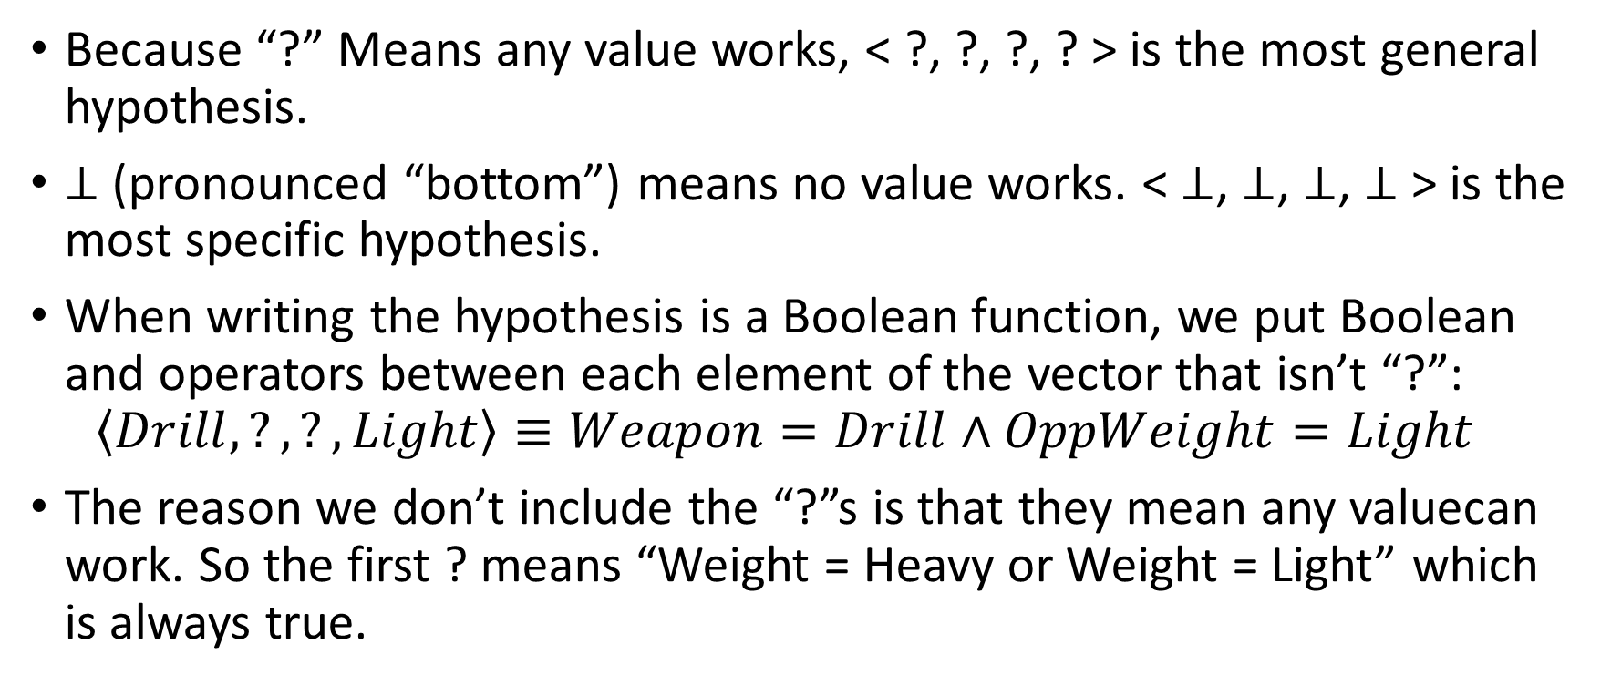
Writing a hypothesis (2)
Because “?” Means any value works, < ?, ?, ?, ? > is the most general hypothesis.
$⊥$ (pronounced “bottom”) means no value works. < $⊥$, $⊥$, $⊥$, $⊥$ > is the most specific hypothesis.
When writing the hypothesis is a Boolean function, we put Boolean and operators between each element of the vector that isn’t “?”: $\left\langle Drill,?,?,Light\right\rangle ≡Weapon=Drill∧OppWeight=Light$
The reason we don’t include the “?”s is that they mean any valuecan work. So the first ? means “Weight = Heavy or Weight = Light” which is always true.

Slide 50
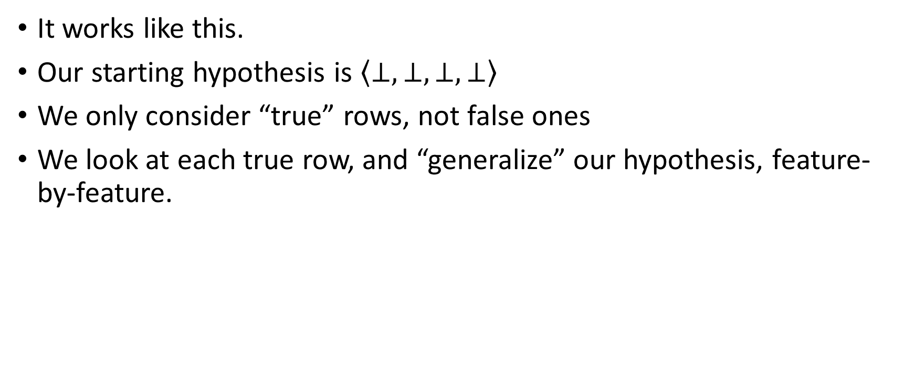
The algorithm
It works like this.
Our starting hypothesis is $\left\langle ⊥,⊥,⊥,⊥\right\rangle$
We only consider “true” rows, not false ones
We look at each true row, and “generalize” our hypothesis, feature-by-feature.

Slide 51
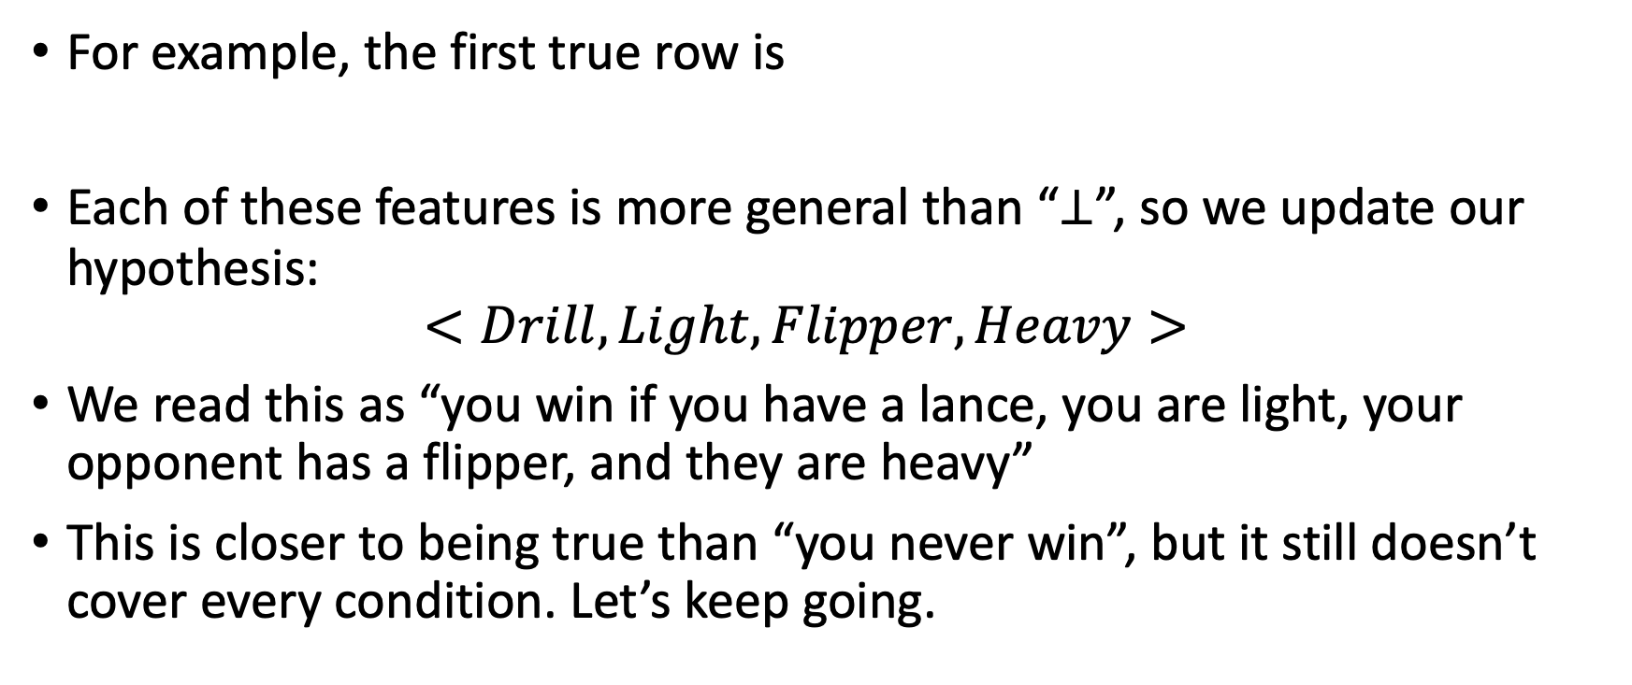
The algorithm (2)
For example, the first true row is
Each of these features is more general than “$⊥$”, so we update our hypothesis: $<Drill,Light,Flipper,Heavy>$
We read this as “you win if you have a lance, you are light, your opponent has a flipper, and they are heavy”
This is closer to being true than “you never win”, but it still doesn’t cover every condition. Let’s keep going.
Drill | Light | Flipper | Heavy

Slide 52
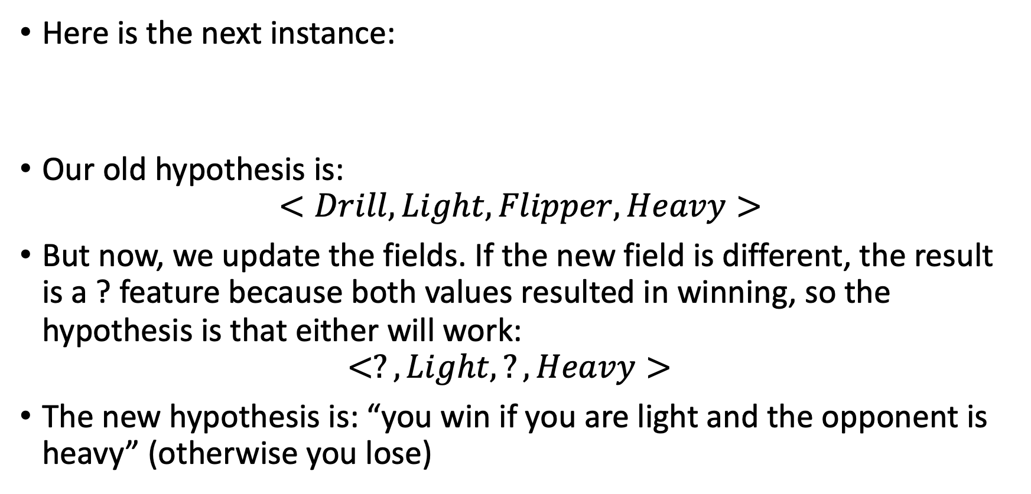
The algorithm (3)
Here is the next instance:
Our old hypothesis is: $<Drill,Light,Flipper,Heavy>$
But now, we update the fields. If the new field is different, the result is a ? feature because both values resulted in winning, so the hypothesis is that either will work: $<?,Light,?,Heavy>$
The new hypothesis is: “you win if you are light and the opponent is heavy” (otherwise you lose)
Flipper | Light | Drill | Light

Slide 53

The algorithm (4)
There is one more true example:
Our old hypothesis is: $<?,Light,?,Heavy>$
Our new hypothesis is: $<?,?,?,?>$
Um…
Flipper | Heavy | Drill | Light

Slide 54
What happened?
Unfortunately, the find-S algorithm cannot handle any inconsistency at all.
If any feature appears as both true and false for a true label, we end up learning ?
This is too simple to learn a good hypothesis in our example
One problem is simple luck: we could have a terrible robot, but it wins by accident (maybe the opponent falls into the pit of oblivion).
This would damage the hypothesis.

Slide 55
Noise in data
When we have data rows which don’t illustrate the underlying truth we’re trying to model, we call that noise.
We’re assuming there is a “true” mathematical function that represents the ideal hypothesis, and that noise instances were introduced by a different means (they don’t come from the same dataset)
Noise could be introduced by digital corruption, bad luck, typos, or it could be a legitimate effect that actually indicates that we didn’t do feature engineering right. There’s no way to know 100%, because if we knew which rows were noise, we could remove them and it wouldn’t be a problem.

Slide 56
Problems with Find-S
One of the ways we compare machine learning algorithms is to compare how resistant to noise they are
Find-S is a very brittle algorithm. A single instance of noise can destroy the hypothesis.
Note: find-S has other problems too. It doesn’t learn from negative examples, which could actually be very useful.
For example, the hypothesis it learned was <?, ?, ?, ?>, but if that hypothesis were really true, there should not be any negative examples. Our dataset contradicts the hypothesis.

Slide 57
Questions?

Slide 58
Class exercise
Take a moment and see if you can come up with a “perfect” hypothesis for this data.
Don’t worry about flipping the competitors around.
Pretend that the robot referred to in the left 2 columns is the robot we’re controlling. We’ve fought 4 matches so far. Here are the results:
Find a hypothesis that gets 100% accuracy. Try to describe it in English and also using Boolean algebra
Weapon A | Weight A | Weapon B | Weight B | Winner? | Predicted
Drill | Light | Flipper | Light | False | False
Drill | Light | Flipper | Heavy | True | True
Flipper | Light | Drill | Light | True | True
Flipper | Heavy | Drill | Light | True | True

Slide 59
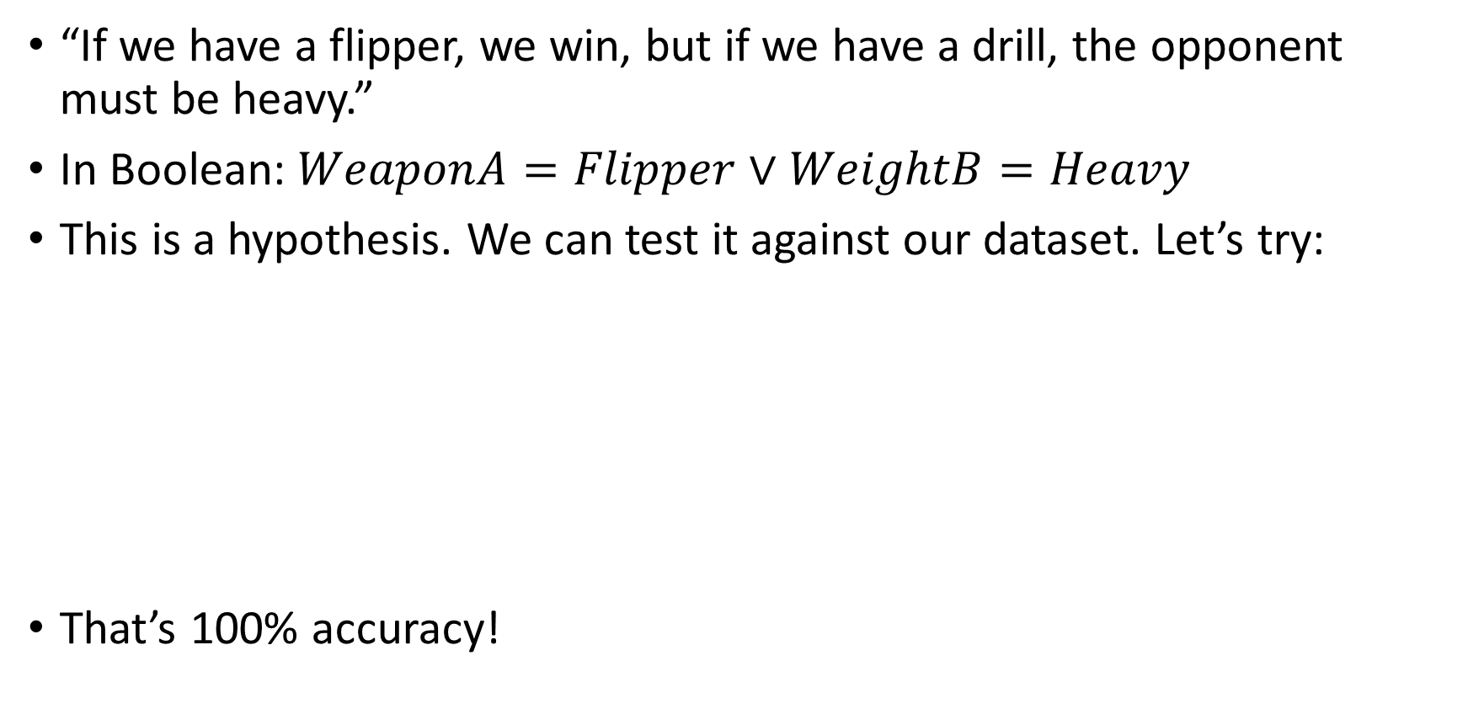
A “perfect” hypothesis
“If we have a flipper, we win, but if we have a drill, the opponent must be heavy.”
In Boolean: $WeaponA=Flipper∨WeightB=Heavy$
This is a hypothesis. We can test it against our dataset. Let’s try:
That’s 100% accuracy!
Weapon A | Weight A | Weapon B | Weight B | Winner? | Predicted
Drill | Light | Flipper | Light | False | False
Drill | Light | Flipper | Heavy | True | True
Flipper | Light | Drill | Light | True | True
Flipper | Heavy | Drill | Light | True | True

Slide 60
Can Find-S learn this hypothesis?
So here’s the issue:
We know that Find-S did not learn this hypothesis. And it learned one that gets worse accuracy (75%,)
The question is: was it possible for Find-S to learn this hypothesis. Maybe if the dataset had been different?
[What do you think?]

Slide 61
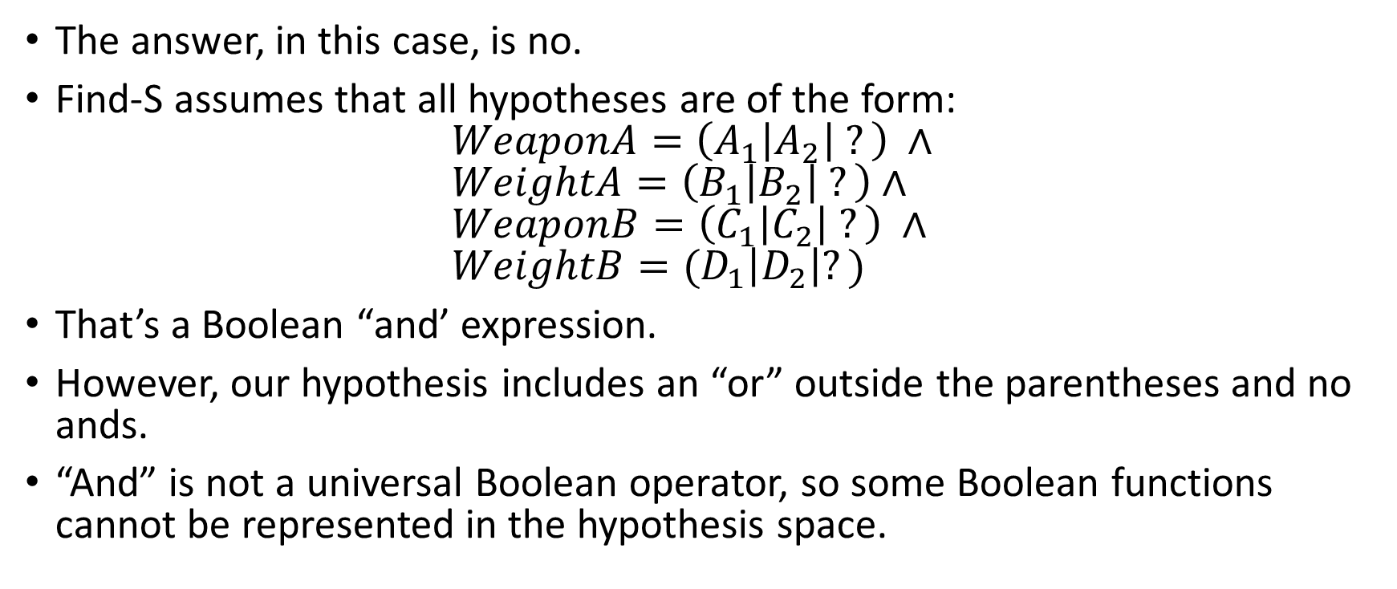
The hypothesis space of Find-S
The answer, in this case, is no.
Find-S assumes that all hypotheses are of the form: $WeaponA={\left(A_{1}\left|A_{2}\right| ?\right)}^{ }∧$ $WeightA=\left(B_{1}\left|B_{2}\right| ?\right)∧$ $WeaponB=\left(C_{1}\left|C_{2}\right| ?\right) ∧$ $WeightB=(D_{1}\left|D_{2}\right|?)$
That’s a Boolean “and’ expression.
However, our hypothesis includes an “or” outside the parentheses and no ands.
“And” is not a universal Boolean operator, so some Boolean functions cannot be represented in the hypothesis space.

Slide 62
The hypothesis space of Find-S (2)
Because of the limitations of Find-S, it is impossible for it to learn our 100% accuracy hypothesis.
There is a “dual” version of Find-S that is based on looking only at negative values instead of positive ones. And instead of treating each hypothesis as a giant Boolean “and”, it treats it as a giant Boolean “or”.
This version still cannot represent every possibility. For example, what if the best hypothesis was an XOR or XNOR type of relationship: “We win if we have a lance and are light, or if we have a flipper and are heavy”
This hypothesis involves ands and ors out of the order that find-S expects, which neither version of Find-S can find.

Slide 63
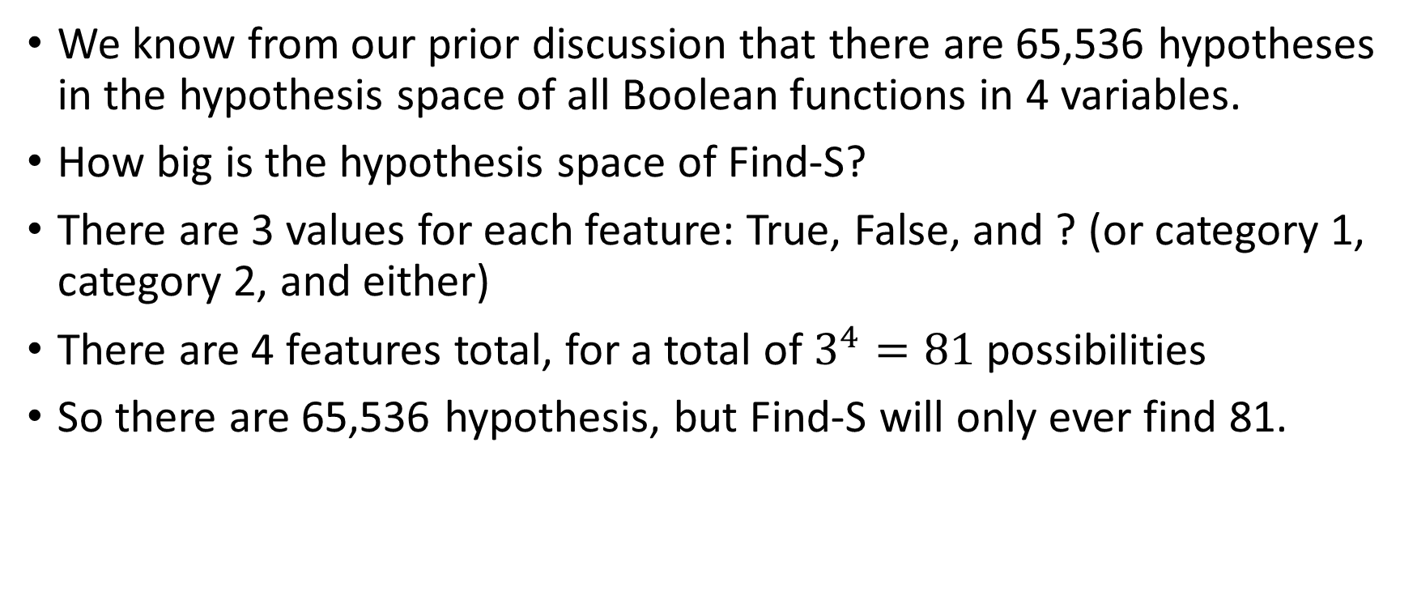
Another explanation of the limitations
We know from our prior discussion that there are 65,536 hypotheses in the hypothesis space of all Boolean functions in 4 variables.
How big is the hypothesis space of Find-S?
There are 3 values for each feature: True, False, and ? (or category 1, category 2, and either)
There are 4 features total, for a total of $3^{4}=81$ possibilities
So there are 65,536 hypothesis, but Find-S will only ever find 81.

Slide 64
How bad is that?
That depends on the application
Find-S is an extremely simple, fast, algorithm
It also requires very few data instances to learn something (most machine learning algorithms need more than 3 rows)
So if you have a tiny data set with only positive examples that is perfectly consistent (no noise), it might be a good option.
If we have 20 features, the space of Boolean functions is too large to exhaustively cover, so we have to have some simplifying assumptions. Algorithms like Find-S might work well there.

Slide 65
Questions?

Slide 66
Vocabulary to know
Feature (or attribute)
Target (or label)
Instance
Classification
Regression
Supervised learning
Categorical feature
Numerical feature
Hypothesis
Hypothesis space
Find-S
Noise

Slide 67
Careful!
Classification is when the label is categorical. It doesn’t matter what type the rest of the data is. You can have all numerical columns, except for the label being categorical, and it’s classification.
Likewise for regression, only label must be numerical for it to be considered regression. You can have all categorical features except the label and have it still be regression.

Slide 68
Suggested practice
https://www.geeksforgeeks.org/ml-find-s-algorithm/
Create your own dataset and apply find-s to it
Then, try to formulate your own 100% accuracy hypothesis
Create a row that prevents 100% accuracy with any hypothesis (a contradiction)

Slide 69
Some questions about hypothesis spaces
Suppose we apply a machine learning algorithm that can learn any function. It takes two Boolean features, but also one categorical feature with 3 values, and one with 5. The function returns bool. What is the size of the hypothesis space?
Suppose we apply Find-S to the algorithm in problem 1. What is the size of the hypothesis space that Find-S can learn? Assuming the variant of find-S we learned in class where the only options for each feature are VariantA | Variant B | … | ? ?

Slide 70
Some questions about hypothesis spaces
The size of the truth table of one function is 3 * 5 * 2 * 2 = 60 The number of these functions is 2^60.
Suppose we apply Find-S to the algorithm in problem 1. What is the size of the hypothesis space that Find-S can learn? 4 * 6 * 3 * 3 = 216 If the first feature has 3 values: A, B, C, then Find-S can learn A, B, C, and ‘?’ for that feature (4 values). Same for the second. 5 values + ‘?’. This means 216 combinations.

Slide 71
Questions?

