Slide 1

CS 483: Machine Learning
Week 5: Pipelines, Transformations, Searching for Hyperparameters

Slide 2
Last week
We talked about regression
We talked about linear regression
We learned about classification, and how we can do it with linear regression (logistic regression)

Slide 3
This week
We will learn how to set up pipelines
Pipelines allow us to set up experiments and make sure our data is processed correctly every time.
We can also use pipelines to determine hyperparameters, which are parameters outside of the model.

Slide 4
But first, the quiz
Pretend it’s a real test
Suggested to use pencil and paper or type on laptop
No need for calculators

Slide 5
The “quiz”
Suppose we have a spreadsheet stored in the file “data.csv”
Load the spreadsheet into a pandas dataframe
Select only the columns “Hp”, “Weight”, “GasMileage”.
Train a linear regression classifier to predict GasMileage from Hp and Weight
Calculate the r2 score of the model on the training set. You don’t have to create a separate training and test set.
You can assume these imports: import pandas as pd from sklearn.linear_model import LinearRegression from sklearn.metrics import r2_score

Slide 6
Quiz answer
# df = pd.read_csv( 'data.csv', names = [ 'Hp', 'Weight', 'GasMileage' ]) # or … df = pd.read_csv( 'data.csv’ ) df = df[ ['Hp', 'Weight', 'GasMileage’] ]
data_x = df[ ['Hp', 'Weight' ] ] data_y = df[ 'GasMileage’ ] model = LinearRegression() model.fit( data_x, data_y ) pred_y = model.predict( data_x )
print( r2_score( list( data_y ), list( pred_y ) ) )

Slide 7

Questions?

Slide 8
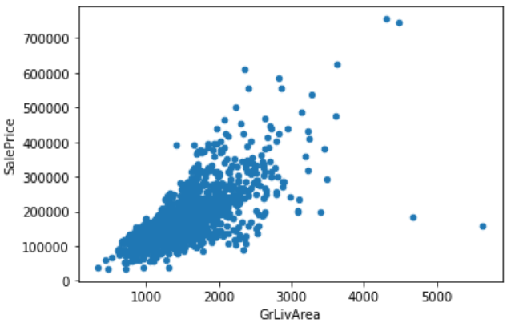
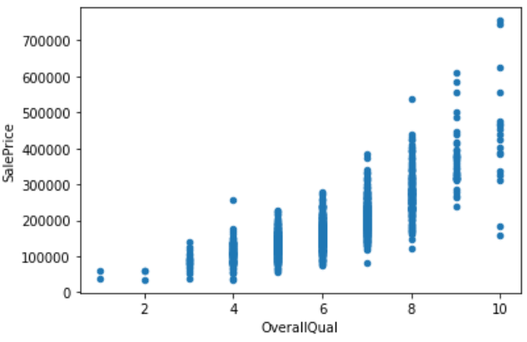
Transforming price data
Let’s recall last class where we related house features to house prices

Slide 9
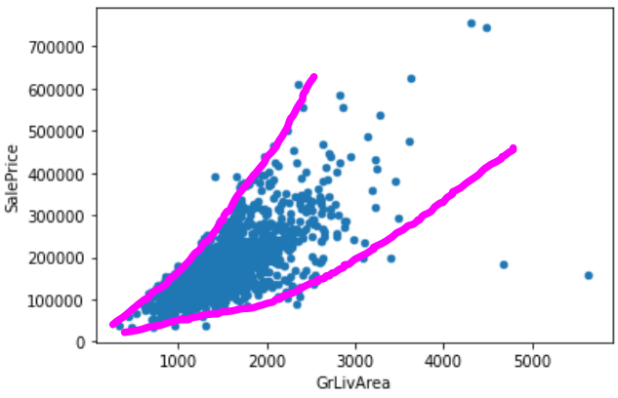
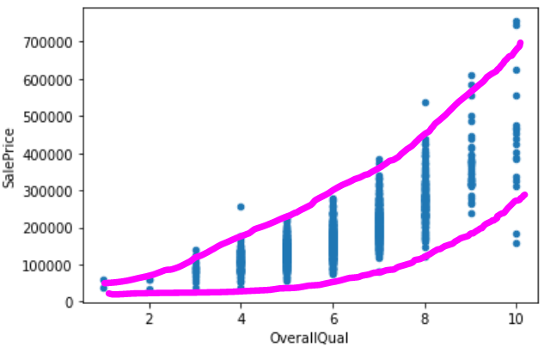
Seeing the skew
It almost seems like there’s a “skew”, to price data. It’s not strictly linear (which is should be for linear regression)

Slide 10
What’s wrong with the skew?
Our linear regression model will only find a line.
If the value we’re predicting is skewed with respect to our inputs, it can’t be accurately fit by a line.
If the skew is predictable (e.g., polynomial or exponential), we can account for it with a simple transformation.
I’ve heard a saying: “quality grows linearly, while price grows quadratically”. Let’s test that.

Slide 11
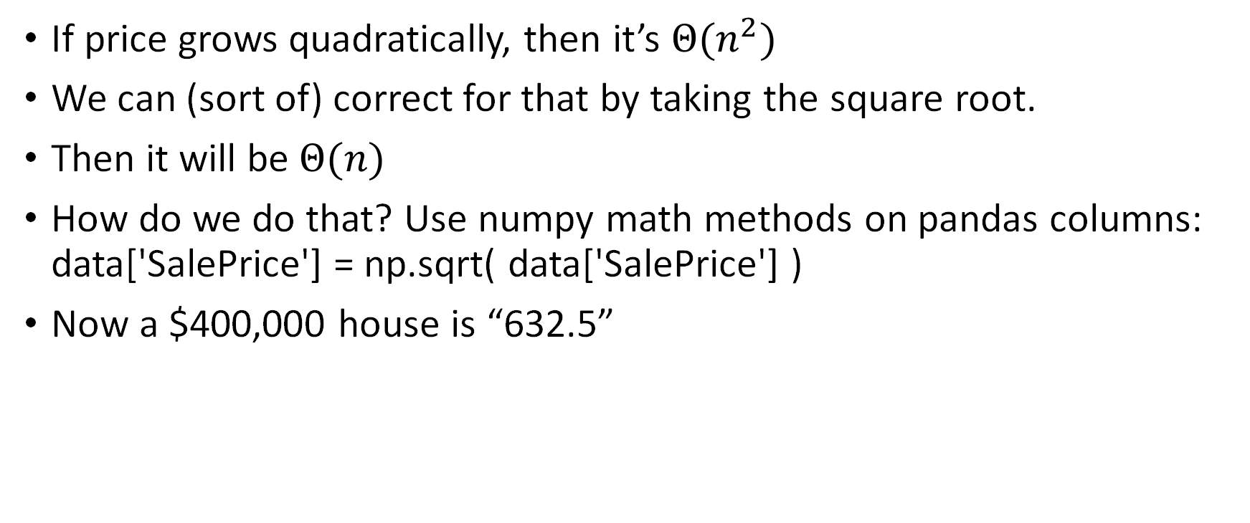
Testing “price grows quadratically”
If price grows quadratically, then it’s $Θ(n^{2})$
We can (sort of) correct for that by taking the square root.
Then it will be $Θ(n)$
How do we do that? Use numpy math methods on pandas columns: data['SalePrice'] = np.sqrt( data['SalePrice'] )
Now a $400,000 house is “632.5”

Slide 12
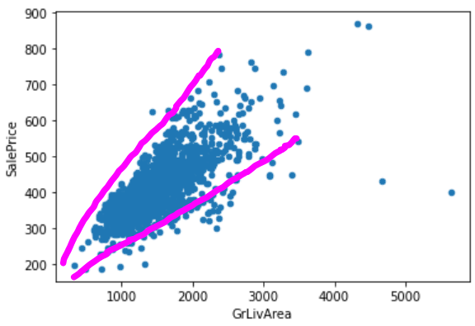
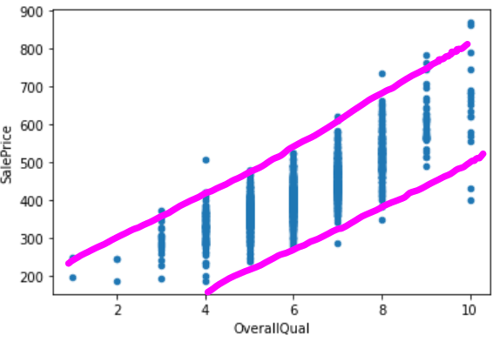
The result:

Slide 13
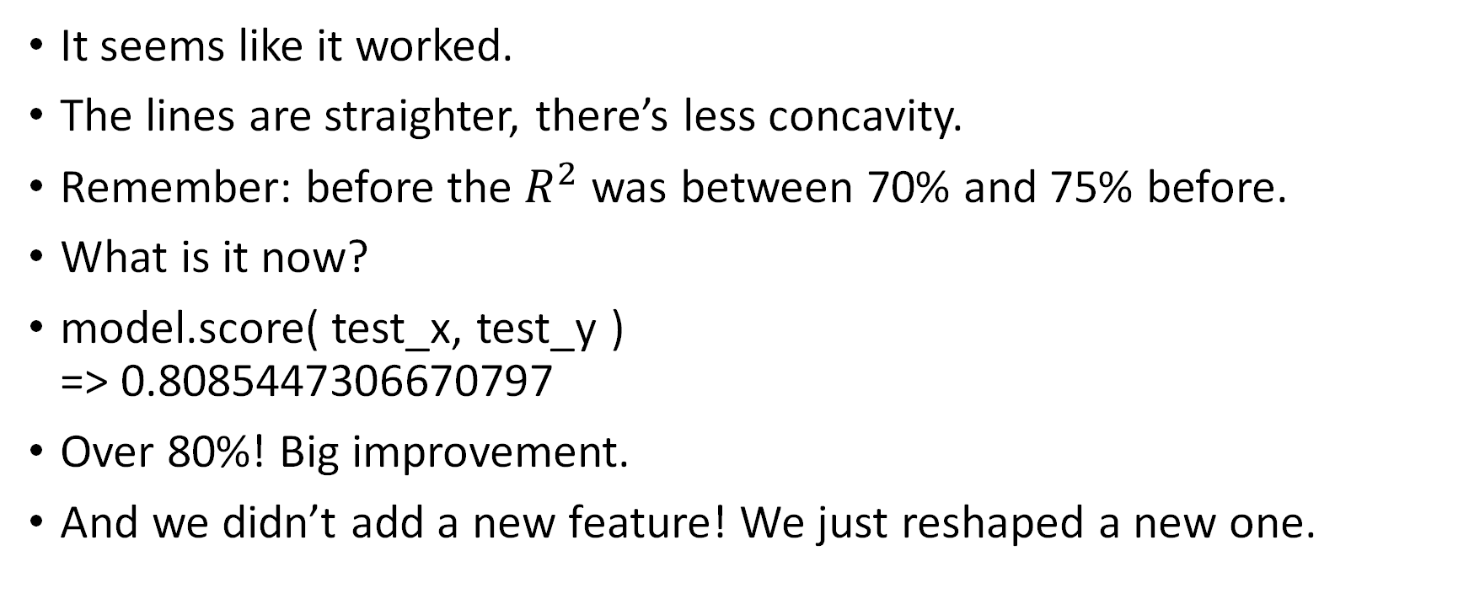
The result: commentary
It seems like it worked.
The lines are straighter, there’s less concavity.
Remember: before the $R^{2}$ was between 70% and 75% before.
What is it now?
model.score( test_x, test_y ) => 0.8085447306670797
Over 80%! Big improvement.
And we didn’t add a new feature! We just reshaped a new one.

Slide 14
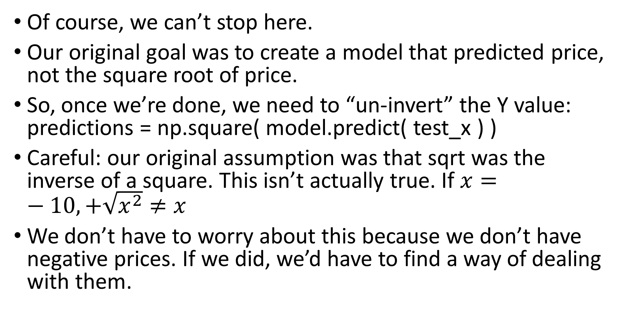
Odds and ends
Of course, we can’t stop here.
Our original goal was to create a model that predicted price, not the square root of price.
So, once we’re done, we need to “un-invert” the Y value: predictions = np.square( model.predict( test_x ) )
Careful: our original assumption was that sqrt was the inverse of a square. This isn’t actually true. If $x=−10, +\sqrt{x^{2}}≠x$
We don’t have to worry about this because we don’t have negative prices. If we did, we’d have to find a way of dealing with them.

Slide 15
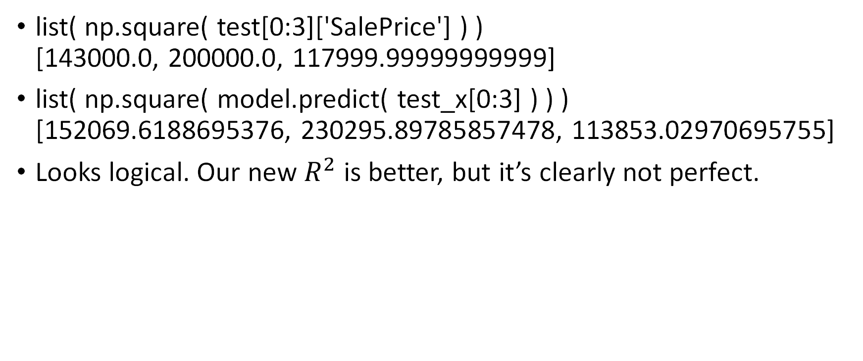
Comparison
list( np.square( test[0:3]['SalePrice'] ) ) [143000.0, 200000.0, 117999.99999999999]
list( np.square( model.predict( test_x[0:3] ) ) ) [152069.6188695376, 230295.89785857478, 113853.02970695755]
Looks logical. Our new $R^{2}$ is better, but it’s clearly not perfect.

Slide 16
Questions?

Slide 17
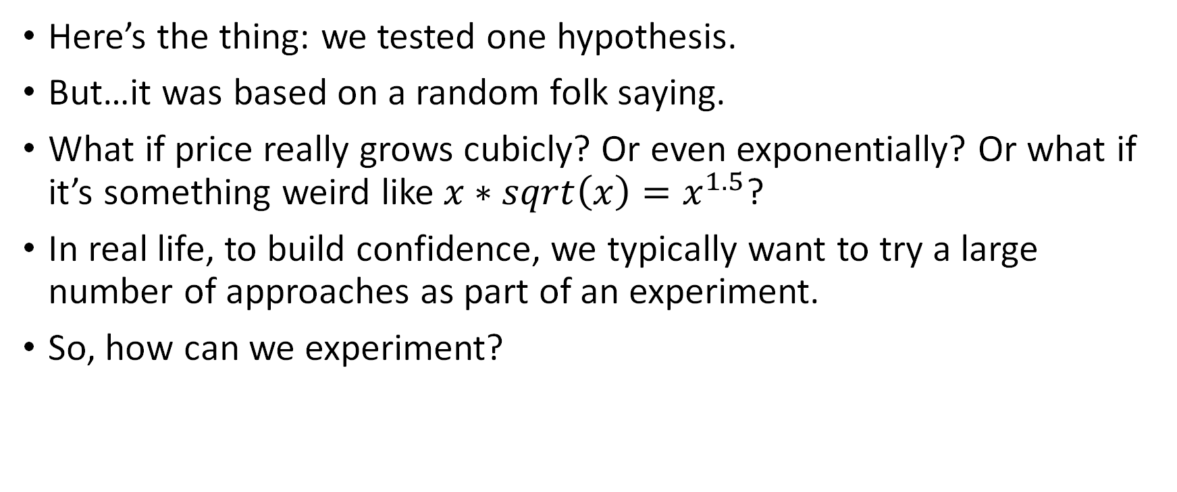
Doing this for real
Here’s the thing: we tested one hypothesis.
But…it was based on a random folk saying.
What if price really grows cubicly? Or even exponentially? Or what if it’s something weird like $x∗sqrt\left(x\right)=x^{1.5}$?
In real life, to build confidence, we typically want to try a large number of approaches as part of an experiment.
So, how can we experiment?

Slide 18
The basic way
Well, we can make many different versions of the dataset: data_unch = data[:] # unchanged data data_sqrt = data[:]; data_sqrt[‘SalePrice’] = np.sqrt(data[‘SalePrice’] ) data_cbrt = data[:]; data_cbrt[‘SalePrice’] = np.cbrt(data[‘SalePrice’] ) data_exp = data[:], data_exp[‘SalePrice’] = np.exp(data[‘SalePrice’] )
And we can build 4 different models: model_unch.fit( data_x, data_unch_y ) model_sqrt.fit( data_x, data_sqrt_y ) …
[Will this work?]

Slide 19
The problem(s)
We’re duplicating potentially a lot of data
We could avoid duplication by doing this after we split the xs from the ys.
That is, the xs is all the data that stays the same.
The ys are the price targets that can change.
But how can we conveniently run our regression system on different targets without having to manually try different functions for them?

Slide 20
More problems
We are going to build a machine learning classifier that takes data, processes it, and outputs predictions
In order for the classifier to work, it will select features and transform them. We won’t only want to transform the target.
We want this to be automatic. We don’t want to have to process all of the inputs our model receives just to make it identical to the training conditions

Slide 21
What about other inputs?
Prices aren’t the only things we want to change.
What if we want to select certain columns and drop others?
We would want that to happen every time the classifier is fit, and also when we use it to predict things.
It’s not good to duplicate code.

Slide 22
Pipelines
The solution to changing the inputs in an organized way is to use something called a pipeline.
Pipelines are graphs of “steps”, where each step does some kind of data science activity.
For example, consider the following steps:
Add column
Drop another column
Transform a column
Fit classifier
We can also have parallel steps. For example, transform columns in different ways (to try different things).

Slide 23
Pipelines (2)
By combining these in a pipeline, we can build the pipeline into a whole classifier that automatically handles the columns. Then, we don’t need to add/remove columns every time we use it.
It’s also easier to experiment. The pipeline will handle the data transformation for us.
In fact, Scikit-learn has experimentation classes which take pipelines and can determine what parameters for them are best.
However, first, let’s take a look at a simple class that will help us transform our linear regression into one that predicts something transformed.
We can then add this to a pipeline, which will handle our transformed X values.

Slide 24
What about the saleprice transformation?
When the column we’re trying to change is in the target position, we don’t usually use a pipeline.
The reason is that when we’re fitting the machine learning classifier, the target is already in a separate variable.
Instead, we use a special wrapper class, called TransformedTargetRegressor. This class has the ability to transform is value with a given function before running a regressor on it.
Together, we can use pipelines and transformers to build systems that can be easily experimented with.

Slide 25
Questions?

Slide 26
Let’s make a pipeline
Pipelines are organized as a list of steps
Steps have to implement two methods:
Fit: receives the output of the previous step and is supposed to prepare the step to operate. It is always called before “transform”.
Transform: actually applies the step, returns a new dataset.
Our first step is to select features. We were using the fields “GrLivArea” and “OverallQual”
Let’s first use a column transformer that does this.

Slide 27
Creating a “transformer”
from sklearn.pipeline import Pipeline from sklearn.base import TransformerMixin, BaseEstimator class SelectColumns( BaseEstimator, TransformerMixin ): # pass the function we want to apply to the column 'SalePrice’ def __init__( self, columns ): self.columns = columns # don't need to do anything def fit( self, xs, ys, **params ): return self # actually perform the selection def transform( self, xs ): return xs[ self.columns ]

Slide 28
What’s going on here?
There’s a lot to this, let’s go line by line.
class SelectColumns( BaseEstimator, TransformerMixin ):
This is a design pattern called a “Mixin”
Mixins use multiple inheritance to add more methods to a class.
When we “bring in” a mixin, we add the mixins methods into the class. Those methods can call methods that we ourselves write in our class.
TransformerMixin in particular adds a method called fit_transform, which fits, and then transforms some data. It calls the fit and transform methods of our class.

Slide 29
BaseEstimator
This is a base class. It adds simple methods that all estimators hav. (anything that supports “fit”)
In our case, the methods we need from BaseEstimator are “set_params” and “get_params”
These methods just provide a way to set data inside of the object. They will be used by the class we use to perform experiments later.

Slide 30
What’s going on here: Fit
As we saw with our models, fit means train.
However, for other types of transformers, fit means “react to this data in order to change yourself”
For example, a clustering algorithm would interpret “fit” as meaning “build a set of clusters”.
In our case, we want to select a set of columns no matter what, so we don’t need to fit.
If we needed to select columns depending on something about the data, we would implement fit.

Slide 31
What’s going on here: transform
Transform means “take the X values and modify them”
This is what we actually want to do
We take the X values and select the columns that we want.
We take the list of columns in the constructor, and return the result
This doesn’t actually require cloning the data_frame, it’s relatively efficient.

Slide 32
How the transformer works
Pipelines are basically machine learning algorithms combined with all the code that transforms the data.
We can call “fit” on the pipeline to “train” it. This calls “fit” on all the stages of the pipeline.
We call “transform” on the pipeline to send some data through it.
Here, our stage of the pipeline only exists to modify the SalePrice field, so it doesn’t need to be trained.
Instead, transform selects the columns we care about and returns the new dataset.

Slide 33
Making the pipeline
First, we describe the steps: steps = [ ( 'column_select', SelectColumns( ['GrLivArea', 'OverallQual'] ) ), ( 'linear_regression', LinearRegression( n_jobs = -1 ) ), ]
The first step calls our custom class which pulls the two columns we care about
The last step is a linear regression model
These happen in order, and the data we pass to the pipeline is transformed by column select and the result is passed to linear regression.

Slide 34
Using the pipeline
steps = [ ( 'transform_price', PriceTransformer( np.sqrt ) ), ( 'linear_regression', LinearRegression( n_jobs = -1 ) ), ]
What do we do with it?
Pipelines support the same methods that models do.
We can “fit” them and we can “predict” with them.
If we call “fit”, we fit the first step, then transform the training data by the first step and fit the second step with it
If we call “predict”, we first call transform_price.transform, and the output of that is fed to linear_regression.predict

Slide 35
Visualization
Fit
Transform
SelectColumns.fit
SelectColumns.transform
SelectColumns.transform
LogisticRegression.predict
LogisticRegression.fit

Slide 36
Code example: using the pipeline
from sklearn.model_selection import train_test_split from sklearn.pipeline import Pipeline pipe = Pipeline( steps ); // steps defined in previous slides
xs = data.drop( columns = [ 'SalePrice' ] ) ys = data[ 'SalePrice’ ] train_x, test_x, train_y, test_y = train_test_split( xs, ys, train_size = 0.7 )
pipe.fit( xs, ys )

Slide 37
Explanation
We’re using a new function: train_test_split, which does the 70%/30% split for us.
It takes the xs and ys from our data, and splits both according to the ratio we give it
It returns a tuple of 4 values. Notice that even though we had to import it and call it, it still takes less code than generating the split manually.
We can fit and predict with pipelines as if they were ordinary machine learning classifiers.

Slide 38
Another benefit of pipelines
One convenient thing about pipelines is that we can save and load them entirely.
For instance, once we train our model, we can save the whole pipeline into a “pickle” (a serialized object)
[do we understand serialization?]
Once we unpickle it, we can feed data to it, and it will remember what columns need to be extracted.
This means our pipeline is robust. We don’t need our columns to exactly match. As long as it has the ones we expect.

Slide 39
Questions?

Slide 40
Transforming sale price
The pipeline is all nice, but our original observation was that sale price doesn’t appear to be linear.
We can’t actually change the Y-value in the pipeline.
The pipeline only contains the x values (the instances without the target).
So how do we transform the price?

Slide 41
TransformedTargetRegressor
There is a class that changes the target of regression
It’s called TransformedTargetRegressor
The idea: it changes the target column for regression, but passes through everything else, so you don’t have to treat it differently than an ordinary LinearRegression class (or whatever else kind of regression)
This is an example of the “wrapper” design pattern.

Slide 42
Wrappers
A wrapper is a class or function that “wraps around” another class or function.
Usually a wrapper will have a similar interface, although it may also add more methods.
In this case, TransformedTargetRegressor can do anything a normal regressor can do.
It stores an underlying regressor (like LinearRegression), and when you call “fit” or “predict” on it, it passes that method call to its underlying regressor after transforming the Y values.

Slide 43
Using TransformedTargetRegressor
from sklearn.linear_model import LinearRegression from sklearn.compose import TransformedTargetRegressor regressor = TransformedTargetRegressor( LinearRegression( n_jobs = -1 ), func = np.sqrt, inverse_func = np.square ) #update the pipeline: steps = [ ( 'column_select', SelectColumns( ['GrLivArea', 'OverallQual'] ) ), ( 'linear_regression', regressor ), ]

Slide 44
What’s going on?
The first argument to the constructor is the regressor that is being “wrapped” by the wrapper.
We pass a logistic regression to it. When we call “fit” on the transformed target regressor, it transforms the y value with the function we provided, and then passes that to the “fit” method of the regressor
We can pretend that the wrapper is the underlying regressor. It supports the most important methods.
If we want to access the underlying regressor directly, we can use the “regressor_” attribute.

Slide 45
The inverse function
In our example, we’re using np.sqrt as our transform function
However, when it comes time to use the regressor to make predictions, we don’t want to see square roots.
The inverse function is used to undo the transformation we applied
Even though it’s obvious to us, there isn’t a way to determine the inverse of a function in general. [why?]
We pass the inverse as a value. In our case, we’re squaring to inverse the square root.

Slide 46
Questions?

Slide 47
Hyper-parameters
We’ve used the word “parameters” to refer to the variables inside the model that affect its predictions directly.
For example, the values in the β vector are parameters of the linear regression model.
But sometimes we have “higher-level” parameters.
For example, what transformation to apply to the Y values.

Slide 48
Hyper-parameters (2)
This isn’t something inside of the linear regression model. It happens outside of the model (the model does not store the transformation, the wrapper does)
Even if the model did store it, it wouldn’t be stored in the vector of parameters. It would be a separate field.
These kinds of “extra parameters” are called hyper parameters
Examples:
The amount of LaPlace smoothing to use in naïve Bayes
The number of layers/nodes in a neural network
The random number seed to use when using randomness in training

Slide 49
What do we want to learn?
One major hyperparameter is the transformation applied to Y
Is it square root? Cubed root? Logarithm?
There are others: what columns to use can be thought of as a hyperparameter.
We have dozens to choose from.

Slide 50
Hyper parameter relationships
Hyper parameters often have non-linear relationships.
For example, adding new columns can slowly increase performance, but maybe going too far and adding one more can cause an extreme loss of performance (maybe due to false correlation).
Likewise, maybe some target transformations work better with some groups of columns, but not others.
We can’t easily optimize using calculus because we aren’t dealing with smooth, differentiable functions. We have to be more exhaustive.

Slide 51
Grid search
One of the most straightforward techniques to optimize the hyperparameters of a model is to use grid searching.
The idea is that we try every possible combination of hyperparameter.
For example, if we have three sets of columns and three choices of transform function, then there are 9 possible combinations.
I’m choosing 3 sets of columns arbitrarily. If we wanted to try every combination of columns this would be intractable.
We have to try all of them to optimize. We can’t assume that we can change one feature at a time to optimize [remember expectation maximization via gradient descent?]
[let’s talk about gradient descent]

Slide 52
Grid visualization
[ ‘GrLivArea‘ ] transform = np.sqrt | [ ‘GrLivArea’, ‘OverallQual’ ] transform = np.sqrt | [ ‘GrLivArea’, ‘OverallQual’, ‘YearBuilt’] transform = np.sqrt
[ ‘GrLivArea‘ ] transform = np.cbrt | [ ‘GrLivArea’, ‘OverallQual’ ] transform = np.cbrt | [ ‘GrLivArea’, ‘OverallQual’, ‘YearBuilt’] transform = np.cbrt
[ ‘GrLivArea‘ ] transform = np.log10 | [ ‘GrLivArea’, ‘OverallQual’ ] transform = np.log10 | [ ‘GrLivArea’, ‘OverallQual’, ‘YearBuilt’] transform = np.log10

Slide 53
Questions?

Slide 54
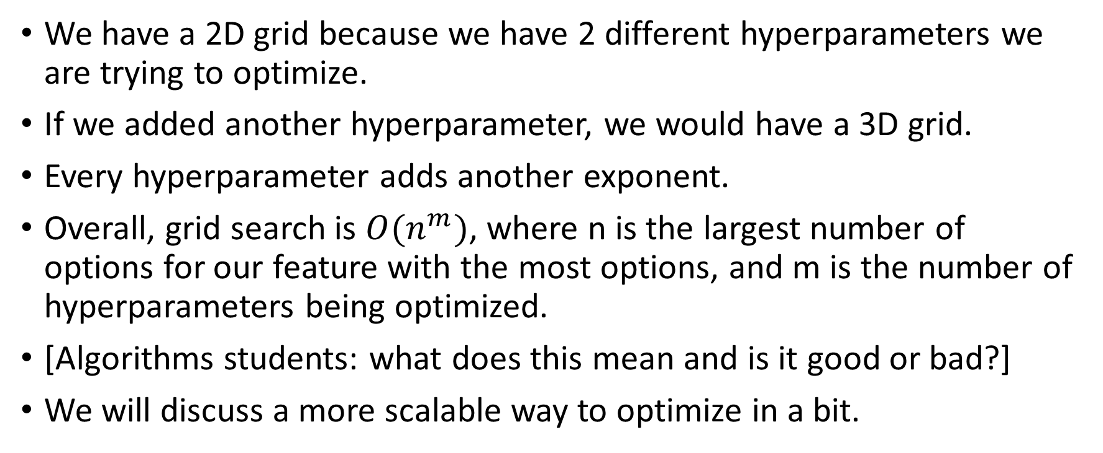
What about more features?
We have a 2D grid because we have 2 different hyperparameters we are trying to optimize.
If we added another hyperparameter, we would have a 3D grid.
Every hyperparameter adds another exponent.
Overall, grid search is $O(n^{m})$, where n is the largest number of options for our feature with the most options, and m is the number of hyperparameters being optimized.
[Algorithms students: what does this mean and is it good or bad?]
We will discuss a more scalable way to optimize in a bit.

Slide 55
Doing an experiment
Grid searching is done with the GridSearchCv class
The CV stands for cross validation. We will discuss this in another lecture. For now: it’s basically a train/test split but with multiple different splits averaged together.
In order to use GridSearchCV, you tell it the grid you want to test, you give it a pipeline, and it trains the pipeline and predicts with it on every combination of features.
Its output is the pipeline trained on the best combination.

Slide 56
An example
Let’s do a grid search on the three combinations of columns:
GrLivArea
GrLivArea, OverallQual,
GrLivArea, OverallQual, YearBuilt
Let’s also try 4 combinations of y transformation:
No transformation at all
Square root
Cubed root
Natural logarithm

Slide 57
Defining the grid
grid = { 'column_select__columns': [ [ 'GrLivArea' ], [ 'GrLivArea', 'OverallQual' ], [ 'GrLivArea', 'OverallQual', 'YearBuilt’ ], ], 'linear_regression’: [ LinearRegression( n_jobs = -1 ), # no transformation TransformedTargetRegressor( LinearRegression( n_jobs = -1 ), func = np.sqrt, inverse_func = np.square ), TransformedTargetRegressor( LinearRegression( n_jobs = -1 ), func = np.cbrt, inverse_func = lambda y: np.power( y, 3 ) ), TransformedTargetRegressor( LinearRegression( n_jobs = -1 ), func = np.log, inverse_func = np.exp), ] }

Slide 58
What’s going on?
Grid is a dictionary
Each key of the dictionary is a different feature to optimize
The keys follow a special naming scheme:
The first part is the name of the pipeline stage
Then, there is a double underscore ‘_ _’
Then, after the double underscore is the parameter to be set
The value is an array of possible values to try for that parameter.

Slide 59
What’s going on? (2)
For example: ‘column_select__columns’ will first be set to [‘GrLivArea’], and ‘linear_regression’ will be set to ‘LinearRegression’ (ordinary regression which does no transformation)
Then, ‘linear_regression’ will be set to ‘TransformedTargetRegressor’ with the given options, while the column_select.columns will still be unchanged.
After we run through all the linear regression choices, we start over with column_select.columns = [ ‘GrLivArea’, ‘OverallQual’ ]

Slide 60
Creating and using the search
Here’s the constructor for GridSearchCV: search = GridSearchCV( pipe, grid, scoring = 'r2', n_jobs = -1 )
Here, we first pass the pipeline we want to optimize for.
Then, we pass the grid dictionary which maps hyperparameters to arrays of their possible values.
We tell it to score using r-squared. This is normal for linear regression.
Lastly, we set n_jobs to -1 which means that each point of the grid can run on a different CPU core. It’s important that none of the code in our custom transformers modifies the dataset, otherwise we get race conditions.

Slide 61
Searching and getting the best params
To do the search, we call “fit” on the grid search: search.fit( xs, ys )
On a normal pipeline or model, this would train one classifier, but here, it trains all 12 combinations of columns and y-transformations.
Once we’re done, the “best_score_” property gives us the best r-squared that any of the combinations achieved: search.best_score_ => 0.75…

Slide 62
Searching and getting the best params (2)
We use the “best_params_” property to get the best combination: search.best_params_ => { 'column_select__columns': ['GrLivArea', 'OverallQual, 'YearBuilt’], linear_regression’: TransformedTargetRegressor( func=<ufunc 'sqrt’>, inverse_func=<ufunc 'square’>, regressor=LinearRegression(n_jobs=-1))}

Slide 63
Searching and getting the best params (3)
The “best_estimator_” parameter is a reference to the best pipeline of the 12 we tested. We can choose to save this to a file, for instance: search.best_estimator_
Lastly, if we call “predict” on the grid search object, it automatically forwards the arguments to the best estimator, so we can pretend the grid search is an ordinary pipeline: search.predict( xs.iloc[:3] ) => array([225596.6375261 , 160156.7138139 , 229148.10384613])
[Note: iloc is how we access instances by row index in pandas]

Slide 64
Protection from hyperparam overfitting
GridSearchCV automatically determines the best parameter on a portion of data, and tests it on a disjoint portion (several times, this is what CV—cross validation—means)
It’s very important not to search for hyperparameters on the whole dataset. If we do that, when we go to test, we’ll be testing on data that our hyperparameter search has seen before
This will lead to misleadingly good results.
We’ll learn more about this when we see grid searching later.

Slide 65
Questions?

Slide 66
Random search
In the future (when we get to random forests), we will have a number of hyperparameter combinations to optimize.
Training a random forest is substantially slower than training linear regression classifiers.
You might be wondering how we get around the exponential growth of adding lots of different hyperparams and values
The answer is…randomness

Slide 67
RandomizedSearchCV
https://scikit-learn.org/stable/modules/generated/sklearn.model_selection.RandomizedSearchCV.html
RandomizedSearchCV does the same thing as GridSearchCV, except it isn’t (usually) deterministic
Instead, it just tries random combinations of hyperparameters
Believe it or not, this is very common
Typically, 50 random samples is enough in most hyperparameter spaces.
You can also grid search around your best random sample

Slide 68
Pickles
If you want to save your best pipeline to a file, use a “pickle”
Pickling is Python’s quirky term for serialization
Deserialization is called “unpickling”
Writing and reading to/from pickle files is easy…

Slide 69
Pickle example
import pickle
# save the pickle with open( ‘my_model.pkl’, 'wb’ ) as f: pickle.dump( search.best_estimator_, f )
# load the pickle with open( ‘my_model.pkl’, ‘rb’ ) as f: my_model = pickle.load( f )
You can even save/load to/from strings instead of files: https://docs.python.org/3/library/pickle.html
[Do we all understand the “with” syntax]

Slide 70
… but pickle doesn’t work here
Pickle is great at saving/loading data, but it can’t save/load code
Pickle doesn’t know how to handle custom functions and lambdas
So our TransformedTargetRegressor cannot be pickled. (because we have to pass lambdas to it for func and inverse_func)
However, there is a better version of pickle that is designed for hosting ML models in limited docker environments that does support arbitrary code.
It’s called cloudpickle: https://pypi.org/project/cloudpickle/
Just replace “pickle” with “cloudpickle” in the previous code snippet, and it will magically work

Slide 71
Questions?

Slide 72
“Quiz”
Create a pipeline given a list of steps
Create a transformer
Perform a grid search over the hyper-parameters of the pipeline

Slide 73
Your new assignment
Let’s take a look at the next assignment
You’ll be using the same dataset (housing prices)
This time, I want you to get a better r-squared than we did in class.
You’ll need to look through all the features, and experiment, to find the best ones.
There’s a competition here, and a reward for the best scores!

Slide 74
Questions?

