Slide 1

CS 483: Machine Learning
Week 6: Evaluating Classifiers

Slide 2
Last week
We learned about pipelines and hyperparameters
Hyperparameters are the parameters that describe our model, separate from the values of the beta vector (or other vectors the model stores to make predictions).
We learned how to set up pipelines, and use GridSearchCV as an optimizer to approximate the best global hyperparameters.

Slide 3
This week
We will finally learn to stop relying on “accuracy”, and actually use metrics that are applicable in professional settings.
We will learn why accuracy is not adequate.
We will learn where the world’s most accurate meteorologists live.
We will not learn cross validation. That will come after the test.

Slide 4
But first, the quiz
Pretend it’s a real test
Suggested to use pencil and paper or type on laptop
No need for calculators

Slide 5
The “quiz”
There’s a dataset that you’re building a pipeline to work with. It has two columns “x”, and “y”. “x” is the non-target feature, and “y” is the target of regression.
Create a transformer that creates a new column name, “x2”, which raises x to a constant power. Drop the old column x. Do not modify the input data. The power method in numpy is “array.power( xs, exponent )”
Create a pipeline that feeds that transformer into a linear regression model.
Create a grid search that tries to find the best constant to multiply x by. You should try all integers between 1 and 5. Print the best parameter.

Slide 6
Quiz answer (1)
class PowColumn( BaseEstimator, TransformerMixin ):
def __init__( self, pow ): self.pow = pow
def fit( self, xs, ys, **params ): return self
def transform( self, xs ):
result = np.power( xs, self.pow )
return pd.DataFrame( result, columns = ['x2'] )

Slide 7
Quiz answer (2)
xs = np.array( [1, 2, 3, 4, 5, 6, 7, 8, 9, 10, ] )
ys = np.array( [1, 16, 81, 256, 625, 1296, 2401, 4096, 6561, 10000 ])
# this is the quiz answer part
steps = [
( 'pow', PowColumn() ),
( 'fit', LinearRegression() )
]
pipe = Pipeline( steps = steps )
# end quiz answer
pipe.fit( xs, ys )
pipe.predict( xs )

Slide 8
Quiz answer (3)
grid = {
'pow__pow': [ 1.0, 2.0, 3.0, 4.0, 5.0 ], # alternative vv
# ‘pow__pow’: range( 1, 6 ),
}
search = GridSearchCV( pipe, grid, n_jobs = -1 )
search.fit( xs, ys )
print( search.best_params_ )

Slide 9

Questions?

Slide 10
The world’s best meteorologist
Predicting the weather is extremely challenging.
Weather is not necessarily uniform over even a single zipcode.
Meteorologists are sometimes unfairly given the reputation of being inaccurate.
If a meteorologist gives a 20% chance of rain, people often interpret that as “will not rain”.
(to be fair, nothing with a 20% or lower chance has ever happened before)

Slide 11
The world’s best meteorologist (2)
A friend tells you that their local cable news channel has a meteorologist that is incredibly accurate.
They are able to predict whether or not it will rain > 1 inch with greater than 98% accuracy.
You express disbelief, but your friend shows you the meteorologist’s predictions from the previous year, and sure enough, they were only wrong one time when predicting rain.
Spoiler: the meteorologist is actually not very good.
Brain teaser: how is this possible?

Slide 12
The world’s best meteorologist (3)
Here’s what happened:
Your friend lives in Las Vegas
In Las Vegas, it rains more than 1” only a few times a year.
The meteorologist can say “won’t rain” and be right almost all of the time, without any analysis whatsoever.

Slide 13
Is it still good?
You might think “doesn’t matter, still very accurate”
And that’s true, but here’s the problem:
In Las Vegas, when it rains heavily, it causes serious problems.
It can flood. The ground is not conducive to absorbing water.
The storm drains are often inhabited. People need to go down in them and warn people.
Basically: it’s unfortunate if we predict it will rain and it doesn’t, but it could be tragic if we fail to predict it will rain and it does
I.e.,: false negatives are worse than false positives
[another story about pine trees]

Slide 14
Questions?

Slide 15
What’s the issue
This problem is caused by an imbalanced dataset
We have two classes: true and false (or rain vs. will not rain)
However, they aren’t equally likely to occur. No rain seems to outnumber rain by roughly 98 or 99 : 1.
We don’t distinguish between false positives and false negatives. Accuracy considers them the same (they are both “false”)
For this reason, we don’t catch the fact that we never catch rain.

Slide 16
True/false positive/negative
There are four types of prediction that we care about:
True positive (we predict rain and it rains)
True negative (we predict no rain and it doesn’t rain)
False positive ( we predict rain but it doesn’t rain)
False negative (we predict no rain but it rains)
We can make there be no false negatives at all by always guessing true, (but then we end up with false positives).
Likewise, we can have no false positives at all by never guessing true. We end up with false negatives in this case.
[Which one is the Las Vegas example?]
Las Vegas was always “no rain”, which is negative.

Slide 17
Quick remark about equivalence
What if we were predicting whether it would be sunny or not?
Then, if we predict always false, we end up with a much lower accuracy (< 2% or so)
Likewise, always true would be very accuracy.
However, our false positives and negatives flip.

Slide 18
The confusion matrix
The problem is that we’re oversimplifying.
We’re breaking down two dimensions (false vs. true and positive vs. negative) and trying to represent it with a single number.
In order to get a better feeling for the performance of a model, we need to consider a grid of positives and negatives.
This is called a “confusion matrix”

Slide 19
Example confusion matrices
Confusion matrix of a high-quality classifier
 | Predicted rain | Predicted no rain
Did rain | 6 | 1
Didn’t rain | 2 | 356
Confusion matrix of a “Las Vegas Weatherperson”
 | Predicted rain | Predicted no rain
Did rain | 0 | 9
Didn’t rain | 0 | 356

Slide 20
Intuitive reading of confusion matrix
For each cell, we read it as “X values were predicted as [predicted value], and were actually [actual value].
In general, it is better to have high numbers along the main diagonal. “predicted as true and were actually true” and “predicted as false and were actually false.”
These are numbers of correct predictions.
If we have a number off the diagonal, it means it was wrong.

Slide 21
Technical reading of confusion matrices
 | Predicted rain | Predicted no rain
Did rain | TRUE POSITIVE (TP) | FALSE NEGATIVE (FN)
Didn’t rain | FALSE POSITIVE (FP) | TRUE NEGATIVE (TN)
 | Predicted true | Predicted false
Actually true | TRUE POSITIVE (TP) | FALSE NEGATIVE (FN)
Actually false | FALSE POSITIVE (FP) | TRUE NEGATIVE (TN)

Slide 22
Questions?

Slide 23
Two new metrics
There are a variety of metrics we can define based on these four values: https://en.wikipedia.org/wiki/Precision_and_recall
The two that I have found most valuable are precision and recall.
Let’s break them both down and learn how together they give rise to a new metric that is more useful than accuracy.

Slide 24
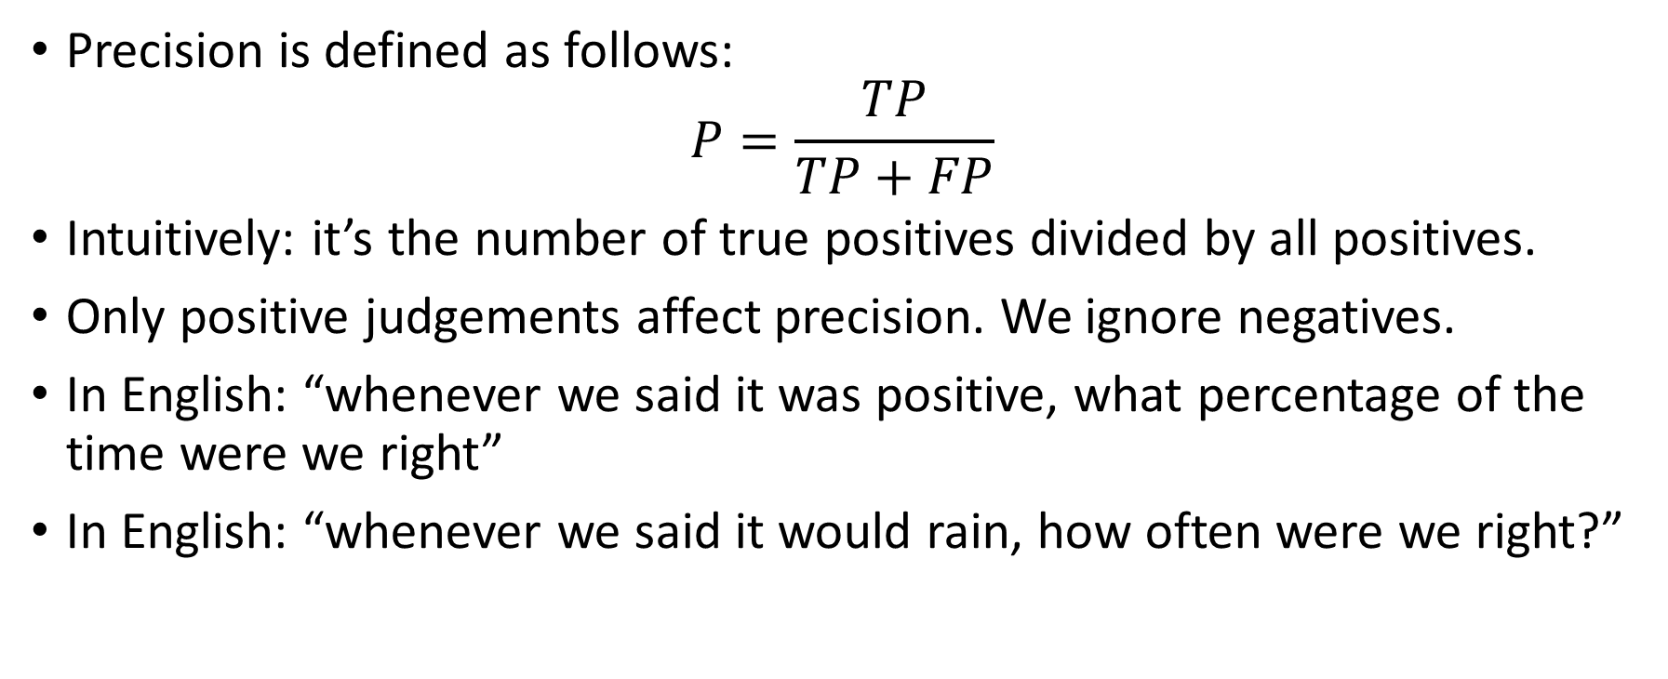
Precision
Precision is defined as follows: $P=\frac{TP}{TP+FP}$
Intuitively: it’s the number of true positives divided by all positives.
Only positive judgements affect precision. We ignore negatives.
In English: “whenever we said it was positive, what percentage of the time were we right”
In English: “whenever we said it would rain, how often were we right?”

Slide 25
Precision example
Suppose our confusion matrix looks like this:
what’s the precision?
Answer: 6 / ( 6 + 2 ) = 6 / 8 = 75%
 | Predicted rain | Predicted no rain
Did rain | 6 | 1
Didn’t rain | 2 | 356

Slide 26
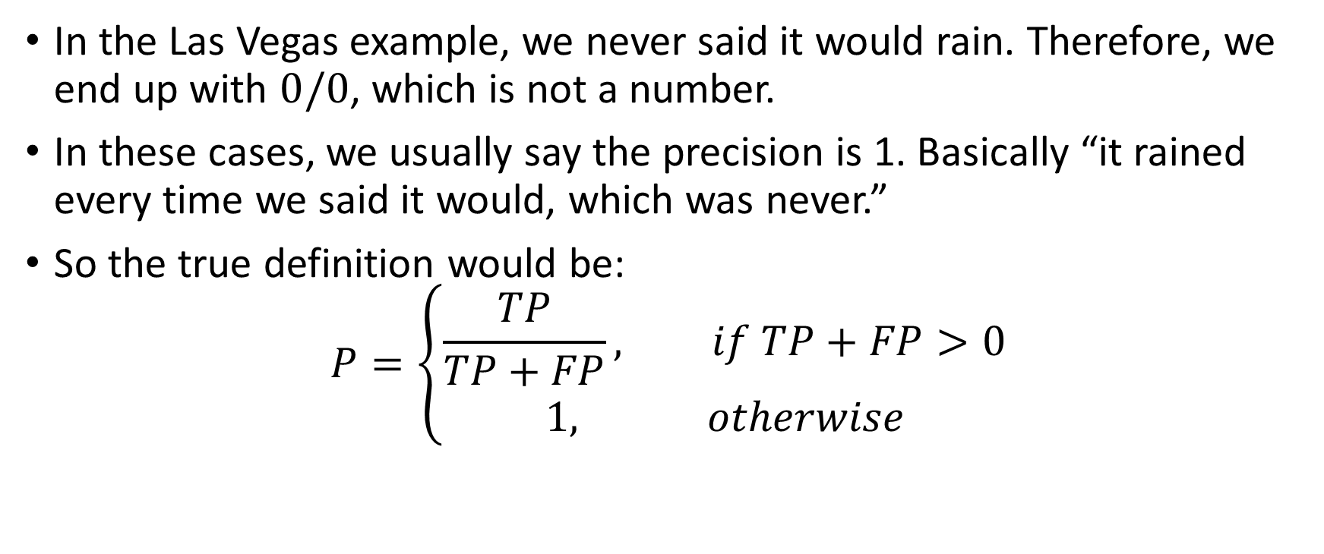
Precision examples (2)
In the Las Vegas example, we never said it would rain. Therefore, we end up with $0/0$, which is not a number.
In these cases, we usually say the precision is 1. Basically “it rained every time we said it would, which was never.”
So the true definition would be: $P=\left\{\begin{aligned}\frac{TP}{TP+FP}, if TP+FP>0 \\ 1, otherwise\end{aligned}\right.$

Slide 27
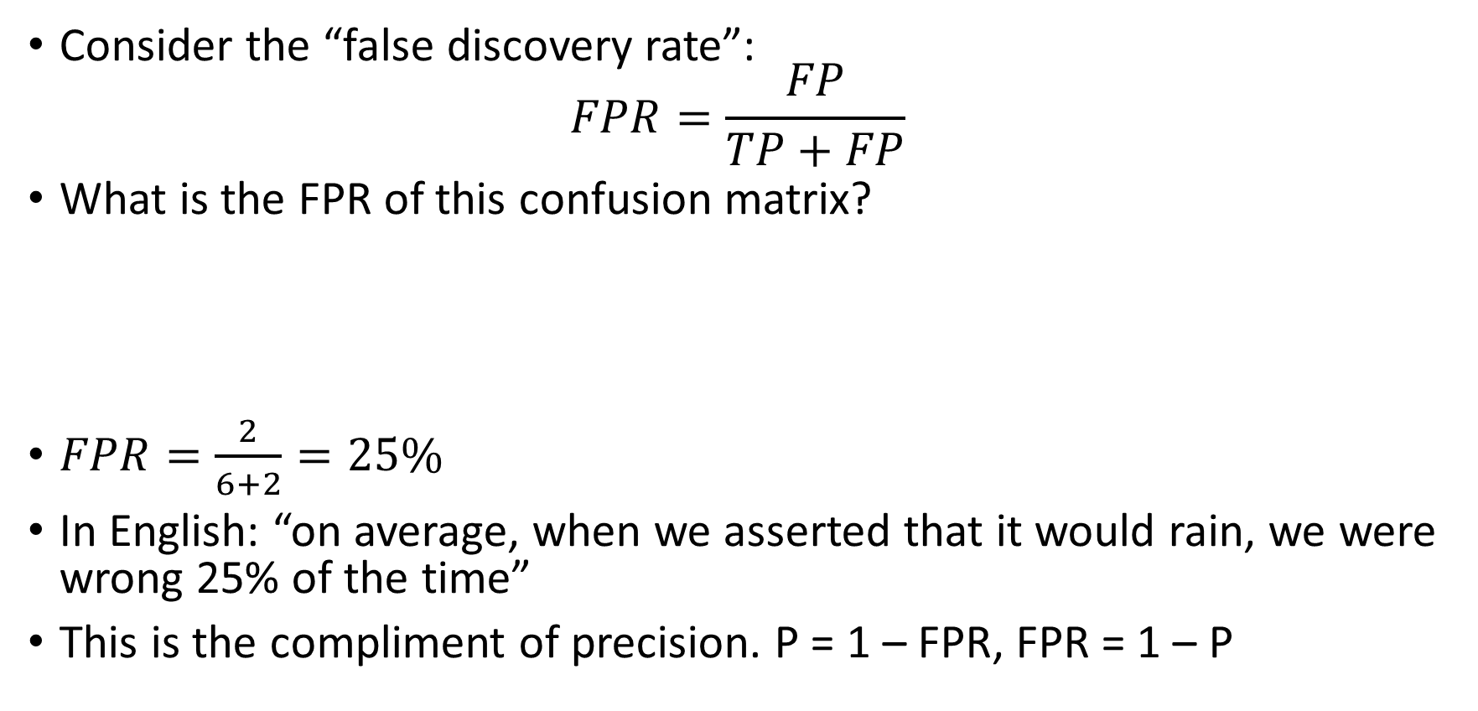
Other ways of understanding precision
Consider the “false discovery rate”: $FPR=\frac{FP}{TP+FP}$
What is the FPR of this confusion matrix?
$FPR=\frac{2}{6+2}=25\%$
In English: “on average, when we asserted that it would rain, we were wrong 25% of the time”
This is the compliment of precision. P = 1 – FPR, FPR = 1 – P
 | Predicted rain | Predicted no rain
Did rain | 6 | 1
Didn’t rain | 2 | 356

Slide 28
More precision examples
Suppose we have a false discovery rate of 44%. What is our precision?
100% - 44% = 56%
Suppose we have 10 TPs, 20 FPs, 30 TNs, and 40 FNs. What is our precision?
10 / ( 10 + 20 ) = 33.3%
What is the FDR in that scenario?
66.7%
Suppose we have 0 FPs, 0 TPs, 350 TNs, and 15 FNs. What is P?
100% by definition (vacuous precision)

Slide 29
What precision means
The purpose of precision is to help us understand how “overconfident” we are being.
If our precision is low, we are being too overconfident, making lots of positive predictions that are not warranted.
If our precision is high, it means we are being careful. We wait until we are really sure before predicting positive.
For example, we might only predict rain if we are very certain that it will rain (barometric pressure, rain clouds, rainy season, etc.)
Low precision means we are uninhibited. We predict rain if there’s a tiny chance that it will rain.

Slide 30
What’s missing?
So we just replace accuracy with precision and we’re good, right?
Not really: we already saw that if we make no predictions, we get 100% precision trivially.
We need another number that helps us know when we’re making too few predictions.
That number is called “recall”

Slide 31
Questions?

Slide 32
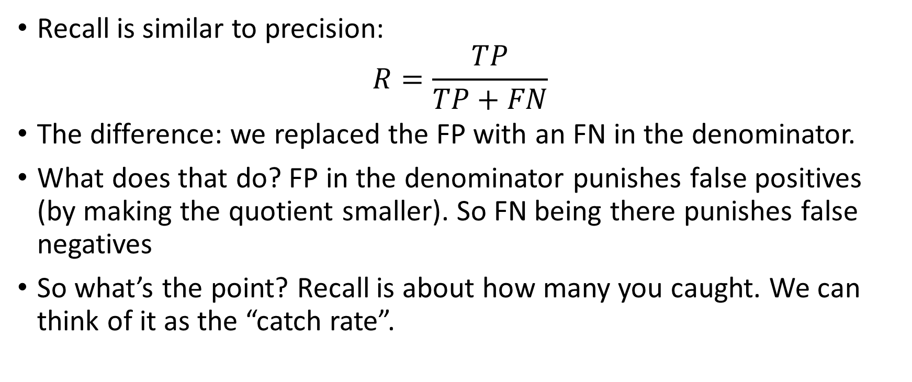
Recall
Recall is similar to precision: $R=\frac{TP}{TP+FN}$
The difference: we replaced the FP with an FN in the denominator.
What does that do? FP in the denominator punishes false positives (by making the quotient smaller). So FN being there punishes false negatives
So what’s the point? Recall is about how many you caught. We can think of it as the “catch rate”.

Slide 33
Recall example
Suppose our confusion matrix looks like this:
what’s the recall?
It rained 7 times
We caught 6 of them.
Answer: 6 / 7= 85.7%
 | Predicted rain | Predicted no rain
Did rain | 6 | 1
Didn’t rain | 2 | 356

Slide 34
Another example
Suppose we are writing a search engine
The user types in a query and hits search.
Out of all web pages that exist (and are indexed), the engine must somehow narrow it down to 10.
If the results are not in the top 10, the user is very unlikely to see them, so let’s assume that a page is “caught” if it is in the top 10.
Suppose there are 5 relevant pages, and the search engine returns 4. What is the recall?

Slide 35
Recall in search engines (2)
Suppose there are 5 relevant pages, and the search engine returns 4. What is the recall?
4/5 = 80%
What about precision?
[class?]

Slide 36
Recall in search engines (3)
…the search engine returned 4 relevant pages. That means 6 were not relevant. P = 4 / ( 4 + 6 ) = 40%
What if there are 15 relevant pages and 10 are returned?
Then it’s 2/3.
It’s not always possible to get perfect recall. In this case, we prevented relevant pages from being returned.
Human attention / peripheral vision is limited, so we may not be able to catch everything under realistic circumstances.

Slide 37
Questions?

Slide 38
Precision vs. recall
100% precision means that no false positives exist.
100% recall means that no false negatives exist.
[What is the P and R of the Las Vegas meteorologist who always guesses “rain = false”?]
Answer perfect precision (vacuously)
Zero recall (missed all the rain = true labels)
If either precision or recall is zero for a Boolean classifier, the classifier is worthless: it either misses everything, or is completely overconfident.

Slide 39
Precision vs. recall (2)
Often, precision and recall trade off against each other.
Think of it like this: the Las Vegas weatherperson was too timid. They never guessed rain.
If they were bolder, they might have caught a bit more rain, improving the recall.
However, becoming bolder comes with a price. The more gutsy we try to be, the more we risk our precision.
On average: raising precision hurts recall and vice versa.
We will see how to make this trade off later. It involves changing your threshold for positive/negative classification.

Slide 40
F-score
Precision and recall are both important, but they trade off against each other.
Sometimes it’s useful to have a combined metric, that gives us information on how good a classifier is.
[personally, I like to always use at least precision and recall along with more data, however, executives typically wanted a single number on a dashboard]
If you had a design a metric that was zero when either precision and recall were zero, and 1 when they were both 1, what would you use?

Slide 41
False answers
The arithmetic mean doesn’t really work here, because if precision is 0 and recall is 1, we get 0.5, which doesn’t really convey how bad the classifier is. It also makes mathematicians unhappy because we are averaging fractions with different denominators.
Multiplication would work, but it would be extremely sensitive. You’d need both precision and recall to be very close to 1 to not have it decay to 0 immediately.
Adding them together and subtracting one works but ends up being negative when they’re bad. Not terrible but not great.
What other kinds of averages do we know?

Slide 42
The harmonic mean
Median and mode don’t really make sense for averaging two values, but there are two other kinds of mean that we occasionally use.
Geometric mean could work, but it has a similar problem as multiplication (it sharply declines as we get towards zero). [when do we use geometric means?]
The real key is to use the harmonic mean.
[Why?]

Slide 43
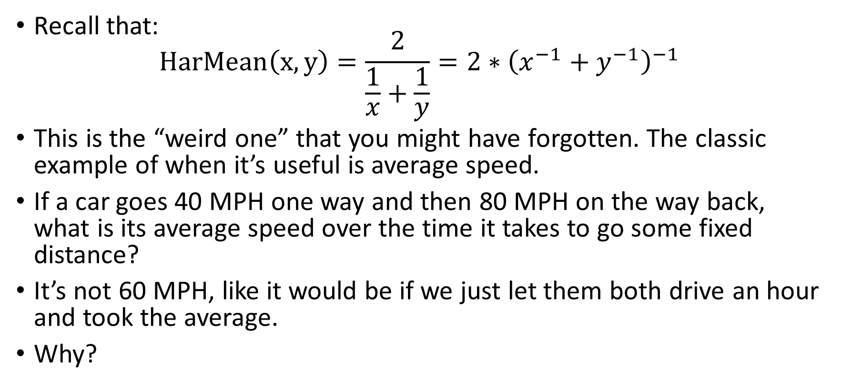
Harmonic mean
Recall that: $HarMean\left(x,y\right)=\frac{2}{\frac{1}{x}+\frac{1}{y}}=2∗{\left(x^{−1}+y^{−1}\right)}^{−1}$
This is the “weird one” that you might have forgotten. The classic example of when it’s useful is average speed.
If a car goes 40 MPH one way and then 80 MPH on the way back, what is its average speed over the time it takes to go some fixed distance?
It’s not 60 MPH, like it would be if we just let them both drive an hour and took the average.
Why?

Slide 44
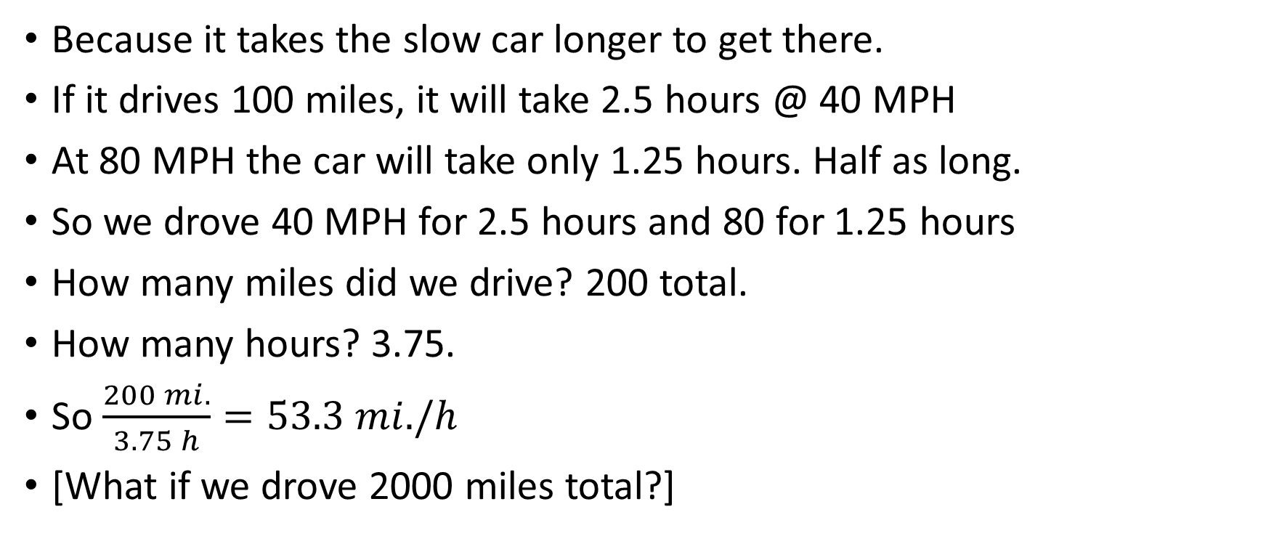
Harmonic mean (2)
Because it takes the slow car longer to get there.
If it drives 100 miles, it will take 2.5 hours @ 40 MPH
At 80 MPH the car will take only 1.25 hours. Half as long.
So we drove 40 MPH for 2.5 hours and 80 for 1.25 hours
How many miles did we drive? 200 total.
How many hours? 3.75.
So $\frac{200 mi.}{3.75 h}=53.3 mi./h$
[What if we drove 2000 miles total?]

Slide 45
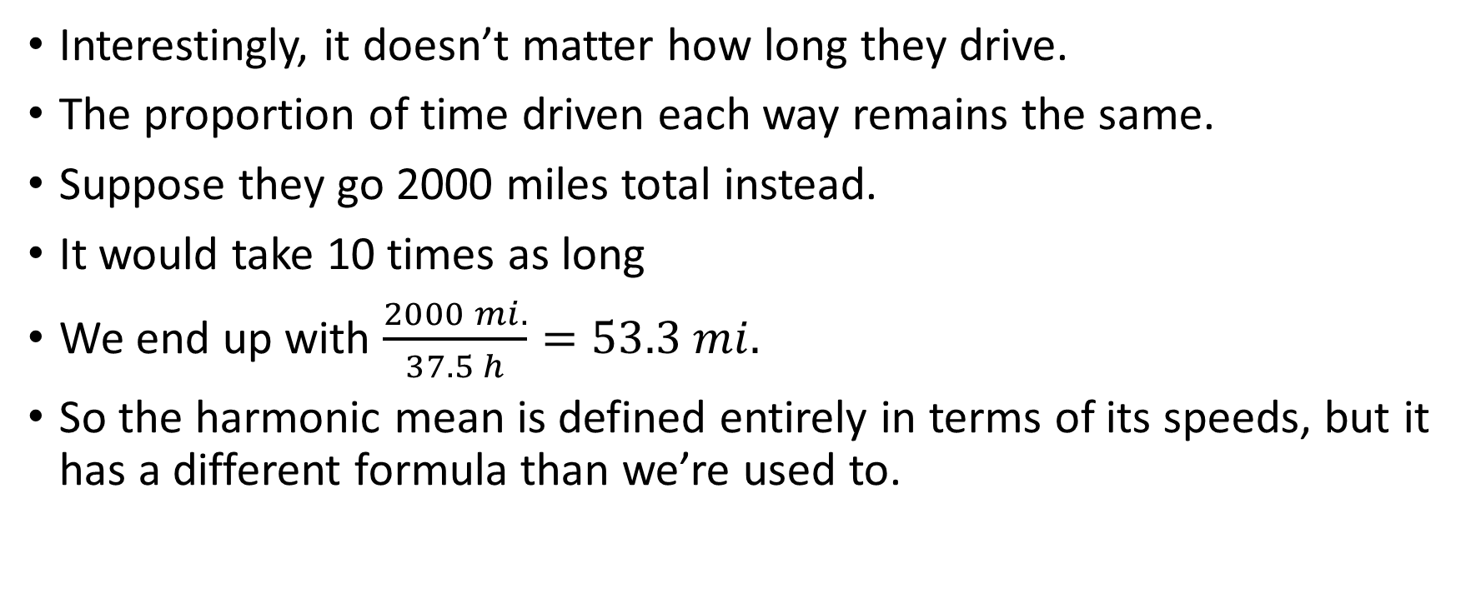
Harmonic mean (3)
Interestingly, it doesn’t matter how long they drive.
The proportion of time driven each way remains the same.
Suppose they go 2000 miles total instead.
It would take 10 times as long
We end up with $\frac{2000 mi.}{37.5 h}=53.3 mi.$
So the harmonic mean is defined entirely in terms of its speeds, but it has a different formula than we’re used to.

Slide 46
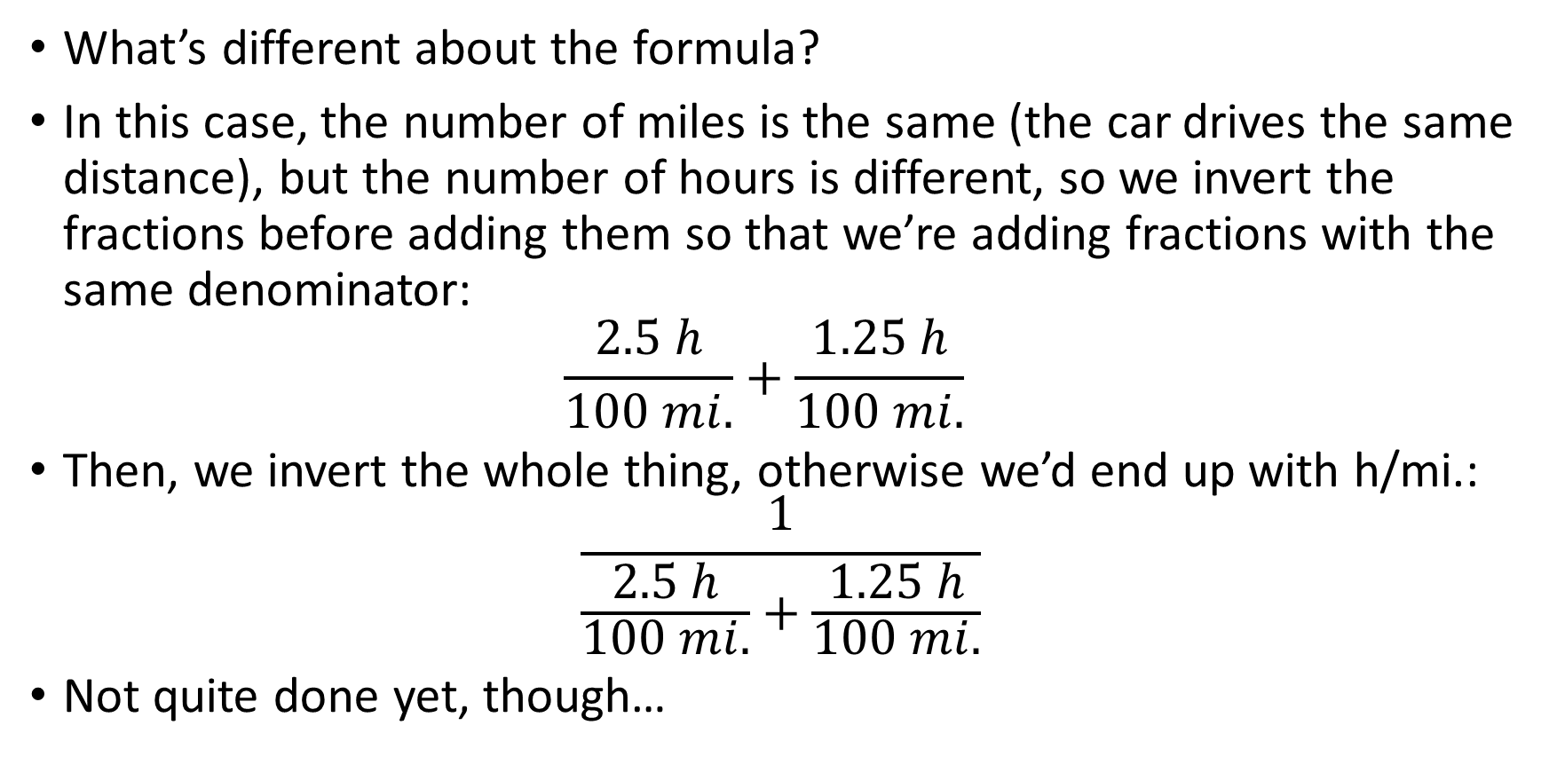
Harmonic mean formula
What’s different about the formula?
In this case, the number of miles is the same (the car drives the same distance), but the number of hours is different, so we invert the fractions before adding them so that we’re adding fractions with the same denominator: $\frac{2.5 h}{100 mi.}+\frac{1.25 h}{100 mi.}$
Then, we invert the whole thing, otherwise we’d end up with h/mi.: $\frac{1}{\frac{2.5 h}{100 mi.}+\frac{1.25 h}{100 mi.}}$
Not quite done yet, though…

Slide 47
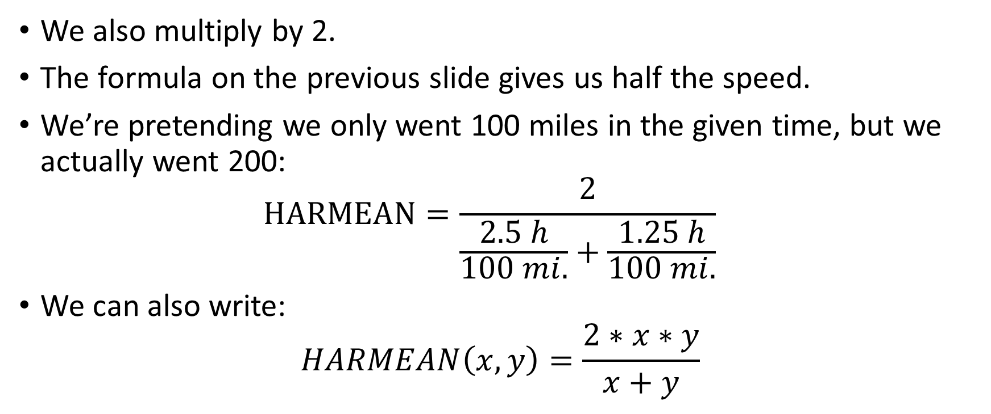
The formula
We also multiply by 2.
The formula on the previous slide gives us half the speed.
We’re pretending we only went 100 miles in the given time, but we actually went 200: $HARMEAN=\frac{2}{\frac{2.5 h}{100 mi.}+\frac{1.25 h}{100 mi.}}$
We can also write: $HARMEAN\left(x,y\right)=\frac{2∗x∗y}{x+y}$

Slide 48
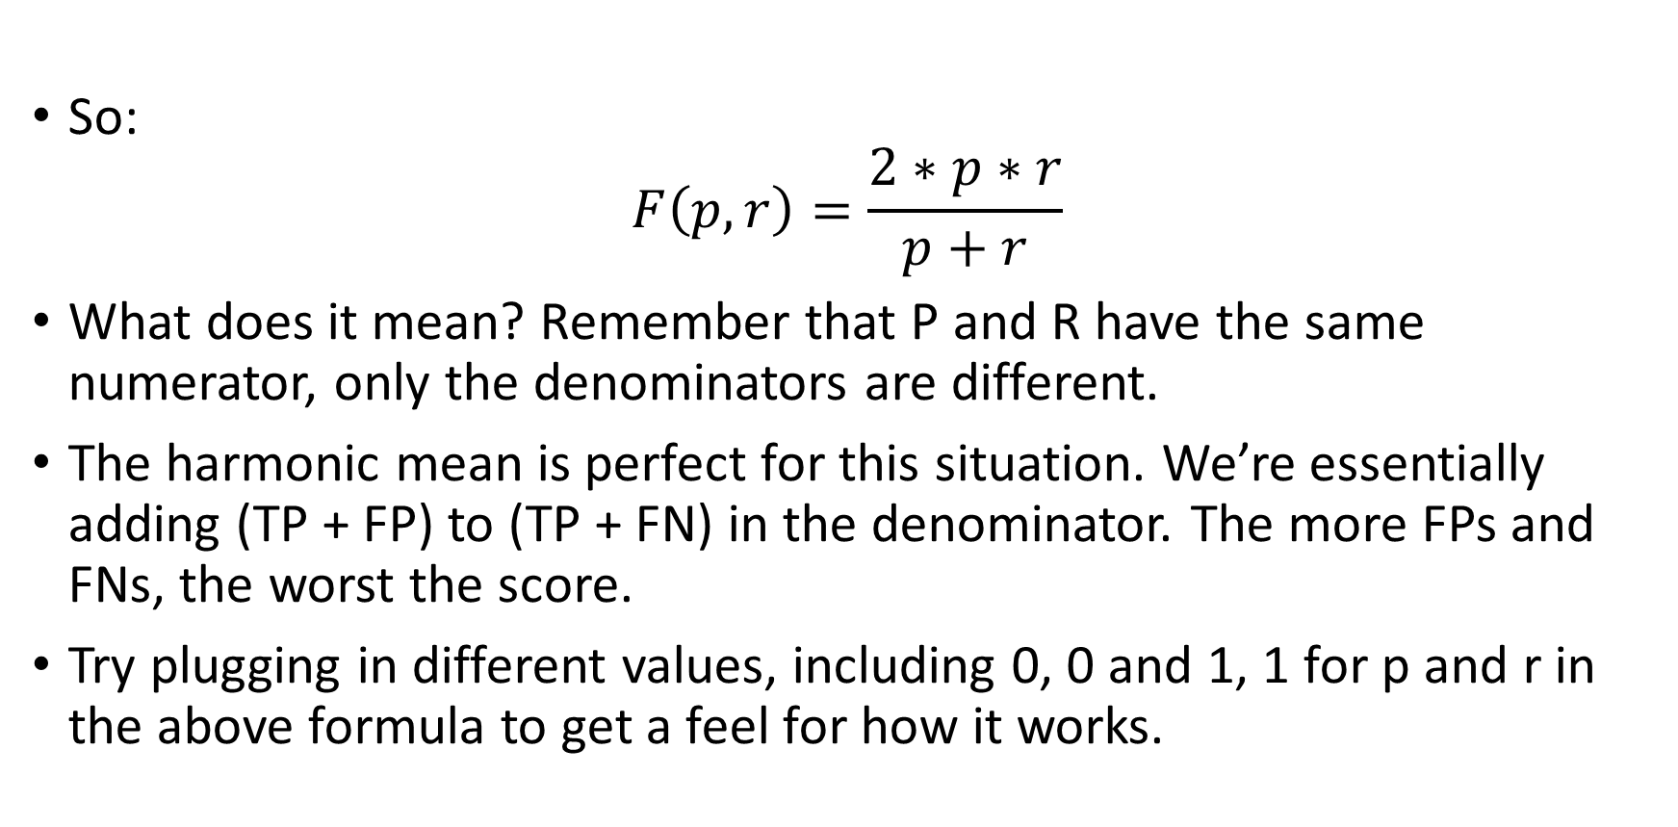
The simpler formula
So: $F\left(p,r\right)=\frac{2∗p∗r}{p+r}$
What does it mean? Remember that P and R have the same numerator, only the denominators are different.
The harmonic mean is perfect for this situation. We’re essentially adding (TP + FP) to (TP + FN) in the denominator. The more FPs and FNs, the worst the score.
Try plugging in different values, including 0, 0 and 1, 1 for p and r in the above formula to get a feel for how it works.

Slide 49
Questions?

Slide 50
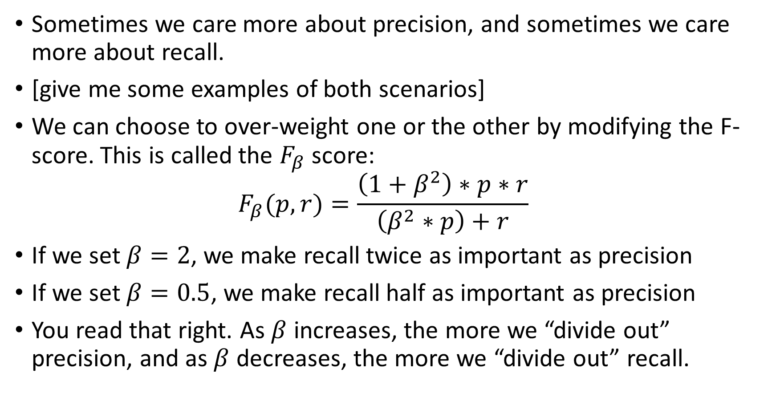
F-beta score
Sometimes we care more about precision, and sometimes we care more about recall.
[give me some examples of both scenarios]
We can choose to over-weight one or the other by modifying the F-score. This is called the $F_{β}$ score: $F_{β}(p, r)=\frac{\left(1+β^{2}\right)∗p∗r}{\left(β^{2}∗p\right)+r}$
If we set $β=2$, we make recall twice as important as precision
If we set $β=0.5$, we make recall half as important as precision
You read that right. As $β$ increases, the more we “divide out” precision, and as $β$ decreases, the more we “divide out” recall.

Slide 51
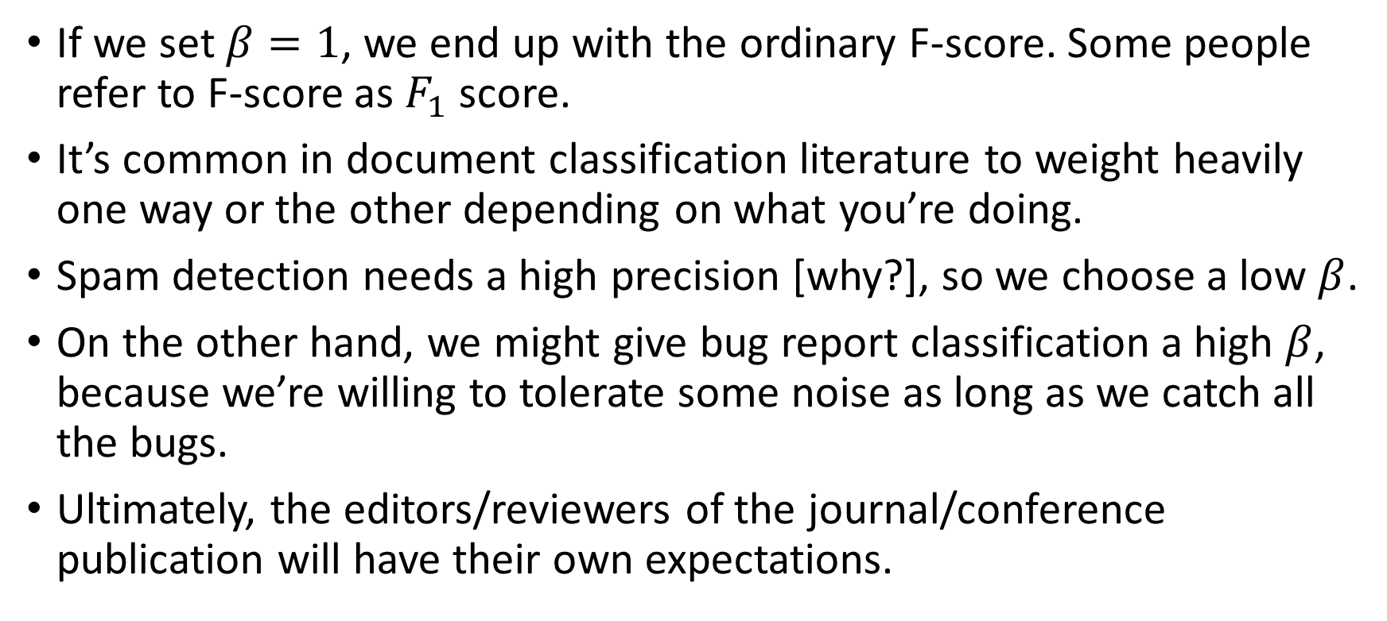
F-1 score
If we set $β=1$, we end up with the ordinary F-score. Some people refer to F-score as $F_{1}$ score.
It’s common in document classification literature to weight heavily one way or the other depending on what you’re doing.
Spam detection needs a high precision [why?], so we choose a low $β$.
On the other hand, we might give bug report classification a high $β$, because we’re willing to tolerate some noise as long as we catch all the bugs.
Ultimately, the editors/reviewers of the journal/conference publication will have their own expectations.

Slide 52
When is F-score a bad metric?
In our Las Vegas example, F-score works, because the recall is 0%, and therefore the F-score is 0%, too.
But, what if we inverted the problem?
What if the goal were to predict when it was sunny?
This becomes a new confusion matrix:
 | Predicted rain | Predicted no rain
Did rain | 0 | 9
Didn’t rain | 0 | 356
 | Predicted sun | Predicted no sun
Did sun | 356 | 0
Didn’t sun | 9 | 0

Slide 53
What are the metrics now?
What are the TP, FP, TN, and FN in this confusion matrix?
TP = 356, FP = 9, TN = 0, FN = 0
Therefore, recall is a perfect 100%
Interestingly, precision is really good too. 356 / (356 + 9) = 97.5%
Wait, we inverted the problem and suddenly the classifier is amazing?
No: this is a known problem with F-score
 | Predicted sun | Predicted no sun
Did sun | 356 | 0
Didn’t sun | 9 | 0

Slide 54
Avoiding mistakes
In order to calculate the F-score, we have to associate it with a class.
I’ve been sloppy saying “we have precision/recall of 100%;0%”. I should have said “we have precision/recall of 100%;0% in for the rain = true class”.
The meteorologist was acting as a 2-class classifier.
Each class has its own precision and recall:
Rain = true: Precision = 100%, Recall = 0%
Rain = false: Precision = 97.5%, Recall = 100%
If any of the four scores is close to zero, it’s a bad classifier.

Slide 55
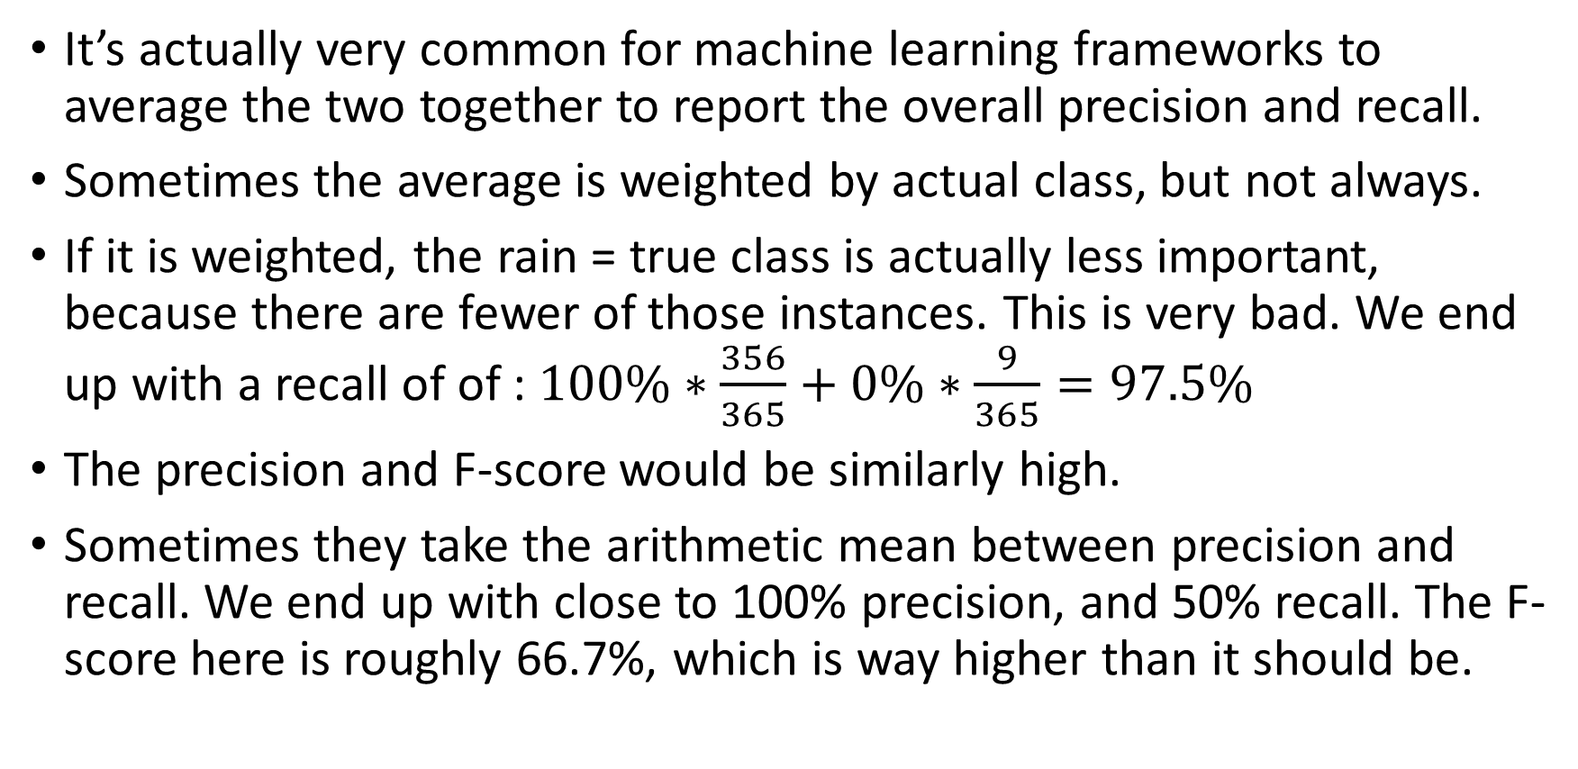
Avoiding mistakes (2)
It’s actually very common for machine learning frameworks to average the two together to report the overall precision and recall.
Sometimes the average is weighted by actual class, but not always.
If it is weighted, the rain = true class is actually less important, because there are fewer of those instances. This is very bad. We end up with a recall of of : $100\%∗\frac{356}{365}+0\%∗\frac{9}{365}=97.5\%$
The precision and F-score would be similarly high.
Sometimes they take the arithmetic mean between precision and recall. We end up with close to 100% precision, and 50% recall. The F-score here is roughly 66.7%, which is way higher than it should be.

Slide 56
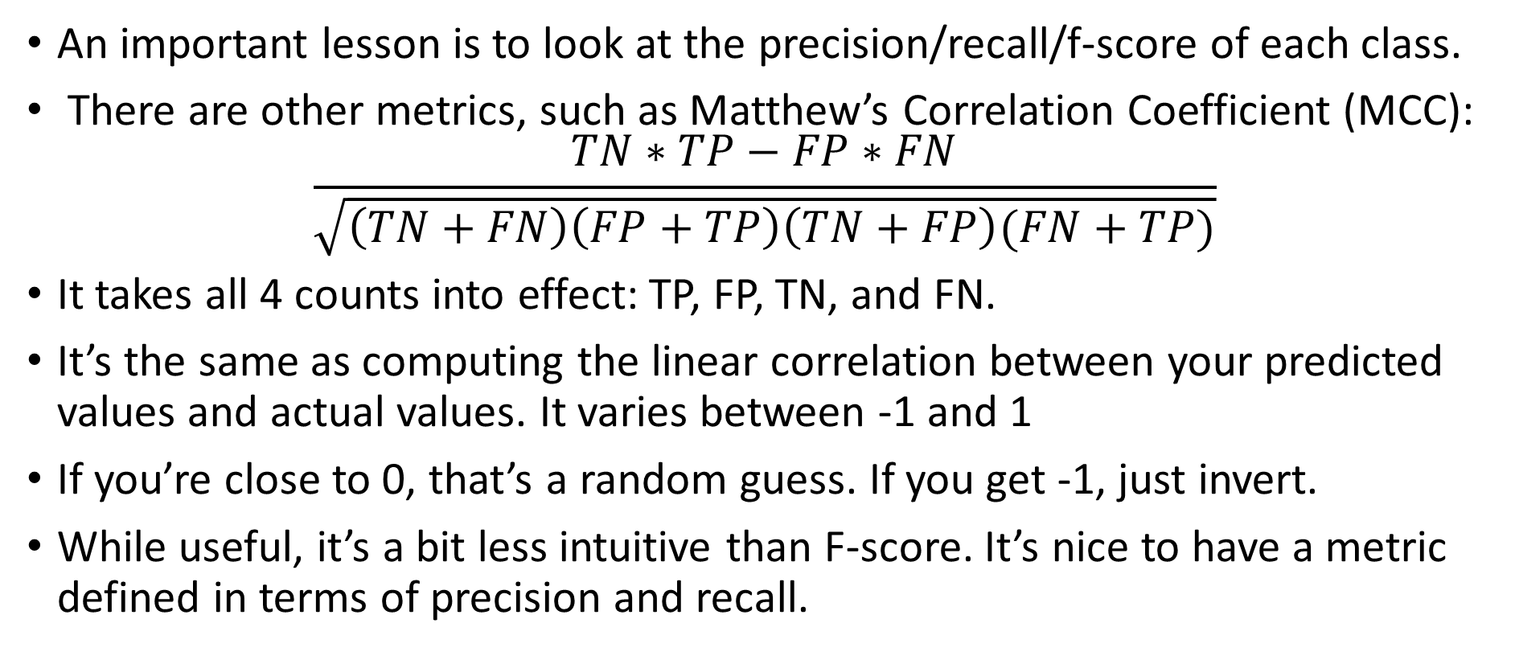
Avoiding mistakes (3)
An important lesson is to look at the precision/recall/f-score of each class.
There are other metrics, such as Matthew’s Correlation Coefficient (MCC): $\frac{TN∗TP−FP∗FN}{\sqrt{\left(TN+FN\right)\left(FP+TP\right)\left(TN+FP\right)(FN+TP)}}$
It takes all 4 counts into effect: TP, FP, TN, and FN.
It’s the same as computing the linear correlation between your predicted values and actual values. It varies between -1 and 1
If you’re close to 0, that’s a random guess. If you get -1, just invert.
While useful, it’s a bit less intuitive than F-score. It’s nice to have a metric defined in terms of precision and recall.

Slide 57
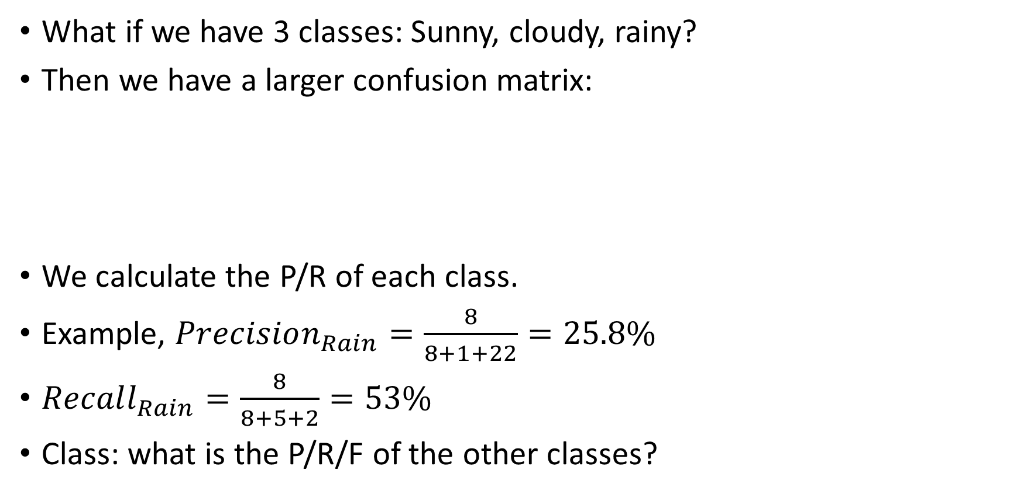
What about 3 classes?
What if we have 3 classes: Sunny, cloudy, rainy?
Then we have a larger confusion matrix:
We calculate the P/R of each class.
Example, $Precision_{Rain}=\frac{8}{8+1+22}=25.8\%$
$Recall_{Rain}=\frac{8}{8+5+2}=53\%$
Class: what is the P/R/F of the other classes?
 | Predicted rain | Predicted clouds | Predicted sun
Actual Rain | 8 | 5 | 2
Actual Clouds | 1 | 9 | 12
Actual Sun | 22 | 6 | 300

Slide 58
Questions?

Slide 59
Thresholds
We’ve talked about how a higher precision means more reluctance to assert a class, and lower precision means being bold.
How do we decide how bold or reluctant to be?
The answer: a threshold
We have classifiers that can return probabilities instead of labels.
So, we decide the threshold at which we label positive.
If we pick 20% as our threshold, then if our classifier is only 20.1% sure that it’s going to rain, it says “rain”. This is very confident.
Otherwise, if we pick 80%, then even if we’re 77% sure it will rain, we still say no rain. High precision, low recall.

Slide 60
Threshold exercises
Suppose we’re programming an intrusion detection system, and we are absolutely willing to tolerate a 9:1 ratio of false positive to true positive to make sure we catch every intrusion. What threshold do we want to use?
Answer: 10% threshold means that if our classifier is accurate (and we still would need to check empirically), we should have 90% false positives.
Suppose we want to be very certain that a particular message is spam before we send it to the “junk” folder. What is an appropriate threshold?
Suppose I have a threshold of 101% percent. What is my precision and what is my recall? You don’t need to know anything else.
Answer: This threshold is impossible to reach, so your precision is 100% and your recall is 0%.

Slide 61
Precision recall curves
Every choice of threshold has its own precision and recall.
Here are some examples of what can happen:
100% threshold, 100% precision (vacuous), 0% recall
90% threshold, 85% precision, 10% recall
80% threshold, 81% precision, 17% recall
70% threshold, 65% precision, 22% recall
60% threshold, 59% precision, 28% recall
50%, 51%, 35%
40%, 40%, 48%
30%, 33%, 59%
20%, 15%, 75%
10%, 9%, 88%
0%, 3%, 100%

Slide 62
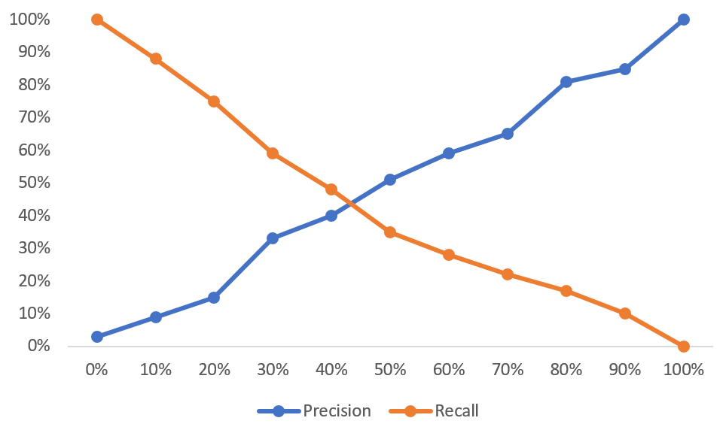
Graphing this data
Threshold

Slide 63
A better way to graph
Both precision are recall are associated with the same point.
Instead of treating the threshold as its own axis, we can use a scatterplot instead: plot the precision against the recall
The result is a precision recall curve.
The higher the precision and recall at each threshold, the better.
We can plot multiple curves to see which model is better.

Slide 64
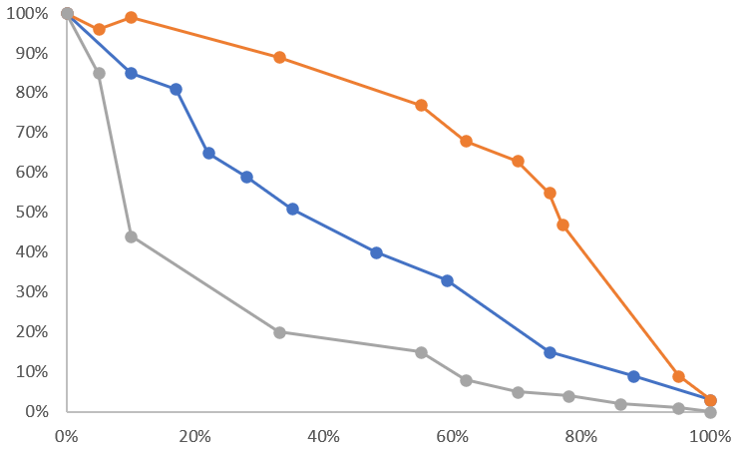
A better way to graph (2)
Orange = good
Blue = random/bad
Gray = very bad
Precision
Recall

Slide 65
How to interpret
Each dot is a precision/recall pair at a particular threshold.
A good curve hugs the top right.
A bad curve hugs the bottom left
A curve down the middle is mediocre and possibly random.
A perfect model (100% accuracy which implies 100% precision and recall) will be a single point in the top right.
It’s not guaranteed that precision is monotonic [why?]
Consider the extremes: it’s rare to get precision = 0%.

Slide 66
How to use
Here’s what I used to do:
Start by asking yourself: “how many false positives can I tolerate?”
If I’m detecting viruses: can I deal with 2 false-positives for every 1 true positive?
If so, that means a precision of 33% is acceptable. Pick that point on the curve and trace your finger across to see what the recall probably is.
Then: try to find a threshold that gets you close
You can also do the same from the opposite perspective: how much recall do I need, and what precision does that get me?

Slide 67
Questions?

Slide 68
More things to know
Sometimes, instead of plotting precision vs. recall, some data scientists plot true positive rate against false positive rate
This is called “receiver operating characteristic”. I was invented to deal with true/false detections in radar towers.
I have never seen it used in the subfields of ML I have worked in, but it’s worth looking up. It’s a similar concept.

Slide 69
More things to know (2)
Precision recall curves only really make sense for binary classifiers
It’s technically possible for multi-class classifiers, but we don’t have the easy to interpret threshold (above threshold = positive prediction, below = negative prediction)
Many situations call for parallel Boolean labels. For example, classifying text as “angry, excited, sad”. It could technically be all or none of those.
So you represent it as three separate binary classifiers, each with their own curve.

Slide 70
Test upcoming
The next class is the first test.
It will be a take-home test
The test will be assigned on Wednesday of next week.
I will be there to explain what to do, but if you want to prepare, start looking through Kaggle datasets right now, because I will ask you to choose one for your take home test.
We can use the remainder of this time as a review.

Slide 71
Questions?

