Slide 1

CS 483: Machine Learning
Week 7: Ethical Concerns

Slide 2
Previously
We've learned about machine learning models
We've built some for a real world dataset
We learned about optimization techniques
We learned about how to evaluate a model and know how good it is.

Slide 3
Today
We've learned that some of us potentially made a horrible mistake
We'll learn about how machine learning can amplify existing ethical problems and social issues.
Specifically, we'll be looking at three kinds of ethical problem that data scientists needs to be aware of:
Bias
Privacy
Bad metrics

Slide 4
A horrible mistake?
That's right, many of us could have made a horrible real-world mistake with our models, depending on real-world circumstances.
Specifically, the best students are the ones who potentially made the horrible mistake. The better you did on the last project (in terms of r^2), the more likely this was.
Remember that housing price dataset we used?

Slide 5
A review of housing prices
We've spent a lot of time on this dataset (and more in the future)
What were some of the columns?
[remind me]
In your own experience, which columns were the most important for maximizing the r^2 of your model?

Slide 6
Columns that weren't a problem
Is it wrong to estimate the price of a house based on how much square footage it has?
Is it biased?
I mean...yes. It's biased against people with small houses.
If you have a small house, you won't make as much money.
Is there an ethical problem with this?
[Folks who took ethics want to chime in?]

Slide 7
Ethical problems
I don't personally think it is unethical to use square footage to estimate house prices.
But how do I justify that? What makes my opinion reasonable?
Well, let's use an ethical system.
Which ethical systems do we know from ethics class?

Slide 8
Ethical theories
There are many ethical theories
Consequentialism is the idea that morality comes from consequences. Things are moral if they are likely to lead to good things.
Deontology is that idea that ethics stem from duties. E.g., we have a duty to support the needy, a duty to defend the powerless, a duty to hold people accountable for wrong doing, etc. Typically this results in making rules. In a pure deontological system (like Kant's), you act *only* according to the rules (i.e., never lie, never steal, always give to the poor, etc.)
Virtue ethics is the idea that certain personality traits are just axiomatically good. Bravery, kindness, mercy, prudence, etc. And ethical behavior acts in accordance with these virtues.
Even more: intuitionistic ethics, pragmatic ethics, etc.

Slide 9
Ethical theories (2)
There are also different variations, specific versions, and combinations of these.
For example, utilitarianism is a form of consequentialism in which we assume that consequences can be measured in some way. I.e., by assigning a "goodness" or "utility" value to societal states. And we assume the goal is to maximize this utility.
And rule consequentialism involves rules, but the rules are chosen using consequentialist reasoning. I.e., pick rules that lead to the best consequences.
Given the number of lenses involved, it can be useful to use more than one. Let's try consequentialism and deontology.

Slide 10
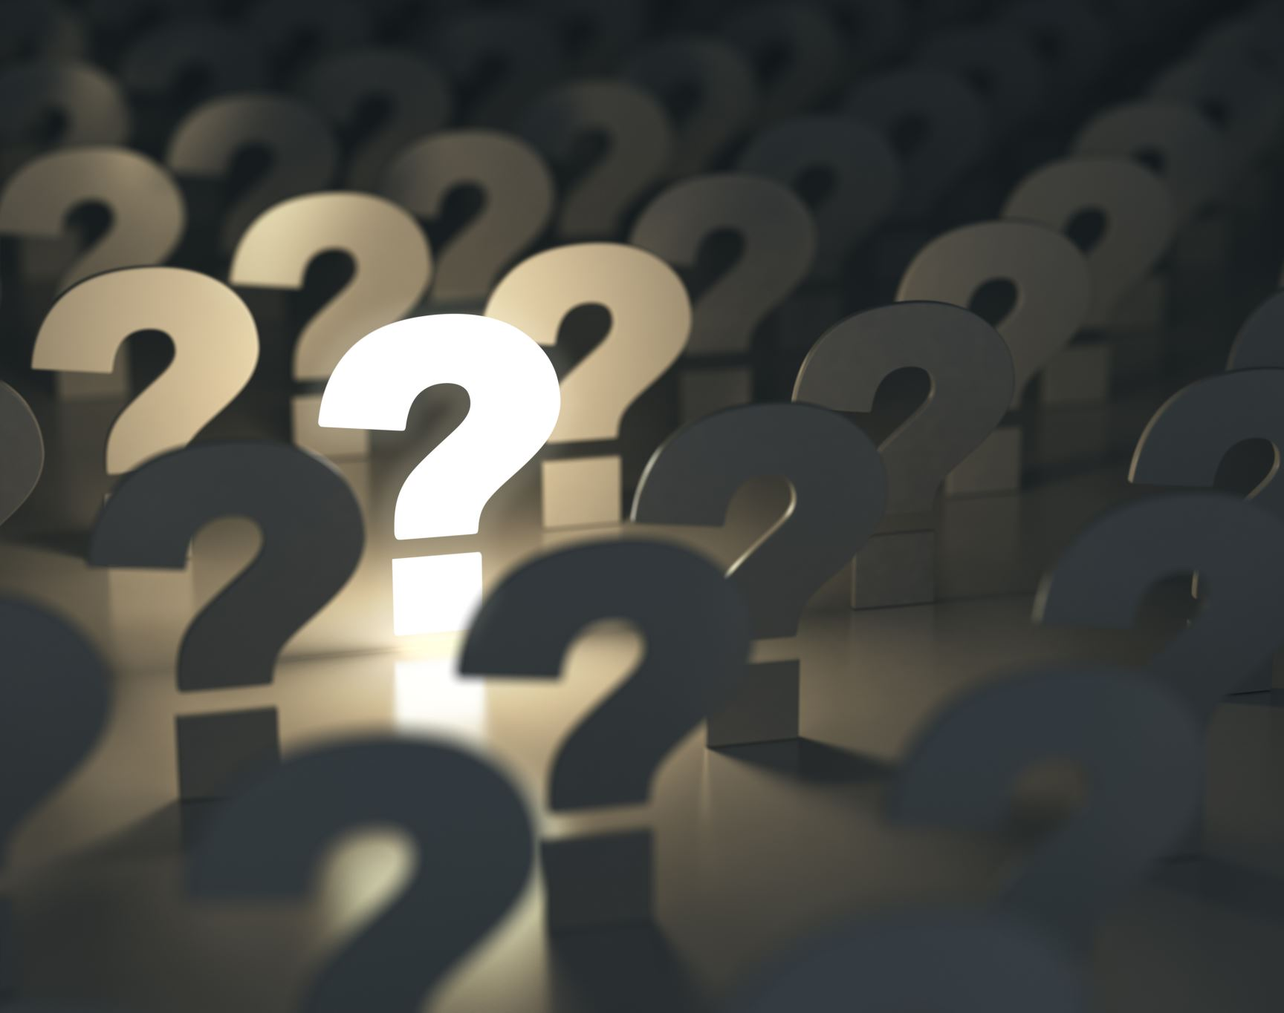
Questions?

Slide 11
Consequentialism
In order to apply consequentialism to evaluate the morality of an action, you ask yourself what the likely consequences of the action will be. (there are many other considerations, but let's keep it system).
Sometimes this is called "act consequentialism" to distinguish it from "rule consequentialism". Let's ignore rules for now. Just consider what happens if we do and do not
What happens to our model and to society if we don't use square footage.

Slide 12
If we leave square footage off
Our housing price no longer depends on square footage.
That means that a 2500 square foot house with 4 bedrooms and a 1000 square foot house with 4 bedrooms cost the same.
Is this bad?
Well, it makes the program basically useless. It's bad at predicting market prices now.
But what about society? If we were able to get people to buy into its new valuation, would the consequences be good?

Slide 13
If we leave square footage off (2)
If our system is popular enough (e.g., Zillow), it might have some effect on people's perceptions of value.
And maybe we could improve housing equity?
But are we really improving housing equity? Ignoring square footage would have the effect of "smooshing" house prices together, so a mansion would cost closer to a duplex.
But that means the duplex gets more expensive. So a poor person with no house at all might actually have to pay more.
So our well meaning idea potentially aided one group of people (people with cheap houses) at the expense of another group (people with no house at all). Probably not great for society.

Slide 14
Deontology
What about through a deontological lens?
What duties do we have?
Well, we may have a duty to be honest to our customers.
We may also have a duty to be good for society. It isn't clear that removing square footage is good for society. This requires some consequentialist reasoning.
Sometimes the different ethical systems aren't cut and dried.

Slide 15
Virtue ethics
Most systems of virtue consider honesty to be a virtue.
Estimating the house price accurately is consistent with that.
Honestly, I can't really see too much else that interacts with virtue ethics here, but I'm not an ethicist.
It's important to note that some virtue ethicists, such as Aristotle, warn that it's possible to go too far in the other direction. For example, someone who is never brave is a coward, but someone who is always brave is foolhardy.
Specifically, an excess of truthfulness was thought to be "boastful" by Aristotle, although that doesn't seem like it applies here. Maybe avoid making nice houses look too awesome?*
*https://philosophy.tamucc.edu/notes/aristotelian-virtues

Slide 16
Alignment of ethical systems
If our ethical analysis doesn't raise any red flags, we can feel a little more confident that we can proceed.
It's unlikely that square footage is a problematic column.
Of course, if more information arises, we might have to change our mind. It's important to note that ethical behavior often depends on conditions of the outside world, so we can't just go on cruise control.
So along these lines, can anyone think of a column in the dataset that could cause an issue?

Slide 17
Questions?

Slide 18
One particularly important column
Of all the columns, one of the most significant is the neighborhood.
Many of
Specifically: with neighborhoods I get an r^2 of 0.85
If I remove them from the analysis, I get 0.82
That's a big deal

Slide 19
Why is neighborhood important?
Neighborhood effects the price of a home for many reason. It has major effects on the following:
Access to transporation
Access to jobs
Access to businesses, entertainment, and government services
Access to schools
Natural beauty and the beauty of the other houses

Slide 20
Why might it be problematic?
Because the US has a history of segregation.
Many neighborhoods are composed primarily of one race.
The neighborhood column might be a partial proxy for "race of home owner".
Obviously it would not be acceptable to use that to determine the price of the home.

Slide 21
Should we get rid of it?
Maybe, but there are some things to consider.
All the other data is also tied up in neighborhood. Access to schools, access to infrastructure, parks, etc.
If we remove neighborhood, we need an alternative way to price that stuff in. And many people do make a decision to buy a house in a certain neighborhood and it's not necessarily racist to do so.
So what can we do to avoid feeding into a problem that leads to racial disparity?

Slide 22
Should we get rid of it? (2)
The Brookings Institute did a study that compared house prices in majority white and majority black neighborhoods.*
They found that there was a major disparity in house prices. Houses in white neighborhoods were on average about twice as expensive.
However, these neighborhoods were often richer. After controlling for all the obvious variables such as schools, crime, access to services, and even college attainment, there was still a ~23% deficit for black neighborhoods relative to white neighborhoods.
Some criticisms of their methodology, if correct, would reduce this deficit. However, there was still an important disparity.
This disparity is an important consideration, and it means that we may be actually biasing our model in a way that is bad for our users as well as for society as a whole.
*https://www.brookings.edu/articles/biased-appraisals-and-the-devaluation-of-housing-in-black-neighborhoods/

Slide 23
Bad for society?
According to the US census, home equity is overwhelmingly the largest source of personal wealth for all races and generations except for gen Z.
(but eventually we would expect even gen Z to be like this)
By under-appraising homes of one group, that group is made poorer.
This has an additional negative effect: typically people sell their house when they move to buy a new one. By underappraising someone's house, you reduce the number of places they can move and "trap" them in their neighborhood.

Slide 24
Bad for users?
Think about it, you want to know what a house is worth to you, not just what its market price is.
If the market price is much lower than its value to you, that implies that it's a good deal.
A real-estate appraisal app could give you access to this information. It could say "here's what we think this house will sell for, but we think that it's being unfairly penalized, so we think it should really be worth this."
By giving access to the whole picture, the app could avoid worsening an unfair evaluation of a particular neighborhood.

Slide 25
Easy fix?
So that's it? We can just improve our model to counteract the unfairly low appraisals? It seems awfully convenient that something that could make us more money is also the morally right thing to do.
That's because there are also complex effects of higher housing prices. Specifically, gentrification.
Gentrification makes a neighborhood more valuable, which is great for existing homeowners, but bad for people who rent.
However, if the existing homeowners don't want to sell, it can be bad for them too: higher property taxes.
Renters' cost of living rises. Possibly there are positive effects that come with that, but it's not a trade that everyone wants to make.

Slide 26
Easy fix? (2)
So, now we're somewhat benefitting existing homeowners and hurting people in that community who don't own a home.
The Brookings institute also has a paper with concrete policy recommendations for mitigating the downsides of gentrification: https://www.brookings.edu/articles/dealing-with-neighborhood-change-a-primer-on-gentrification-and-policy-choices/
However, as a business, we have limited ability to implement these policies. Some businesses create PACs to have political impact, and we could consider doing that to help reduce the fact that our app may contribute to gentrification.
However, you can probably see how creating a PAC opens an entirely new ethical can of worms.

Slide 27
What Zillow does
Zillow and other real estate estimation apps seem to factor in the neighborhood very heavily.
Despite controversies over professional appraisals being unfair, I haven't seen automatic appraisals specifically targetted for criticism.
It might be that Zillow appraisals are less biased than professional appraisors, so they may already be estimating house prices as higher in minority neighborhoods.
However, it's not hard to imagine them being singled out as a major factor driving the disparity in prices. It's worth watching to see if this happens.

Slide 28
What's the moral?
We just saw an example of where naïvely using all data available leads to a model that can exacerbate an existing problem in society.
What's more, in doing so it could actually be hiding useful information from the users.
And fixing this required carefully looking for sources of bias in the model and searching current research to learn more about how to adjust for it.
However, fixing it does not make our app magically better for everyone. It seems like the more influential our app is, the greater its impact will be, and therefore the greater our moral responsibility.

Slide 29
What's the moral? (2)
And yet, the greater our moral responsibility, the worse tools we have access to to fix our negative impact (e.g., PACs)
Maybe the true moral is that it's bad for one app or software service to have too much impact in society.
Perhaps if our app were localized to one city or county we could work with the local government in a positive way without forming a PAC.
Unfortunately, the economic incentive is to grow as big as you can.
Tread carefully: it is very likely that many of you will work for big companies with outsized impact. They will tell themselves that they are highly moral, but there will be massive blindspots in their ability to see negative effects in their actions. [I speak from experience.]

Slide 30
Questions?

Slide 31
Privacy
Now, let's consider another ethical issue that is having a massive impact on our lives: the issue of privacy.
Why is privacy so important?
The main reason companies want to take your privacy away, is that the more they know about you, the more valuable you are.
Selling ads is a major revenue source.
Let's learn more about this.

Slide 32

Selling ads
When the internet started to get huge, advertising was very lucrative.
For example, reportedly the first banner ad ever was by marketing company HotWired on behalf of AT&T.
The ad took the user to a landing page with more information about AT&T. Reportedly (I can't find a solid source for this), it had a clickthrough rate of >70%. People were fascinated by the first digital billboard.
More info: https://www.theatlantic.com/technology/archive/2017/04/the-first-ever-banner-ad-on-the-web/523728/

Slide 33
Selling ads
Online advertising spread like wildfire.
People stopped being impressed by the novelty, and click rates for ads started to go down.
It's hard to compete with something that's free, so online apps tried to attract users and then ratchet up the advertising later.
This gets diminishing returns, so companies looked for new ways to get users to click on things.
One of the most effective: targetted advertising

Slide 34
Targetted advertising
Selling ads without knowing your users does not work very well.
To see why: disable targetted advertising on some of your apps and see what happens. Ads for mobile puzzle games, solar panels, and health insurance plans will follow.
It is very unlikely that you will click on these ads, and therefore, the marketing companies will not bid very much to show them to you.
However, if the company knows that you're a gardener, now they can show you ads for gardening equipment?
How do they find out you're a gardener?

Slide 35
How targetting ads work
They find out because you tell them:
Cookies can track what products you view on online stores.
Fingerprinting can track what pages you view across the internet
Data science can analyze what you talk about in your posts.
Your car insurance app could be tracking which stores you visit.
Companies you do business with sell your activity data.
Most of these things are listed in the terms of service. Unfortunately many of these TOSs are for services that are very challenging to do without, due to a lack of competition.

Slide 36
Facebook
One of the industry leaders in targetted advertising is facebook.
Facebook has an interesting history of increasing surveillance of its users over time: https://www.nbcnews.com/tech/social-media/timeline-facebook-s-privacy-issues-its-responses-n859651
Fun note: originally users protested when the timeline was introduced...because the idea that your posts would be broadcast to all your friends felt incredibly invasive. (it was a different time)
The Cambridge analytica leak revealed that some of the 3rd party apps that Facebook gave users' data to were using it in invasive and unauthorized ways, including ways which affected people who weren't using those apps.

Slide 37
The morality of privacy violations
Why is it bad to violate peoples' privacy?
Some reasons:
It can endanger them. It makes identity theft, phishing, and other scams much easier.
It's not clear that getting people to buy more stuff with more effective ads is a social good.
People are have been shown to be highly concerned with their information privacy: https://www.tandfonline.com/doi/full/10.1080/10447318.2020.1794626 . Therefore there are emotional issues to consider (e.g., anxiety)
Some research suggests that people continue to use privacy-violating apps out of a sense of fatalism. They can't stop people from tracking them, so they might as well use the apps. It is clearly not ethical to exploit people who are using an app because of this attitude. Source: https://www.researchgate.net/publication/329424302_Revealing_the_relationship_between_rational_fatalism_and_the_online_privacy_paradox

Slide 38
Moral alternatives?
The massive violations of privacy we're seeing cannot be justified in my opinion.
Especially when you consider: the advertising values of users are now quite low.
That raises the question? Why not charge small subscriptions?
DuoLingo did, and it works well for them: https://www.statista.com/statistics/1248140/duolingo-revenues-by-segment/
Their subscription revenue is about 5 times higher than their ad revenue, and this ratio appears to be growing.
Ultimately, we may just have to pay for the services we use.

Slide 39
Questions?

Slide 40
Bad metrics
Another issue that confronts data scientists is the issue of metrics.
Specifically, bad ones.
What's a metric?
It's a way of measuring performance. Job performance, program performance, etc.
Using metrics in a scientific way to measure performance is surprisingly recent, but very important to understand.

Slide 41
Pre-modern taxes (lack of metrics)
Even back during ancient times, a local ruler had to know how much they expected fields to be able to produce. They tried to obtain this information in different ways.
In early dyntastic egypt, the Pharoah collected a fifth share of all grain (as well as similar amounts of other goods). This still incentivized farmers to grow as much as they could, since they got to keep most of it.
However, In the republic of Rome, a flat property tax (land value tax) was levied based on the expected fertility of the land. This incentivized landowners to improve their land, since it wouldn't cause the tax to increase.
A more ordinary property tax was common through many Chinese dynasties, with additional commercial taxation
And in the Roman empire, tax farming was practiced. This was usually a brutal system applied to conquered territories in which the right to use force collect taxes was auctioned off. In theory the contract stipulated how many taxes could be collected. In practice, more was often collected. This could be a flat tax, which in theory would incentivize the worker to work because they got to keep everything above the tax. In practice, the tax collecter was motivated to collect everything they could get, which had the opposite incentive.

Slide 42
Pre-modern taxes (2)
Notice that all of these systems had some kind of incentive built in.
The sherriff did not want to have to stand behind peasants yelling at them to make them work harder.
So instead, systems of pay were created that incentivized people to work on their own by letting them keep some of what they made. Some of these systems were based on taking a cut, others based on imposing a rent.
However, notice that it's very rare for modern work to work this way. The vast majority of us work for a wage, instead.

Slide 43
Metrics in a wage-labor world
The industrial revolution changed how people were compensated in a big way.
For small goods, people were often paid for piece-work, meaning that the worker would get a cut of all the goods they produced (e.g., for every 10 pieces of fabric you cut correctly, you get a X$). Piece work existed back during guild-days and before.
However, this form of compensation becomes harder to administor when there are large, complex goods requiring many forms of skilled labor. Piecework may incentivize "rushing" work and would need to be closely monitored. Therefore, many factories payed an hourly wage instead (time work).
But time work has its own incentives...

Slide 44
Scientific management
One particularly influential industrialist was Frederick Winslow Taylor. He was famous for applying scientific empiricism to work output.
A lot of his work was on developing training programs for workers (which beforehand were largely expected to figure things out for themselves).
However, he was most famous for trying to scientifically establish the amount of output the best worker "should" be able to achieve, and then using this as a barometer for compensation—including firing workers who fell too far below.
He was also known for identifying maximally productive body movements and asking workers to move their bodies in a particular motion.
He called all of his methods together "Scientific Management".

Slide 45
Scientific management (2)
His methods did result in an increase of productive output, and were largely developed in parallel by Henry Ford (who worked independently from Taylor but who largely discovered a lot of the same things).
This is where we get the idea of workers doing exactly one repetitive thing, over and over again, on the early assembly line.
His methods were adopted throughout the country, and were often extremely unpopular (sometimes called "Taylorism" by detractors).

Slide 46
Scientific management (3)
Taylor had intended that costs and profits should be shared between workers, management, and owners. So high performers should get large wage bonuses, because he had observed that a productive worker was often 3 times more productive than an average worker.
Likewise, low performers were meant to be penalized, which could result in docked wages or being fired.
In general, Taylor saw himself as being favorable to labor, because he advocated for more rest breaks and higher pay.
However, some factory managers realized that in certain economic environments, they could get away with just threatening people who fell below output targets, while still implementing Taylor's scientific style.
This was miserable for workers and was opposed by labor unions. It even led to a congressional investigation of scientific management.

Slide 47
Back to metrics
What does this have to do with us?
Scientific management did not go away after the industrial revolution.
Now we have Digital Taylorism
And this form of management relies very heavily on monitoring everything. Potentially including your screen, your phone, and you, personally.
In order for any of this to be worthwhile, there needs to be a metric.

Slide 48
Example metric
Suppose an Amazon warehouse wants you to move X packages per day. Suppose they have applied Taylorist techniques and have built a wristband that will monitor your arm to make sure it moves the right way.
They may have determined the ideal way to move arms, but how do they know how many packages you can move?
Probably from a data scientist. This person may have conducted observational studies or performed controlled experiments.
But that determines how many packages people could move under other circumstances. What if things are not identical to you? What if your body type or work environment is different?

Slide 49
Bad metrics
It is extremely challenging to make a perfect metric. One that takes in to account everything it should in order to be meaningful.
Getting it wrong and oversetting a metric can be miserable for employees.
For example, Wells Fargo's CEO infamously set a target for branch employees to sell at least 8 financial products to customers. This target was extremely high, and led to bank employees fraudulently opening accounts in customers names, leading to negative financial impacts to them.

Slide 50
Bad metrics: machine learning
Consider what happens when these metrics are driven by machine learning.
If you are developing a system that will evaluate someone, you have a greater ethical responsibility.
[example about Microsoft ML classifier judges and one random judge]
To avoid making a wrong decision and causing damage to someone, human beings need to be in the loop.
Unfortunately, there is a trend that is moving in the other way.
Quote from the owner: “Imagine you’re managing somebody and you could stand and watch them all day long, and give them recommendations on how to do their job better,” says Weir. “That's what we’re trying to do. That’s what we’ve built.”

Slide 51
Your responsibilities
Ultimately, if you are working for a firm like this, your own ethics end up tied to the firm.
If you don't agree with them, there may be no choice but to quit.
It's extremely important before taking a job to evaluate the company's worldview and whether it is aligned with yours and your own desires to make the world better.
This is also something to ask during an interview.

Slide 52
Questions?

Slide 53
Many more ethical issues exist
The use of biased training sets which make models work better for some groups of people than for others (e.g., voice activation, facial recognition, etc.). Doing a bad job can exclude people from access.
The use of ML in safety-critical domains such as medical research, cancer diagnosis, and assisted surgery. Doing a bad job can kill people or lead to other serious negative health outcomes.
The use of ML for auto-moderation, such as demonitization of youtube videos, spam detection, and removal of facebook posts. Doing a bad job harms freedom of speech.
The use of data science in public policy. Doing a bad job can harm society as a whole.
Even more...
This is an important field and carries a lot of ethical responsibility. Be sure to learn about your domain and what ethics are relevant. [my domain]

Slide 54
Questions?

