Slide 1

CS 483: Machine Learning
Week 8: Cross Validation and Trees

Slide 2
Last module (before the test)
We learned why accuracy is not adequate
We learned about confusion matrices
We learned about precision, recall, and F-score
We learned about P/R curves

Slide 3
This module
We will learn why we can’t rely on a train/test split in most circumstances.
We will learn what the “CV” stands for in GridSearchCV.
We will learn about the limitations in linear machine learning algorithms.
We will learn our first non-linear algorithm: the decision tree.

Slide 4
Let’s start with a problem
Remember your first homework?
You had to classify zoo animals according to a bunch of features.
You had to get at least a certain level of overall accuracy.
We had a 70%/30% train/test split
Did you notice anything when you were running the program?

Slide 5
The thing you might have noticed
I noticed that my accuracy fluctuated wildly
Going from a low of 83% to a high of 100%, I found that my mean was roughly 93%.
This is a big range.
If you were tasked with demonstrating the performance of a machine learning system, you might not be comfortable moving forward.
Clients will want to see demonstrable, stable performance [machine learning can make people nervous]

Slide 6
Why does it fluctuate so much?
Some instances are harder to classify than others.
If you ran your ML classifier on individual instances, you probably noticed that sometimes, the probability was very high: 99% certainty for example
However, sometimes, for our 7 classes of animals, we might only be 20% certain that a particular animal is in a particular class.
Remember, if the probability of each class is equal, 20% is good enough to classify. But we’re still only 20% sure that the animal is a mammal.

Slide 7
Why does it fluctuate so much? (2)
In fact, when things get difficult, the classifier will often go with whatever has the biggest prior.
Meaning: if we don’t know what an animal is, just pick mammal, because that has the highest prior.
The sensitivity of this behavior is adjusted with the “alpha” parameter for naïve bayes.
[why does having a low alpha make us pick the animal with the lowest prior, but having a high alpha not?]

Slide 8
Why does it fluctuate so much? (3)
So why the fluctuation?
When we select our 70% train / 30% test set, we’re randomly sampling until 70% of our data is in the train set, and then whatever is left goes into the test set.
Sometimes, the test set is full of hard instances with 20% classification probabilities, and sometimes it’s full of easy instances with 99% probabilities.
Big point: not only are the hard instances likely to hurt performance when they’re in the test set, they also help performance when they’re in the train set. They end up adding the most clarity when training.

Slide 9
Machine teaching
Why does this happen?
Let’s say we’ve learned that animals with 4 legs which lay eggs are overwhelmingly likely to be reptiles
Then suppose we see this instance here: < legs = 4, young = eggs, has_bill = false, class = reptile >
What have we learned?
Not much. We were already classifying that instance as a reptile anyway. All we’ve done is further reinforce our idea that egg-laying quadrupeds are reptiles.
Maybe we went from 99% probability to 99.1% or something.

Slide 10
Machine teaching (2)
But what if we see a platypus? < legs = 4, young = eggs, has_bill = true, class = mammal >
Now we’ve really learned something. “has_bill” is very important to distinguish between reptiles and mammals.
If this instance is in the training set, it’s very useful.
If, however, it’s only in the test set, we will likely get it wrong.
The overall balance of hard instances is why train/test has variance.
[machine teaching example (FACE)]

Slide 11
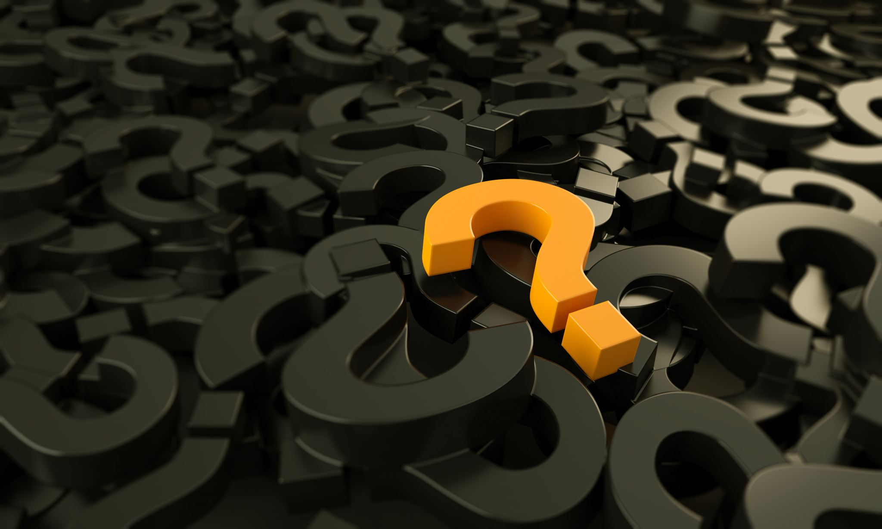
Questions?

Slide 12
Why can’t we just average 10 train/tests?
So, you may have the idea that we can run a train/test split over and over again and then average the results together.
This sort of works, but it’s not ideal.
The train/test datasets are random, so these two things could happen:
We end up training on platypus 7 times and testing on it 3 times
We end up training on platypus 10 times and testing on it 0 times
We end up training on platypus 5 times and testing on it 5 times
We could hope that these effects balance out, but it would be nice if we could be sure that it appears in both sets the correct number of times so we don’t have to worry about that source of variance.

Slide 13
Why can’t we just average 10 train/tests? (2)
What if we change the ratio?
So instead of 70% / 30%, we use 90% / 10%?
This is expected to improve the performance of the model on average, because we have more data for it to learn from.
The downside is, we now have more variance in testing.
[what does this mean?]

Slide 14
Testing variance
With 30% test and 10 attempts, it was unlikely that we didn’t see platypus a single time (roughly 3% chance)
With 10% test and 10 attempts, it’s far more likely (35%)
[how did I get these numbers?]
There is a lot of variance in the figures we get: precision, recall, etc.
If we’re doing regression, there is a lot of variance in r2.
We can lower variance by increasing the number of trials, but keep in mind: training and testing is slow for many serious models, so moving to 100 is not ideal either.

Slide 15
Introducing cross validation
In order to reduce variance while guaranteeing a reasonable ratio for our trains/tests, we don’t have to sample randomly
Instead, let’s break our data set into 5 pieces (called “folds”):
And let’s use 4 of these folds to train, and 1 to test:
20%
20%
20%
20%
20%
20%
20%
20%
20%
20%

Slide 16
What did that accomplish?
Absolutely nothing. That was equivalent to an 80% / 20% train/test
But what if we did it…again?
We first tested this split:
Now, let’s hold out the second to last block for testing, and use the others for training:
20%
20%
20%
20%
20%
20%
20%
20%
20%
20%

Slide 17
And let’s keep doing that
20%
20%
20%
20%
20%
20%
20%
20%
20%
20%
20%
20%
20%
20%
20%

Slide 18
So what happened?
We just performed 5 different 80%/20% train/test splits.
We now have 5 data points that give us 5 different precisions and recalls (or 5 different r2s, or 5 different accuracies, etc.)
We take the arithmetic mean between these metrics. Now we get the mean precision/recall/F1/etc. but the variance is 5-times lower.
And what’s more: we know that every single instance has been tested exactly once.
That’s key. Not only have we ensured that every instance was tested, we also ensured that every instance wasn’t tested too many times.

Slide 19
What is this called?
This technique, of partitioning the data and making sure every partition gets tested, is called “cross validation”.
Using 5 trials with 5 folds is called 5-fold cross validation.
Using 10 trials with 10 folds is called 10-fold cross validation.
We call the technique “K-fold” cross validation if we want to discuss the general technique, and don’t know how many folds the data scientist is planning to use

Slide 20
What does it get us?
We gain more trust in our figures. We can’t trust a single precision/recall number as much as 5
We gain variance information: we can look at the different folds to see how much the metrics for each fold are similar.
We might be happy if we get an overall F1 of 80%, but what if one fold has 60% and another has 100%. That would clue us in that we probably don’t have enough training data to be confident in our classifier.
We get this reduction in variance while still getting to use lots of training data.

Slide 21
Questions?

Slide 22
How many folds should I use?
It seems like the more, the better, right?
If we have 2 folds, we end up training on 50% of the data
If we have 5 folds, we end up training on 80% of the data
If we have 50 folds, we end up training on 98% of the data
What happens if we have as many folds as we have instances?

Slide 23
Leave-one-out cross validation (LOOCV)
Suppose we have 10,000 instances.
We can split those into 10,000 folds, so that we do 10,000-fold CV.
So, we train on 9,999 folds and test on a single instance.
This gives us the lowest bias possible for our model.
What does this mean?

Slide 24
We use the whole dataset to train the model
We’ve talked a lot about how to evaluate machine learning models.
I haven’t talked about using them. This is called “operationalization”.
When we operationalize a model, we install it to a computer system (often in the cloud) so we can actually use it to make predictions.
We always want to use as much training data as possible to deploy the model. The more training data we use, the better it will perform (on average).
However, that means that our model will typically perform differently than it was evaluated…

Slide 25
Bias vs. variance
The smaller our training size, the more our model under evaluation will differ (by being probably worse) than the model we will deploy.
The smaller the test size, the more variance we will have in our performance metrics.
Why? If we use LOOCV, we are either 100% right or 100% for classification. We either classified the instance correctly or not.
That means we can take the mean, but we don’t get to look at realistic scenarios for performance. We see a bunch of “model is literally perfect” and “model is actual garbage”.

Slide 26
Seriously, how many folds do I use?
Typically either 5 or 10.
10 is a good baseline
Fewer is okay, too. I used to use 5 when I wanted to make sure that the model wasn’t sensitive to a borderline count of training instances.
Most of the research on this is empirical:
Kohavi, R. (1995, August). A study of cross-validation and bootstrap for accuracy estimation and model selection. In Ijcai (Vol. 14, No. 2, pp. 1137-1145).
PDF: http://robotics.stanford.edu/%7Eronnyk/accEst.pdf

Slide 27
Questions?

Slide 28
Being careful with cross validation
Pipelines are very important to helping us be careful with cross validation.
So far, we have only used our pipelines for transformation.
However, we can also do automated feature selection with pipelines.
Examples: https://scikit-learn.org/stable/auto_examples/feature_selection/plot_select_from_model_diabetes.html#sphx-glr-auto-examples-feature-selection-plot-select-from-model-diabetes-py

Slide 29
Sequential feature selection
Sequential feature selection is a technique that is an automated version of what many of us probably did to complete the previous assignment:
Find a group of features that are good, and keep trying to add another features until adding one raises our r2 score.
This is a greedy algorithm, we aren’t guaranteed to find an optimum selection of features (due to correlations), but the computer is very patient, and can test thousands of features, whereas a human cannot.
We need to be careful when doing this…

Slide 30
Automated feature selection: dangers
You might think that this kind of automated feature selection should happen first, before we start training and testing.
This leads to a big problem with the believability of the results for your model.
For example, suppose we apply sequential feature selection and we find 3 features that lead to very high r2 score.
Then, we cross-validate a model that uses those features.
We just made a big error without realizing it.
[Can anyone tell me what it is?]

Slide 31
Data dredging
When we have a huge dataset with lots of features, it is virtually certain that some of them are very predictive of our target, even by shear chance.
For example: did you know that the conference (NFC or AFC) of the superbowl is a leading indicator for the stock market?
It’s true. If the NFC team wins, the stock market is more likely to go up the following year.
Should you change your investment behavior based on this information? It doesn’t seem like a good idea to me.

Slide 32
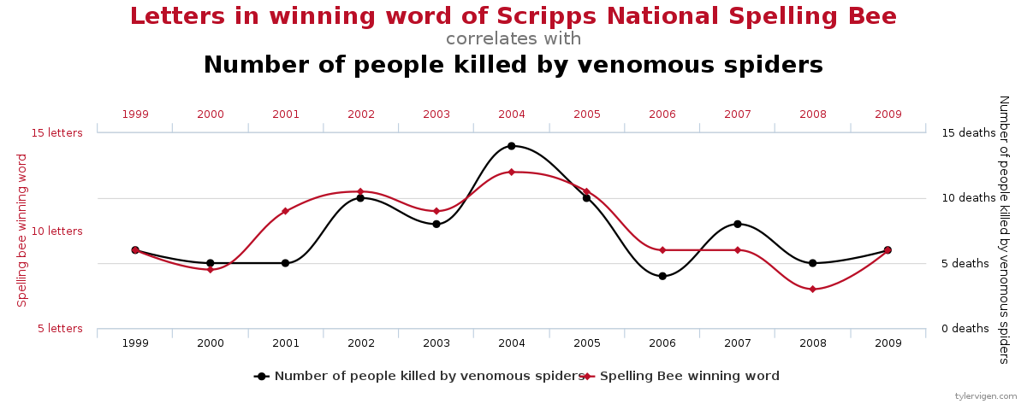
Data dredging (2)
If we include every feature ever, we are guaranteed to find weird correlations.
Like this one:
[discussion of data dredging / p-hacking]
Image: Tyler Vigen, CC-BY-SA, https://en.wikipedia.org/wiki/File:Spurious_correlations_-_spelling_bee_spiders.svg

Slide 33
What did we do wrong?
We ran an automated feature finder on all the data
However, that means that we never tested whether the feature was good during cross validation.
Let me repeat that: when we were selecting features, we used all the data we had available.
But if we had only had 80% of the data available, we might have picked different features.
We never cross validated our feature selection. We don’t know if the features we selected were spuriously predictive.
In real life, we never know. That’s why we do train/test splits.

Slide 34
Fixing it
Easy fix: just use a pipeline
Do your feature selection in an early stage, build the model in a later stage.
This way, when we run GridSearchCV or cross_val_score on the pipeline, we’re only doing feature selection on the train part.
Now we can actually detect if we’ve selected our features spuriously.

Slide 35
Questions?

Slide 36
Linear classification
What is a linear classifier?
Linear functions look like this: f(x) = a + bx + cy + dz + …
(note: naïve Bayes doesn’t look like this, but it’s equivalent in power to logistic regression which does)
We like linear functions because they are so easy to work with: We can solve for any term individually using basic arithmetic
We don’t need many datapoints to derive inference
However, because linear functions are so nice, we really really want them to work. Unfortunately, some functions are not linear.

Slide 37
What can’t linear/logistic regression do?
You might be thinking: okay, if I want to predict a quadratic function, obviously I can’t use a linear model.
But you actually can, just take the square root, fit the model, and then square it again
So are there any functions that we can’t transform our way around?
[class]?

Slide 38
An example: XOR
The simplest example of a function that we cannot match with a linear classifier/regressor is xor.
Not and, not or, not “not”, but only xor (and xnor)
Why?
Let’s look at and, or, and not.
Suppose x and y are variables that are either 0, for false, or something larger than zero for true.

Slide 39
Xor, not, and “and”
How do we implement “not” as a linear classifier?
not(x) = 1 – x
What about “or”?
or( x, y ) = x + y
What about “and”?
and(x, y) = x / 2 + y / 2

Slide 40
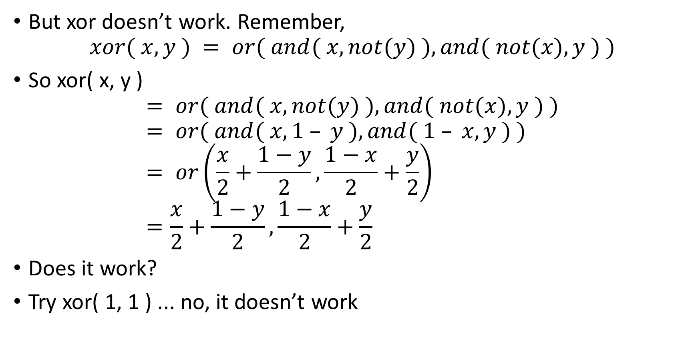
XOR doesn’t work
But xor doesn’t work. Remember, $xor( x, y ) = or( and( x, not(y) ), and( not(x), y ) )$
So xor( x, y ) $= or( and( x, not(y) ), and( not(x), y ) )$ $= or( and( x, 1 – y ), and( 1 – x, y ) )$ $= or\left(\frac{x}{2}+\frac{1−y}{2},\frac{1−x}{2}+\frac{y}{2}\right)$ $=\frac{x}{2}+\frac{1−y}{2},\frac{1−x}{2}+\frac{y}{2}$
Does it work?
Try xor( 1, 1 ) ... no, it doesn’t work

Slide 41
Neither does general clustering
Other things that linear algorithms cannot do: separate clusters in space from each other (note, this is actually similar to xor)
Class 1
Class 0
Y
Class 1
Class 0
X

Slide 42
So what?
Now it’s time to learn a new algorithm
One that is widely used…
…simple to implement…
…fast…
…and which can work co-operatively with other versions of itself to improve performance

Slide 43
Questions?

Slide 44
Decision trees
The algorithm we will learn is the decision tree
Decision trees are non linear algorithms that work like a giant, complex if-statement.
The result of training a decision tree is basically a giant flowchart, where each node splits its data in half based on one of the features.
Here’s an example of a simple decision tree for the “zoo” dataset

Slide 45
Milk?
No: 47
Yes: 28
Feathers?
Mammal
No: 34
Yes: 13
Fins?
Bird
10
Invertebrate (guess)
Fish

Slide 46
Using the decision tree
Decision trees are like any other tree. They have a root, inner nodes, and leaves.
Each inner node has a decision criterion. The root here tests whether or not the animal produces milk.
If so, go to the right. It must be a mammal.
If not, go to the left.
Then we test whether it has feathers:
If so, go to the right. It must be a bird.
If not, go to the left.

Slide 47
Using the decision tree (2)
Then we test whether it has fins:
If yes: fish
If no…
If no…we give up and guess whatever is most likely
The animals that are left are as follows:
Reptile: 5
Amphibian: 2
Bug: 7
Invertebrate : 10
So we guess invertebrate, because it’s the most common.

Slide 48
Improving the tree
The most obvious way to improve the tree is to add more levels.
We can split on more of the remaining features.
First, let’s start over from the root and see what classes we’re classifying at each level.
Root node:
The classes going into this are 28 mammals, 13 are birds, 5 are reptiles, etc.
At each stage, keep track of the numbers of each kind of animal.
Feature: Milk
Classes: [28, 13, 5, 10, 2, 7, 10]

Slide 49
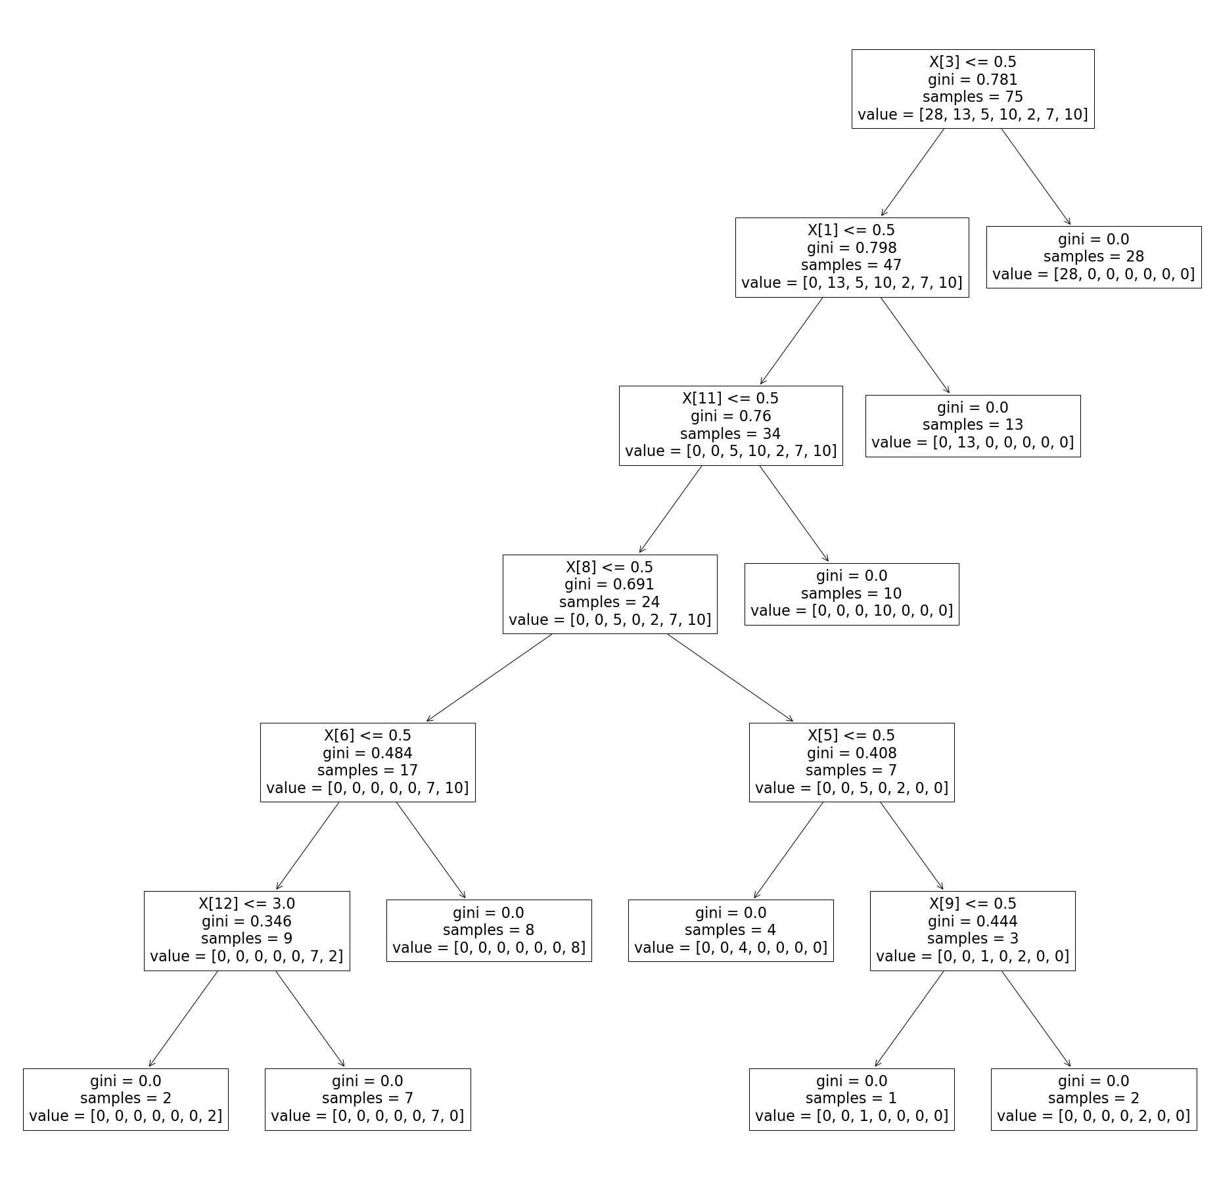
Super zoomed out screenshot

Slide 50
Feature: Milk
Classes: [28, 13, 5, 10, 2, 7, 10]
Feathers
Classes: [0, 13, 5, 10, 2, 7, 10]
Mammal (finished)
Classes: [28, 0, 0, 0, 0, 0, 0]
Fins
Classes: [0, 0, 5, 10, 2, 7, 10]
Bird (finished)
Classes: [0, 13, 0, 0, 0, 0, 0]

Slide 51
Quick notes
From now on:
right arrow means “yes”
left arrow means “no”
[Why were we finished when we reached “mammal” or “bird”?]
Reason: the goal of the decision tree is to classify. Once we reach a point in the flow chart where all the members are a particular class, we are definitely done.
There is no point in breaking it down further because there is nothing to be gained by having two different groups of all mammals. Once we hit that point, we know we have a mammal.

Slide 52
Continuing…
Fins
Classes: [0, 0, 5, 10, 2, 7, 10]
Backbone
Classes: [0, 0, 5, 0, 2, 7, 10]
Fish
Classes: [0, 0, 0, 10, 0, 0, 0]
Predator
Classes: [0, 0, 0, 0, 0, 7, 10]
Aquatic
Classes: [0, 0, 5, 0, 2, 0, 0]

Slide 53
More notes
Now we actually split in half.
Neither side is finished, we still have more features and more class mixture.
Let’s look at the right half first

Slide 54
The right half
Aquatic
Classes: [0, 0, 5, 0, 2, 0, 0]
Reptile
Classes: [0, 0, 4, 0, 0, 0, 0]
Breathes
Classes: [0, 0, 1, 0, 2, 0, 0]
Also Reptile (seasnake) [0, 0, 1, 0, 0, 0, 0]
Amphibian
Classes: [0, 0, 0, 0, 2, 0, 0]

Slide 55
Notes (3)
Notice that we have two reptile predictions
The first one: if we have an animal that is not aquatic, has a backbone, does not have feathers, and does not nurse its young, then we call it a reptile
However, we don’t catch all the reptiles with that, because there is an aquatic reptile: the seasnake.
Another problem: there are another bunch of aquatic animals we want to separate the seasnake from. Apparently they don’t breath, so we use that test to separate the seasnake from the other aquatic animals.

Slide 56
The left half
Predator
Classes: [0, 0, 0, 0, 0, 7, 10]
Legs
Classes: [0, 0, 0, 0, 0, 7, 2]
Invertibrate
Classes: [0, 0, 0, 0, 0, 0, 8]
Invertebrate
Classes: [0, 0, 0, 0, 0, 0, 2]
Bug
Classes: [0, 0, 0, 0, 0, 7, 0]

Slide 57
Questions?

Slide 58
But how do we make the tree?
It’s easy to follow the tree once it’s made, but the key is making it.
It turns out, the algorithm is straightforward.
For each node of the tree, we have to choose exactly one feature that that node is going to test.
The root of our animal tree chose the “milk” feature. If an instance nurses young, it goes to the right subtree, otherwise to the left.
But why did we pick that feature first?

Slide 59
Entropy
Ultimately, the goal of the tree is to perform splits that lead to “pure” collections of instances.
That is, we want all the animals in a group to belong to the same class.
If we start with a mammal, and follow it through the tree, testing each feature, we want to end up in a place where all the animals there are “mammals”
In that case, we would say “mammal” with 100% confidence (or less if using LaPlace smoothing).

Slide 60
Entropy (2)
Entropy is a measure of “chaos” in a set.
The entropy of a set/bag is 0 if every element in a set is the same. For example: entropy { mammal * 5 } = 0
Note: a bag is a set that can have more than one of an item
Entropy gets higher the more classes are present in the bag and the more balanced the numbers are.
Entropy gets lower the more skewed the distribution is towards one class. This bag has low entropy: { mammal * 500, bird * 1, reptile * 1 }

Slide 61
Calculating entropy
Entropy (as we use it) is a concept from information theory.
The unit of entropy is either “bits” or “shannons”
The idea is to calculate how many bits it would take to efficiently encode an event.
What does that mean?
Suppose there are 4 possible cases:
It’s sunny and there’s a baseball game
It’s rainy and there’s a baseball game
It’s sunny and there’s not a baseball game
It’s rainy and there’s not a baseball game

Slide 62
If all cases are equal…
If all 4 cases are equally likely, how should we encode them in binary?
We need a bit for each possibility. We can encode “it’s sunny” as 1 and “it’s rainy” as 0. “Baseball” as 1 and “no baseball” as 0.
So, it’s sunny and we played baseball would be “11”
It’s rainy and we didn’t play baseball would be “00”
It’s sunny and we didn’t play baseball would be “10”
You get the idea
How much entropy does this encoding have?
It requires 2 bits for each possibility, and each possibly is equally likely, therefore, we say that this probability space has 2 bits of entropy.

Slide 63
Slight adjustment
Baseball isn’t played in the rain
So there’s really only 3 possibilities:
Sunny and we play baseball: 25%
Sunny and we don’t play baseball: 25%
Rainy and we don’t play baseball: 50%
This changes the entropy.
Why? We can encode more efficiently now. If the first number is a 0, we don’t need to encode the next number (because 01 is impossible, we only have 00, but we don’t even need the second 0).

Slide 64
Slight adjustment 2
So we have this table of encodings and probabilities:
11: sunny + baseball, 25% chance
10: sunny + no baseball, 25% chance
0: rainy, 50% chance
Now, instead of requiring 2 bits on average, we need fewer:
50% of the time we need 1 bit
50% of the time we need 2 bits
Therefore, on average we need 1.5 bits. This table of probabilities has 1.5 bits of entropy (or 1.5 Shannons)

Slide 65
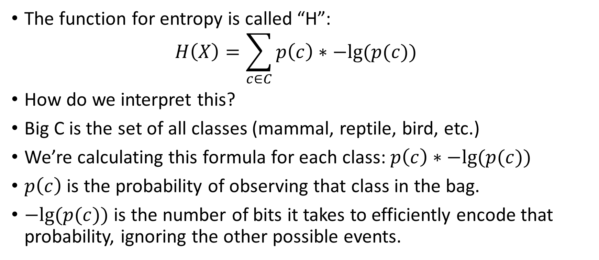
What’s the formula?
The function for entropy is called “H”: $H\left(X\right)=\sum_{c∈C}{p\left(c\right)∗−lg⁡(p(c))}$
How do we interpret this?
Big C is the set of all classes (mammal, reptile, bird, etc.)
We’re calculating this formula for each class: $p\left(c\right)∗−lg⁡(p(c))$
$p\left(c\right)$ is the probability of observing that class in the bag.
$−lg⁡(p(c))$ is the number of bits it takes to efficiently encode that probability, ignoring the other possible events.

Slide 66
Why?
The more likely something is, the fewer bits we want to use
If it always happens, we need 0 bits (just assume it happened)
If it happens 50% of the time, we use 1 bit
If it happens 25% of the time, we use 2 bits (like the equal weight baseball example)
If it happens 12.5% of the time, we use 3 bits.
If we take the base 2 logarithm of 12.5%, we get -3. So we need to add a minus sign to invert it back.
In theory, if something happens > 50% of the time, we could use one bit to signify multiple occurrences. We won’t worry about that now.

Slide 67
The intuition
Essentially this formula is first calculating how many bits we would need to encode all the possible events individually
Then, we weight them by their probability
So if one of our events is roughly on in a thousand, we might need 10 bits to encode it.
However, it’s rare, so that 10 bit signature only appears once every thousand events.
So we end up adding .001 * 10 to our average number of bits

Slide 68
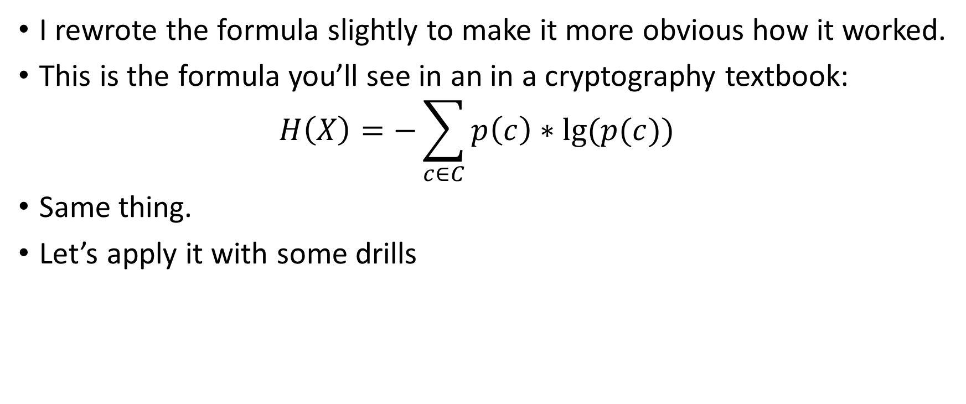
“official” formula
I rewrote the formula slightly to make it more obvious how it worked.
This is the formula you’ll see in an in a cryptography textbook: $H\left(X\right)=−\sum_{c∈C}{p\left(c\right)∗lg⁡(p(c))}$
Same thing.
Let’s apply it with some drills

Slide 69
Solved examples
What is the entropy of this bag: { 1 red, 1 blue }
What is the entropy of this bag: { 1 reptile, 8 birds, 3 fish }
Do you expect this bag to have higher or lower entropy than #2?: { 2 reptiles, 5 birds, 4 fish, 3 whales }

Slide 70
Solved examples
What is the entropy of this bag: { 1 red, 1 blue } 50% * -lg(1/2) + 50% * -lg(1/2) = 50% * 1 + 50% * 1 = 1 bit
What is the entropy of this bag: { 1 reptile, 8 birds, 3 fish } 1/12 * -lg(1/12) + 8/12 * -lg(8/12) + 3/12 * -lg(3/12) = 1.18 bits
Do you expect this bag to have higher or lower entropy than #2?: { 2 reptiles, 5 birds, 4 fish, 3 whales } Higher. It’s less skewed (no class is >50% likely) and there are more classes. (feel free to calculate it)

Slide 71
Questions?

Slide 72
Using entropy to make the tree
Remember, we have to decide which feature to test (Feathers? Aquatic? 4 legs? )
So which one do we pick?
It’s the one that reduces entropy the most
If it takes a mess of samples with very high entropy (roughly same number of each class) …
… and turns it into two sets with lower entropy (fewer classes or more skewed)
That’s a good choice.

Slide 73
Building trees
Next week, we’re going to build our decision tree by hand
We’ll also learn how to build them in Sci-kit learn
We’ll also learn about using groups of trees together (a decision forest, or random forest)
However, now that we have an idea of how they work, let’s take a look at their pros and cons.

Slide 74
Decision tree pros
Decision trees are a universal machine learning algorithm
This means that they can technically learn to approximate any function over a fixed interval, given enough training data.
They aren’t necessarily efficient at learning every function. If the function requires recursion, for example, we might need an arbitrarily deep tree (neural networks are better for this)
However, they are very good for any situation requiring straightforward application of rules.
Basically, if you would use a big nested if statement in an algorithm, a decision tree is a good way to learn the if conditions.

Slide 75
Decision tree pros (2)
Decision trees are fast to predict with:
Worst case, O(n), where n is the number of features (same as naïve bayes and linear/logistic regression)
Average case, O(lg(n)) (better than naïve bayes)
Best case, O(1) (like the mammal case in our example)
They aren’t the fastest algorithm to learn with, but they aren’t too slow either: O(n^2) in number of features worst and average case.

Slide 76
Decision tree cons
If you train a decision tree on a dataset and you don’t apply limits (such as a height limit, a feature limit, or a minimum entropy), the tree will learn to perfectly fit the data
The only time it will fail is if the data is contradictory
This may seem like a good thing, but it actually leads to extreme overfitting in most cases.
Basically, if you have enough features, the decision tree will give you 100% training accuracy and terrible test accuracy
[stock trading story]

Slide 77
Decision tree cons
The overfitting problem is actually quite severe.
Even though decision trees are powerful, it’s rare to see them applied by themselves.
Instead, we typically combine many small decision trees into groups. There are two typical ways to do this:
Random forest: lots of semi-randomly constructed trees that vote together
Gradient boosting trees: a series of trees that each tries to correct the bias of the tree before it, run in a series.
These techniques are what we will discuss in the next module.

Slide 78
Questions?

Slide 79
Next week
Next week we will finish building a tree.
We will learn another metric used to build trees besides entropy: Gini Impurity
We will learn how to use decision trees as regressors instead of just as classifiers
We will learn how to combine multiple decision trees into a group and have them all work together

Slide 80
Questions?

