Slide 1

CS 483: Machine Learning
Week 9: Making Trees and Forests

Slide 2
Last module
We learned about cross validation and how to perform it.
We learned about the shortcomings of linear classifiers
We learned about the decision tree
We saw how to use a decision tree
We learned about entropy

Slide 3
This module
We will learn about another way of measuring dis-unity.
We will build a decision tree from scratch.
We will begin to learn about techniques for combining decision trees.
We will apply what we learned in a project.

Slide 4
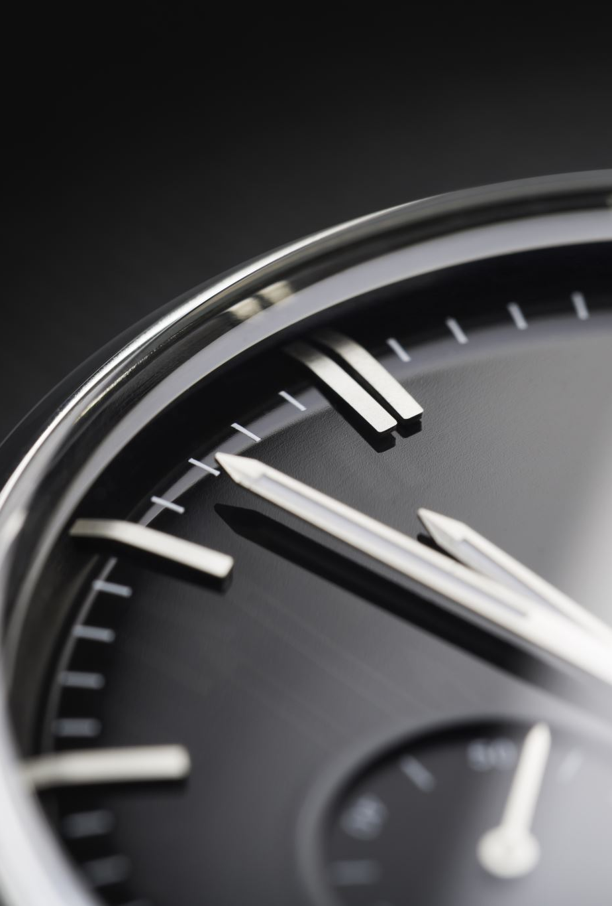
Quiz time
Let’s have a fake quiz
get ready!

Slide 5
The quiz
Generate your own bag, with any elements at all, that has at least 3 bits of entropy.
Create a decision tree that encodes the following logic: “If it is fluffy and it hops, it is a rabbit. If it is fluffy and does not hop, it is a cat. If it is not fluffy and it hops, it is a cavy. If it is not fluffy and it does not hop, it is a dinosaur.”

Slide 6
Quiz answers
The easiest way to do this is to have a bag with 8 equal-weight items: { 1 * a, 1 * b, 1 * c, 1* d, 1 * e, 1 * f, 1 * g, 1 * h } How did we come up with this? We wanted 3 bits. It takes 3 bits to encode 8 values.
This is one tree: (hops could be root, too)
Fluffy?
Hops?
Hops?
Dinosaur
Cavy
Cat
Rabbit

Slide 7

Questions?

Slide 8
Building decision trees
Last module we saw an example of a tree in action
However, the tree was pre-built
Now, let’s learn to build the tree ourselves
Here’s a dataset…

Slide 9
A simple non-linear dataset
Remember the “is wilted” dataset?
Let’s see how well trees can do…
Watered | Rained | Cactus | Count (Wilted, Not)
1 | 1 | 1 | 15, 2
1 | 1 | 0 | 1, 44
1 | 0 | 1 | 5, 5
1 | 0 | 0 | 19, 1
0 | 1 | 1 | 1, 2
0 | 1 | 0 | 1, 19
0 | 0 | 1 | 1, 5
0 | 0 | 0 | 10, 1

Slide 10
Reading the dataset
Each row consists of 3 features, and 2 counts
The first count is the number of instances with those features that are in the positive class (Wilted = true), and the second is the number that are in the negative class (Wilted = false).
If we treated each row separately (without the count column), there would be 132 rows total.

Slide 11
Describing the dataset in code
plants_arr = \ [ [ 1, 1, 1, 1 ] ] * 15 +\ [ [ 1, 1, 1, 0 ] ] * 2 +\ [ [ 1, 1, 0, 1 ] ] * 1 +\ [ [ 1, 1, 0, 0 ] ] * 44 +\ [ [ 1, 0, 1, 1 ] ] * 5 +\ [ [ 1, 0, 1, 0 ] ] * 5 +\ [ [ 1, 0, 0, 1 ] ] * 19 +\ [ [ 1, 0, 0, 0 ] ] * 1 +\ [ [ 0, 1, 1, 1 ] ] * 1 +\ [ [ 0, 1, 1, 0 ] ] * 2 +\ [ [ 0, 1, 0, 1 ] ] * 1 +\ [ [ 0, 1, 0, 0 ] ] * 19 +\ [ [ 0, 0, 1, 1 ] ] * 1 +\ [ [ 0, 0, 1, 0 ] ] * 5 +\ [ [ 0, 0, 0, 1 ] ] * 10 +\ [ [ 0, 0, 0, 0 ] ] * 1
plants = pd.DataFrame( plants_arr, columns = [ 'Watered' , 'Rained', 'Cactus', 'Wilted' ] )

Slide 12
What is the starting entropy of the dataset?
We care about the entropy of the class we are classifying.
This is the only entropy we will calculate
There are 79 examples of wilted plants in our dataset, and 53 that are not wilted. 132 rows in total.
How do we calculate the entropy of this dataset overall?

Slide 13
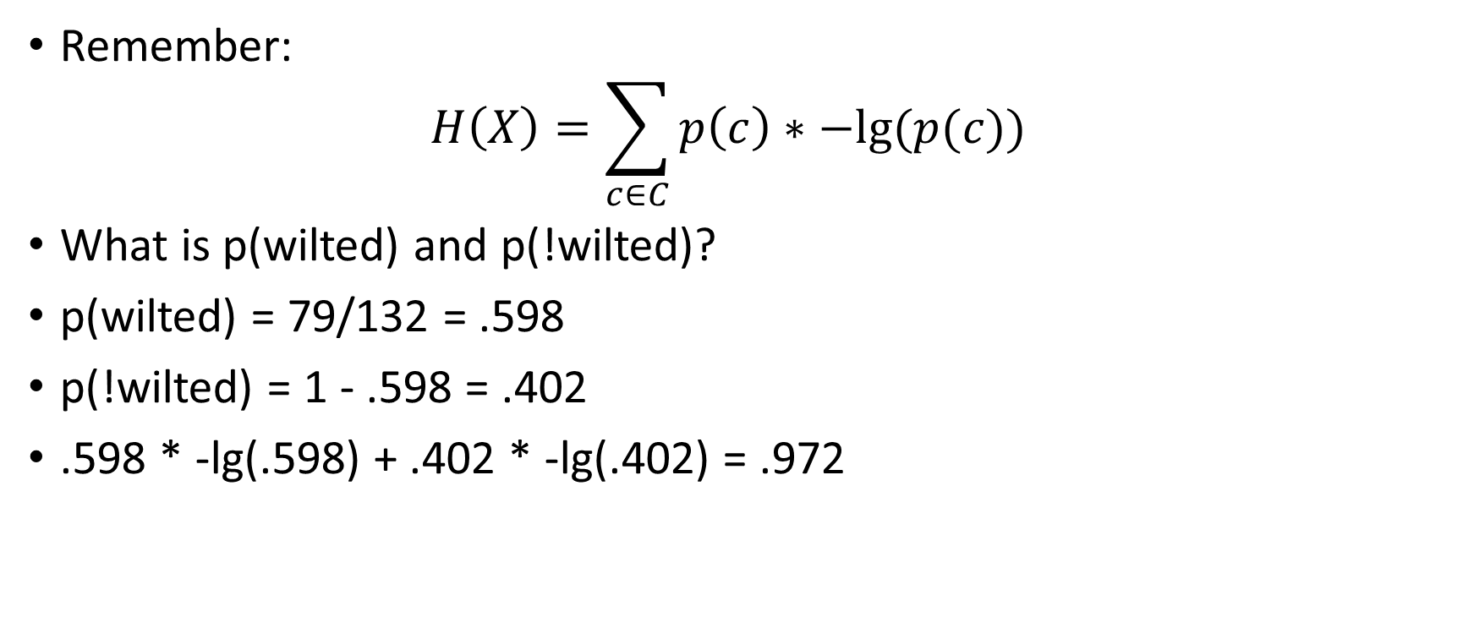
Calculating the entropy
Remember: $H\left(X\right)=\sum_{c∈C}{p\left(c\right)∗−lg⁡(p(c))}$
What is p(wilted) and p(!wilted)?
p(wilted) = 79/132 = .598
p(!wilted) = 1 - .598 = .402
.598 * -lg(.598) + .402 * -lg(.402) = .972

Slide 14
Which feature do we split on?
We have three features.
We need to know which one will reduce this entropy the most.
That is, which feature will give us the most information gain?
Information gain: we want the weighted entropy of the children to be as low as possible.
We must calculate this for each feature in order to choose the best one.

Slide 15
Information gain of “watered”
Suppose we use “watered” as our splitting feature.
What would our left and right children look like?
Watered | Rained | Cactus | Count (Wilted, Not)
1 | 1 | 1 | 15, 2
1 | 1 | 0 | 1, 44
1 | 0 | 1 | 5, 5
1 | 0 | 0 | 19, 1
0 | 1 | 1 | 1, 2
0 | 1 | 0 | 1, 19
0 | 0 | 1 | 1, 5
0 | 0 | 0 | 10, 1
Watered
!Watered

Slide 16
Information gain of “watered” (2)
According to the table, there are:
15 + 1 + 5 + 19 = 40 watered plants that are wilted
2 + 44 + 5 + 1 = 52 watered plants that are not wilted
1 + 1 + 1 + 10 = 13 unwatered plants that are wilted
2 + 19 + 5 + 1 = 27 unwatered plants that are not wilted
There are 53 wilted plants, and 79 non-wilted plants
So, if we used “watered” as our splitting criterion, this is what would happen:
watered [79, 53]
[27, 13]
[52, 40]

Slide 17
Interpreting this
Remember, our goal is to end up with groups that are as pure as possible. Ideally, we would end up with this tree:
[How much entropy does this tree have on either side?]
Answer: zero. Both children have only one kind of label.
feature [53, 79]
[53,0]
[0,79]

Slide 18
Does it make it better
However, we did not get the ideal split. Our split is worse.
The question is: does it make things better?
To learn the answer, we need to calculate the entropy of both children, and take the weighted average (weighted by count)
[What are the entropies of both children?]:
H( { 13 * Wilted, 27 * not } ): ???
H( { 30 * Wilted, 52 * not } ): ???
Answer:
H( { 13 * Wilted, 27 * not } ): (13/40) * -lg(13/40) + (27/40) * -lg(27/40) = .910
H( { 30 * Wilted, 52 * not } ): (30/82) * -lg(30/82) + (52/82) * -lg(52/82) = .947

Slide 19
Does it make it better? (2)
We know the entropy of both children, assuming we use “Watered” as the splitting feature.
We aren’t done, though. Now we have to figure out how much information we gained.
To do this, we take the entropy of each child, and weight it by how many of the instances are in each child

Slide 20
Does it make it better? (3)
The left child has 30 instances, so its weight is 30/132
The right child has 82 instances, so its weight is 82/132
We multiply these weights by the children’s respective entropies to get the average entropy of the children after splitting on “watered”: 30/132 * .910 + 82/132 * .947 = .795
Our original set (before splitting) had entropy of .972, so our information gain is: .980 - .795 = .177 bits

Slide 21
What does that tell us?
It’s not a very high number, but it does make things better.
[What do I mean by better?]
I mean, the balance between the wilted and not wilted plants are more skewed in the children.
With the original set, we had 53 wilted and 79 not wilted plants. So if we were given a plant, we would just have to guess that there was a 53/(53+79) = 40% chance that it was wilted.
However, if we know that it was watered, that goes up to 40/(40+52) = 43.5% (we have a lot of cacti in our dataset)
So we gained a little bit information from that feature. The question is, are any other features better?

Slide 22
Questions?

Slide 23
Trying the other features
decision trees use a greedy algorithm
That means, at each step, they always choose the “best” feature they can find.
What does that mean?
We always select the feature with the best information gain to use as our splitting criterion.
So, let’s keep going.

Slide 24
The next feature: “Rained”
Now we consider how valuable it would be to split on “rained”:
18 plants got rain and were wilted
67 plants got rain and were not wilted
35 plants got no rain and were wilted
12 plants got no rain and were not wilted
There are 18 + 67 = 85 plants on the rain side
There are 35 + 12 = 47 plants on the no rain side
Let’s calculate the entropies

Slide 25
The entropies
For the left child, we want to determine how many plants with no rain ended up wilting, and how many did not.
From the table, it’s: [35, 12]
For the right child, which is rain = true, it’s: [18, 67]
[Help me calculate the entropy of these two bags.]

Slide 26
Calculations
No rain: 35/(35+12) * -lg(35/(35+12)) + 12/(35+12) * -lg(12/(35+12)) = 0.820
Rain: 18/(18+67) * -lg(18/(18+67)) + 67/(18+67) * -lg(67/(18+67)) = 0.745
Weighted entropy: 47 have no rain, 85 have rain, 132 total. 47/132 * .820 + 85/132 * .745 = .772
Is that better than the one we had before (Feature = Watered)?

Slide 27
Comparison
Remember, we started with 0.980 bits of entropy
Using “Rained” as our splitting criterion, we reduced the two child sets to an average of .772 entropy
[What’s our information gain?]
Answer: .980 - .772 = .208
The information gain for “Watered” was .043.
What’s the verdict?

Slide 28
The verdict
It’s way better to use “Rained” than “Watered”. We get much more information out of it, and the classifier ends up being substantially more confident.
However, that doesn’t mean we should pick “Rained”. What about “Cactus”?
[help me out]

Slide 29
Questions?

Slide 30
What’s next?
Spoiler alert: “rains” was the best feature to split on.
After we choose a feature, let’s update our tree:
This classifier is better than just saying “not wilted” with 79:53 odds, but we can do better. [what is the predicted probability if Rains = false?]
Rains [53, 79]
[35, 12]
[18, 67]

Slide 31
Selecting the next feature
So, we have two more features: “Watered”, and “Cactus”.
Which one do we use for the left child?
Here’s our updated dataset for the left child:
Let’s experiment with “Watered”
Watered | Rained | Cactus | Count (Wilted, Not)
1 | 0 | 1 | 5, 5
1 | 0 | 0 | 19, 1
0 | 0 | 1 | 1, 5
0 | 0 | 0 | 10, 1

Slide 32
Splitting on “watered”
From the previous table:
24 are watered and wilted
6 are watered and didn’t wilt
11 are not watered and wilted
6 are not watered and didn’t wilt
There are 35 wilted and 12 unwilted
How good is this from an information theory perspective?

Slide 33
Calculating the entropy
H( { 11 * wilted, 6 * not } ) = 11/17 * -lg(11/17) + 6/17 * -lg(6/17) = .937
H( { 24 * wilted, 6 * not } ) = 24/30 * -lg(24/30) + 6/30 * -lg(6/30) = .722
Weighted entropy: 17/(17+30) * .937 + 30/(17+30) * .722 = .800
Not amazing, let’s look at the other feature

Slide 34
What about other features?
There’s one other feature. “Cactus”.
[Help me determine the split.]
Now that we know which split is best, we need to move to the other child.
[help me out]
Result: cactus ends up being better: left entropy: 2 wilted, 29 not wilted → .345 bits right entropy: 10 wilted, 6 not wilted → .954 bits weighted = 31/(31+16)*.345 + 16/(31+16)*.954 = .552 bits

Slide 35
Visualizing the whole tree
There’s a useful method in sklearn.tree called “plot_tree”
It does exactly what you think: sklearn.tree.plot_tree( the_tree )
It can be a little hard to read for big trees, so it’s nice to increase the figure size: plt.figure(figsize=(33,33)) sklearn.tree.plot_tree( the_tree )

Slide 36
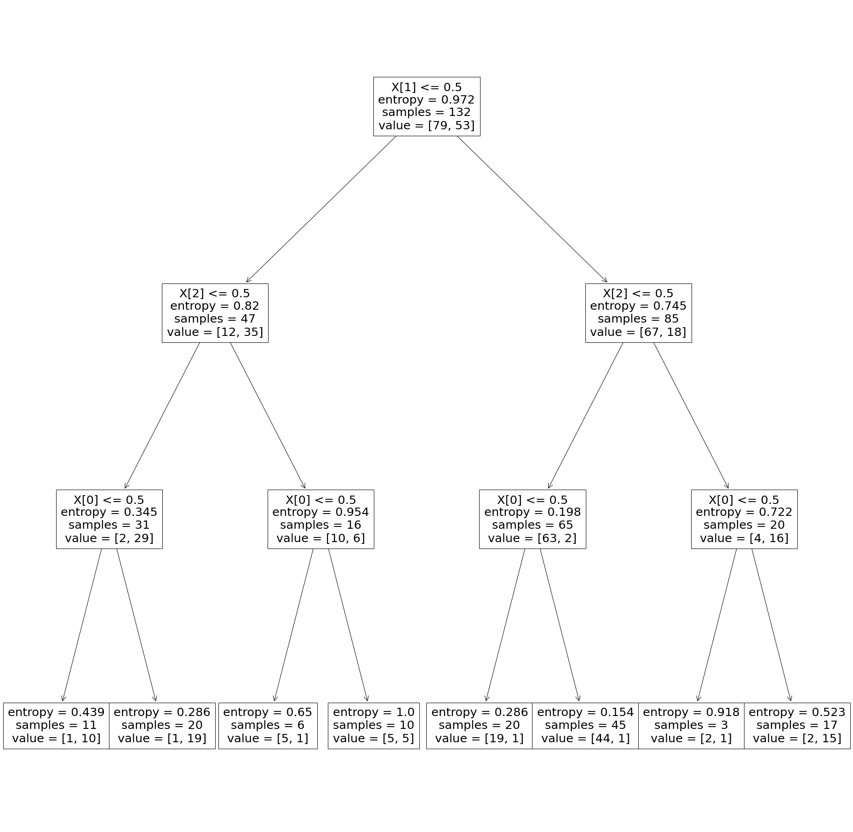

Slide 37
What to study?
Try to generate the same tree as the previous slide by hand.
If you want to make your own, look at how we generated a dataset earlier, and use sklearn.tree.DecisionTreeClassifier
tree = DecisionTreeClassifier(criterion = 'entropy’ ) tree.fit( xs, ys )
Use sklearn.tree.plot_tree( tree ) to visualize it.
(note: if you don’t use criterion = ‘entropy’, it will use a different measure of randomness called “Gini impurity”. We’ll talk about this in a moment)

Slide 38
Questions?

Slide 39
Another criterion for splitting
We’ve been using entropy to determine which feature to select
Entropy works well, but it’s a little awkward to use because it has no upper bound.
Another metric is a bit more regular: Gini Impurity
In fact, Gini impurity is the default metric for trees in SciKit-learn

Slide 40
The Gini coefficient
You may have heard the term “Gini coefficient”
It is named after Italian mathematician Corrado Gini
It is a measure of income or wealth inequality in a country
If a country has a Gini coefficient of 0, it is completely equal (every single person has the same income or wealth)
If a country has a Gini coefficient of 1, it is completely unequal (a single person has all the wealth)
A similar concept exists for the randomness of sets

Slide 41
Gini impurity
Gini impurity is the chance that randomly selecting an element from your set and then randomly classifying it will be wrong.
That is, we:
First, randomly sample an item from a bag (weighted by count)
Then, randomly sample a class from the bag (weighted by count)
Then, check to see if we were right or wrong
The chance that we are wrong for any random element is the Gini impurity

Slide 42
Calculating the Gini impurity
Suppose that this is our bag: { 3 * reptile, 5 * bird, 2 * mammal }
What is the chance of selecting each kind of element?
Reptile: 3/(3+5+2) = 3/10 = 30%
Bird: 50%
Mammal: 20%
Suppose we selected a reptile. What is the chance that it is classified correctly or incorrectly?
30% of classifying it as a reptile
50% + 20% of classifying it as a bird or mammal (which is wrong)

Slide 43
Calculating the Gini impurity (2)
So there is a 30% chance that we pick a reptile, and a 30% chance that we classify it correctly.
Likewise, there is a 50% chance that we pick a bird, and a 50% chance that we classify it correctly.
And there is a 20% chance that we pick a mammal, and a 20% chance that we classify it correctly
(note, when I say “classify it correctly”, I mean that we randomly selected the class that matches the random instance we sampled)

Slide 44
Calculating the Gini impurity (3)
These probabilities are disjoint.
That is, if we sample a reptile, we know it is not a bird.
Therefore, we can add them together to get the chance of picking something and then classifying it correctly: 30% * 30% + 50% * 50% + 20% * 20% = 38%
However, we want the chance of it being classified incorrectly: 1 – 38% = 62%
There you go. A bit easier than entropy.

Slide 45
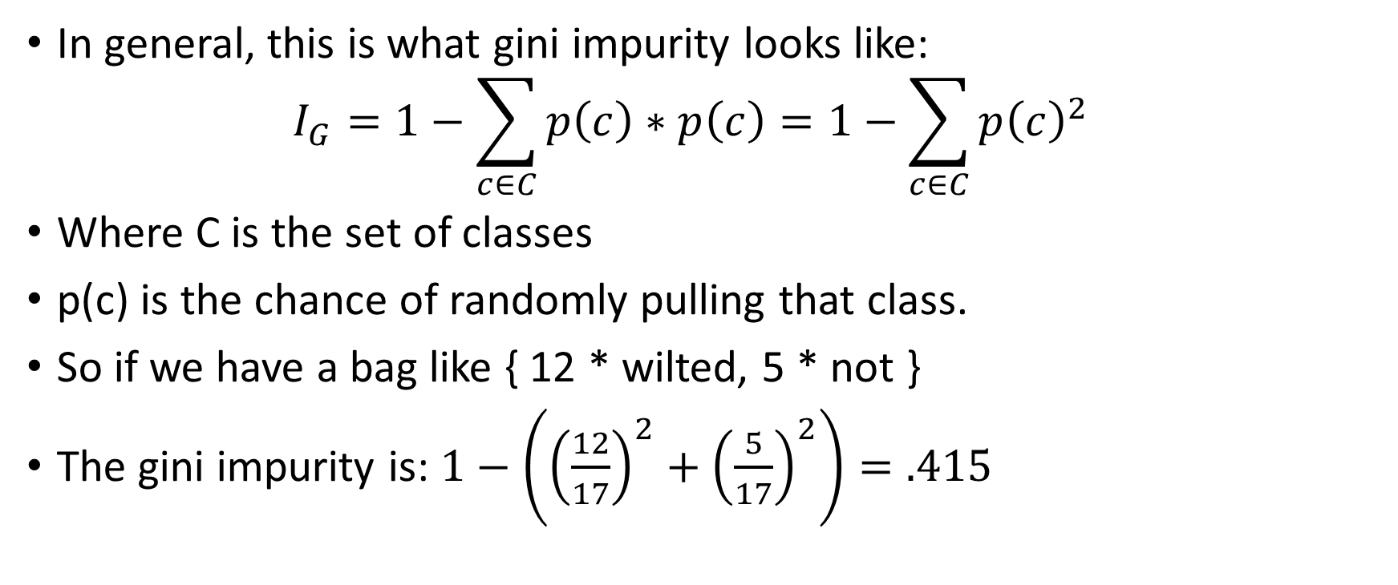
Calculating this in general
In general, this is what gini impurity looks like: $I_{G}=1−\sum_{c∈C}{p\left(c\right)∗p\left(c\right)}=1−\sum_{c∈C}{p{\left(c\right)}^{2}}$
Where C is the set of classes
p(c) is the chance of randomly pulling that class.
So if we have a bag like { 12 * wilted, 5 * not }
The gini impurity is: $1−\left({\left(\frac{12}{17}\right)}^{2}+{\left(\frac{5}{17}\right)}^{2}\right)=.415$

Slide 46
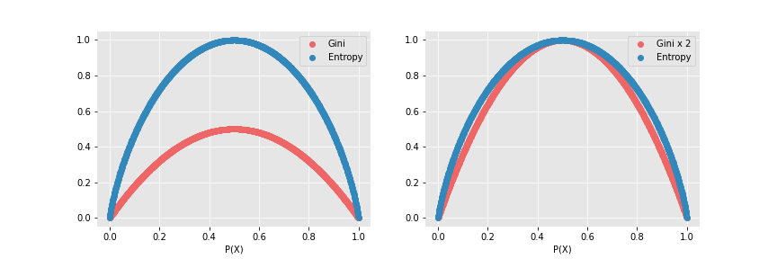
Gini vs. entropy.
The left shows Gini impurity vs. entropy
The right shows them scaled. They perform almost the same.
Sklearn defaults to Gini (due to speed), but I want you to know both.
Image source: https://quantdare.com/decision-trees-gini-vs-entropy/

Slide 47
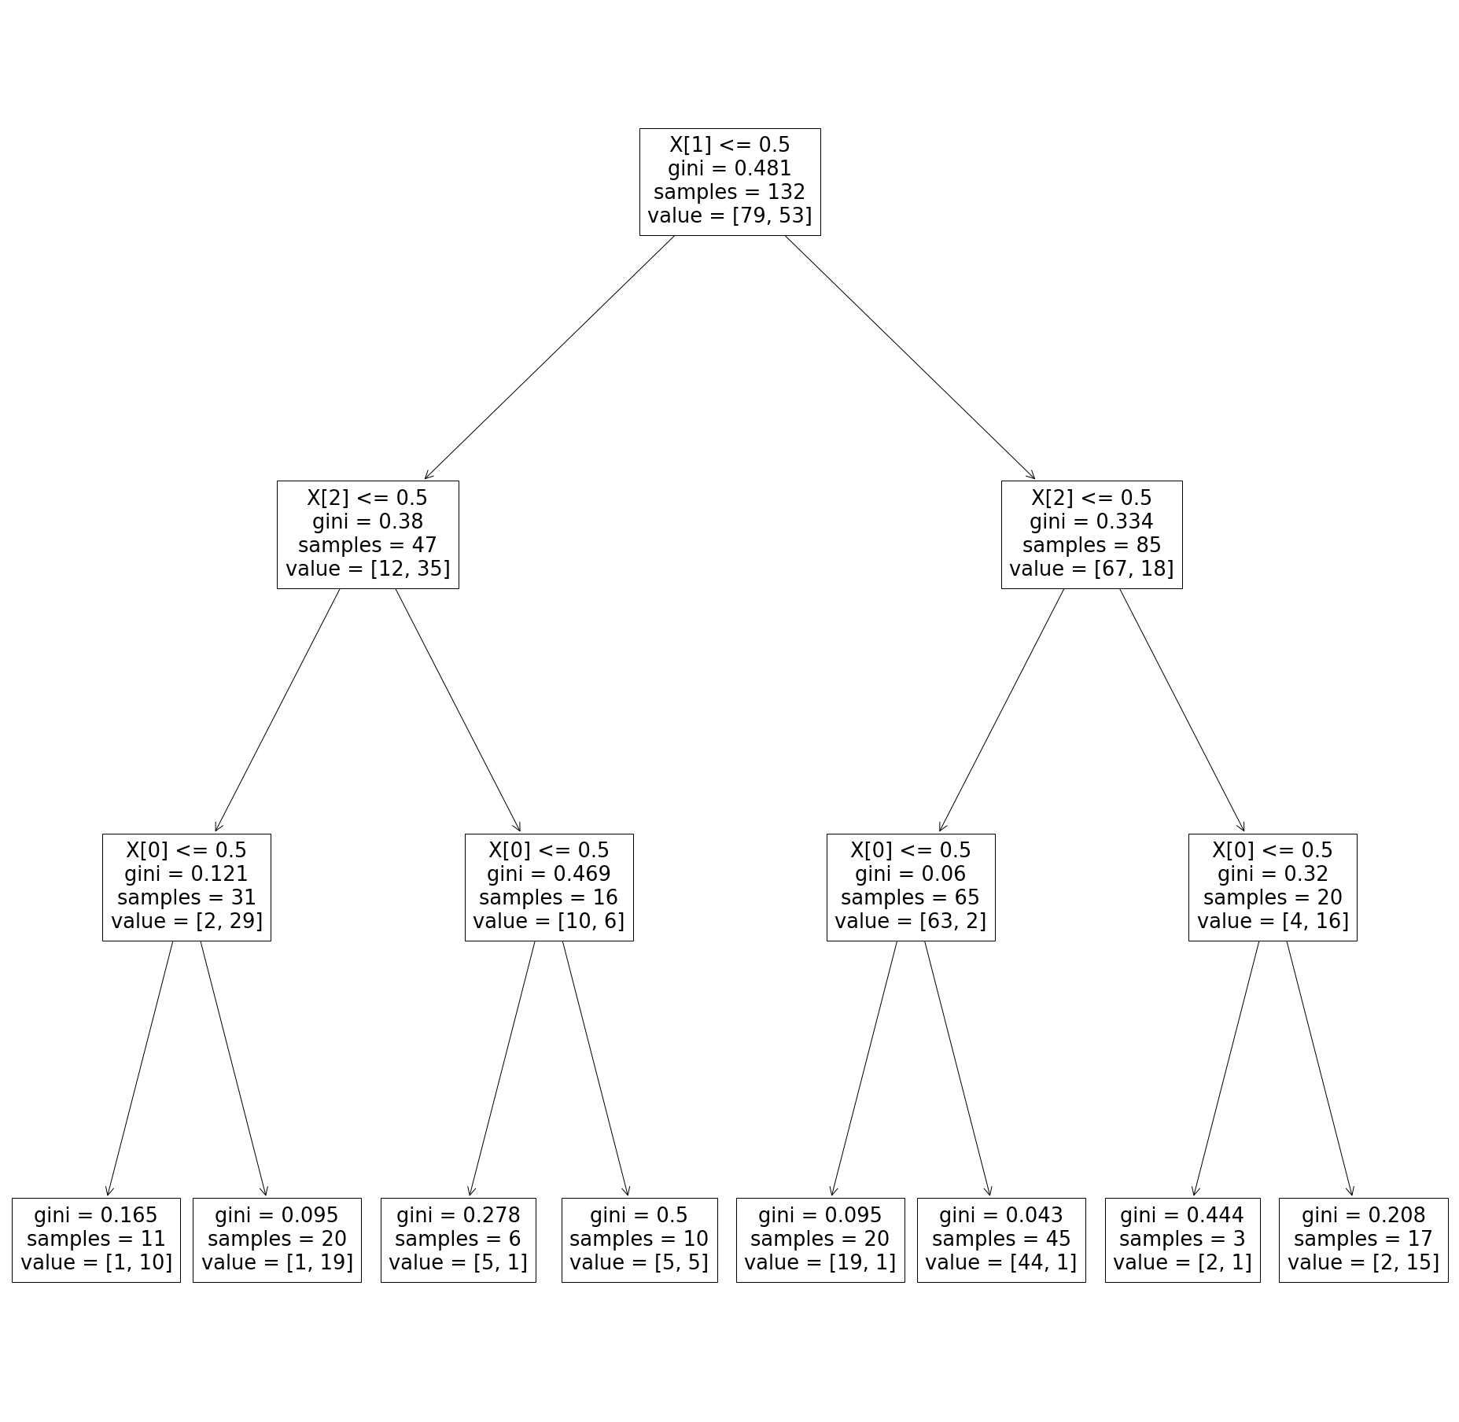

Slide 48
Questions?

Slide 49
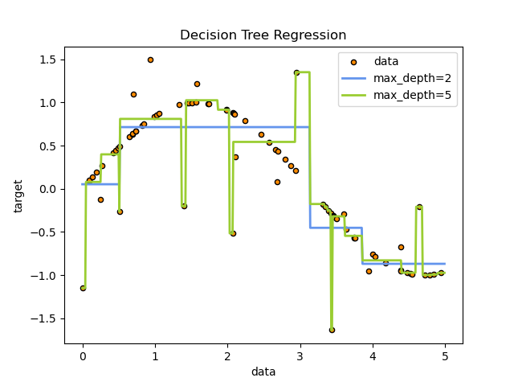
Are trees good?
It’s actually very rare to use trees by themselves
The problem is…they’re too good.
A tree can learn pretty much anything.
Note: the input features don’t have to be Booleans. We can split on numbers too.

Slide 50
The problem of overfitting
We discussed overfitting before, but as a reminder, it happens when the model perfectly learns the training set, but what it learns isn’t really useful.
Another example:
Suppose you are making an AI that looks at pictures of houses and classifies how much they will sell for
You use google street view images that you have labeled to train it.
It just so happens that the street view van was in a lower priced neighborhood early in the morning, and a higher priced neighborhood later on.
The model learns that the color of the pixels along the top of the image predict the price of the house because of the time of day.

Slide 51
What to do about it
There are fundamentally two remedies to overfitting:
Make the dataset bigger
Make the model dumber
The first one is obviously preferred.
However, the simpler the model is, the less it can focus microscopically on one thing.
For example, a tree can learn to predict based on microscopically small features which are hyper specialized for particular instances.
Given that we can’t always afford to make the dataset bigger, let’s talk about making the model dumber.

Slide 52
Making it dumber
I know it’s surprising that we want to make our model dumber, but if you had to do it, what would you change about the decision tree to do that?
[class?]

Slide 53
Making it dumber
The easiest way to make a decision tree dumber is to cut off levels.
Technically, without any branches at all, the tree just predicts according to the odds ratio.
If we add a level, we get more accuracy, but also more specific.
There might be a level where it maxes out.
How would we find that level? [class]

Slide 54
GridSearchCV
Let’s get optimizing
First, we make our estimator: tree = DecisionTreeClassifier( criterion = 'entropy’ )
Then we make our hyper-parameter grid: grid = { 'max_depth': range(1, 10), #this is the parameter we want }
Create the grid search CV object: search = GridSearchCV( tree, grid, cv = 10 )
It will use 5 fold cross validation by default, which is fine, but I wanted to use 10 fold, so we add the cv = 10 parameter.

Slide 55
GridSearchCV (2)
Now that we have our grid search set up to find the best “max_depth”.
Perform the fit: search.fit( plants_x, plants_y )
Drumroll…….. search.best_params_
…..2
It was 2 for me.
We have 3 features, so, it makes some sense. Still, there’s a problem here.

Slide 56
No granularity
We can add or remove depth to and from the tree, but we can only go one layer at a time
There’s no way to simplify the tree without hacking off an entire branch.
This makes the structure hard to optimize. It’s too granular.
There are other optimization parameters, such as the minimum size for a split, but that is unlikely to help here.

Slide 57
Questions?

Slide 58
Ensembles
A common question I used to get is “is there some way we can combine multiple machine learning models to make a better model?”
The answer is yes. This is called an ensemble model.
(pronounced in English as “on-somble” from the musical ensemble, which is when musicians play a piece together)

Slide 59
Ensembles (2)
You might think that more classifiers are always better, but this isn’t the case.
For example, two different linear regression classifiers will typically end up being correlated to each other and will generally predict the same things
So we want an ensemble of very different classifiers, that tend to make different kinds of errors that will balance out to the correct answer wisdom-of-crowds-style.
[wisdom of crowds] https://en.wikipedia.org/wiki/The_Wisdom_of_Crowds

Slide 60
Random forests
One of the most popular kind of ensemble is the random forest.
The idea is to have a bunch of small trees that vote on the classification.
We end up averaging the votes together
Next class we’ll see how they are created, but for now, note that the process has a degree of randomness to it, so the trees don’t always agree with each other.
Let’s see an example.

Slide 61
Random forest example
Suppose we have this instance: <scaly, four legs, cold blooded>
We apply these three trees separately:
scaly [30, 70]
4-legs [50, 50]
cold blood [10, 90]
15% !reptile
85% reptile
55% !reptile
45% reptile
5% !reptile
95% reptile

Slide 62
Random forest example (2)
The instance we passed to the three trees takes the right path for all three. Therefore, we get the following:
85% reptile
45% reptile
95% reptile
The actual classification is the average of these: ( .85 + .45 + .95 ) / 3 = 75%

Slide 63
Why do this?
Before, we could only simplify our tree by cutting its height
But now, we can add back lots of trees to partially make up for that
That means we have more fine-grained control over overtraining.
How do we use this?

Slide 64
sklearn.ensemble
from sklearn.ensemble import RandomForestClassifier
We can use RandomForestClassifier the exact same as how we use DecisionTreeClassifier.
The only difference is that we have a few more parameters: forest = RandomForestClassifier( max_depth = 2, n_estimators = 50 );
See the parameters here: https://scikit-learn.org/stable/modules/generated/sklearn.ensemble.RandomForestClassifier.html

Slide 65
Assignment and next time
We will learn more about forests next class, but for now, you know enough to start on the assignment.
Let’s take a look.

