Slide 1
LC3 Instructions & Data Path &controller
JIANG Xiaohong
jiangxh@zju.edu.cn

Slide 2
Instruction Processing: FETCH
F
Load next instruction (at address stored in PC) from memory into Instruction Register (IR).
Copy contents of PC into MAR. MAR←PC
Send “read” signal to memory. MDR←MEM[MAR]
Copy contents of MDR into IR. IR ←MDR
Then increment PC, so that it points to the next instruction in sequence.
PC becomes PC+1. PC ←PC+1
D
EA
OP
EX
S

Slide 3
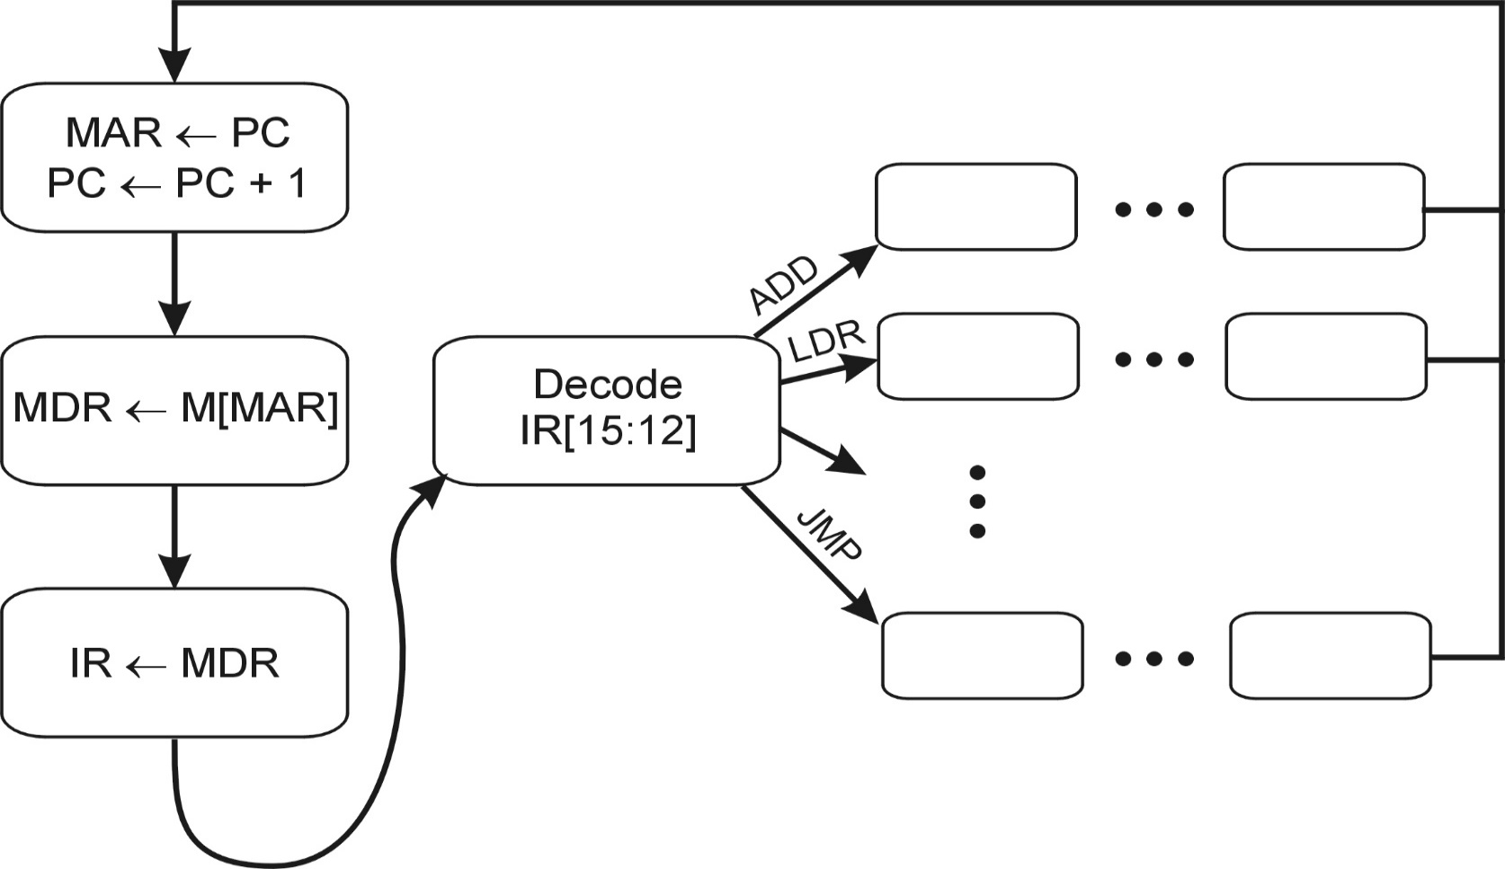
Control Unit State Diagram
The control unit is a state machine. Here is part of a simplified state diagram for the LC-3:
A more complete state diagram is in Appendix C.
It will be more understandable after Chapter 5.

Slide 4
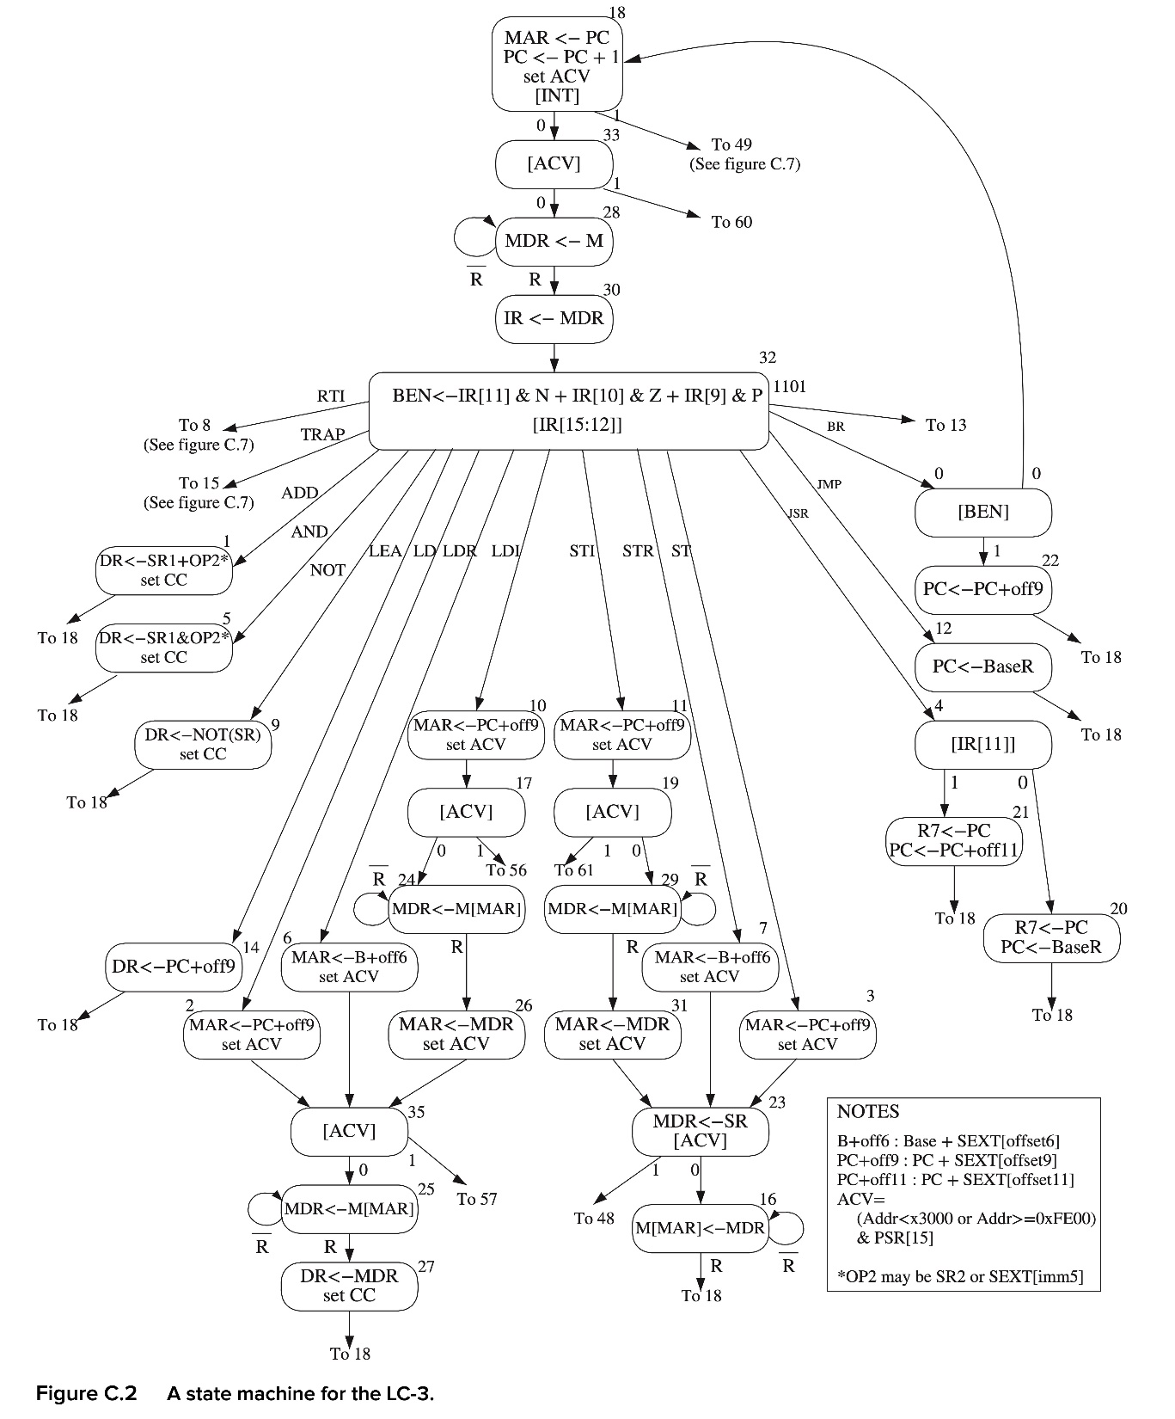
P702

Slide 5
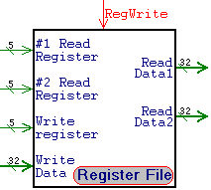
LD.PC
opcode
nextPC
PC
IR[5]
IR[10..9]
Controller
Combinational
logic
IR
Ready
datapath
Combinational
logic
6
nextstate
6
state
state
nextstate
state’
CLK
nextPC
PC’
LD.PC

Slide 6
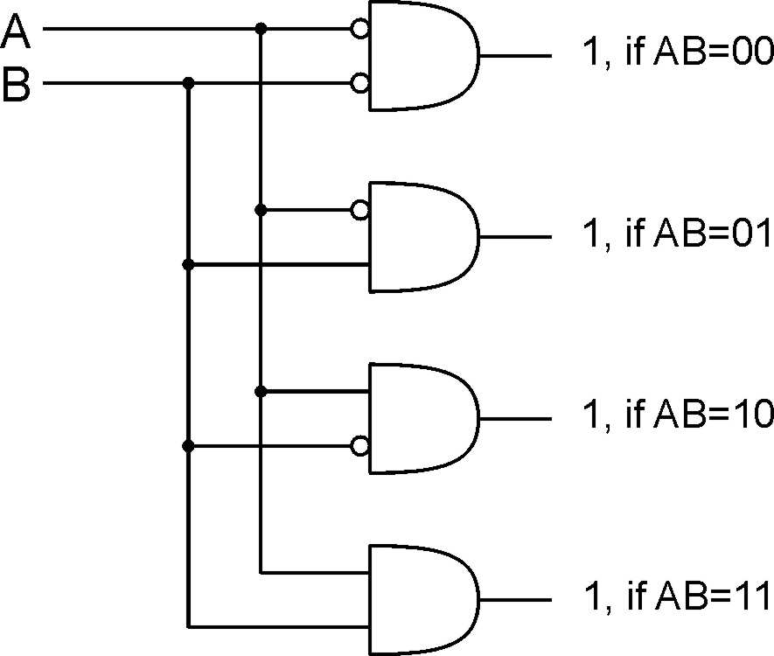
Decoder
n inputs, 2^{n} outputs
exactly one output is 1 for each possible input pattern
2-bit
decoder
Notes:
Uses of decoder:
convert memory/register address to a control line that selects that location
convert an opcode to one of n control lines

Slide 7
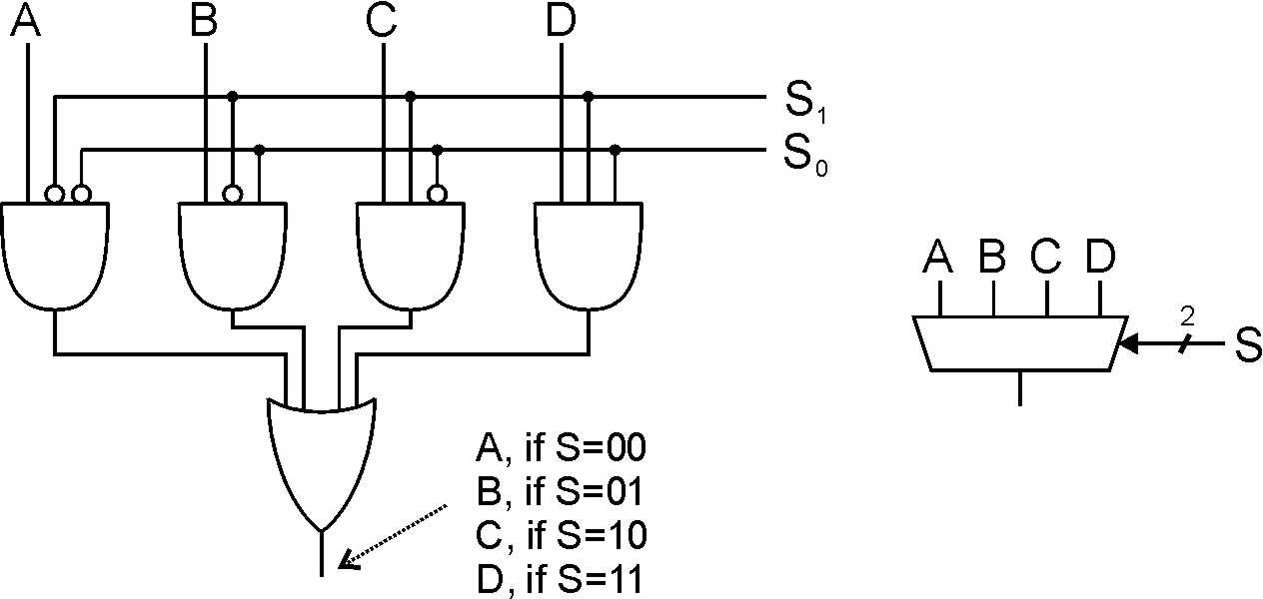
Multiplexer (MUX)
n-bit selector and 2^{n} inputs, one output
output equals one of the inputs, depending on selector
4-to-1 MUX
Notes:
Another view: decode S, and AND each output with one of the MUX inputs.
Also explain multi-bit inputs.
Uses of multiplexer:
select which input to use for function
select which computed value to pass to next stage (or to place on bus)

Slide 8
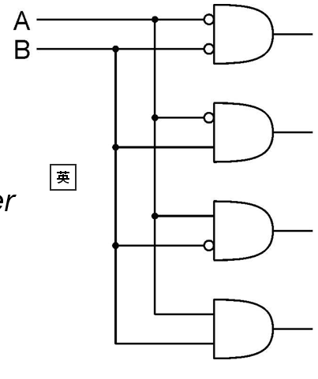

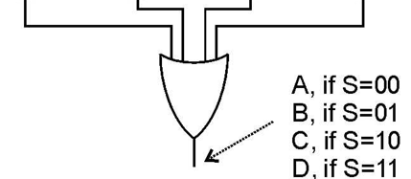
1/4Mux (multiplex)
S0
S1
A
B
C
D

Slide 9
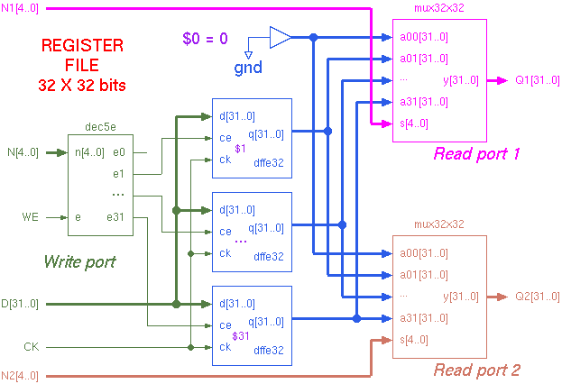
Register File
2
8X16
15
15
8 X 16
15
15
07
15
15
2
3E
15
2
2
7
15
15
8X16
15
15
15
15
15
15
15
07
15
7
2
2

Slide 10
DR
3
DataIn
REG
FILE
Q2 Q1
MUX
LD.PC
PC
LD.Reg
16
3
SR2
SR1
3
+
+1
MUX
B A
ALU
2
MAR
LD.MAR
ALUK
LD.IR
DataIn Addr
Memory
Dataout
IR
Ready
R/W
N | Z | P
16
En
LOGIC

Slide 11
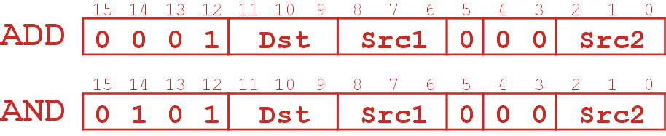
LC3 Instructions
NOT R2, R1
ADD R3, R1, R2
AND R3, R1, R2
1
imm5
ADD R3, R1, #4
1
imm5
AND R3, R1, #4

Slide 12
Instruction fetch
Gpc
LD.PC
PC
+1
16
LD.IR
IR
GMDR
LD.MAR
MAR
MDR
LD.MDR
DataIn Addr
Memory
Dataout
Ready
R/W
16
En

Slide 13
Truth table for Control signals
 |  | Gpc | LD.MAR | LD.PC | R/W | En | LD.MDR | G.MDR | LD.IR | GALU | ALUK | LD.Reg | Sel.B | GmARMUX | SR1MUX | MDRMUx
Instr. Fetch | S18 | 1 | 1 | 1 |  |  |  |  |  |  |  |  |  |  | 0 | 0
 | S28 |  |  |  | 0 | 1 | 1 |  |  |  |  |  |  |  | 0 | 0
 | S30 |  |  |  |  |  |  | 1 | 1 |  |  |  |  |  | 0 | 0
Decode | S32 |  |  |  |  |  |  |  |  |  |  |  |  |  | 0 | 0

Slide 14
NOT
ADD/AND R
Gpc
DR
3
DataIn
REG FILE
Q2 Q1
LD.Reg
LD.PC
PC
+1
SR2
3
SR1
3
16
Sel.B
Controller
B A
ALU
2
ALUK
LD.IR
IR
G.ALU
GMDR
LD.MAR
MAR
MDR
LD.MDR
DataIn Addr
Memory
Dataout
Ready
R/W
16
En

Slide 15
Truth table for Control signals
 |  | Gpc | LD.MAR | LD.PC | R/W | En | LD.MDR | G.MDR | LD.IR | GALU | ALUK | LD.Reg | Sel.B | GmARMUX | SR1MUX | MDRMUx
Instr. Fetch | S18 | 1 | 1 | 1 |  |  |  |  |  |  |  |  |  |  | 0 | 0
 | S33 |  |  |  | 0 | 1 | 1 |  |  |  |  |  |  |  | 0 | 0
 | S35 |  |  |  |  |  |  | 1 | 1 |  |  |  |  |  | 0 | 0
Decode | S32 |  |  |  |  |  |  |  |  |  |  |  |  |  | 0 | 0
NOT | S9 |  |  |  |  |  |  |  |  | 1 | NOT | 1 |  |  | 0 | 0
+/*R | S1 |  |  |  |  |  |  |  |  | 1 | +/* | 1 |  |  | 0 | 0

Slide 16
NOT
ADD/AND R
ADD/AND Imm
Gpc
DR
3
DataIn
REG FILE
Q2 Q1
LD.Reg
LD.PC
PC
+1
SR2
3
SR1
3
16
EXT5
Sel.B
1 MUX 0
Controller
B A
ALU
2
ALUK
LD.IR
IR
G.ALU
GMDR
LD.MAR
MAR
MDR
LD.MDR
DataIn Addr
Memory
Dataout
Ready
R/W
16
En

Slide 17
Truth table for Control signals
 |  | Gpc | LD.MAR | LD.PC | R/W | En | LD.MDR | G.MDR | LD.IR | GALU | ALUK | LD.Reg | Sel.B | GmARMUX | SR1MUX | MDRMUx
Instr. Fetch | S18 | 1 | 1 | 1 |  |  |  |  |  |  |  |  |  |  | 0 | 0
 | S33 |  |  |  | 0 | 1 | 1 |  |  |  |  |  |  |  | 0 | 0
 | S35 |  |  |  |  |  |  | 1 | 1 |  |  |  |  |  | 0 | 0
Decode | S32 |  |  |  |  |  |  |  |  |  |  |  |  |  | 0 | 0
NOT | S9 |  |  |  |  |  |  |  |  | 1 | NOT | 1 |  |  | 0 | 0
+/*R | S1 |  |  |  |  |  |  |  |  | 1 | +/* | 1 |  |  | 0 | 0
+/* i | S5 |  |  |  |  |  |  |  |  | 1 | +/* | 1 | 1 |  | 0 | 0

Slide 18
NOT
ADD/AND R
ADD/AND Imm
Gpc
DR
3
DataIn
REG FILE
Q2 Q1
LD.Reg
LD.PC
PC
+1
SR2
3
SR1
3
16
EXT
Sel.B
1 MUX 0
Controller
B A
ALU
2
ALUK
LD.IR
IR
G.ALU
GMDR
LD.MAR
MAR
MDR
LD.MDR
DataIn Addr
Memory
Dataout
Ready
R/W
16
En

Slide 19
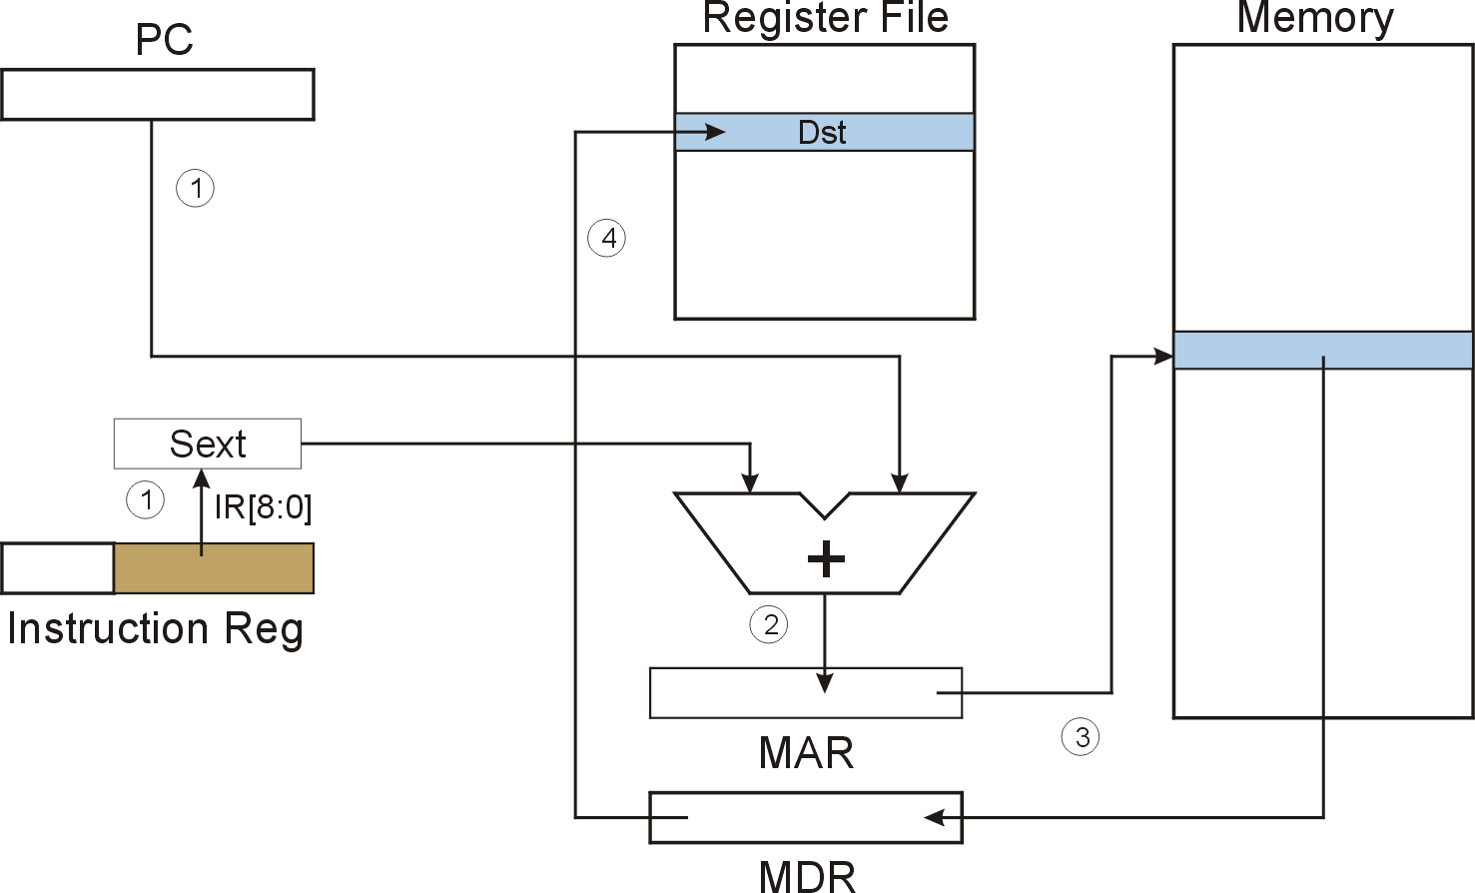
LD (PC-Relative)
LD R1, PCoffset ; Rd <- Memory[ PC + Pcoffset]

Slide 20
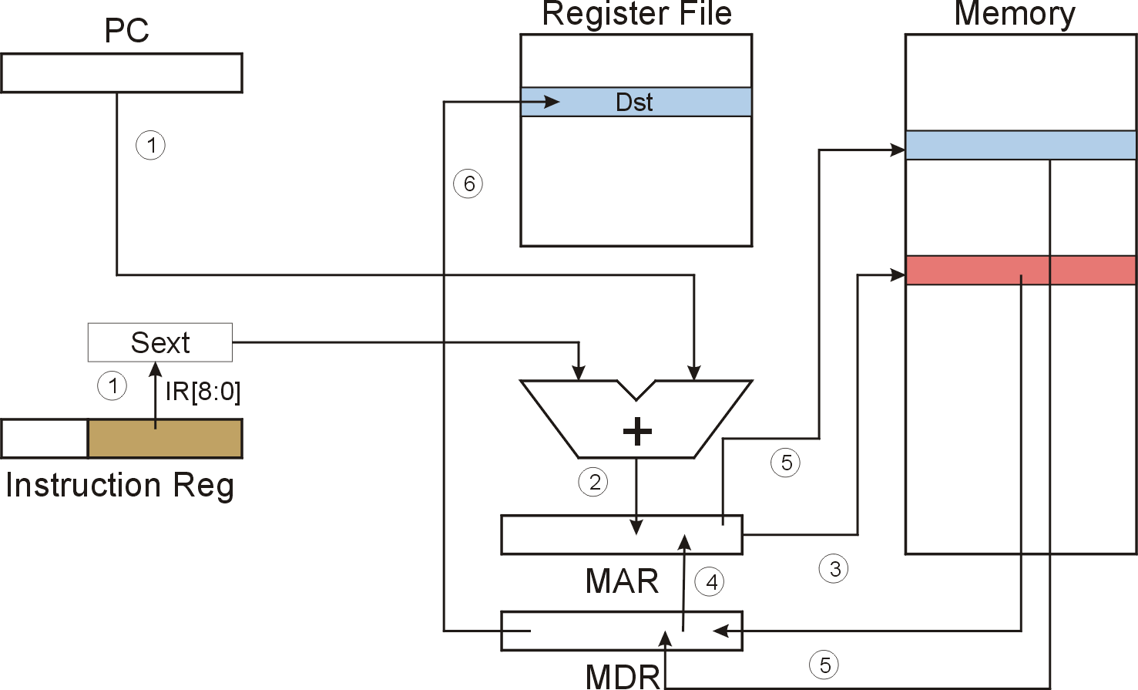
LDI (Indirect)

Slide 21
LD/LDI
GMARmux
Gpc
IR[11..9]
DR
3
DataIn
REG FILE
Q2 Q1
LD.PC
PC
+1
LD.Reg
16
3
+
SR2
SR1
3
IR[2..0]
IR[8..6]
9EXT
Sel.B
1 MUX 0
5EXT
B A
ALU
Controller
2
ALUK
LD.IR
IR
G.ALU
GMDR
LD.MAR
MAR
MDR
LD.MDR
DataIn Addr
Memory
Dataout
Ready
R/W
16
En

Slide 22
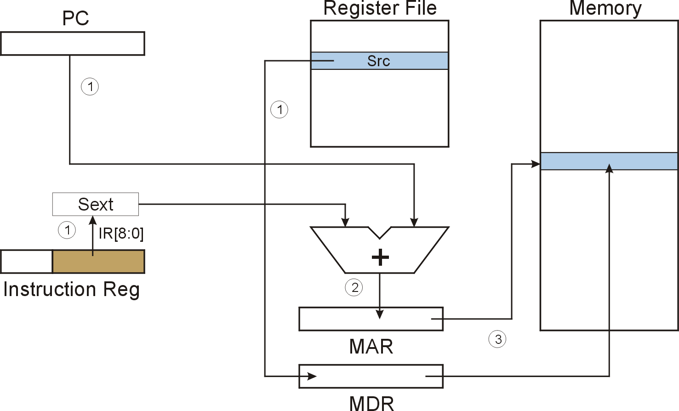
ST (PC-Relative)
ST R1, PCoffset ; Memory[ PC + Pcoffset] <- R1

Slide 23
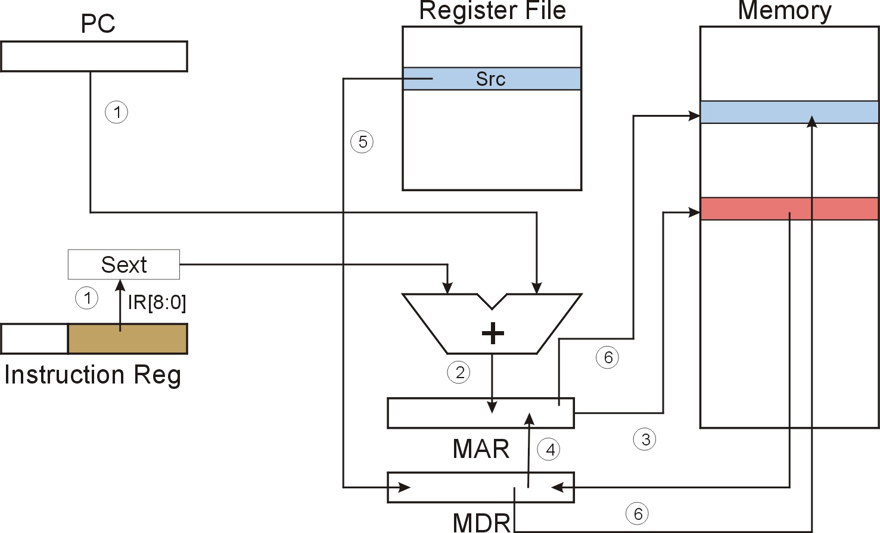
STI (Indirect)

Slide 24
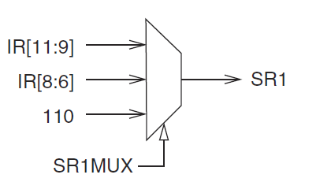
LD/LDI
GMARmux
Gpc
IR[11..9]
DR
3
DataIn
REG FILE
Q2 Q1
LD.PC
PC
+1
LD.Reg
16
+
SR2
3
SR1
3
IR[2..0]
IR[8..6]
9EXT
Sel.B
1 MUX 0
5EXT
B A
ALU
Controller
2
ALUK
LD.IR
IR
G.ALU
GMDR
LD.MAR
MAR
MDR
LD.MDR
1
0
2
MDRMUX
DataIn Addr
Memory
Dataout
1 MUX 0
Ready
R/W
16
En
ALU: NOT, ADD, AND, passthrouth

Slide 25
LD/LDI
ST/STI
GMARmux
Gpc
IR[11..9]
DR
3
DataIn
REG FILE
Q2 Q1
LD.PC
PC
+1
LD.Reg
16
+
SR2
3
SR1
3
IR[11..9]
9EXT
Sel.B
1 MUX 0
5EXT
B A
ALU
Controller
2
ALUK
LD.IR
IR
G.ALU
GMDR
LD.MAR
MAR
MDR
LD.MDR
1
0
2
MDRMUX
DataIn Addr
Memory
Dataout
1 MUX 0
Ready
R/W
16
En
ALU: NOT, ADD, AND, passthrouth

Slide 26
Truth table for Control signals
 |  | Gpc | LD.MAR | LD.PC | R/W | En | LD.MDR | G.MDR | LD.IR | GALU | ALUK | LD.Reg | Sel.B | GmARMUX | SR1MUX | MDRMUx
Instr. Fetch | S18 | 1 | 1 | 1 |  |  |  |  |  |  |  |  |  |  | 0 | 0
 | S33 |  |  |  | 0 | 1 | 1 |  |  |  |  |  |  |  | 0 | 0
 | S35 |  |  |  |  |  |  | 1 | 1 |  |  |  |  |  | 0 | 0
Decode | S32 |  |  |  |  |  |  |  |  |  |  |  |  |  | 0 | 0
NOT | S9 |  |  |  |  |  |  |  |  | 1 | NOT | 1 |  |  | 0 | 0
+/*R | S1 |  |  |  |  |  |  |  |  | 1 | +/* | 1 |  |  | 0 | 0
+/* i | S5 |  |  |  |  |  |  |  |  | 1 | +/* | 1 | 1 |  | 0 | 0
LD/LDI/ST/STI | S2/S3/ S10/s11 |  | 1 |  |  |  |  |  |  |  |  |  |  | 1 | 0 | 0
LD /LDR /LDI | S25 |  |  |  | 0 | 1 | 1 |  |  |  |  |  |  |  | 0 | 0
 | S27 |  |  |  |  |  |  | 1 |  |  |  | 1 |  |  | 0 | 0
ST /STR /STI | S23 |  |  |  |  |  |  | 1 |  | 1 | ps |  |  |  | 1 | 1
 | S16 |  |  |  | 1 | 1
LDI/STI | S26/S31 |  | 1 |  |  |  |  | 1

Slide 27
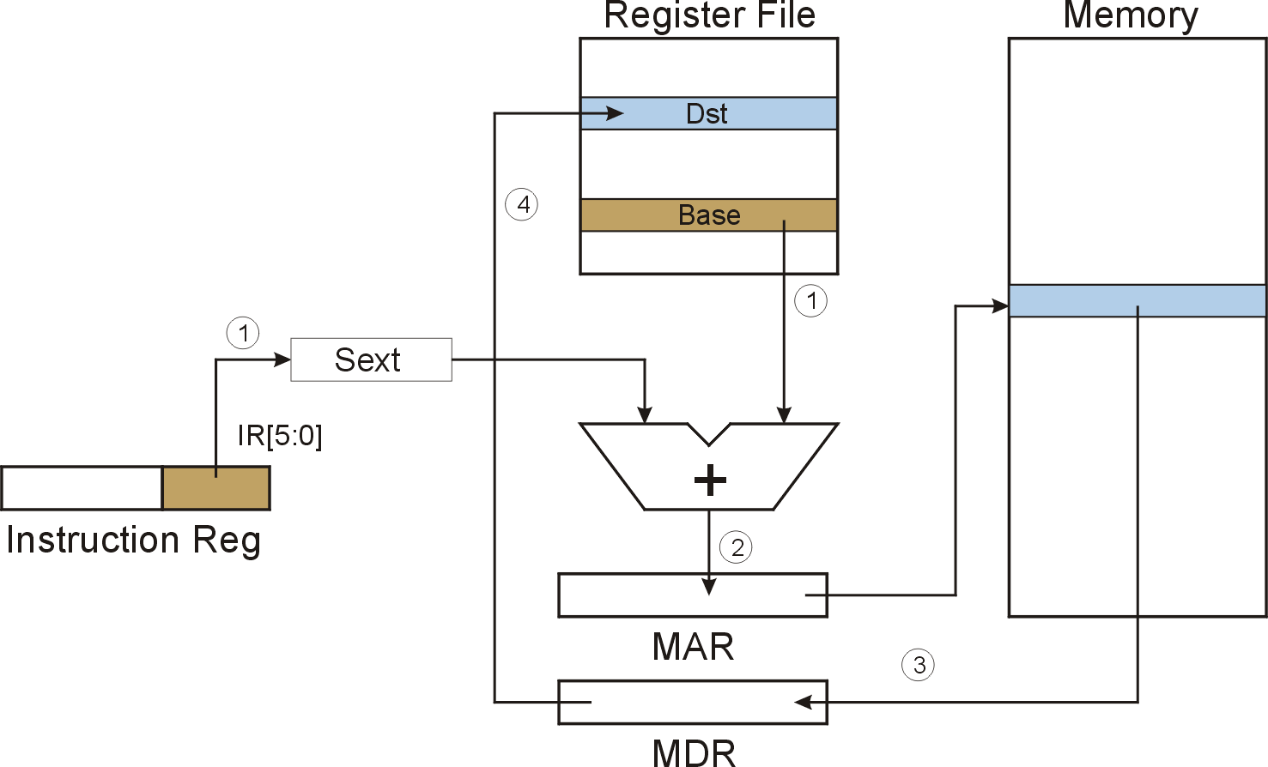
LDR (Base+Offset)

Slide 28

STR (Base+Offset)

Slide 29
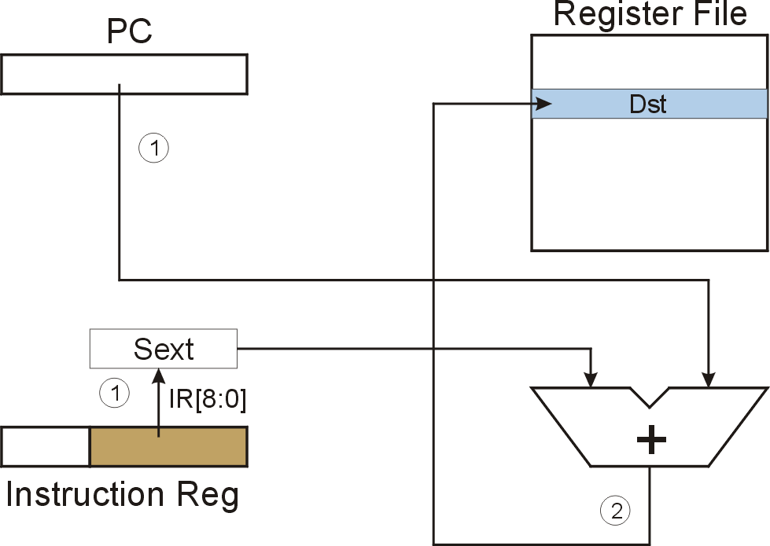
LEA (Immediate)

Slide 30
LDR
STR
LEA
GMARmux
Gpc
IR[11..9]
DR
3
DataIn
REG FILE
Q2 Q1
LD.PC
PC
+1
LD.Reg
+
16
+2MUX
+1MUX
SR2
3
SR1
3
1MUX0
0MUX1
IR[2..0]
IR[8..6]
6EXT
9EXT
Sel.B
1 MUX 0
5EXT
B A
ALU
Controller
2
ALUK
LD.IR
IR
G.ALU
GMDR
LD.MAR
MAR
MDR
LD.MDR
1
0
2
MDRMUX
DataIn Addr
Memory
Dataout
1 MUX 0
Ready
R/W
16
En
ALU: NOT, ADD, AND, passthrouth

Slide 31
Truth table for Control signals
 |  | Gpc | LD.MAR | LD.PC | R/W | En | LD.MDR | G.MDR | LD.IR | GALU | ALUK | LD.Reg | Sel.B | GmARMUX | SR1MUX | MDRMUx | +1MUX | +2MUX
Instr. Fetch | S18 | 1 | 1 | 1 |  |  |  |  |  |  |  |  |  |  | 0 | 0
 | S33 |  |  |  | 0 | 1 | 1 |  |  |  |  |  |  |  | 0 | 0
 | S35 |  |  |  |  |  |  | 1 | 1 |  |  |  |  |  | 0 | 0
Decode | S32 |  |  |  |  |  |  |  |  |  |  |  |  |  | 0 | 0
NOT | S9 |  |  |  |  |  |  |  |  | 1 | NOT | 1 |  |  | 0 | 0
+/*R | S1 |  |  |  |  |  |  |  |  | 1 | +/* | 1 |  |  | 0 | 0
+/* i | S5 |  |  |  |  |  |  |  |  | 1 | +/* | 1 | 1 |  | 0 | 0
LD/LDI /ST/STI | S2/S3/ S10/s11 |  | 1 |  |  |  |  |  |  |  |  |  |  | 1 | 0 | 0
LD /LDR /LDI | S25 |  |  |  | 0 | 1 | 1 |  |  |  |  |  |  |  | 0 | 0
 | S27 |  |  |  |  |  |  | 1 |  |  |  | 1 |  |  | 0 | 0
ST /STR /STI | S23 |  |  |  |  |  |  | 1 |  | 1 |  |  |  |  | 1 | 1
 | S16 |  |  |  | 1 | 1
LDI/STI | S26/S31 |  | 1 |  |  |  |  | 1
LDR/STR | S6/s7 |  | 1 |  |  |  |  |  |  |  |  |  |  | 1 | 0 |  | 1 | 1
LEA | S14 |  |  |  |  |  |  |  |  |  |  | 1 |  | 1 |  |  | 0 | 0

Slide 32
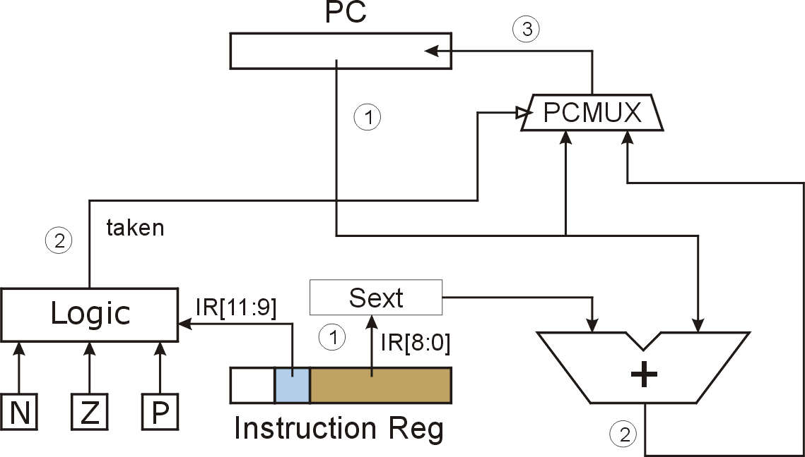
BRn PCoffset ;if(CC == n) PC <- PC + PCoffset
Taken = (N*n + Z*z + P*p)* BR
N = bus[15]
P = not bus[15]
Z = or (bus[15]..bus[0])
What happens if bits [11:9] are all zero? All one?
Notes:
If all zero, no CC is tested, so branch is never taken. (See Appendix B.)
If all one, then all are tested. Since at least one of the CC bits is set to one after each operate/load instruction, then branch is always taken. (Assumes some instruction has set CC before branch instruction, otherwise undefined.)

Slide 33
BR
GMARmux
Gpc
DR
3
DataIn
REG FILE
Q2 Q1
wpc
PC
+1
LD.Reg
+
16
Pcmux
3
1MUX0
+2MUX
0MUX1
+1MUX
2 1 0
SR2
SR1
3
IR[8..6]
6EXT
9EXT
Sel.B
1 MUX 0
TAKEN
5EXT
B A
ALU
Controller
2
ALUK
N | Z | P
WPC = LD.PC+ TAKEN
LD.IR
IR
G.ALU
LOGIC
GMDR
LD.MAR
MAR
MDR
LD.MDR
1
0
2
MDRMUX
DataIn Addr
Memory
Dataout
1 MUX 0
Ready
R/W
16
En
ALU: NOT, ADD, AND, passthrouth

Slide 34
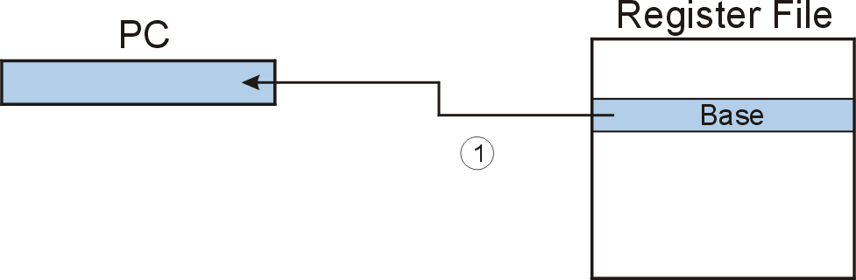
JMP (Register)
Jump is an unconditional branch -- always taken.
Target address is the contents of a register.
Allows any target address.

Slide 35
BR
JMP
GMARmux
Gpc
DR
3
DataIn
REG FILE
Q2 Q1
wpc
PC
+1
LD.Reg
+
16
Pcmux
3
1MUX0
+2MUX
0MUX1
+1MUX
2 1 0
SR2
SR1
3
IR[8..6]
6EXT
9EXT
Sel.B
1 MUX 0
TAKEN
5EXT
B A
ALU
Controller
2
ALUK
N | Z | P
WPC = LD.PC+ TAKEN
LD.IR
IR
G.ALU
LOGIC
GMDR
LD.MAR
MAR
MDR
LD.MDR
1
0
2
MDRMUX
DataIn Addr
Memory
Dataout
1 MUX 0
Ready
R/W
16
En
ALU: NOT, ADD, AND, passthrouth

Slide 36
Truth table for Control signals
 |  | Gpc | LD.MAR | LD.PC | DRMUX | R/W | En | LD.MDR | G.MDR | LD.IR | GALU | ALUK | LD.Reg | Sel.B | GmARMUX | SR1MUX | MDRMUx | +1MUX | +2MUX | pcMuX | MARMuX
Instr. Fetch | S18 | 1 | 1 | 1 |  |  |  |  |  |  |  |  |  |  |  | 0 | 0
 | S33 |  |  |  |  | 0 | 1 | 1 |  |  |  |  |  |  |  | 0 | 0
 | S35 |  |  |  |  |  |  |  | 1 | 1 |  |  |  |  |  | 0 | 0
Decode | S32 |  |  |  |  |  |  |  |  |  |  |  |  |  |  | 0 | 0
NOT | S9 |  |  |  |  |  |  |  |  |  | 1 | NOT | 1 |  |  | 0 | 0
+/*R | S1 |  |  |  |  |  |  |  |  |  | 1 | +/* | 1 |  |  | 0 | 0
+/* i | S5 |  |  |  |  |  |  |  |  |  | 1 | +/* | 1 | 1 |  | 0 | 0
BR | S22 |  |  | 0 |  |  |  |  |  |  |  |  |  |  | 1 | 0 |  | 0 | 0 | 1 | 0
JMP | s12 |  |  | 1 |  |  |  |  |  |  | 1 | pass |  |  |  | 0 |  |  |  | 2 | 2
Trap | S15 |  | 1 |  |  |  |  |  |  |  |  |  |  |  | 1 |  |  |  |  |  | 1
 | S28 | 1 |  |  | 2 | 1 | 1 | 1 |  |  |  |  | 1 |  |  |  | 0
 | S30

Slide 37
CH5 LC-3
JSR PCoffset11 ;R7 <- PC, PC <- PC + PCoffset
JSR R_{base} ; R7 <- PC, PC <- R_{base}

Slide 38
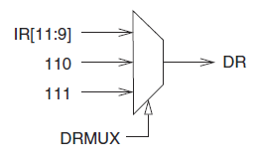
JSR
JSRR
GMARmux
Gpc
R7:111
3
DR
DataIn
REG FILE
Q2 Q1
wpc
PC
+1
LD.Reg
+
16
Pcmux
3
0
3 2 1 0
+2MUX
+1MUX
2 1 0
SR2
SR1
3
0MUX1
IR[8..6]
11 EXT
6EXT
Sel.B
1 MUX 0
9EXT
TAKEN
5EXT
B A
ALU
Controller
2
ALUK
N | Z | P
WPC = LD.PC+ TAKEN
LD.IR
IR
G.ALU
LOGIC
GMDR
LD.MAR
MAR
MDR
LD.MDR
0
1
2
1
0
2
MDRMUX
DataIn Addr
Memory
Dataout
1 MUX 0
Ready
R/W
16
En
ALU: NOT, ADD, AND, passthrouth

Slide 39
Truth table for Control signals
 |  | Gpc | LD.MAR | LD.PC | DRMUX | R/W | En | LD.MDR | G.MDR | LD.IR | GALU | ALUK | LD.Reg | Sel.B | GmARMUX | SR1MUX | MDRMUx | +1MUX | +2MUX | pcMuX | MARMuX
Instr. Fetch | S18 | 1 | 1 | 1 |  |  |  |  |  |  |  |  |  |  |  | 0 | 0
 | S33 |  |  |  |  | 0 | 1 | 1 |  |  |  |  |  |  |  | 0 | 0
 | S35 |  |  |  |  |  |  |  | 1 | 1 |  |  |  |  |  | 0 | 0
Decode | S32 |  |  |  |  |  |  |  |  |  |  |  |  |  |  | 0 | 0
NOT | S9 |  |  |  |  |  |  |  |  |  | 1 | NOT | 1 |  |  | 0 | 0
+/*r | S1 |  |  |  |  |  |  |  |  |  | 1 | +/* | 1 |  |  | 0 | 0
+/* i | S5 |  |  |  |  |  |  |  |  |  | 1 | +/* | 1 | 5ext |  | 0 | 0
BR | S22 |  |  | 0 |  |  |  |  |  |  |  |  | 1 |  | 1 | 0 |  | 0 | 0 | 1 | 1
JMP | s12 |  |  | 1 |  |  |  |  |  |  | 1 | pass |  |  |  | 0 |  |  |  | 2
Trap | S15 |  |  | 1 |  |  |  | 1 |  |  |  |  |  |  |  |  |  |  |  | 0
 | S37 |  | 1 |  | 2 |  |  |  |  |  | 1 | + | 1 | -1 |  | 2
 | 54 |  | 1 |  |  |  |  |  |  |  |  |  |  |  |  |  |  |  |  |  | 1
JSR | S21 | 1 |  | 1 | 2 |  |  |  |  |  |  |  | 1 |  |  |  |  | 0 | 2 | 1
JSRR | S20 | 1 |  | 1 | 2 |  |  |  |  |  | 1 | pass | 1 |  |  | 0 |  |  |  | 2
NOTE: DRmux, Wpc, LD.PSR are not in the table. You can add for your self.

Slide 40
1) If PSR[15] =1 Switch user stack to System stack
Saved_USP←SP; SP← saved_SSP; SP(R6)
2) Push PSR, Push PC+1
3) PSR[15] ← 0
4) PC← MEM[ 0x00yy]
Calls a service routine, identified by 8-bit “trap vector.”
Use RTI to back When routine is done,
vector | routine
x23 | input a character from the keyboard
x21 | output a character to the monitor
x25 | halt the program
RTI
1 0 0 0
0 0 0 0 0 0 0 0 0 0 0 0
Pop PC， Pop PSR
If PSR[15] =1 Switch syste stack back to user stack
Saved_SSP←SP; SP← saved_USP; SP(R6)

Slide 41
TRAP/RTI
GMARmux
Gpc
1MUX0
R6:110
3
MARmux
DR
DataIn
REG FILE
Q2 Q1
Table
&Vector
wpc
+
PC
+1/
-1
LD.Reg
Table
vector
16
PCmux
+1MUX
2 1 0
SR2
3
SR1
3
0
3 2 1 0
0MUX1
+2MUX
R6:110
11 EXT
+1 -1
6EXT
9EXT
Sel.B
1 MUX 0
TAKEN
5EXT
B A
ALU
Controller
0MUX1
2
ALUK
N | Z | P
SaveSSP
SaveUSP
PSR
LD.IR
IR
G.ALU
LOGIC
GMDR
LD.MAR
MAR
MDR
LD.MDR
0
1
2
1
0
2
MDRMUX
DataIn Addr
Memory
Dataout
1 MUX 0
Ready
R/W
16
En
ALU: NOT, ADD, AND, passthrouth

