Slide 1
MiCa-Expo-App

Slide 2
Why are we here ?

Slide 3
Contents
Overview
Data-ETL
  Data models
  postgreSQL
  Scheduler
UI
  Research new exhibs
    Filtering
    Recommandations
  Consult chosen exhibs
    Map
    Prioritize
    Agenda
Go beyond

Slide 4
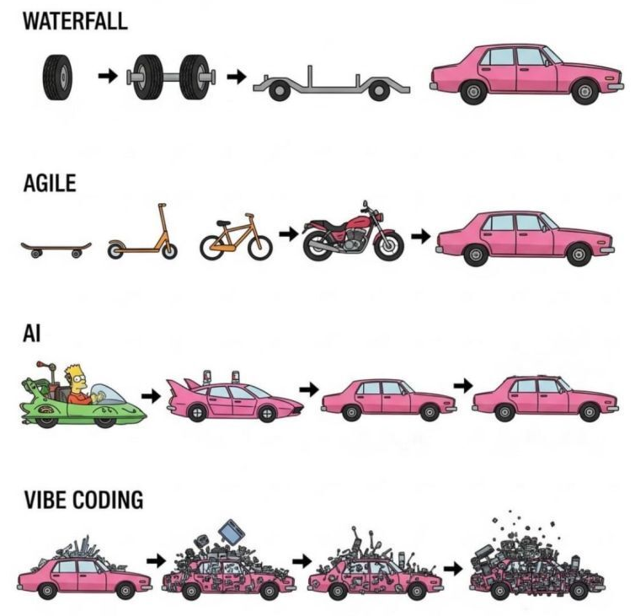
Why is it sooooo long

Slide 5
1 - Overview

Slide 6
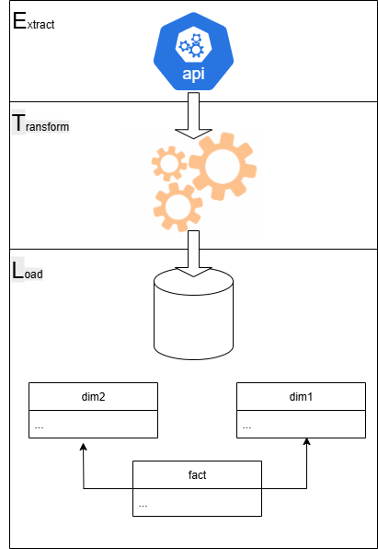
DATA-ETL
  Data models
  postgreSQL
  Scheduler

Slide 7
API – OpenData « Que-Faire-a-Paris »
"id":"11138",
"event_id":4404,
"url":"https://www.paris.fr/evenements/paris-12e-ou-donner-vos-vetements-a-paris-11138",
"title":"Paris 12e : où donner vos vêtements à Paris ?",
"lead_text":"Pulls, blousons, pantalons… Ne laissez plus vos vieux vêtements s'entasser dans les armoires, et ne les jetez pas non plus ! En donnant à ceux qui en ont besoin vous ferez une bonne action et vous donnerez une seconde vie à vos vêtements.",
"description":"<p>La <a href="https://www.aurore.asso.fr/neufs et non périmés<br></br></p>",
"date_start":null,
"date_end":null,
"occurrences":null,
"date_description":null,
"cover_url":"https://cdn.paris.fr/qfapv4/2021/11/08/huge-9884909f7c8464401211b7ab907803d7.jpg",
"cover_alt":"vestiaire",
"cover_credit":"Emilie Chaix / Ville de Paris",
"locations":
69 columns
"accessibility":
{
"blind":null,
"pmr":null,
"deaf":null,
"sign_language":null,
"mental":null
}
,
"address_street":"6-8 passage Raguinot",
"address_zipCode":"75012",
"address_details":null,
"address_name":"Halte Femme",
"address_lat_lon":"0.0,0.0",
"location_type":"address",
"address_city":"Paris"
}
]
,
"address_name":"Halte Femme",
"address_street":"6-8 passage Raguinot",
"address_zipcode":"75012",
"address_city":"Paris",
"lat_lon":
{
"lon":0,
"lat":0
}
,
"address_url_text":null,
"address_text":null,
"title_event":"Paris 12e : où donner vos vêtements à Paris ?",
"audience":"Tout public.",
"childrens":null,
"group":"Agenda",
"locale":"fr",
"rank":433.86,
"weight":1,
"qfap_tags":null,
"universe_tags":null,
"event_indoor":1,
"event_pets_allowed":0,
"contact_organisation_name":null,
"contact_url_text":"Halte Femme",
"contact_vimeo":null,
"contact_deezer":null,
"contact_tiktok":null,
"contact_twitch":null,
"contact_spotify":null,
"contact_youtube":null,
"contact_bandcamp":null,
"contact_linkedin":null,
"contact_snapchat":null,
"contact_whatsapp":null,
"contact_instagram":null,
"contact_messenger":null,
"contact_pinterest":null,
"contact_soundcloud":null,
"univers":null
"pmr":null,
"blind":null,
"deaf":null,
"sign_language":null,
"mental":null,
"transport":null,
"contact_url":"https://www.aurore.asso.fr/hauts-de-seine-paris-sud-est-iml/esi-halte-femmes",
"contact_phone":null,
"contact_mail":null,
"contact_facebook":null,
"contact_twitter":null,
"price_type":"gratuit",
"price_detail":null,
"access_type":"non",
"access_link":null,
"access_link_text":null,
"updated_at":"2021-11-08T20:15:29+00:00",
"image_couverture":null,
"programs":null,
"address_url":null,

Slide 8


Data model
Primary key Foreign key
Location
Location_id Address_name Address_city Address_zipcode Lat_long
Events
Event_id url Title Description Date_start Date_end Updated_at Location_id Categories_id
Cards_locations
Card_id Location_id
Event_categories
Event_id Categories_id
Cards
Card_id Name Description
UserInterests
Event_id User_id
CardHolders
Cards_id User_id
Users
User_id First_name Last_name Email
Categories
Categories_id Name Description
User_Categories_interest
User_id Categories_id

Slide 9
Data model
V0.01
Primary key Foreign key
Events
Event_id url Title Description Date_start Date_end Updated_at flag_interest qfap_tags Address_name Address_city Address_zipcode Lat_lon

Slide 10
Data model
V0.02
Primary key Foreign key
Events
Event_id url Title Description Date_start Date_end Updated_at Location_id flag_interest flag_new qfap_tags
Location
Location_id Address_name Address_city Address_zipcode Lat_long fcard

Slide 11


Insert / Update
event_id exists
Update event
Location exists
set id_location
Create & set id location
Insert event
Locations exists
set id_location
Create & set id location

Slide 12
New event incoming ?
Split API inputs

