Slide 1
Components of successful online courses
Ali Ahmad, Ph.D.
Professor
Department of Mathematics and Statistics
Division of Science, Engineering and Math
New Mexico Stat University-Dona Ana Community College
MichMATYC Oct 29, 2020
❖ Albuquerque, NM  February, 2007

Slide 2
Inside Higher ED Article
What Community College Students Say Impedes Their Progress, Ashley Smith, Feb 12, 2019
6,000 two-year college students from 10 community colleges in California, Michigan, Nebraska, North Carolina, South Dakota, Texas, Virginia, Wisconsin and Wyoming in fall 2017 and 2018.
Notes:
N=6235

Slide 3
Inside Higher ED Article
Problems with online education:
Fifty-three percent of them reported difficulties with learning online.
44 percent said the lack of interaction with faculty is a problem.
Throwing courses online with no real interaction is a recipe for disaster,” Phil Hill, an education technology consultant.
Notes:
N=6235

Slide 4
Inside Higher ED Article
Problems with online education:
A well-designed online learning system at California Community College Systems helped close the gap between the rate of students successfully completing traditional courses and online classes from 17 percent to 4 percent in 2016.
Notes:
N=6235

Slide 5
Inside Higher ED Article
Problems with online education Comments:
If students require the flexibility of online education in order to succeed, why does the faculty not spend some time rethinking ways to provide necessary interaction within that modality.
the best chance of success came when I treated online education as if it was actually an in-class experience.
Notes:
N=6235

Slide 6
Basic online checklist DACC-NMSU
1. A current syllabus is available in the course.
2. Instructor’s contact information and office hours are provided.
3.Textbook information (with ISBN) and/or other required materials are identified and included in the LMS.
4. Expected turn-around time in responding to students’ emails is stated (e.g., within 24 hours or 24–48 hours).
Notes:
N=6235

Slide 7
Basic online checklist DACC-NMSU
5. Instructor is active in the course and communicating with students (e.g., logging in a minimum of once a week AND a minimum of 1 hour per week of activity, updates and changes via announcements or e‐mail, progress and feedback via Gradebook, etc.).
6. Assignments are scheduled and have due dates.
7. A variety of assessment methods and types are included.
Notes:
N=6235

Slide 8
Basic online checklist DACC-NMSU
8. Use of LMS tools to support course activities/assignments (e.g., announcements, assignments, discussions, conferences, quizzes, etc.
Adapted from Online Course Basic Checklist on pages 2 & 3 and R. Poulin; 2012, April 20
Poulin, R. (2012, April 20). Is your distance education course actually a correspondence course? Retrieved from https://wcetblog.wordpress.com/2012/04/20/correspondence‐definition/
Notes:
N=6235

Slide 9
Quality Assurance Online Course Checklist Information
Getting Started Module and/or Syllabus Information
Organization and Navigation
Assessment and Feedback
4. Communication and Interaction
5. Usability and Accessibility
Notes:
N=6235

Slide 10
1. Getting Started Module and/or Syllabus Information
Students are directed where to begin on the home page.
A self-introduction and welcome is provided by the instructor.
A syllabus is provided with all information required in the DACC Syllabus checklist.
A list of required materials is posted.
The course grading policy is provided.
Instructor contact information and office hours are provided.
Technology requirements are provided.
Notes:
N=6235

Slide 11
2. Organization and Navigation Information
Course content is organized in modules.
Modules are organized logically by topic, unit, or week.
Each module states the learning objectives that will be addressed.
Notes:
N=6235

Slide 12
3. Assessment and Feedback
Work toward having each module containing at least one formative assessment
Multiple assessment strategies are used to measure student achievement throughout the course.
Instructions are provided for each assignment.
Due dates are listed for each assignment.
Grading criteria is provided for each assignment.
Notes:
N=6235

Slide 13
4. Communication and Interaction
Each module has a least one opportunity for student-instructor interaction.
Opportunity for student-student interaction is provided in the course.
Netiquette policies are provided.
Notes:
N=6235

Slide 14
5. Usability and Accessibility
Videos contain transcripts or are closed captioned.
Images that are used for educational purposes (not decorative) have tags or descriptions.
Course structure is clear, consistent, and easy to navigate
Notes:
N=6235

Slide 15


Well-designed Course
Notes:
N=6235

Slide 16



Why Presence?
Notes:
N=6235

Slide 17
Well Design Course
Establish Presence
The ability to establish presence is closely connected to the ability of the instructor to create a sense of community among learners in an online course. (Palloff & Pratt, The Excellent Online Instructor, 2011)
Notes:
N=6235

Slide 18
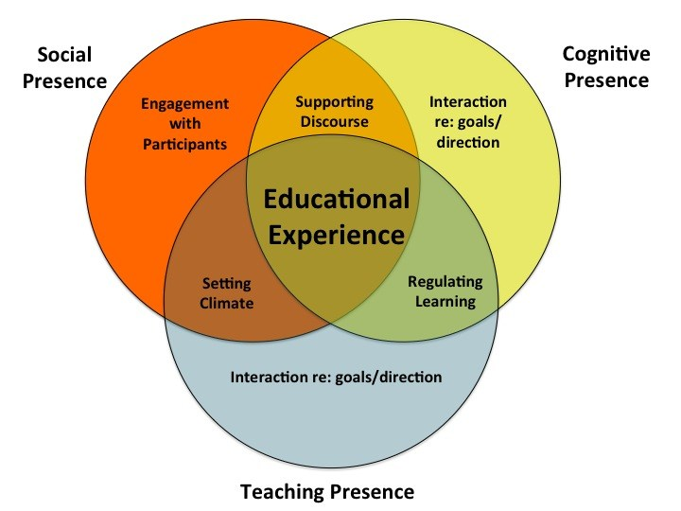
Instructor Presence
Garrison, D. R., Anderson, T., & Archer, W. (2000)
Notes:
N=6235

Slide 19
Cognitive Presence
Students:
Construct meaning through communication.
Understanding of tasks
Understanding with high expectations
Relate the course content to their lives
Why? More likely to listen, reflect, respond, analyze ideas.
How? Assignments, authentic assessments and discussions
Notes:
N=6235

Slide 20
Cognitive Presence
Sample assignment post
1. Read the chapter resources, watch the videos and formulate your thoughts into a written response.
2. This initial post is due by 11:00 p.m on Wednesday and should be at least 200 words. You need to include one problem from the material and share your solution.
3. The reflection post is due by 11:00 p.m on Wednesday. You must respond to at least one of your peers and should be at least 3 sentences.
Notes:
N=6235

Slide 21
Cognitive Presence
For homework, quizzes and tests assignments via MyLab, you will receive immediate feedback
upon submitting your work. If necessary, I will send you more feedback within 24 hours of the
deadline. For discussions, you will receive your grade within 24 hours of the deadline
Notes:
N=6235

Slide 22
Teaching Presence
Students:
Maintain interest and motivation, facilitate engagement
Know the instructor is always visible
Why? More likely to success (Guide, support and shape their experiences)
How? Instructor Introduction (Video), Canvas announcements, email, chat, assessments feedback, videos, web conferencing
and social networking apps.
Notes:
N=6235

Slide 23
Teaching Presence
Q&A Discussion
Students are encouraged to post questions about assignments or course content here. Students are encouraged to answer their peer's questions. I will also monitor this discussion area to provide input as well. By answering questions here, I can provide a single answer for the entire class. In some cases, if I receive an e-mail from you, I may move your question into this forum (though I will try to make it anonymous unless I've checked with you first).
Notes:
N=6235

Slide 24
Teaching Presence
COMMUNICATION WITH THE INSTRUCTOR:
Our primary means of communication will be online via the LMS and emails. For any question, please send me an email, I will reply to your email within 24 hours. You may call me at (575) 527-7687.
Notes:
N=6235

Slide 25
Teaching Presence
For homework, quizzes and tests assignments via MyLab, you will receive immediate feedback
upon submitting your work. If necessary, I will send you more feedback within 24 hours of the
deadline. For discussions, you will receive your grade within 24 hours of the deadline
Notes:
N=6235

Slide 26
Social Presence
Students:
know and trust each other.
Make interpersonal connection with each other
Know and trust the instructor.
Why? More likely to engage with the course.
How? Introduce themselves, Weekly Discussions, Mail, Chat, Web conferencing, Blogs, Wikis, Social networking apps
Notes:
N=6235

Slide 27
Social Presence
Introduce yourself to the class
Please introduce yourself here.
1. Tell us your name and, if you have a nickname
2. Tell us what what your area of study
3. Tell us about your expectations from this class and how to meet those expectations.
4. You may tell us about your hobbies if you choose to.
5. Read other posts and respond to at least one post
Notes:
N=6235

Slide 28
Questions
In what ways do you encourage online participation and engagement?
How do you measure online participation and engagement?
Notes:
N=6235

Slide 29
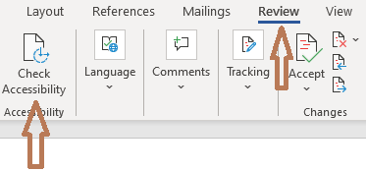
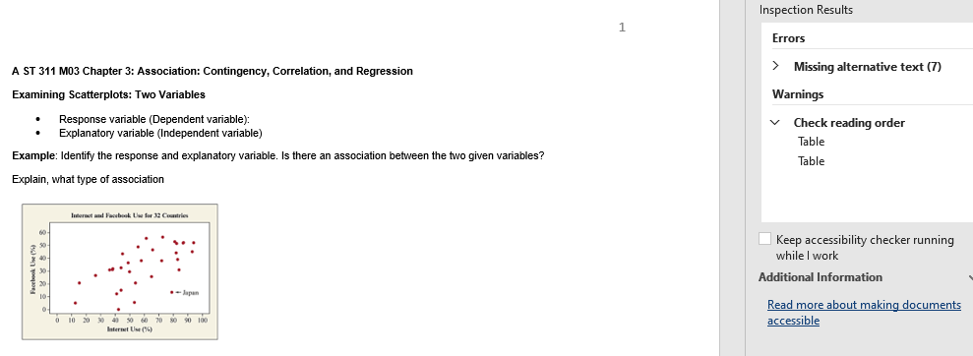
Check Accessibility of your Word Document
To run the accessibility checker:
Select Review>Check Accessibility
Accessibility checker will be open: error,tips
Notes:
N=6235

Slide 30
Check Accessibility of your Word Document
Errors: content can not read by students with learning disability
Warnings: less serious
Tips: issues may cause problems
Notes:
N=6235

Slide 31
ALT Text
Pictures
Charts
Tables
Shapes
Objects
Clip art
Notes:
N=6235

Slide 32
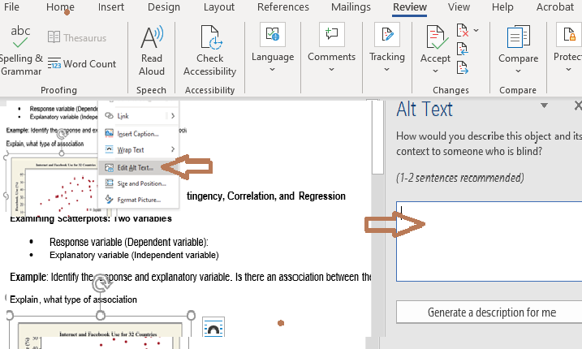
ALT Text
Alt text to any picture
Right click on the picture>Edit Alt Text
Notes:
N=6235

Slide 33
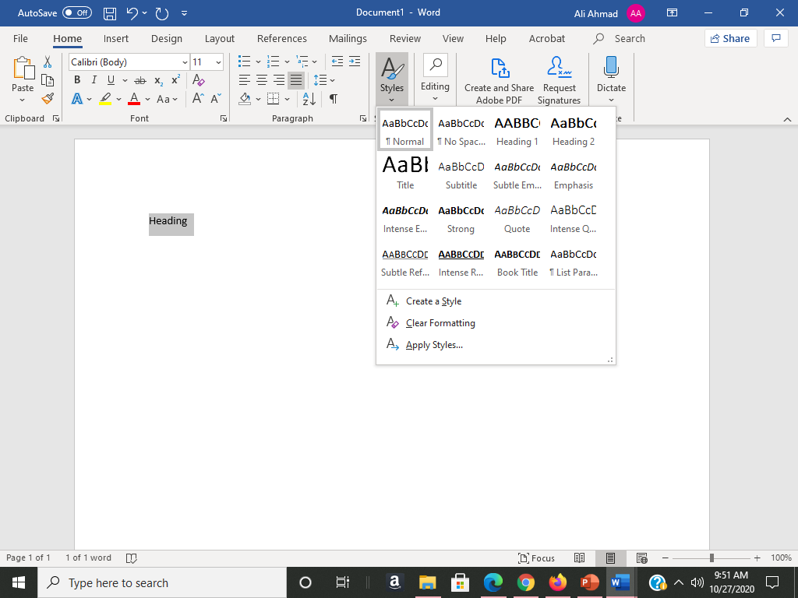
Improve Heading Accessibility
Select the text
Select Home then Style
Pick the Heading Style
Notes:
N=6235

Slide 34
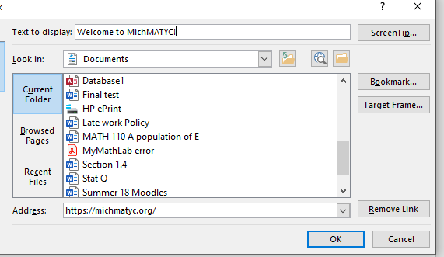
Create Accessible Links
Incorrect: https://michmatyc.org/
Click edit hyperlink
Correct: Welcome to MichMATYC!
Notes:
N=6235

Slide 35
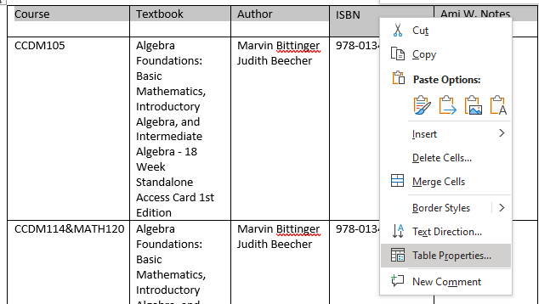
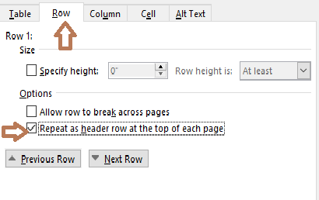
Create Accessible Tables
Navigate using the tab key from left to right.
Select the row as a header
Check Alt text
Notes:
N=6235

Slide 36
DISCUSSION

Slide 37

Sources
https://www.insidehighered.com/news/2019/02/12/survey-asks-community-college-students-detail-their-challenges
https://teachonline.asu.edu/2014/10/important-instructor-presence-online-course/
https://cdl.ucf.edu/files/2016/01/slides_online_engagement.pdf
https://support.microsoft.com/en-us/office/video-check-the-accessibility-of-your-document-9d660cba-1fcd-45ad-a9d1-c4f4b5eb5b7d

