Slide 1
Creating, Implementing and Surviving
Co-requisite/Co-support courses
Leslie Mohnke
Lansing Community College
10.9.2021

Slide 2


Slide 3
C O R E Q U I S I T E

Slide 4
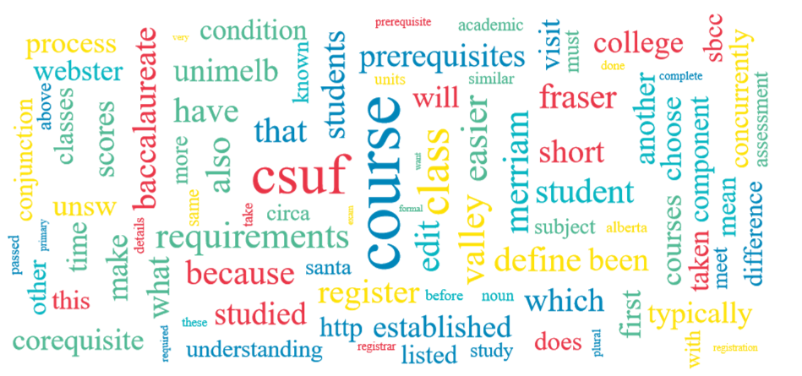

Slide 5
Co-requisite link
https://educalingo.com/en/dic-en/corequisite

Slide 6
TENDENCIES OF USE OF THE TERM «COREQUISITE»
The term «corequisite» is regularly used and occupies the 106,202 position in our list of most widely used terms in the English dictionary.

Slide 7
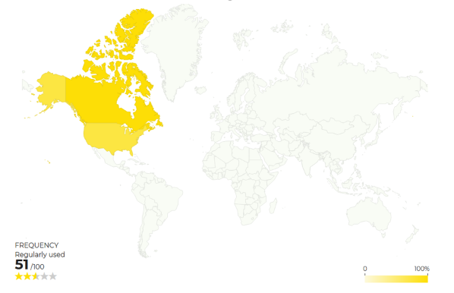
Map gives frequency of use of the term <corequisite> in different countries.

Slide 8
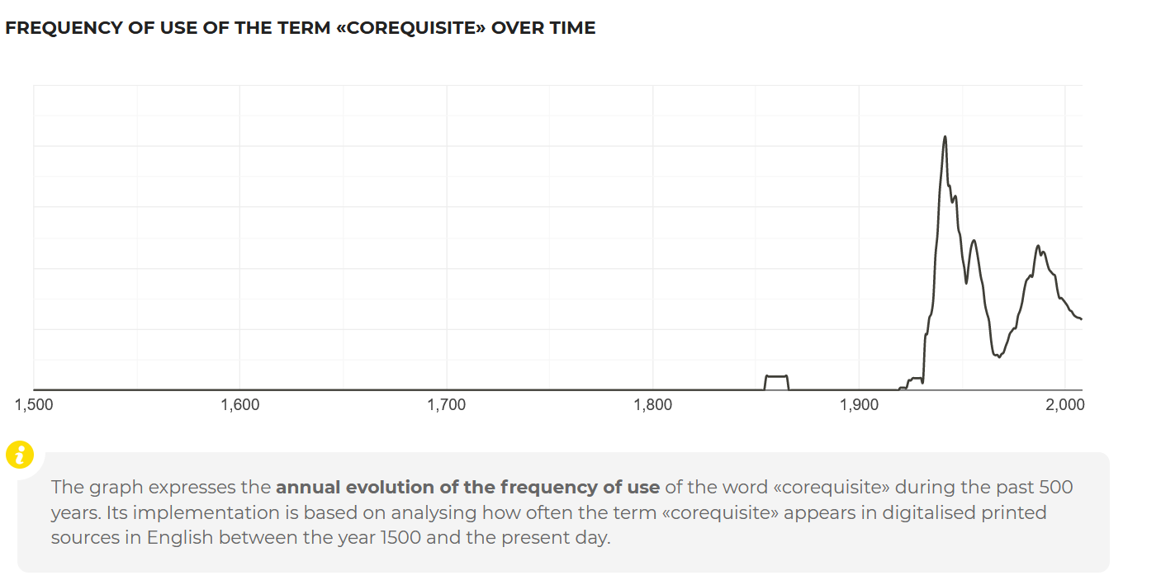

Slide 9
CHAT BOX
#BeenThereDoneThat
Taught it but not any longer
#InTheTrenches
Currently teaching a form of it
#Familiar
Heard it but don’t know too much
#Newbie
Totally new to the idea

Slide 10
Corequisite Definition
A formal course of study required to be taken simultaneously with another.
A corequisite is a course that must be taken at the same time as another course.

Slide 11
LCC’s Co-support course DEFINITION
Course is designed to provide embedded academic support to students whose skill set is not at level to take college level math as a stand-alone course.

Slide 12
CHAT BOX
Share ideas to add to the definition of Co-requisite or Co-support course as you or your college interprets or understands it

Slide 13
In the beginning -
High school GPA
Developmental Math Spotlight
Tennessee Model
Accelerated Math programs
Financial Aid
Math Boot Camps
Credentials – Higher Learning Commission
Math Literacy and Quantitative Reasoning

Slide 14
LCC journey began 2017-2018 Implementation 2019-2020
Who is part of the Conversation?
Broaden the Buy-in

Slide 15
CHAT BOX
State the name of your college if you are currently offering some form of a corequisite or co-support class. State the college level course it supports.

Slide 16
Investigating Different Models
On your campus
In Michigan
Nationwide
Not just Math co-requisite
Dana Center

Slide 17
Which college level course?
Credit bearing
Gateway course
Higher enrollment
Math Pathway

Slide 18
LCC – two math pathways
Math 097
Supports Math 119 (QR course)
Supports Stat 170 (Introductory Statistics)
Math 098
Supports Math 120 (College Algebra)

Slide 19
Back-Mapping
Quantitative Reasoning
Introductory Statistics
Pre-Calculus (College Algebra)

Slide 20
BACK MAPPING
To identify learning outcomes for support courses, list the specific skills from the learning outcomes of the college-level course in the first column. In the second column, identify the competencies needed in order to successfully engage in activities that develop the skills in the first column. Those competencies become the descriptors of the learning outcomes of the pre/co-requisite course.
Learning Outcome
In the college-level course, students will: | Therefore, they need the ability to: | These skills should be:
 |  | Taught in support course | Reinforced in college level | Taught in college level

Slide 21
Corequisite – Co-support models
Cohort
Co-Mingled
Just-In-Time Support

Slide 22
CHAT BOX
Share other models that are out there or ideas for other models to consider

Slide 23
LCC model
2 credits
16-week
First time math students
Meets 1X for 2 hours vs. Meets 2X for 1 hour
Created our own materials
Embedded tutors
Small class size (n=20)
Non-cognitive skills

Slide 24
Key Components
Student centered
Active Learning
Collaboration with co-support instructor/students/tutor
Relaxed Learning Environment
Development of student and college level instructor relationship
Student takes responsibility for their own learning
Link students to college-wide resources
Students earn a grade

Slide 25
Co-support Format
Warm up
Notes
Activities
Discussion Topics
Bridge Assignments
Quizzes
Portfolio
Weekly Touchpoints
Engagement Assignments
Additional Resources

Slide 26
Math 097 Description
This course aligns with knowledge of human cultures and the physical and natural world by involving mathematics skills and applications across many disciplines such as Science, Business, and Medical, giving students practical and needed information for living in the real world. Big conceptual questions that engage students will be integrated throughout. This course also aligns with intellectual and practical skills, specifically including inquiry and analysis, critical and creative thinking, written and oral communication, quantitative literacy, information literacy, teamwork and problem-solving. These skills will be integrated throughout. Lastly, this course aligns with personal and social responsibility by building foundations and practicing skills for life-long learning.

Slide 27
Math 097 Objectives
Develop numeracy to use the Real Number line, judge the reasonableness of an answer, and understand scientific notation.
Identify the basic mathematical operations and the order that they are completed.
Use geometry to find perimeter, area, and volume.
Construct proportional relationships to solve problems involving rates, ratios, percent, and proportions.
Describe and apply function concepts and procedures to understand mathematical relationships
Formulate problem-solving skills and conceptual understanding through mathematical investigation.
Model real-life situations with equations and functions.
Interpret data displayed in both graphical and table form.
Employ appropriate technology to solve problems.

Slide 28
Math 097 modules
Operations and Applications with Fractions
Perimeter, Area, and Volume
Place Value, Rounding and operations with zeros
Scientific Notation
Percent Sense, reasonableness and applications
Using Formulas
Evaluating, Simplifying and Solving
Linear Models
Numerical Patterns
Charts, Tables and Graphs
Units of Measure and Dimensional Analysis
Integer Arithmetic, exponents and order of operations

Slide 29
Math 098 description
This course aligns with knowledge of human cultures and the physical and the natural world by involving mathematics skills and applications across many disciplines such as Natural and Physical Sciences, Business and Economics, giving students practical and needed information for living in the real world. Big conceptual questions that engage students will be integrated throughout. This course also aligns with intellectual and practical skills, specifically including inquiry and analysis, critical and creative thinking, written and oral communication, quantitative literacy, information literacy, teamwork and problem-solving. These skills will be integrated throughout. Lastly, this course aligns with personal and social responsibility by building foundations and practicing skills for life-long learning.

Slide 30
Math 098 Objectives
Manipulate and apply operations to algebraic expressions.
Recognize, model, and define functions to be able to represent and interpret using function notation.
Identify functions from their equation, graph, or verbal description and indicate characteristics.
Solve equations and inequalities algebraically using a variety of methods.
Employ the graphing calculator to solve equations and inequalities.
Illustrate algebraic modeling, to be able to list and explain important characteristics for functions.
Calculate the domain and range of a function from its equation and graphical representation.
Model a variety of real-world applications and be able to solve and interpret the answers in context.

Slide 31
Non-cognitive Assignments
Skills for Success
Math Anxiety
Test Preparation
Asking for Help
Successful Online Learning
Time Management
Grit and Perseverance
Growth Mindset
Help Resources at LCC
Exercise and the Brain

Slide 32
Engagement Assignments
Meet your tutor
Error Analysis of Test 1
Mid-semester Grade reflection
Final Exam preparation

Slide 33
Challenges
Who is going to teach it?
Same instructor for both or two instructors
Registration
Marketing
Co-support Classroom
Day 1
Communication with college level instructor
Staying co-enrolled

Slide 34
CHAT BOX
SHARE ANY CHALLENGES OR ROADBLOCKS THAT HAVE BEEN EXPERIENCED.

Slide 35
Is it working???

Slide 36
Q & A
OPEN DISCUSSION AND SHARING

Slide 37
Contact Information
Leslie Mohnke
mohnkel@lcc.edu

