Slide 1
Teacher Education Programs- Changes on the Horizon
Brenda Sheperd – Lake Michigan College
Deborah Zopf – Henry Ford College

Slide 2
Program Development Timeline
Elementary School Education (B-K, PreK-3, 3-6)
Four-Year school programs beginning Fall 2022 or Fall 2023
Middle School Education (5-9)
To be determined
High School Education (7-12)
To be determined

Slide 3
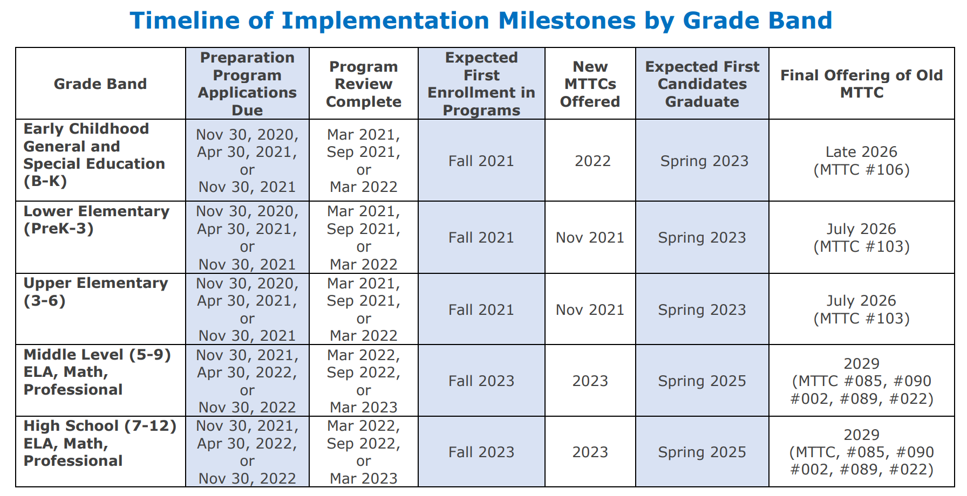
Timeline of Implementation

Slide 4
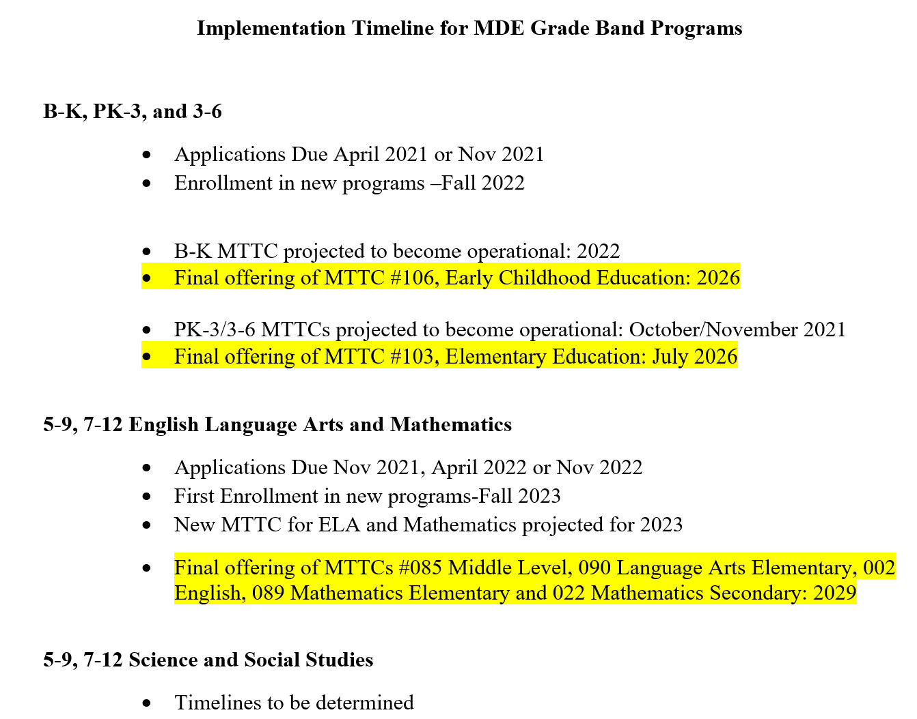
Implementation Timeline for MDE Grade Band Programs

Slide 5
Where can you get more information?
https://www.michigan.gov/documents/mde/Certificate_Structure_623452_7.pdf
https://www.michigan.gov/documents/mde/Clinical_Experiences_Requirements_648342_7.pdf
https://www.michigan.gov/documents/mde/Lower_Elementary_PK-3_Education_Preparation_Standards_649824_7.pdf
https://www.michigan.gov/documents/mde/Upper_Elementary_3-6_Education_Preparation_Standards_649826_7.pdf

Slide 6
Degree Structure Comparison
Prior to 2022
Degree in Elementary Education
Content majors / minors
Language Arts
Social Studies
Math
Science
2022 and moving forward
Degree in Education
Certification Track as majors
Birth – Kindergarten
PreK – Grade 3
Grade 3 – Grade 6
Special Education
Bilingual

Slide 7
Mathematics Courses for Pre-Service Elementary Teachers
What do we know?
Central Michigan University
Eastern Michigan University – Two 3-credit courses
Grand Valley State University –
University of Michigan- Dearborn – Four 3-credit courses
University of Michigan – Flint
Wayne State University – Two 3-credit courses
Western Michigan University – Four 3 credit courses
Any others???

Slide 8
How are the new courses different?
Integration of content, pedagogy, and possibly field experiences
Addressing the standards for three grade bands / or creating courses specific to grade bands

Slide 9
What are your experiences ?
To which four-year schools do your students transfer?
Are mathematics courses for pre-service elementary teachers remaining the same or changing?
How will transfer guides or articulation agreements be affected?

