Slide 1
Red Belly: A Secure, Fair and Scalable Open Blockchain
T. Crain, C. Natoli, V. Gramoli
Presented by:
Bolong Tang, Michał Rączkiewicz
12-01-2024

Slide 2
Description of the problem
Double spending
Human errors
Incorrectly signed transactions
Existing blockchains
don’t offer high throughput
assume synchrony
RBBC achieves strong form of scalability
Throughput not impacted by number of nodes
Secure (see figure)
t < n/3 nodes can be Byzantine
Single point of slowdown
Researched threats
Unfairness
Faulty leaders
Network attacks
Adversarial
schedulers
12-01-2024

Slide 3
Related work
Describe what has been researched, how other blokchains deal with problems, their performance, etc.
12-01-2024

Slide 4
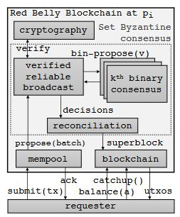
Overview of RBBC
Sharding of signatures – different verifiers verify distinct transactions
Improves performance
Reduces per verifier load which allows scalability
Each transaction checked by at least t + 1 verifiers
Use superblocks – merge multiple transactions
O(1) vs O(n) – transactions
Resolve conflicts within superblocks by reconciliation algorithm
Proposers, requesters and verifiers
Requester finds proposers based on transaction’s source account
If primary proposer fails, use secondary proposer
t + 1 primary and t secondary verifiers for each transaction
12-01-2024

Slide 5
Performance evaluation
Experiments and their outcomes
12-01-2024

Slide 6
Suggestions
Well written paper, interesting
Lacking motivation for caring out the experiment in geodistributed context, why not just have delays built in?
Background an threat model section too extensive
12-01-2024

Slide 7
Q&A

Slide 8
We can use this if we need a graph
09-10-2020

