Slide 1



63-51 Emerging Technologies
Elm
Bregy Noah, Donnet-Money Mégane, Meichtry Micha

Slide 2
Table of Content
GitHub Structure & Project Flow
Part 1: What Is Elm and Why Does It Exist?
Part 2: How Does Elm Compare?
Part 3: Elm in Practice (Examples)
Part 4: Prototype Demo
Part 5: When Would You Actually Use Elm?

Slide 3
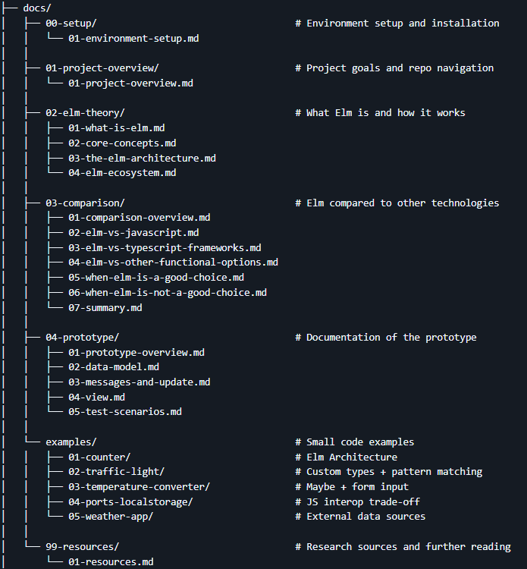
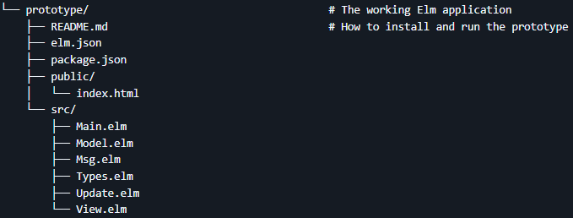

GitHub Structure & Project Flow
Notes:
Show GitHub repo to explain intended reading flow

Slide 4
Part 1: What Is Elm and Why Does It Exist?

Slide 5
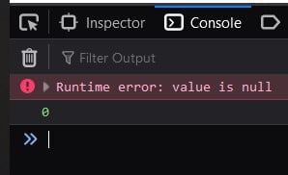
The Problem
JavaScript not designed for large, complex frontend applications
Runtime errors (only appear when code runs)
Unpredictable state (mutable values and side effects)
Ecosystem fragility requires stacking React + Redux + TypeScript + Babel …
Example:

Slide 6
What Elm is
Functional programming language that compiles to JavaScript
Designed exclusively for browser-based user interfaces
Created by Evan Czaplicki as his Harvard thesis in 2012
Reliability is built into the language, not added on top
No runtime exceptions by design
The compiler catches errors before the program runs

Slide 7
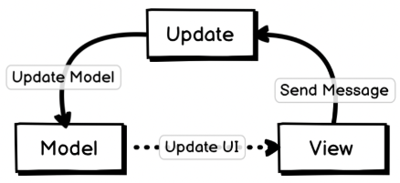
The Elm Architecture (TEA)
The mandatory pattern every Elm application is built on
Model: The complete application state - one place, no hidden values
Msg: Every possible user action declared as a custom type variant
Update: Pure function: takes Model + Msg, returns a new Model
View: Pure function of the Model - same input always produces same HTML

Slide 8
The Key Guarantees
No null, no undefined, no exceptions
Absent values are expressed as Maybe, which the compiler forces you to handle
Exhaustive pattern matching
Every case expression must handle all variants - missing branches are compile errors
Immutability
Update always returns a new Model - the old one is never mutated
Friendly compiler errors
The compiler names the missing variant and tells you what to do next

Slide 9
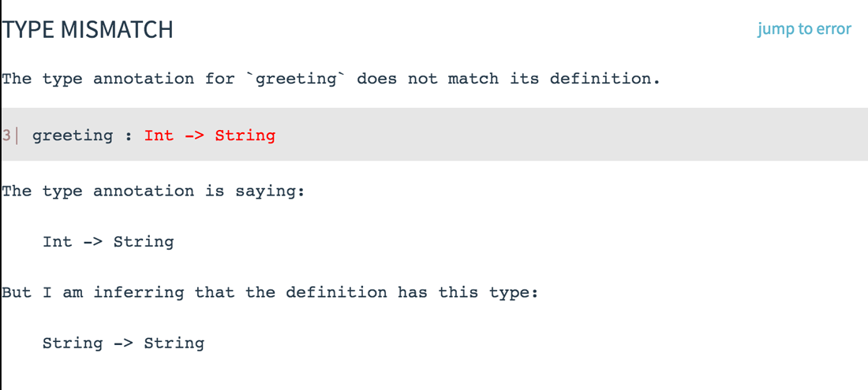
Friendly Compiler Messages
Type annotation does not match function definition
Annotation: Int -> String
Actual: String -> String
Cause: Function treats input as String
Fix: Change annotation to String -> String

Slide 10
Security
Handled by Design
Outside Elm’Scope
XSS via DOM injection «Html.text»
Escapes all output automatically
No raw HTML injection possible from code
No dynamic code execution at runtime
Compiled to static JavaScript
Type-safe form inputs → no unvalidated strings reach the logic
Package logic of Elm Package registry
Code on GitHub is reviewable
Port boundary, JS subscribers not checked
npm building tool → third-party packages
Network security (HTTPS, CORS …)
Authentication and authorization
Needs to be done by backend
Backend and API security
Security in Elm
Notes:
The same design that eliminates runtime errors also eliminates a class of frontend security vulnerabilities - not by convention, but by construction.
XSS / Html.text (Cross-Site-Scripting) - every string rendered in the UI passes through Html.text, which escapes it - you cannot accidentally render user input as HTML
No innerHTML - there is no way to inject raw HTML from Elm code, the virtual DOM only accepts typed nodes
No eval - Elm compiles to a static bundle, there is no mechanism to execute strings as code at runtime
Type-safe forms - form inputs are plain strings in the model, they must be explicitly validated before they touch any logic
Port boundary - once data crosses into JavaScript, Elm's guarantees stop - port subscribers are regular JS and need the same scrutiny as any JS code
npm tooling - the build pipeline may pull in JS packages, those are outside Elm's type system entirely
Network security - HTTPS, CORS (Cross-Origin Resource Sharing), and security headers are infrastructure decisions, the language has no opinion on them
Auth - authentication and authorization are backend concerns, Elm handles the UI layer only
Backend and API - whatever the app talks to is out of scope - Elm can decode responses safely, but cannot control what the server does

Slide 11
Part 2: How Does Elm Compare?

Slide 12






The Comparison Landscape
Notes:
Who are the realistic alternatives when building a frontend web application?
JavaScript The default - ubiquity, zero setup, maximum flexibility
React + TypeScript Dominant industry stack, large ecosystem, optional typing
Vue + TypeScript Gentler learning curve, strong conventions
ReScript / PureScript Functional alternatives that also compile to JavaScript

Slide 13
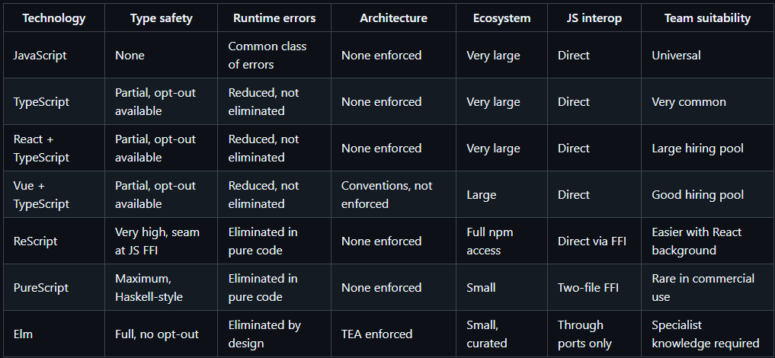
The Key Trade-off in One Table
Notes:
Explain the most important factors (type-safety, runtime errors)

Slide 14
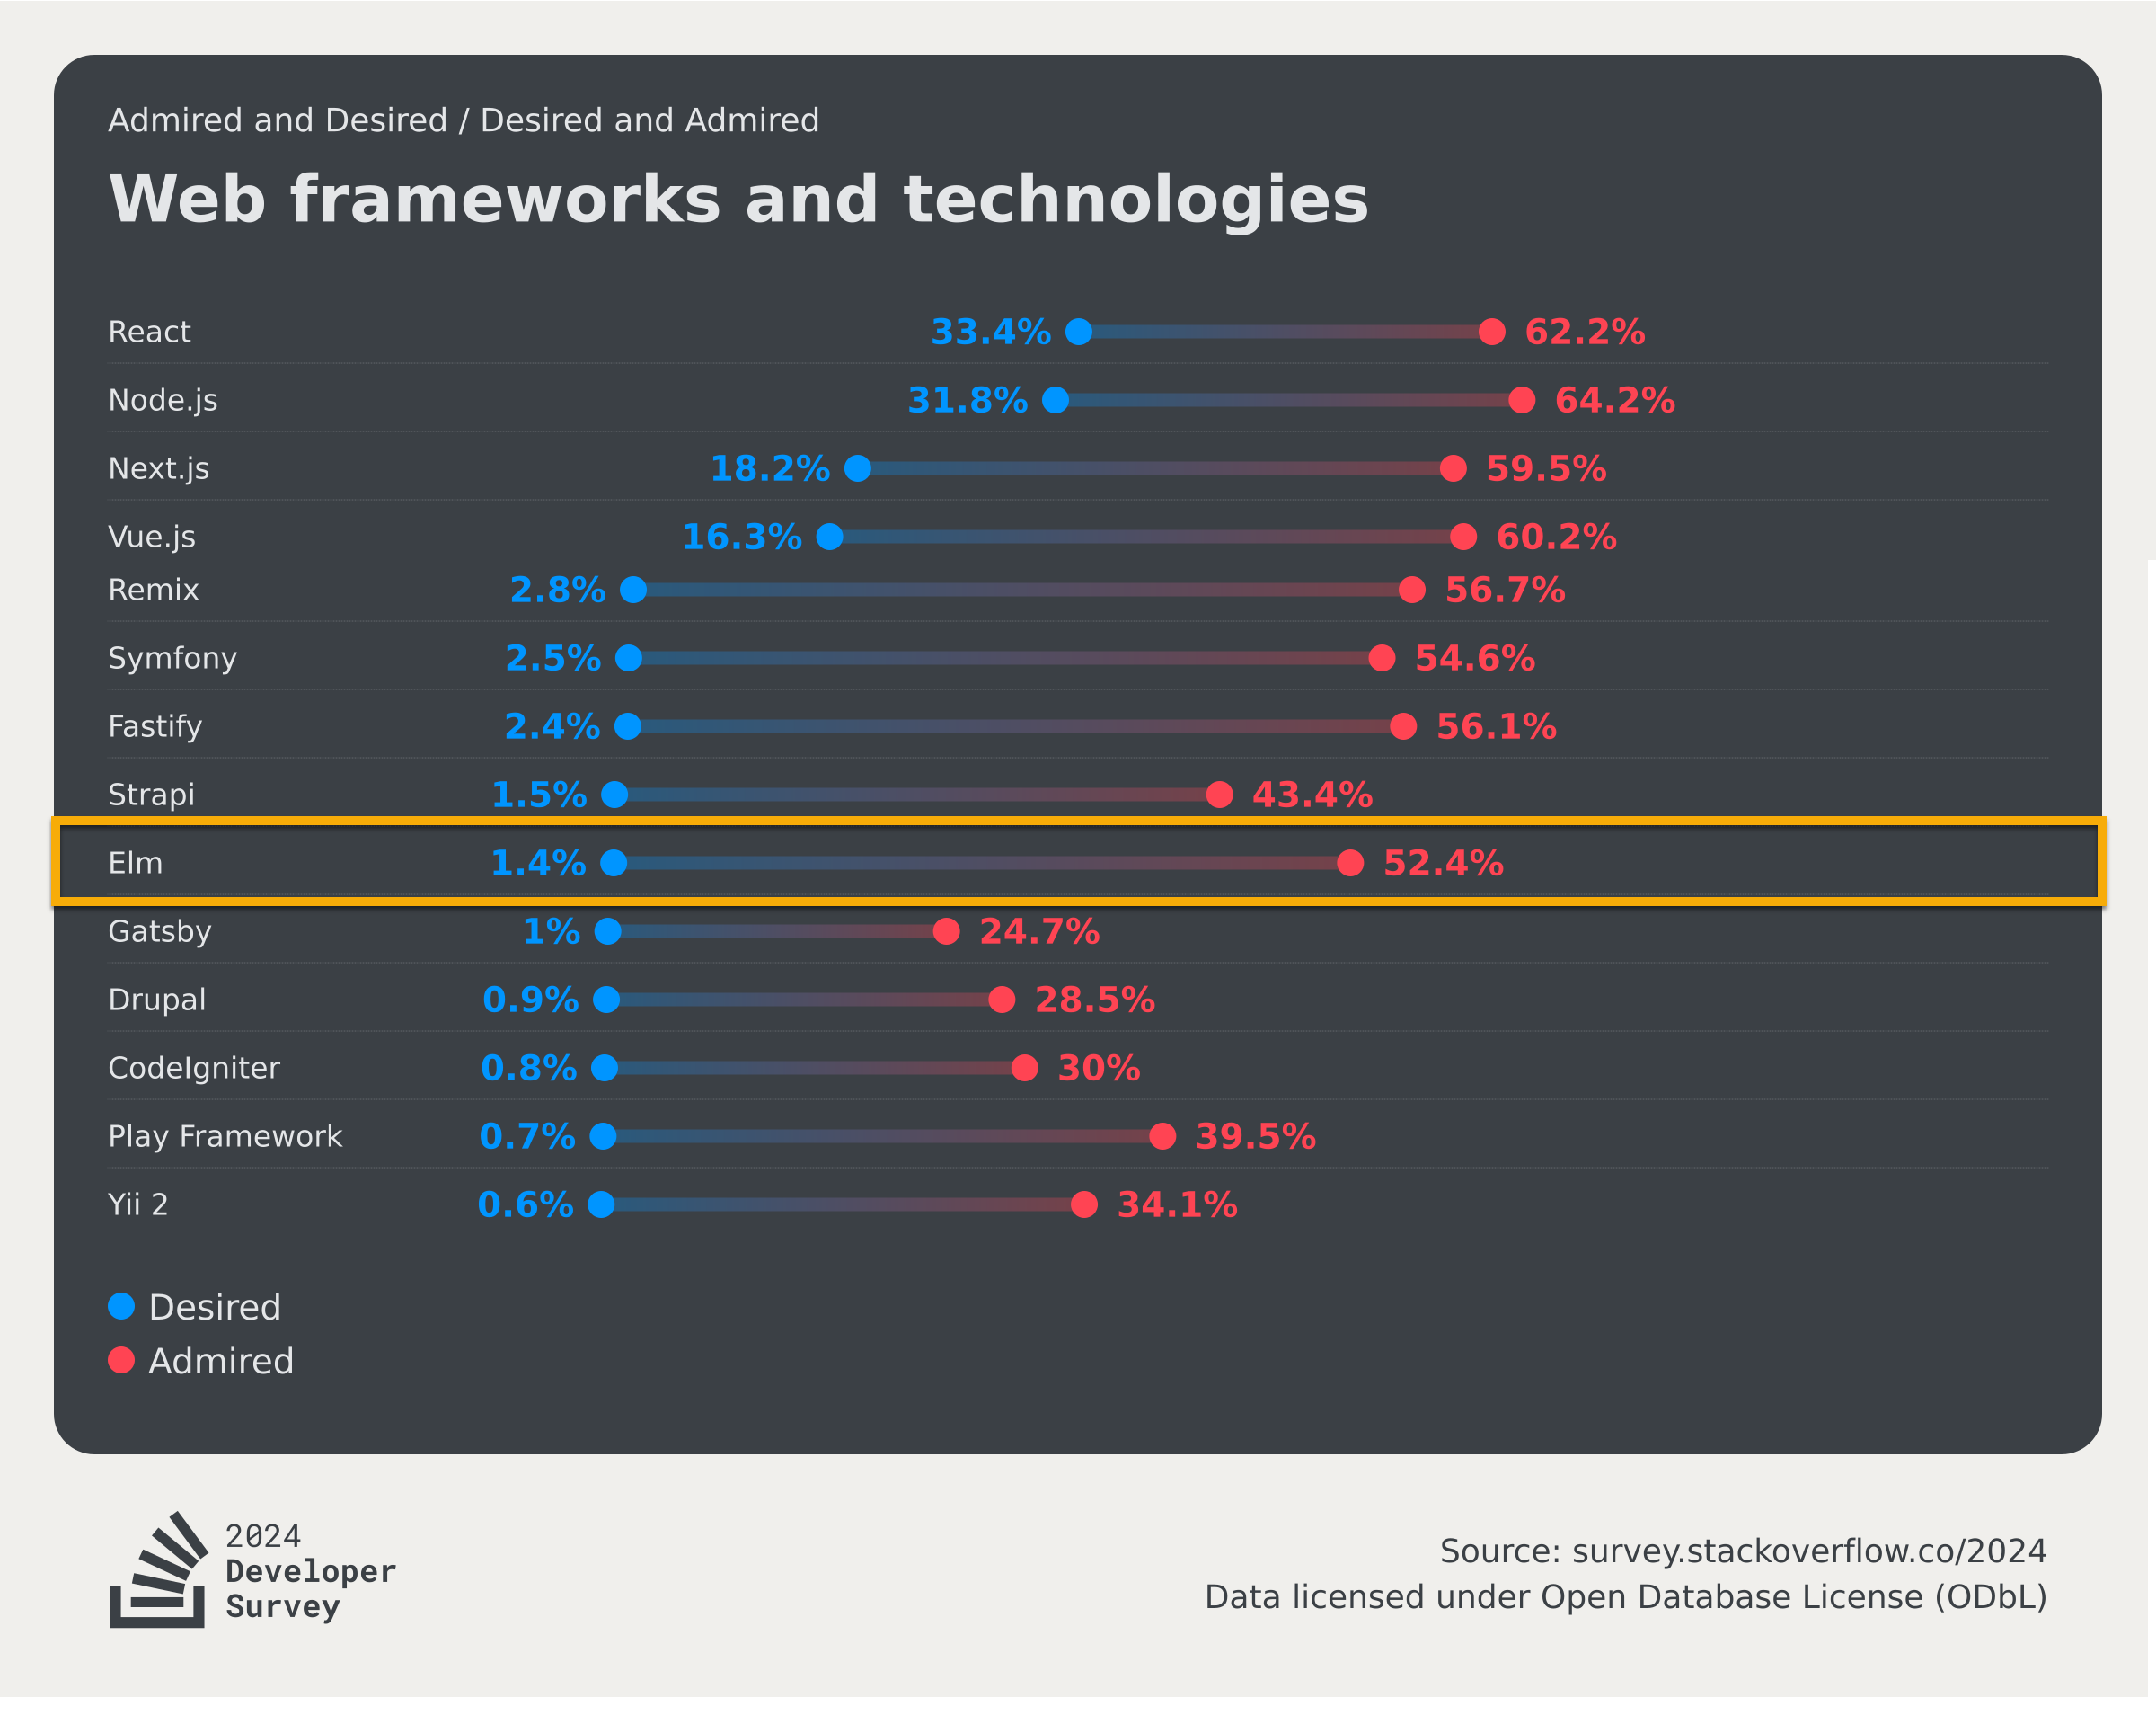
The Admiration Gap (Stack Overflow 2024)
Notes:
Explain the admiration group of the Stackoverflow survery
Very small community but supportive community --> admiration

Slide 15
Part 3: Elm in Practice (Examples)

Slide 16


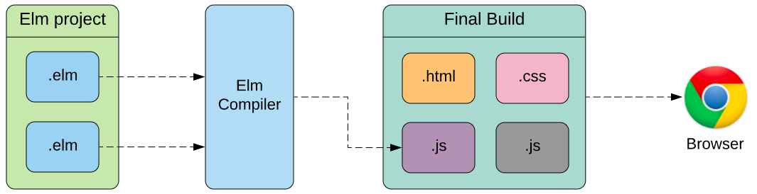
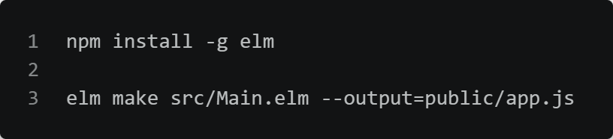
How to Run Elm Code
Notes:
one file = Ellie (simple examples)
multiple files = elm make (complex prototype)
Example 04 with ports → not possible in Ellie online

Slide 17
Example 1-5
Example 1: Counter - The Elm Architecture in under 50 lines
Example 2: Traffic Light - Custom types and exhaustive pattern matching
Example 3: Temperature Converter - Maybe type and input validation
Example 4: Persistent Note - Ports and JavaScript interop (localStorage)
Example 5: Weather App - HTTP requests and JSON decoding

Slide 18
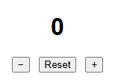
Example 1: Counter
A counter with three buttons: +, -, Reset
Model: A single Int - the entire application state
Msg: Increment, Decrement, Reset
Update: case msg of - each branch returns a new Int, nothing is mutated
Notes:
Show GitHub README of example
Show application & functionality (UI)
Show code and explain
Change code to init at 10 and increase by 10 → compile
Change code to add in a Msg «Delete» → show error on compilation

Slide 19

Example 2: Traffic Light
A traffic light cycling Red, Green, Yellow, Red
Custom type:
type TrafficLight = Red | Yellow | Green
invalid states are impossible
Pattern matching:
update, lightColor, and label
all case-match on every variant independently
Notes:
Show GitHub README of example
Show application & functionality (UI)
Show code and explain
Change code to init traffic light on Green → compile
Change labels to display a new text → compile
Change code to add in a «Orange» in «TrafficLight» → show error on compilation
Fix it by correctly implementing Orange in TrafficLight, Update (Yellow -> Orange, Orange -> Red), lightcolor (#e67e22), trafficlight (Orange -> "Orange - Prepare to Stop")
compile and show that the circle is missing in the UI → add in the missing circle

Slide 20
Part 4: Prototype Demo

Slide 21
Prototype Description
IT Service Desk Ticket Management System
Built entirely in Elm, runs in the browser with no backend
Why this domain?
Tickets, statuses, filters, and forms map naturally onto TEA
Features
Create tickets, filter by status, search by keyword, view details, post comments, track history
Files
Main.elm / Types.elm / Model.elm / Msg.elm / Update.elm / View.elm

Slide 22
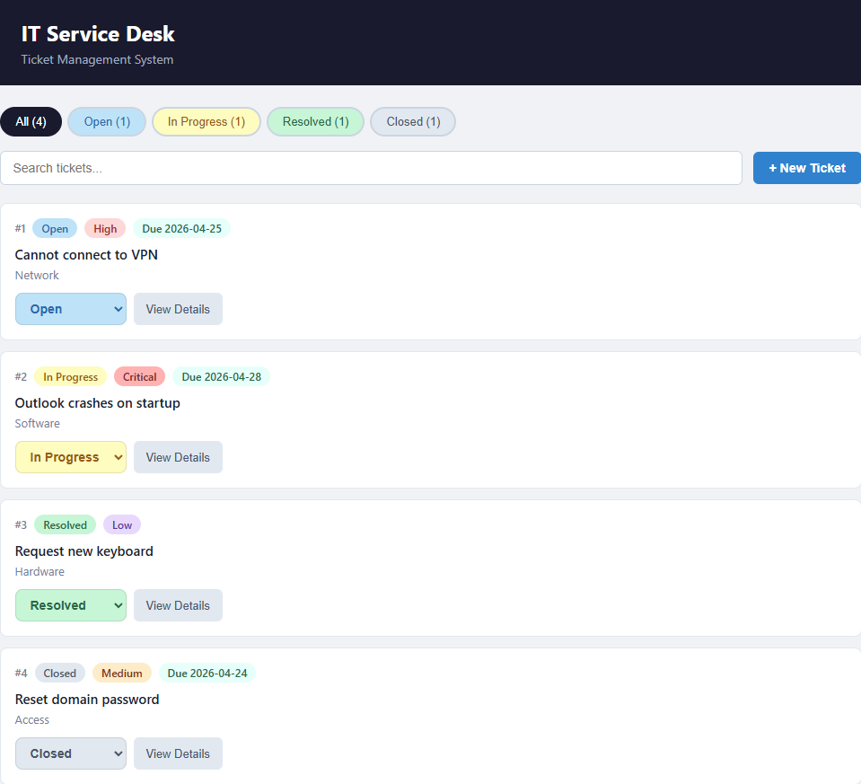
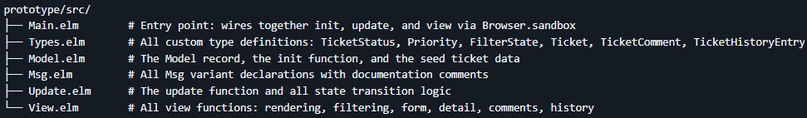
Prototype Demo
Notes:
Explain simplifications (no backend, no persistence, timestamps are hardcoded, single page only)
Show the prototype functionalities
Ticket list & navigation > filtering & search > create ticket form > ticket detail view > due date and overdue badge > comments > status history timeline

Slide 23
What the Prototype Demonstrates (Test Scenarios)
Status badges (Open / In Progress / Resolved / Closed)
Custom type - invalid states are structurally impossible
Due date badge turns red when overdue
Maybe String - absent due date cannot be accidentally used
Form error appears and clears as you type
Maybe String in the model - Nothing renders nothing
History timeline grows with each status change
Immutable record update - old ticket replaced, never mutated
Filter counts and search update in real time
Pure List.filter on the model - no cached state
All state survives navigation between views
Single Model - no component state, no sync needed
Notes:
Show test scenarios in GitHub → tell them to test the application

Slide 24
Part 5: When Would You Actually Use Elm?

Slide 25
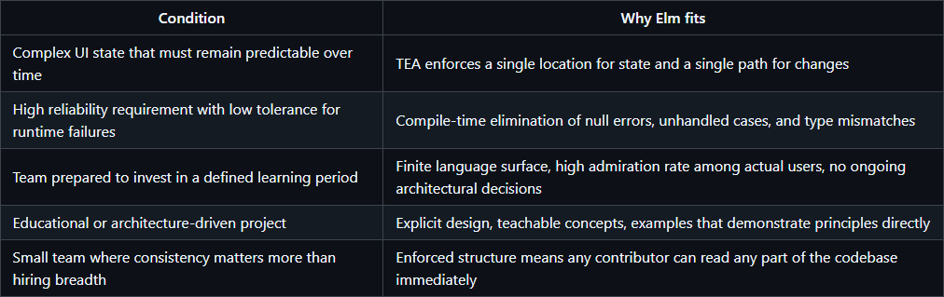
When Elm Is a Good Choice

Slide 26
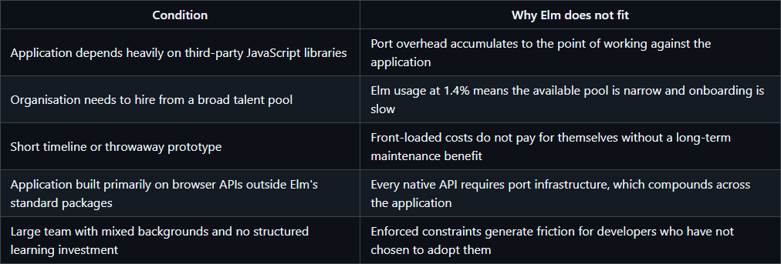
When Elm Is Not a Good Choice

Slide 27

Thank you for your attention.
School of Management
Route de la Plaine 2
3960 Sierre
hevs.ch/heg

