Slide 1
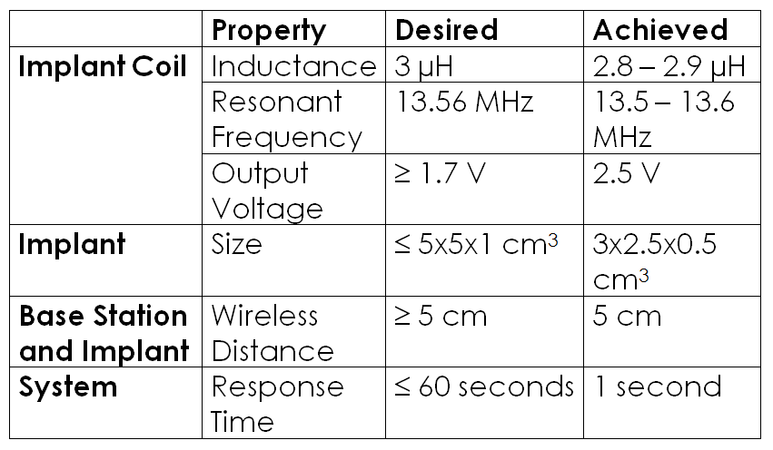
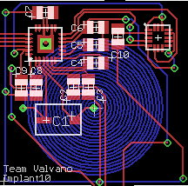
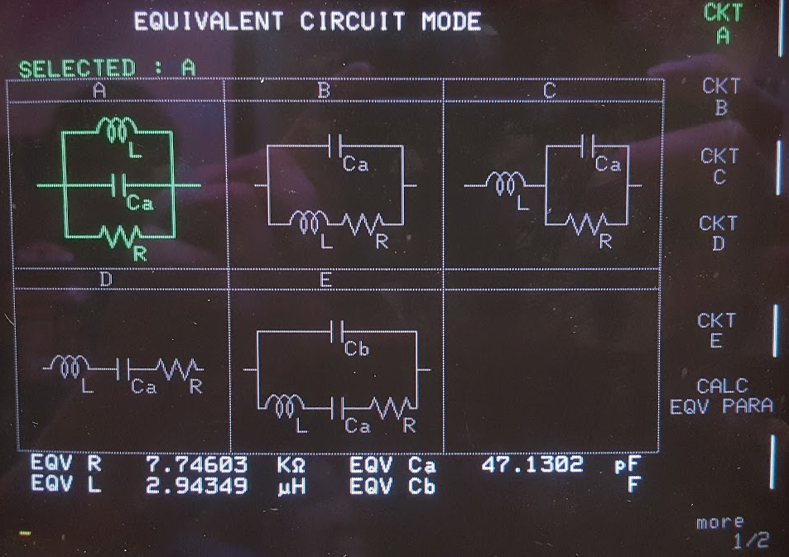
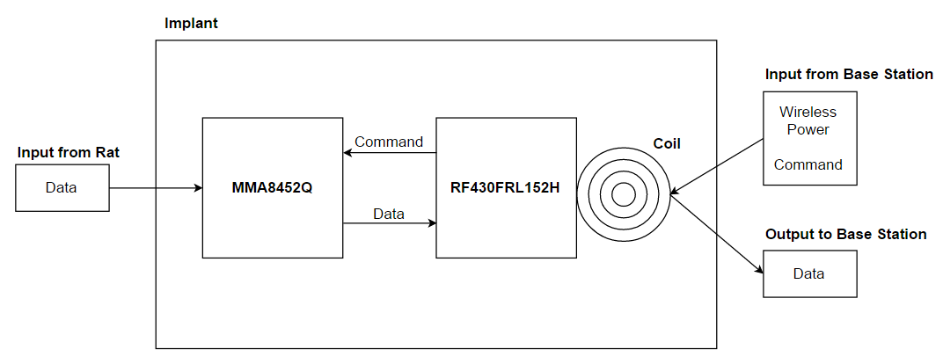
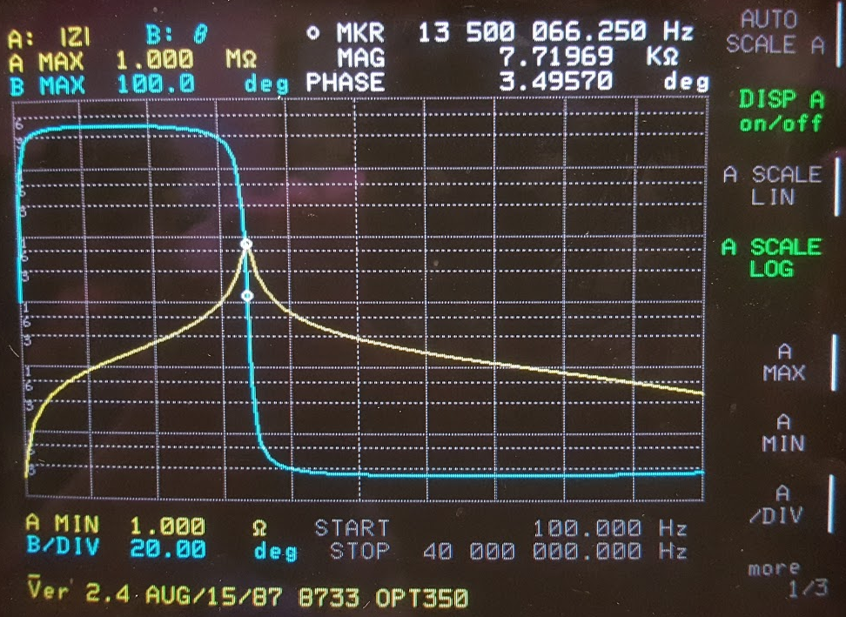
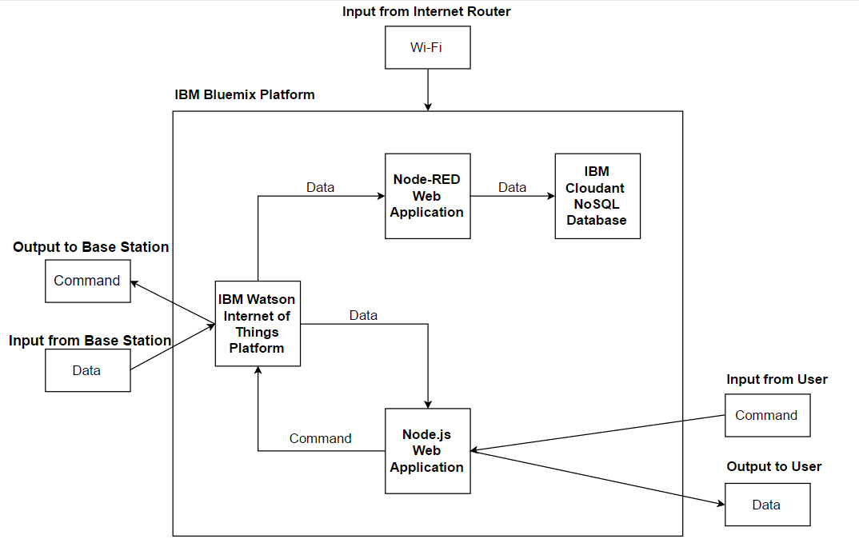
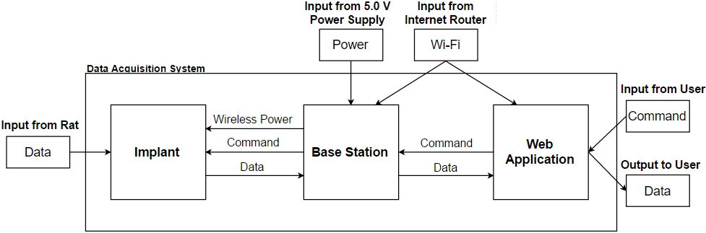

BATTERYLESS AND WIRELESS IMPLANT AND DATA ACQUISITION SYSTEM
Problem Statement
Faculty Mentor: Dr. Jonathan Valvano
Testing & Evaluation
Current methods that scientists use to collect data from laboratory rats are expensive and inefficient. Typical experiments require manually taking various measurements over and over again for a long period of time. Therefore, our team was responsible for designing a low-cost system that allows researchers to accurately and efficiently collect data from laboratory rats.
Corey Cormier, Thomas Ermis, Devin Marzullo, Michael Park, Makeila Sorensen, Anish Vaghasia
In order to evaluate our system, we tested key components, each subsystem, and the system as a whole. The table below describes the most significant results that we obtained from our testing.
Implant Design
Responsible for receiving commands from the base station, collecting temperature and acceleration data, and sending the data back to the base station.
Selected the TI RF430FRL152H chip because of its wireless power transmission and communication capabilities, low power consumption, I²C communication interface, and14-bit internal temperature sensor.
Designed the coil to have an inductance of 3 µH and added a tuning capacitor in order to tune the resonant frequency to 13.56 MHz.
Selected the NXP MMA8452Q accelerometer because of its low supply voltage requirements, low power consumption, I²C communication interface, and 12-bit triple-axis acceleration measurements.
Requirements
The implant needs to have a long lifespan so that it does not need to be replaced.
The implant needs to be biocompatible so that it does not affect the health of the rat.
The implant needs to be small so that it can fit comfortably inside of the rat.
The implant cannot have a battery and must be wireless.
The implant needs to measure temperature and acceleration in real-time.
The system needs to have a user-friendly readout.
Conclusion & Next Steps
We successfully built a data acquisition system that collects data from a batteryless and wireless implant. The list below describes additional steps to improve upon our current design.
Design a smaller implant coil in order to reduce the size of the implant.
Design a custom base station with a larger coil in order to boost the range of wireless power transmission and communication.
Add authentication to the web application in order to separate users and protect data.
Design Specifications
The minimum lifespan of the implant is 6 months.
The implant needs to comply with the ISO 10993 standard of biocompatibility.
The maximum size of the implant is 5x5x1 cm³.
The temperature and acceleration measurements have an accuracy of 95%.
The implant must be able to receive power and communicate at a distance of 5 cm.
The minimum bandwidth of the implant is 1 Hz.
The maximum response time of the system is 60 seconds.
Web Application Design
Impact
Responsible for receiving input from the user, sending commands to and receiving data from the base station, and displaying the data back to the user.
In addition to laboratory research, our data acquisition system impacts other areas. The list below describes additional applications of our system.
Bridge monitoring and alert system
Detect deformation and trigger preventative maintenance
Human identification and verification
Replace physical identification cards
Configure for automatic access
Replace bank cards
Patient tracking and monitoring
Detect anomalies and trigger preventative care
System Design
Selected the IBM Bluemix platform because of its robust catalog of application runtimes, services, and APIs.
Selected the Node-RED and Node.js runtimes because of their ease of use and scalability.
Selected the IBM Watson Internet of Things Platform service because of its ability to connect smart devices to web and mobile applications.
Selected the IBM Cloudant NoSQL Database service because of its powerful data storage and querying abilities.
The system consists of an implant, a base station, and a web application. The implant collects data from the rat. The base station wirelessly transmits power to and communicates with the implant. The web application displays the data to the user.
A special thank you to Dr. John Pearce,
Andrew Wang, Lucas Holt, and Alex Kozitsky.

