Slide 1
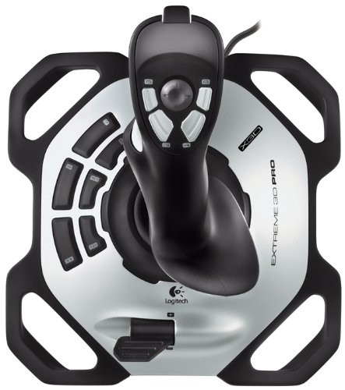
Close Gripper
Open Gripper
Upper Joint
Lower Joint
Enable Rotate
Enable Lower
Enable Upper
Base Joint
Speed

